Slide 1

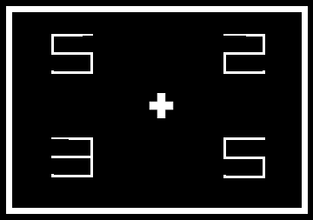
You will now put both of those skills together and practice them.
You will now see the circle on some trials, indicating that you should
make an eye movement.
And no circle on other trials, indicating that you should maintain
fixated at the centre of the screen and ignore the arrow.
But for both types of trial, you will need to make the same decision
about whether you saw an E or a Ǝ

