Slide 1
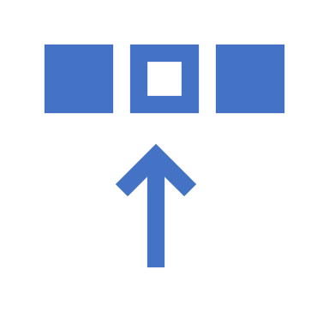


Angular 8 Introduction
Pau Castells

Slide 2
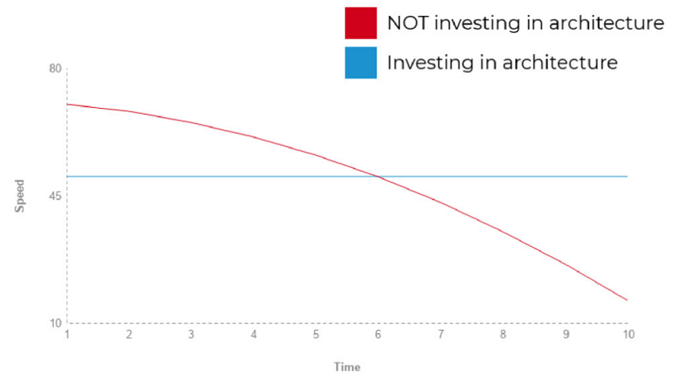
Scalability in front-end problems
Rich user interactions
Responsibilites have moved to front-end
Requirements grow over time
Application performance has to be mantained
Development teams have high rotation/fast growing
Notes:
Presentation layer
Let’s start analyzing our system break-down from the presentation layer. This is the place where all our Angular components live. The only responsibilities of this layer are to present and to delegate. In other words, it presents the UI and delegates user’s actions to the core layer, through the abstraction layer. It knows what to display and what to do, but it does not know how the user’s interactions should be handled.
Abstraction layer
The abstraction layer decouples the presentation layer from the core layer and also has it’s very own defined responsibilities. This layer exposes the streams of state and interface for the components in the presentation layer, playing the role of the facade. This kind of facade sandboxes what components can see and do in the system. We can implement facades by simply using Angular class providers.
expose methods for the components in which we:
delegate logic execution to the core layer,
decide about data synchronization strategy (optimistic vs. pessimistic),
expose streams of state for the components:
pick one or more streams of UI state (and combine them if necessary),
cache data from external API.
Core layer
The last layer is the core layer. Here is where core application logic is implemented. All data manipulation and outside world communication happen here. If for state management, we were using a solution like NgRx, here is a place to put our state definition, actions and reducers.
Sync strategy
Optimistic update changes the UI state first and attempts to update the backend state. This provides a user with a better experience, as he does not see any delays, because of network latency. If backend update fails, then UI change has to be rolled back. Pessimistic update changes the backend state first and only in case of success updates the UI state. Usually, it is necessary to show some kind of spinner or loading bar during the execution of backend request, because of network latency.

Slide 3
Architecture of an Angular App
An architecture is the highest-level breakdown of a system into its parts.
– Martin Fowler
Data
(bindings)
State Management
Asynchronous
Services
CORE
Application Facade
ABSTRACTION
Presentation
Module 1
Presentation
Module 2
PRESENTATION
Events
Notes:
Presentation layer
Let’s start analyzing our system break-down from the presentation layer. This is the place where all our Angular components live. The only responsibilities of this layer are to present and to delegate. In other words, it presents the UI and delegates user’s actions to the core layer, through the abstraction layer. It knows what to display and what to do, but it does not know how the user’s interactions should be handled.
Abstraction layer
The abstraction layer decouples the presentation layer from the core layer and also has it’s very own defined responsibilities. This layer exposes the streams of state and interface for the components in the presentation layer, playing the role of the facade. This kind of facade sandboxes what components can see and do in the system. We can implement facades by simply using Angular class providers.
expose methods for the components in which we:
delegate logic execution to the core layer,
decide about data synchronization strategy (optimistic vs. pessimistic),
expose streams of state for the components:
pick one or more streams of UI state (and combine them if necessary),
cache data from external API.
Core layer
The last layer is the core layer. Here is where core application logic is implemented. All data manipulation and outside world communication happen here. If for state management, we were using a solution like NgRx, here is a place to put our state definition, actions and reducers.

Slide 4
Modular design
MODULE 1
MODULE N
CORE
State Management
Asynchronous
Services
ABSTRACTION
Application Facade
PRESENTATION
Presentation
Module 1
Presentation
Module 2
Notes:
We have covered the horizontal division in our system and the communication patterns across it. Now we are going to introduce a vertical separation into feature modules. The idea is to slice the application into feature modules representing different business functionalities. This is yet another step to deconstruct the system into smaller pieces for better maintainability. Each of the features modules share the same horizontal separation of the core, abstraction, and presentation layer. It is important to note, that these modules could be lazily loaded (and preloaded) into the browser increasing the initial load time of the application.

Slide 5
Presentation layer, data bindings.
Data
(bindings)
Container (Smart) 1
import facade;
var data;
.
.
Func OnCreate() {
data = facade.getData();
}
Dumb 1
<h1> {{data.title}} </h1>
Hello World!
Notes:
First, are the smart components (aka containers). These components usually:
have facade/s and other services injected,
communicate with the core layer,
pass data to the dumb components,
react to the events from dumb components,
are top-level routable components (but not always!).
In the second category, there are dumb components (aka presentational). Their only responsibilities are to present UI element and to delegate user interaction “up” to the smart components via events.
Explain change detection propagation.

Slide 6
Presentation layer, events.
Container (Smart) 1
//Suscribed to Dumb1Event()
import facade;
.
.
.
Func Dumb1EventSuscriber(e) {
facade.Save(e.Data);
}
Data
(bindings)
Dumb 1
//Suscribed to Show(), Hide() and Save()
.
.
.
Func SaveSuscriber() {
emit(“Dumb1Event”, e);
}
Events
Dumb 1.1
emit(“Show”)
Dumb 1.2
emit(“Hide”)
Dumb 1.3
emit(“Save”)
Notes:
First, are the smart components (aka containers). These components usually:
have facade/s and other services injected,
communicate with the core layer,
pass data to the dumb components,
react to the events from dumb components,
are top-level routable components (but not always!).
In the second category, there are dumb components (aka presentational). Their only responsibilities are to present UI element and to delegate user interaction “up” to the smart components via events.

Slide 7
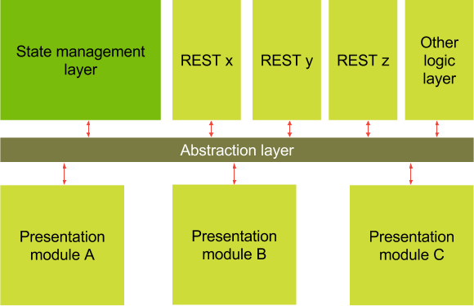
Abstraction Layer
Notes:
Asynchronicity of the api calls presents a problem when we have to decide how to maintain the sync between the UI state and the back-end
Sync strategy
Optimistic update changes the UI state first and attempts to update the backend state. This provides a user with a better experience, as he does not see any delays, because of network latency. If backend update fails, then UI change has to be rolled back.
Pessimistic update changes the backend state first and only in case of success updates the UI state. Usually, it is necessary to show some kind of spinner or loading bar during the execution of backend request, because of network latency.

Slide 8
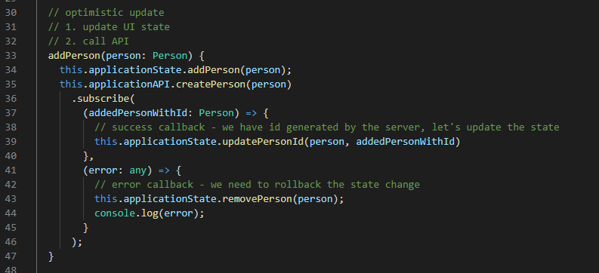
Abstraction Layer – Optimistic update
State
Update
Backend
Update
Rollback
OK?
NO
Notes:
Asynchronicity of the api calls presents a problem when we have to decide how to maintain the sync between the UI state and the back-end
Sync strategy
Optimistic update changes the UI state first and attempts to update the backend state. This provides a user with a better experience, as he does not see any delays, because of network latency. If backend update fails, then UI change has to be rolled back.
Pessimistic update changes the backend state first and only in case of success updates the UI state. Usually, it is necessary to show some kind of spinner or loading bar during the execution of backend request, because of network latency.

Slide 9
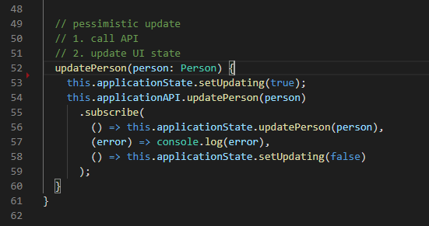
Abstraction Layer – Pessimistic update
Backend
Update
OK?
Yes
Update UI
State
Update
Notes:
Asynchronicity of the api calls presents a problem when we have to decide how to maintain the sync between the UI state and the back-end
Sync strategy
Optimistic update changes the UI state first and attempts to update the backend state. This provides a user with a better experience, as he does not see any delays, because of network latency. If backend update fails, then UI change has to be rolled back.
Pessimistic update changes the backend state first and only in case of success updates the UI state. Usually, it is necessary to show some kind of spinner or loading bar during the execution of backend request, because of network latency.

Slide 10
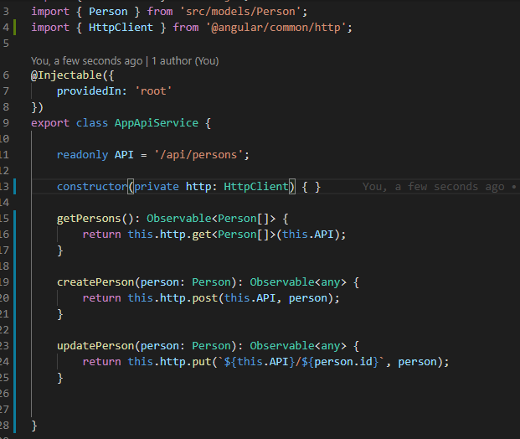
Core Layer
All data manipulation and outside world communication happens here, it also holds the state definitions, actions and reducers if a state management solution is used (i.e. NgRx).
Notes:
Asynchronicity of the api calls presents a problem when we have to decide how to maintain the sync between the UI state and the back-end
Sync strategy
Optimistic update changes the UI state first and attempts to update the backend state. This provides a user with a better experience, as he does not see any delays, because of network latency. If backend update fails, then UI change has to be rolled back.
Pessimistic update changes the backend state first and only in case of success updates the UI state. Usually, it is necessary to show some kind of spinner or loading bar during the execution of backend request, because of network latency.

Slide 11
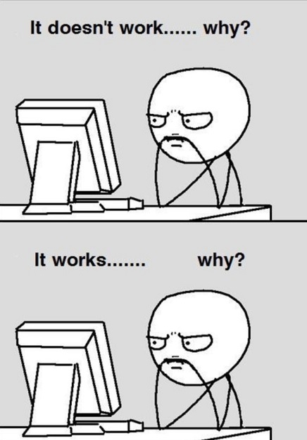
Hands on Workshop! Full “working” code @ https://github.com/pauades/angulartraining
Notes:
Asynchronicity of the api calls presents a problem when we have to decide how to maintain the sync between the UI state and the back-end
Sync strategy
Optimistic update changes the UI state first and attempts to update the backend state. This provides a user with a better experience, as he does not see any delays, because of network latency. If backend update fails, then UI change has to be rolled back.
Pessimistic update changes the backend state first and only in case of success updates the UI state. Usually, it is necessary to show some kind of spinner or loading bar during the execution of backend request, because of network latency.

Slide 12
Prerequisites
Node.js
https://nodejs.org/en/
“Node.js is an asynchronous event-driven JavaScript runtime, Node.js is designed to build scalable network applications”
npm package manager
npm client is installed by Node.js by default
Angular CLI
A command line interface for Angular
Visual Studio Code (optional)
https://code.visualstudio.com/
Augury for Chrome (debugging extension)
> node -v
> npm install -g @angular/cli

Slide 13
CLI Cheatsheet
New app: > ng new <name> [options]
Generate component: > ng generate component <name> [options]
Generate service: > ng generate service <name> [options]
Generate module: > ng generate module <name> --route <route_name> --module <module_name>
Example: ng generate module things --route things-list --module app.module
Note: Set Powershell execution policy to unrestricted: > Set-ExecutionPolicy Unrestricted

Slide 14
Bibliography
https://blog.strongbrew.io/A-scalable-angular2-architecture/
https://angular-academy.com/angular-architecture-best-practices/
https://angular.io/

