Slide 1
Surface Classification
Using Transfer Deep Learning
Dr. Pakorn Ubolkosold
Bangkok University

Slide 2
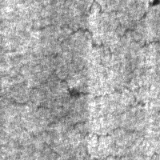
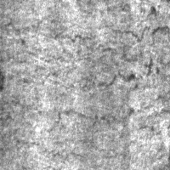
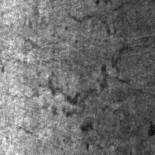
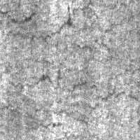
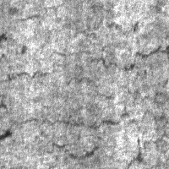
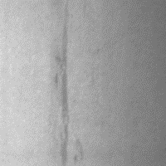
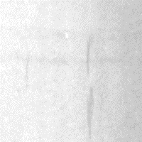
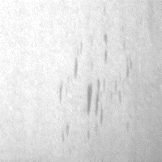
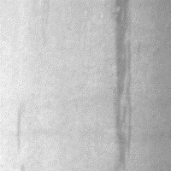
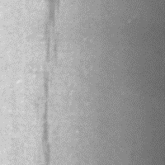
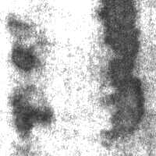
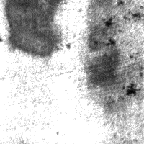
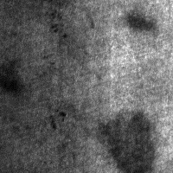
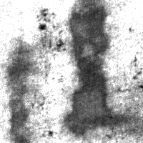
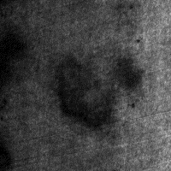
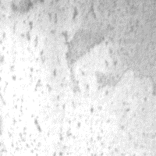
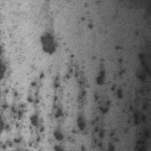
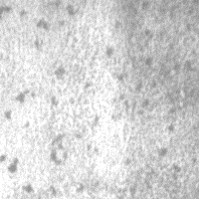
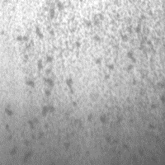
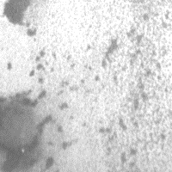
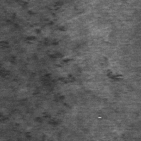
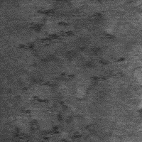
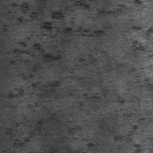
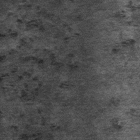
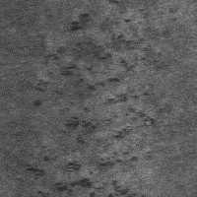
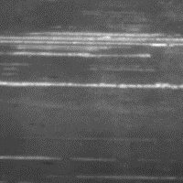
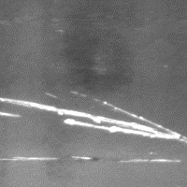
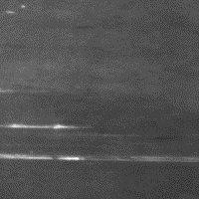
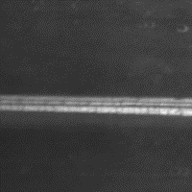
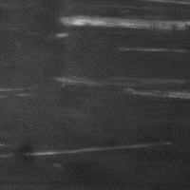
Class Cr (Crazing)
Class In (Inclusion)
Basic Information
6 Classes
300 images each class (1,800 in total)
Image size 200 x 200
Dataset: Northeastern University (NEU)
surface defect database
Class Pa (Patches)
Class Ps (Pitted Surface)
Download Dataset
Class RS (Rolled-in Scale)
Class Sc (Scratches)

Slide 3
Solution
Concatenate the pre-trained model (google mobilenet) with the custom model (neural network)
Quick initialize weights of the customer model
freeze all layers of the pre-trained model, and train only the custom model (neural network)
Fine tuning (joint training of pre-train and customer model)
Un-freeze some layers of the pre-trained model, and jointly retrain both un-freezed layers of the pre-train model and the previously weight-initialized custom model

Slide 4
Parameters Setup
Custom model:
Neural networks of 4 hidden layers each with 512 nodes and ‘relu’ as activation function
Output layer uses ‘softmax’
Pre-trained model:
mobilenet
Frozen layers : 0th – 19th layer (first 20 layers of mobilenet)
Retrained layers : the rest
Optimization:
optimizer = 'Adam',
loss = 'categorical_crossentropy',
metrics = ['accuracy']

Slide 5
Parameters Setup
Use augmented image via ImageDataGenerator :
preprocessing_function = preprocess_input,
rotation_range = 90,
zoom_range = 0.15,
width_shift_range = 0.2,
height_shift_range = 0.2,
shear_range = 0.15,
horizontal_flip=True,
fill_mode = "nearest"
Pre-trained model :
mobilenet
Frozen layers : 0th – 19th layer (first 20 layers of mobilenet)
Retrained layers : the rest
Training parameters:
batch_size = 30, num_epochs = 100

Slide 6
Validation
Divide dataset into 70% for training – 30% for validation
240 images for training
60 images for vali
Experiment result
Accuracy = 100%

