Slide 1
ROAD MAP
Mathematical Background
Fundamental Data Structures
  Linear Data Structures
  Graphs
  Trees
What is an algorithm ?
Analysis of algorithms
Different Problems and their analysis
Running time functions

Slide 2
Mathematical Background
Functions
Logarithm
Summation
Probability
Asymptotic Notations
Recursion
  Recurrence equation

Slide 3
Fundamental Data Structures
A data structure is a particular scheme of organizing related data items
  Linear Data Structures
    Array
    Linked list
    Stack
    Queue
    Prioritiy Queue
  Graphs
  Trees

Slide 4
Linear Data Structures
Array
  An array is a sequence of n items of the same data type that are stored contiguously in computer memory
  Array is accessible by specifying a value of the array’s index
Item[0] | Item[1] | … | Item[n-1]
Array of n elements

Slide 5
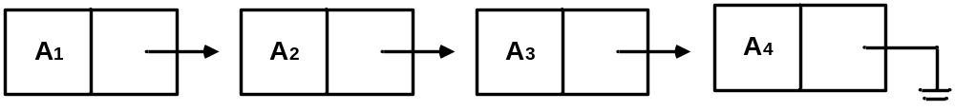
Linear Data Structures
Linked List
  A linked list is a sequence of zero or more elements called nodes
  Each node contains two kinds of information :
    some data
    one or more linkes called pointers to other nodes of the linked list

Slide 6
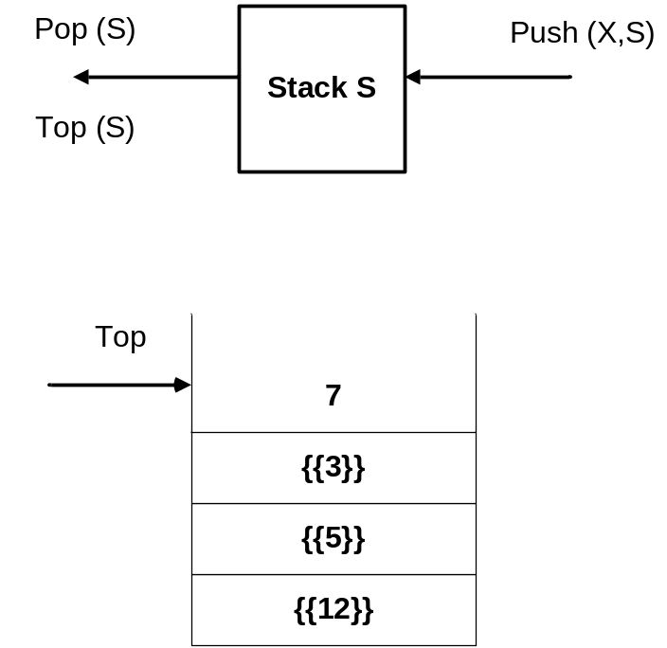
Linear Data Structures
Stack
  A stack is a list in which insertions and deletions can be done only at the end (called top)
  Last In First Out (LIFO)

Slide 7
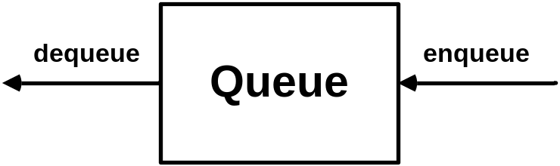
Linear Data Structures
Queue
  A queue is a list whose elements are deleted from one end of the structure, called front
    dequeue operation
  New elements are added to the other end of the queue, called rear
    enqueue operation
  First In First Out (FIFO)

Slide 8
Linear Data Structures
Priority Queue
  A priority queue is a collection of data items from a totally ordered universe
    e.g. integer or real numbers
  Requires a selection of an item of the highest priority among a dynamically changing set of candidates
  Principal operations:
    Insert → adding a new element
    Delete → deleting largest/smallest element
    Search → find largest/smallest element
  A better implementations of a priority queue is based on an ingenious data structure called heap

Slide 9
Graphs
A graph is a tuple G=(V,E)
  V : set of vertices or nodes
  E : set of edges
    each edge is a pair (v,w), where v,w Є V
  If the pairs are ordered, then the graph is directed
    directed graphs are sometimes refered as digraphs
  If the pairs are unordered, then the graph is undirected
  Vertex w is adjacent to v iff (v,w) Є E

Slide 10
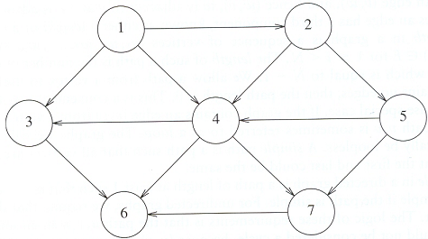
Graphs
A graph with 7 vertices and 12 edges

Slide 11
Graphs
A path is a sequence of vertices from v to w
If all edges in a path are distinct the path is said to be simple
Lenght is the total number of edges in a path
A cycle is a path with length ≥ 1 where u=w
A graph is acyclic if it has no cycles
A graph with 7 vertices and 12 edges

Slide 12
Graphs
A graph with every pair of its vertices connected by an edge is called complete
A graph with relatively few possible edges missing is called dense
A graph with few edges relative to the number of its vertices is called sparce
A graph is connected if for every pair of vertices u and v there is a path from u to v
A graph with 7 vertices and 12 edges

Slide 13
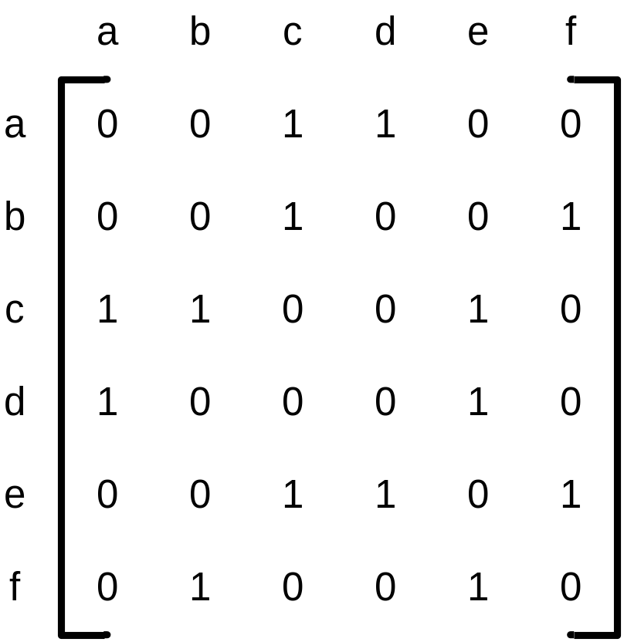
Graph Representations
Adjacency Matrix Representation
It is n-by-n boolean matrix with one row and one column for each of the graph’s vertices
  ith row and jth column is equal to 1 if there is an edge from the ith vertex to the jth vertex
  ith row and jth column is equal to 0 if there is no such edge

Slide 14
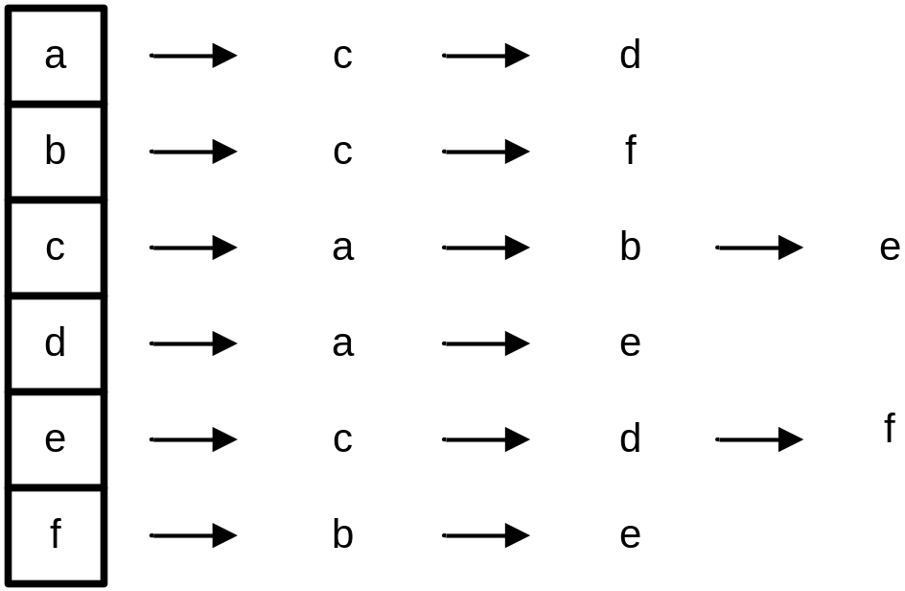
Graph Representations
Adjacency List Representation
  Is a collection of linked lists, one for each vertex, that contain all the vertices adjacent to the list’s vertex
  If the graph is not dense (is sparse) adjacency list representation is a better solution

Slide 15
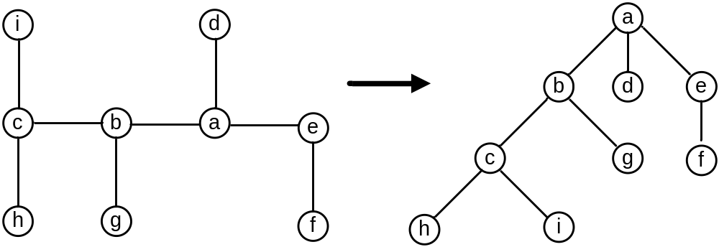
Trees
A tree is a connected acyclic graph
  rooted tree
    Specialized node caled root
tree rooted tree

Slide 16
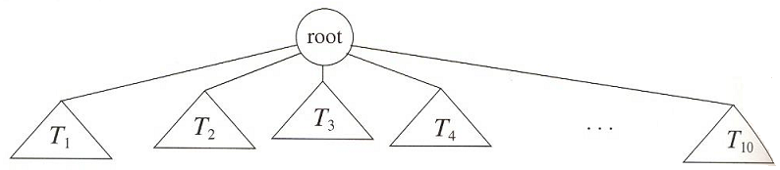
Trees
Recursive Definition of Rooted Trees:
Tree is a collection of nodes
  A tree can be empty
  A tree contains zero or more subtrees T₁, T₂,… T_{k} connected to a root node by edges

Slide 17
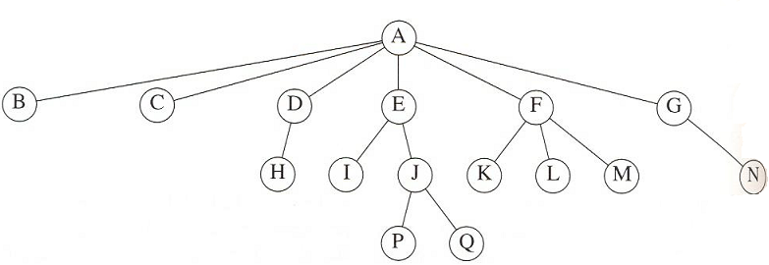
Trees - Terminology
Family Tree Terminology
child → F is child of A
parent → A is the parent of F
  each node is connected to a parent except the root
sibling → nodes with same parents (K, L, M)
leaf → nodes with no children (P, Q)
Ancestor / Descendant

Slide 18
Path : a sequence of nodes n₁, n₂, … n_{k}, where n_{i} is the parent of n_{i}+1 1≤i<k
Lenght : number of edges on the path (k-1)
Depth : depth of n_{i} is the lenght of unique path from the root to n_{i}
  depth of root is 0
  depth of a tree = depth of the deepest leaf
Height : height of n_{i} is the lenght of the longest path from n_{i} to a leaf
  height of a leaf is 0
  height of a tree = height of the root = depth of the tree

Slide 19
Trees
Ordered tree
  A rooted tree in which all the children of each vertex are ordered
Binary tree
  An ordered tree in which every vertex has no more than two children
  Each child designated as either a left child or a right child of its parent

Slide 20
Trees
Binary Search Tree (BST)
  A binary tree
    No repeated element
  Satisfies Search Tree Property
    Elements on left subtree is smaller than root
    Elements on right subtree is greater than root
    Left and right subtrees are BST
Heap
  An implementation of priority queue
  A binary tree
  Satisfies heap order property
    Each element is larger than the parent

Slide 21
ROAD MAP
Mathematical Background
Fundamental Data Structures
  Linear Data Structures
  Graphs
  Trees
What is an algorithm?
Analysis of algorithms
Different Problems and their analysis
Running time functions

Slide 22
What is an Algorithm ?
An algorithm is a finite, clearly specified sequence of instructions to be followed to solve a problem or compute a function
An algorithm generally
  takes some input
  carries out a number of effective instructions in a finite amount of time
  produces some output.
An effective instruction is an operation so basic that it is possible to carry it out using pen and paper.

Slide 23
Expressing Algorithms
Algorithms can be expressed in
  natural languages
    verbose and ambiguous
    rarely used for complex or technical algorithms
  pseudocode, flowcharts
    structured ways to express algorithms
    avoid ambiguities in natural language statements
    independent of a particular implementation language
  programming languages
    intended for expressing algorithms in a form that can be executed by a computer
    can be used to document algorithms

Slide 24
Example:
Problem: Find the largest number in an (unsorted) list of numbers.
Idea: Look at every number in the list, one at a time.
Natural Language:
Assume the first item is largest.
Look at each of the remaining items in the list and if it is larger than the largest item so far, make a note of it.
The last noted item is the largest in the list when the process is complete.

Slide 25
Example:
Pseudocode:
Algorithm LargestNumber
Input: A non-empty list of numbers L.
Output: The largest number in the list L.
largest ← L₀
for each item in the list L_{i≥1}, do
if the item > largest, then
largest ← the item
return largest

Slide 26
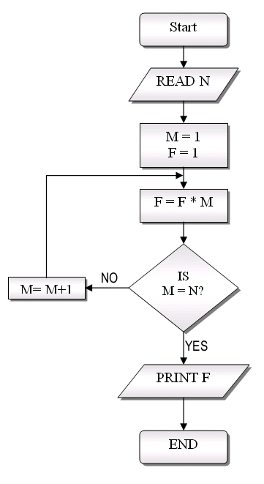
Example:
Flowchart:

Slide 27
Properties of an Algorithm
Effectiveness
  Instructions are simple
    can be carried out by pen and paper
Definiteness
  Instructions are clear
    meaning is unique
Correctness
  Algorithm gives the right answer
    for all possible cases
Finiteness
  Algorithm stops in reasonable time
    `produces an output

Slide 28
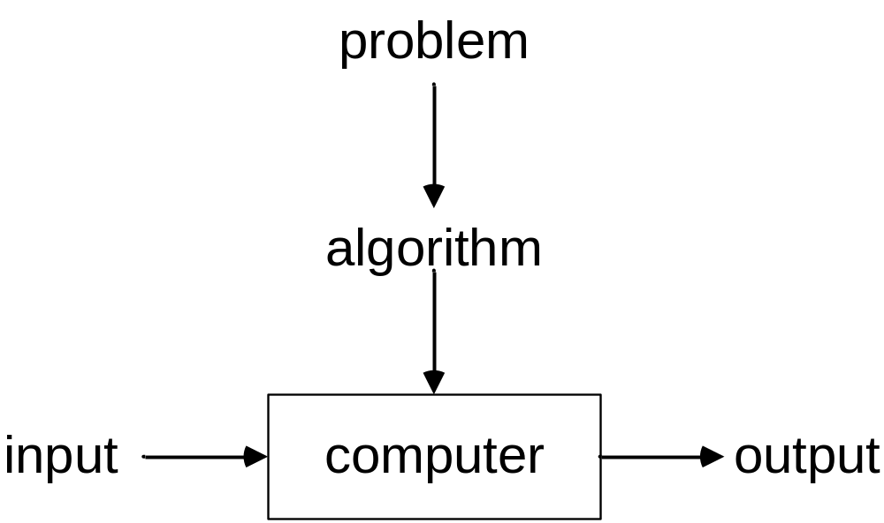
Notion of an Algorithm
Algorithm Design
Programming the Algorithm

Slide 29
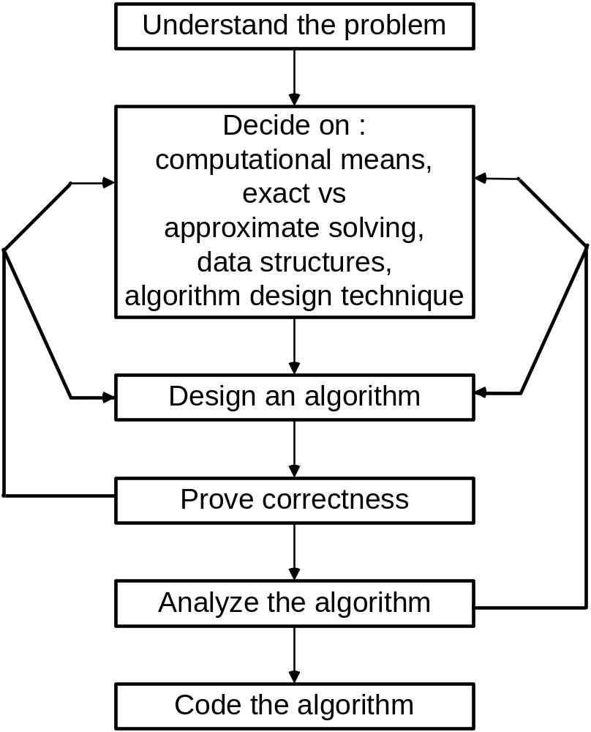
Algorithm Design Process

Slide 30
Analysis of Algorithms
Study complexity of an algorithm
  How good is the algorithm?
  How it compare with other algorithms?
  Is it the best that can be done?

Slide 31
Analysis of Algorithms
Complexities
  Space
    Number of bits
    Number of elements
  Time
    Number of operations
      Depends on model
      RAM
      Turing Machines

Slide 32
Run-Time Analysis of Algorithms
Algorithm complexity is investigated as a function of some parameter n indicating problem’s size
Time complexity, T(n), is can be computed as the number of times the algorithm’s most important operation -- called its basic operation -- is executed
Space complexity, S(n), is usually computed as the size of memory space used during an execution of the algorithm

Slide 33
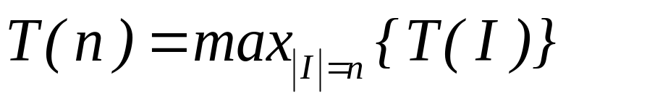
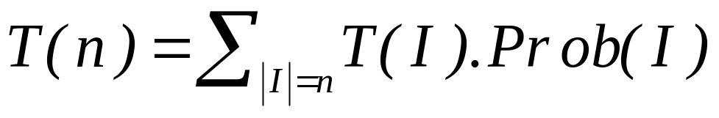
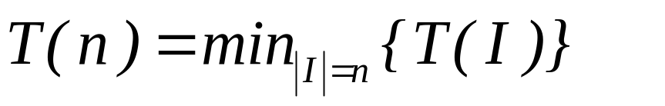
Types of Complexities
Worst case
Average case
Best case

Slide 34
Table Method
Table Method is used to calculate complexity of an algorithm
Example :
Adding elements of an array
sum = 0 for i = 1 to n sum = sum + a[i] report sum | steps/exec | freq | total
 | 1 | 1 | 1
 | 1 | n+1 | n+1
 | 1 | n | n
 | 1 | 1 | 1
 |  |  | 2n+3

Slide 35
Table Method
Table Method is used to calculate complexity of an algorithm
Example :
Adding elements of an array
sum = 0 for i = 1 to n sum = sum + a[i] report sum | steps/exec | freq | total
 | 1 | 1 | 1
 | 1 | n+1 | n+1
 | 1 | n | n
 | 1 | 1 | 1
 |  |  | 2n+3
What is the basic operation? How many times it is executed?

Slide 36
Table Method
Table Method is used to calculate complexity of an algorithm
Example :
Adding elements of an array
sum = 0 for i = 1 to n sum = sum + a[i] report sum | steps/exec | freq | total
 | 1 | 1 | 1
 | 1 | n+1 | n+1
 | 1 | n | n
 | 1 | 1 | 1
 |  |  | 2n+3
Basic operation is executed n times and n is proportional to 2n+3

Slide 37
Table Method
Example :
Matrix addition
Assume a, b, c are mxn matrices
for i = 1 to m for j = 1 to n c[i,j] = a[i,j] + b[i,j] | steps/exec | freq | total
 | 1 | m+1 | m+1
 | 1 | m(n+1) | mn+m
 | 1 | mn | mn
 |  |  | 2mn+2m+1

Slide 38
ROAD MAP
Mathematical Background
Fundamental Data Structures
  Linear Data Structures
  Graphs
  Trees
What is an algorithm?
Analysis of algorithms
Different Problems and their analysis
Running time functions

Slide 39
Important Problem Types
Sorting
Searching
String Processing
Graph Problems
Combinatorial Problems
Geometric Problems
Numerical Problems

Slide 40
Searching
Problem definition:
Given a list, locate the search key

Slide 41
Linear Search
Approach
  1. start with the first element
  2. if the element is the search key
  return the position
  3. otherwise continue with the next element
  4. return fail if the end of list reached

Slide 42
Linear Search
Pseudo – code
  Given A[1], … , A[n] and search key
  1. i=1
  2. while i ≤ n
  3. if A[i] = key return i
  4. else i = i+1
  5. return fail
What about best, worst and average cases ?

Slide 43
Linear Search
Algorithm Complexity:
Best case
A[1] = key
Worst case
A[i] ≠ key for any key
    time is proportional to the number of elements
    time complexity of linear search is O(n)
Average case
    if any key is equally likely ~ n/2

Slide 44
Insertion Sort
Goal
  Given A[1] … A[n], give a sorted sequence
Approach
  1. The sequence A[1] is sorted
  2. Suppose A[1] ≤ A[2] … ≤ A[j-1] are already sorted
  3. Pick up the next element and place it with its appropriate place

Slide 45
Insertion Sort
Pseudo code
  1. for j=2 to n
  2. key = A[j]
  3. i = j-1
  4. while i>0 and A[i]>key
  5. A[i+1] = A[i]
  6. i = i-1
  7. A[i+1] = key

Slide 46
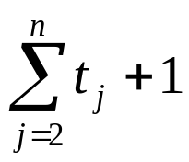
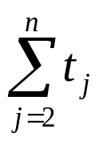
Insertion Sort
Analysis
Step Cost Time
1 c₁ n
2 c₂ n-1
3 c₃ n-1
4 c₄
5 c₅
6 c₆
7 c₇ n-1
t_{j} = number of times the while loop executes for j

Slide 47
Insertion Sort
t_{j} depends on the problem instance (input)
Best-case
When A is sorted t_{j}=0 for all j
T(n) = linear function in n
= O(n)

Slide 48
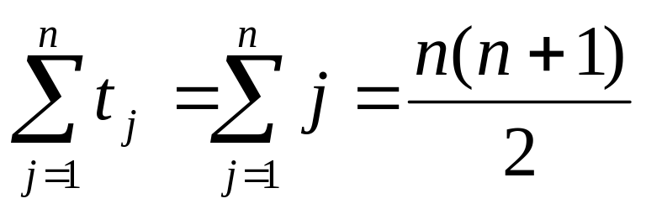
Insertion Sort
Worst-case
When A is in reverse sorted order
t_{j} = j for j=2,…,n
T(n) = quadratic function
= O(n²)

Slide 49
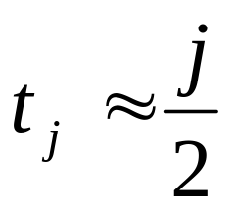
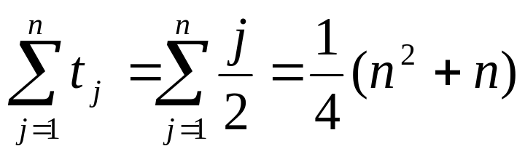
Insertion Sort
Average-case
We choose n numbers randomly
Where in A[1…j-1] will A[j] be inserted ?
Roughly half way i.e.
T(n) → quadratic

Slide 50
Insertion Sort
Not a right way of calculating the average case.
Proof:
Use notion of inversion
  The number of inversions is the total number of swaps necessary
What is the average number of inversions?
  If the input is uniformly distributed...

Slide 51
Polynomial Evaluation
Given : f(x) = a_{n}x^{n} + a_{n-1}x^{n-1} +…+ a₁x¹ + a₀x⁰
Gool : evaluate f(y)
Incremental Approach
  1. Sum = a₀
  2. for i = 1 to n
    add a_{i}y^{i} to the sum

Slide 52
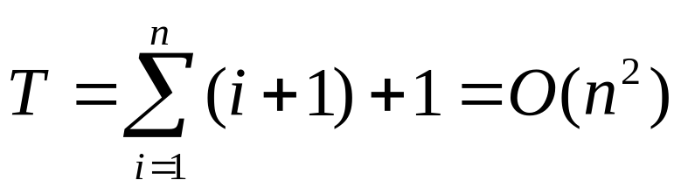
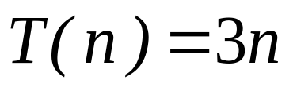
Polynomial Evaluation
Analysis
  i multiplications and 1 additions at i^{th} step
Improvement
  We know y^{i-1} from previous stage
  2 multiplication & 1 addition

Slide 53

Polynomial Evaluation
Further improvement
P_{n}(x) = x(a_{n}x^{n-1} + … + a₁) + a₀
1 multiplication & 1 addition

Slide 54
GCD Problem
Problem definition
  Calculate the greatest common divisor of two nonnegative integers m and n
    n>m>0
Ex: gcd(60,24)=12

Slide 55
A Simple Solution to GCD
Approach
  Try all possible values from m to 2
    1. for i=m to 2
    2. if i divides both m and n
    3. return i

Slide 56
Middle School Solution to GCD
Approach
Find prime factorizations of n and m,
Identify all the common primes,
Multiply them to get the g.c.d.

Slide 57
Middle School Solution to GCD
Example: gcd(60, 24)
60 2 24 2
30 2 12 2
15 3 6 2
5 5 3 3
1 1
So, gcd(60, 24) = 2*2*3 =12

Slide 58
Another GCD Algorithm
Approach
Consider the following property :
gcd(n, m) = gcd(n-m, m)
Can you prove this property?
What about the resulting algorithm?
  Pseudocode
  Analysis

Slide 59
Euclid’s GCD Algorithm
Approach
use the following property :
gcd(n, m) = gcd(m, n mod m)
    1. divide n by m, let r be the remainder
    2. if r=0 return m
    3. set n=m and m=r
    4. continue until r=0

Slide 60
Euclid’s GCD Algorithm
Pseudo-code
  Recursive
  Euclid(n , m)
  if m=0
  return n
  else
  return Euclid(m,n mod m)
  Iterative
  Euclid(n , m)
  while (m>0)
  t=n mod m
  n=m
  m=t
  return n

Slide 61
Euclid’s GCD Algorithm
Correctness
For any two integers n>m≥0
gcd (n, m) = gcd (m, n mod m)
Proof
We show that they divide each other

Slide 62
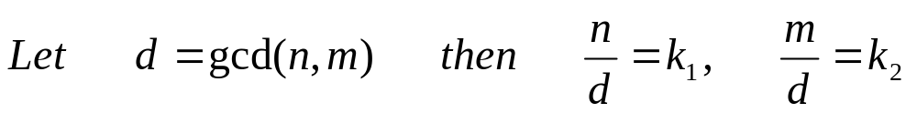
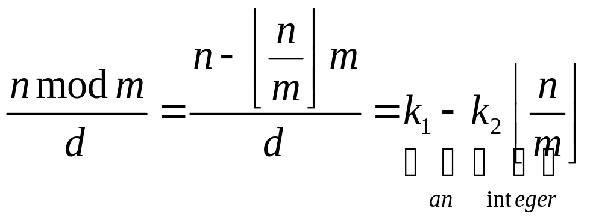
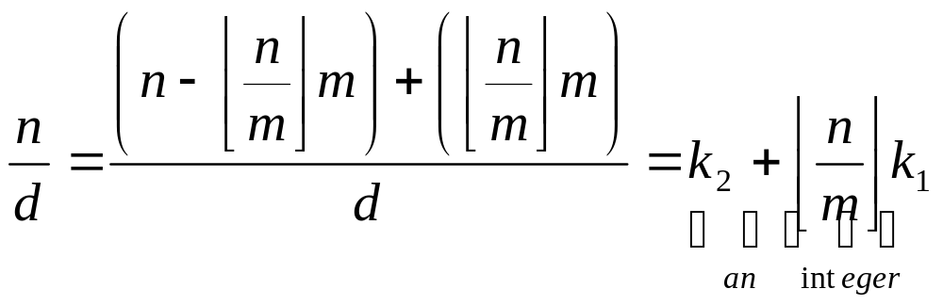
Euclid’s GCD Algorithm

Slide 63
Euclid’s GCD Algorithm Analysis
Lemma: For any two integers m and n such that n≥m , it is always true that
n mod m < n/2
Proof
If m≤n/2 then correct
If m>n/2 then n mod m = n-m < n/2

Slide 64
Euclid’s GCD Algorithm Analysis
i n m
0 n₀=n m₀=m
1 n₁=m₀ m₁=n₀ mod m₀
2 n₂=m₁ m₂=n₁ mod m₁=m mod m₁ m₂<m₀ / 2
3 n₃=m₂ m₃=n₂ mod m₂
4 n₄=m₃ m₄=n₃ mod m₃ =m₂ mod m₃ m₄< m₂ / 2
…
k-1 n_{k-1}= … 1
k n_{k}= … 0
In general n_{i}= m_{i-1}
m_{i-1}= n_{i-2} mod m_{i-2} n_{i} < n_{i-2} / 2
m_{i} < m_{i-2} / 2

Slide 65
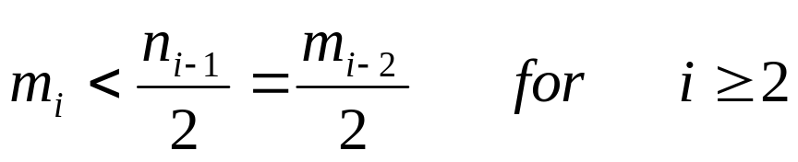
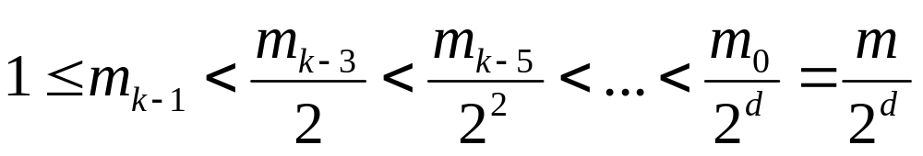
Euclid’s GCD Algorithm Analysis
From the lemma

Slide 66
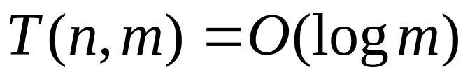
Euclid’s GCD Algorithm Analysis
So,
Is it true to say “complexity is logarithmic”?
  Algorithm is very fast?
What is the problem size?
What about the resulting complexity?

Slide 67
Complexity of a Problem
Not same as algorithm complexity!..
min_{A} { complexity of A }
Quite difficult to compute!...
Upper Bound
  Algorithm with given complexity guarantee f(n)
Lower Bound
  Proof that any algorithm for a problem must have complexity f(n)

Slide 68
Complexity of Searching
Upper Bound = O(n)
  Linear search gives O(n) solution
Lower Bound = O(n)
  Need to check all the values against the key to find the correct result.
Complexity of Searching problem is O(n)
Linear search is an optimal algorithm
  Complexity of the algorithm matches the problem complexity

Slide 69
Complexity of Sorting
Upper Bound = O(n log n)
  Mergesort gives O(n log n) solution
Lower Bound = O(n log n)
  We will prove this using decision trees.
Complexity of sorting is O(n log n)
Mergesort and heapsort are optimal algorithms.

Slide 70
ROAD MAP
Mathematical Background
Fundamental Data Structures
  Linear Data Structures
  Graphs
  Trees
What is an algorithm ?
Analysis of algorithms
Different Problems and their analysis
Running time functions

Slide 71
Running Time Functions
Definition
A nondecreasing function is called running time function if
f:Z⁺→R such that f(n)>0 for all n≥m where m is some positive integer
Z⁺ = { 1, 2, 3, … }

Slide 72
Asymptotic notations
O notation
Definition
Let f and g are running time functions. We denote f(n) = O(g(n)) if there exists a real constant c and integer m such that
f(n) ≤ c (g(n)) for all n≥m

Slide 73
O notation
Ex:
7n + 5 = O(n)
Ex:
10n² + 4n + 2 = O(n²)
Ex:
7n + 5 = O(n²)
Ex
7n + 5 ≠ O(1)

Slide 74
Asymptotic notations
Ω notation
Definition
Let f and g are running time functions. We denote f(n) = Ω(g(n)) if there exists a real constant c and integer m such that
f(n) ≥ c (g(n)) for all n≥m

Slide 75
Ω notation
Ex:
3n + 2 = Ω(n)
Ex:
6.2^{n} + n² = Ω(2^{n})
Ex:
3n - 7 = Ω(1)

Slide 76
Asymptotic notations
θ notation
Definition
Let f and g are running time functions. We denote f(n) = θ(g(n)) if there exists real constants c₁ and c₂ and integer m such that
c₁ g(n) ≤ f(n) ≤ c₂ g(n) for all n≥m

Slide 77
θ notation
Ex:
3n + 2 = θ (n)
Ex:
10 logn + 4 = θ (logn)
Ex:
3n + 2 ≠ θ (1)

Slide 78
Asymptotic notations
O(1) < O(logn) < O(n) < O(n logn) < O(n²) < O(n³) < O(2^{n})
f(n) = O(g(n))
    g is an upper bound of f
    f grows no faster than g
How tight is this bound ?
    n=O(n²)
    n=O(2^{n})
f(n) = O(g(n)) → g(n) = O(f(n)) ?

Slide 79
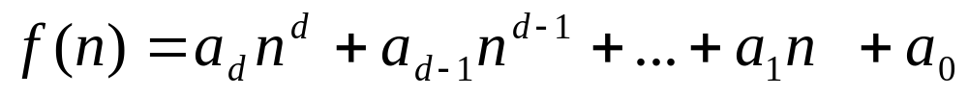
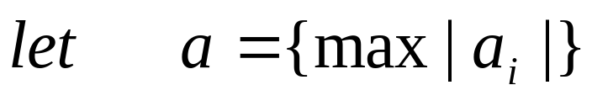
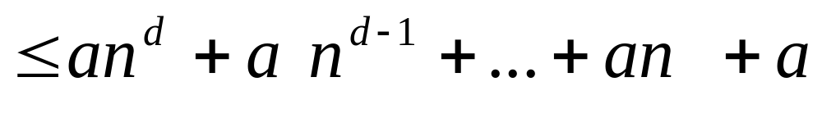
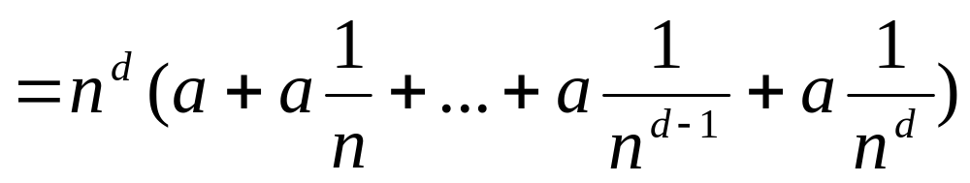
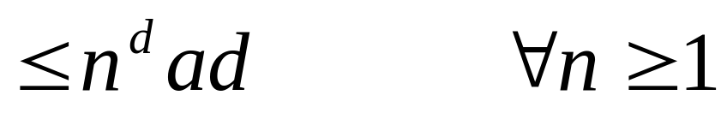
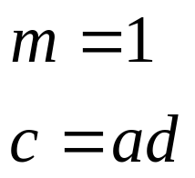
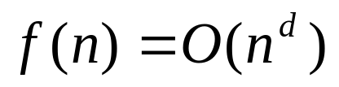
Theorem : polynomial

Slide 80
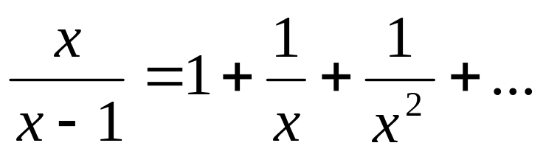

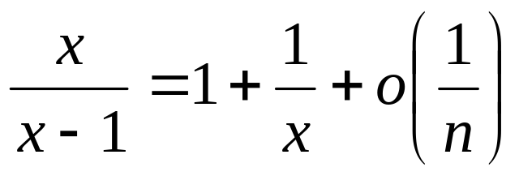
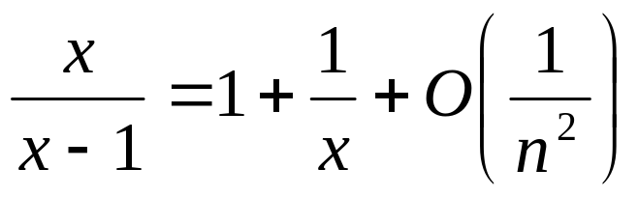
Example

Slide 81
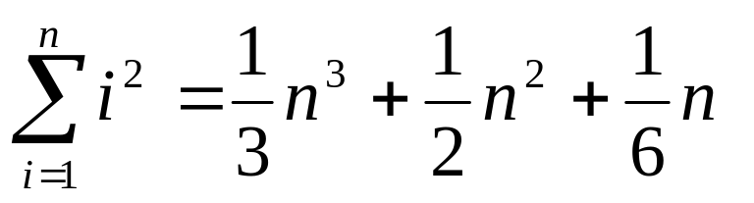
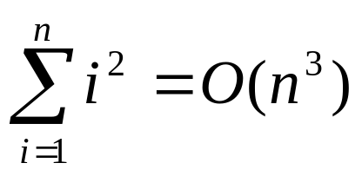
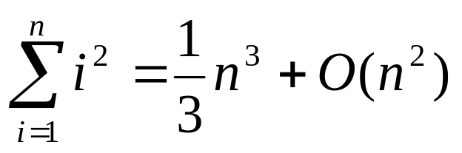
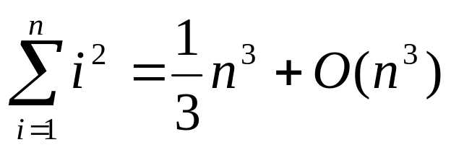
Example

Slide 82
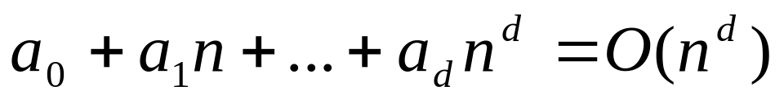
Some Rules
Transitivity
Addition
Polynomials

Slide 83

Some Rules
θ is equivalence notation

Slide 84
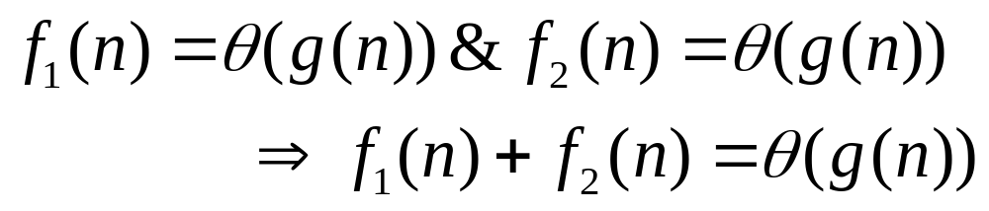
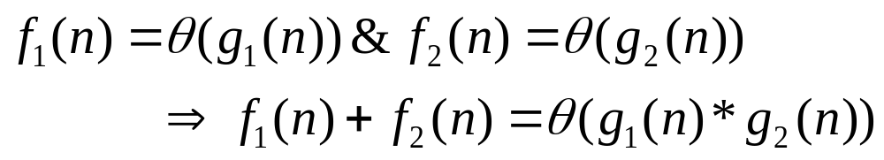
Some Rules

