Slide 1
Introduction to Algorithm Design
Lecture Notes 3

Slide 2
ROAD MAP
Brute Force
  Selection Sort
  Bubble Sort
  Sequential Search
  String Matching
  Closest-Pair Problem
  Convex-Hull Problems
  Travelling Salesman Problem
    Exhaustive Search
  Knapsack Problem
  Assignment Problem

Slide 3
Brute Force
Applicable to wide variety of problems
Easiest way solving problem
  Do not think much
  Just do it!..
Brute force is a straightforward approach based on
  the problem’s statement
  definitions of the concepts

Slide 4
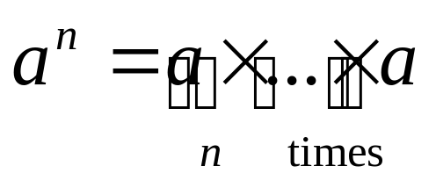
Brute Force
Example :
Compute a^{n} for a given number a and a nonnegative integer n
By the definition of exponentiation,

Slide 5
Brute Force
Brute force approach: used for many elementary but important algorithmic tasks
  compute sum of n numbers
  find largest element in a list
    yields reasonable algorithms of practical value
  sorting
  searching
  string matching
    inefficient but can be used to solve small-size instances of a problem

Slide 6
Sorting Problem
Problem definition:
Given a list of n items, rearrange them in non-decreasing order.

Slide 7
Selection Sort
Approach :
1. scan the entire given list to find its smallest element
2. exchange it with the first element, i.e., put the smallest element in its final position
3. scan the list starting with second element, find smallest among last n-1 elements
4. exchange it with second element i.e., put the second smallest element in its final position

Slide 8
Selection Sort
In general
On the i^{th} pass of the algorithm through the list
search for the smallest item among the last n-i elements
swaps it with A_{i}
A₀ ≤ A₁ ≤ … ≤ A_{i-1} | A_{i} , … , A_{min} , … , A_{n-1}
in their final position the last n-i elements
after n-1 passes, the list is sorted

Slide 9
Selection Sort
Algorithm :
// The algorithm sorts a given array by selection sort
// Input : An array A[0 .. n-1] of orderable elements
// Output : Array A[0 .. n-1] sorted in ascending order
SelectionSort (A[0 .. n-1])
for i ← 0 to n-2 do
min ← i
for j ← i+1 to n-1 do
if A[j] < A[min] min ← j
swap A[i] and A[min]

Slide 10
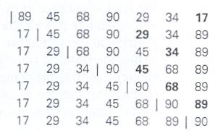
Selection Sort
Example
Selection sort’s operation on the list 89, 45, 68, 90, 29, 34, 17

Slide 11
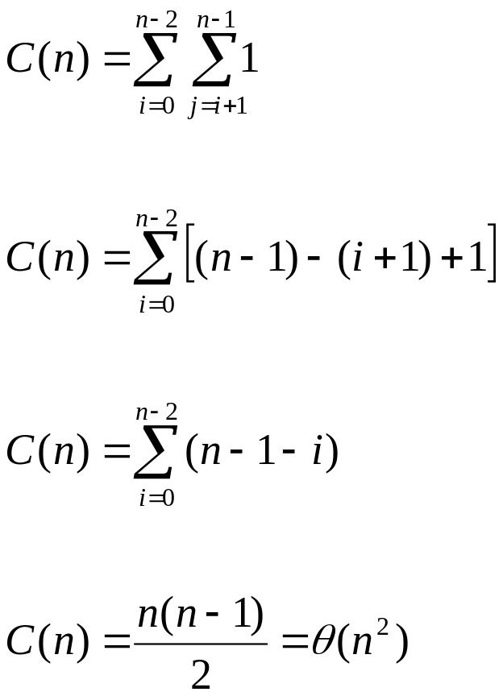
Selection Sort
Analysis : The number of comparisons

Slide 12
Selection Sort
Discussion :
  The number of key swaps is only θ(n)
    more precisely, n-1
    one for each repetation of the loop
  But selection sort is still a θ(n²) algorithm

Slide 13
Bubble Sort
Approach :
1. Compare adjacent elements of the list
2. Exchange them if they are out of order
  After i^{th} pass
  A₀ , … , A_{j} ? A_{j+1}, …, A_{n-i-1} | A_{n-i} ≤ … ≤ A_{n-1}
  in their final position

Slide 14
Bubble Sort
Algorithm :
// The algorithm sorts a given array by buble sort
// Input : An array A[0 .. n-1] of orderable elements
// Output : Array A[0 .. n-1] sorted in ascending order
BubbleSort ( A[0..n-1])
for i←0 to n-2 do
for j←0 to n-2-i
if A[j+1] < A[j] swap A[j] and A[j+1]

Slide 15
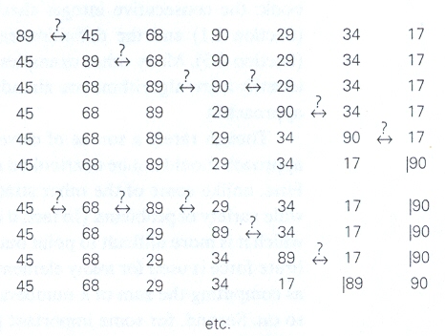
Bubble Sort
Example
The first two passes of bubble sort on the list 89, 45, 68, 90, 29, 34, 17

Slide 16
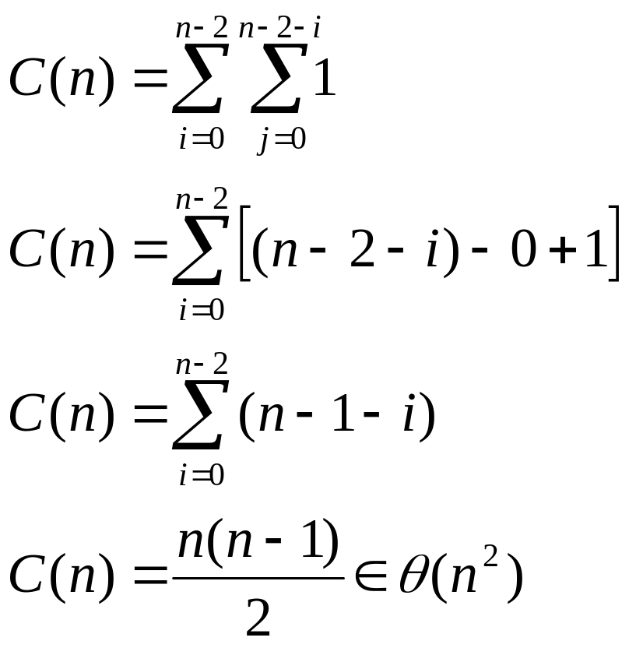
Bubble Sort
Analysis : The number of comparisons

Slide 17
Bubble Sort
An improvement:
If a pass makes no swaps, the list is already sorted
  Do not make any more passes
Does not improve worst case
Just runs faster for some inputs

Slide 18
Bubble Sort
Discussion :
  The number of key swaps depends on the input.
    for the worst case of decreasing arrays, same as the number of comparisons
  The improved algorithm works very well on already sorted lists
    performs just one pass on them

Slide 19
Search Problem
Definition :
Search Problem is to find a given item (some search key K ) in a list of n elements
    A match with the search key is found in the list
    The search key is not in the list

Slide 20
Sequential Search
Approach :
1. compare successive elements of a given list with a given search key
2. exit if search key matches the element of the list
3. exit if search key does not match any elements of the list

Slide 21
Sequential Search
Algorithm :
// The algorithm implements sequential search with a search key as a sentinel
// Input : An array of n elements and a search key
// Output : The position of the first element in array A[0 .. n-1] whose value is equal to K or -1 if no such element is found
SequentialSearch(A[0..n], K)
  A[n] ← K
  i ← 0
  while A[i] ≠ K do
  i ← i+1
  if i < n return i
  else return -1

Slide 22
Sequential Search
Analysis :
T(n) = θ (n)

Slide 23
Sequential Search
Any idea of improvement?..
What if the list is sorted?..

Slide 24
String Matching
Problem definition:
Given a string of n characters called text
Given a string of m characters called pattern
Find a substring of the text that matches the pattern

Slide 25
String Matching
Brute-force Approach?..

Slide 26
String Matching
Approach :
1. align the pattern against the first m characters of the text
2. start matching the corresponding pairs of characters from left to right
- until either all m pairs of the characters match or
- mismatching pair is encountered
3. shift the pattern one position to the right
4. resume character comparisons, starting with the first character of the pattern and its counterpart in the text

Slide 27
String Matching
Algorithm :
// The algorithm implements brute-force string matching
// Input1 : An array T[0..n-1] of n characters represents a text
// Input2 : An array P[0..m-1] of m characters represents a pattern
// Output : The position of the first character in the text that starts the first matching substring if the search is successfull and -1 otherwise
for i ← 0 to n-m do
j ← 0
while j < m and P[j]=T[i+j] do
j ← j+1
if j = m return i
return -1

Slide 28
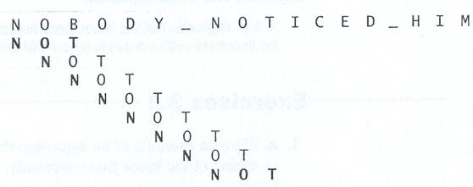
String Matching
Example
The pattern’s characters that are compared with their text counterparts are in bold type

Slide 29
String Matching
Analysis??

Slide 30
String Matching
In worst case, the algorithm make all m comparisons before shifting the pattern
There are n-m+1 tries.
So in worst case the algorithm is θ(nm)
The average case should be better than worst case
  All tries cannot make m comparisons!..
It has been shown that in random texts, algorithm is θ(n+m)= θ(n)

Slide 31
String Matching
Discussion :
There are several more sophisticated and more efficient algorithms for string matching.
We will discuss them later !

Slide 32
ROAD MAP
Brute Force
  Selection Sort
  Bubble Sort
  Sequential Search
  String Matching
  Closest-Pair Problem
  Convex-Hull Problems
  Travelling Salesman Problem
    Exhaustive Search
  Knapsack Problem
  Assignment Problem

Slide 33
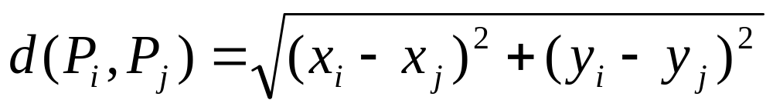
Closest - Pair Problem
Problem Definition :
Find the closest points in a set of n points.
  We consider the two dimensional case of the problem
  We assume that points in question are specified in a standard fashion by their (x,y) Cartesian coordinates
  We assume that distance between two points P_{i} = (x_{i}, y_{i}) and P_{j} = (x_{j}, y_{j}) is the standard Euclidean distance

Slide 34
Closest - Pair Problem
Approach :
  1. compute distance between each pair of distinct points
  2. find a pair with the smallest distance
  We do not want to compute the distance between same pair of points twice
    consider only the pairs of points (P_{i}, P_{j}) for which i < j

Slide 35
Closest - Pair Problem
Algorithm :
// Input : A list P of (n≥2) points
P₁ = (x₁, y₁) , … P_{n} = (x_{n},y_{n})
// Output : Indicates index1 and index2 of the closest pair of points
dmin ← ∞
for i ← 1 to n-1 do
for j ← i+1 to n do
d ← sqrt ( (x_{i}-x_{j})² + (y_{i}-y_{j})² )
if d < dmin
dmin ← d; index1 ← i ; index2 ← j
return index1, index2

Slide 36
Closest - Pair Problem
Analysis :
What is the basic operation?

Slide 37
Closest - Pair Problem
Discussion :
  Basic operation is computing Euclidean distance between two points
    square root is not a simple operation such as addition or multiplication
  So, is it an algorithm?..
  We can ignore square root function and compare values (x_{i}-x_{j})² + (y_{i}-y_{j})² themselves
    the smaller a number of which we take square root, the smaller its square root
    square root function is strictly increasing

Slide 38
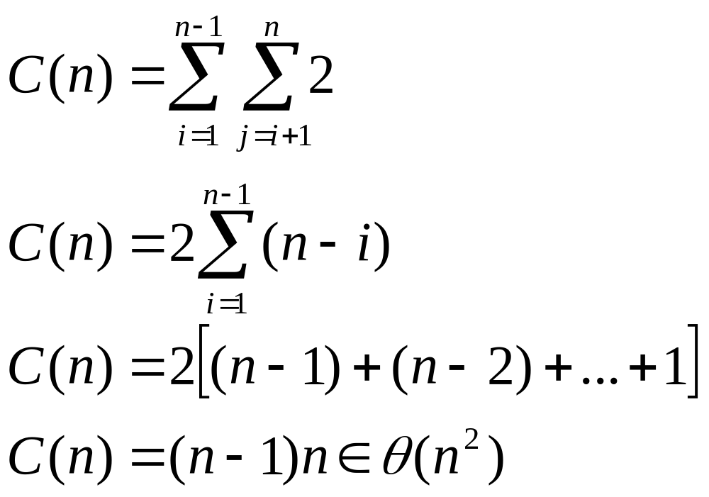
Closest - Pair Problem
Analysis : The number of basic operations (multiplications)

Slide 39
Convex-Hull Problem
What is convex ?
A set of points (finite or infinite) on the plane is called convex if for any two points P and Q in the set, the entire line segment with the end points P and Q belongs to the set

Slide 40
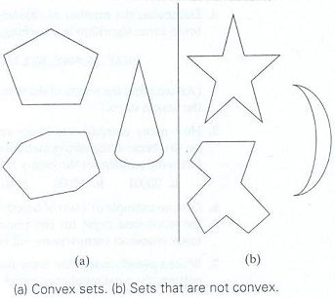
Convex-Hull Problem

Slide 41
Convex-Hull Problem
What is convex hull ?
The convex hull of a set S of points is the smallest convex set containing S.
The smallest requirement means that the convex hull of S must be a subset of any convex set containing S

Slide 42
Convex-Hull Problem
What is convex hull ?
  If S is convex, its convex hull is obviously S itself
  If S is a set of two points, its convex hull is the line segment connecting these points
  If S is a set of three points not on the same line, its convex hull is the triangle with the vertices at the three points given
    If three points do lie on the same line, the convex hull is the line segment with its end points at the two points that are farthest apart

Slide 43
Convex-Hull Problem
Theorem :
  The convex hull of any set S of n>2 points (not on the same line) is a convex polygon with the vertices at some of the points of S.
    If all the points do line on the same line, the polygon degenerates to a line segment but still with the end points at two points of S

Slide 44
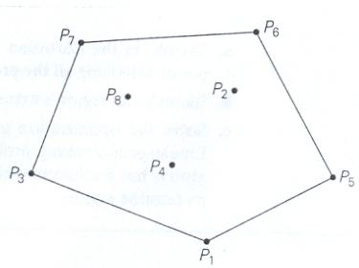
Convex-Hull Problem
Convex hull for set of 8 points:
polygon with its vertices at P₁, P₅, P₆, P₇ , P₃

Slide 45
Convex-Hull Problem
Problem Definition :
Convex hull problem is the problem to constructing the convex hull for a given set S of n points

Slide 46
Convex-Hull Problem
Need to find the the vertices of the polygon
  called “extreme points”
  extreme point of a convex set is a point of this set that is not a middle point of any line segment with end points in the set
    extreme points of a triangle are its three vertices
Find which pairs of points need to be connected to form the boundary of the convex hull
  List of extreme points in clockwise order
  So, how can we solve convex-hull problem in a brute force manner ?

Slide 47
Convex-Hull Problem
Problem has no obvious algorithmic solution !
Idea :
  A line segment connecting two points P_{i} and P_{j} of a set of n points is a part of its convex hull’s boundary iff all the other points of the set lie on the same side of the straight line through these two points
  Repeating this test for every pair of points yields a list of line segments that make up the convex hull’s boundary

Slide 48
Convex-Hull Problem
How to check whether all points in the set are on the same side of the line connecting two points:
  Straight line through two points (x₁,y₁), (x₂,y₂) in the coordinate plane is
  ax+by=c
  where a=y₂-y₁, b=x₁-x₂, c=x₁y₂-y₁x₂
  Such a line divides plane into two half-planes
    The points in one half→ ax+by>c
    The points in other → ax+by<c
  To check whether certain points lie on the same side of the line, we can check whether the expression ax+by-c has the same sign at each of these points

Slide 49
Convex-Hull Problem
Analysis :
for each of n(n-1)/2 pairs of distinct points.
  check the sign of ax+by-c for each of the other n-2 points
T(n) = O(n³)
There are more efficient algorithms for this problem.
We will discuss them later !

Slide 50
Convex-Hull Problem
Discussion :
  Convex hull problem has no obvious algorithmic solution.
  But there exists simple algorithms for this problem

Slide 51
Traveling Salesman Problem
Problem definition :
Find the shortest tour through a given set of n cities that visits each city exactly once before returning to the city where it started

Slide 52
Traveling Salesman Problem
The problem can be modeled by a weighted graph
Vertices represents cities
Edge weights represent the distances
Exhaustive search can be used to solve the problem

Slide 53
Exhaustive Search
Exhaustive search is a simple brute force approach to combinatorial problems
Exhaustive search suggests
  Generating each and every element of the problem’s domain
  Selecting those of them that satisfy the problem constraints
  Finding a desired element
    Optimizes some objective function

Slide 54
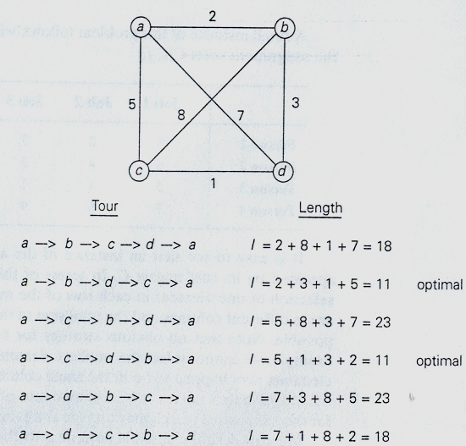
Traveling Salesman Problem
A solution to a small instance of the traveling salesman problem by exhaustive search

Slide 55
Traveling Salesman Problem
Discussion :
  This problem has been intriguing for the last 150 years by
    seemingly simple formulation,
    important applications and
    interesting connections to other combinatorial problems

Slide 56
Knapsack Problem
Problem Definition :
Given n items of known weights w₁, …, w_{n} and values v₁, …, v_{n} and a knapsack of capacity W.
Find the most valuable subset of the items that fit into the knapsack

Slide 57
Knapsack Problem
Exhaustive Search Approach :
  Consider all the subsets of the set of n items given
  Compute the total weight of each subset in order to identify feasible subsets
  Find a subset of the largest value among them

Slide 58
Knapsack Problem
Analysis:
# of subsets of an n-element set is 2^{n}
So exhaustive search leads to a Ω(2^{n})algorithm

Slide 59
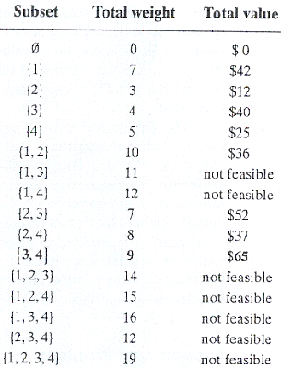
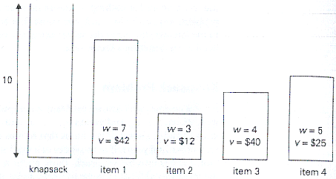
Knapsack Problem

Slide 60
Knapsack Problem
Discussion :
  Knapsack is a well known problem in algorithmics
  Exhaustive search leads to algorithms that are extremely inefficient on every input
  In fact knapsack is one of the examples of NP-hard problems
  No polynomial-time algorithm is known for any NP-hard problem !

Slide 61
Assignment Problem
Problem Definition :
  There are n people who need to be assigned to execute n jobs, one person per job.
  The cost of assigning the ith person to the jth job is a known quantity C[i,j] for each pair i,j=1, … , n.
  Problem is to find an assignment with smallest total cost !

Slide 62
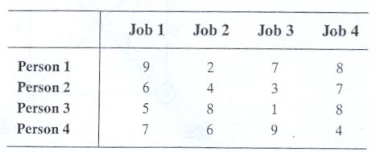
Assignment Problem
Exhaustive Search Approach :
  Assignment problem is completely specified by its cost matrix C [i,j]
  Example

Slide 63
Assignment Problem
Exhaustive Search Approach :
  Describe n-tuples (j₁, …, j_{n}) in which the ith component, i=1, …, n, indicates the column of the element selected in the ith row
  There is a one to one correspondence between feasible assignments and permutations of the first n integers
  1. generate all permutations of integers 1,2,…,n
  2. compute the total cost of each assignment by summing up the corresponding elements of the cost matrix
  3. select the one with smallest sum

Slide 64
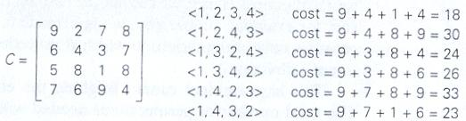
Assignment Problem
First few iterations of solving a small instance of the assignment problem by exhaustive search

Slide 65
Assignment Problem
Discussion :
  The fact that the problem’s domain grows exponentially (or faster) does not necessarily imply that there can be no efficient algorithm for solving it
  We will discuss them later !

