Slide 1
Introduction to Algorithm Design
Lecture Notes 4

Slide 2
ROAD MAP
Divide And Conquer
  Binary Search
  Maximum Subsequence Problem
  Merge Sort
  Quick Sort
  Multiplication of Large Integers
  Strassen’s Matrix Multiplication
  Closest Pair of Points
  Convex Hull

Slide 3
Divide And Conquer
A well known general algorithm design technique
Approach:
A problem’s instance is divided into several smaller instances of the same problem
  ideally of about the same size
The smaller instances are solved
  typically recursively
The solutions obtained for the smaller instances are combined to get a solution to the original problem

Slide 4
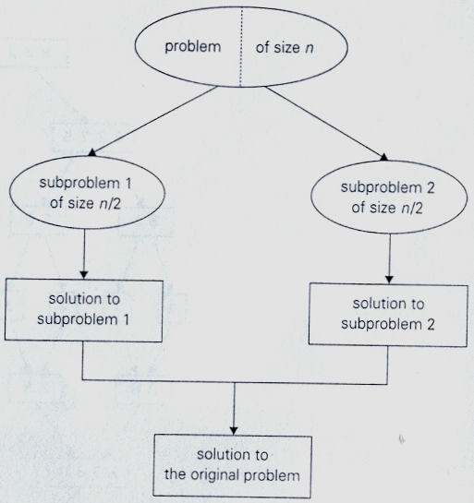
Divide And Conquer

Slide 5
Divide And Conquer
Algorithm :
D&C (P)
if small (P) then return S(P)
else
{
divide P into P₁, P₂, …, P_{k} k≥1
apply D&C to P_{i}
return combine ( D&C (P₁), …, D&C (P_{k}) )
}

Slide 6
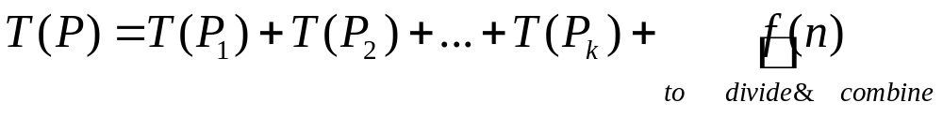
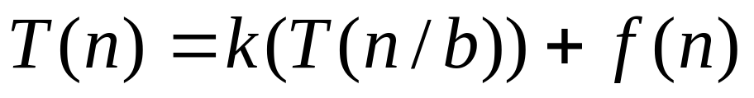
Divide And Conquer
Analysis :

Slide 7
A simple Example
Problem:
Compute the sum of n numbers
Approach:
Divide the problem into two subproblems
What about the analysis?
  Is it more efficient than brute force approach?

Slide 8
Binary Search
Binary search is a remarkably efficient algorithm for searching in a sorted array
An array A[0 .. n-1] and a search key K is given
Approach :
1. Comparing a search key K with the array’s middle element A[m]
2. If they match, the algorithm stops
3. Otherwise same operation is repeated recursively for the first half of the array if K<A[m] and for the second half if K>A[m]

Slide 9
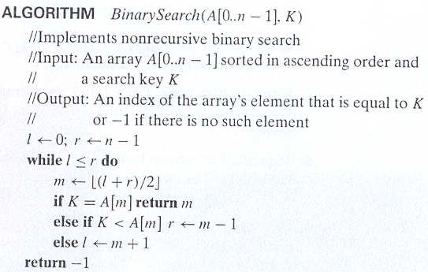
Binary Search

Slide 10
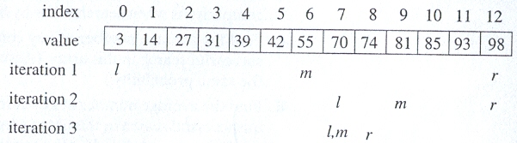
Binary Search
Example :
Apply binary search to searching for K =70 in the array

Slide 11
Binary Search
Analysis :
What is the basic operation ?

Slide 12
Binary Search
Basic operation is the comparison of the search key and an element of the array
How many comparisons are made?
  Depends on n
  Also depends on the problem instance
Requires best, worse and average case analysis

Slide 13
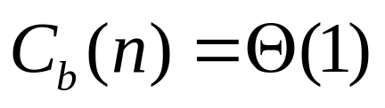
Binary Search
Best case: When the search key is in the middle of the array.

Slide 14
Binary Search
Worst case: When the search key is not found in the array
By assuming that n = 2^{k} and solving the recurrence by backward substitution, we get
In general

Slide 15


Binary Search
It is possible to verify the general formula by substituting it into the recurrence equation:
left-hand side of recurrence equation for n = 2i is
right-hand side of recurrence equation for n = 2i is
Since both expressions are same, verification is achieved.

Slide 16
Binary Search
What can you say about the average case ?

Slide 17
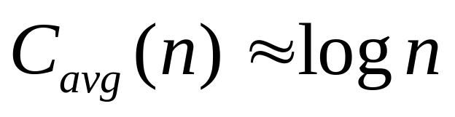
Binary Search
An analysis shows that the average number of key comparisons made by binary search is only slightly smaller than that in the worst case

Slide 18
Binary Search
Discussion :
advantages
  be able to process large amounts of data
  has a low cost per run
disadvantages:
  needs to be able to look at the whole array.
  if there is too many data items then it requires a lot of memory.

Slide 19
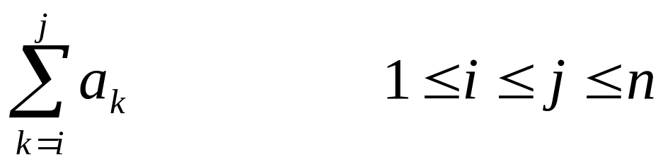
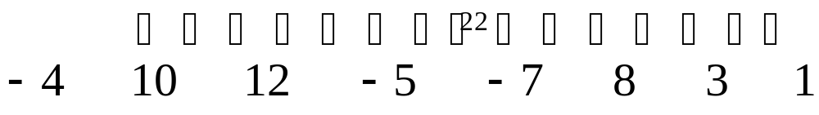
Maximum Subsequence Sum Problem
Problem Definition :
Given possibly negative integers a[1], …, a[n]
find the maximum value of the
Example :

Slide 20
Maximum Subsequence Sum Problem
Divide and Conquer Algorithm
1. divide the sequence into two halves
2. find MAXSUM (L)
3. find MAXSUM (R)
4. MAXSUM = max ( MAXSUM (L), MAXSUM (R) )
5. find MAXSUM’ (L)
6. find MAXSUM’ (R)
7. MAXSUM = max ( MAXSUM (L), MAXSUM (R)
MAXSUM’ (L) + MAXSUM’ (R) )

Slide 21
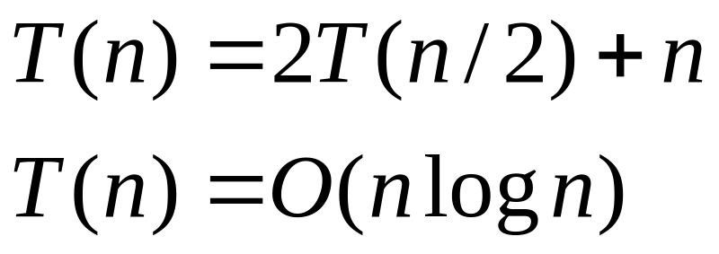
Maximum Subsequence Sum Problem
Analysis :

Slide 22
ROAD MAP
Divide And Conquer
  Binary Search
  Maximum Subsequence Problem
  Merge Sort
  Quick Sort
  Multiplication of Large Integers
  Strassen’s Matrix Multiplication
  Closest Pair of Points
  Convex Hull

Slide 23
Mergesort
Mergesort is a perfect example of a successfull application of divide & conquer technique
Solves the sorting problem
Given array A[0..n-1]
Approach :
1. divide array into two halves
A[0..n/2-1] and A[n/2..n-1]
2. sort each halve recursively
3. merge two smaller sorted arrays into a single sorted one

Slide 24
Mergesort
ALGORITHM Mergesort (A[0..n-1])
// sorts array A[0..n-1] by recursive mergesort
// input : An array A[0..n-1] of orderable elements
// output : Array A[0..n-1] sorted in nondecreasing order
If n>1
copy A[0..(n/2)-1] to B[0..(n/2)-1]
copy A[n/2..n-1] to C[0..(n/2)-1]
Mergesort (B[0..(n/2)-1])
Mergesort (C[0..(n/2)-1])
Merge (B, C, A)

Slide 25
Mergesort
ALGORTHM Merge (B[0..p-1],C[0..q-1],A[0..p+q-1])
// Merges two sorted arrays into one sorted array
// Input : Arrays B[0..p-1] and C[0..q-1] both sorted
// Output : Sorted array A[0..p+q-1] of the elements of B and C
i←0 ; j←0, k←0
while i<p and j<q do
if B[i]≤C[j]
A[k]←B[i]; i←i+1
else
A[k]←C[j]; j←j+1
k←k+1
if i=p copy C[j..q-1] to A[k .. p+q-1]
else copy B[i..p-1] to A[k .. p+q-1]

Slide 26
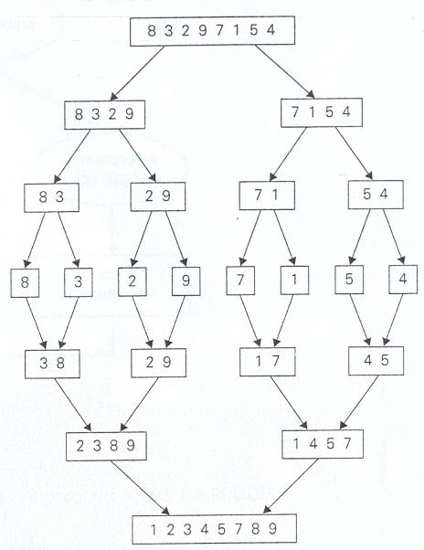
Mergesort Example

Slide 27
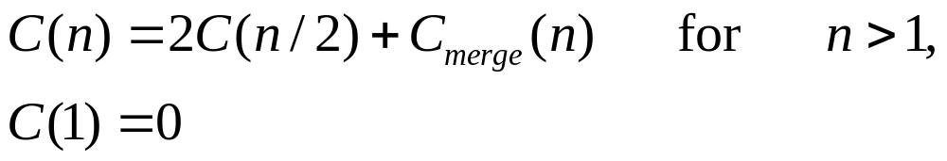
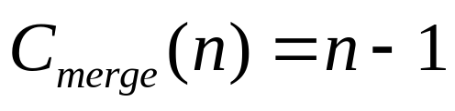
Mergesort
Analysis :
Count the number of comparisons
What about the merge operation?
  Worst case: when the smaller comes from alternating array

Slide 28
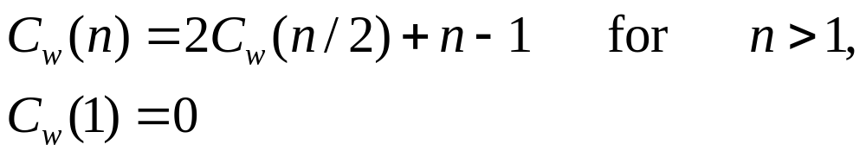
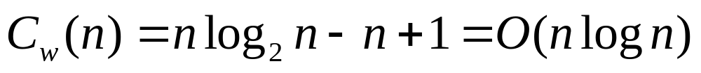
Mergesort
Analysis :
By backward substitution
Or we can use Master Theorem if asymptotic solution is sufficient

Slide 29
Mergesort
Discussion :
  Perfect example of a successfull application of divide & conquer technique
  Optimal with respect to number of comparisons
  Disadvantages
    Extra space used in Merge
      How big it is?
      How to reduce?
    Recursive calls – stack space
      use insertion sort for small # of elements
      iterative

Slide 30
Quicksort
Quicksort is an important sorting algorithm based on D & C strategy
It sorts a given array A[0..n-1]

Slide 31
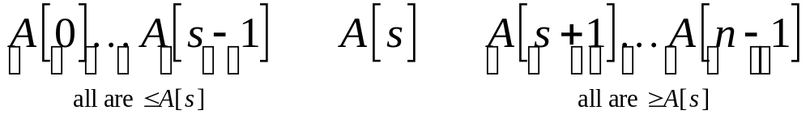
Quicksort
Given an array A[0..n-1]
Approach :
  1. Divide input’s elements according to their values
    Rearrange elements of a given array A[0..n-1] to achieve a partition
    After a partition has been achieved, A[s] will be in its final position in sorted array
  3. Continue sorting two subarrays of elements preceding

Slide 32
Quicksort
ALGORITHM Quicksort (A[l..r])
// Sorts a subarray by quicksort
// Input : A subarray A[l..r] of A[0..n-1], defined by its left and right indces l and r
// Output : The subarray A[l..r] sorted in nondecreasing order
If l<r
s←Partition(A[l..r])
//s is a split position
Quicksort(A[l..s-1])
Quicksort(A[s+1..r])

Slide 33
Quicksort
How to achieve a partition of A[0..n-1] ?
  Select an element with respect to whose value we are going to divide subarray
    this element is called pivot
There are several strategies to select a pivot.
For now we use the simplest strategy
  Pivot is subarray’s first element; p=A[1]

Slide 34



Quicksort
Partitioning :

Slide 35
Quicksort
ALGORITHM Partition (A[l..r])
// Partitions a subarray by using its first element as a pivot
// Input : A subarray A[l..r] of A[0..n-1], defined by its left and right indices l and r (l < r)
// Output : A partition of A[l..r], with the split position returned as this function’s value
p ← A[l]; i ← l ; j ← r+1
repeat
repeat i ← i+1 until A[i]≥p
repeat j ← j-1 until A[j]≤p
swap (A[i], A[j])
until i≥j
swap (A[i], A[j]) // undo last swap when i≥j
swap (A[l], A[j])
return j

Slide 36
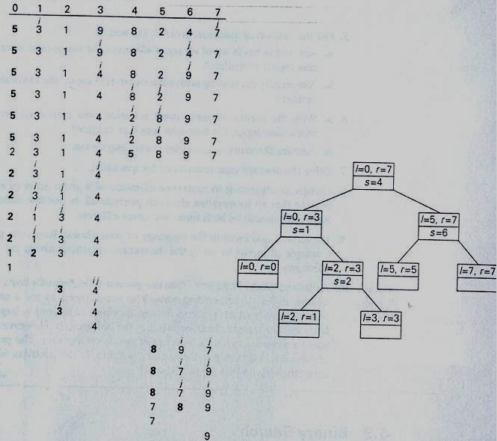

Slide 37
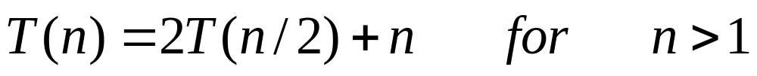
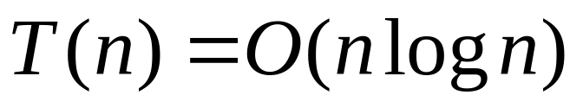
Quick Sort
Analysis :
n:# of elements
T(partition) = O(n) → n+1
  Best case
  If all the splits happen in the middle of the corresponding subarrays, it is the best case

Slide 38

Quick Sort
Analysis :
  Worst-case
    All splits will be skewed to the extreme
      One of the two subarrays will be empty while the size of the other will be just one less than the size of a subarray being partitioned
      If A[0 .. n-1] is a strictly increasing array and we use A[0] as the pivot
        Left to right scan will stop on A[1]
        Right to left scan will go all the way to reach A[0]

Slide 39
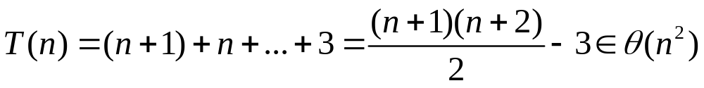
Quick Sort
Analysis :
  Worst-case
    After comparisons and exchanging the elements the array must be sorted
    So

Slide 40
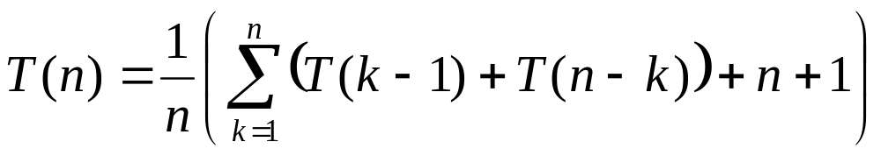
Quick Sort
Analysis :
Average Case
each element has an equal probability of being the pivot
P = 1/n

Slide 41
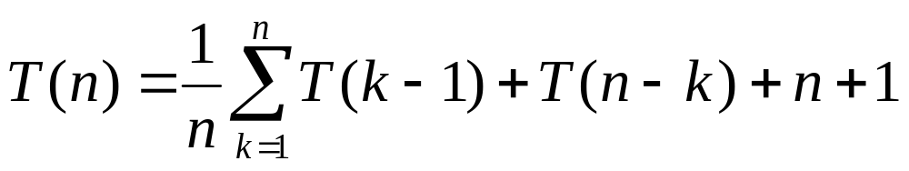
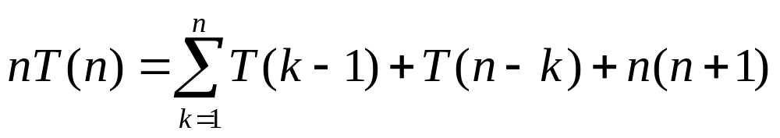
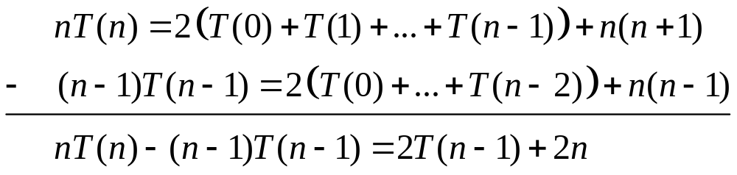
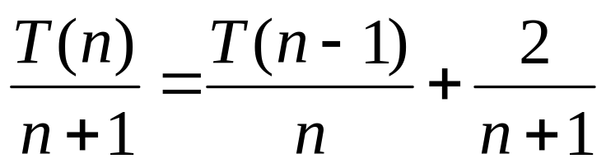
Quick Sort

Slide 42
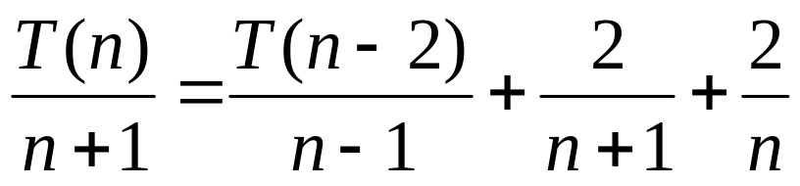
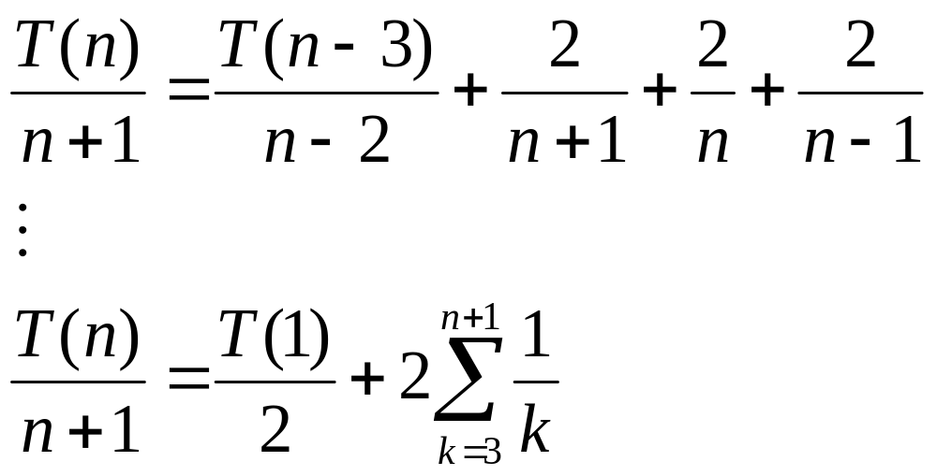
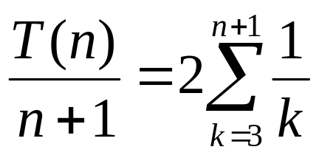
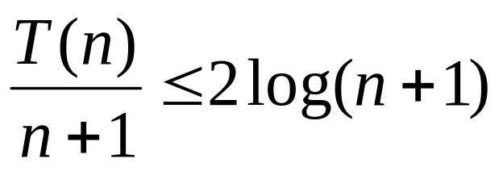
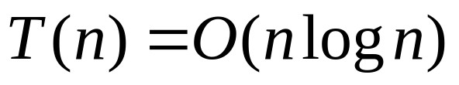

Slide 43
Quick Sort
Discussion :
Quicksort is a very efficient algorithm
However, its performance depends on the pivot point
The farther we get from the median for the pivot value the more lopsided the partitions become and the greater the depth of the recursion needs to be
Also requires a higher level of knowledge on the part of the programmer

Slide 44
Binary Tree and Its Properties
Recall recursive definition of Binary Trees
Many problems about BTs can be solved by applying divide-and-conquer technique
  The height of the tree
  The number of nodes in the tree
  Traversals
    Preorder
    Postorder
    Inorder

