Slide 1
Introduction to Algorithm Design
Lecture Notes 5

Slide 2
ROAD MAP
Divide And Conquer
  Binary Search
  Maximum Subsequence Sum Problem
  Merge Sort
  Quick Sort
  Binary Tree and Its Properties
  Multiplication of Large Integers
  Strassen’s Matrix Multiplication
  Closest Pair of Points
  Convex Hull

Slide 3
Multiplication of Large Integers
Some applications require manupilation of large integers (over 100 decimal digits long)
  Such as cryptology
Such integers are too long to fit in a special word of a modern computer
  They require special treatment
  Does not take unit time

Slide 4
Multiplication of Large Integers
Classical pen-pencil algorithm for multiplying two n-digit integer
  Each of n digits of the first number is muliplied by each of n digits of second number
The total is n² digit multiplications
Is it possible to design an algorithm with fewer than n² digit multiplication?

Slide 5

Multiplication of Large Integers
Example: multiply 23 and 14
There are 4 multiplications in total
The middle term can also be calculated as
So the result can be obtained by three multiplications only

Slide 6
Multiplication of Large Integers
In general:
For any pair of two-digit integers a =a₁a₀ and b=b₁b₀, their product c can be computed by the formula
c = a*b = c₂10² + c₁10¹ + c₀
where
c₂ = a₁*b₁ → product of their first digits
c₀ = a₀*b₀ → product of their second digits
c₁ =(a₁+a₀)*(b₁+b₀)-(c₂+c₀) → product of the sum of the a’s digits and the sum of the b’s digits minus the sum of c₂ and c₀

Slide 7
Multiplication of Large Integers
Approach :
If we want to multiply two n-digit integers a and b where a is positive even number
  Divide both numbers in the middle
  Denote first half of the a’s digits by a₁ and second half by a₀
    Same notations for b
  a = a₁a₀ implies that a=a₁10^{n/2} + a₀ and
  b = b₁b₀ implies that b=b₁10^{n/2} + b₀

Slide 8
Multiplication of Large Integers
We get
c = a*b = (a₁10^{n/2} + a₀) * (b₁10^{n/2} + b₀)
  c =(a₁*b₁)10^{n} + (a₁*b₀ + a₀*b₁)10^{n/2} +(a₀*b₀)
  c = c₂10^{n} + c₁10^{n/2} + c₀
where
c₂ = a₁*b₁ → product of their first halves
c₀ = a₀*b₀ → product of their second halves
c₁ =(a₁+a₀)*(b₁+b₀)-(c₂+c₀) → product of the sum of the a’s halves and the sum of the b’s halves minus the sum of c₂ and c₀

Slide 9
Multiplication of Large Integers
If n/2 is even, we can apply same method for computing products of c₂, c₁ and c₀.
Thus we have a recursive algorithm to compute product of two n-digit integers
Recursion is stopped
  when n becomes 1
  when we deem n small enough to multiply the numbers of that size directly

Slide 10
Multiplication of Large Integers
Analysis :
How many digit multiplications does this algorithm make?

Slide 11



Multiplication of Large Integers
Analysis :
Multiplication of n-digit numbers requires three multiplications of n/2 digit number
So
solving it by backward substitution for n = 2^{k} yields
since k = log₂n

Slide 12
Multiplication of Large Integers
Discussion :
Used in many problems today
  Cryptography
  Security units of mobile devices
Divide and conquer algorithm outperform the pen-and-pencil method on integers over 600 digits long

Slide 13
Matrix Multiplication
Problem Definition :
Find product C of two n-by-n matrices A and B
We will see that matrix multiplication can be done using less than n³ scalar multiplications

Slide 14
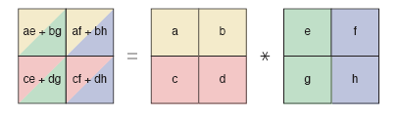
Matrix Multiplication
A simple divide and conquer strategy:
Let A and B be two n-by-n matrices where n is a power of 2
We can divide A, B and their product C into four n/2-by-n/2 submatrices each as follows

Slide 15
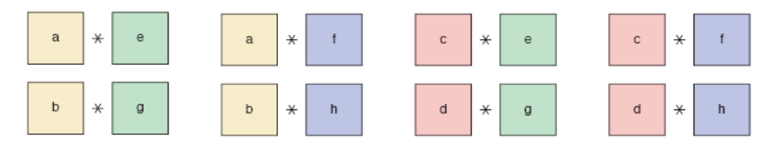

Matrix Multiplication
8 Sub-Problems:
Analysis:
8 multiplication operation → (n/2)-by-(n/2) matrix
4 addition operation → (n/2)-by-(n/2) matrix
T(n)=8*T(n/2)+Θ(n²) = Θ (n³)

Slide 16
Strassen’s Matrix Multiplication
To perform matrix multiplication using less than n³ scalar multiplications
First lets consider the case of 2-by-2 matrix multiplication
  We will show that this can be done using 7 multiplications instead of 8 multiplications required by brute-force algorithm.

Slide 17
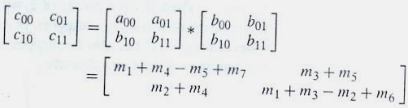
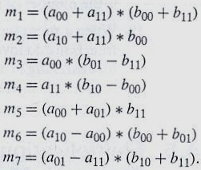
Strassen’s Matrix Multiplication
We can use the following formulas
where

Slide 18
Strassen’s Matrix Multiplication
There are 7 multiplications.
But how many additions are there?
Is it good idea to use this method for 2-by-2 matrices?

Slide 19
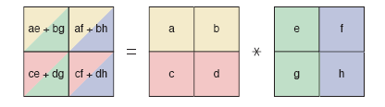
Strassen’s Matrix Multiplication
7 multiplication operation
P1=a*(f-h) P2=(a+b)*h P3=(c+d)*e P4=d*(g-e) P5=(a+d)*(e+h) P6=(b-d)*(g+h) P7=(a-c)*(e+f)
Solution:
a*e+b*g = P5+P4-P2+P6
a*f+b*h = P1+P2
c*e+b*h = P3+P4
c*f + d*h = P5+P1-P3-P7

Slide 20
Strassen’s Matrix Multiplication
Approach:
Let A and B be two n-by-n matrices
  where n is a power of 2
Divide A and B into four n/2-by-n/2 submatrices
Calculate 7 submatrix multiplications recursively
Perform required additions to obtain the matrix C

Slide 21



Strassen’s Matrix Multiplication
Analysis :

Slide 22
Strassen’s Matrix Multiplication
Discussion :
  Saving in # of multiplications was achieved at the expense of making extra additions
    We must check # of additions A(n)
    A(n) Є Ө(n^{log}2⁷)
    Same order of growth as # of multiplication
  Efficiency is better than brute force
    Brute force algorithm is n³
  Is it good for memory efficiency?
  It is not the best algorithm for matrix multiplication
    Coopersmith and Winogrand algorithm’s efficiency is O(n^{2.376})

Slide 23
ROAD MAP
Divide And Conquer
  Binary Search
  Maximum Subsequence Problem
  Merge Sort
  Quick Sort
  Multiplication of Large Integers
  Strassen’s Matrix Multiplication
  Closest Pair of Points
  Convex Hull

Slide 24
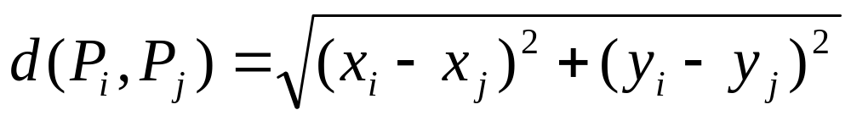
Closest-Pair Problem
Problem Definition :
Find the closest points in a set of n points.
  We consider the two dimensional case of the problem
  We assume that points in question are specified in a standard fashion by their (x,y) Cartesian coordinates
  We assume that distance between two points Pi = (xi, yi) and Pj = (xj,yj) is the standard Euclidean distance

Slide 25
Closest-Pair Problem
Approach :
1. Divide points given into two subsets S₁ and S₂ of n/2 points each by drawing a vertical line x=c
  c is be the median μ of x coordinates
  So, n/2 points lie on the left or on the line itself, and n/2 points lie on the right

Slide 26
Closest-Pair Problem
Approach :
2. Find recursively the closest pair in the left subset S₁ and the right subset S₂
  let d₁ and d₂ be the smallest distances between pairs of points in S₁ and S₂
  let d = min{d₁, d₂}
  d is not necessarily the smallest distance between all pairs of points in S₁ and S₂
    A closer pair of points can lie on the opposite sides of the seperating line
  Should also consider the points in symetric vertical strip of width 2d
    the distance for any other pair of points is greater that d

Slide 27
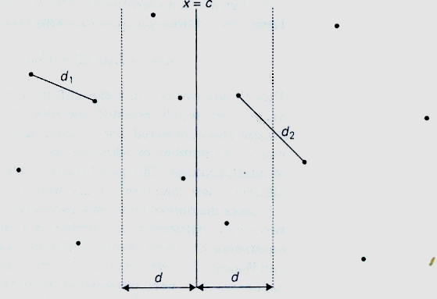
Closest-Pair Problem
Idea of the d&c algorithm for the closest-pair problem

Slide 28
Closest-Pair Problem
Approach :
Let C₁ and C₂ be the subsets of points in the left and right parts of the strip respectively
4. For every point P(x,y)in C₁, inspect points in C₂ that may be closer to the P than d
    Such points must have their y coordinates in the interval [y-d, y+d]
    So there can be no more than such 6 points

Slide 29
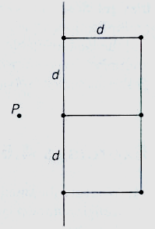
(a) Idea of the d&c algorithm for the closest-pair problem
(b) The six points that may need to be examined for point P
(worst case)

Slide 30
Closest-Pair Problem
Approach :
6.Maintain list of points in C₁ and C₂ in ascending order of their y coordinates
    This ordering can be maintained by merging two previously sorted lists
  7.Process C₁ points sequentially while a pointer into the C₂ list scans an interval of width 2d

Slide 31
Closest-Pair Problem
Analysis :
The recurrence for T(n), on n presorted points :
T(n) = 2 T(n/2) + M(n)
T(n) Є O(nlogn)

Slide 32
Convex-Hull Problem
Problem Definition :
Find the smallest convex polygon that contains n given points in a plane

Slide 33
Convex-Hull Problem
There are several divide&conquer algorithms for the convex-hull problem.
We will look at the simplest one !
This algorithm is sometimes called quickhull
  its operations resemble those of quicksort

Slide 34
Convex-Hull Problem
Any İdea????

Slide 35
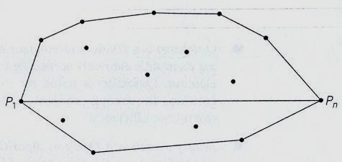
Convex-Hull Problem
Let P₁ = (x₁, y₁), …, P_{n}=(x_{n}, y_{n}) be a set of n>1 points in the plane
We assume that points are sorted in increasing order of their x coordinates
Leftmost point P₁ and rightmost point P_{n} are two distinct extreme points

Slide 36
Convex-Hull Problem
Let P₁P_{n} be the straight line through point P₁ and P_{n}
This line seperates the points of S into two sets
  S₁ is the set of points on the left of this line
  S₂ is the set of points on the right of this line
The points of S on the line P₁P_{n} other than P₁ and P_{n} can not be extreme points of convex-hull

Slide 37
Convex-Hull Problem
Boundary of convex hull of S is made of two polygonal chains
  Upper boundary called upper hull is a sequence of line segments including
    Line segment connecting P₁ and P_{n}
    Line segments connecting some points in S₁
  Lower boundary called lower hull is a sequence of line segments including
    Line segment connecting P₁ and P_{n}
    Line segments connecting some points in S₂
  Convex-hull of the entire set is composed of the upper and lower hulls

Slide 38
Convex-Hull Problem
How to construct the upper hull and lower hull?
Is the problem same as the original convex-hull problem?
Where is the divide and conquer technique?

Slide 39
Convex-Hull Problem
We will use divide-and-conquer technique to construct the upper hull and lower hull.
  Then the algorithms is called quickhull

Slide 40
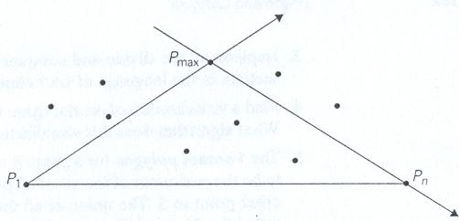
Convex-Hull Problem
Idea of quickhull

Slide 41
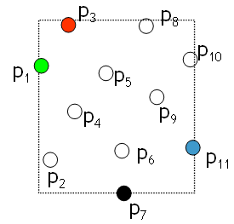
Quickhull Example
Find extreme points above, below, left and right
Define a quadrilateral connecting extreme points, discard internal points
Process 4 triangles recursively
For each triangle, find vertex with greater distance from the triangle baseline.
Define another triangle and discard internal triangles
Process 2 triangles recursively

Slide 42
Quickhull Example
Find extreme points above, below, left and right
Define a quadrilateral connecting extreme points, discard internal points
p₃
p₈
p₁₀
p₁
p₅
p₄
p₉
p₆
p₁₁
p₂
p₇

Slide 43
Quickhull Example
Find extreme points above, below, left and right
Define a quadrilateral connecting extreme points, discard internal points
Process 4 triangles recursively
p₃
p₈
p₁₀
p₁
p₅
p₄
p₉
p₆
p₁₁
p₂
p₇

Slide 44
Quickhull Example
Find extreme points above, below, left and right
Define a quadrilateral connecting extreme points, discard internal points
Process 4 triangles recursively
For each triangle, find vertex with greater distance from the triangle baseline.
Define another triangle and discard internal triangles
p₃
p₈
p₁₀
p₁
p₅
p₄
p₉
p₆
p₁₁
p₂
p₇

Slide 45
Quickhull Example
Find extreme points above, below, left and right
Define a quadrilateral connecting extreme points, discard internal points
Process 4 triangles recursively
For each triangle, find vertex with greater distance from the triangle baseline.
Define another triangle and discard internal triangles
Process 2 triangles recursively
p₃
p₈
p₁₀
p₁
p₅
p₄
p₉
p₆
p₁₁
p₂
p₇

Slide 46
Quickhull Example
Find extreme points above, below, left and right
Define a quadrilateral connecting extreme points, discard internal points
Process 4 triangles recursively
For each triangle, find vertex with greater distance from the triangle baseline.
Define another triangle and discard internal triangles
Process 2 triangles recursively
p₃
p₈
p₁₀
p₁
p₅
p₄
p₉
p₆
p₁₁
p₂
p₇

Slide 47
Quickhull Example
Find extreme points above, below, left and right
Define a quadrilateral connecting extreme points, discard internal points
Process 4 triangles recursively
For each triangle, find vertex with greater distance from the triangle baseline.
Define another triangle and discard internal triangles
Process 2 triangles recursively
p₃
p₈
p₁₀
p₁
p₅
p₄
p₉
p₆
p₁₁
p₂
p₇

Slide 48
Quickhull Example
Find extreme points above, below, left and right
Define a quadrilateral connecting extreme points, discard internal points
Process 4 triangles recursively
For each triangle, find vertex with greater distance from the triangle baseline.
Define another triangle and discard internal triangles
Process 2 triangles recursively
p₃
p₈
p₁₀
p₁
p₅
p₄
p₉
p₆
p₁₁
p₂
p₇

Slide 49
Quickhull Example
Find extreme points above, below, left and right
Define a quadrilateral connecting extreme points, discard internal points
Process 4 triangles recursively
For each triangle, find vertex with greater distance from the triangle baseline.
Define another triangle and discard internal triangles
Process 2 triangles recursively
p₃
p₈
p₁₀
p₁
p₅
p₄
p₉
p₆
p₁₁
p₂
p₇

Slide 50
Quickhull Example
Find extreme points above, below, left and right
Define a quadrilateral connecting extreme points, discard internal points
Process 4 triangles recursively
For each triangle, find vertex with greater distance from the triangle baseline.
Define another triangle and discard internal triangles
Process 2 triangles recursively
p₃
p₈
p₁₀
p₁
p₅
p₄
p₉
p₆
p₁₁
p₂
p₇

Slide 51
Quickhull Example
Find extreme points above, below, left and right
Define a quadrilateral connecting extreme points, discard internal points
Process 4 triangles recursively
For each triangle, find vertex with greater distance from the triangle baseline.
Define another triangle and discard internal triangles
Process 2 triangles recursively
p₃
p₈
p₁₀
p₁
p₅
p₄
p₉
p₆
p₁₁
p₂
p₇

Slide 52
Quickhull Example
Find extreme points above, below, left and right
Define a quadrilateral connecting extreme points, discard internal points
Process 4 triangles recursively
For each triangle, find vertex with greater distance from the triangle baseline.
Define another triangle and discard internal triangles
Process 2 triangles recursively
p₃
p₈
p₁₀
p₁
p₅
p₄
p₉
p₆
p₁₁
p₂
p₇

Slide 53
Quickhull Example
Find extreme points above, below, left and right
Define a quadrilateral connecting extreme points, discard internal points
Process 4 triangles recursively
For each triangle, find vertex with greater distance from the triangle baseline.
Define another triangle and discard internal triangles
Process 2 triangles recursively
p₃
p₈
p₁₀
p₁
p₅
p₄
p₉
p₆
p₁₁
p₂
p₇

Slide 54
Quickhull Example
Find extreme points above, below, left and right
Define a quadrilateral connecting extreme points, discard internal points
Process 4 triangles recursively
For each triangle, find vertex with greater distance from the triangle baseline.
Define another triangle and discard internal triangles
Process 2 triangles recursively
p₃
p₈
p₁₀
p₁
p₅
p₄
p₉
p₆
p₁₁
p₂
p₇

Slide 55
Quickhull Example
Find extreme points above, below, left and right
Define a quadrilateral connecting extreme points, discard internal points
Process 4 triangles recursively
For each triangle, find vertex with greater distance from the triangle baseline.
Define another triangle and discard internal triangles
Process 2 triangles recursively
p₃
p₈
p₁₀
p₁
p₅
p₄
p₉
p₆
p₁₁
p₂
p₇

Slide 56
Convex-Hull Problem
Analysis :
  Worst case efficiency is Ө(n²)
    As quicksort
  In average case we expect a better performance
    Under a natural assumption that points given are chosen randomly from a uniform distribution over some convex region, average case turns to be Ө(nlogn)

Slide 57
Convex-Hull Problem
Discussion :
Quickhull has the same efficiency with quicksort
  Ө(nlogn) in average case but Ө(n²) in worst case
There exists more sophisticated d&c algorithms for this problem with the worst case efficiency Ө(nlogn)

Slide 58
Divide & Conquer
Discussion :
There are 3 criterias for efficiency of D&C algorithms
  # of subproblems
  Proportion of the main problem and subproblem
  Time to divide the problem and combine the sub-solutions

