Slide 1

UNIT-1 INTRODUCTION

Slide 2
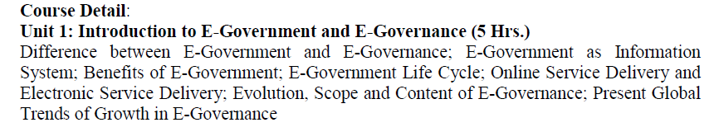
SYLLABUS

Slide 3
E-government
E-government is the use of technological communications devices, such as computers and the Internet to provide public services to citizens and other persons in a country or region.
It refers to the implementation of information and communication technology.
Through the use of technology, it improves the government activities and process.

Slide 4
Four Domains of e-Government
e-Administration – Improving government processes by using ICTs and government process management. No paperwork, each and every process need to be done via the use of ICT.
e-Government services – Delivering government services electronically to citizens, businesses, and government employees. Example- application for citizenship through the online system.
e-Democracy – Improving transparency and democratic decision making, as well as citizens’ participation in public decisions. e-Voting is a perfect example here.
e-Governance – It is a development, deployment, and enforcement of the policies, laws, and regulations necessary for developing cooperation, networking and partnerships between government units, citizens and the business. Citizen will get government services using technology.

Slide 5
Benefits of e-Government
Better provision of government services
Improved interaction with different groups and citizen
Citizen empowerment through access to information
Efficient government management
Easy implementation of Right to Information
It is a two-way process Government to citizen and vice versa.

Slide 6
E GOVERNANCE
It is a part of e-Government.
E-Governance is dealing with all regulations and policies to control the services provided by the e-Government.
However, the E-Government is an electronic government, which should be regulated by the E-Governance.
e-Governance refers to the utilization of information and communication technology (ICT) for providing government services, disseminating information, communication operations with the general public.

Slide 7
Benefits of e-Governance
Better provision of government services
Improved interaction with different groups
Citizen empowerment through access to information
Efficient government management

Slide 8
Key difference between e-Government & e-Governance?
e-Government is a system whereas e-Governance is a functionality
e-Government means the application of ICT in government operations, as a tool to make better government. e-Governance, on the other hand, implies the use of ICT in transforming and supporting functions and structures of the system.
It is a one-way protocol but e-Governance is a two-way protocol(government to citizen and vice versa)
e-Governance is the part of e-Government. e-Governance never comes alone.

Slide 9
Good Governance
Good governance can be enabled by e governance if it is implemented properly.
Here good governance stands for SMART (Simple, Moral, Accountable, Responsive and Transparent) governance which is very important for developing nations.
It is needed for public or citizen to interact with government through electronics means in order to get the services as ease.

Slide 10
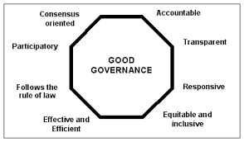

Slide 11
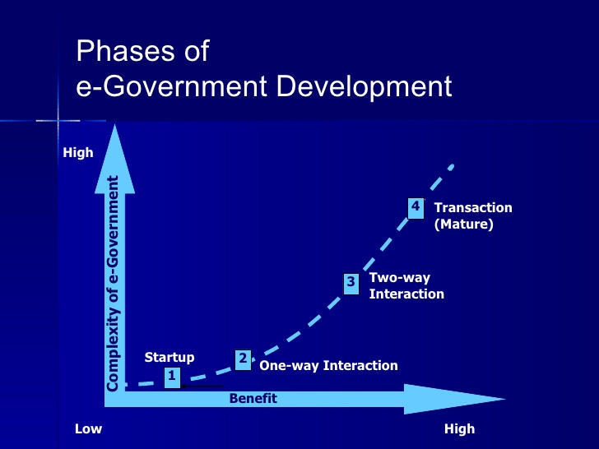
Phase of e- Governance

Slide 12
Types of e-governance
G2G(Government to Government)
G2C(Government to Citizen)
G2B(Government to Business)
G2E(Government to Employee)

Slide 13
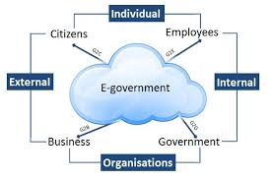

Slide 14
Government-to-Citizen (G2C):
The Government-to-citizen mentions the government services that are acquired by the citizens.
Most of the government services come under G2C.
Similarly, the primary aim of Government-to-citizen is to supply facilities to the citizens.
It also helps the ordinary people to minimize the time and cost to carry out a transaction.
A citizen can retrieve the facilities anytime from anywhere.
Paying the administrative fee online is also possible due to G2C.
The facility of Government-to-Citizen allows the ordinary citizen to outclass time limitation.
It also focuses on geographic land barriers.

Slide 15
Government-to-business (G2B):
The Government-to-business is the interchange of services between Government and Business firms.
It is productive for both government and business firms. G2B provides access to pertinent forms needed to observe.
It also contains many services interchanged between business sectors and government.
Similarly, the Government-to-business provides timely business information.
A business organization can have easy and easy online access to government agencies. G2B plays a important role in business development.
It upgrades the efficiency and quality of communication and transparency of government projects.
Eg: Insurance, taxation

Slide 16
Government-to-Government (G2G):
The Government-to-Government mentions the interaction between different government departments, firms and agencies.
This increases the efficiency of government processes.
In G2G, government agencies can share the same database using online communication. The government departments can work together.
This service can increase international discretion and relations.
G2G services can be at the local level or at the international level. It can convey with both global government and local government.
It also provides safe and secure inter-relationship between domestic or foreign government. G2G builds a universal database for all members to upgrade service.

Slide 17
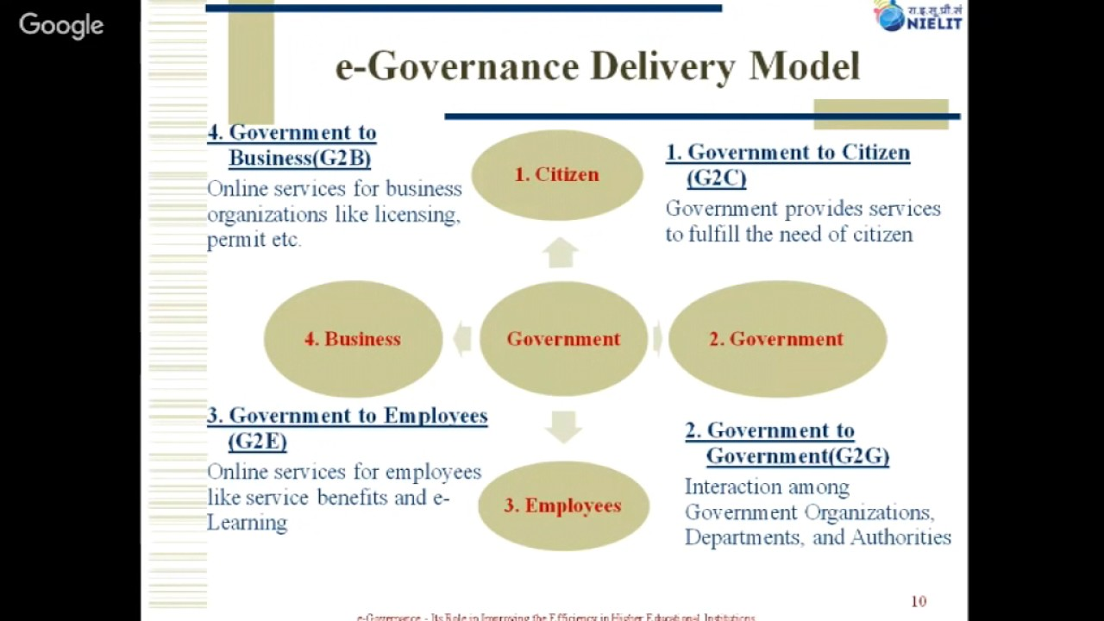

Slide 18
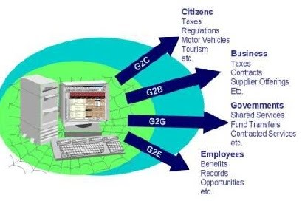

Slide 19
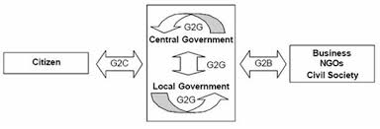

Slide 20
NEED OF E GOVERNANCE
To provide SMART government.
Information delivery is greatly simplified for citizens and businesses.
It gives varied departments’ information to the public and helps in decision making.
It ensures citizen participation at all levels of governance.
It leads to automated services so that all works of public welfare is available to all citizens.

Slide 21
It revolutionizes the functions of the government and ensures transparency.
Each department and its actions is closely monitored.
Public can get their work smartly done and save their time.
It provides better services to citizens and brings government close to public. Public can be in touch with the government agency.

Slide 22
MIDDLEMAN PROBLEM
It cuts middlemen and bribery if any from the picture.
The main difficulty faced by peoples while dealing with government work is the delay and the problem created by the middleman.
Hence to minimize the interruption of middleman and make it easy for people to get all the services provided by the government.

Slide 23
Evolution of E-Governance, Its Scope and Content
Initiatives were take up as early as 1972 by Chile
Prof. Stafford Beer implemented for President Allende of Chile, the first governance software that would help the government survive a severe crisis.
Major contribution by US Vice President Al Gore in early 1990s which rooted worldwide in the information superhighway.
Widespread in US, UK, Canada, Australia and India
Focus largely on development of infrastructure such as fiber optic networks.
Concept of Information Society or Knowledge Society evolved
E-governance came into a formalized and focused manner with partial success to implement Information System in the government departments and public organizations

Slide 24
During 1980s and 90s, govt. all over the world lagged behind the commercial world in accepting and implementing ICT.
Commercial and industrial world went far ahead all over the world in harnessing the potential of ICT in their core and peripheral activities.
They used ICT to reach out to their customers and business partners, thereby impressively enhancing their quality, speed and convenience.
Visible success cases of use of ICT
– ATM services
– 24 hour call center
– E-Shopping

Slide 25
Software export increase (banking, financial, aviation, industrial sector from India, Ireland, Israel, China)
1990s and 2000 - Development of ITES (IT enabled Society)
– resulted in remote services like call centers, data entry
Initial Efforts in E-governance:
– Partial automation of existing paper based manual process
– Did not result in significant Business Reengineering Process compared to private sector

Slide 26
– No big changes seen in government enterprises due to Conservatism, Resistance to change , Rigidity of legislative body
Thus, the scope of ICT implementation in government machinery can result in :
improvement of efficiency and effectiveness of the executive functions of the government, including delivery of public services;
greater transparency of government to citizens and business, permitting greater access to the information generated or collated by the government;
fundamental changes and improvement in relation between citizen and the state thereby improving the democratic process; and better interactions and relationships amongst different
wings of the same government
state of local governments within a country,
countries whose governments are web-enabled.

Slide 27
Any e-governance activity/project involves appropriate :
hardware and corresponding system software,
networking of the hardware identified above—both the Internet and Intranet environment, and
application software along with appropriate database management software

Slide 28
Present Global Trends of Growth in E-Governance: Other Issues
Governments are called to take on a new role in this favorable convergence.
The focus must now lie on the digital transformation of society as a whole.
Governments are no longer only providing services to end users, whether these are citizens or businesses.
Press reports (during the end of 2002) indicate a trend of global growth in e-governance utilization by people in different categories. They indicate the following:

Slide 29
The proportion of adults worldwide using the Internet to access government services or products during the past 12 months has increased by around 15 percent, according to the findings of the second Government Online Study published by Taylor Nelson Sofres.
Three out of ten citizens (30 percent) globally said that they had accessed government services online compared with only (26 per cent) questioned a year ago.
Government online services are most commonly used to search for information (24 per cent users) and to download information (11 per cent of the users).

Slide 30
The increased use of government online services is primarily due to rise in the proportion of people searching for information (from 20 to 24 per cent during the period from September 2001 to September 2002).
Globally, online government transactions increased from just 6 percent to 7 percent during this period and the percentage of those providing personal details to government increased from 7 per cent to 8 per cent.
In some countries, percentage increase has been significantly higher than in others.
Among the most significant increases in the use of government services online are Australia (from 31 per cent to 46 per cent), Turkey (from 3 per cent to 13 per cent), the Netherlands (from 31 per cent to 41 per cent), and the US (from 34 per cent to 43 per cent).
In contrast, in Japan, however, government online usage fell by 4 per cent (17 per cent to 13 per cent of the citizens) between 2001 and 2002.

Slide 31
While security issues about accessing government services online were the main concern for many countries during 2001, perceptions of safety improved globally during 2002.
When 23 per cent of citizens worldwide said that they feel safe disclosing personal information such as credit card and bank account numbers online compared to just 14 per cent of citizens in 2001, representing thus an increase of almost two-thirds (64 per cent).
As for the use of government online, the Scandinavian markets (Denmark, Finland, Norway, and Sweden), together with some South East Asian markets (Singapore and Hong Kong), have perceived the highest levels of safety (around one-third of users), in the system.
In contrast, the greatest safety concerns were expressed by citizens in Japan (90 per cent said they felt accessing government service online was "unsafe"), Germany (82 per cent) and France (76 per cent).

Slide 32
Other Issues
Globally, government online use is more prevalent among men (33 per cent) than women (26 per cent), and among those aged under 35 compared with other age groups.
During the past 12 months substantial increases in government online use have taken place among 35-44 years-old (from 22 per cent to 36 per cent) and 55-64 years-old (from 2 per cent to 18 per cent).
In contrast, use among those aged 65 and above decreased (from 7 per cent in 2001 to 5 per cent in 2002).
Globally, the proportion of Internet users who have made transactions using government services online is equal to the proportion of users who made online shopping transactions.

Slide 33
Fifteen per cent of Internet users have made an online government transaction and in addition 15 per cent have made an online purchase at least once during the past 12 months.
The percentage of Internet users who access government online services varies considerably across different countries from 16 per cent in Hungary to 81 per cent in Norway. Wendy Mellor, Director, Taylor Nelson Sofres commented:
The increase in the use of government online services at a global level suggests that the public see the Internet as a more acceptable means of getting involved in the government activity at both national and local levels.
However, significant differences exist between countries, may be due to, awareness of services, perceptions of safety, relevance of the site to users, and access to the Internet, among others.

Slide 34
In countries such as Singapore, Norway and Sweden, where the use of government services online is high, it is likely that a significant proportion of citizens feel comfortable with this approach of dealing with government.
Yet in countries such as Britain, New Zealand and South Korea, where usage lags behind general Internet use, more needs to be done to assess why uptake of online services is slow and what steps need to be taken to address this.
All the above statistics on usage is time bound.
Over the years there has been a definite rise in the usage of e-governance all over the world.

Slide 35
E-Government as Information System
To understand this topics we need to first know some terms like information technology, system information system and E-Government system.
Information technology (IT) is the use of any computers, storage, networking and other physical devices, infrastructure and processes to create, process, store, secure and exchange all forms of electronic data.

Slide 36
System is defined as a set of components for collecting, creating, storing, processing, and distributing information, typically including hardware and software, system users, and the data.
“Information systems are interrelated components working together to collect, process, store, and disseminate information to support decision making, coordination, control, analysis, and visualization in an organization.”

Slide 37
E-Government means office automation and internal management information systems and expert systems, as well as client-facing web sites. it must be seen to consist of technology plus information plus people who give the system purpose and meaning plus work processes that are undertaken.

Slide 38
E-Government as Information System can be represented as ‘onion-ring’ model. It consist of two parts: one inner part and other outer part.
Inner part represent the Information system and the outer part consist of Organization and Environment.
Information: Information is a set of data which is processed in a meaningful way according to the given requirement. Information is processed, structured, or presented in a given context to make it meaningful and useful.
Data is a raw and unorganized fact that required to be processed to make it meaningful.

Slide 39
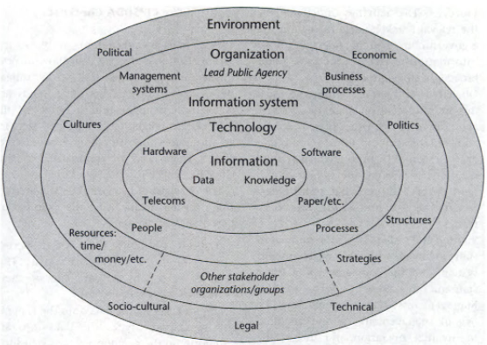

Slide 40
Knowledge is facts, information, and skills acquired through experience or education; the theoretical or practical understanding of a subject.
Technology: Technology is the sum of techniques, skills, methods, and processes used in the production of goods or services or in the accomplishment of objectives, such as scientific investigation. It consist of Hardware, Software, Telecom etc.
Information systems are interrelated components working together to collect, process, store, and disseminate information to support decision making, coordination, control, analysis, and visualization in an organization.

Slide 41
Processes: The activities undertaken by the relevant stakeholders for whom the e-government system operates, both information-related processes and broader business processes.
Objectives and values: Often the most important dimension since the objectives component covers issues of self-interest and organizational politics, and can even be seen to incorporate formal organizational strategies; the values component covers culture: what stakeholders feel are the right and wrong ways to do things.
Staffing and skills: Covers the number of staff involved with the e-government system, and the competencies of those staff and other users.

Slide 42
Management systems and structures: The overall management systems required to organize operation and use of the e-government system, plus the way in which stakeholder agencies/groups are structured, both formally and informally.
Other resources: Principally, the time and money required to implement and operate the e-government system.
Outside world: The political, economic, socio-cultural, technological and legal factors

Slide 43
E-Government Life Cycle
E-Government development project typically consists of five stages; (1) project assessment, (2) analysis of current reality, (3) design of the new system, (4) system construction, and (5) implementation and beyond.

Slide 44
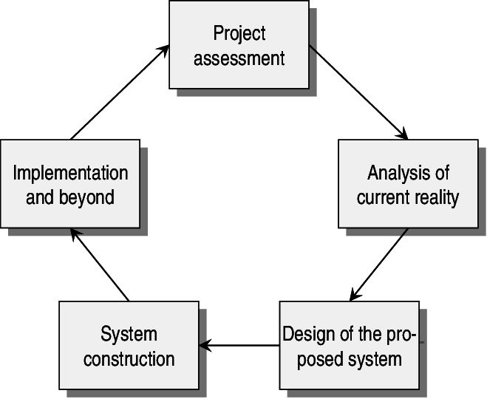

Slide 45
Project assessment
Project assessment, in the development model is the identification of possible e-government projects.
At this stage the outline of basic project parameters is completed, with the assessment of whether or not to proceed with a project.
New e-government projects are typically initiated based on: “a problem that needs to be solved” or “identification of an opportunity which could be seized” .

Slide 46
That kind of opportunity can arise from several different sources, such as from internal sources or external (environmental) sources.
Examples of external sources are: complaints from the media, politicians or citizens, new legislations or directives, technological innovation, and economic crises.
Examples of internal sources are: strategic planning, staff problems, and the individual’s desire to give his/her career a boost .

Slide 47
Analysis of current reality
Analysis of current reality means that descriptions of information, technology, processes, objectives and values, staffing and skills, management systems and structures, and other resources such as money and time are created.
This stage consists of a mixture of hard and soft techniques such as an information systems audit, an information systems analysis, a problem analysis, a context analysis, etc., in order to build an overall picture.
A SWOT-analysis can, for example, be performed .

Slide 48
Design stage
The design stage of the proposed new situation consists of setting objectives related to the above mentioned dimensions of the new system – putting together the different objectives for the new system to meet.
In this stage issues of software and hardware need to be dealt with.
Work processes are also necessary to take into account from a design perspective, and not just the front-end processes, but also the underlying processes.

Slide 49
System construction
System construction consists of the process and activities in acquiring any new IT, undertaking detailed design of the new e-government system (for example a system installation), building it, testing it, and documenting it.

Slide 50
Implementation
Implementation and beyond is represented by the planning of implementation processes,
for example: training users to use the new information system; converting data from old to new formats; systems maintenance activities; introducing the new e-government system; monitoring and evaluating its performance and context; and undertaking necessary activities .
The efforts concerning post implementation tasks such as marketing and support, in order to avoid the common “build it and they will come” strategy, are also important .

Slide 51
Online Service Delivery and Electronic Service Delivery
Online service delivery is an effective way to build closer relationships with customers, partners, and the public while simultaneously cutting costs and reducing delays.
Increasingly, organizations across a number of sectors are offering external-facing online services. They are also looking for the best ways to overcome challenges presented by registering and managing external identities, providing secure authentication, and managing access rights.
Electronis Service delivery or ESD refers to providing government service through the internet or other electronics means. It is related to e- service and e -government .
E service is highly generic term usially referring to " The provision of service via the internet".
Thus e service may also include e commerce although it may also include non commercial sevices(online) which is usually provided by the government (Main focus is government service provide by government to public)

Slide 52
E-Participation
E-Participation is a medium that is provided to engage citizens in policy-making, decision-making and design services through the use of information and communication technologies. Citizen engagement through e-participation has always been recognized by the Government so that the agency can:
1. Local development / new services and insights from the perspective of the people,
2. Identify sources of information/services needed by the people,
3. Decision-making and progress with regard to the potential reserves of the people.
However, people have to abide by the terms and conditions of a predetermined time to provide feedback. E-Participation initiative provided in the Ministry / Department / Agency is such as e-information, e-consultation and e-decision.

Slide 53
Electronic services delivery or ESD refers to providing government services through the Internet or other electronic means. It is related to e-services and e-government.
E-service (or eservice) is a highly generic term usually referring to ‘The provision of services via the Internet (the prefix 'e' standing for ‘electronic’, as it does in many other usages), thus e-Service may also include e-Commerce, although it may also include non-commercial services (online), which is usually provided by the government.’ (Alexei Pavlichev & G. David Garson, 2004: 169-170; Muhammad Rais & Nazariah, 2003: 59, 70-71).
‘An umbrella term for services available on the Internet, e-Service include e-Commerce transaction services for handling online orders, application hosting by application service providers (ASPs) and any processing capability that is obtainable on the Web.’ (Computer Desktop Encyclopedia, 2009)
E-Service or 'electronic service' constitutes the online services available on the Internet, whereby a valid transaction of buying and selling (procurement) is possible, as opposed to the traditional websites, whereby only descriptive information are available, and no online transaction is made possible.

