Slide 1

A brief deep intro to...
ft. memes, lots of memes

Slide 2




About Pau Cervelló
A BRIEF DEEP INTRO TO… ASP.NET 2.1
Senior .NET developer
Living in Lleida
Likes manual crafting & mountain walks
Inner peace? Well, trying to know what’s that
@pau_cervello
pcervello
pauer24

Slide 3

A BRIEF DEEP INTRO TO… ASP.NET 2.1
Agenda
Getting started
Configuration, logging & HttpClient
.NET Core intro & metapackages
Middlewares, DI & routing

Slide 4

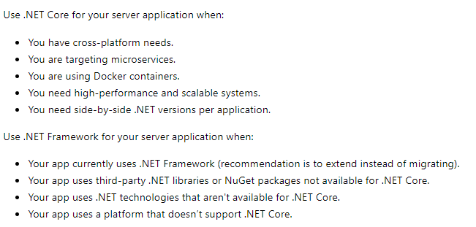
01..NET FW vs .NET Core
A BRIEF DEEP INTRO TO… ASP.NET 2.1
Which one to choose?
Notes:
What does MS says about .NET core vs .NET FW? Basically use .NET Core whenever possible

Slide 5
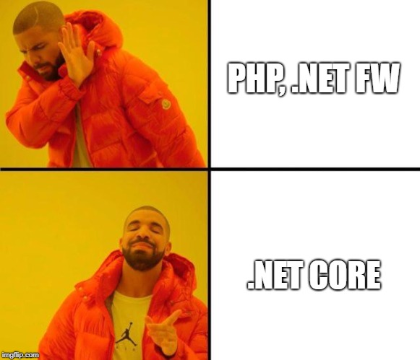
01..NET Core
A BRIEF DEEP INTRO TO… ASP.NET 2.1

Slide 6
01.SDK’s
A BRIEF DEEP INTRO TO… ASP.NET 2.1
.NET Core (2.1.2)
ASP.NET Core (2.1.2)
.NET Core Standard (2.0.3)
Notes:
.NET Standard:
Only usable as library project
Highly recommended when generating libraries that may interact with .NET FW
Be careful if you need to use it with the last version of .NET Core. It’s not supported yet
ASP.NET:
When working with web/api stuff

Slide 7
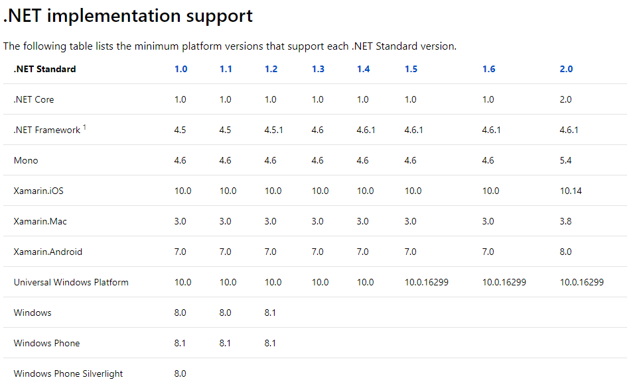
01..NET implementation support
A BRIEF DEEP INTRO TO… ASP.NET 2.1
Docs
Notes:
As you can see, the version 2.1 of .NET Core is not supported by .NET Standard

Slide 8
01..NET Core metapackages
A BRIEF DEEP INTRO TO… ASP.NET 2.1
01
What’s it? A NuGet package with no code. Only describes a set of necessary packages.
Why? Correct package versions and lightweight apps on some cases
Main metapackages – shared runtimes (each one includes the packages above)
Microsoft.NetCore.App
Microsoft.AspNetCore.App
Microsoft.AspNetCore.All ⚠ (not recommended)
Notes:
Advantages of metapackages:
All versions of inner packages are defined
The interaction between all packages has been tested as well.
Light deployments on some cases
Runtimes: for netstandard and netcoreapp. Distributions are
NetCore.App: for console Apps
AspNetCore.App: for ASP Apps
AspNetCore.All: for ASP Apps. Includes the same packages as AspNetCore.All plus extra packages: https://docs.microsoft.com/en-us/aspnet/core/fundamentals/metapackage?view=aspnetcore-2.1#migrate
Code section:
- See which type of NuGet package is added by default to the projects and compare it with what the csproj says.

Slide 9
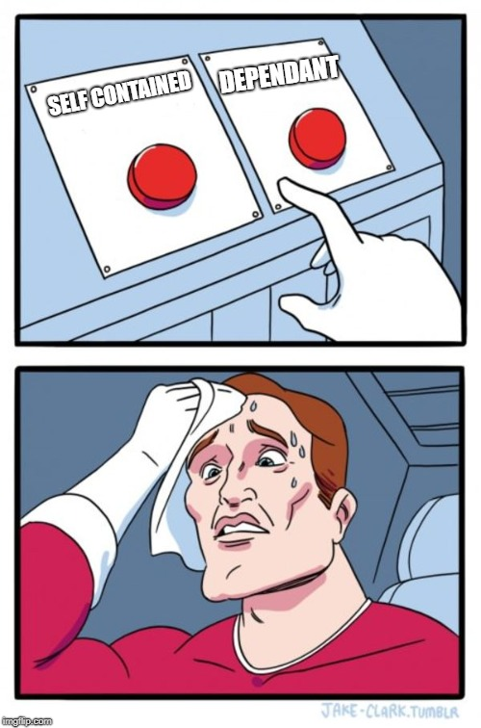
01.Deployments…
A BRIEF DEEP INTRO TO… ASP.NET 2.1
01
Notes:
Self contained: the entire .NET Core packages are deployed with the program itself (machines with no .NET Core installed). Much heavier
Dependant: to machines that have the .NET Core installed. Much lighter and optimized when using metapackages
RID’s: https://docs.microsoft.com/en-us/dotnet/core/rid-catalog
CODE:
Command to publish: dotnet publish –o C:\temp\deployments -c release -r win-x64
Show the difference of a program deployed self-contained or dependant

Slide 10

02. ASP.NET Core - Lets get started
A BRIEF DEEP INTRO TO… ASP.NET 2.1
Just a console app with the ASP.NET package that generates a server in the Main
Configure the services (Startup.ConfigureServices)
Configure the pipeline (Startup.Configure)
Build().Run()
Notes:
ConfigureServices
Register dependencies
Configure services
For huge services with lots of registration and configuration. Do an extension method to keep the Startup method as clean and readable as possible
Configure
Configuring the pipe of requests
Adding/removing functionality via middleware’s
It is not mandatory to configure the server behavior or services on Startup. It can be done using Extension Methods

Slide 11

02.Check it out!
A BRIEF DEEP INTRO TO… ASP.NET 2.1
02
CreateDefaultWebHost source code
Notes:
WebHost.CreateDefaultBuilder()
.Configure(app =>
{
app.Run(context =>
{
return context.Response.WriteAsync("Heeeey it's working");
});
}).Build().Run();

Slide 12
03.Middlewares
A BRIEF DEEP INTRO TO… ASP.NET 2.1
03
When the order matters. Lasts will be lasts…
Inline middlewares
app.Run: pipeline finisher
app.Use: pipeline appender
app.Map: divide el pipeline en función del path de la request
app.MapWhen: divide el pipeline en función de un predicado
Notes:
Middleware is a piece of code/class that will affect every request.
Todos los middlewares se configuran en el Configure mediante el IApplicationBuilder

Slide 13
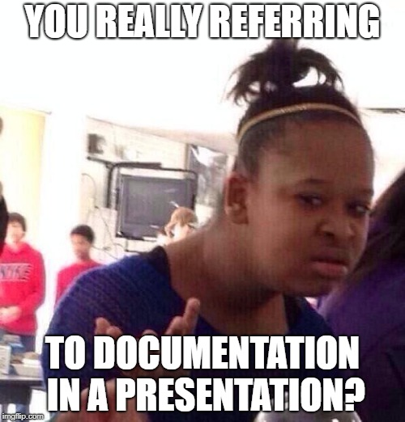
03.Conventional middlewares
A BRIEF DEEP INTRO TO… ASP.NET 2.1
Middleware documentation
In resume: a class with
Invoke/InvokeAsync method that receives an HttpContext
A constructor that gets RequestDelegate (next)
Registered using app.UseMiddleware<middlewareType>();
Notes:
All middlewares will be configured in Configure section using IApplicationBuilder

Slide 14
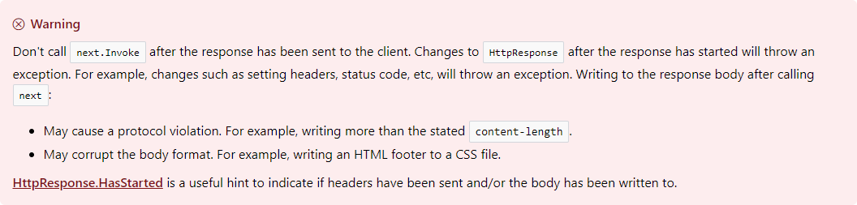
03.Middlewares considerations
A BRIEF DEEP INTRO TO… ASP.NET 2.1
Lifecycle: singleton
Notes:
Lifecycle of a middleware is Singleton. If you have to inject an scoped service. Inject it in the Invoke method, not the constructor to prevent unwanted behavior

Slide 15

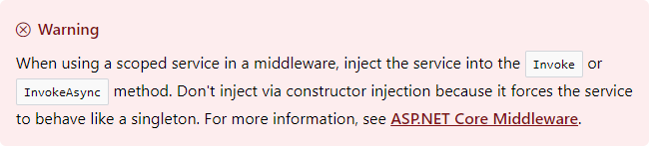
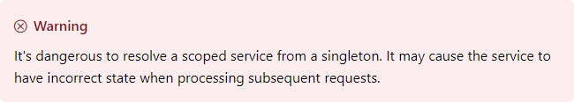
03.Good guy DI
A BRIEF DEEP INTRO TO… ASP.NET 2.1
Don’t use 3rd party packages unless urgent need
Lifetimes and management
Notes:
Container por defecto de ASP.NET Core:
Viene por defecto: no require nada de configuración
Senzillo de usar
Optimizado
No usar ningún otro a no ser que el default no nos sirva por restricciones de la aplicación.
Lifetime soportados:
Transient
Scoped
Singleton
Siempre que las instancias de los servicios sean registradas y por tanto instanciadas automáticamente, el Container se encargará de hacer el dispose de la clase instanciada.

Slide 16
03.Routing
A BRIEF DEEP INTRO TO… ASP.NET 2.1
Define route templates
Type constraints
Define expected types or regex
Docs

Slide 17

04.Configuration – Set up
A BRIEF DEEP INTRO TO… ASP.NET 2.1
04
Define configuration providers
Define the class that will map those config values
Register how class is gonna be read from any config provider
Inject the configuration as IOptions<MyOptionsClass>
Get it with .Value
Notes:
Main package: Microsoft.Extension.Configuration

Slide 18
04.Still with configuration
A BRIEF DEEP INTRO TO… ASP.NET 2.1
Providers: Microsoft.Extensions.Configuration.{}
Json
Xml
InMemory
EnvironmentVariables
CommandLine
AzureKeyVault
UserSecrets
Use IOptionsSnapshot to read the configuration on every request. IOptions will only read the configuration when booting the app.

Slide 19
04.Defaults of Configuration
A BRIEF DEEP INTRO TO… ASP.NET 2.1
When using WebHost.CreateDefaultBuilder it will:
appsettings.json
appsettings.{env}.json
UserSecrets (only if env.IsDevelopment())
EnvironmentVariables
CommandLineArgs

Slide 20
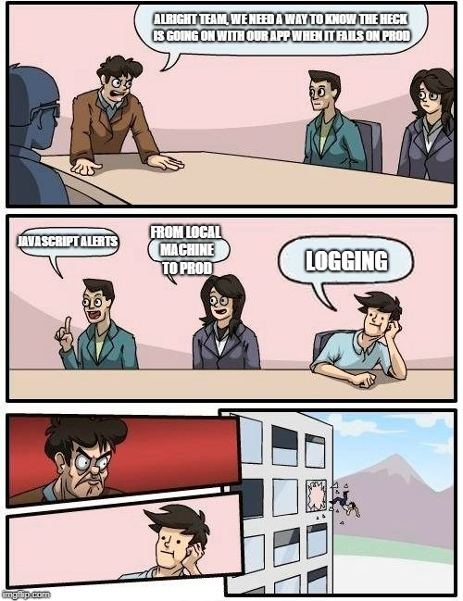
04.Logging – how to start
A BRIEF DEEP INTRO TO… ASP.NET 2.1
05
Configure the log providers.
ConfigureLogging(Action)
Ask for ILogger<T>
Start logging
Notes:
Consider that T is going to classify our log. Be careful to not granuralize it too much. Ideally always the same for an app.
Log levels:
Debug: the only level that can contain sensible information. Never setted in prod.
Info
Warning
Error
Critical

Slide 21
04.Logging considerations and defaults
A BRIEF DEEP INTRO TO… ASP.NET 2.1
WebHost.CreateDefaultBuilder will include Debug and Console providers to Info level
Using a LogEventId will group log traces
For really high-performance environments use LoggerMessage better

Slide 22

04.IHttpClientFactory
A BRIEF DEEP INTRO TO… ASP.NET 2.1
PROS
Configure different clients (by name or type)
Configuring Middleware for client
Pool and lifetime management of the clients managed automatically
Prevent classic DNS problems
Unified logging
CONS
NONE

Slide 23
04.Configuring IHttpClientFactory
A BRIEF DEEP INTRO TO… ASP.NET 2.1
06
services.AddHttpClient(); (using Microsoft.Extensions.DependencyInjection)
Inject the factory on the service that will make http calls
Call CreateClient() to build a client when needed
MORE CODE!

Slide 24

The code can be found at:
https://github.com/pauer24/AspNetCoreBasics
Thanks!
😀
Any questions?
You can find me at:
pau.cervello@tokiota.com

