Slide 1


GAME DESIGN
Where do ideas come from?
DESIGNER

Slide 2
GAME DESIGN
How to make a game?
Think of an idea
Try it out
Keep changing it until it seems good enough

Slide 3
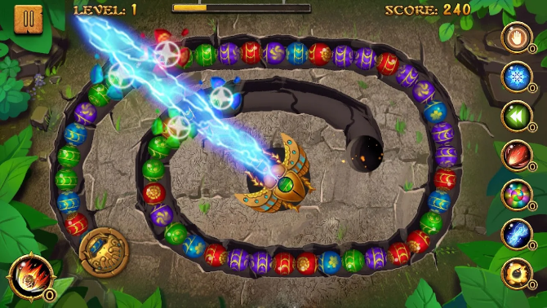

GAME DESIGN
Where do ideas come from?
DESIGNER
Other Games

Slide 4

GAME DESIGN
Where do ideas come from?
DESIGNER
THE WORLD

Slide 5

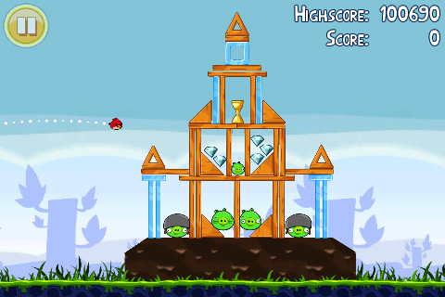
GAME DESIGN
Where do ideas come from?

Slide 6
GAME DESIGN
GO OUT AND WRITE DOWN
EVERYTHING INTERESTING
TIME: 15 min
DESIGNER
THE WORLD

Slide 7

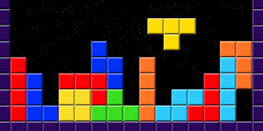
GAME DESIGN
Where do ideas come from?
DESIGNER
OTHER ART FORMS

Slide 8

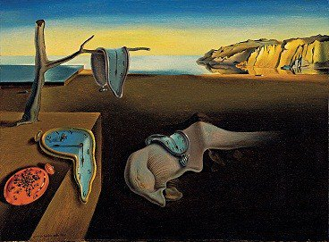
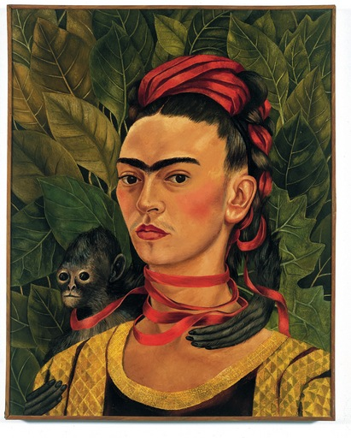
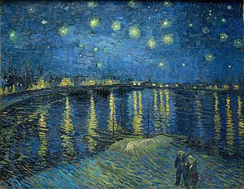

GAME DESIGN
PICK ONE AND THINK OF GAME MECHANICS

Slide 9

GAME DESIGN
Where do ideas come from?
DESIGNER
THE WORLD
THE INNER
WORLD

Slide 10
GAME DESIGN
GAME DESIGN 1
GAME DESIGN PRINCIPLE n.º 42
VISUALIZATION
Be open
Be generous
Share your ideas
GAME
DESIGNER
DESIGNER
THE WORLD
THE INNER
WORLD

Slide 11
GAME DESIGN
GAME DESIGN PRINCIPLE n.º 42
Be open
Be generous
Share your ideas
GAME
DESIGNER

Slide 12
BRAINSTORMING
Don’t Judge
Write it down
Make Jokes
Sketch
Embrace the Ridiculous
Use Toys
Make numbered lists
Change perspective
Use Keywords
Destroy assumptions
Be crazy

Slide 13
BRAINSTORMING
GROUPS of 2-3
One member presents shortly his/her game.
Others give as many ideas as possible.
Repeat
TIME: 30 min

Slide 14
FILTERS
Does it feel right?
Will the audience like the game?
Is it well designed?
Is it novel enough?
Will it be profitable?
Is it (technically) possible to make the game?

Slide 15
FILTERS
Same group
Apply these filters to your ideas!
TIME: 10min
Does it feel right?
Will the audience like the game?
Is it well designed?
Is it novel enough?
Will it be profitable?
Is it (technically) possible to make the game?

Slide 16
HOMEWORK
Based on what you have found
in the inner or outer world, think
of 4 game ideas.

Slide 17
Relevant questions
What is a game?
Where do (good) ideas
come from?
What is the magic circle?
What is the flow channel?

