Slide 1
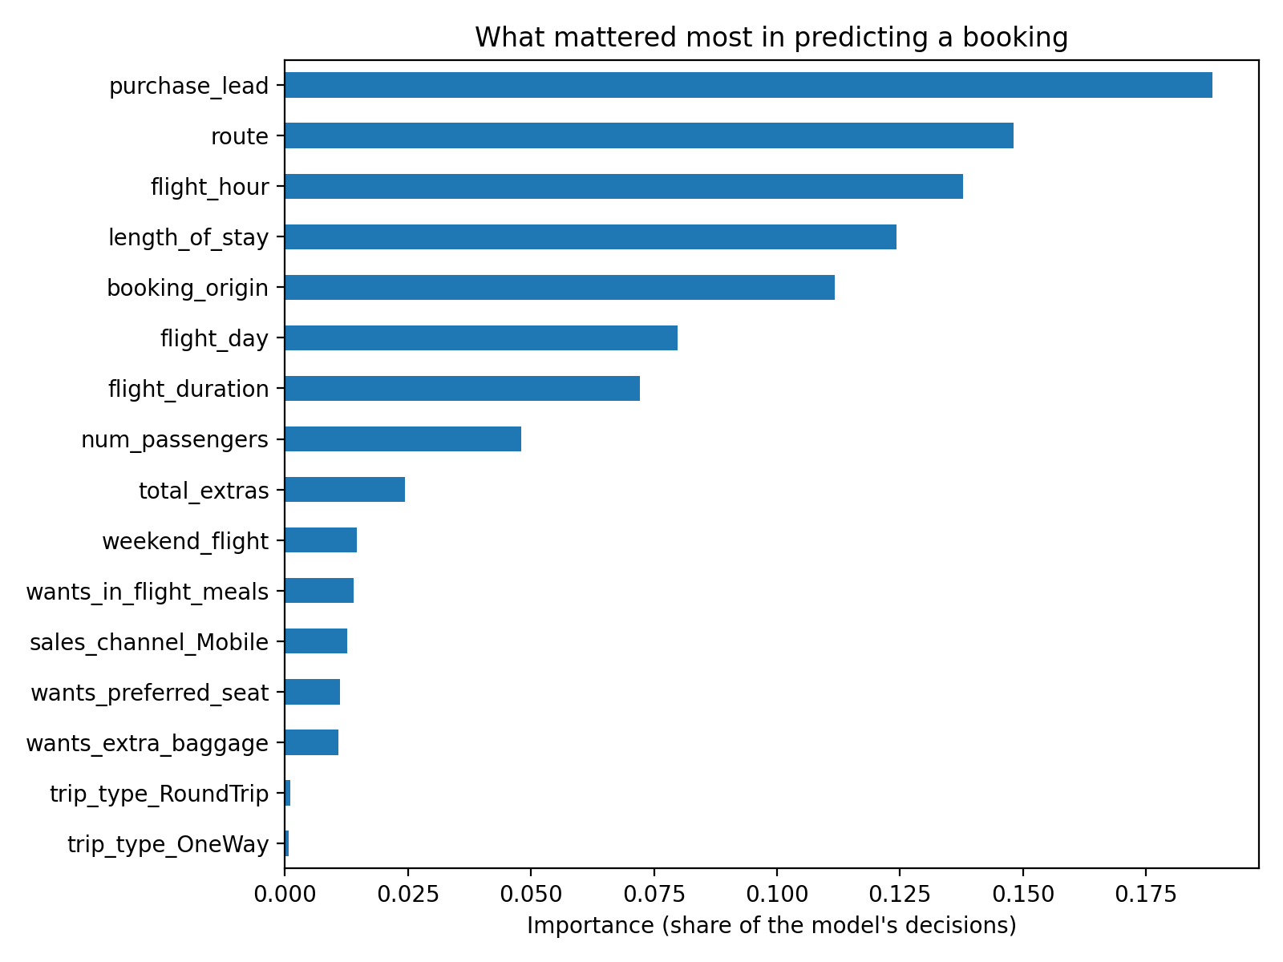
Booking data is only weakly predictive of who will buy
RandomForest on 49,281 customer bookings (15% completed a booking), checked with 5-fold cross-validation
85%
Accuracy: no better than always guessing "no booking" (also 85%)
0.76
AUC: the model can rank likely bookers (0.5 = coin flip, 1.0 = perfect)
10%
Recall: finds only 1 in 10 real bookers; about half its "will book" flags are right
Top drivers: purchase lead time, route, flight hour, length of stay, booking country. Next: test a lower decision threshold to catch more bookers, and add customer history data.
Notes:
Route and booking origin were converted to number codes, which can overstate their importance. Duplicates (719 rows) were removed before modelling. Metrics are for the class of customers who completed a booking.

