Slide 1
Got a CMS? Get Your Webdevmojo Back with JavaScript!
2014 Minnesota Government IT Symposium
For State Agencies, Counties, Cities, Higher Education and Nonprofits
December 9-11, 2014 RiverCentre, St. Paul, MN www.mngts.org/itsym
(Presented by GTS Educational Events)
Session 31
Got a CMS? Get Your Webdevmojo Back with JavaScript!
Paul Burtness, Anoka County, MN
Wednesday, December 10, 2014
2:00 p.m. – 3:00 p.m.

Slide 2

Losing it?
Austin Powers: The Spy Who Shagged Me

Slide 3
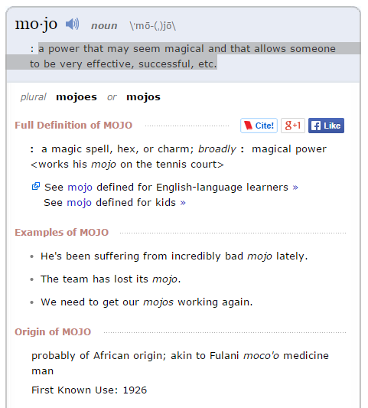
What is it?
http://www.merriam-webster.com/dictionary/mojo
a power that may seem magical and that allows someone to be very effective, successful, etc.

Slide 4
How do you get it back?
Example of Inmate Locator

Slide 5
Why JavaScript?

Slide 6
How do you play?
JavaScript basics
HTML page in browser
<script></script>
Code between tags
Src that loads file from server

Slide 7
Can you play?
How to get JavaScript into the page
HTML editor
Custom HTML
Editable part of a template
How to see if it works
Check with support/documentation
Try it
Does it stay
Does it cause an error
Does it display

Slide 8
Why can’t you play?
Good reasons why provider may not want to allow embedded scripting:
May mess up something else on the page
Can be a security risk
Too complicated

Slide 9
What do you have to play with?
Widgets/template editors
Existing JavaScript functions and variables
Libraries (jQuery)

Slide 10
How do you “play well with others?”
Problem: Inserting your JavaScript into a webpage with existing scripts can break the page.
Reason: By default, everything in JavaScript is global.
Consequences: You can overwrite existing variables and functions or they can overwrite your code.
Example: Broken Page

Slide 11
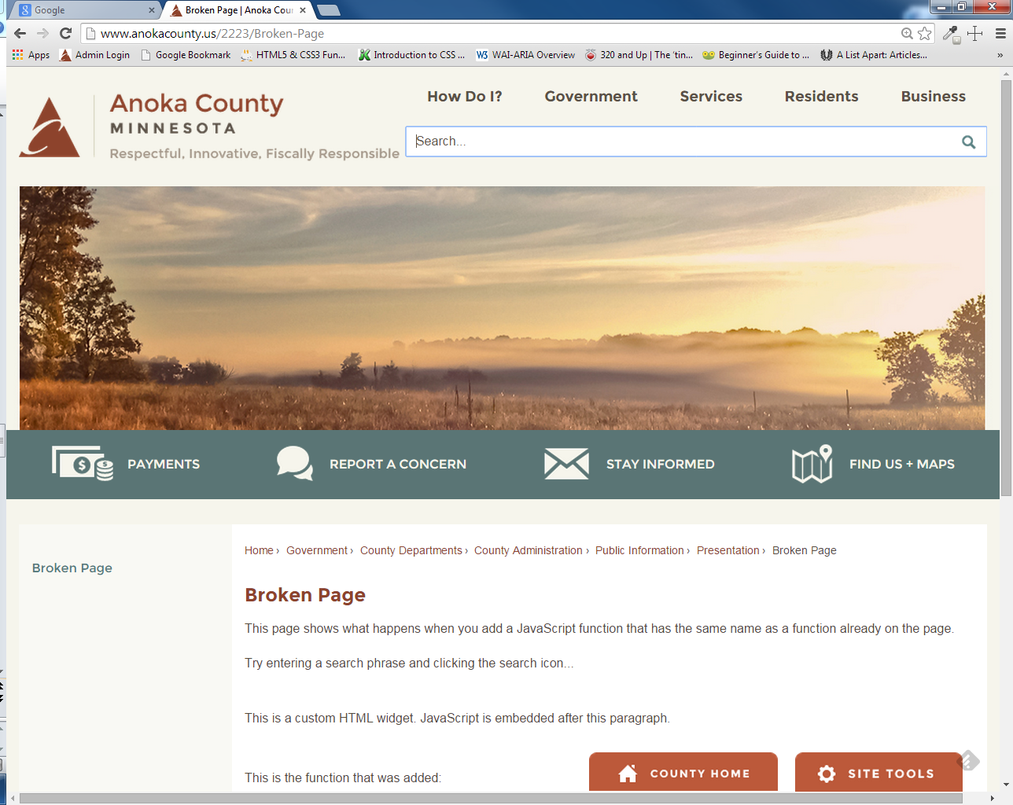

Slide 12
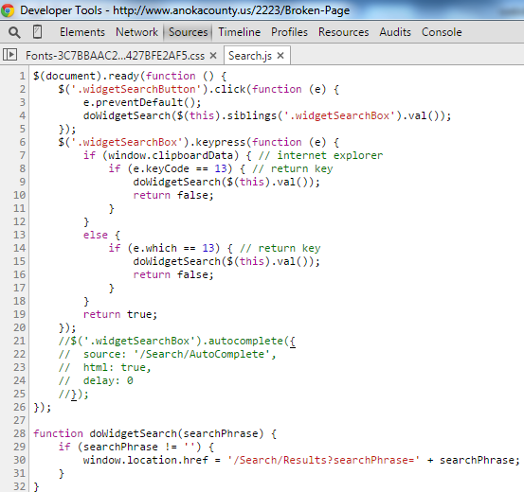

Slide 13
<p>This is a custom HTML widget. JavaScript is embedded after this paragraph.</p>
<script type="text/javascript">
function doWidgetSearch(searchPhrase) {
if (searchPhrase != '') {
alert("Search is now broken!");
}}
</script>

Slide 14
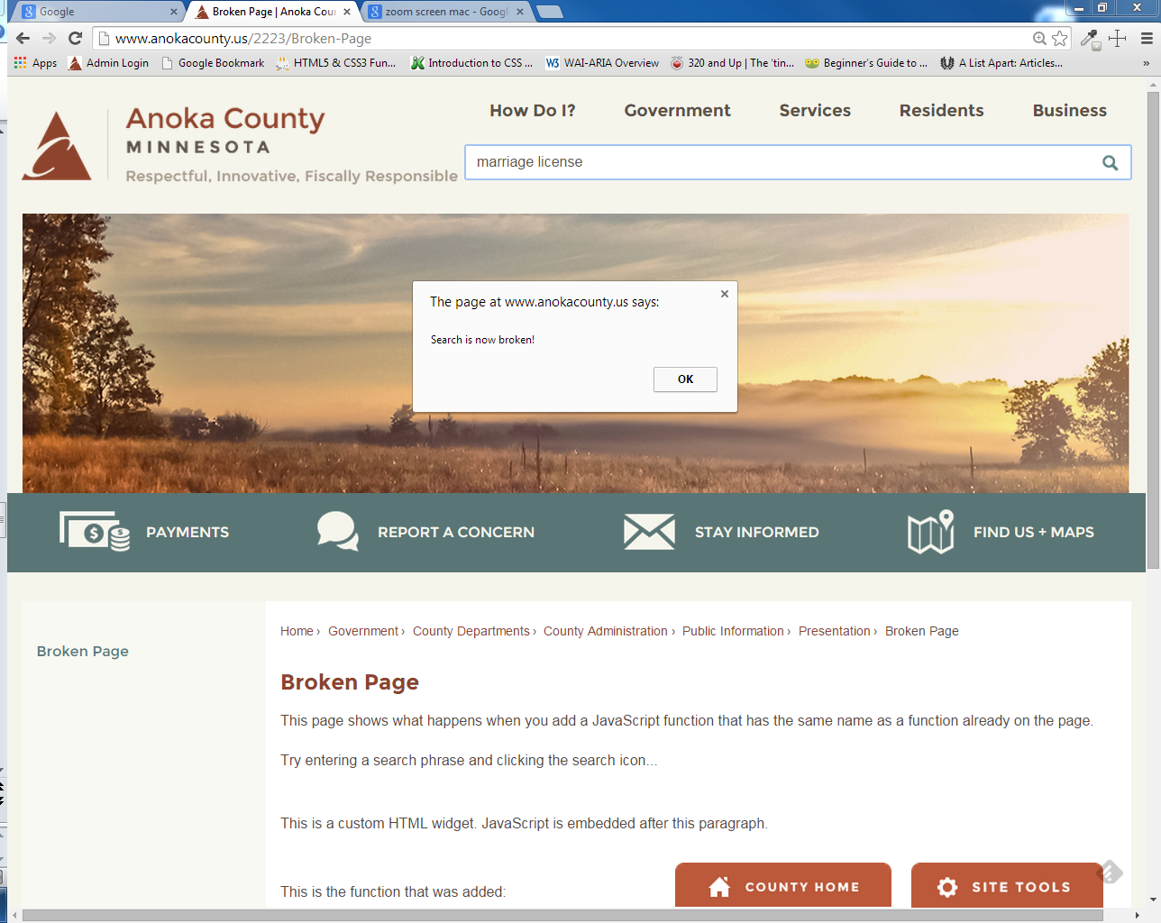

Slide 15
How do you “play well with others?”
Problem: Inserting your JavaScript into a webpage with existing scripts can break the page.
Reason: By default, everything in JavaScript is global.
Consequences: You can overwrite existing variables and functions or they can overwrite your code.
Example: Broken Page
Solution: Create a JavaScript “namespace” – a single global object that contains all variables and functions
For more information:
http://www.kenneth-truyers.net/2013/04/27/javascript-namespaces-and-modules/
http://appendto.com/2010/10/how-good-c-habits-can-encourage-bad-javascript-habits-part-1/

Slide 16
Patterns

Slide 17
Keep it accessible

Slide 18
Working environment
IDE – Visual Studio Express, Brackets, Webstorm
Copying a page then using it as the template
Tracking the pages you put JavaScript on
Using git (github.com bitbucket.com) or some other versioning system

