Slide 1
▒▒▒ CLASSIFIED ▒▒▒
"TRUST, BUT VERIFY"
Building a Software Safety Snapshot
Before Deploying to Your Fleet
MacAD.UK · 2026
AGENTS: Toms & Cossey
довеpяй, но провеpяй
Notes:
BT - Introduce the presentation as a top-secret briefing on software safety, inspired by Cold War spy themes. Emphasise the importance of `Trust, but Verify` in the context of Mac administration and software deployment.

Slide 2
AGENT DOSSIERS
AGENT
Ben Toms
ROLE
Principal Software Engineer
ORG
Jamf
CLEARANCE
████████████
STATUS: ACTIVE
AGENT
Paul Cossey
ROLE
Client Platform
Engineer
ORG
Jamf
CLEARANCE
████████████
STATUS: ACTIVE
REDACTED
REDACTED
Notes:
BT - Introduce ourselves as the agents behind this operation. Use the dossier format to playfully present our roles, organisations, and top-secret clearance levels. The REDACTED stamps add a fun touch of mystery and intrigue.
PC – Hi, I’m Paul, and I’m a Client Platform Engineer at Jamf, and I work on the Jamf Auto Update product.
Like all good straight-to-Betamax spy thrillers, my IT origin story starts by… Sorting mail in the Virgin Direct Postroom in the late 90’s
I’d always had an interest in computers so, when I discovered that helpdesk teams were a thing; I decided that was the career for me. But other than completing Doom and Quake I had no real-world IT experience to get myself there, so I volunteered my free time for hardware rebuilds, and office moves during a site wide network upgrade from Token Ring to Ethernet to get some experience.
This led on to a secondment to the helpdesk, which then turned into a permanent role.
My first 10 years or so were Windows-based with roles at Norfolk County Council, James Paget Hospital and Great Yarmouth & Waveney PCT - in 2006 I joined Cambridge Education Group, where there was a small but quickly growing Mac estate, it was there that I began to drift from Microsoft to Apple.
From Cambridge Education Group my next role was much closer to home at Norwich University of the Arts, where I spent eleven years as the technical owner of the Apple estate.
As we were coming out of the pandemic, I applied for a role at dataJAR to work on the Auto Update product, and somehow managed to convince Ben and Yannis that I was the man for the job, a decision I’m sure they regret at least every other day. Sorry about that!
dataJAR was then acquired by Jamf, and I moved over to continue work on the rebranded Jamf Auto Update product in the App Lifecycle and Software Update teams.

Slide 3
JAMF AUTO UPDATE
Automated application packaging and deployment
service for Jamf Pro
1k+ macOS software titles
✓ App Store-like update experience for 3rd party apps
✓ Cloud-based, managed patch definitions for Jamf Pro
✓ Native Notification Centre integration
ENHANCED SECURITY & PACKAGE VALIDATION:
Titles pass Developer Signing Certificate checks,
SHA-256 verification, and VirusTotal analysis
before release to production.
datajar.co.uk/products/jamf-auto-update
Notes:
BT – So what is Jamf Auto Update? It’s an automated application packaging and deployment service for Jamf Pro. It provides over 1,000 macOS software titles, with an App Store-like update experience for third-party applications outside of the Mac App Store.
It integrates natively with Jamf Pro patch management and includes native Notification Centre integration so users get notified of pending and completed updates.
Critically for this talk, titles are not released into production until they’ve passed a number of security checks – Developer Signing Certificate verification, SHA-256 checks, and VirusTotal analysis. That’s the process we’re going to dive into today.

Slide 4

START OF BRIEFING
Notes:
PC and BT – Secret agent duck animation

Slide 5
ORIGIN
"Trust, but verify."
— Ronald Reagan, 1987 (INF Treaty signing)
Russian proverb: "довеpяй, но провеpяй"
Reagan used it so often that Gorbachev once replied:
"You repeat that at every meeting!"
Today: the foundation of Zero Trust security models.
Notes:
PC – So, “Trust, but verify” – it’s a phrase you’re probably more used to hearing in the identity space, but it’s actually an old Russian proverb. It rhymes in Russian: “doveryay, no proveryay”.
The phrase became internationally known thanks to an American scholar called Suzanne Massie, she met with Reagan many times between '84 and '87, she taught him the proverb and told him: “The Russians like to talk in proverbs. It would be nice of you to know a few. You are an actor – you can learn them very quickly.”
Reagan loved it and adopted it as his signature phrase when discussing relations with the Soviet Union. He used it so often that at the signing of the INF Treaty on 8th December 1987, Gorbachev finally replied: “You repeat that at every meeting!” Reagan’s response was “I like it.”
As a fun side note: while Reagan was quoting Russian proverbs, Gorbachev was quoting Ralph Waldo Emerson back at him – “The reward of a thing well done is to have done it.” Emerson had apparently been popular in the USSR when Gorbachev was at university.
The phrase has had a long afterlife too. In 2001, the National Infrastructure Protection Center published a paper called “Trust but verify” about protecting yourself from email viruses. In 2013, John Kerry updated it for the Syria chemical weapons deal, saying Reagan’s old adage was “in need of an update” and that they’d committed to a standard of “verify and verify.” In 2020, Pompeo went even further, saying the US should “distrust and verify” when dealing with China.
But for many in IT today, it’s the foundation of Zero Trust security models – and the perfect lens for thinking about how we verify software before it hits our fleets.

Slide 6
FIELD INTELLIGENCE
What clearance level do you use before 3rd party
software deploys to your fleet?
Level 0: Blind Trust
9%
The vendor said it's safe. Ship it.
Level 1: Quick Pat-Down
26%
Install it, check it launches.
Level 2: Entry & Exit Check
39%
Test install and uninstall.
Level 3: Interrogation
22%
Install + run through security tools.
Level 4: Full Dossier
4%
Install, monitor, scan, profile, uninstall, report.
// 23 responses
Notes:
PC – So, we ran a session poll in the Whova App, and there’s been some encouraging responses - looks like most of you are already doing some level of verification before deploying, which is great!
We’ve even got someone at Level 4 already! Hopefully by the end of this session, we can convince a few more of you to go for the full dossier!

Slide 7
THE THREAT LANDSCAPE
Deploying software is a core Mac Admin responsibility.
But software can get compromised:
⚠ XcodeGhost — infected IDE distributed via China (2015)
⚠ KeRanger — ransomware trojan horse (2016)
⚠ HandBrake — trojanised download mirror (2017)
⚠ Codecov — bash uploader tampered for months (2021)
⚠ Axios — supply chain attack (2026)
Trusting a vendor alone is not enough.
You need to verify every asset before it enters the homeland.
Notes:
BT - So most of you are already doing some level of checking, which is great. But let's look at why even that might not be enough. Here are some real-world examples of supply chain attacks where software was compromised before it reached you.
Blog posts / sources for reference:
XcodeGhost: unit42.paloaltonetworks.com/novel-malware-xcodeghost-modifies-xcode-infects-apple-ios-apps
KeRanger: unit42.paloaltonetworks.com/new-os-x-ransomware-keranger-infected-transmission-bittorrent-client-installer
HandBrake: objective-see.org/blog/blog_0x1D.html
Codecov: about.codecov.io/security-update
General supply chain: objective-see.org/blog/blog_0x75.html

Slide 8
THE THREAT LANDSCAPE
Deploying software is a core Mac Admin responsibility.
But software can get compromised:
⚠ XcodeGhost — infected IDE distributed via China (2015)
⚠ KeRanger — ransomware trojan horse (2016)
⚠ HandBrake — trojanised download mirror (2017)
⚠ Codecov — bash uploader tampered for months (2021)
⚠ Axios — supply chain attack (2026)
Trusting a vendor alone is not enough.
You need to verify every asset before it enters the homeland.
Notes:
BT - These first three examples (XcodeGhost, KeRanger, HandBrake) were cases where code signature verification would have failed because the software was tampered with before it was signed.

Slide 9
CODE SIGNATURE VERIFICATION
codesign --display -r- --deep -v "/Applications/Google Chrome.app"
Executable=/Applications/Google Chrome.app/Contents/MacOS/Google Chrome
Identifier=com.google.Chrome
Format=app bundle with Mach-O universal (x86_64 arm64)
CodeDirectory v=20500 size=893 flags=0x12a00(kill,restrict,library-validation,runtime) hashes=17+7 location=embedded
Signature size=8989
Timestamp=6 Apr 2026 at 21:44:58
Info.plist entries=45
TeamIdentifier=EQHXZ8M8AV
Runtime Version=26.2.0
Sealed Resources version=2 rules=13 files=63
Nested=Frameworks/Google Chrome Framework.framework
designated => (identifier "com.google.Chrome" or identifier "com.google.Chrome.beta" or identifier "com.google.Chrome.dev" or identifier "com.google.Chrome.canary") and anchor apple generic and certificate 1[field.1.2.840.113635.100.6.2.6] /* exists */ and certificate leaf[field.1.2.840.113635.100.6.1.13] /* exists */ and certificate leaf[subject.OU] = EQHXZ8M8AV
Notes:
BT - These first three examples (XcodeGhost, KeRanger, HandBrake) were cases where code signature verification would have failed because the software was tampered with before it was signed.

Slide 10
CODE SIGNATURE VERIFICATION
pkgutil --check-signature /Users/ronald/Downloads/JamfAutoUpdate-1.5.pkg
Package "JamfAutoUpdate-1.5.pkg":
Status: signed by a developer certificate issued by Apple for distribution
Notarization: trusted by the Apple notary service
Signed with a trusted timestamp on: 2026-04-08 12:33:51 +0000
Certificate Chain:
1. Developer ID Installer: JAMF Software (483DWKW443)
Expires: 2027-06-01 16:58:54 +0000
SHA256 Fingerprint:
CB 3C 51 9C E7 9B 47 8D 81 4A C7 FA 17 46 36 1F 9F 3C F9 5A 7B 48
92 E7 DF 0B 58 DD E1 EE 1B DD
------------------------------------------------------------------------
2. Developer ID Certification Authority
Expires: 2031-09-17 00:00:00 +0000
SHA256 Fingerprint:
F1 6C D3 C5 4C 7F 83 CE A4 BF 1A 3E 6A 08 19 C8 AA A8 E4 A1 52 8F
D1 44 71 5F 35 06 43 D2 DF 3A
------------------------------------------------------------------------
Notes:
BT - These first three examples (XcodeGhost, KeRanger, HandBrake) were cases where code signature verification would have failed because the software was tampered with before it was signed.

Slide 11
CODE SIGNATURE VERIFICATION
spctl -a -vv "/Applications/Google Chrome.app"
/Applications/Google Chrome.app: accepted
source=Notarized Developer ID
origin=Developer ID Application: Google LLC (EQHXZ8M8AV)
spctl -a -vv -t install /Users/ronald/Downloads/JamfAutoUpdate-1.5.pkg
/Users/ronald/Downloads/JamfAutoUpdate-1.5.pkg
source=Notarized Developer ID
origin=Developer ID Application: JAMF Software (483DWKW443)
Notes:
BT - These first three examples (XcodeGhost, KeRanger, HandBrake) were cases where code signature verification would have failed because the software was tampered with before it was signed.

Slide 12
THE THREAT LANDSCAPE
Deploying software is a core Mac Admin responsibility.
But software can get compromised:
⚠ XcodeGhost — infected IDE distributed via China (2015)
⚠ KeRanger — ransomware trojan horse (2016)
⚠ HandBrake — trojanised download mirror (2017)
⚠ Codecov — bash uploader tampered for months (2021)
⚠ Axios — supply chain attack (2026)
Trusting a vendor alone is not enough.
You need to verify every asset before it enters the homeland.
Notes:
BT - These first three examples (XcodeGhost, KeRanger, HandBrake) were cases where code signature verification would have failed because the software was tampered with before it was signed.

Slide 13
THE THREAT LANDSCAPE
Deploying software is a core Mac Admin responsibility.
But software can get compromised:
⚠ XcodeGhost — infected IDE distributed via China (2015)
⚠ KeRanger — ransomware trojan horse (2016)
⚠ HandBrake — trojanised download mirror (2017)
⚠ Codecov — bash uploader tampered for months (2021)
⚠ Axios — supply chain attack (2026)
Trusting a vendor alone is not enough.
You need to verify every asset before it enters the homeland.
Notes:
BT - Discuss the limitations of relying solely on code signature verification as a security measure. Use the examples of real-world supply chain attacks to illustrate how even signed software can be compromised. Emphasise the need for a more comprehensive approach to verifying software safety.

Slide 14
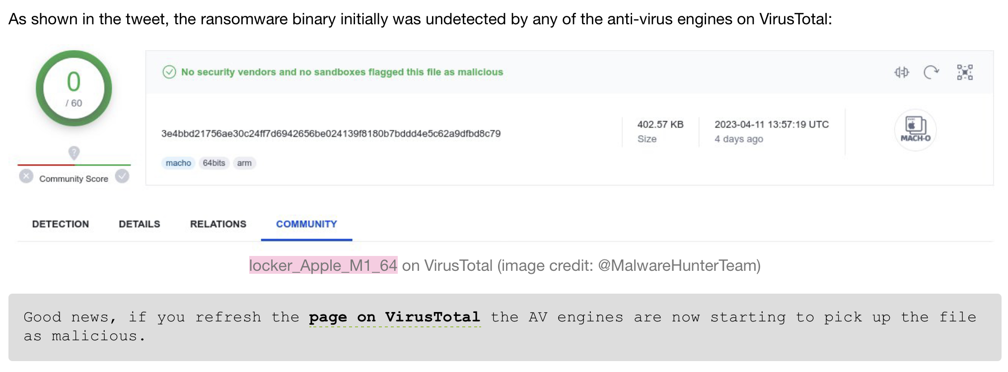
INTELLIGENCE HISTORY
The evolution of our verification process:
Inherited basic checks
Code signature validation and VirusTotal
Objective-See tools on test devices
Manual observation for suspicious behaviour
The checklist
Structured, repeatable process for every title.
Posts like this made us question whether basic checks were enough:
“The LockBit ransomware (kinda) comes for macOS” — objective-see.org/blog/blog_0x75.html
Notes:
PC – Before I joined dataJAR, Ben was already doing code signature verification and VirusTotal checks on new titles. And I followed in those footsteps but got increasingly concerned about the risk of inadvertently adding compromised software to the catalog.
Blog posts like Objective-See’s - “The LockBit ransomware (kinda) comes for macOS” really drove it home – because VirusTotal initially didn’t flag anything untoward with the "locker_Apple_M1_64" sample.
I’d noticed a pattern in Patrick blog posts. His tools seemed to stop a lot of previously unknow malware with no specific knowledge of them before hand.
So, I added the some of Objective-See tools to my test devices and just started observing for suspicious behavior during installs. That then evolved into a checklist that I’d fill out for every title and attached to the new title request ticket.

Slide 15
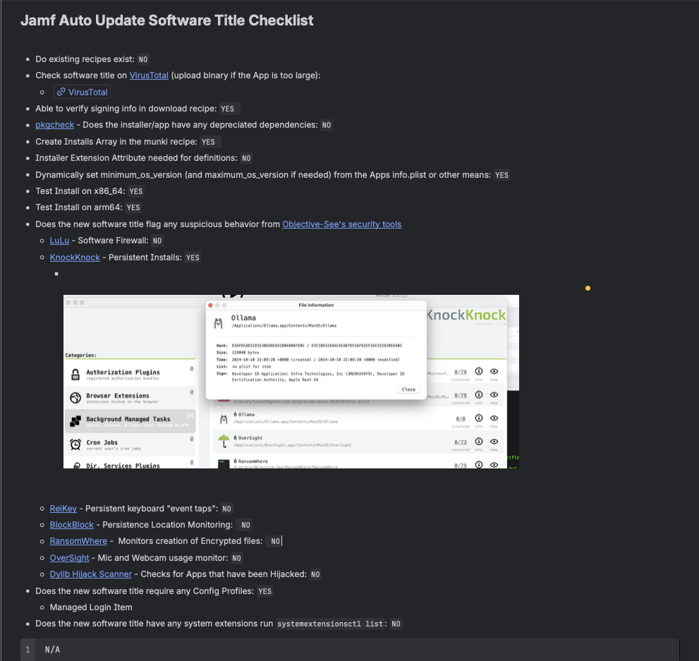
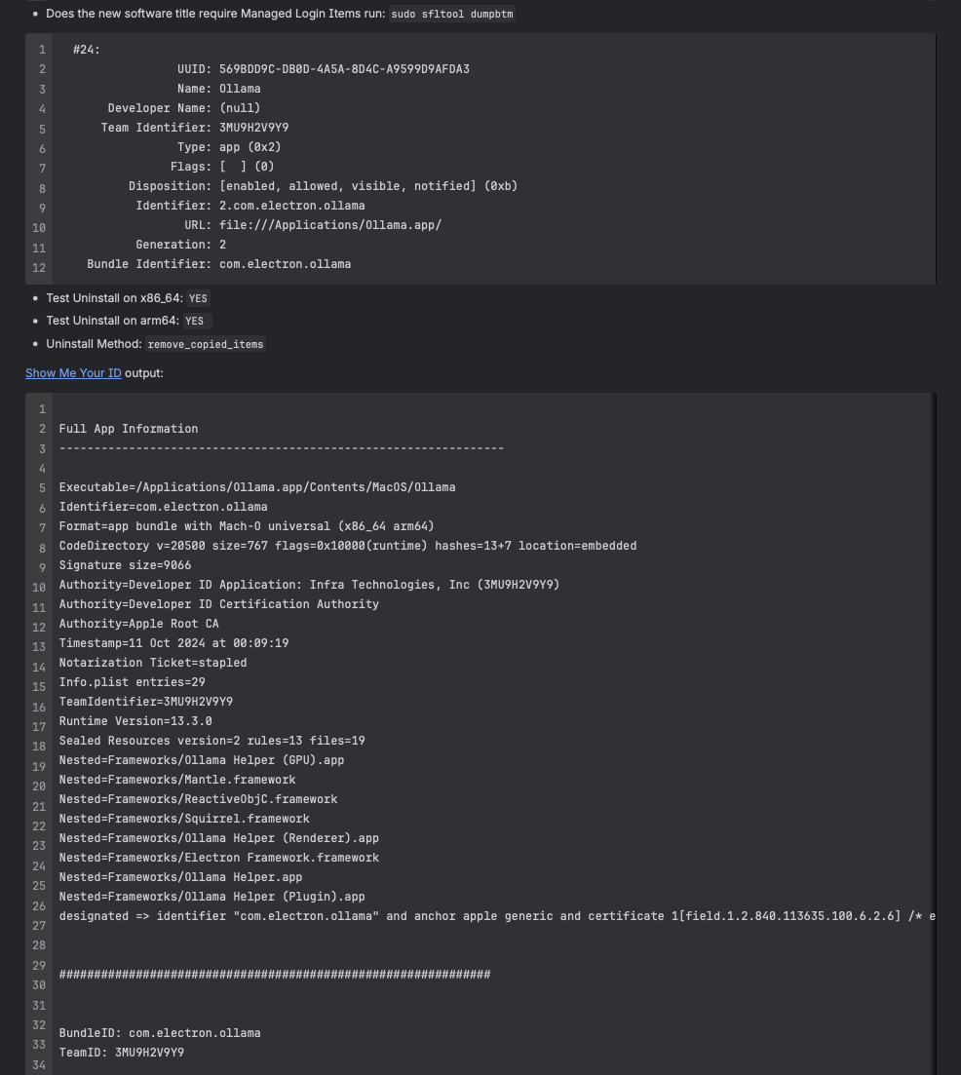
THE CHECKLIST
Notes:
PC – And this is the checklist. I used it as an installation test snapshot it covered a bunch things I would sometimes forget to add to recipes, a link to VirusTotal, code signing, screenshots of tiggered Objective-See tool, what config profiles the title needed, whether a pkg had deprecated dependencies like Python 2 in its scripts.
With the pace of new titles requests we’d receive, this process was manageable, but it was a bit of a faff filling it out, making sure we get all the screenshots and command output. But it was still prone to human error, as super easy to forget to take a screenshot or check something off the list, the Irony that I created it in the hope it would stop me forgetting things isn’t lost me!

Slide 16
MISSION BRIEFING
Before any title enters Jamf Auto Update, we build
a safety snapshot of the asset.
OPERATION PHASES:
1 ░ PROFILE — Collect system data and state, tool details
2 ░ MONITOR — Start real-time surveillance
3 ░ SCAN — Run the asset through intelligence systems
4 ░ INSTALL — Deploy the asset in isolation
5 ░ ANALYSE — Inspect the asset and monitor behaviour
6 ░ UNINSTALL — Remove the asset & verify clean extraction
7 ░ STOP MONITORING — Stand down real-time surveillance
8 ░ REPORT — Compile the full dossier
9 ░ DECIDE — Clear or reject
All using open-source and free-to-use tools.
Notes:
PC – So what do we do now? Well last summer we had a batch of about 20 or so new title requests come in at once, and the thought of running though the checklist one after the other kinda filled me with dread!
I’d had the idea to write a script to automate a lot of the testing process, but knew it would be quite a complicated task, so it stayed just an idea, but thankfully this batch of new title requests coincided with the release of a new internal AI tool called Ask Jamf. I figured this was the perfect opportunity to test out the new tech and write the orchestration script I’d had whirring in the back of my mind. I’ve now migrated to using copilot agents and Claude, which is much quicker and easier than the copy and pasting I was originally doing with Ask Jamf!
When we test titles we ALWAYS test on actual hardware, and we test on both Apple Silicon and Intel. Although I’m a great believer in any testing is better than no testing! One of the main reasons we test on hardware is malware authors are sneaky buggers, they’ll often check to see if their code is being executed inside a VM or a sandbox and then bail before anything malicious runs, to try and avoid discovery by security researchers.
So, what does the script do?

Slide 17
FIELD EQUIPMENT
DIVISION EQUIPMENT CODENAME
──────────────────── ────────────────────────────── ────────────────────
Malware Intel VirusTotal 70+ intel agencies
Binary Polygraph Jamf ThreatLabs Mach-O deep scan
Sleeper Detection KnockKnock Persistence sweep
Counter-Surveillance BlockBlock Persistence alerts
Comms Intercept LuLu Network monitoring
Border Security XProtect Apple's own guard
Ransom Watch RansomWhere Encryption detection
Audio/Visual OverSight Camera / mic watch
Keylogger Sweep ReiKey Keyboard events
Supply Chain DHS Dylib hijack scan
Pkg Inspection pkgcheck Deprecated deps scan
Orchestration Title Tester The handler (Python)
Notes:
PC – These tools form the security backbone, lets take a closer look at each

Slide 18
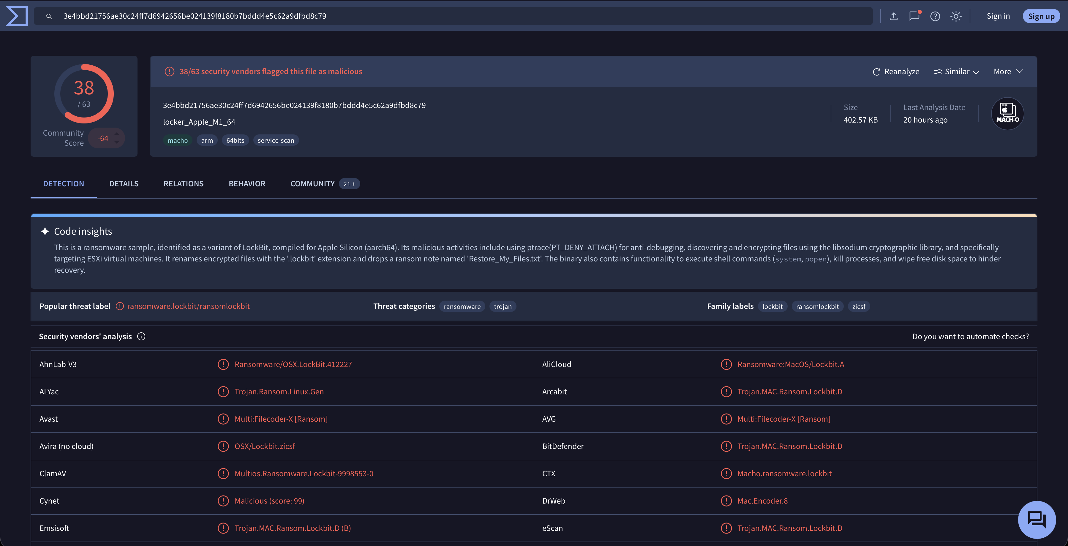
VIRUSTOTAL
70+ antivirus engines in one scan
We use VirusTotal for two things:
1. Upload installer media
(DMG, PKG, ZIP — up to 600MB)
2. Submit captured URLs/IPs
(from LuLu network intercepts)
API KEY REQUIRED
• Free public tier works fine
• 600MB upload limit
• Fine for business workflows as
long as you upload new samples
virustotal.com
REAL WORLD:
OSX.Dummy (2018) — 0/60 AV engines; 3CX supply chain (2023) — 0 detections
objective-see.org/blog/blog_0x32.html
Notes:
PC – We use it in two ways: first, we upload the installer media itself and scan. We then submit any URLs or IP addresses captured by LuLu during install or after launching the application.
You’ll need an API key, the free public tier works fine for this, there is a 600MB upload limit, which covers most installer media. It’s perfectly fine for business workflows as long as you’re uploading new samples – VirusTotal shares submissions with the security community, so just be aware of that if you’re testing internal software.
Real-world: In 2018, OSX.Dummy targeted the crypto community and was completely undetected – zero out of 60 AV engines flagged it on VirusTotal. Similarly, in 2023 the trojanized 3CX supply chain attack shipped a malicious libffmpeg.dylib that was notarized by Apple and undetected by every AV engine on VirusTotal when first uploaded. Cases like these show why we can’t rely solely on Virus Tiotal

Slide 19
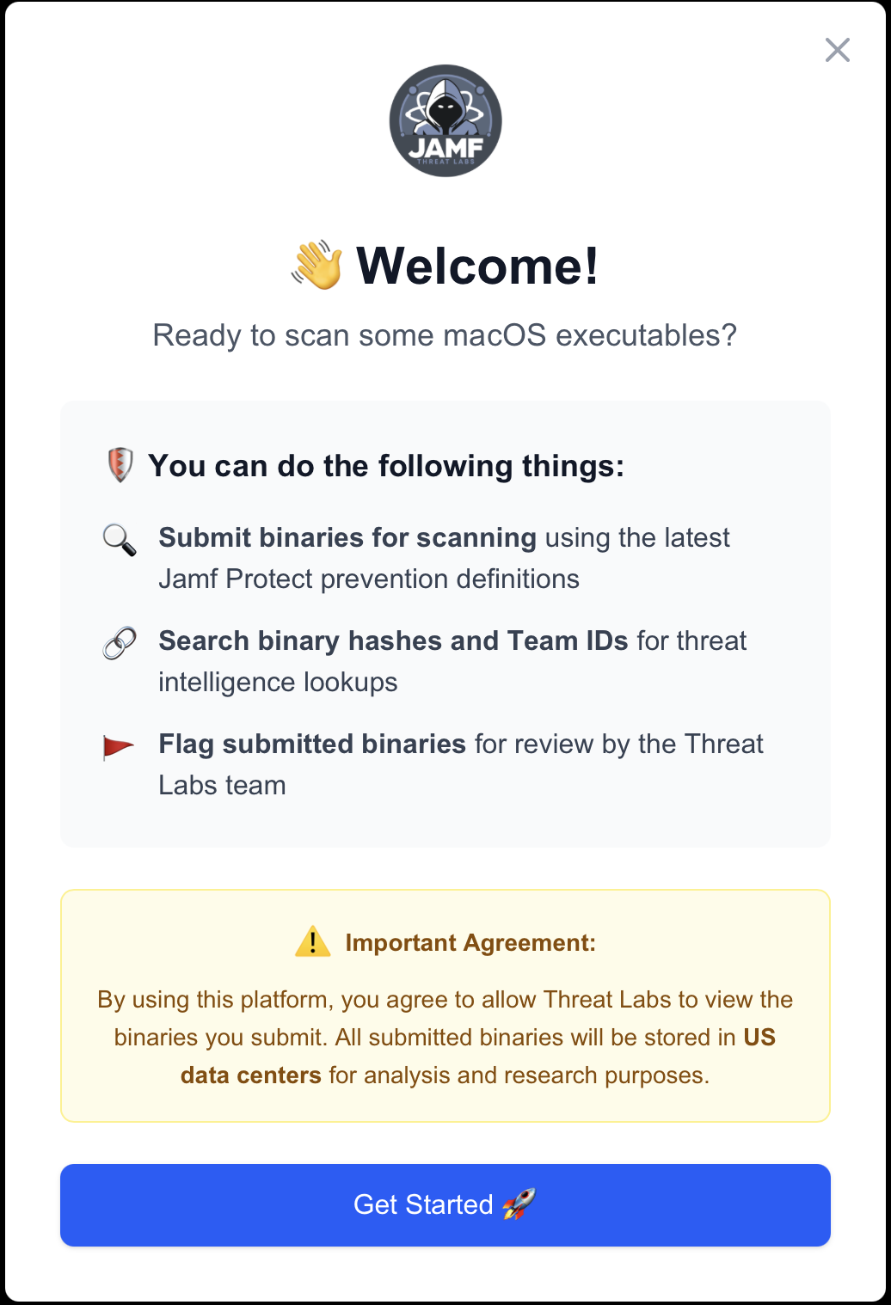
JAMF THREAT LABS
Mach-O binary deep-scan
• Scans executable binaries
• Validates Mach-O header signatures
• YARA rule matching
• Threat level classification
API KEY REQUIRED - 30 day renewal
• Currently in beta for Jamf customers
• Speak to Ben or Paul for an invite to the beta!
Notes:
PC – I think this is a bit of an exclusive first look. Jamf Threat Labs provides dedicated Mach-O binary scanning service. Where VirusTotal scans the installer media as a whole, Threat Labs goes deeper – it scans executable binaries, validates Mach-O headers, runs YARA rules, and classifies threat levels.
It needs an API key that renews every 30 days and is currently in beta for Jamf customers. If you’d like an invite to the beta, come and speak to Ben or myself after the demo and we’ll sort you out.

Slide 20
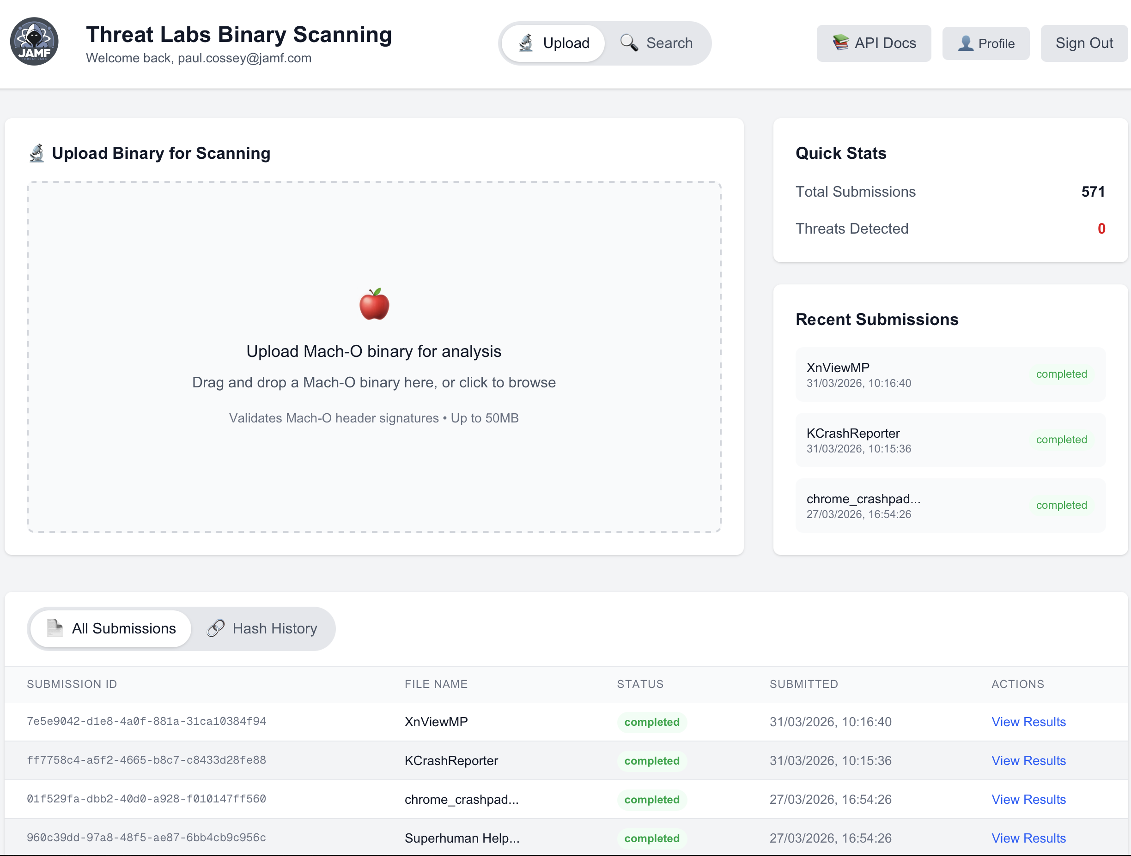
JAMF THREAT LABS
Notes:
PC – This is the Threat Labs dashboard. You can see the upload area for Mach-O binaries, recent submissions with their status, and the quick stats showing total submissions and threats detected. The submissions table shows the full history with file names, status, and the ability to view detailed results for each scan.

Slide 21
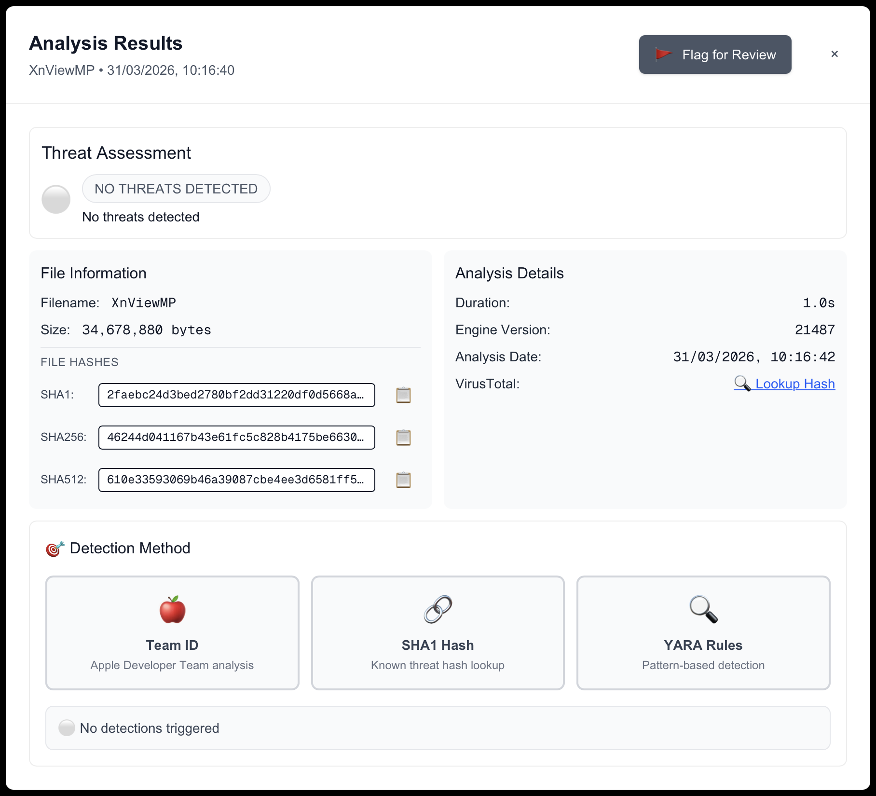
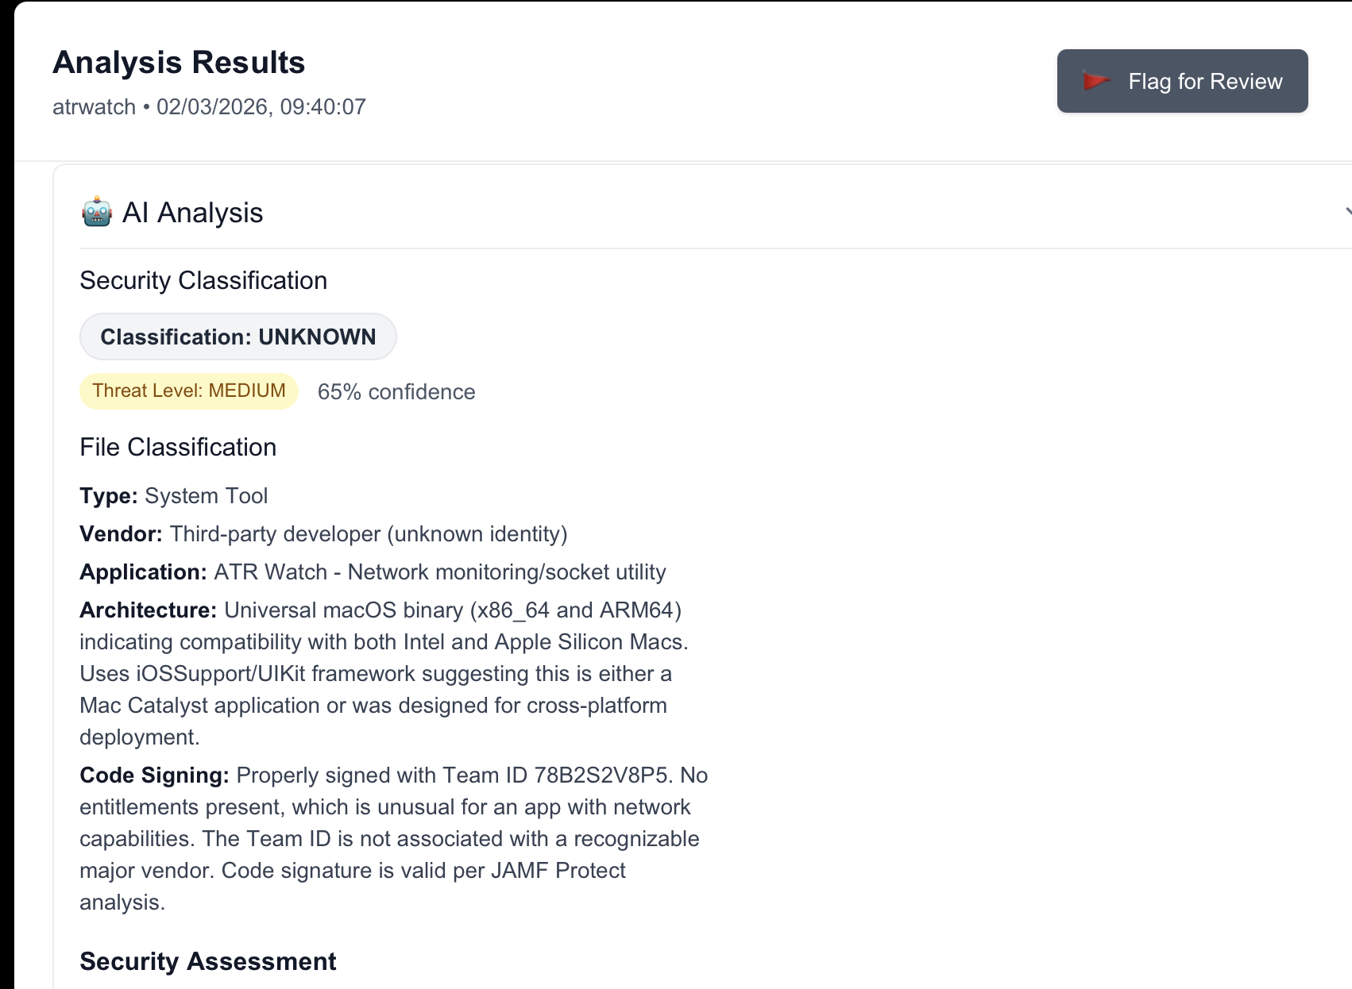
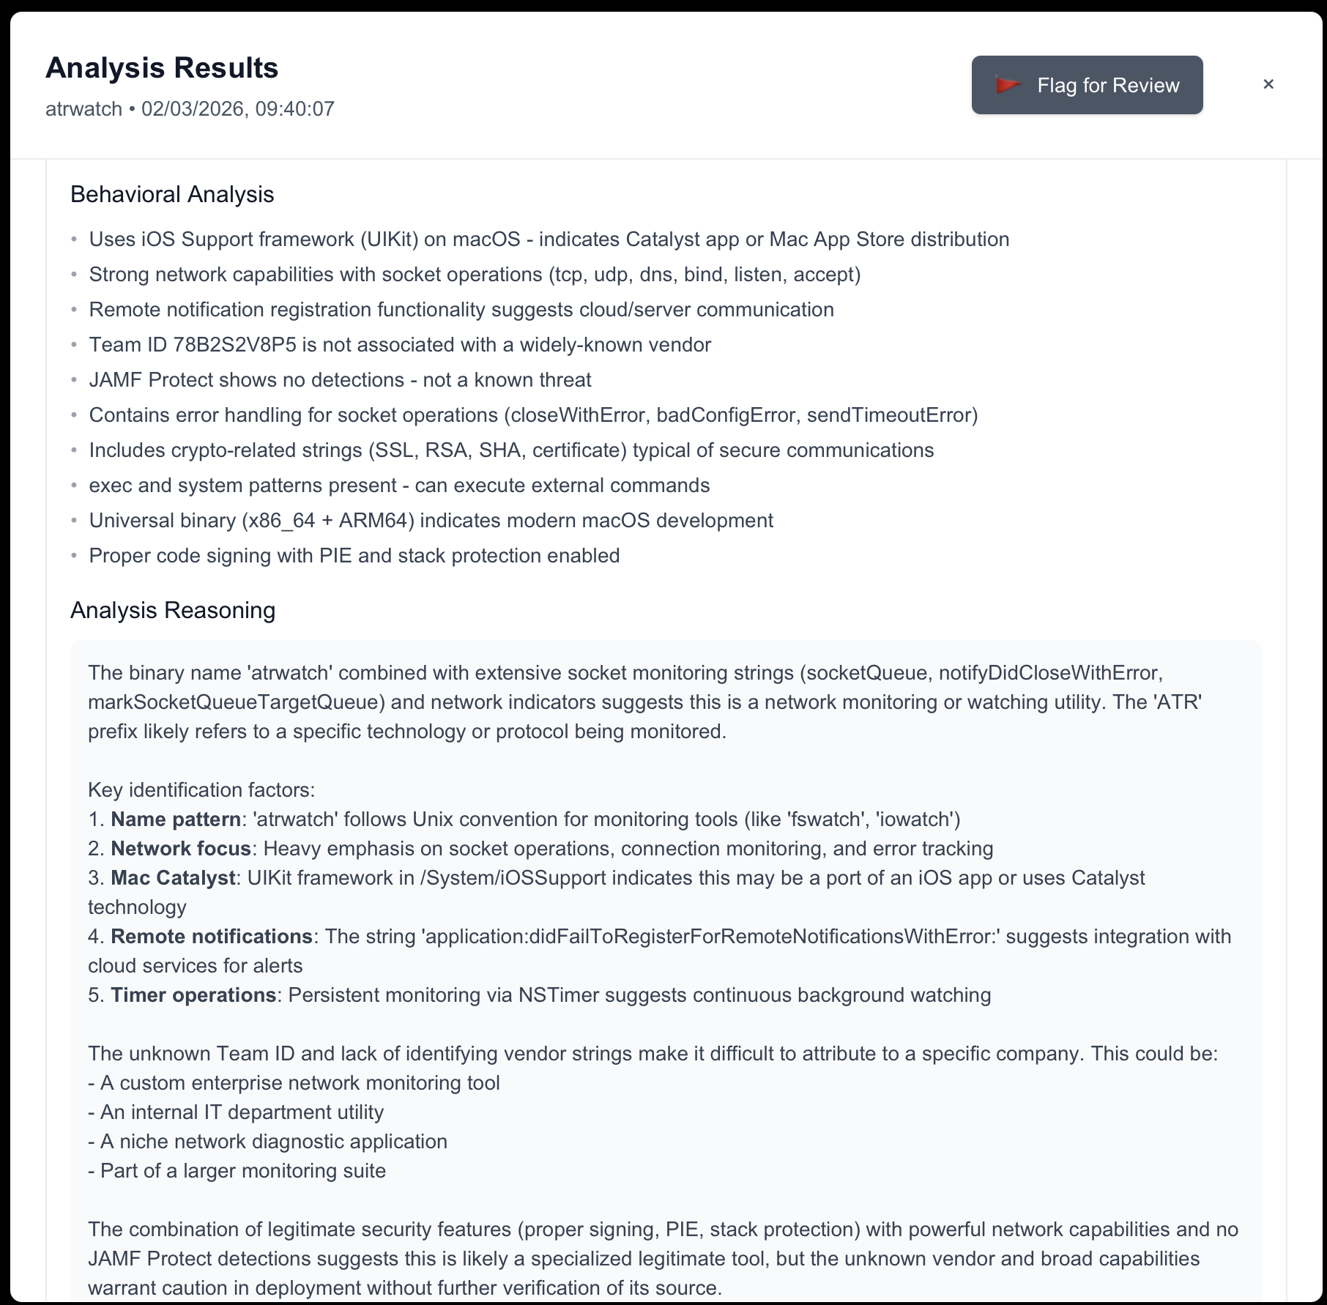
THREAT LABS: VIEW RESULTS
Notes:
PC – Three examples of the Threat Labs results page. On the left is the standard result – threat assessment, file hashes, analysis details, and the detection methods used: Team ID analysis, SHA1 hash lookup, and YARA rules.
In the middle is the AI Analysis for a flagged binary – security classification, threat level, and file classification identifying the type of tool, vendor, architecture, and code signing status.
On the right is the Behavioral Analysis and reasoning. It examines the binary’s strings, frameworks, and capabilities to determine what the application actually does. In this example it identified a network monitoring tool with socket operations and an unknown Team ID – flagging it as medium threat requiring further verification.

Slide 22
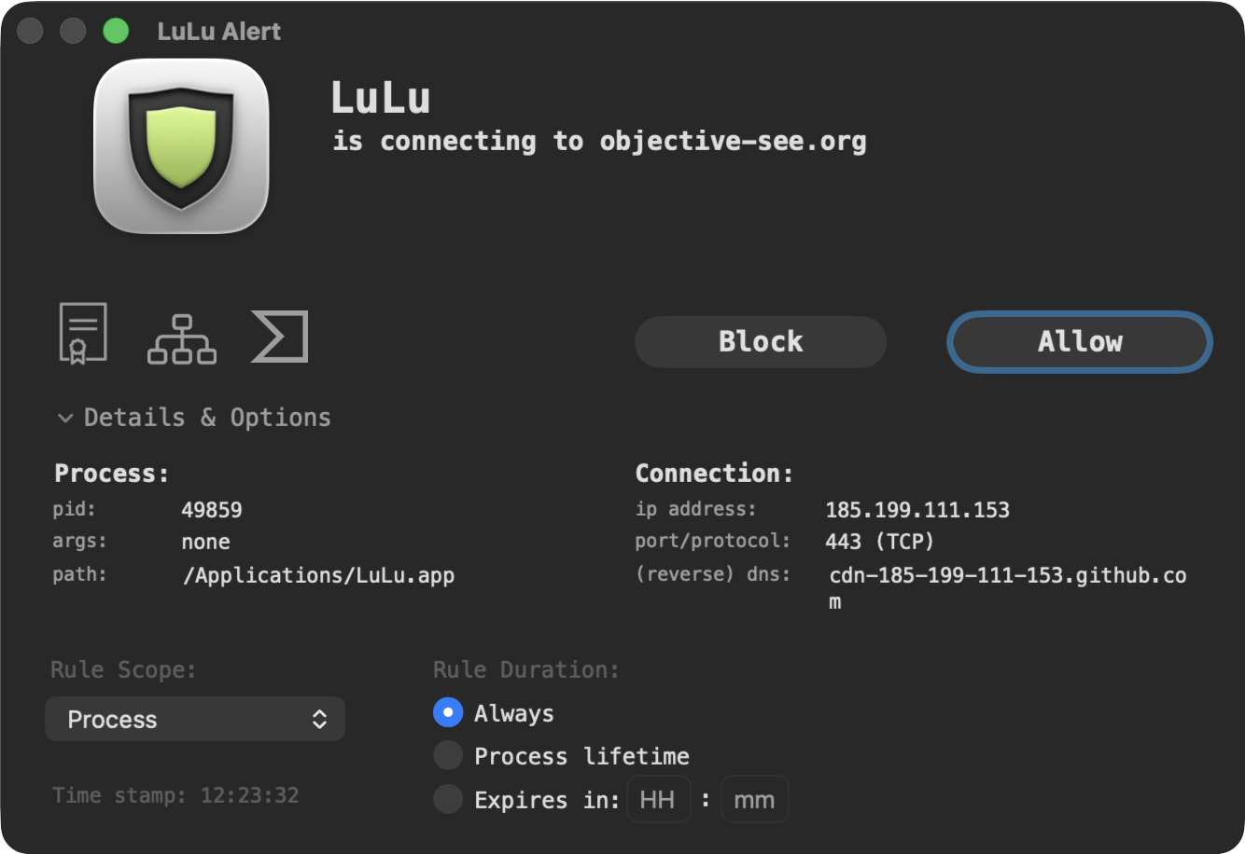
LULU
macOS firewall
• Monitors all outbound connections
• Intercepts URLs/IPs for VT analysis
objective-see.org/products/lulu.html
UNIFIED LOG:
log stream --level debug --predicate "subsystem='com.objective-see.lulu'"
Events: (user) response:, presenting alert, creating rule
REAL WORLD:
OSX.Dummy (2018) — LuLu caught reverse shell to 185.243.115.230:1337
objective-see.org/blog/blog_0x32.html
Notes:
PC – LuLu is a firewall for macOS. It monitors all outbound network connections and alerts you when an application tries to connect to a remote server.
During testing, we stream LuLu’s events via the unified log.
Captured connections are then submitted to VirusTotal for analysis. – pretty common to see connections to CDN’s and update feeds.
Real-world: In 2018, OSX.Dummy tricked crypto community users into running a malicious binary. The malware set up a persistent reverse shell to 185.243.115.230 on port 1337, giving the attacker root access. LuLu detected this outbound connection immediately – even though every AV engine on VirusTotal missed the malware entirely.

Slide 23
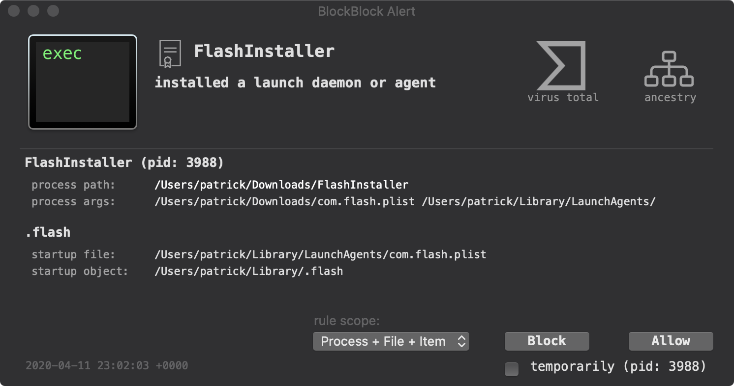
BLOCKBLOCK
Persistence mechanism monitor
• Monitors persistence locations
• Detects login items & BTM changes
• ClickFix paste protection (v2.3.0+)
• Real-time allow/block decisions
objectivesee.org/products/blockblock.html
UNIFIED LOG:
log stream --predicate "subsystem == 'com.objective-see.blockblock'"
Events: user says 'allow'/'block', installed a launch daemon/agent
REAL WORLD:
OSX.Dummy (2018) — caught com.startup.plist LaunchDaemon persistence
objective-see.org/blog/blog_0x32.html
Notes:
PC – BlockBlock monitors persistence locations on macOS. Whenever something tries to install a new LaunchAgent, LaunchDaemon, login item, or other persistence mechanism, BlockBlock raises an alert.
We capture these events from the unified log during testing. This tells us exactly what persistence mechanisms the title installs – which also feeds directly into the configuration profiles we generate.
Real-world: In 2018, OSX.Dummy installed a malicious LaunchDaemon at /Library/LaunchDaemons/com.startup.plist that persisted a reverse shell script. BlockBlock detected and alerted on this persistence attempt immediately. In 2026, BlockBlock v2.3.0 added paste protection against ClickFix attacks – where attackers trick users into pasting malicious commands into Terminal. North Korean actors used this technique in fake video calls, and LLM-generated instructions were found propagating ClickFix payloads via Google Sponsored results.

Slide 24
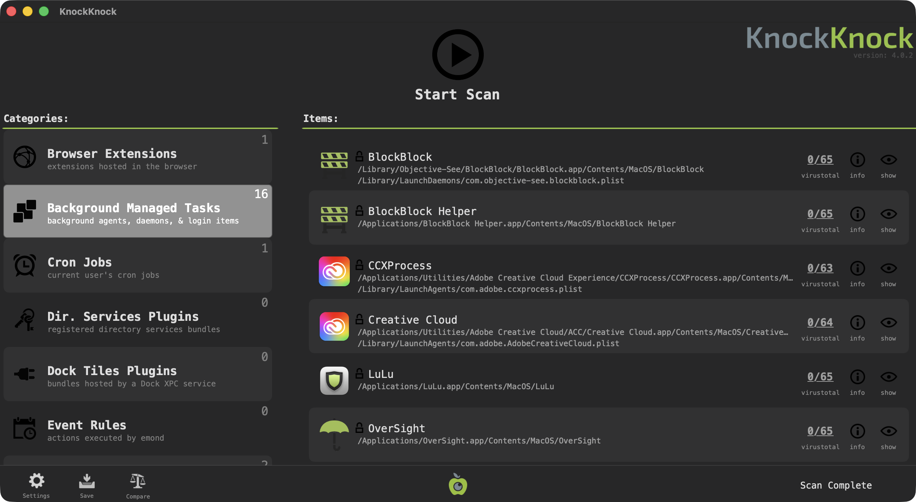
KNOCKKNOCK
Persistence mechanism scanner
• Scans for persistent software
• LaunchAgents/Daemons, login items
• Browser & kernel extensions
• Shell config (.zshrc, .bashrc)
• VirusTotal v3 API integration
• BTM enumeration (v4.0.3+)
Before/after comparison: baseline scan → post-install delta
COMMAND LINE:
/Applications/KnockKnock.app/Contents/MacOS/KnockKnock -whosthere -verbose -pretty
Output: JSON — persistence items across 20+ categories
REAL WORLD:
OSX.Dummy — found unsigned persistence; Zoom — detected proxy dylib
objective-see.org/blog/blog_0x32.html
Notes:
PC – KnockKnock scans for persistently installed software. Unlike the streaming tools, it’s a point-in-time scanner – we run it before and after installation and compare the results.
The delta tells us exactly what persistence mechanisms the title added: LaunchAgents, LaunchDaemons, login items, browser extensions, shell config changes, and more. Version 4.0.3 added enhanced BTM enumeration, and the VirusTotal v3 API integration lets us cross-reference any new items.
Real-world: Running KnockKnock as root on a system infected with OSX.Dummy revealed the unsigned com.startup.plist LaunchDaemon executing a script from /var/root/. In the 2020 Zoom vulnerability, KnockKnock detected the proxy library injection in Zoom’s Frameworks directory – a dylib that wasn’t part of the original application bundle.

Slide 25
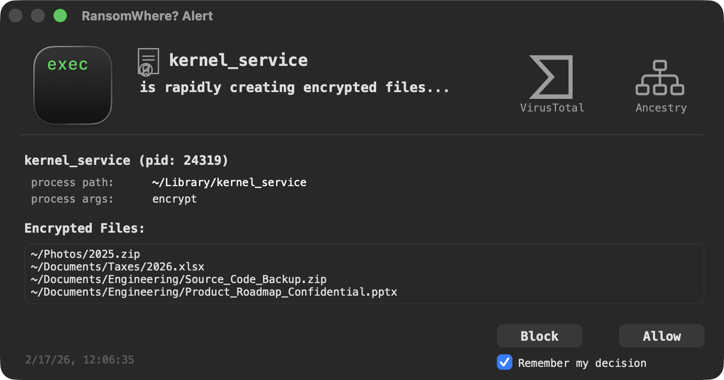
RANSOMWHERE?
Ransomware detection via file-system
• Monitors for encrypted file creation
• Detects suspicious encryption patterns
• Suspends offending processes
• User allow/terminate decision
• v2.0+ Apple Endpoint Security API
objective-see.org/products/ransomwhere.html
UNIFIED LOG:
log stream --level debug --predicate "subsystem='com.objective-see.ransomwhere'"
Events: file is encrypted, suspended: <process>, user says 'allow'
REAL WORLD:
Turtle ransomware (2023) — generically thwarted with zero prior knowledge
objective-see.org/blog/blog_0x76.html
Notes:
PC – RansomWhere monitors the file system for the rapid creation of encrypted files – a hallmark of ransomware. When it detects suspicious encryption activity, it suspends the offending process and alerts the user.
Version 2.0 moved to Apple’s Endpoint Security framework for better detection. We stream its events during testing to ensure the title under test isn’t doing anything that looks like ransomware behavior.
Note - Not uncommon for apps to encrypt files, for example Chromium based apps tend to encrypt some files in user space Application Support folder. So you really want to be paying attention to where the files are being encrypted, and how many!
Real-world: In 2023, a cross-platform ransomware called Turtle appeared, written in Go with builds for macOS, Windows and Linux. RansomWhere generically detected and thwarted it with absolutely no prior knowledge of the malware – it simply spotted the rapid creation of encrypted files by an untrusted process. Patrick Wardle also recovered the hardcoded AES key "wugui123wugui123" (wugui means turtle in Chinese) and published a decryptor.

Slide 26
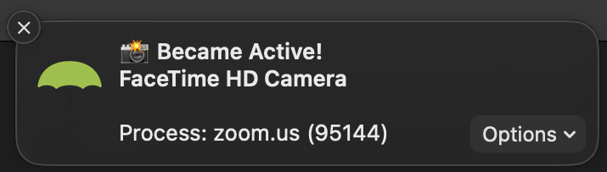
OVERSIGHT
Camera & microphone monitor
• Monitors internal mic activation
• Detects webcam access by processes
objective-see.org/products/oversight.html
UNIFIED LOG:
log stream --level debug --predicate "subsystem='com.objective-see.oversight'"
Events: camera access detected, microphone access detected
REAL WORLD:
Zoom (2020) — OverSight caught invisible background mic & camera hijacking
objective-see.org/blog/blog_0x56.html
Notes:
PC – OverSight monitors your Mac’s camera and microphone. If any process activates the mic or accesses the webcam, OverSight raises an alert and identifies the responsible process.
During testing, we stream these events to catch any title that silently accesses audio or video hardware.
Real-world: In 2020, Patrick Wardle demonstrated that malicious code injected into Zoom’s process could inherit its mic and camera permissions – recording audio and video with zero user prompts. Zoom could even be launched hidden via /usr/bin/open -j. OverSight would alert the user any time the mic or camera activated, even from an invisible Zoom session. Earlier, in 2016, OverSight exposed Shazam keeping the microphone active even when the user toggled it off – proving the tool catches both malicious and misbehaving software.

Slide 27
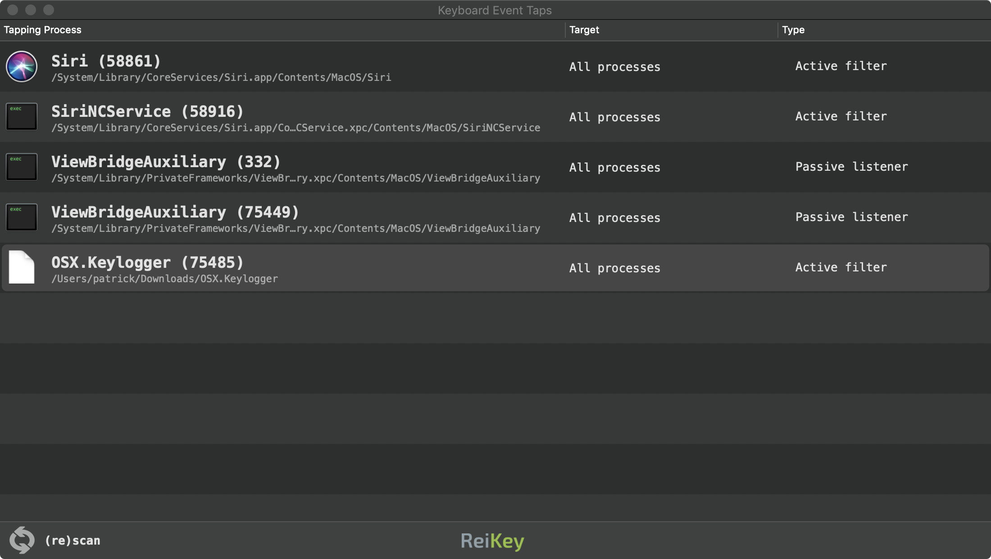
REIKEY
Keyboard event tap monitor
• Detects CoreGraphics event taps
• Scans for existing keyboard taps
• Alerts on new tap installation
• Passive listener vs active filter
objective-see.org/products/reikey.html
COMMAND LINE:
/Applications/ReiKey.app/Contents/MacOS/ReiKey -scan -pretty -skipApple
Output: JSON — active keyboard event taps with process & target info
REAL WORLD:
OSX.FruitFly — keylogger with event taps undetected for 13+ years
objective-see.org/blog/blog_0x36.html
Notes:
PC – ReiKey scans for and monitors CoreGraphics keyboard event taps – the most common technique used by macOS keyloggers. It can scan for existing taps and alert in real time when a new one is installed.
During testing we run a scan before and after installation. Any new keyboard event tap installed by the title under test is flagged – legitimate apps rarely need to intercept keystrokes globally.
The tool distinguishes between passive listeners and active filters, which helps gauge the severity of the finding.
Real-world: OSX.FruitFly was written over a decade ago but only discovered in 2017. It installed keyboard event taps to log keystrokes and used synthetic mouse and keyboard events to dismiss security prompts – even dumping the user’s keychain. ReiKey would have detected the event tap installation immediately.

Slide 28
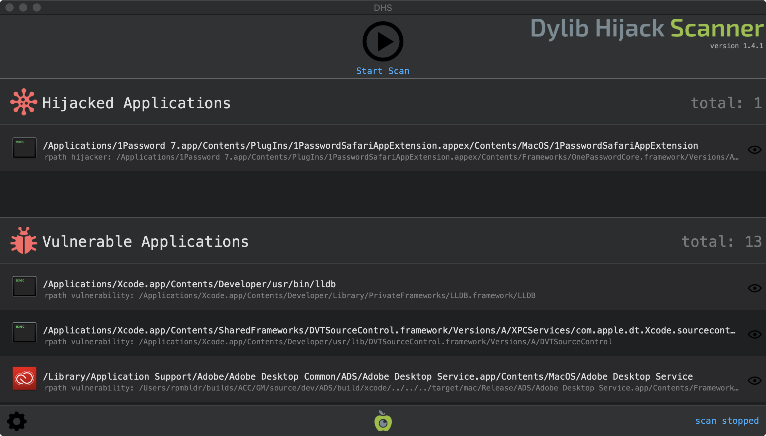
DHS
Dynamic library hijack detector
• Scans for vulnerable applications
• Detects hijacked dylibs
• Weak import hijack detection
• Full filesystem scan option
objective-see.org/products/dhs.html
WHAT WE CHECK:
Post-install scan → does the title introduce any hijackable or hijacked dylibs?
Findings saved as JSON via 'save results' preference
REAL WORLD:
Zoom (2020) — dylib proxy hijack gave mic & camera access without prompts
objective-see.org/blog/blog_0x56.html
Notes:
PC – DHS – Dylib Hijack Scanner – checks for applications vulnerable to dynamic library hijacking and detects any that have already been hijacked.
Dylib hijacking is a technique where an attacker plants a malicious dynamic library in a location that the OS will load before a legitimate one. This can give persistence and code execution in the context of a trusted application.
After installing a title, we run DHS to check whether the new application introduces any hijackable paths or, worse, ships with already-hijacked libraries.
Real-world: In 2020, Patrick Wardle demonstrated that Zoom’s macOS client had a disable-library-validation entitlement, allowing any library to be loaded into its process space. By proxying a legitimate SSL library, an attacker could inherit Zoom’s mic and camera access – completely invisible to the user. DHS would flag the hijackable dylib paths. Many other apps including MS Office had similar vulnerabilities.

Slide 29
XPROTECT
Apple's built-in antivirus technology
• YARA signature-based detection
• Blocks execution of known malware
• Remediates infections automatically
• Scans on first launch & file changes
• Signatures updated independently of OS
🔗 support.apple.com/en-gb/guide/security/sec469d47bd8/web
UNIFIED LOG:
log stream --predicate "subsystem == 'com.apple.xprotect'"
Events: malware detection, quarantine actions, signature updates
REAL WORLD:
Bonzai (2025) — DPRK stealer detected via XProtect v5304 YARA rules
eclecticlight.co/2025/07/11/what-happened-to-xprotect-this-week
Notes:
PC – XProtect is Apple’s built-in antivirus, using YARA signatures to detect known malware. It works in three layers: preventing launch via Gatekeeper, blocking known malware from running, and remediating infections that slip through.
Signatures are updated automatically and independently of system updates. XProtect scans apps on first launch and whenever they change on disc.
We monitor XProtect events during testing via the unified log, watching for any malware detections or quarantine actions triggered by the title under test.
Real-world: In July 2025, Apple pushed XProtect v5304 with substantial new YARA rules for a malware family code-named Bonzai – five variants including Bonanza, Barricade, Blaster, Bonder and Banana. Security researchers linked these to DPRK’s BlueNoroff group targeting crypto and Web3 platforms. The malware was a stealer written in Go, targeting browser extensions for Chrome, Brave, Edge and Firefox. Apple also used MRT to forcibly remove Zoom’s vulnerable web server component from Macs worldwide in 2019 – the only time they’ve ever taken that action.
Reference: https://support.apple.com/en-gb/guide/security/sec469d47bd8/web

Slide 30
CONFIG PROFILES
Auto-generated MDM profiles
based on observed behaviour
✓ PPPC (Privacy Preferences)
✓ Notifications allowlisting
✓ System Extensions
✓ Managed Login Items
✓ Screen Recording permissions
✓ Content Filters
✓ Kernel Extensions (legacy)
WHY DOES THIS APP NEED THAT?
✓ Zoom → Camera, Mic
Makes sense for video calls
⚠ Text editor → Camera
Why does Notepad need a camera?
⚠ Calculator → Full Disk Access
Highly suspicious
⚠ PDF viewer → Accessibility
Unusual unless it has automation
NS USAGE DESCRIPTIONS WE CHECK (Info.plist):
NSCameraUsageDescription NSMicrophoneUsageDescription
NSAppleEventsUsageDescription NSScreenCaptureUsageDescription
NSAccessibilityUsageDescription NSLocationUsageDescription
NSContactsUsageDescription NSCalendarsUsageDescription
NSPhotoLibraryUsageDescription NSRemindersUsageDescription
These declare what the app says it needs — we verify against actual entitlements.
macOS uses just-in-time enablement — apps may not request access until they actually need it.
Check entitlements up front to see what an app is capable of asking for.
Notes:
PC – One of the most useful outputs is the automatic generation of configuration profiles. But the key insight is context – does the access request make sense?
Zoom asking for camera and mic? Pretty reasonable, right? A text editor asking for camera access? Bit a red flag. A calculator wanting Full Disk Access? That’s suspicious.
Crucially, we check these because of just-in-time enablement. macOS uses a just-in-time model for permissions – an app might not request access to the camera, microphone, or file system until it actually needs to perform that action. So you can’t just install an app and wait for prompts – you need to check the entitlements and Info.plist declarations up front to know what it’s capable of asking for, even if it hasn’t asked yet.
We check the NS Usage Description keys in the Info.plist to see what the app declares it needs, then we verify those claims against the actual code signature entitlements.

Slide 31
ON-DISK DISCOVERY
Why entitlements aren't enough
• Not all developers declare them
• NS Usage keys often missing
• Some apps install helpers/agents
• Need to see what's actually on disk
What we inspect post-install
• Background Task Management (BTM)
• LaunchAgents & LaunchDaemons
• Login items & helper tools
• System & network extensions
KEY COMMANDS:
sfltool dumpbtm
→ Dumps Background Task Management database — login items, agents, daemons
systemextensionsctl list
→ Lists all installed system extensions (network filters, endpoint security)
We combine these with entitlement and persistence data to auto-generate PPPC, login item, and extension profiles.
Notes:
PC – So, we can’t relay solely on entitlements and NS Usage Description keys. Not all developers declare them properly, and some don’t declare them at all. An app might install helper tools, background agents, or login items that don’t show up in the main app’s entitlements.
So we go beyond entitlements and look at what’s actually on disk after installation. The key tool here is sfltool dumpbtm, which dumps the Background Task Management database. This tells us every login item, LaunchAgent, and LaunchDaemon that the system knows about – regardless of whether the developer declared anything in their entitlement – there is definetly overlap here with BlockBlock, and KnockKnock, but we want to sure we catch as much possible.
We also enumerate system extensions with systemextensionsctl. By combining these on-disk sources with the entitlement and persistence data from our other tools, we can auto-generate accurate PPPC, login item, and extension profiles that reflect what the app actually does, not just what the developer says it does.

Slide 32
PHASE 6: THE DOSSIER
# Jamf Auto Update Software Title Installation Test Report
Generated: 2026-04-18 12:34:03
Application: EpidemicSound (x86_64) (version: 1.18.10)
## System Information
Detected macOS version: 26.4.1 (macOS Tahoe)
Detected architecture: x86_64
Detected Munki version: 6.6.5.4711
Console user: test
User admin status: Administrator
Model Identifier: MacBookPro16,1
System type: Physical Hardware — MacBook Pro
Serial number: C02FV960MD6R
Security tools detected: 7 tools
BlockBlock: 2.4.2
LuLu: 4.3.1
ReiKey: 1.4.2
RansomWhere: 2.1.2
OverSight: 2.4.0
XProtect: 5338 (Installed: 2026-04-13 07:33:53)
KnockKnock: 4.0.3
XProtect Configuration:
Launch scans: enabled
Background scans: enabled
## Rosetta Compatibility
Epidemic Sound.app:
Runs natively on Apple Silicon
Intel binary (x86_64)
runs natively on Intel, requires Rosetta 2 on Apple Silicon
Notes:
PC - A comprehensive markdown report is generated after every title test. It’s important to note that it’s not specifically designed for pass/fail scenarios, it’s designed to give you the information you need to investigate anything that that you find suspicious. Unless of course ThreatLabs and all the VirusTotal vendors flags it as malicious, probably safe to automatically fail that!
This is a real example from testing Epidemic Sound 1.18.10.
We record a bunch of system info, installed security tools with their version number, and Rosetta Compatibility.

Slide 33
THE DOSSIER
## Catalog Validation
Uninstall Method: remove_copied_items
Found 1 item(s) in installs array
Validating installs array item 1:
Found minosversion: 12.0
✅ CFBundleShortVersionString matches (1.18.10)
Path: /Applications/Epidemic Sound.app
Type: application
Bundle ID: com.electron.epidemic-sound
OS Version Validation:
Found 1 minosversion(s): 12.0
✅ Highest minosversion matches minimum_os_version (12.0)
## Installation Details
Selected application: EpidemicSound
Version: 1.18.10
Architecture: (x86_64)
Installation started: 2026-04-18 12:34:11
→ The software was successfully installed.
Installation completed: 2026-04-18 12:39:20
Installation duration: 5m 8s
## Package Analysis
Packages analysed: 1
Total deprecated dependency issues: 0
Critical issues (Python 2): 0
✅ No deprecated dependencies found.
## Test Results
✅ Successfully installed and tested EpidemicSound (version: 1.18.10)
Loop Install Test: PASSED
✅ Performed post-install looping installation check
✅ No reinstallation required
Loop Uninstall Test: PASSED
✅ Performed post-uninstall looping uninstallation check
✅ No re-uninstallation required
Notes:
PC - Catalog validation confirms the munki pkginfo is well-formed – installs array, version matching, min OS version. Installation took 5 minutes 8 seconds, passed install and uninstall looping tests. No deprecated dependencies found like python 2 in the package, not least as this title is drag and drop dmg.

Slide 34
THE DOSSIER: SECURITY EVENTS
## VirusTotal Malware Analysis
Files analyzed: 1
Clean files: 1
Malicious files: 0
Suspicious files: 0
Manual check required: 0
Analysis errors: 0
Detailed analysis results:
File: EpidemicSound-1.18.10.dmg (127.28 MB)
Status: ✅ CLEAN (0/62 detections)
Report URL: https://www.virustotal.com/gui/file/b8b6e8494797d73ee2c0e8c4739d95b07ad0f3fc8f598dd50aa934fde3b10fcf
Analysis type: file
SHA-256: b8b6e8494797d73ee2c0e8c4739d95b07ad0f3fc8f598dd50aa934fde3b10fcf
✅ All analyzed files passed malware screening.
Notes:
PC - VirusTotal scanned the DMG – clean across all 62 engines. Full SHA-256 hash and report URL shown for verification or further investiagion.

Slide 35
THE DOSSIER: SECURITY EVENTS
## Jamf ThreatLabs Binary Analysis
Total binaries extracted: 5
Binaries submitted: 5 Skipped: 0
Results: Clean: 5 Suspicious: 0 Malicious: 0 Pending: 0
Detailed Binary Analysis:
Binary: Epidemic Sound
Source: EpidemicSound-1.18.10.dmg
App Bundle: Epidemic Sound.app
Path: Epidemic Sound
SHA-256: 9b4431c359fbbc6c763917e227a7f0c4
3635320136d9cad7f98c8d2b0caf6715
Submission ID: 09a64670-c97b-4d3f-95c2-3bd089925a39
Threat Level: ✅ CLEAN
Binary: Epidemic Sound Helper
Source: EpidemicSound-1.18.10.dmg
App Bundle: Epidemic Sound.app
Path: Epidemic Sound Helper.app/Contents/
MacOS/Epidemic Sound Helper
SHA-256: 32d1289e1bb71d2e84173fe4c3c7543f
be43b60621ab1e7a7fd5392d851cd648
Submission ID: b963e8a8-b820-4577-abe7-23cd03eecf86
Threat Level: ✅ CLEAN
✅ All analyzed binaries passed security screening.
Notes:
PC - Threat Labs extracted and scanned 5 Mach-O binaries from the app bundle. Showing two in this example – the main Epidemic Sound binary and the Helper app. All 5 came back clean.

Slide 36
THE DOSSIER: SECURITY EVENTS
## KnockKnock Persistence Analysis
Scan Summary:
Baseline items: 52
Post-install items: 52
Changes Detected:
New persistence items: 0
Modified items: 0
Removed items: 0
## BlockBlock
Installation Phase Events:
[2026-04-18 12:34:50] BlockBlock allowed:
Unknown application
Path: Unknown application
Action: user_allowed
## DHS
Vulnerable Applications:
Binary: /Applications/BBEdit.app/Contents/
MacOS/BBEdit
Issue: rpath
Dylib: /Applications/BBEdit.app/Contents/
Frameworks/CrashReporter.framework/
Versions/A/CrashReporter
Notes:
PC - KnockKnock found no new persistence items. BlockBlock allowed an unknown application event during installation this was actually the script when it 1st ran, we run the tool in Notarization mode which will block anything that isn’t notorized. DHS flagged a BBEdit rpath vulnerability – not related to Epidemic Sound.

Slide 37
THE DOSSIER: SECURITY EVENTS
## VirusTotal Network Analysis
[12:45:09] Network scan:
142.250.140.95 - clean (0/98 vendors flagged)
✅ Connection appears clean
(not flagged by any vendors)
[12:45:09] Network scan:
es-plugin-builds.storage.googleapis.com
clean (0/91 vendors flagged)
✅ Connection appears clean
## LuLu
[2026-04-18 12:44:19] LuLu allowed:
Epidemic Sound Helper.app
Application Path: /Applications/Epidemic Sound.app/
Contents/Frameworks/Epidemic Sound Helper.app
Network Connection: 142.250.140.95:443
[2026-04-18 12:44:21] LuLu allowed:
Epidemic Sound.app
Network Connection: es-plugin-builds.storage.
googleapis.com:443
## XProtect
No XProtect events detected
## RansomWhere
RansomWhere Alert #1
Timestamp: 2026-04-18 12:44:27
✅ User allowed application
Severity: high
Path: /Applications/Epidemic Sound.app/
Contents/Frameworks/Epidemic Sound
Helper.app/.../Epidemic Sound Helper
PID: 95396
## OverSight
No camera/microphone access events detected
## ReiKey
No keylogger events detected
Notes:
PC - VirusTotal Network scan found two connections – one to a Google IP and one to googleapis.com, both clean. LuLu confirmed the same connections from the Helper app and main app. RansomWhere flagged the Helper creating encrypted files in Application Support. No events from XProtect, OverSight, or ReiKey.

Slide 38
THE DOSSIER: SYSTEM CHANGES
## System Extensions
No System Extensions found
## Managed Login Items
No login items changes detected
## Notification Changes
Application: com.electron.epidemic-sound
New notification permission: Inactive
Path: /Applications/Epidemic Sound.app
Notes:
PC - System changes after installation. No system extensions. No login item changes. One new notification permission registered for com.electron.epidemic-sound but inactive.

Slide 39
THE DOSSIER: RESULTS
## Uninstall Results
✅ Successfully uninstalled EpidemicSound
Uninstalled at: 12:55:21
Uninstallation duration: 32s
✅ Successfully uninstalled EpidemicSound (version: 1.18.10)
## Code Signing Results
Application: /Applications/Epidemic Sound.app
Executable=.../Epidemic Sound
Identifier=com.electron.epidemic-sound
Format=app bundle with Mach-O thin (x86_64)
CodeDirectory v=20500 flags=0x10000(runtime)
Signature size=9054
Authority=Developer ID Application:
Epidemic Sound AB (LE95XJ5KXM)
Authority=Developer ID Certification Authority
Authority=Apple Root CA
Timestamp=Mar 3, 2026 at 2:32:29 PM
Notarization Ticket=stapled
TeamIdentifier=LE95XJ5KXM
Runtime Version=26.0.0
Sealed Resources: rules=13 files=15
BundleID: com.electron.epidemic-sound
Notes:
PC - Uninstall succeeded – Epidemic Sound was cleanly removed in 32 seconds. Code signing looks solid – properly signed by Epidemic Sound AB with Developer ID, notarized with stapled ticket, hardened runtime enabled.

Slide 40
THE DOSSIER: CONFIG PROFILES
## Configuration Profiles Generated
Profile: Screen Recording
Filename: Screen Recording - Allow EpidemicSound.mobileconfig
Applications: Epidemic Sound.app
Bundle ID: com.electron.epidemic-sound
Profile: Notifications
Filename: Notifications - Allow EpidemicSound.mobileconfig
Applications: Epidemic Sound.app
Bundle ID: com.electron.epidemic-sound
Notes:
PC - Two configuration profiles auto-generated: Screen Recording and Notifications. Both for Epidemic Sound.

Slide 41
FIELD OPERATION
[ LIVE DEMO ]
"Trust, but verify" — let's verify, live.
Notes:
PC and BT - Transition to the live demo portion of the presentation. Set the stage for showing the live demonstration.

Slide 42
RECRUITMENT
REQUIREMENTS:
macOS 11+ · Python 3.9+ · pure stdlib (no pip installs)
Xcode Command Line Tools
Test hardware (or VM if none available)
SETUP:
$ git clone https://github.com/paul-cossey/macaduk-2026-trust-but-verify
$ python3 configure.py --edit
$ sudo python3 main.py
RECOMMENDED:
Install Objective-See tools for full coverage
Free VirusTotal API key (public tier works)
Jamf ThreatLabs key (free for Jamf customers, beta)
Notes:
PC – There will be a version of that script that removes a couple of Jamf Auto Update specific things called InstallAudit at that GitHub address for you have a play with.

Slide 43
FUTURE OPS
What's on the roadmap:
░ Remove Python dependency — port to Swift
░ Convert to an LLM Skill / AI agent workflow
░ Persistence evaluation
░ Community contributions welcome
Notes:
PC - Share your roadmap for future development and improvements to the software verification process.

Slide 44
END OF BRIEFING
"Trust, but verify."
GitHub: jamf.it/kdt6wC
DECLASSIFIED
QUESTIONS?
Notes:
PC and BT - Q&A slide. Provide contact information and links to resources for further learning.
Titles we’d declined to add
Titles we removed
- Ngrok (unable to reliably scan due to constant flagging by VT vendors as a hacking tool)

