Slide 1
proTrade
A Professional Tennis Trading
Environment

Slide 2
Agenda
Tennis Trading
  The Market
  The Traders
Existing solutions
proTrade – The Vision
  Features
  Architecture
Demo
Conclusions

Slide 3
About Us
Students
proTrade – 3rd year group project
Experience
no previous experience with betting or trading
limited experience with GUI design and multi-threaded apps
limited experience with other APIs (Betfair, SWT)

Slide 4
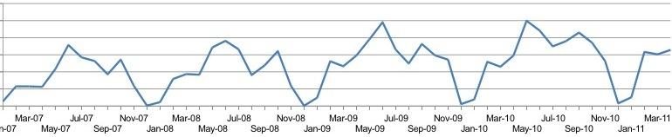
Tennis Trading
Volume of tennis market is steadily increasing
Market liquidity gives Betfair the edge
Better tools attract users
More users increase market liquidity
In-play betting ~ 70% of the market
http://www.fracsoft.com/index.php?option=com_content&task=view&id=109&Itemid=137

Slide 5
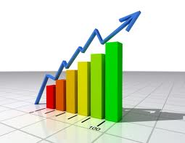
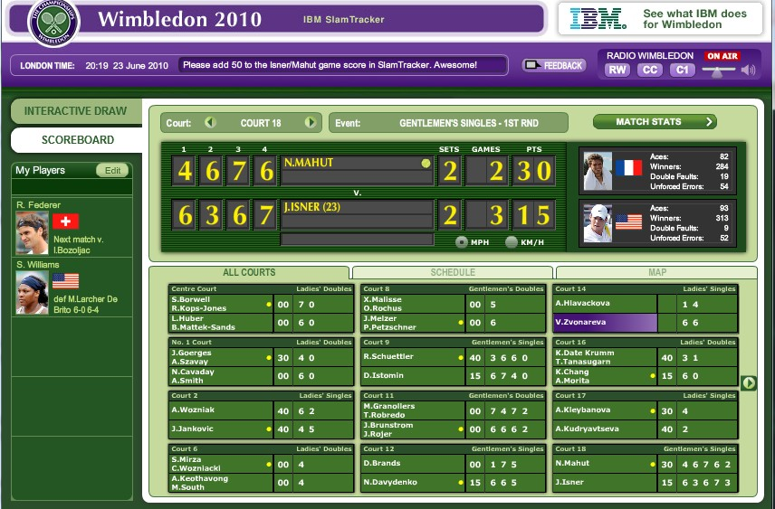

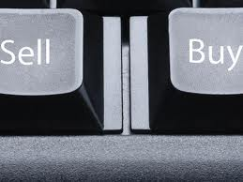
What Traders Need
analysis and inference
score and statistics feed
trading functions
video feed

Slide 6
Current Options
Few tennis trading platforms
None brings together all the required data
None exploits the current match models to infer data

Slide 7
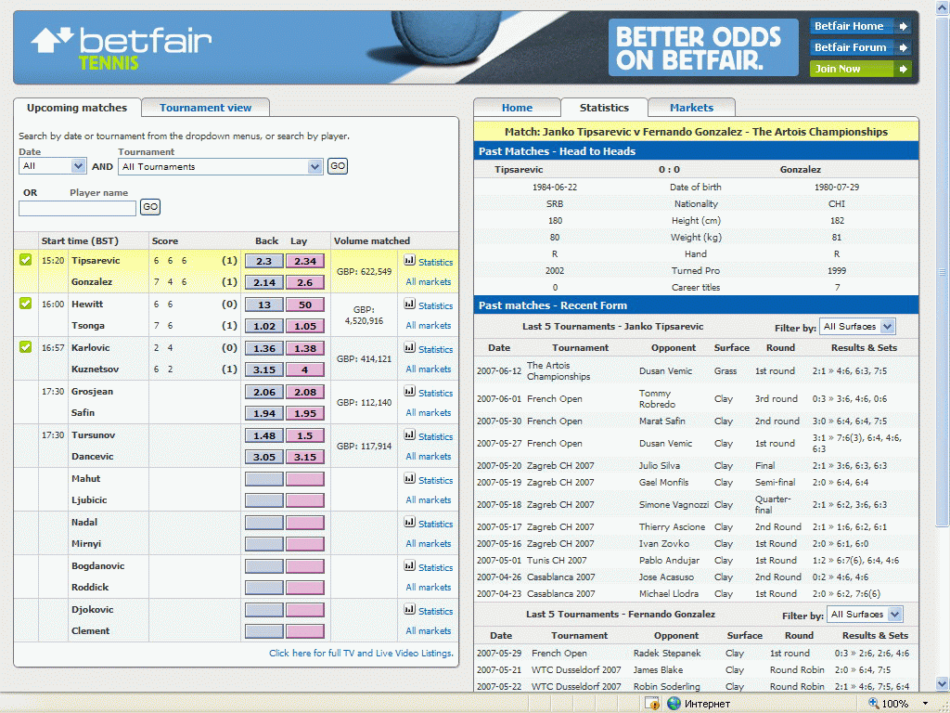
Options - Betfair

Slide 8
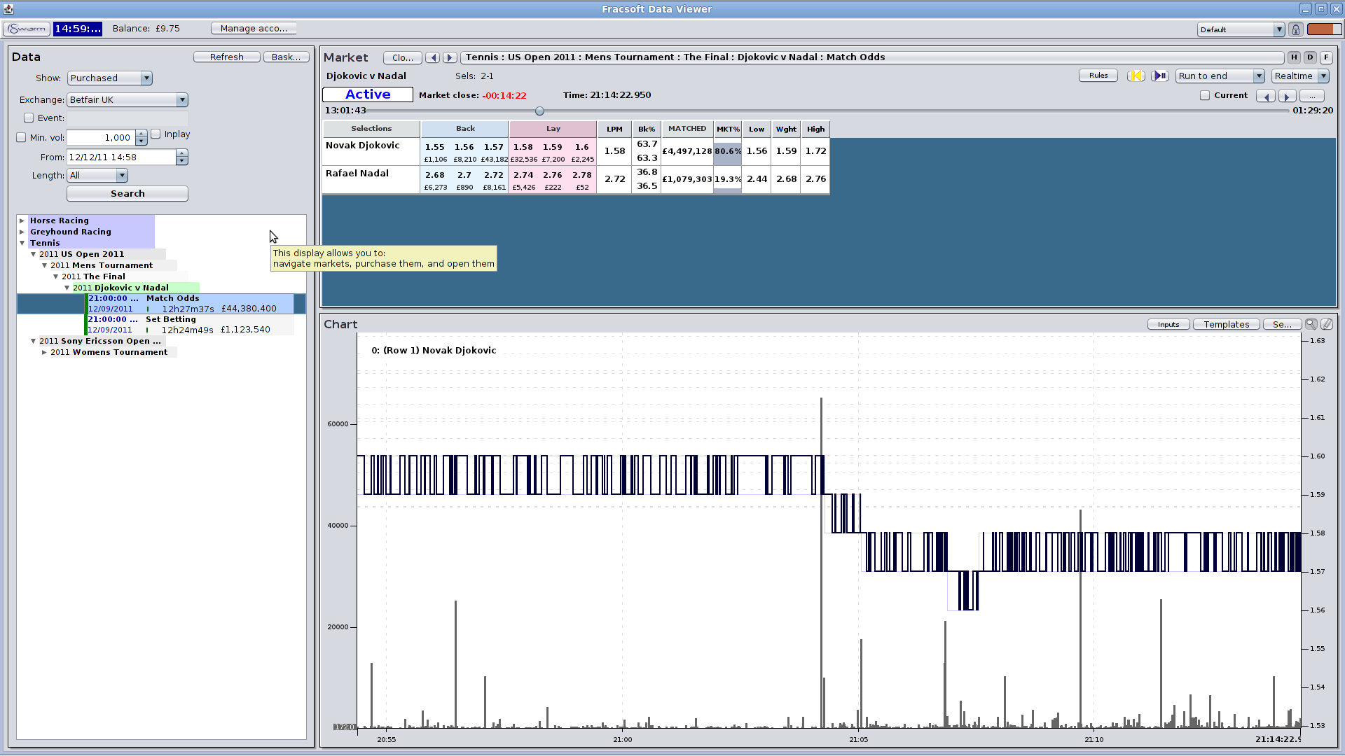
Options – Fracsoft

Slide 9
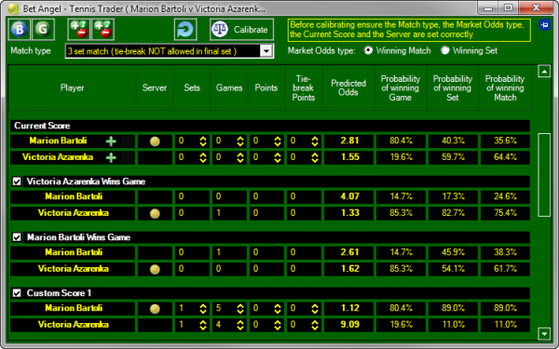
Options - BetAngel

Slide 10
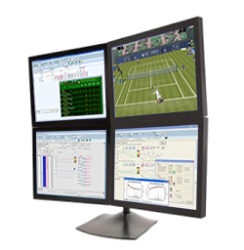
Vision – all in one

Slide 11
Features
Inference
  Goal: predict odds evolution
  Based on service percentages compute probability of winning a point
  Compute probability of wining a game, set, match, tournament etc.
Data acquisition
  (user account) fetch statistical data, score etc.

Slide 12
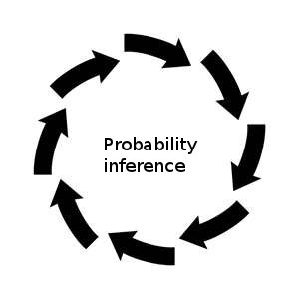
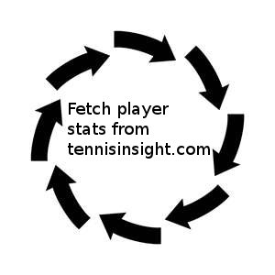
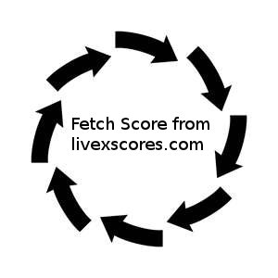
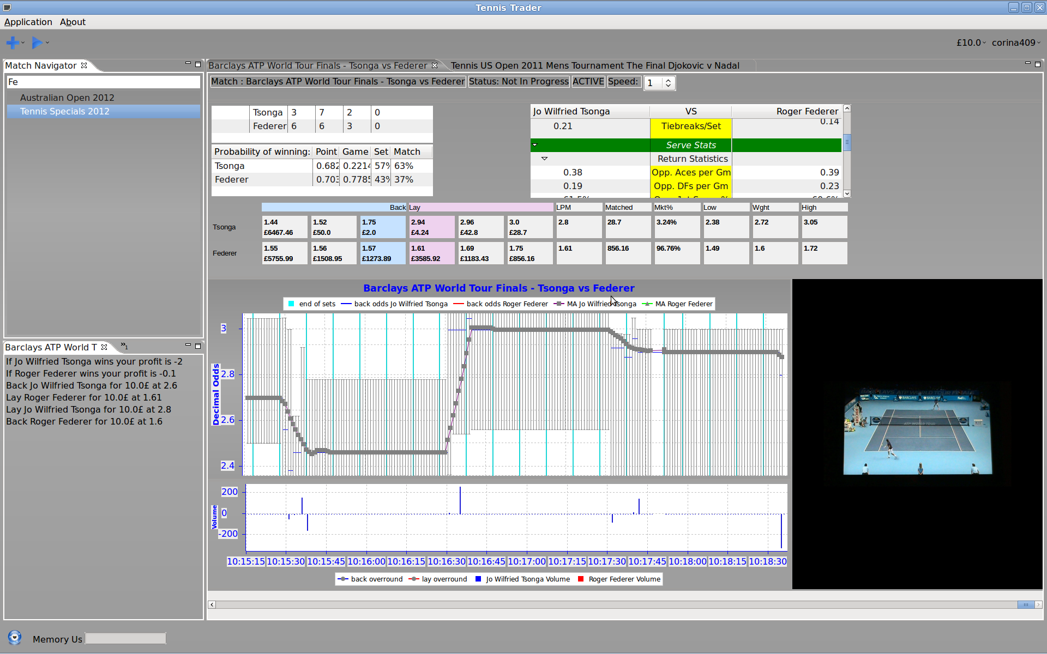
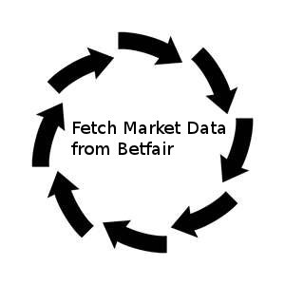
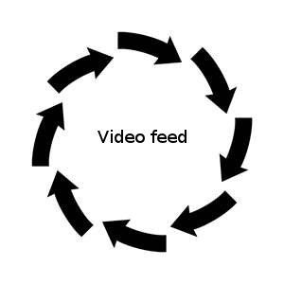
Architecture

Slide 13
Challenges
Where to fetch all data from
Synchronize all fetched data and video
Multi-threaded application

Slide 14
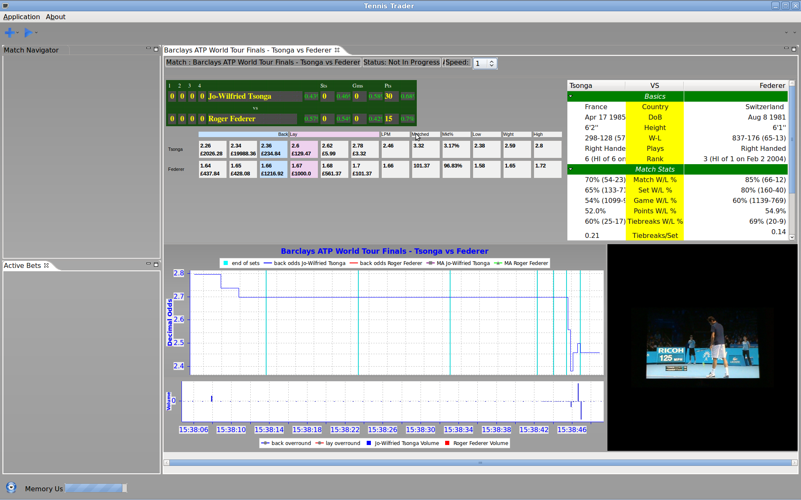

Slide 15
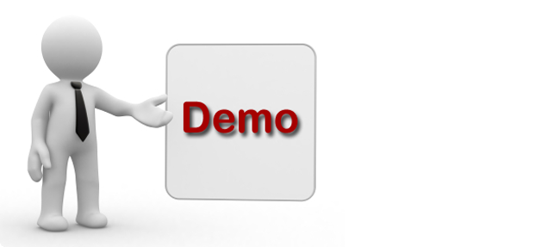
Live Demo

Slide 16
Problems
Portability – hard to find portable, versatile and efficient implementations (e.g. for video streaming)
Dependency on a large number of external data providers
Legal issues

Slide 17
Future Developments
Pub/sub system to which users can subscribe for all required data
Data caching
Enhance user interface design

Slide 18
Conclusions
It is possible to create an application to fetch all the data and provide trading/inference functionality
Such an application could greatly increase a trader's profit, attracting more users, and increasing market liquidity
Exchanges should invest in this type of platforms

Slide 19


The End
Questions?
Suggestions?

