Slide 1
proTrade
A Professional Tennis Trading
Environment

Slide 2
Agenda
Tennis Trading
  The Market
  The Traders
Existing solutions
proTrade – The Vision
  Features
  Architecture
Demo
Conclusion

Slide 3
About Us
Students
3rd year Computing, Imperial College London
proTrade – BEng group project
Experience
no previous experience with betting or trading
limited experience with GUI design and multithreaded app
limited experience with the APIs (Betfair, SWT)

Slide 4
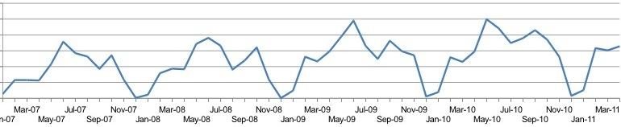
Tennis Trading
Volume of tennis market is steadily increasing.
Market liquidity gives Betfair the edge.
Better tools attract users.
More users increase market liquidity.
In-play betting ~ 70% of the market
http://www.fracsoft.com/index.php?option=com_content&task=view&id=109&Itemid=137

Slide 5
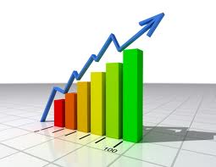
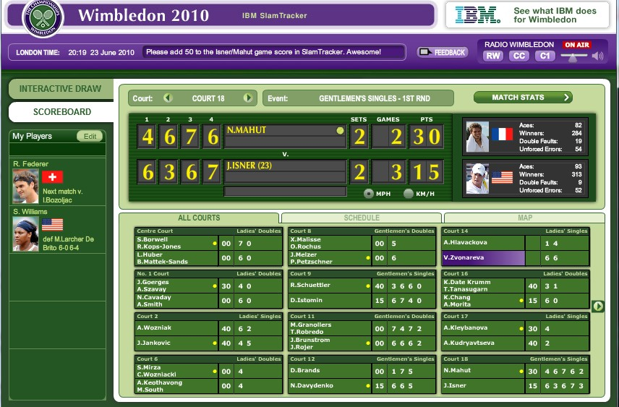
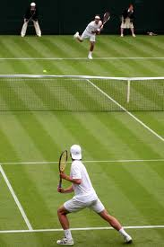

What Traders Need
analysis and inference
score and statistics feed
trading functions
video feed

Slide 6
Competition
Few tennis trading platforms
None brings together all the required data
None exploits the current match models to infere data

Slide 7
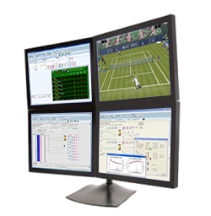
Vision – all in one

Slide 8
Features
Inference
  Goal: predict odds evolution
  Based on service percentages compute probability of winning a point
  Compute probability of wining a game, set, match, tournament etc.
Data acquisition
  (user account) fetch statistical data, score etc.

Slide 9
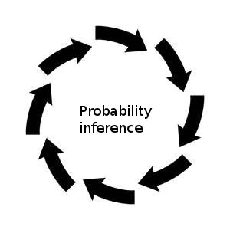
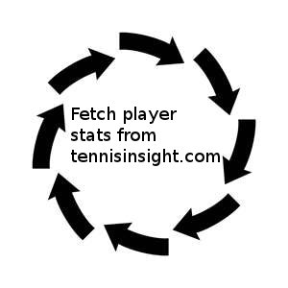
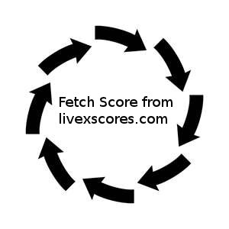
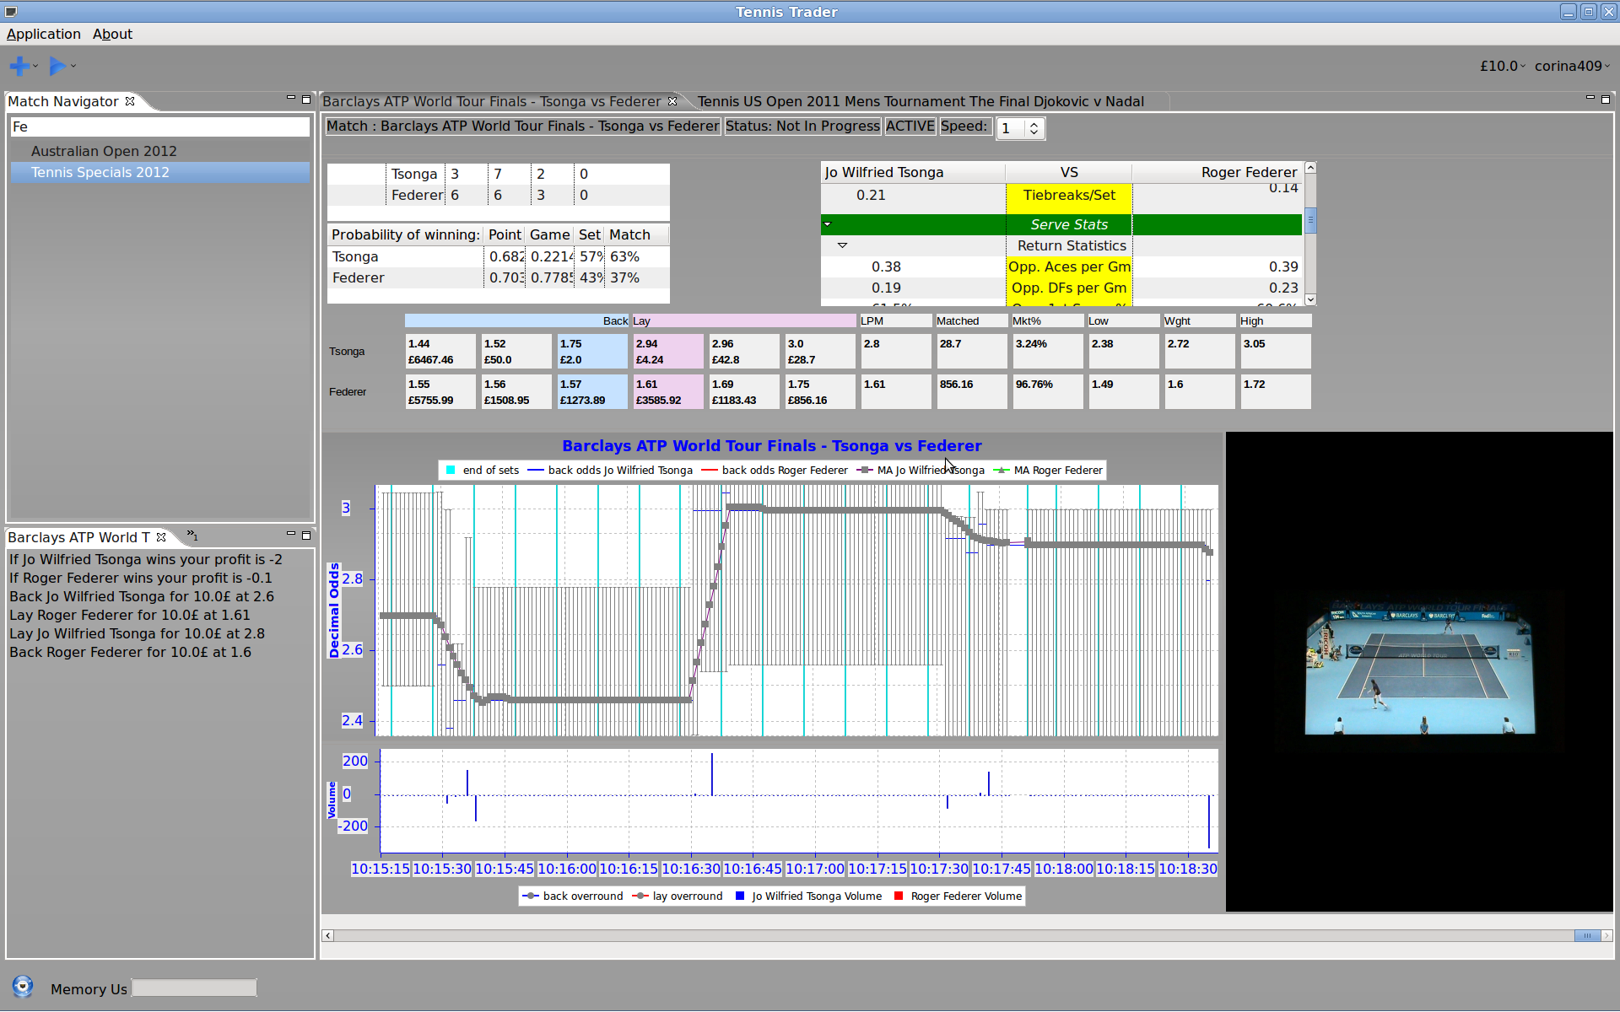
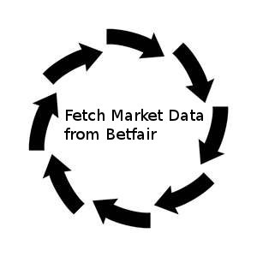
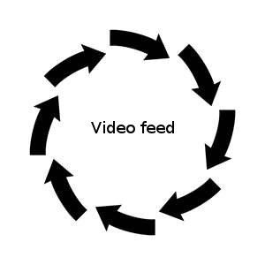
Architecture

Slide 10
Challenges
Where to fetch all data from?
Synchronize all fetched data and video
Multi-threaded application

Slide 11


Slide 12
Problems
Dads
dsadsa

Slide 13


The End
Questions?
Suggestions?

