Slide 1
Candle
Candle
Candle
Candle
Candle
Candle
Candle

Slide 2

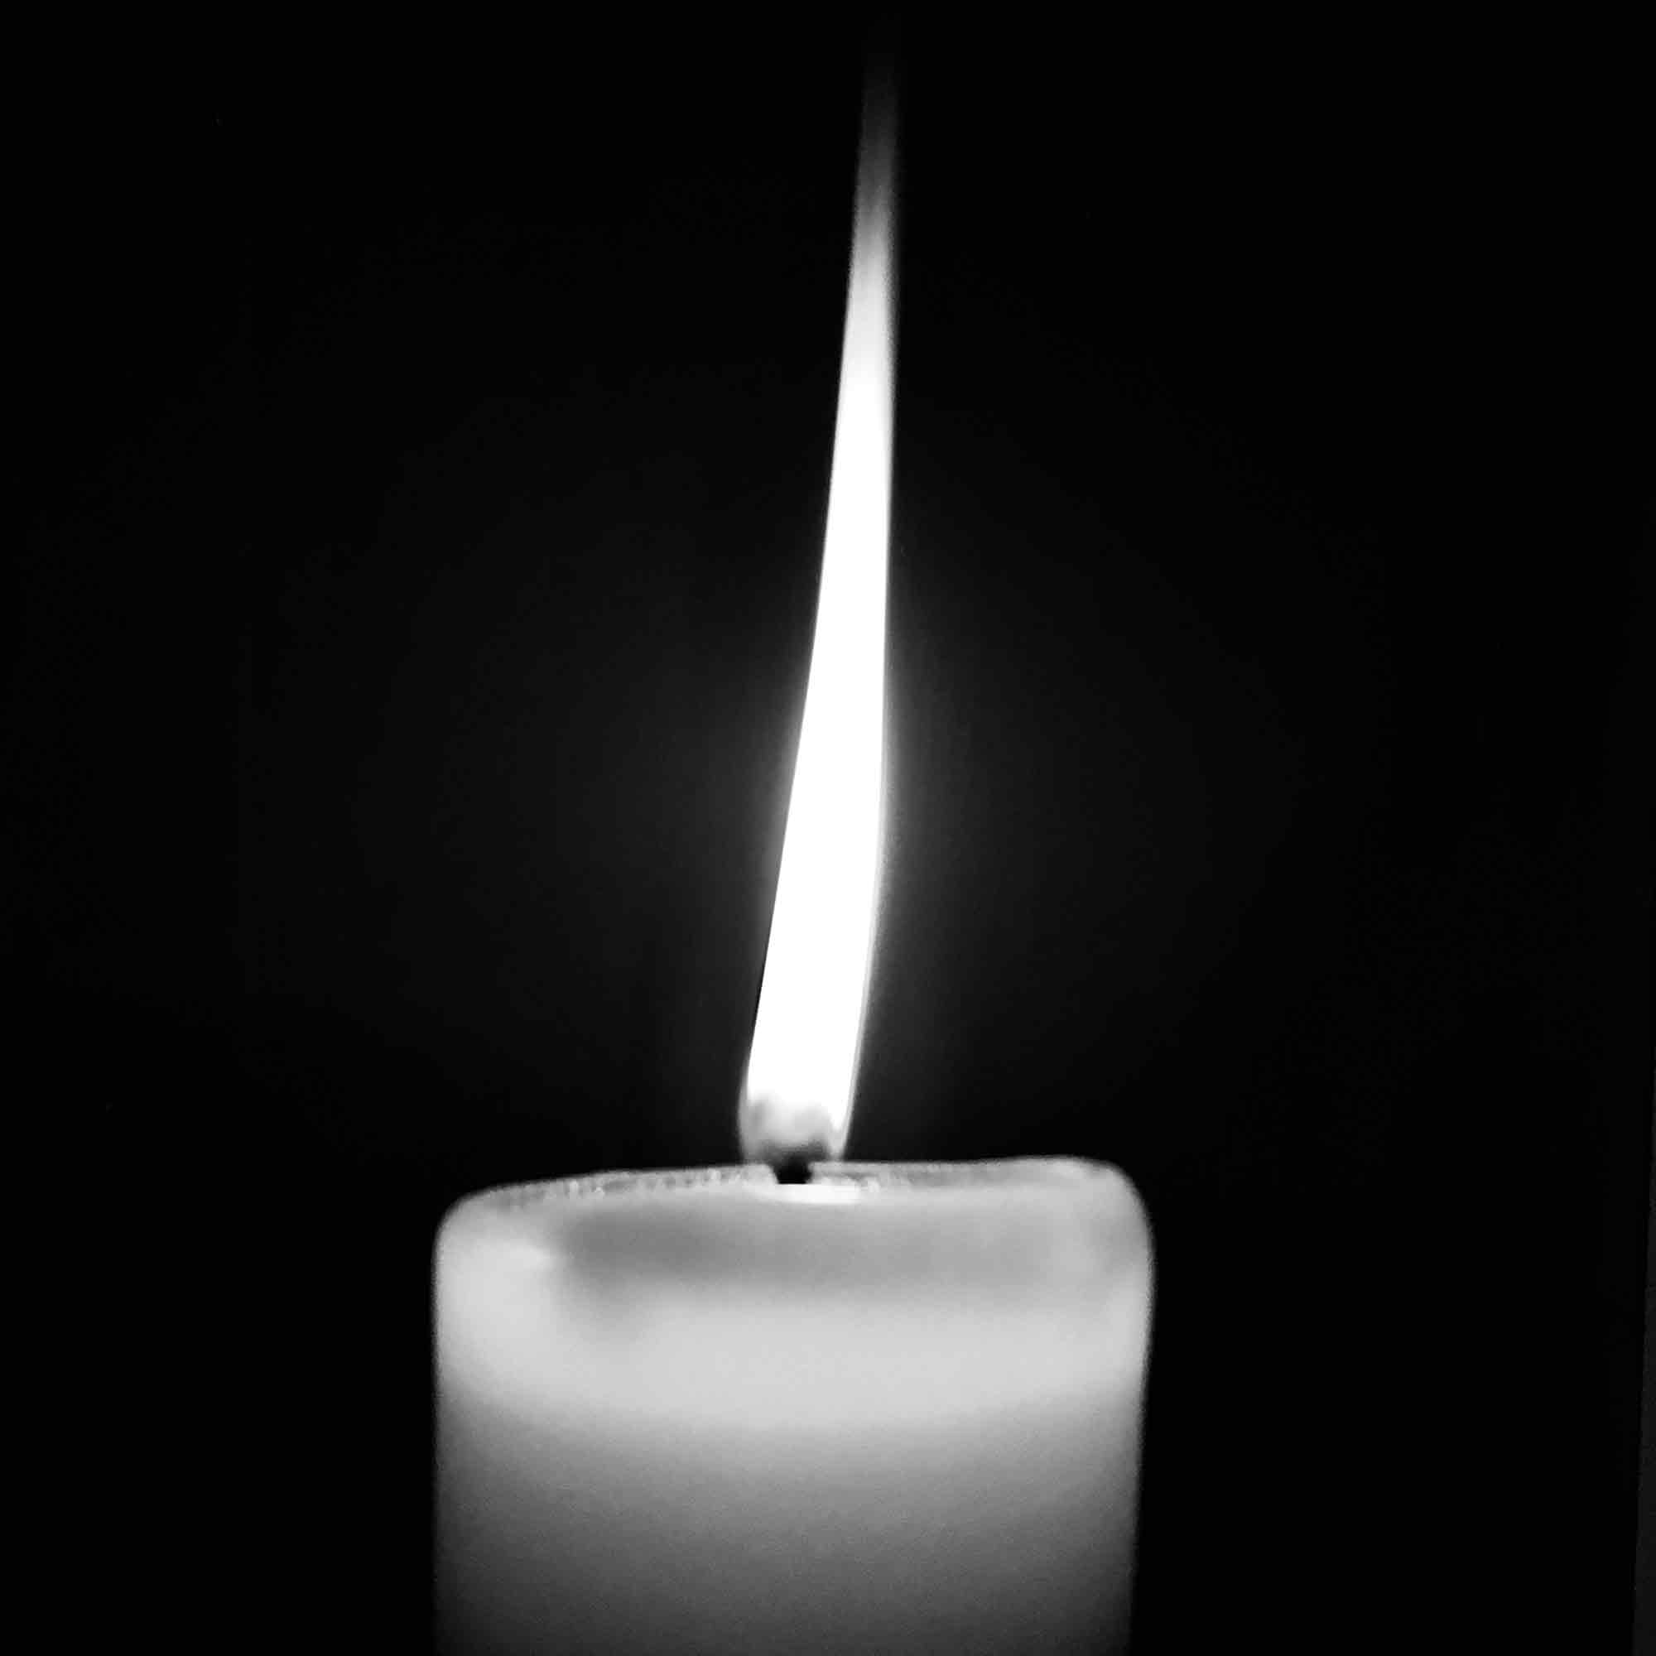
Agile
Cloud
Candle
Definition
Definition
Candle
Ice breakers. Looking at future technologies and discussion. Agile methodology -- Focus, Collaboration, Motivation - concrete, short range deadlines - Lower Risk - don’t spend months on things that don’t work – Flexibility- regular feedback from stakeholders- Outcome oriented
Stable – platform independent. Secure. Resilient – backed up offshore. At Scale – if something is popular, can scale up quickly. Cheaper
Candle
Candle
Candle
Candle

Slide 3
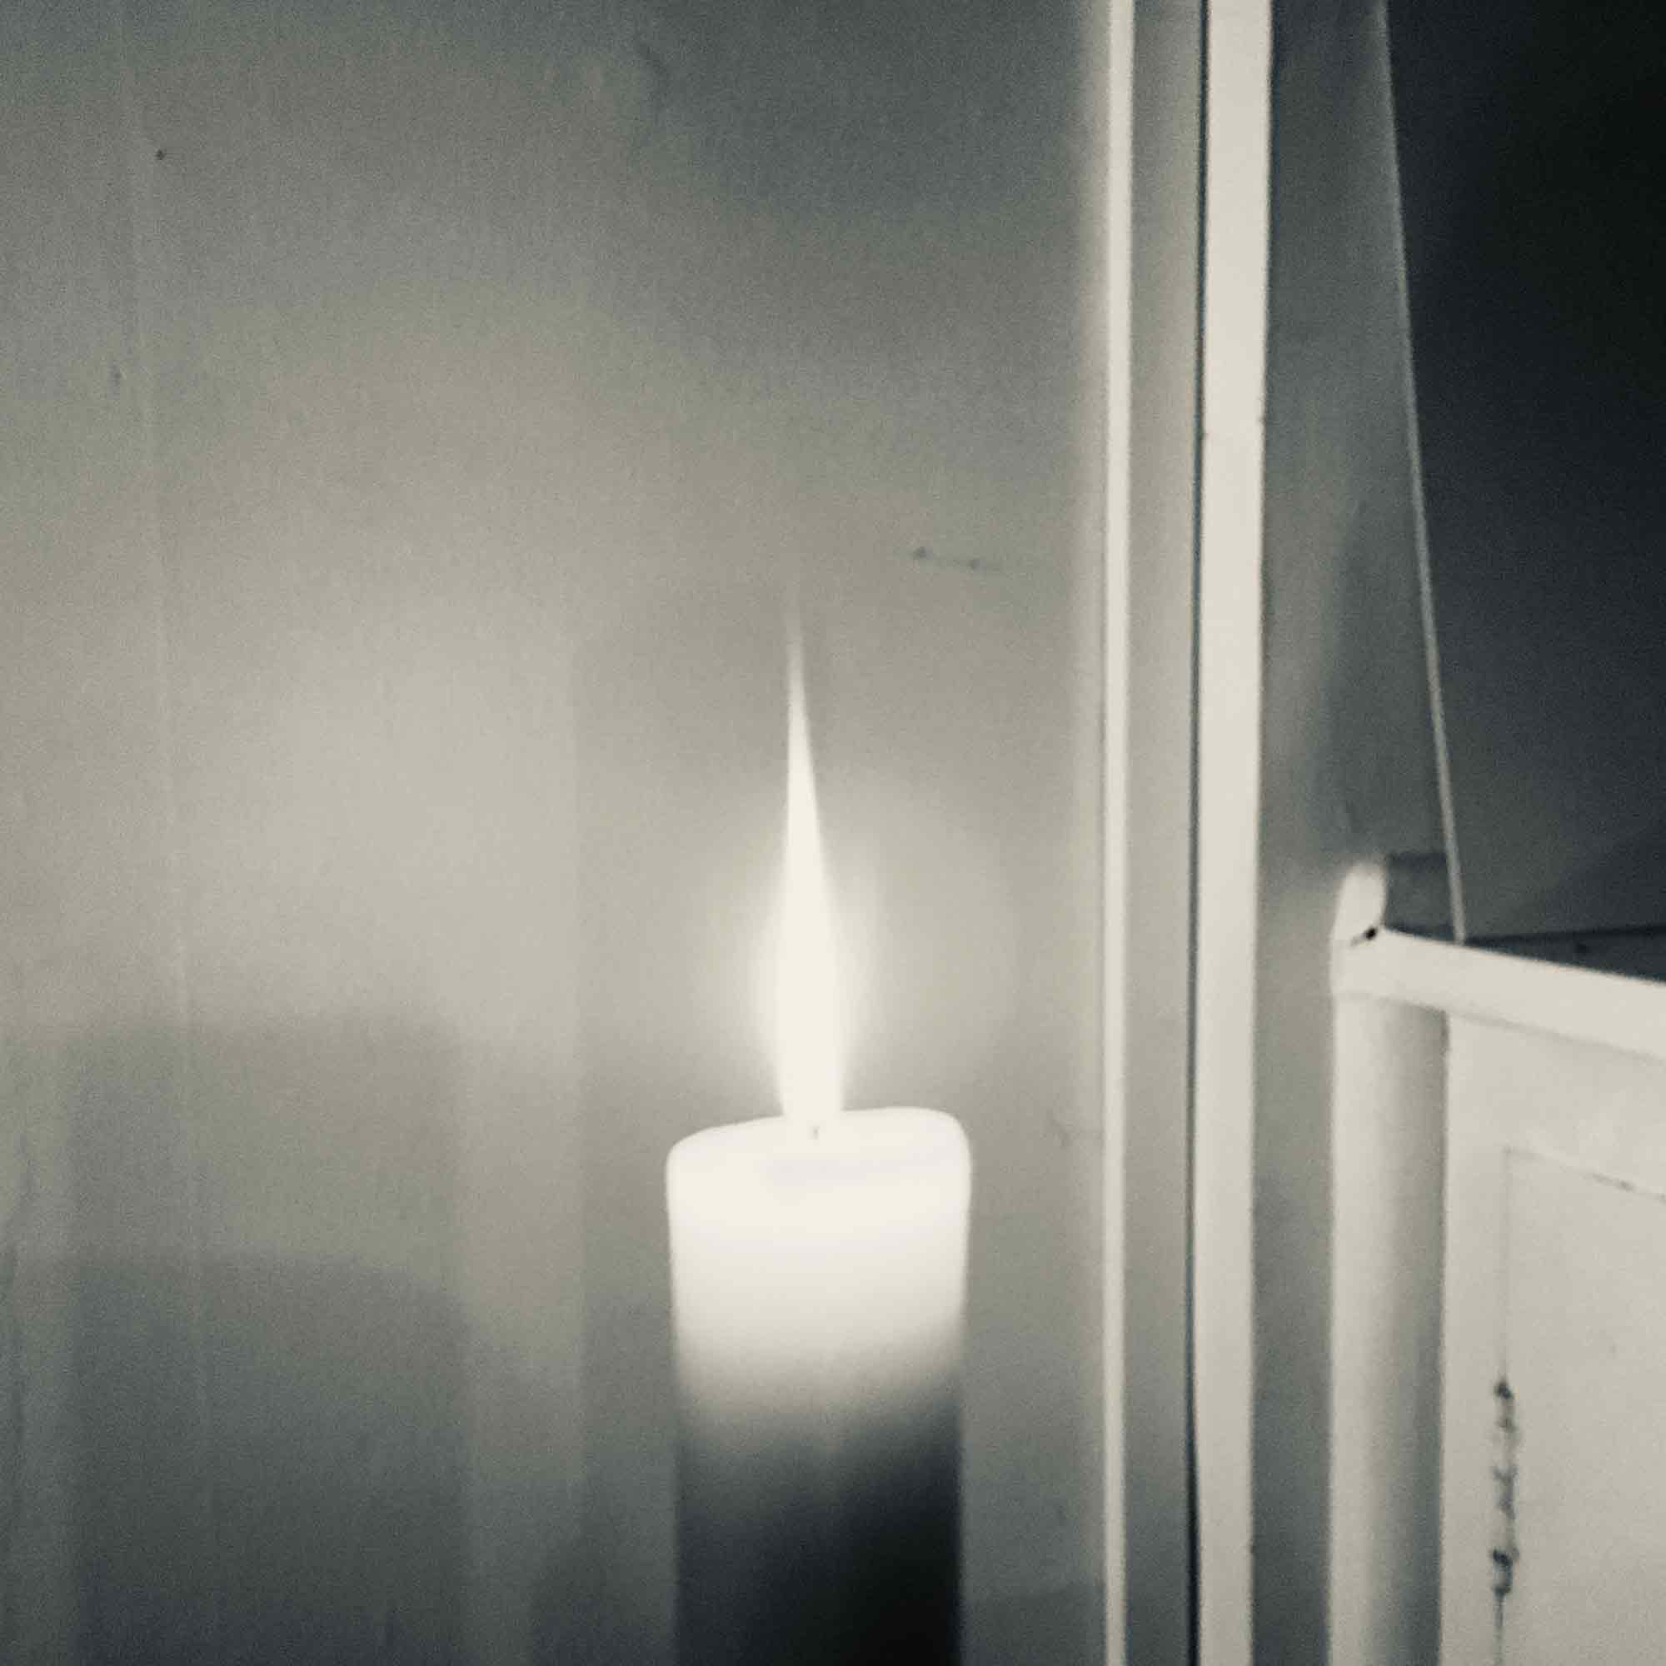
Candle
Chatbot
Theming
Candle
Definition
Collect ideas together and theme them
Candle
Solving a problem around a restaurant.
Human Centred Design (focused on the customer).
How might we enhance the restaurant experience using a chatbot ______ so that our customers
Hygiene – dirty cups, under cooked food also bathrooms
Tables – where to sit and pre-ordering. Ordering food.
Problem stage: Not the solution stage
Problem statement forming.
Candle
Candle
Candle
1 Problem

Slide 4
Candle
Theming
Theming
Candle
Collect ideas together and theme them
Problem Statement Themes
Candle
Hygiene – dirty cups, under cooked food also bathrooms
Tables – where to sit and pre-ordering. Ordering food.
Problem stage: Not the solution stage
Problem statement forming.
Communication
---
Ordering
Candle
How might we enhance the restaurant experience so that our customers :
Can easily alert staff of orders or concerns.
Are catered to their food preferences with accuracy and efficiency.
Candle
Candle
1 Problem

Slide 5
Candle
Theming
Crazy 8
Candle
Problem Statement
Can be ridiculous
--> 8 ideas 3 minutes
--> Individual
--> No talking.
--> Time-boxed.
--> Must log the ideas
Sketch ideas, make notes, no limits.
Playback with your best ideas. (10 mins)
Share 3 favourite ideas.
Candle
How might we enhance the restaurant experience using a chatbot so that our customers can communicate with staff about their concerns and preferences with accuracy and efficiency
Candle
Candle
Candle
Just start with customers

Slide 6
Candle
Iteration 1
Candle
Paper plane activity:
Paper plane activity:
Standup: 5 minutes
Iteration: 60 minutes
Demo: 10 minutes
Retrospective: 15 minutes
6 minutes:
Can design build test in any order, at any time.
(working on an approved design)
6 minutes
Figure out how to maximize production of the best plane
Count up (by testing) each team’s total number of approved products.
Candle
Standup: 5 minutes
Iteration: 60 minutes
Demo: 10 minutes
Retrospective: 15 minutes
Candle
Each Team:
2 Developers
2 Designers
1 Business Analyst
6 minutes: 1.5 minutes designing , 3 minutes building, 1.5 minutes testing
Estimate and tell customer how many they can build (can be multiples of same design )
Candle
Maximum of two folds before passing to next team member
Can only work on planes in your inbox if there are none in your outbox.
Candle
No one should ever have nothing to do: Productivity -> Performance
Plane must clear distance line
Plane must be “liked” by customer

Slide 7
Candle
Dialogflow
Candle
Intents
Planning – 30%
Planning lets you work much faster.
Candle
Candle
Candle
Candle

