Slide 1
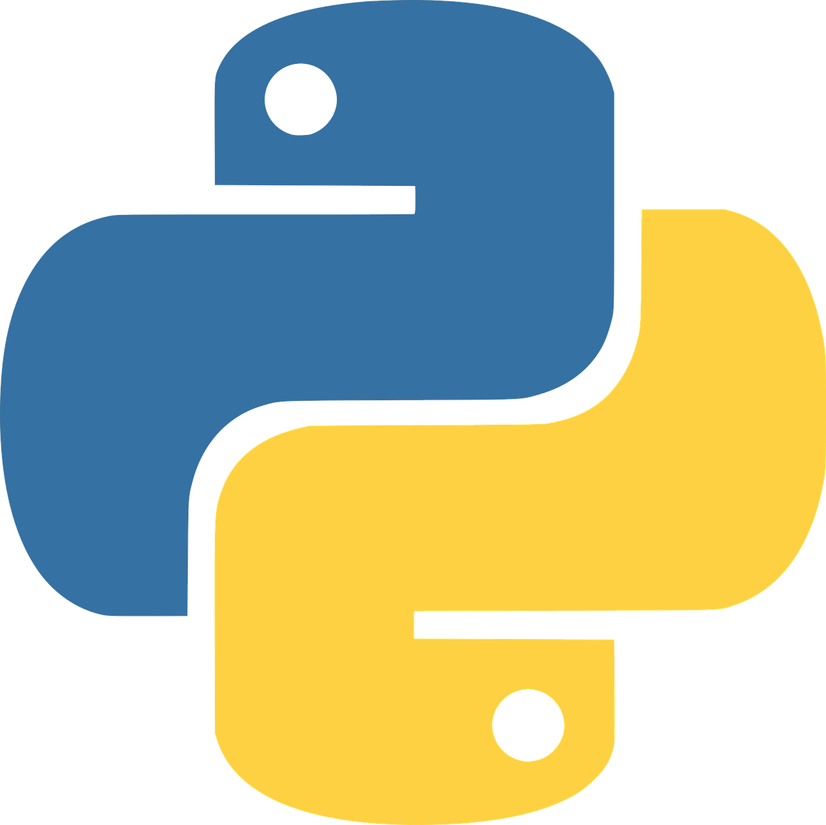
Introduction to Python
Module 3- Advanced Topics
Instructors: Anwar-Ul-Azim Bhuiya & Pias Paul
Introduction to Python

Slide 2
Objectives
Function
Scripting
Class and Object
Iterators
Generators
Assignment
Introduction to Python

Slide 3
Function
What is Function?
A function is a block of organized, reusable code that is used to perform a single related action which provides better modularity for an application.
Why do we need Functions?
They allow us to conceive of a program as a bunch of sub-steps.
They allow us to reuse code instead of rewriting it.
Functions allow us to keep our variable namespace clean.
Introduction to Python
Notes:
Subroutine, procedure, y=f(x)

Slide 4
Function
Function Properties
Function Name
Parameter(s)
Function Body
Return Type
Defining a function
def function_name( parameter ):
body of the function
return [expression]
Introduction to Python

Slide 5
Function
Default Arguments
Global / Local Variables
A block of code that has a name, but doesn't run until we tell it to. | Function
A statement that makes a function run. | Function Call
A value that we can pass to a function when we call that function. | Argument
A function associated with an object. | Method
Introduction to Python

Slide 6
Function
Variable Scope:
If a variable is created inside a function, it can only be used within that function and known to be has local scope.
Variables defined outside functions is said to have a global scope.
Lambda Expressions
Lambda expressions are used to create anonymous functions that is, functions that don’t have a name.
Map():It is a higher-order built-in function that takes a function and iterable as inputs, and returns an iterator that applies the function to each element of the iterable.
Filter(): It is a higher-order built-in function that takes a function and iterable as inputs and returns an iterator with the elements from the iterable for which the function returns True.
Introduction to Python
Notes:
lambda expressions aren’t ideal for complex functions, but can be very useful for short, simple functions.

Slide 7
Scripting
Error & Exception
Syntax Errors – When Python can’t interpret.
Exception – When unexcepted things happen during execution of a program.
Error Handling
Try Statement
Except
Else
finally
Introduction to Python
Notes:
Nameerror, valueerror

Slide 8
Class
What is a class?
A class is a code template for creating objects. Objects have member variables and have behavior associated with them. In python a class is created by the keyword class.
Attributes and Methods in class:
>>> class Snake:
... name = "python" # set an attribute `name` of the class
...
Introduction to Python
Notes:
https://www.tutorialsteacher.com/python/private-and-protected-access-modifiers-in-python
https://www.hackerearth.com/practice/python/object-oriented-programming/classes-and-objects-i/tutorial/

Slide 9
Iterators
Iterators : Iterables are objects that can return one of their elements at a time, such as a list. Many of the built-in functions we’ve used so far, like 'enumerate,' return an iterator.
An iterator is an object that represents a stream of data. This is different from a list, which is also an iterable, but is not an iterator because it is not a stream of data.
Introduction to Python

Slide 10
Generators
Generator: Generators are a simple way to create iterators using functions. You can also define iterators using classes, which you can read more about here.
def my_range(x):
i = 0
while i < x:
yield i
i += 1
Yield allows the function to return values one at a time, and start where it left off each time it’s called. This yield keyword is what differentiate a generator from a typical function.
Introduction to Python
Notes:
sum returns the sum of the elements in a list, and pop is a list method that removes the last element from a list and returns it.

Slide 11
Assignment
Introduction to Python

