Slide 1
Using trena & friends to explore regulation in erythropoiesis
Master regulators: GATA1, GATA2, KLF1, TAL1

Slide 2
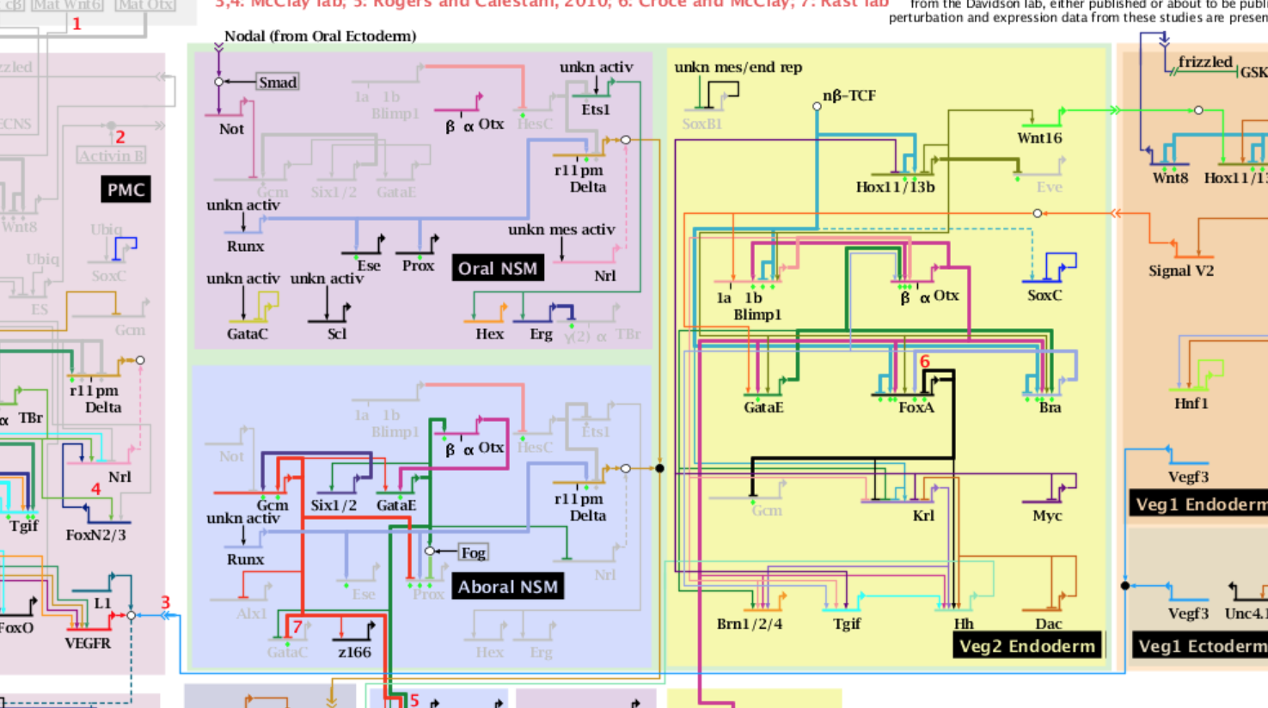
Sea Urchin Endomesoderm Specification
21 to 30 hours:
Davidson & Longabaugh et al

Slide 3
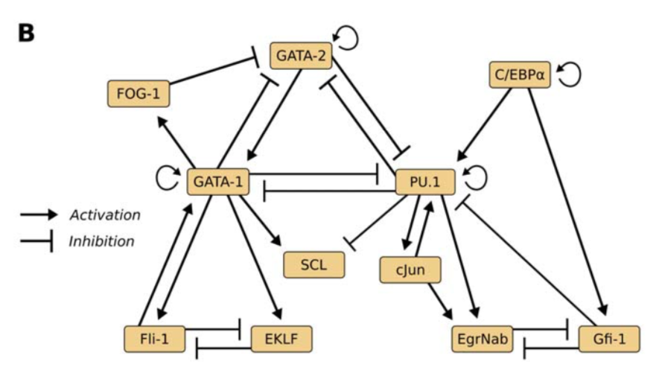
Hierarchical differentiation of myeloid progenitors is encoded in the
transcription factor network. Krumsiek et al, PLoS ONE. 2011

Slide 4
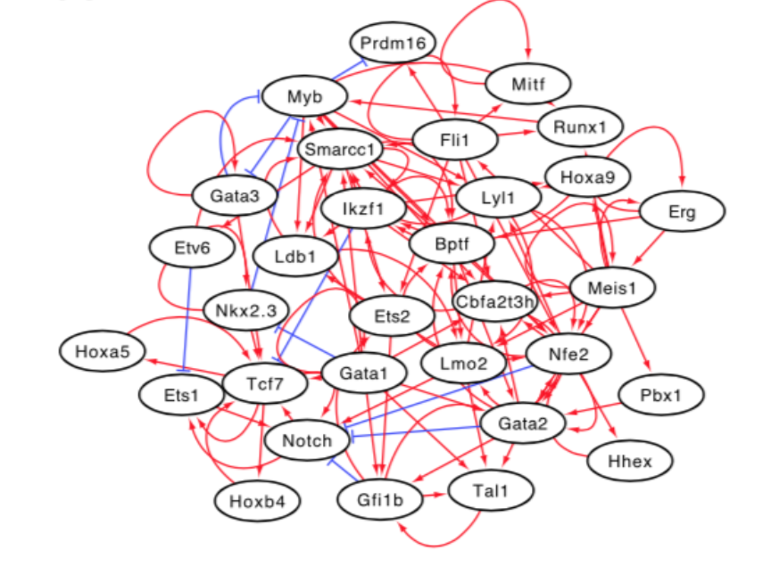
Reconstructing blood stem cell regulatory network models from single-cell molecular profile
Hamey et al, PNAS 2017

Slide 5
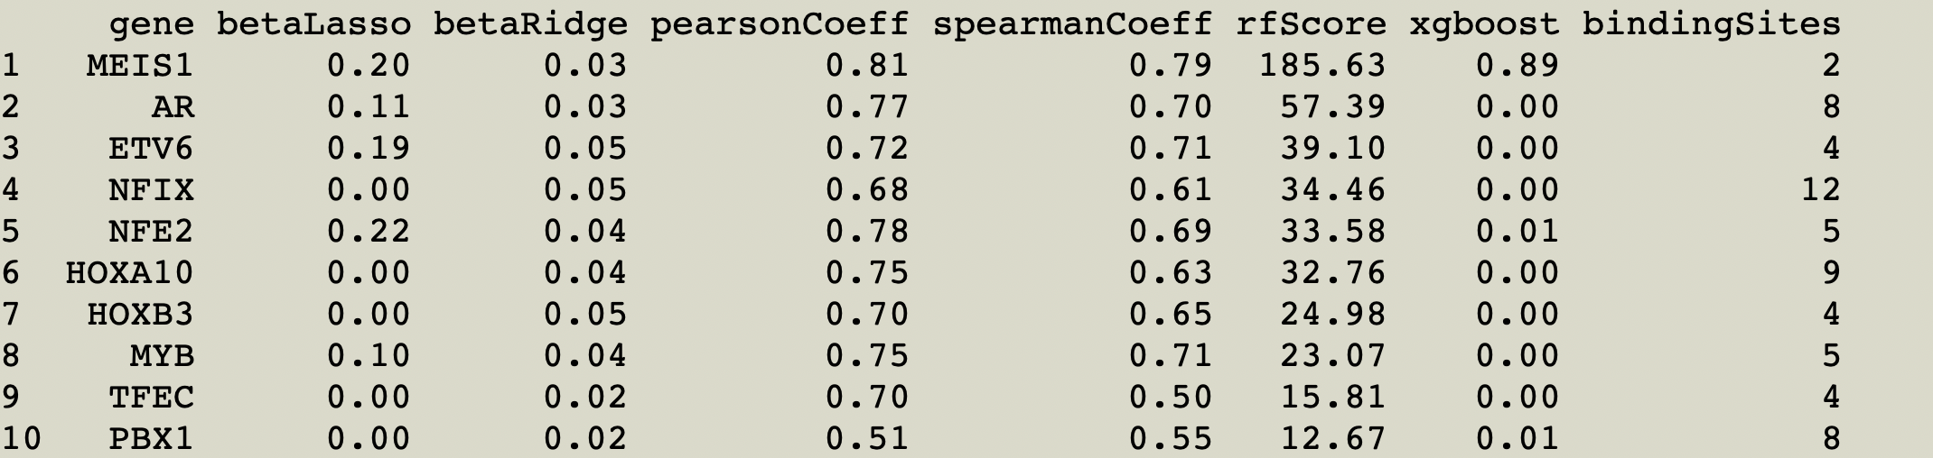
Corces, M. Ryan, et al. "Lineage-specific and single-cell chromatin accessibility charts human hematopoiesis and leukemia evolution." Nature genetics 48.10 (2016): 1193.
FIMO 1e-4 phast7 conservation 50%
Zeddies, Sabrina, et al. "MEIS1 regulates early erythroid and megakaryocytic cell fate." Haematologica 99.10 (2014): 1555-1564.

Slide 6
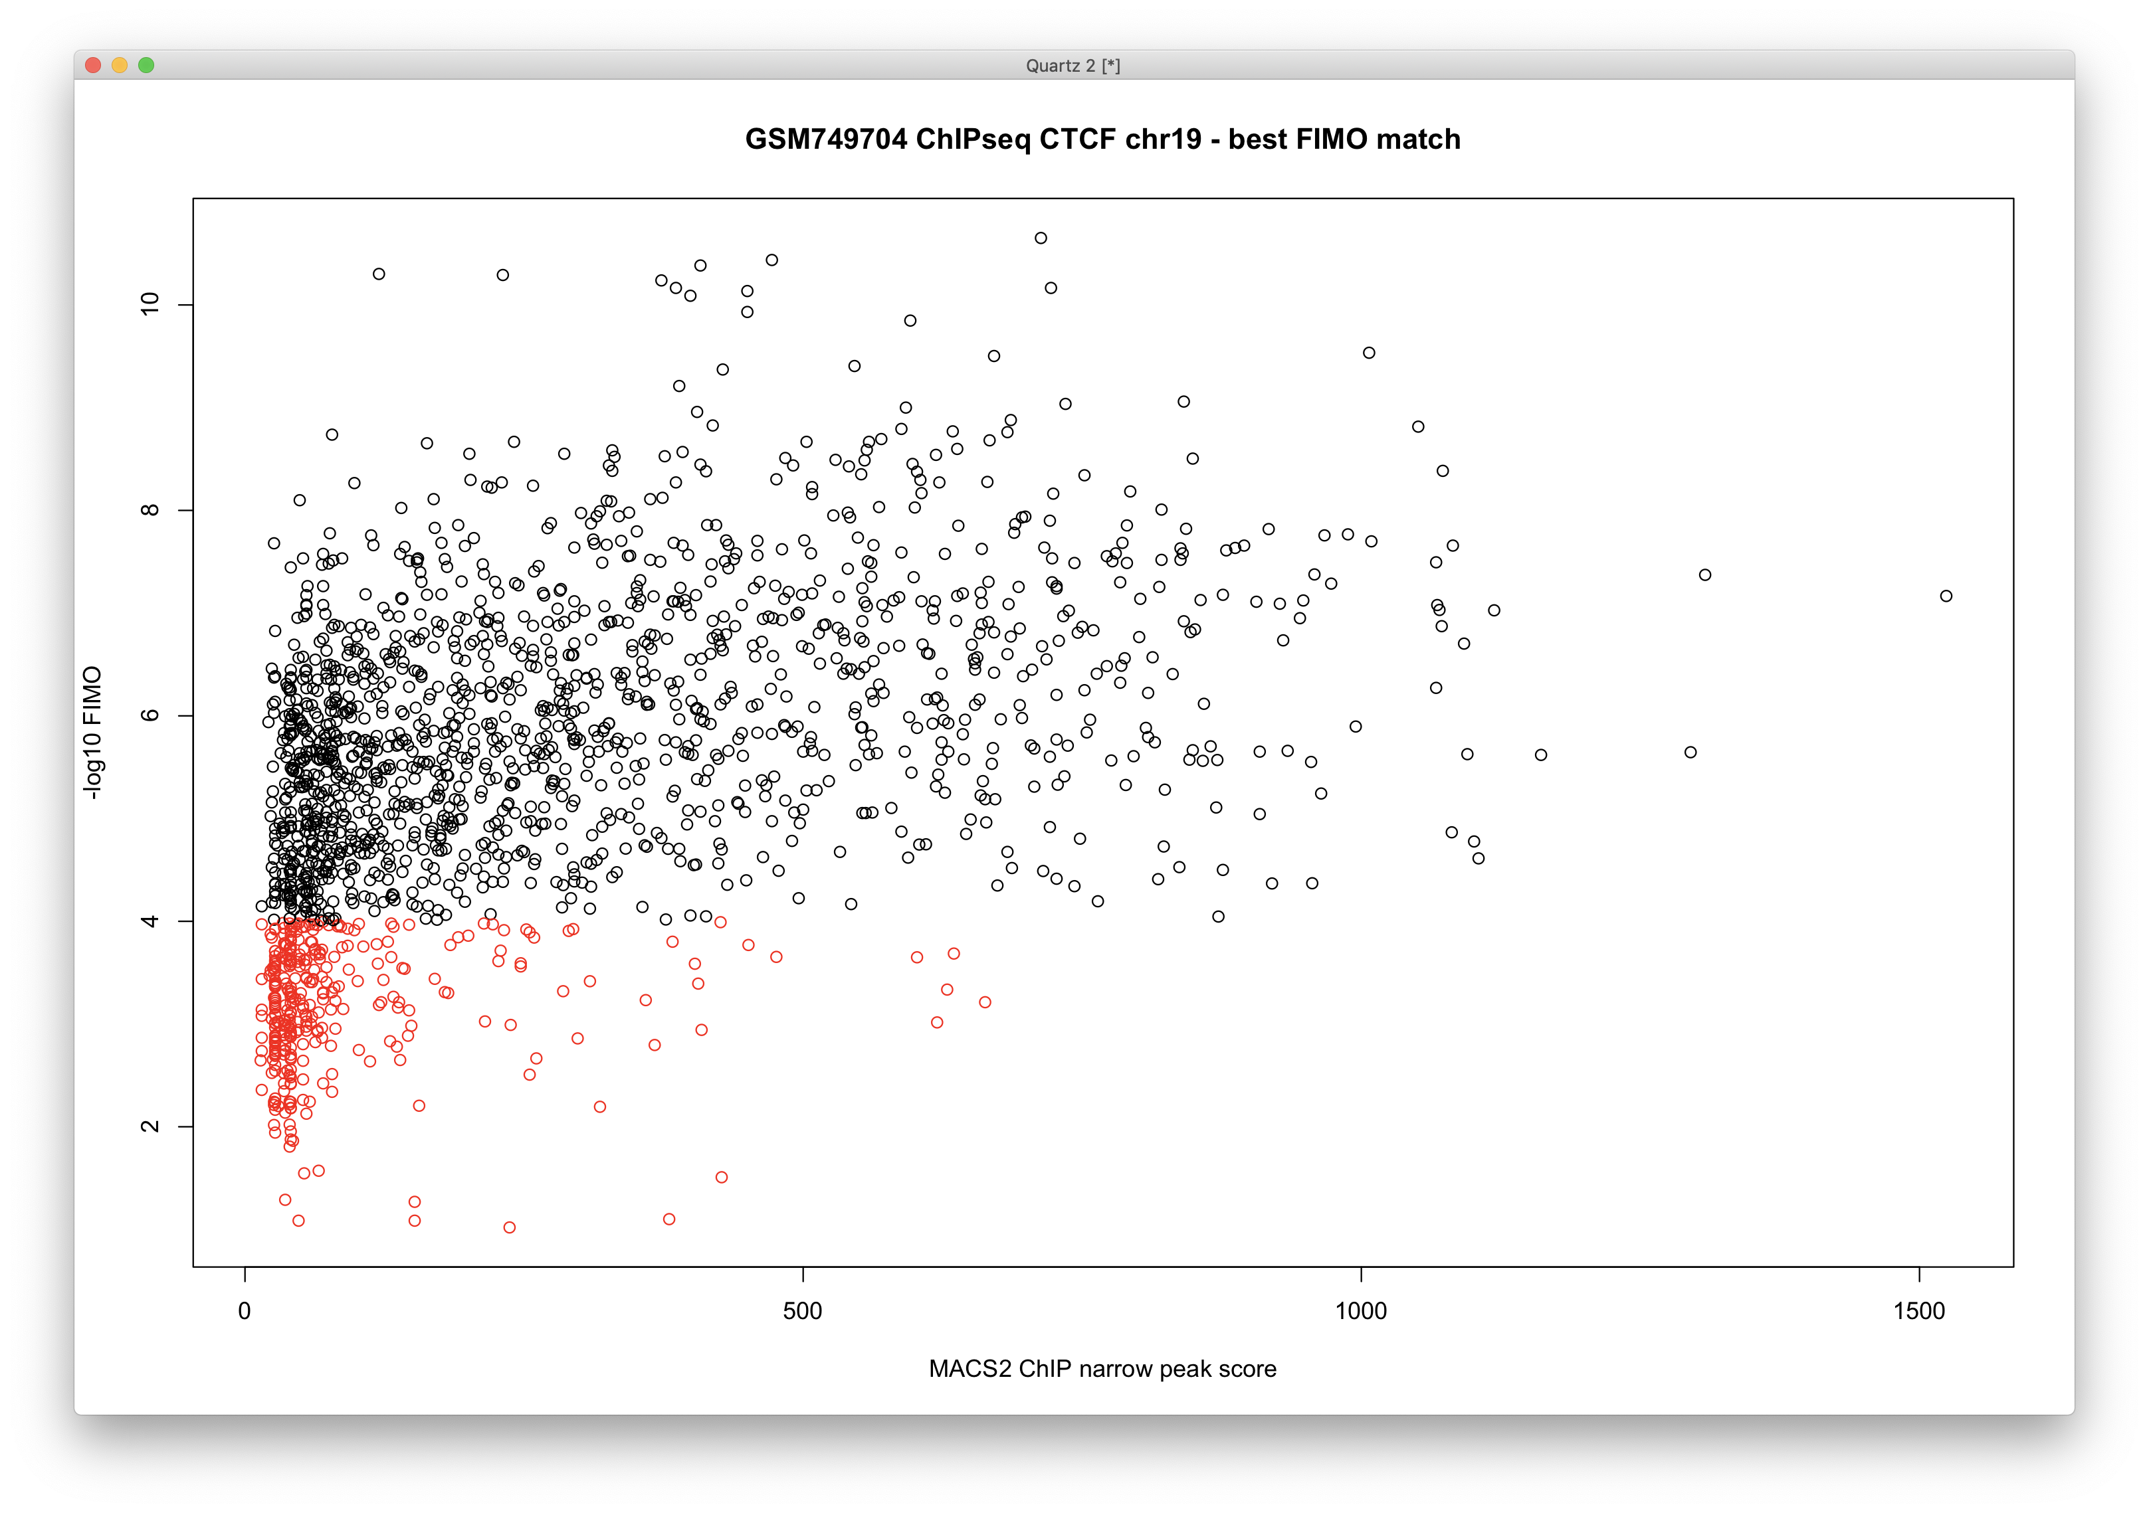

Slide 7
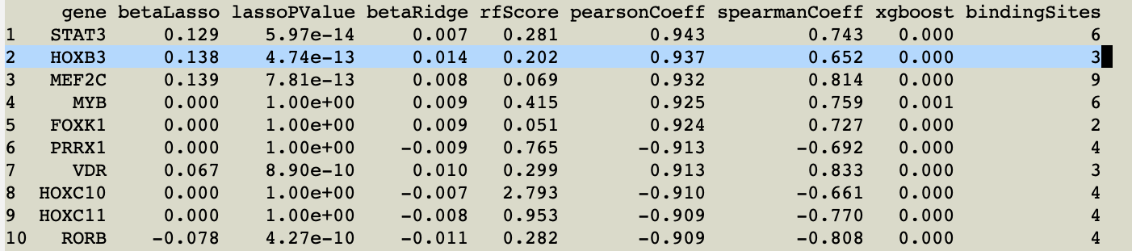
Trena model of GATA2 in Eryrthropoiesis Time Course
(Brand & Ranish)
FIMO 1e-4 phast7 conservation 90%

Slide 8
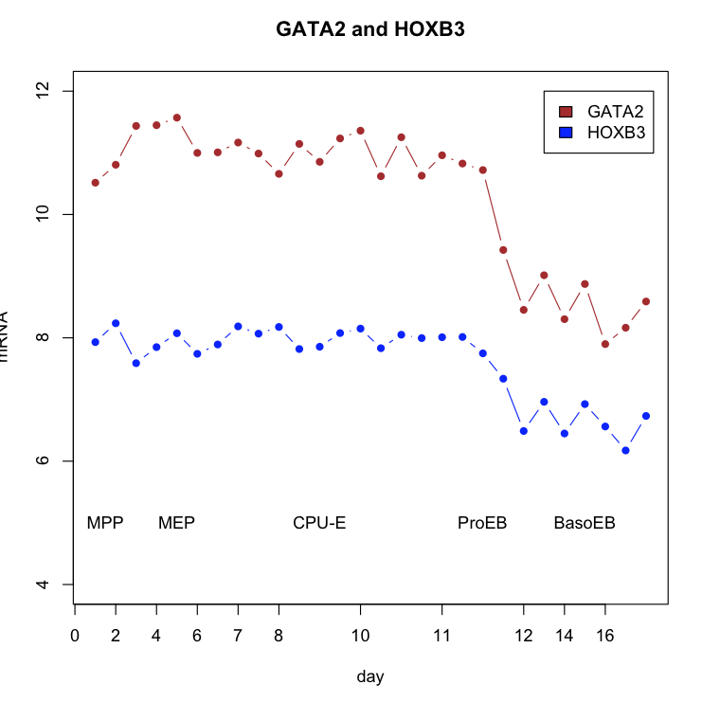

Slide 9
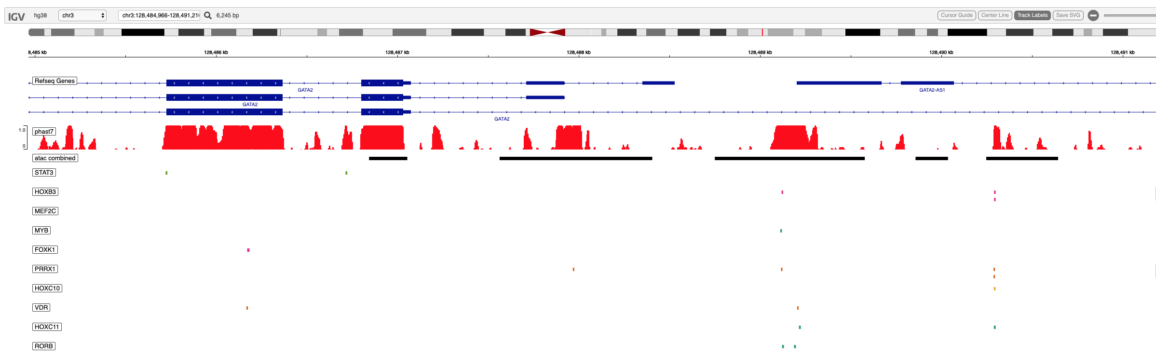
~Promoter Region of GATA2

Slide 10
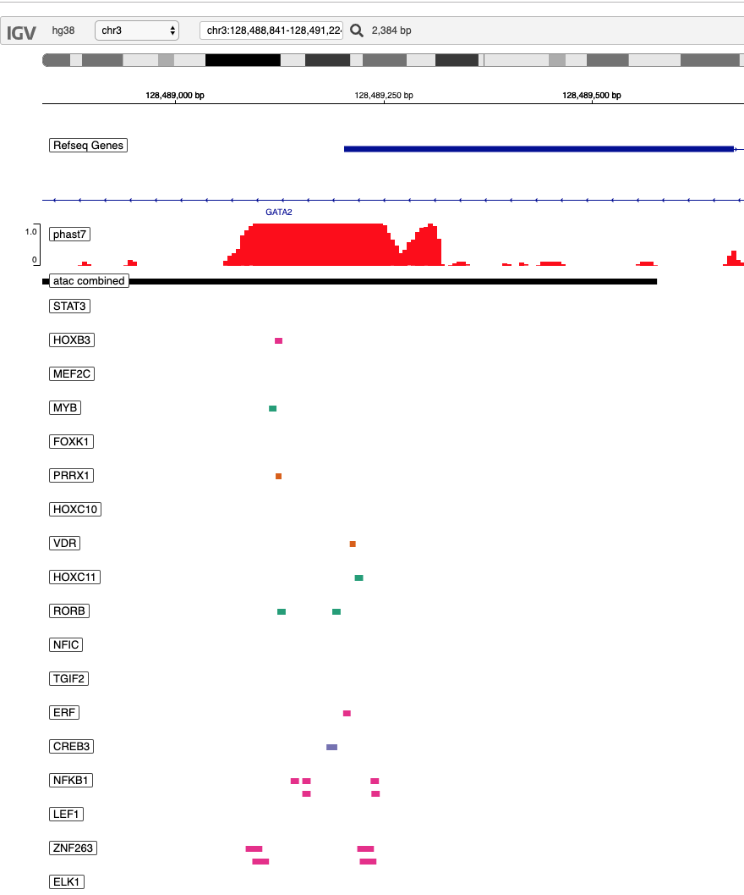

Slide 11
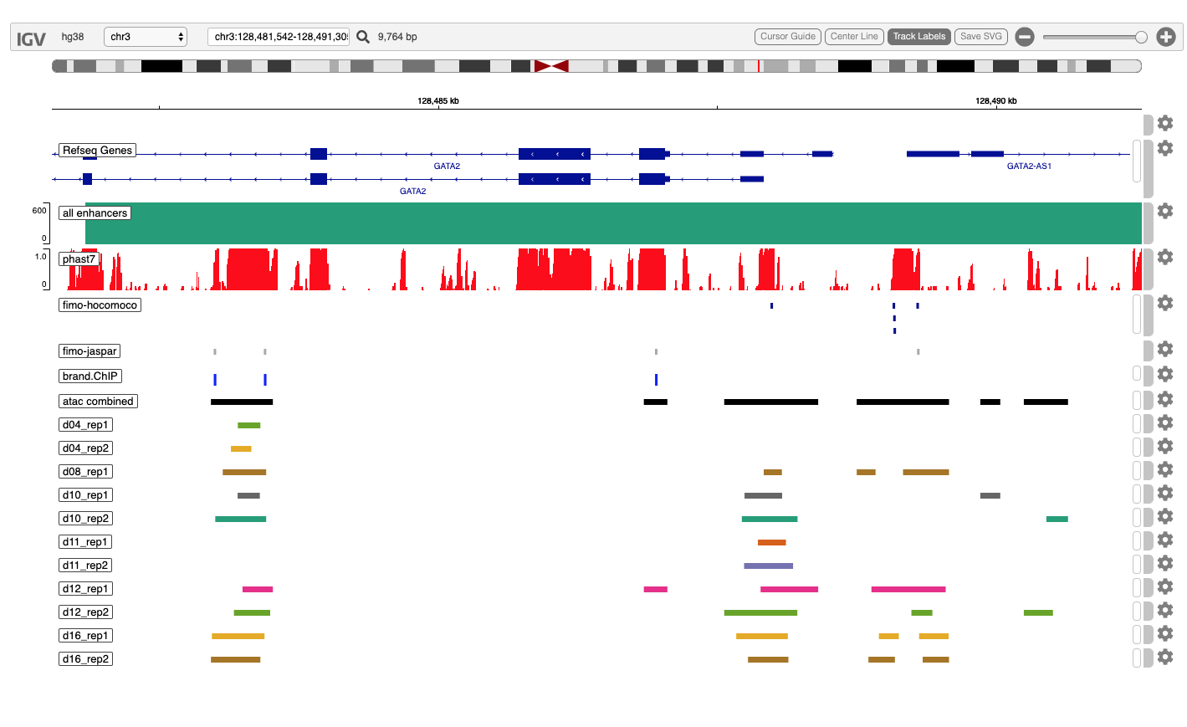
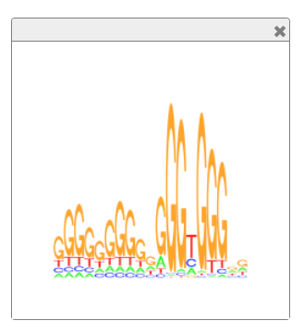
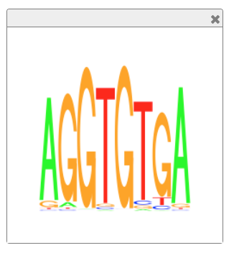
TBX15 TFBS: GeneHancer, phast7, ATAC-seq

Slide 12
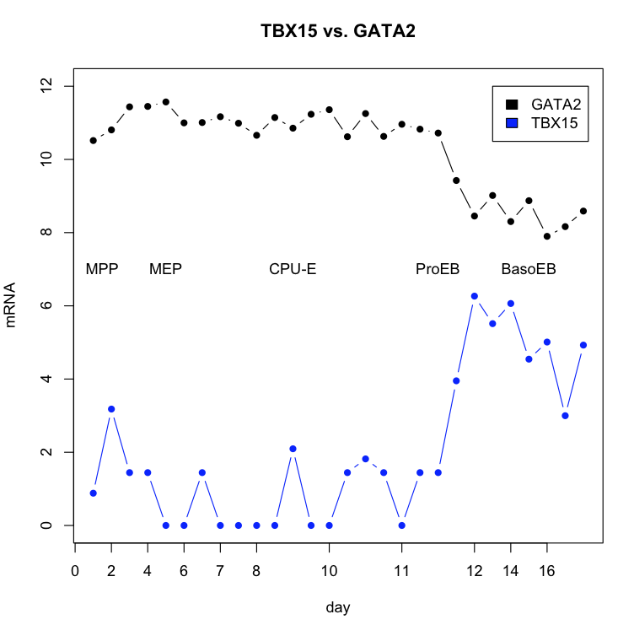
MPP: multipotent progenitor
MEP: megakaryocyte-erythroid progenitor
CPU-E: colony forming unit-erythroid
ProEB: proerythroblast
BasoEB: basophilic erythroblast

Slide 13
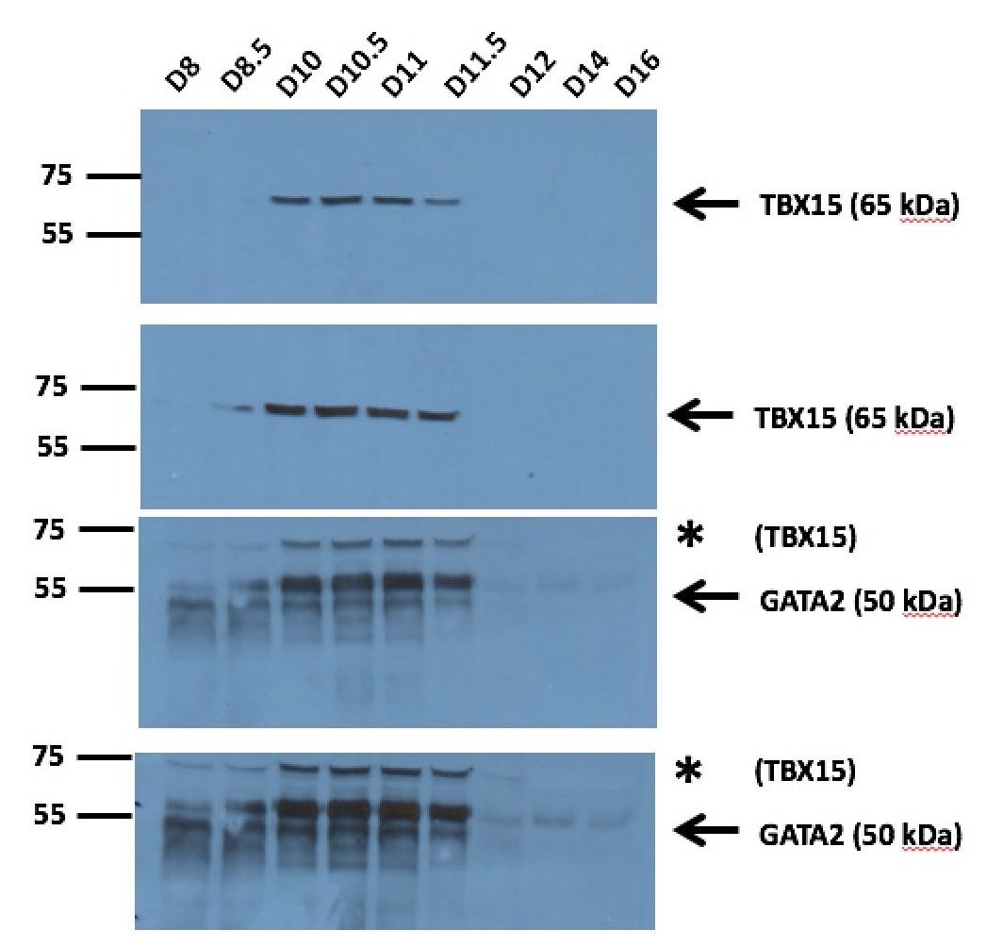

Slide 14
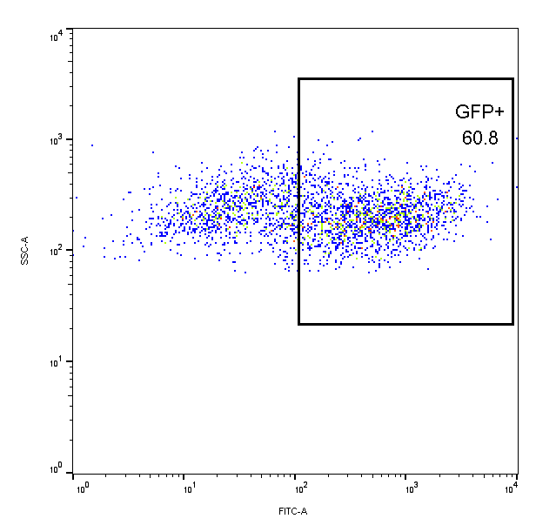
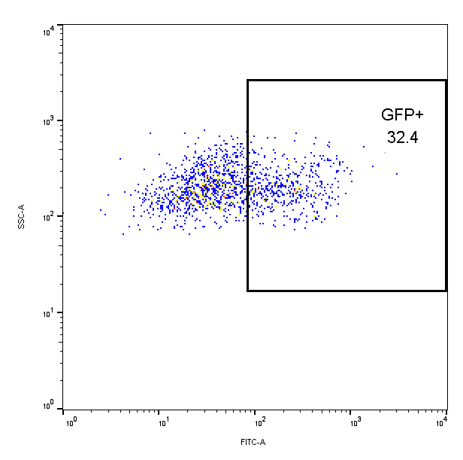
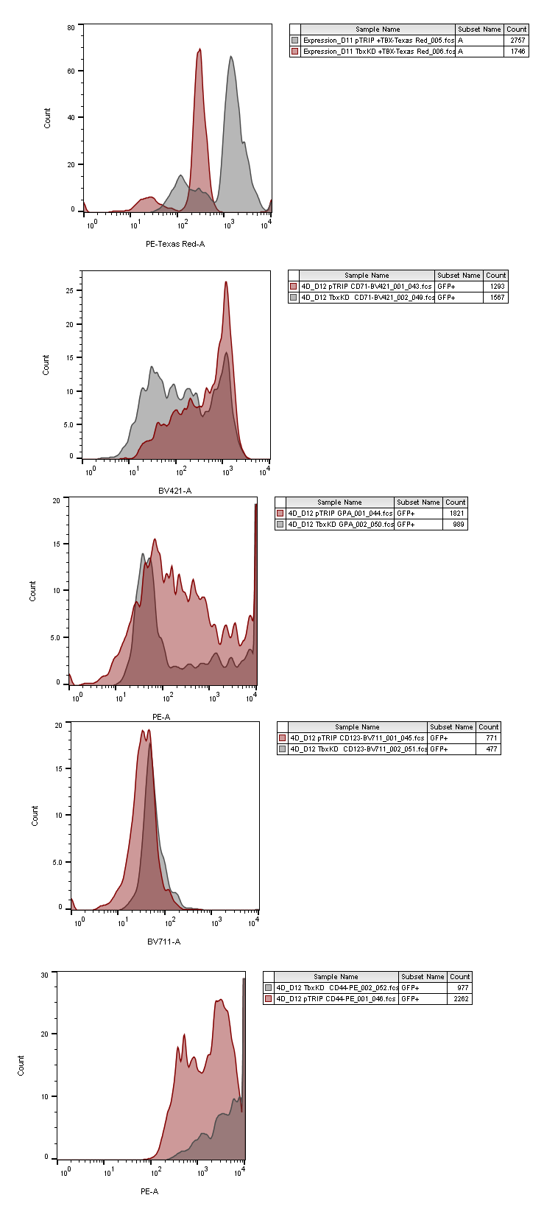
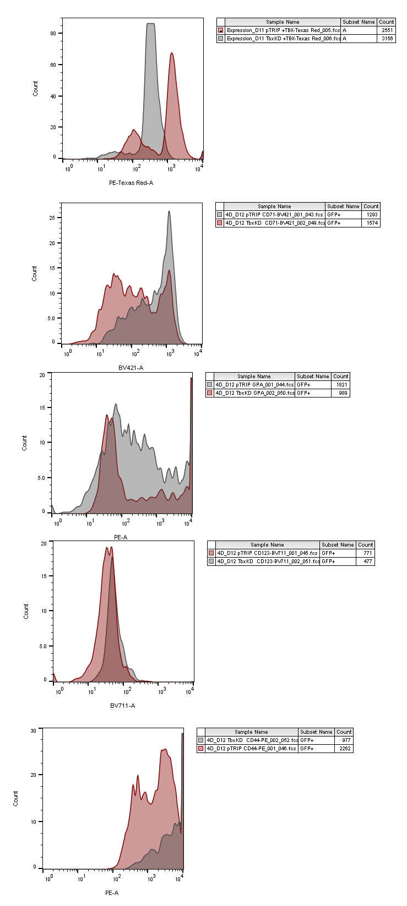
A
B
Lentivirus infection
(GFP and shTBX15)
Control
(GFP only)
Knockdown
(GFP and shTBX15)
10⁴
10⁴
Days
10³
10³
0
8
9
11
12
20
SSC-A
10²
10²
proEB
EB
10¹
10¹
GFP⁺ selection
& analysis
10⁰
10⁰
10⁰
10¹
10²
10³
10⁴
10⁰
10¹
10²
10³
GFP
GFP
10⁴
C
D
TBX15
CD71
GPA
80
Control
80
80
Ctrl
60
shTBX15
60
60
shTBX15
40
Count
40
40
20
Count
Count
10
20
20
0
10
10
10⁰
0
0
10¹
10²
10³
10⁴
10⁰
10¹
10²
10³
10⁰
10⁴
10¹
10²
10³
10⁴
MFI
MFI
MFI
The transcription factor TBX15 is an important regulator of the pro-erythroblast (proEB) to erythroblast (EB) transition.
A. ProEB were infected with lentiviruses expressing GFP and a TBX15-specific shRNA or only GFP (as a control). B. Cells at Day12 were harvested and gated by FACS to separate infected (GFP-positive) and non-infected (GFP-negative) cells
C. GFP-positive cells display a strong knockdown of TBX15.
D. Erythroid cells with reduced levels of TBX15 do not upregulate erythroid-specific cell surface markers CD71 and GPA, suggesting a block at the proEB stage.
MFI, mean fluorescence intensity.

Slide 15
TBX15 ChIP – Day11 Ery cells
1st Nov 2019
Site 1
Site 2
Site 3
Site 4
IP/Input
4 regions de putative binding for TBX15 close to the GATA2 gene, Hsapiens-jaspar2018-TBX15-MA0803.1 chr3 +
1: chr3:128,483,003-128,483,009 6.642737 0.8767398 AGGGGTGA
2: chr3:128,483,452-128,483,457 6.658030 0.8787582 CGGTGTGA
3: chr3:128,486,956-128,486,962 6.658030 0.8787582 CGGTGTGA
4: chr3:128,497,528-128,497,534

