Slide 1
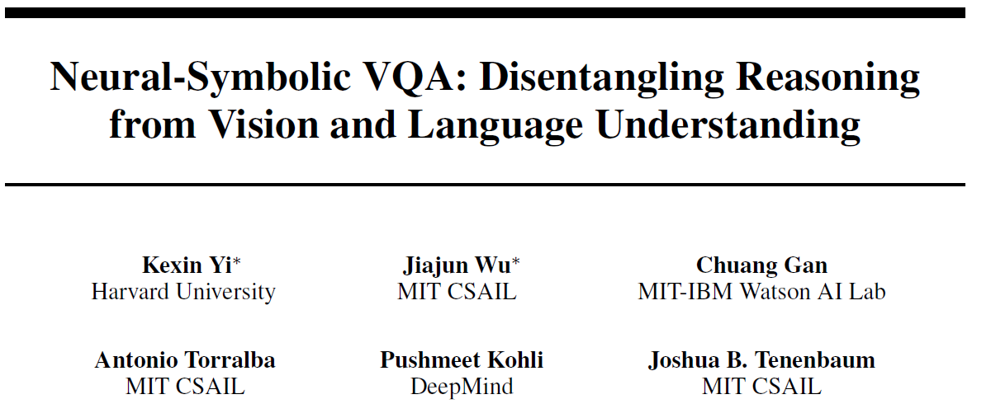

32nd Conference on Neural Information Processing Systems (NeurIPS 2018), Montréal, Canada.
Lu Zhen 1st year PhD student City University of Macau

Slide 2
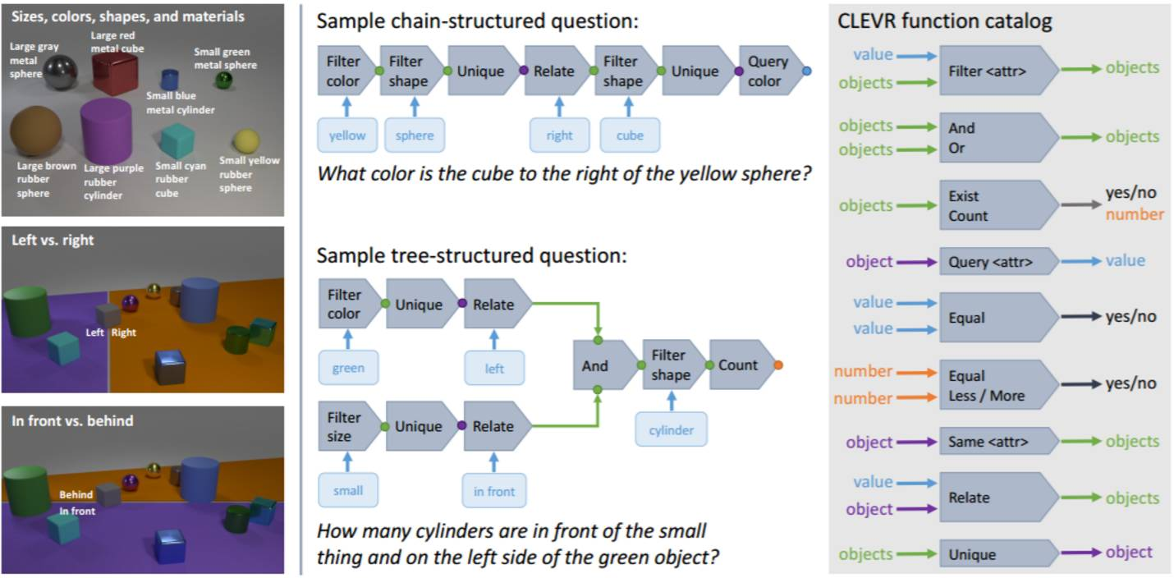
dataset——CLEVR

Slide 3
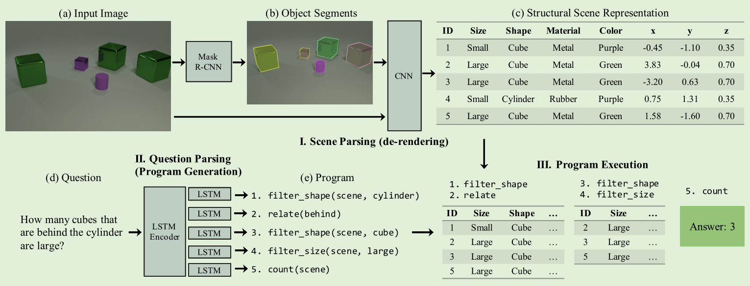
2018
Neural symbolic vqa disentangling reasoning from vision and language understanding
ResNet-34
NS-VQA
bidirectional LSTM

Slide 4

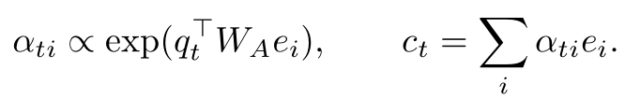

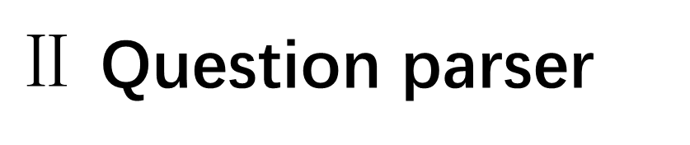
$Ⅱ$ Question parser
The encoder is a bidirectional LSTM that takes as input a question of variable lengths and outputs an encoded vector $e_{i}$at time step $i$ as
Decoder
Attention layer
a fully connected layer

Slide 5
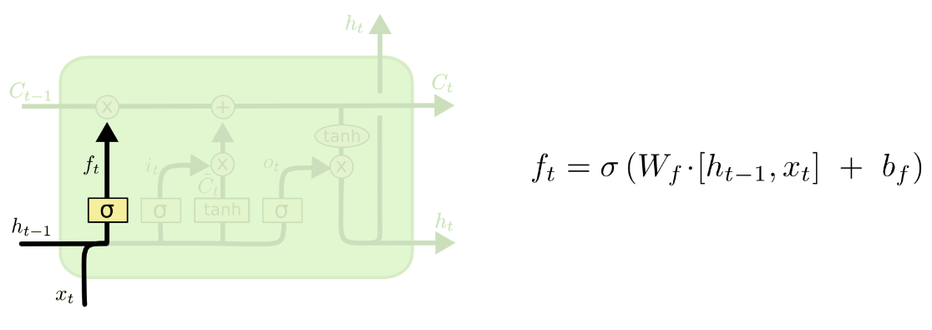
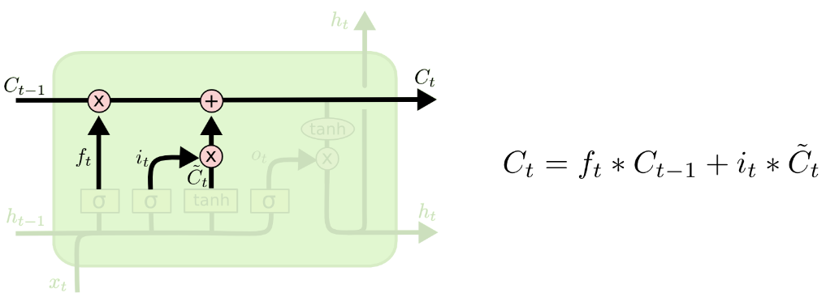
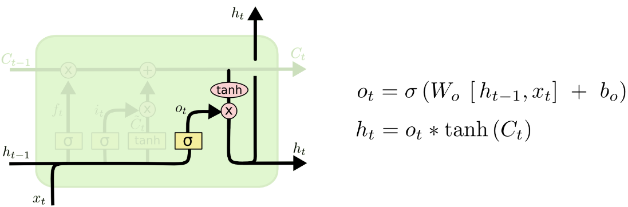
LSTM

Slide 6
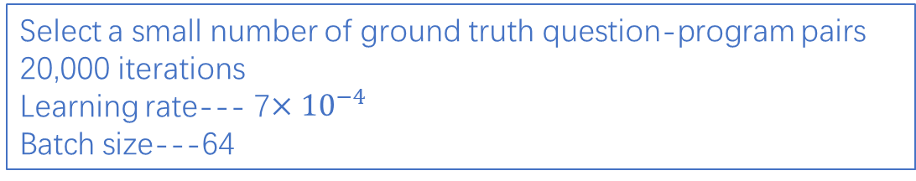

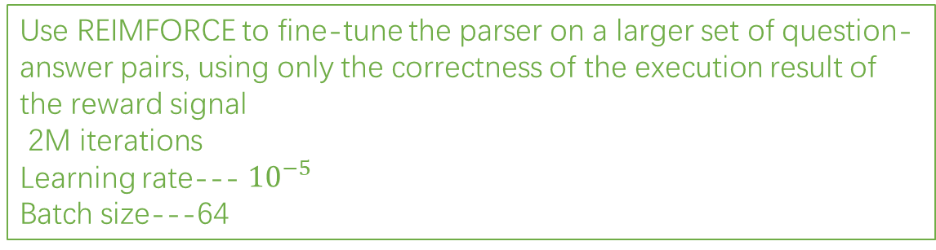
T$raining paradigm$
object proposal network
Mask R-CNN(use ResNet-50 FPN as the backbone)
30000 interations with eight images per batch
Scene parsing
feature extraction network
Loss function---the mean square error
Learning rate--- 0.002
Batch size---50
Select a small number of ground truth question-program pairs
20,000 iterations
Learning rate--- 7$×{10}^{−4}$
Batch size---64
Supervised pretrainig
Reasoning
Use REIMFORCE to fine-tune the parser on a larger set of question-answer pairs, using only the correctness of the execution result of the reward signal
2M iterations
Learning rate--- ${10}^{−5}$
Batch size---64
Fine-tune the parser

Slide 7
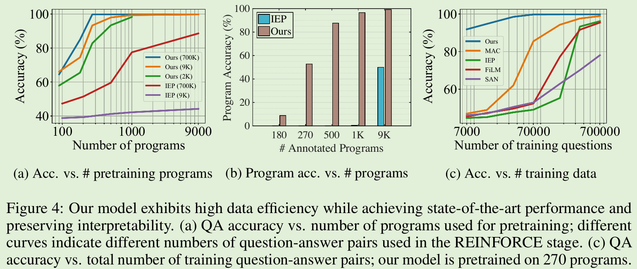
Evaluations

Slide 8
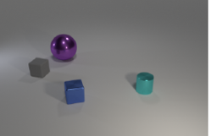
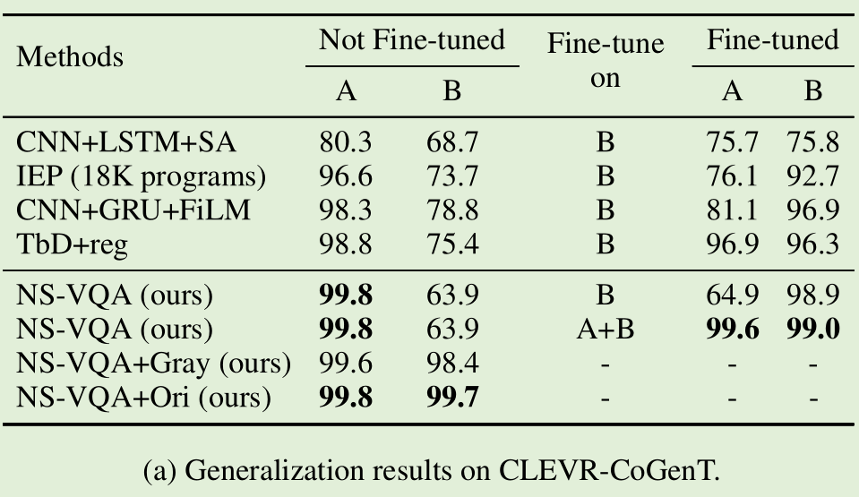
Generalizing to Unseen Attribute Combinations
dataset：CLEVR-CoGenT
split A:
cubes --gray, blue, brown or yellow
cylinders --red, green, purple or cyan;
split B:
the opposite color-shape pairs for cubes and cylinders.

Slide 9
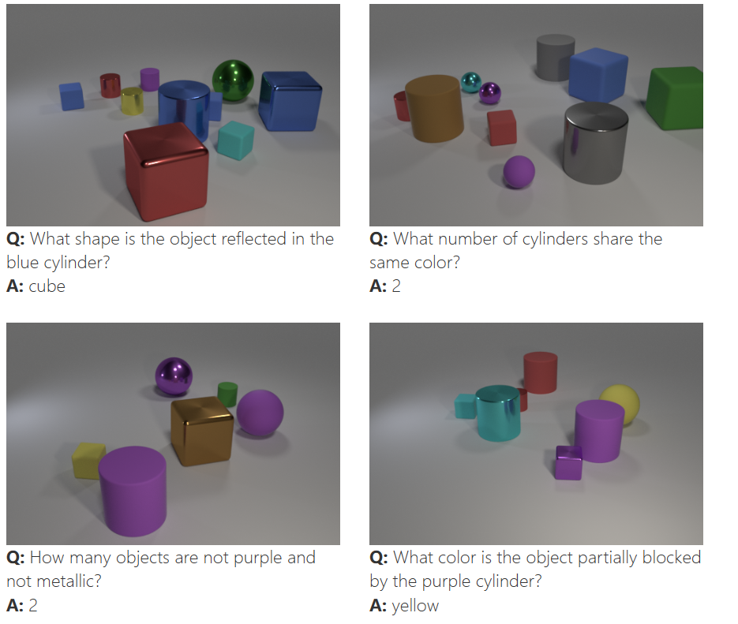
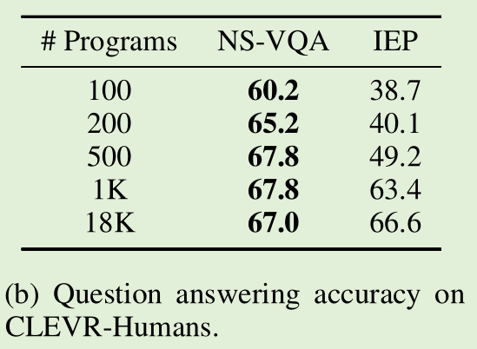
Generalizing to Questions from Humans
dataset： CLEVR-Humans

Slide 10
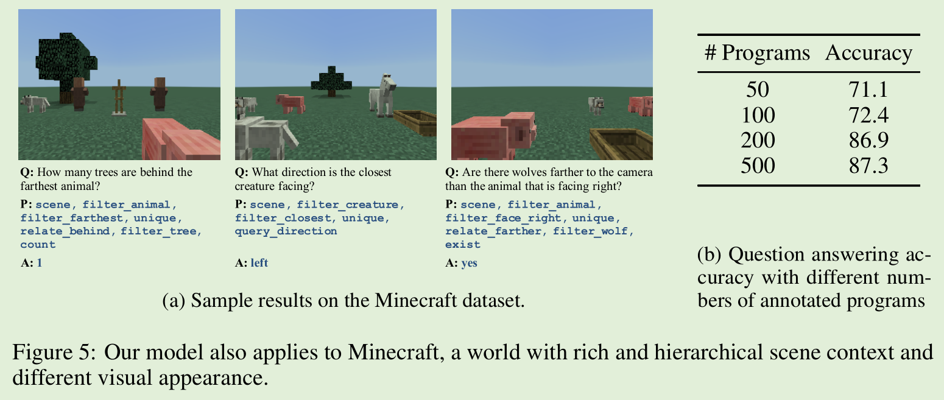
Extending to New Scene Context
dataset： Minecraft world

Slide 11

Discussion
Challenge--generalize to truly novel situations

Slide 12



