Slide 1
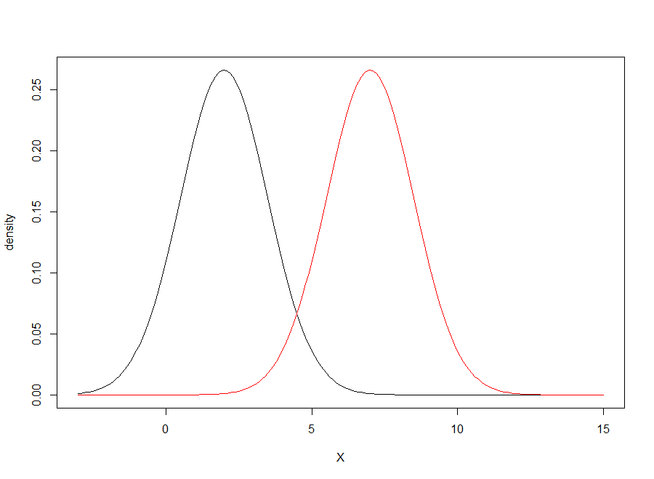


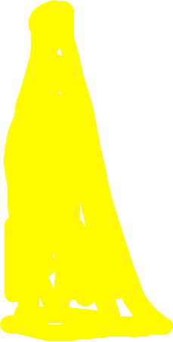
Type II Error
Type I Error
Power
μ₀
α
μ_{TRUE}

Slide 2
High-High TOM
High Density
Low-Low TOM
Low Density
High-Low TOM

