Slide 1
Chapter 2: Intro to Relational Model

Slide 2

Example of a Relation
attributes
(or columns)
tuples
(or rows)

Slide 3
Why it is called Relational DB?
What is a relation?

Slide 4







Example of Relation

Slide 5
Binary relations
Let A, B be any two sets.
A binary relation R from A to B
  Written R: A↔B
  is a subset of A×B.
E.g., let < : N↔N :≡ {(n,m) | n < m}

Slide 6
Relations notations
The notation a R b means (a,b)∈R.
  E.g., a < b means (a,b)∈ <
A binary relation R corresponds to a predicate function
P_{R}: A× B→{T,F} defined over the 2 sets A,B
  e.g.,
  “eats” :≡ {(a,b)| a eats b}
Notes:
predicate 謂語

Slide 7
Question Time
Cartesian product ×
  A1 = {1001, 1002, 1003}
  A2 = {John, Mary}
  A3 = {CS, EE}
What is the result of A1×A2 ?
What is the result of A1×A2 ×A3 ?

Slide 8
Relation Schema and Instance
A₁, A₂, …, A_{n} are attributes
R = (A₁, A₂, …, A_{n} ) is a relation schema
Example: instructor = (ID, name, dept_name, salary)
Given sets D₁, D₂, …. D_{n} a relation r is a subset of
D₁ x D₂ x … x D_{n}
Department
C.S.
Finance
Music
Physics
History
Biology
E.E.

Slide 9
Relation Schema and Instance
The current values (relation instance) of a relation are specified by a table
An element t of r is a tuple, represented by a row in a table.

Slide 10
Attribute Types
The set of allowed values for each attribute is called the domain of the attribute
  E.g. Integer, Char(10)
Attribute values are (normally) required to be atomic; that is, indivisible
  E.g. Department: “Computer Science”
The special value null is a member of every domain

Slide 11

Question Time
Cartesian product ×
What is the result of instructor×department ?

Slide 12

Relations are Unordered
Order of tuples is irrelevant
Example: instructor relation with unordered tuples
Notes:
relation 無順序概念

Slide 13
Instructor relation

Slide 14
Database
A database consists of multiple relations
Information about an enterprise is broken up into parts
instructor
student
advisor
Bad design:
univ (instructor -ID, name, dept_name, salary, student_Id, ..) results in
  repetition of information
  the need for null values
Normalization theory (Chapter 7) deals with how to design “good” relational schemas

Slide 15
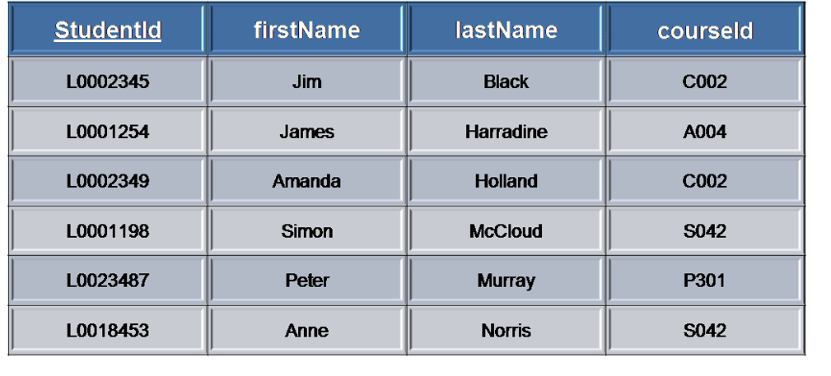
Keys
Let K ⊆ R
K is a superkey of R if values for K are sufficient to identify a unique tuple of each possible relation r(R)
  Example:

Slide 16
Keys
Superkey K is a candidate key if K is minimal
Example: {ID} is a candidate key for Instructor
One of the candidate keys is selected to be the primary key.
Notes:
superkeys
candidate keys:
studentid
firstname+lastname
not candidate keys:
studentid+lastname
在此之minimal是以集合而言
假設無同名同姓

Slide 17
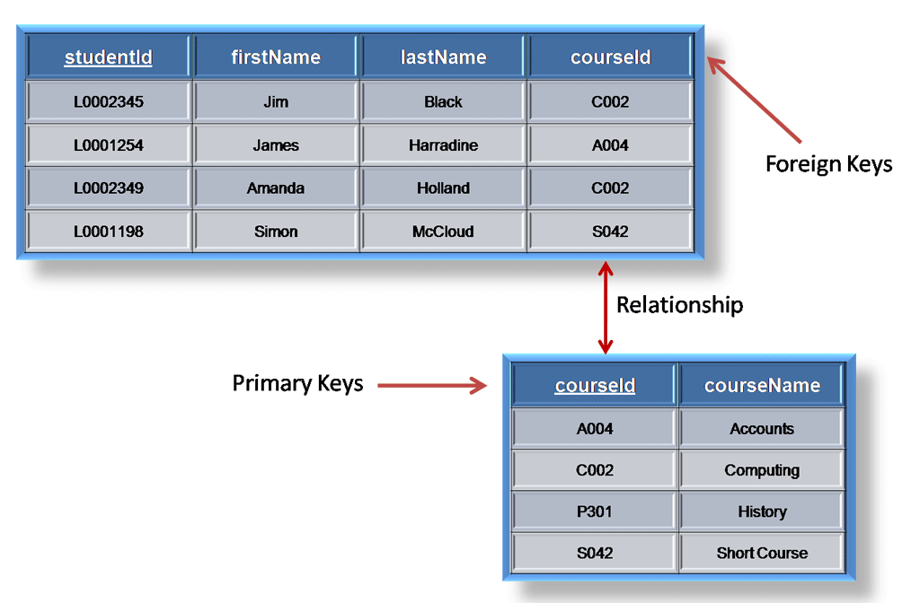
Keys
Foreign key constraint: Value in one relation must appear in another
  Referencing relation
  Referenced relation
Notes:
連接與另外一個表之關係
referenced –要是primary key
referencing-是foreign key

Slide 18

Course relation

Slide 19

Section relation

Slide 20
Instructor relation

Slide 21

Teach relation

Slide 22

Prereq relation

Slide 23

Takes relation

Slide 24
Department relation

Slide 25
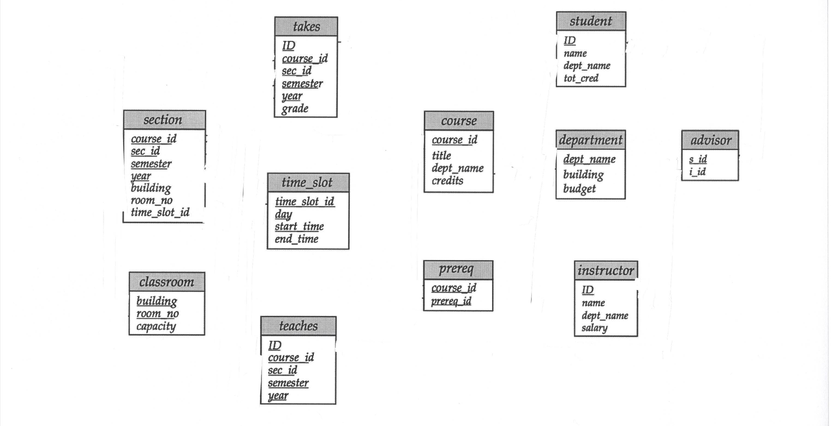
Schema Diagram for University Database
Notes:
section 開課
被指到的需要是他的primary key
time slot 非foreign key
→代表reference

Slide 26
Relational Query Languages
Procedural vs.non-procedural, or declarative
“Pure” languages:
  Relational algebra
  Tuple relational calculus
  Domain relational calculus
Relational operators

Slide 27

Result of Selection
σ _{salary>=85000} (instructor)

Slide 28

Result of Projection
∏_{ID, salary} (instructor)

Slide 29

Result of Natural Join
Instructor department

Slide 30

Result of Selection and Projection
∏_{ID, salary}(σ _{salary>=85000} (instructor))

Slide 31

Example of Relational Algebra Queries
Notes:
predicate-述詞

