Slide 1
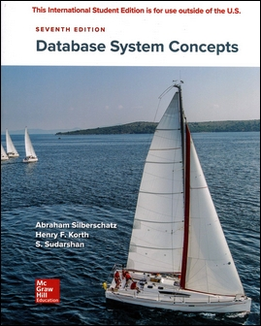
Chapter 3: Introduction to SQL

Slide 2
Chapter 3: Introduction to SQL
Overview of The SQL Query Language
Data Definition
Basic Query Structure
Additional Basic Operations
Set Operations
Null Values
Aggregate Functions
Nested Subqueries
Modification of the Database
Notes:
1

Slide 3
History
IBM Sequel language
  part of System R project at the IBM San Jose Research Laboratory
Renamed Structured Query Language (SQL)
ANSI and ISO standard SQL:
  SQL-86
  SQL-89
  SQL-92
  SQL:1999
  SQL:2003
  SQL:2006
  SQL:2011
  SQL:2016
Notes:
sequel 續編

Slide 4
Data Definition Language
The SQL data-definition language (DDL)
allows the specification of information about relations:
The schema for each relation.
The domain of values associated with each attribute.
Integrity constraints (candidate keys, foreign keys …)
Other information such as
  The set of indices to be maintained
  Security and authorization information
  The physical storage structure of each relation on disk
Notes:
specification詳細說平

Slide 5
Domain Types in SQL
char(n)
varchar(n)
int
smallint
numeric(p,d)
real, double precision
float(n)
More are covered in Chapter 4.

Slide 6
Create Table Construct
Define an SQL relation:
create table r (A₁ D₁, A₂ D₂, ..., A_{n} D_{n},
(integrity-constraint₁),
...,
(integrity-constraint_{k}))
  r : the name of the relation
  A_{i} : an attribute name
  D_{i} : the data type of attribute A_{i}
Example:
create table instructor (
ID char(5),
name varchar(20),
dept_name varchar(20),
salary numeric(8,2))

Slide 7
Integrity Constraints in Create Table
not null
primary key (A₁, ..., A_{n} )
foreign key (A_{m}, ..., A_{n} ) references r
Declare branch_name as the primary key for branch
create table instructor (
ID char(5),
name varchar(20) not null,
dept_name varchar(20),
salary numeric(8,2),
primary key (ID),
foreign key (dept_name) references department);
primary key declaration on an attribute ensures not null

Slide 8

Practice Time
請以DDL 定義 student 的 schema,
其中 ID, name, dept_name 為 varchar
(可自訂長度),
name 不可為空值
tot_cred 為 numeric(3,0),
並設定 primary key 及 foreign key
create table student (
ID char(5),
name varchar(20) not null,
dept_name varchar(20),
tot_cred numeric(3,0),
primary key (ID),
foreign key (dept_name) references department);

Slide 9
Practice Time
請以DDL 定義 takes 的 schema,
並設定 primary key 及 foreign key

Slide 10
Update Schema
Alter
  alter table r add A D;
    A: the name of the attribute to be added to relation r
    D: the domain of A.
    All tuples in the relation are assigned null for attribute A.
  alter table r drop A;
    A is the name of an attribute of relation r
Drop Table
  drop table r;

Slide 11
Updates to tables
Insert
  insert into instructor values
  (‘10211’, ’Smith’, ’Biology’, 66000);
Delete
  delete from student;

Slide 12
Basic Query Structure
A typical SQL query has the form:
select A₁, A₂, ..., A_{n}
from r₁, r₂, ..., r_{m}
where P
  A_{i} represents an attribute
  R_{i} represents a relation
  P is a predicate
The result of an SQL query is a relation.
Notes:
2

Slide 13
The select Clause
The select clause
  list the attributes in the result of a query
  the projection operation of the relational algebra
Example: find the names of all instructors:
select name
from instructor;
NOTE: SQL names are case insensitive
  E.g., Name ≡ NAME ≡ name
∏_{name} (instructor)
Notes:
3

Slide 14
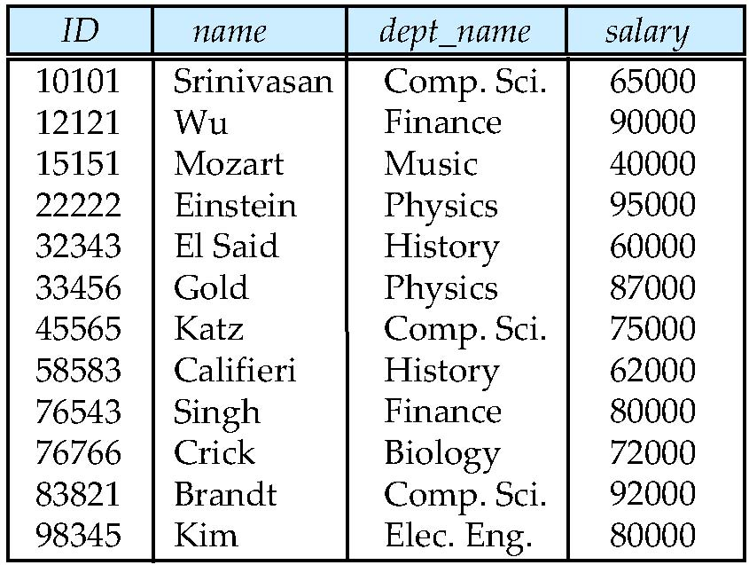

Example for Select Clause (1)
instructor
select name
from instructor;

Slide 15
The select Clause (Cont.)
SQL allows duplicates in relations as well as in query results.
To force the elimination of duplicates
  insert the keyword distinct after select
Find the department names of all instructors, and remove duplicates
select distinct dept_name
from instructor
The keyword all specifies that duplicates not be removed.
select all dept_name
from instructor
Notes:
4

Slide 16

Example for Select Clause (2)
instructor
select dept_name
from instructor;
select all dept_name
from instructor;

Slide 17
Example for Select Clause (3)
instructor
select distinct dept_name
from instructor;

Slide 18
The select Clause (Cont.)
An “*” in the select clause denotes “all attributes”
select *
from instructor
The select clause can contain arithmetric expressions on constants or attributes of tuples.
The query:
select ID, name, salary/12
from instructor
the value of the attribute salary is divided by 12.
Notes:
5

Slide 19
The where Clause
The where clause specifies conditions that the result must satisfy
  the selection predicate of the relational algebra
To find all instructors in Comp. Sci. dept with salary > 70000
select name
from instructor
where dept_name = ‘Comp. Sci.' and salary > 70000
Notes:
6

Slide 20
The where Clause
The where clause specifies conditions that the result must satisfy
  the selection predicate of the relational algebra
Predicates can be combined using and, or, and not.
Comparisons can be applied to results of arithmetic expressions
  e.g. salary/12 > 600
Notes:
6

Slide 21
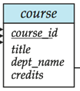
Practice Time
Find the titles of courses provided by the Comp. Sci. department that have 3 credits.
select title
from course
where dept_name = ‘Comp. Sci.' and credits = 3

Slide 22
The from Clause
More than one relation in the from clause
  corresponds to the Cartesian product operation of the relational algebra.
Find the Cartesian product instructor X teaches
select ∗
from instructor, teaches
  generates every possible instructor – teaches pair
  with all attributes from both relations.
instructor × teaches
Notes:
8

Slide 23



Cartesian Product
instructor
teaches
select *
from instructor, teaches

Slide 24

Example for Join Relations
teaches
instructor
select name, course_id
from instructor, teaches
where instructor.ID = teaches.id;
Notes:
在此join=natural join

Slide 25


Example for Join Relations(1)
instructor
department
select name, instructor.dept_name, building
from instructor, department
where instructor.dept_name =
department. dept_name

Slide 26


Practice Time
Retrieve the names of all instructors, along with their department names and department building names,
where the budget of their department is larger than 90000
select name, instructor.dept_name, building
from instructor, department
where instructor.dept_name =
department. dept_name
and budget > 90000

Slide 27


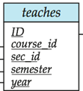
Practice Time
Find the IDs of all students who were taught by an instructor named Einstein; make sure there are no duplicates in the result.
select takes.ID
from instructor, takes, teaches
where takes.course_id = teaches.course_id
and takes.year = teaches.year
and takes.semester = teaches.semester
and takes.sec_id = teaches.sec_id
and teaches.ID = instructor.ID
and instructor.name = ‘Einstein’

Slide 28
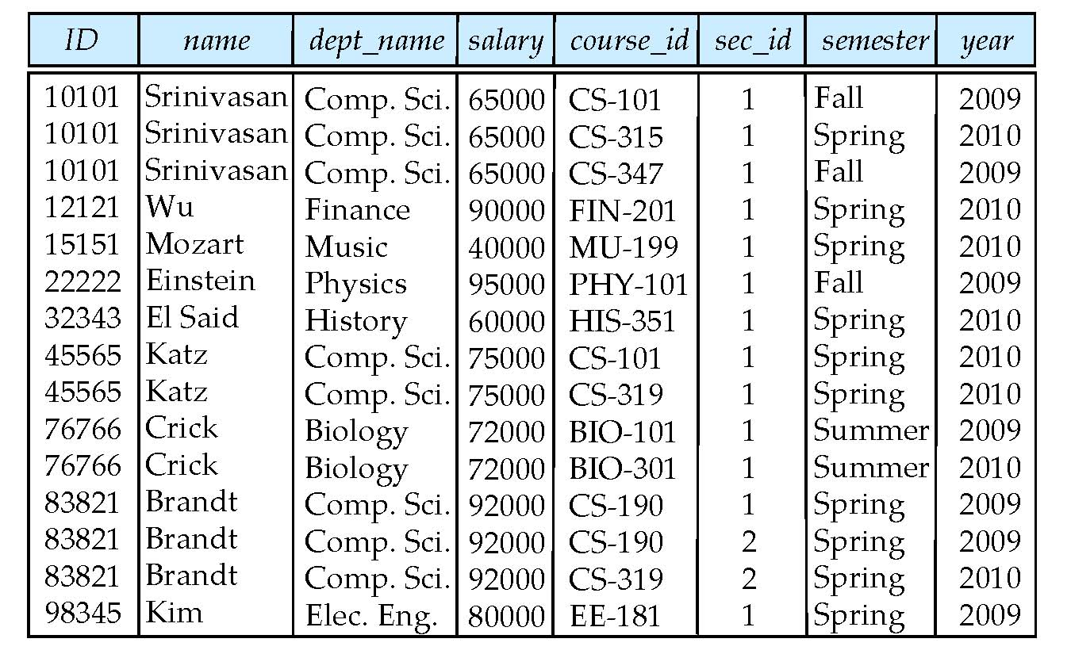
Natural Join
select *
from instructor natural join teaches;

Slide 29
Natural Join
instructor
teaches
select *
from instructor natural join teaches;

Slide 30
Practice Time
用 natural join 語法查詢
Retrieve the names of all instructors, along with their department names and department building names,
where the budget of their department is larger than 90000
select name, instructor.dept_name, building
from instructor natural join department
where budget > 90000

Slide 31

Note about Natural Join
List the names of instructors along with the titles of courses that they teach.
  select name, title
  from instructor natural join teaches, course
  where teaches.course_id = course.course_id;
  select name, title
  from instructor natural join teaches natural join course;
instructor
teaches
course
Q: 這兩個查詢的結果可能不一樣, 想想看為什麼?

Slide 32
Practice Time
在from 中結合 natural join 語法查詢
Find the IDs of all students who were taught by an instructor named Einstein; make sure there are no duplicates in the result.
select takes.ID
from takes, instructor natural join teaches
where takes.course_id = teaches.course_id
and takes.year = teaches.year
and takes.semester = teaches.semester
and takes.sec_id = teaches.sec_id
and instructor.name = ‘Einstein’

Slide 33
The Rename Operation
The SQL allows renaming relations and attributes using the as clause:
old-name as new-name
Appear in the from clause
  select S.name, T.course_id
  from instructor as S, teaches as T
  where S.ID = T.ID;
  S, T are called tuple variables
Notes:
9

Slide 34
The Rename Operation
The SQL allows renaming relations and attributes using the as clause:
old-name as new-name
Appear in the from clause
  select distinct T. name
  from instructor as T, instructor as S
  where T.salary > S.salary
Notes:
9

Slide 35
The Rename Operation Example
  select distinct T. name
  from instructor as T, instructor as S
  where T.salary > S.salary
instructor
T
instructor
S

Slide 36
The Rename Operation
The SQL allows renaming relations and attributes using the as clause:
old-name as new-name
Appear in the select clause
  select name as instructor_name, course_id
  from instructor, teaches
  where instructor.ID = teaches .ID;
Notes:
9

Slide 37
Practice Time
Find the names of all instructors who have a higher salary than some (at least one) instructor in ‘Computer Science’.
如何修改?
  select distinct T. name
  from instructor as T, instructor as S
  where T.salary > S.salary
  and S.dept_name = ‘Comp. Sci’
Notes:
9

Slide 38
Where Clause Predicates (1)
SQL includes a between comparison operator
Example: Find the names of all instructors with salary between $90,000 and $100,000 (that is, ≥ $90,000 and ≤ $100,000)
  select name
  from instructor
  where salary between 90000 and 100000
  select name
  from instructor
  where salary <=100000 and salary >= 90000;
Notes:
7

Slide 39
Where Clause Predicates (2)
Tuple comparison
  select name, course_id
  from instructor, teaches
  where (instructor.ID, dept_name) =
  (teaches.ID, ’Biology’);
  (a1, a2) <= (b1, b2)
    If a1 <= b1 and a2 <= b2
Notes:
7

Slide 40
Where Clause Predicates (3)
A string-matching operator like
  for comparisons on character strings patterns
    percent (%): matches any substring
    underscore (_): matches any character
Find the names of all instructors whose name includes the substring “dar”.
select name
from instructor
where name like '%dar%'

Slide 41
Where Clause Predicates (3)
A string-matching operator like
  for comparisons on character strings patterns
    percent (%): matches any substring
    underscore (_): matches any character
Match the string “100%”
like ‘100 \%' escape '\'

Slide 42
Where Clause Predicates (3)
SQL supports a variety of string operations such as
  concatenation (using “||”)
  converting from upper to lower case (and vice versa)
  finding string length, extracting substrings, etc.

Slide 43
Where Clause Predicates (3)
Patters are case sensitive.
Pattern matching examples:
  ‘Intro%’ matches any string beginning with “Intro”.
  ‘%Comp’ matches any string containing “Comp” as a substring.
  ‘_ _ _’ matches any string of exactly three characters.
  ‘_ _ _ %’ matches any string of at least three characters.

Slide 44
Ordering the Display of Tuples
List the names of all instructors in the Physics department in alphabetic order
select distinct name
from instructor
where dept_name = ‘Physics’
order by name
Specify desc for descending order or asc for ascending order, for each attribute;
  ascending order is the default.
desc

Slide 45
Ordering the Display of Tuples
Order by can sort on multiple attributes
select distinct salary, name
from instructor
  where depa_name = ‘Physics’
  order by salary desc, name asc
什麼意思?

Slide 46



Combine two SQL clauses
(Set operations)
Find courses that ran in Fall 2009 or in Spring 2010
(select course_id from section where sem = ‘Fall’ and year = 2009)
union
(select course_id from section where sem = ‘Spring’ and year = 2010)
union all
union
union all

Slide 47

Set Operations
Find courses that ran in Fall 2009 but not in Spring 2010
(select course_id from section where sem = ‘Fall’ and year = 2009)
intersect
(select course_id from section where sem = ‘Spring’ and year = 2010)
intersect all
intersect
intersect all

Slide 48

Set Operations
Find courses that ran in Fall 2009 but not in Spring 2010
(select course_id from section where sem = ‘Fall’ and year = 2009)
except
(select course_id from section where sem = ‘Spring’ and year = 2010)
except

Slide 49
Practice Time
Find courses that ran in Spring 2010 but not in Fall 2009
(select course_id from section where sem = ‘Spring’ and year = 2010)
except all
(select course_id from section where sem = ‘Fall’ and year = 2009)
except all

Slide 50
Set Operations
Set operations union, intersect, and except
  Each of the above operations automatically eliminates duplicates
To retain all duplicates use the corresponding multiset versions union all, intersect all and except all.

Slide 51
Set Operations
To retain all duplicates use the corresponding multiset versions union all, intersect all and except all.
Suppose a tuple occurs m times in r and n times in s, then, it occurs:
  m + n times in r union all s
  min(m,n) times in r intersect all s
  max(0, m – n) times in r except all s

Slide 52
Practice Time
Find the ids of all instructors whose salaries are higher than every instructor of “Computer Science”.
(select ID
from instructors )
except
(select S.ID
from instructor as S, instructor as T
where
)
S.salary <= T.salary
and T.dept_name = ‘Comp. Sci.’

Slide 53
Null Values
It is possible for tuples to have a null value in their attributes
The result of any arithmetic expression involving null is null
  Example: 5 + null returns null
The predicate is null can be used to check for null values.
  Example: Find all instructors whose salary is null.
select name
from instructor
where salary is null

Slide 54
1.p.41
2.p.52非computer science 但薪水小於computer scienc老師者也會被選到?
3.p53

