Slide 1
Chapter 4: Intermediate SQL

Slide 2
Joined Relations
Join operations take two relations and return as a result another relation.
A Cartesian product which requires that tuples in the two relations match some condition.
It also specifies the attributes that are present in the result of the join
The join operations are typically used as
subquery expressions in the from clause

Slide 3
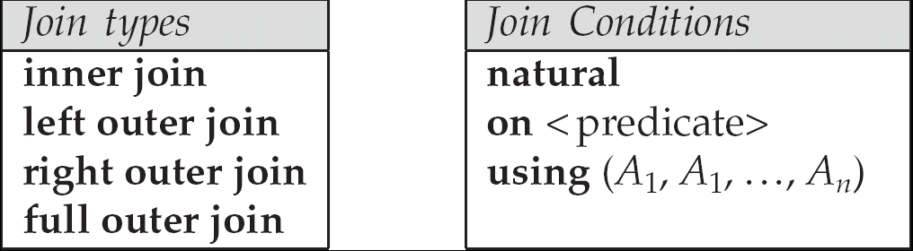
Joined Relations
Join type – defines how tuples in each relation that do not match any tuple in the other relation are treated.
Join condition –
defines which tuples in the two relations match, and
what attributes are present in the result of the join.
Notes:
Join type –沒match者處理方式
Join condition-決定誰match以及呈現那些attributes

Slide 4
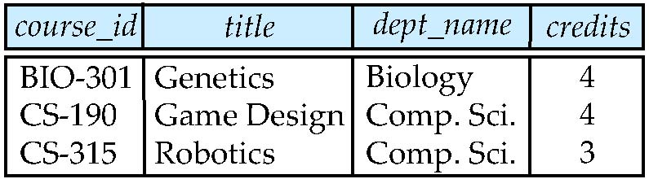
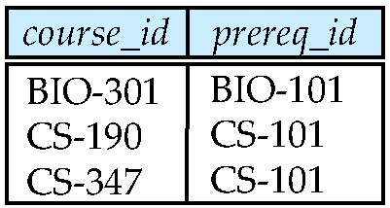
Join operations – Example
Relation course
Relation prereq

Slide 5
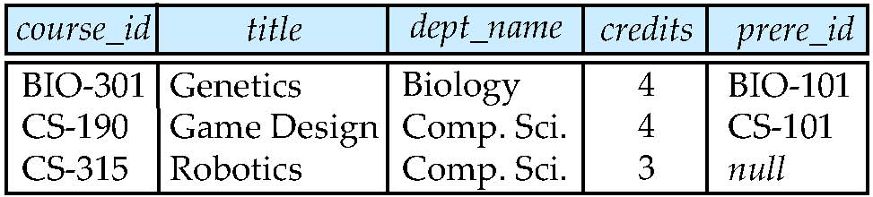
Natural Inner Join operations
course natural join prereq

Slide 6
Outer Join
Computes the join
then adds tuples form one relation that does not match tuples in the other relation to the result of the join.
Uses null values.

Slide 7
Natural Left Outer Join
course natural left outer join prereq

Slide 8
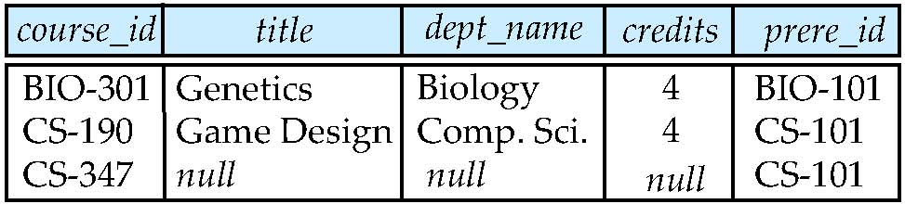
Natural Right Outer Join
course natural right outer join prereq

Slide 9
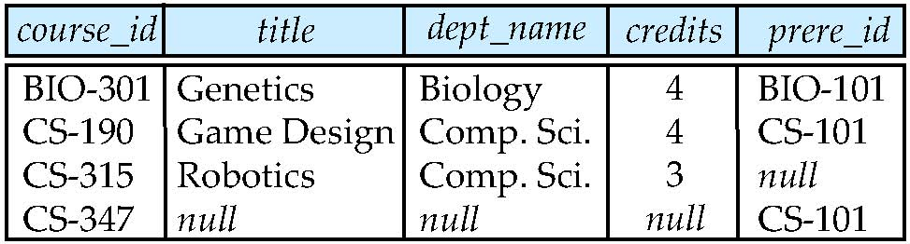
Natural Full Outer Join
course natural full outer join prereq

Slide 10
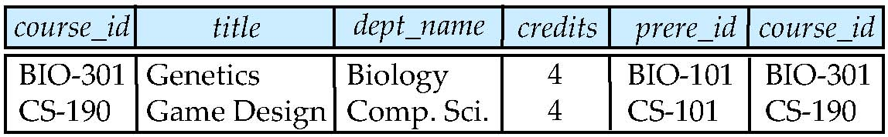
Inner Join on
course inner join prereq on course.course_id=prereq.course_id
What is the difference between the above and a natural join?
Notes:
10

Slide 11
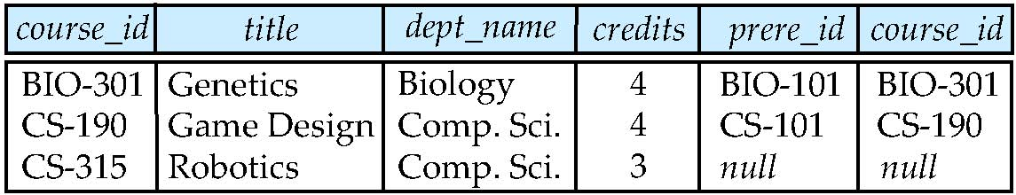
Outer Join on
course left outer join prereq on course.course_id = prereq.course_id
inner join

Slide 12
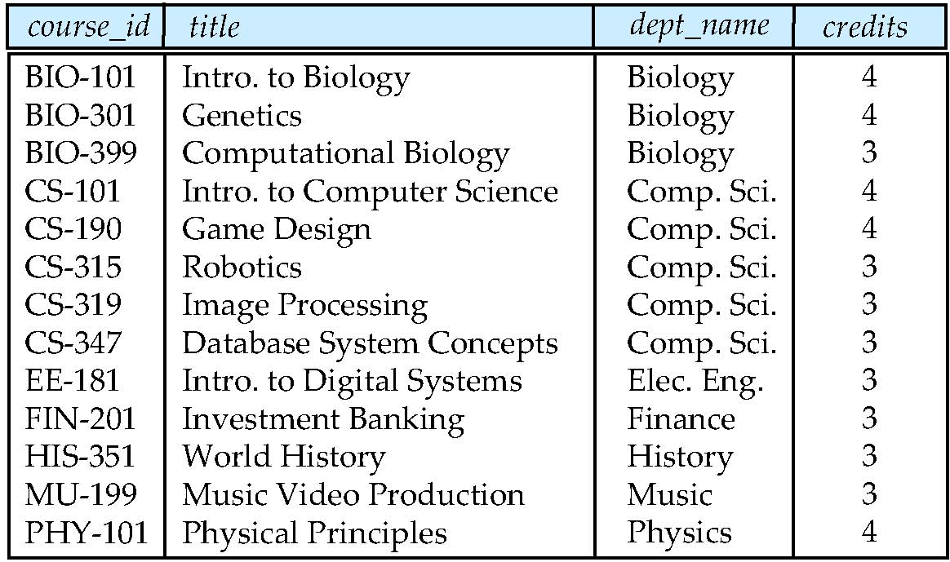
Outer Join on
course left outer join prereq on course.course_id = prereq.prereq_id
inner join
null
null
null
null

Slide 13
Inner Join using
course inner join prereq using (course_id)

Slide 14
Outer Join using
course full outer join prereq using (course_id)

Slide 15
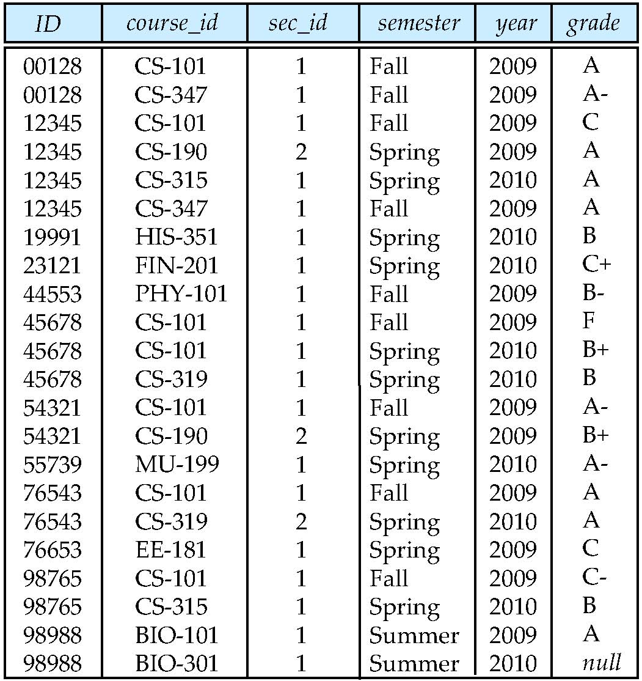
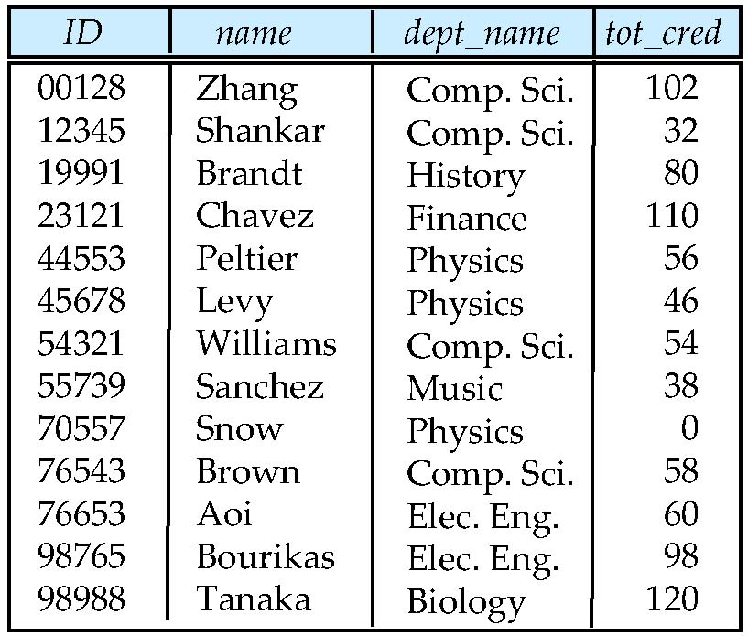
Examples of Joins
takes
students
Notes:
15

Slide 16
Practice Time
How many tuples in
students natural join takes?
22 tuples
How many attributes in
students natural join takes?
9 attributes

Slide 17
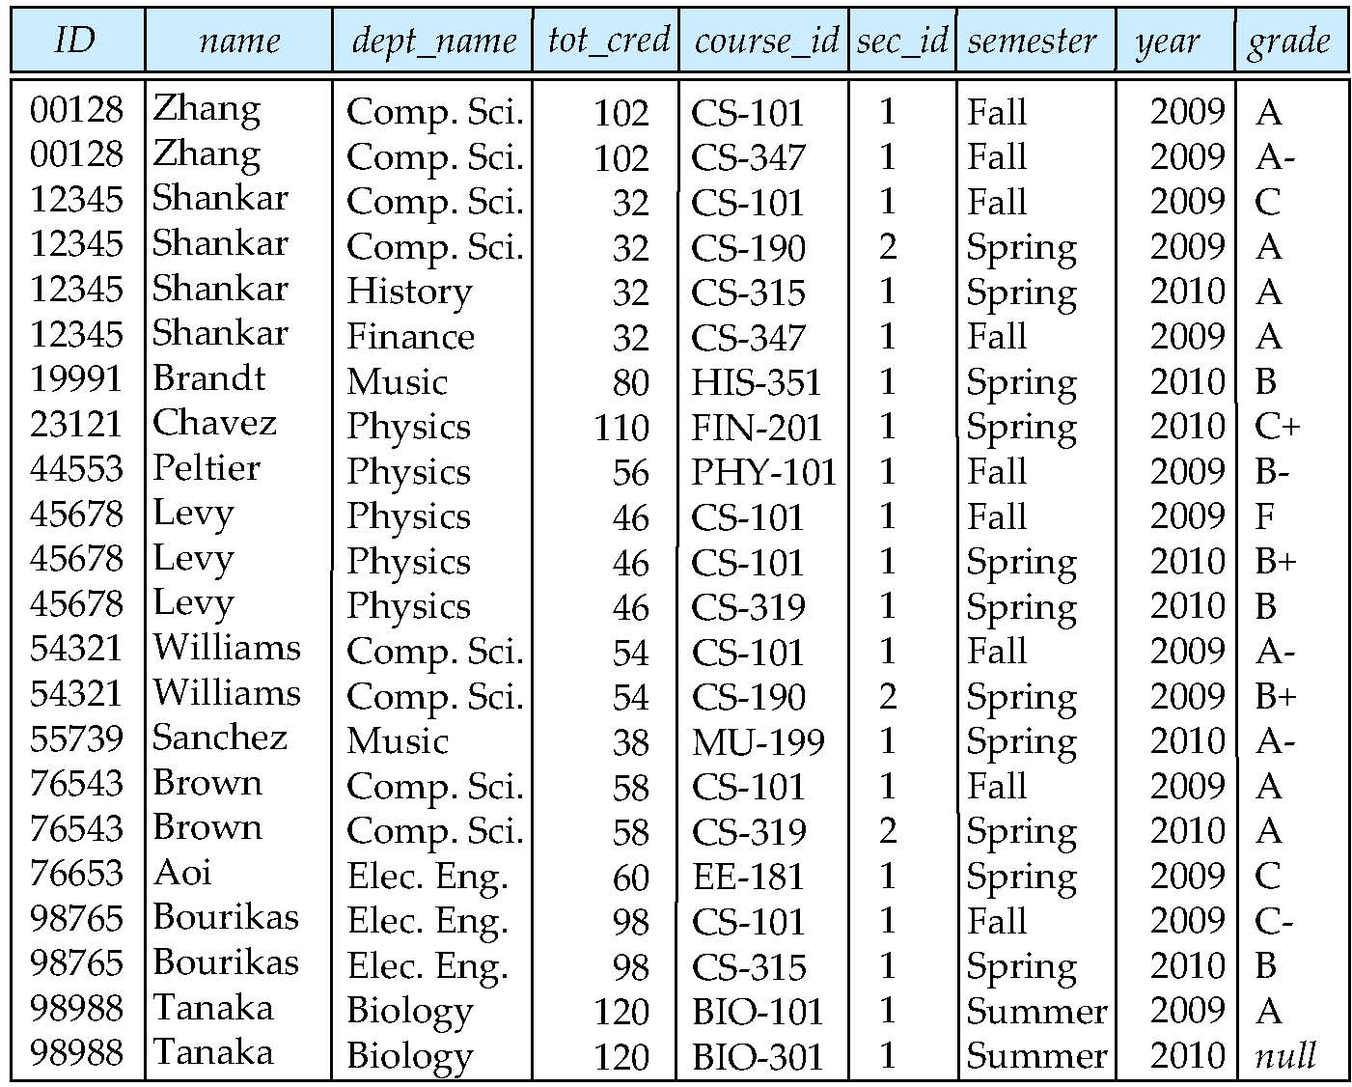
Natural Inner Join
Notes:
17

Slide 18
Question Time
How many tuples in
students natural left outer join takes ID?
23 tuples
How many attributes in
students natural left outer join takes ID?
9 attributes

Slide 19
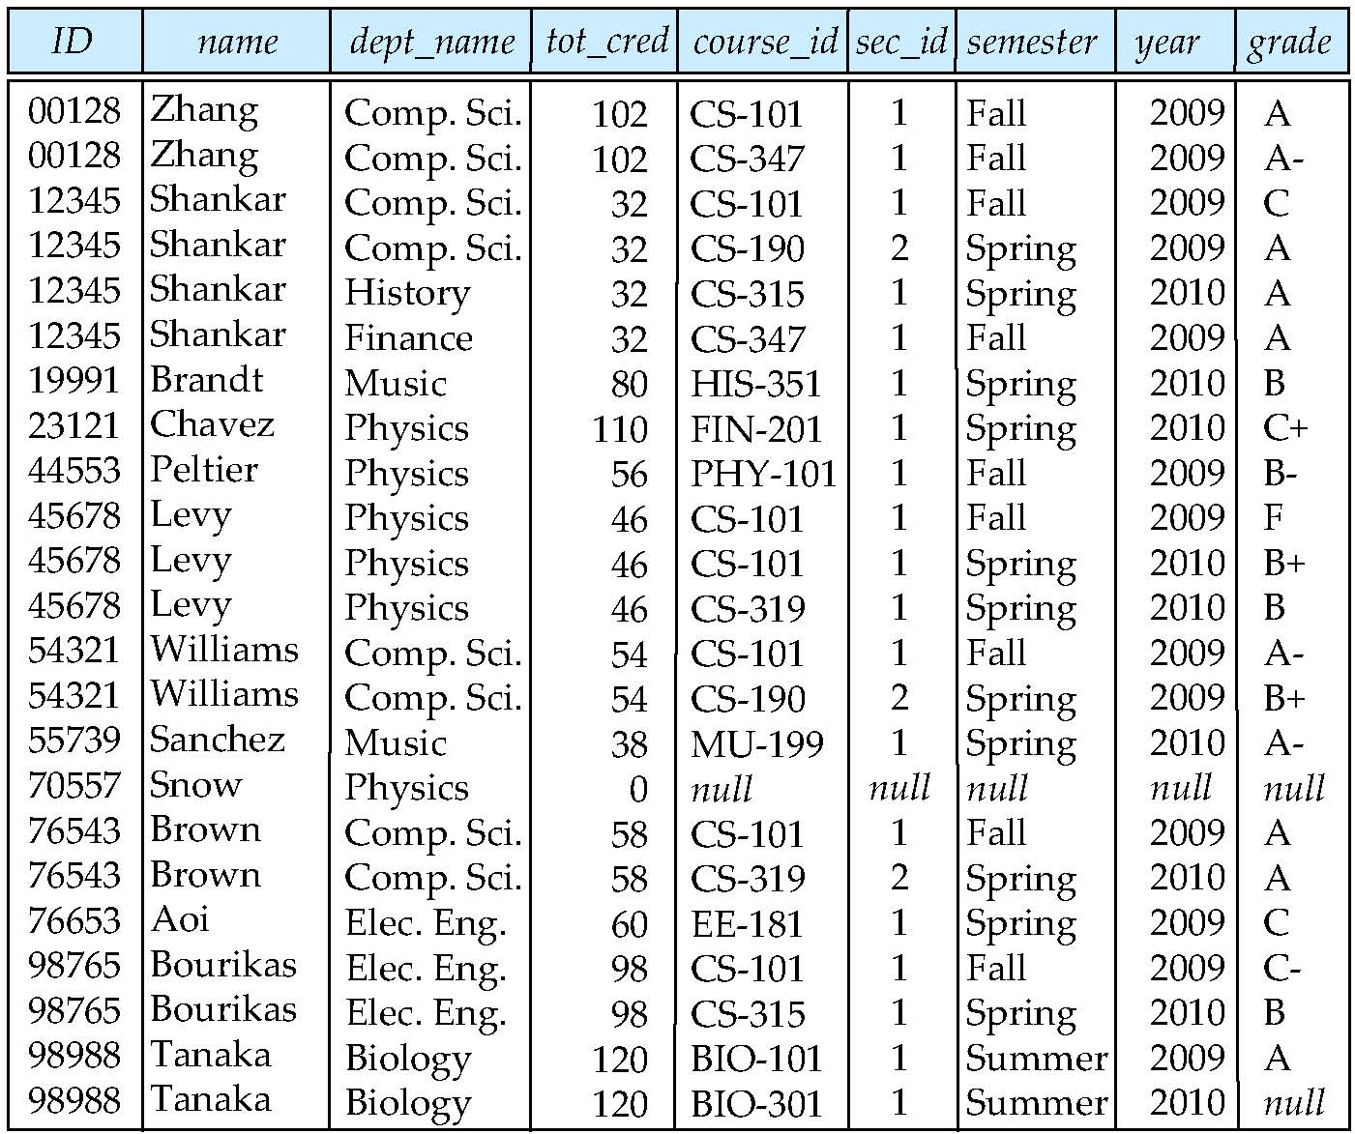
student Natural Left Outer Join takes
Notes:
19

Slide 20
Question Time
student natural left outer join takes
= takes natural right outer join student
student left outer join takes using ID
=student natural left outer join takes
takes right outer join student using ID
=takes natural right outer join student

Slide 21
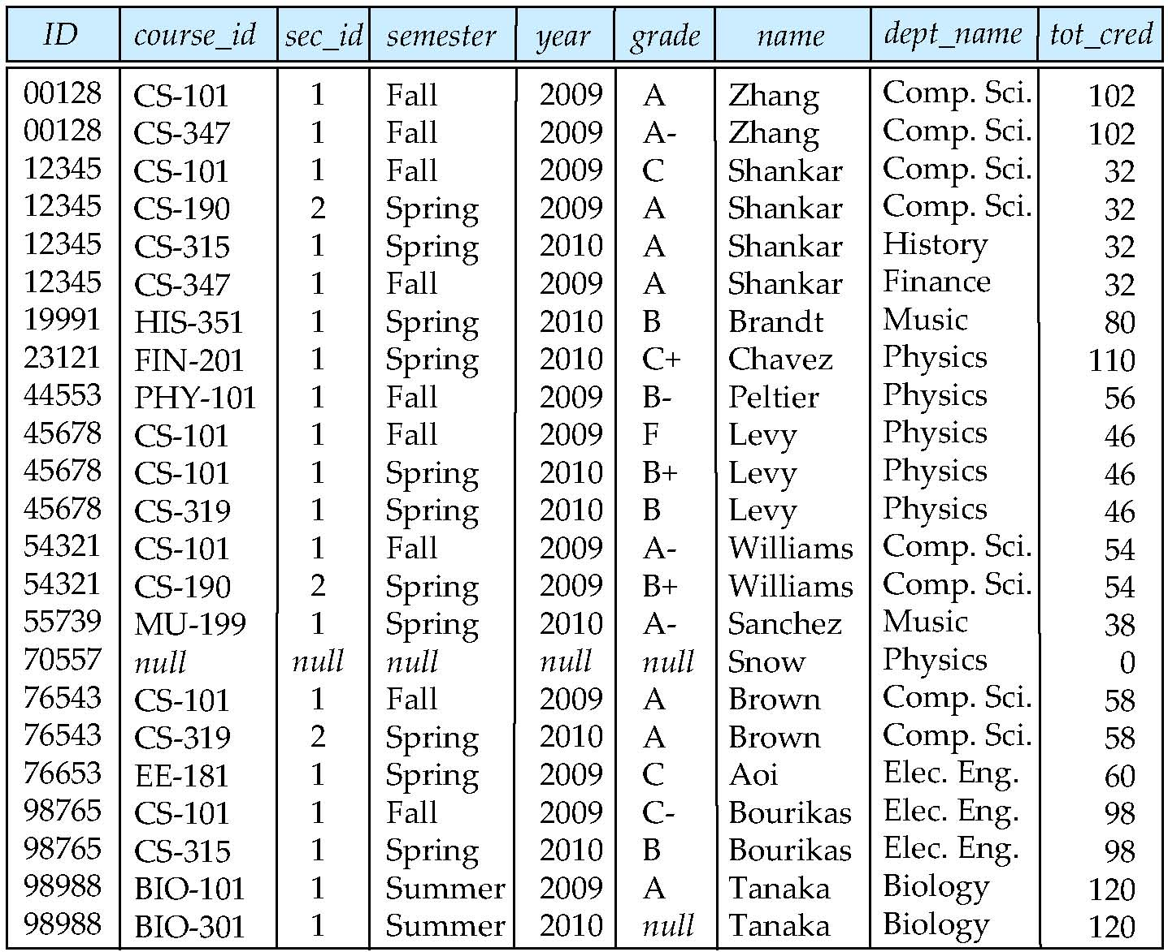
takes Right Outer Join student on ID
Notes:
21

Slide 22
Practice Time
Display a list of all students, showing their ID, name, and the number of course that they have taken.
Make sure to show the number of sections as 0 for students who have not taken any section. Your query should use an outer join.
Select ID, name,count(course_id)
From student natural left outer join takes
Group by ID;

