Slide 1
Chapter 6: Formal Relational Query Languages
(Relational Algebra)

Slide 2
Additional Operations
Additional operations that do not add any power to the
relational algebra, but that simplify common queries.
Set intersection
Natural join
Assignment
Outer join

Slide 3
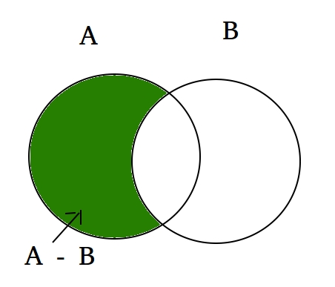
Set-Intersection Operation
Notation: r ∩ s
Defined as:
r ∩ s = { t | t ∈ r and t ∈ s }
Assume:
  r, s have the same arity
  attributes of r and s are compatible
Note: r ∩ s = r – (r – s)
A ∩ B

Slide 4

Set-Intersection Operation – Example
Relation r, s:
r ∩ s

Slide 5

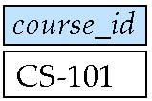
Example of Set-Intersection
section
Find the set of all courses taught in both the Fall 2009 and
The Spring 2010 semesters.
    ∏_{course_id} (σ _{semester=“Fall” ∧ year=2009}(section))
∩
    ∏_{course_id} (σ _{semester=“Spring” ∧ year=2010}(section))

Slide 6
Natural-Join Operation
Let r and s : relations on schemas R and S respectively
r s is a relation on schema R ∪ S obtained as follows:
  Consider each pair of tuples t_{r} from r and t_{s} from s.
  If t_{r} and t_{s} have the same value on each of the attributes in R ∩ S, add a tuple t to the result, where
    t has the same value as t_{r} on r
    t has the same value as t_{s} on s

Slide 7

Natural Join Example
Relations r, s:
r s

Slide 8
Natural-Join Operation
Example:
  R = (A, B, C, D)
  S = (E, B, D)
  Result schema = (A, B, C, D, E)
Q: How to generate each pair of tuples t_{r} from r and t_{s} from s
  r s is defined as:
  ∏_{r.A, r.B, r.C, r.D, s.E} (σ_{r.B = s.B ∧ r.D = s.D} (r x s))

Slide 9

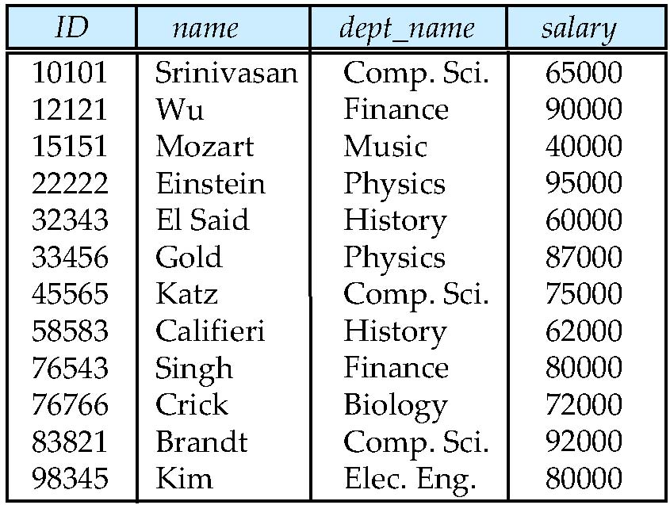

Example of Natural Join
teaches
instructor
instructor teaches

Slide 10
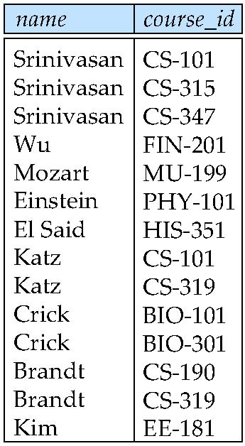
Example of Natural Join
∏_{name,} _{course_id} (instructor teaches)

Slide 11
Practice Time
找出 building 在 Watson大樓的教室 上課的課程名稱 及 開課系所

Slide 12
Natural Join
Find the names of all instructors in the Comp. Sci. department together with the course titles of all the courses that the instructors teach
  ∏ _{name, title} (σ _{dept_name=“Comp. Sci.”}
  (instructor teaches course))

Slide 13
Natural Join
Natural join is associative
  (instructor teaches) course is equivalent to
  instructor (teaches course)
Natural join is commutative
  instructor teaches is equivalent to
  teaches instructor

Slide 14

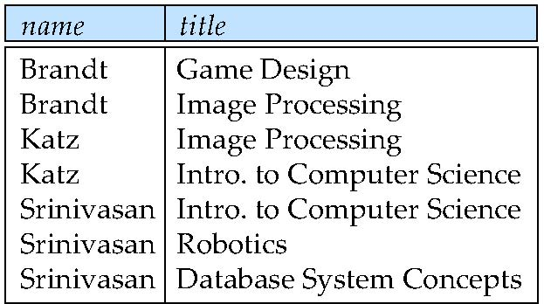
Example of Natural Join
  ∏ _{name, title} (σ_{dept_name=“Comp. Sci.”} (instructor teaches course))

Slide 15
Practice Time
Find the IDs of all students who were taught by an instructor named Einstein.

Slide 16
Example of Natural Join
  ∏ _{name, title} (σ_{dept_name=“Comp. Sci.”} (instructor teaches course))
instructor teaches
course
BIO-399
Q: 如果老師開其他系的課, 找得出來嗎?
為什麼?
Notes:
會找不到

Slide 17
Natural Join and Theta Join
The theta join operation r _{θ} s is defined as
  r _{θ} s = σ_{θ} (r x s)
  teaches teaches.course_id=course.course_id course
  = σ teaches.course_id=course.course_id (teaches × course)
teaches
course
Q1: theta join 做完的結果有哪幾個欄位?
Q2: teaches course (natural join) 做完的結果有哪幾個欄位?
Q3: 兩者的差別在哪?
Notes:
Q1:9個
Q2:8個(共同欄位省略)
Q3:不會有老師開其他系的課找不到之問題

Slide 18
Practice Time
  ∏ _{name, title} (σ_{dept_name=“Comp. Sci.”} (instructor teaches course))
instructor teaches
course
BIO-399
Q: 請用theta join 修改上述查詢,
讓老師若開其他系的課也找得出來

Slide 19
Assignment Operation
The assignment operation (←) to a temporary relation variable
  Write query as a sequential program consisting of
    a series of assignments
∏_{r.A, r.B, r.C, r.D, s.E} (σ_{r.B = s.B ∧ r.D = s.D} (r x s))
temp1← (r x s)
temp2← σ_{r.B = s.B ∧ r.D = s.D} (temp1)
result← ∏_{r.A, r.B, r.C, r.D, s.E} (temp2)

Slide 20
Outer Join
Computes the join
adds tuples form one relation that does not match to the result of the join.
Uses null values:
  the value is unknown or does not exist

Slide 21
Outer Join – Example
Relation instructor Relation teaches
ID
name
dept_name
ID
course_id
10101
12121
15151
Srinivasan
Wu
Mozart
Comp. Sci.
Finance
Music
10101
12121
76766
CS-101
FIN-201
BIO-101
Join
instructor teaches
ID
name
dept_name
course_id
10101
12121
Srinivasan
Wu
Comp. Sci.
Finance
CS-101
FIN-201
Notes:
可以指定篩選條件為空值

Slide 22
Outer Join – Example
ID
name
dept_name
ID
course_id
10101
12121
15151
Srinivasan
Wu
Mozart
Comp. Sci.
Finance
Music
10101
12121
76766
CS-101
FIN-201
BIO-101
Join
instructor teaches
ID
name
dept_name
course_id
10101
12121
Srinivasan
Wu
Comp. Sci.
Finance
CS-101
FIN-201
null values
  the value is unknown or does not exist
Left Outer Join
instructor teaches
ID
name
dept_name
course_id
10101
12121
15151
Srinivasan
Wu
Mozart
Comp. Sci.
Finance
Music
CS-101
FIN-201
null

Slide 23
Practice Time
Find the IDs of all instructors who didn’t teach any course.
(提示: 用left outer join 運算結果加一個篩選條件)
ID
name
dept_name
course_id
10101
12121
15151
Srinivasan
Wu
Mozart
Comp. Sci.
Finance
Music
CS-101
FIN-201
null

Slide 24
Outer Join – Example
ID
name
dept_name
ID
course_id
10101
12121
15151
Srinivasan
Wu
Mozart
Comp. Sci.
Finance
Music
10101
12121
76766
CS-101
FIN-201
BIO-101
Join
instructor teaches
ID
name
dept_name
course_id
10101
12121
Srinivasan
Wu
Comp. Sci.
Finance
CS-101
FIN-201
Right Outer Join
instructor teaches
ID
name
dept_name
course_id
10101
12121
76766
Srinivasan
Wu
null
Comp. Sci.
Finance
null
CS-101
FIN-201
BIO-101

Slide 25
Practice Time
Find the course_id of all courses whose teacher didn’t in the table of instructors.
(提示: 用right outer join 運算結果加一個篩選條件)
ID
name
dept_name
course_id
10101
12121
76766
Srinivasan
Wu
null
Comp. Sci.
Finance
null
CS-101
FIN-201
BIO-101

Slide 26
Outer Join – Example
ID
name
dept_name
ID
course_id
Join
instructor teaches
10101
12121
15151
Srinivasan
Wu
Mozart
Comp. Sci.
Finance
Music
10101
12121
76766
CS-101
FIN-201
BIO-101
ID
name
dept_name
course_id
10101
12121
Srinivasan
Wu
Comp. Sci.
Finance
CS-101
FIN-201
Full Outer Join
instructor teaches
ID
name
dept_name
course_id
10101
12121
15151
76766
Srinivasan
Wu
Mozart
null
Comp. Sci.
Finance
Music
null
CS-101
FIN-201
null
BIO-101

Slide 27
Extended Relational-Algebra-Operations
Generalized Projection
Aggregate Functions

Slide 28
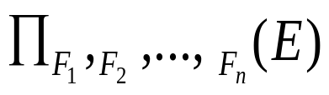
Generalized Projection
Allow arithmetic functions to be used in the projection list.
E is any relational-algebra expression
Each of F₁, F₂, …, F_{n} are arithmetic expressions involving constants and attributes of sE.
∏ID, name, dept_name, salary ÷ 12 (instructor)

Slide 29
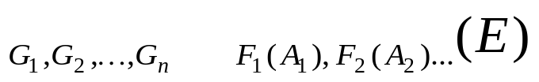

Aggregate Functions and Operations
Aggregation function takes a collection of values and returns a single value as a result.
avg: average value
min: minimum value
max: maximum value
sum: sum of values
count: number of values
Aggregate operation in relational algebra
E is any relational-algebra expression

Slide 30
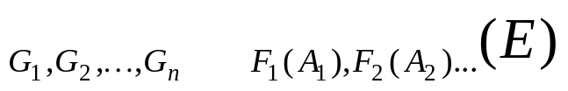
Aggregate Operation – Example
Relation r:
A
B
C
α
α
β
β
α
β
β
β
7
7
3
10
Gi denotes a set of attributes to group the data
could be empty
_{sum(C)} (r)
sum(C)
27

Slide 31
Aggregate Operation – Example
Relation r:
A
B
C
α
α
β
β
α
β
β
β
7
7
3
10
_{A} _{sum(C)} (r)
A
sum(C)
α
β
14
13

Slide 32


Aggregate Operation – Example
Find the average salary in each department
_{dept_name} _{avg(salary)} (instructor)
先將dept_name 相同的分在同一組
每一組 列出平均 salary
avg(salary)

Slide 33
Aggregate Functions (Cont.)
Result of aggregation does not have a name
  Can use rename operation to give it a name
_{dept_name} _{avg(salary) as avg_sal} (instructor)
avg_sal

Slide 34
Practice Time
Find the highest salary of instructors.
Find the names of the instructors earning the highest salary
(提示: 先將上一題結果暫存起來, 每個老師的薪水再跟它比較)

Slide 35
Practice Time
Find the enrollment (選課人數) of each section that was offered in Autumn 2009.
Find the course_id that had the maximum enrollment, across all sections, in Autumn 2009.
( 提示: 先將上一題結果暫存起來, 回想如何用 × 運算從section找出Autumn 2009修課人數最多的課程id)

