Slide 1
Chapter 7: Entity-Relationship Model

Slide 2
Chapter 7: Entity-Relationship Model
Design Process
Modeling
Constraints
E-R Diagram
Weak Entity Sets
Design of the University Database
Extended E-R Features
Design Issues
Reduction to Relation Schemas
Database Design

Slide 3
Design Process
Characterize the data needs
Conceptual design
Specify functional requirements
Implementation
Logical-design phase
Physical-design phase
Design alternatives
Redundancy
Incompleteness

Slide 4
Modeling
A database can be modeled as:
a collection of entities
relationship among entities
An entity is an object which is distinguishable from other objects
Example: specific person, company, event, plant
An entity set: a set of entities of the same type that share the same properties
Entities have attributes
Example: people have names and addresses

Slide 5
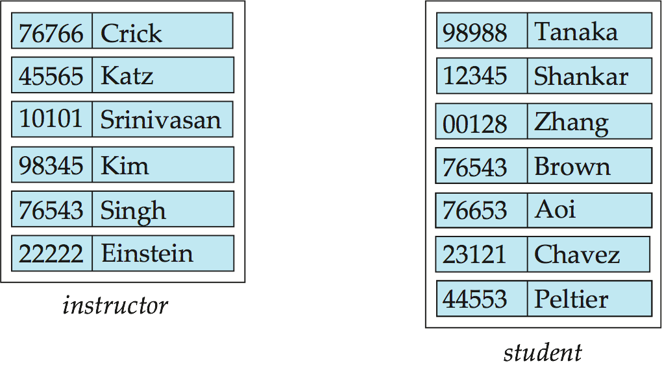
Entity Sets instructor and student
instructor_ID instructor_name student-ID student_name

Slide 6
Keys
A super key of an entity set
a set of one or more attributes
whose values uniquely determine each entity
A candidate key of an entity set is a minimal super key
ID is candidate key of instructor
course_id is candidate key of course
Several candidate keys may exist
one is selected to be the primary key.

Slide 7
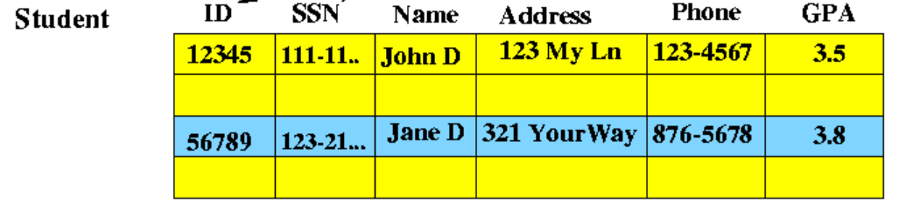
Practice Time
Please decide which attributes are superkeys/candidate keys of the table.
ID, SSN, Name, Name+Address, ID+Phone, Phone

Slide 8
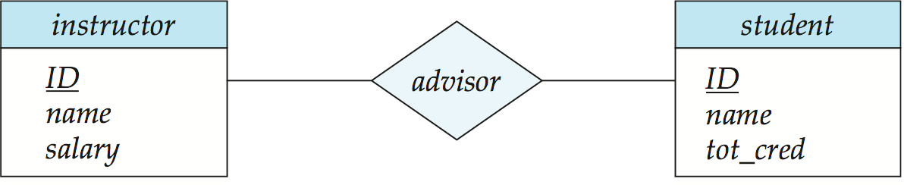
E-R Diagrams
Rectangles represent entity sets.
Attributes listed inside entity rectangle
Underline indicates primary key attributes

Slide 9
Attributes
An entity is represented by a set of attributes
Example:
instructor = (ID, name, street, city, salary ) course= (course_id, title, credits)
Domain – the set of permitted values for each attribute
Attribute types:
Simple and composite attributes.

Slide 10
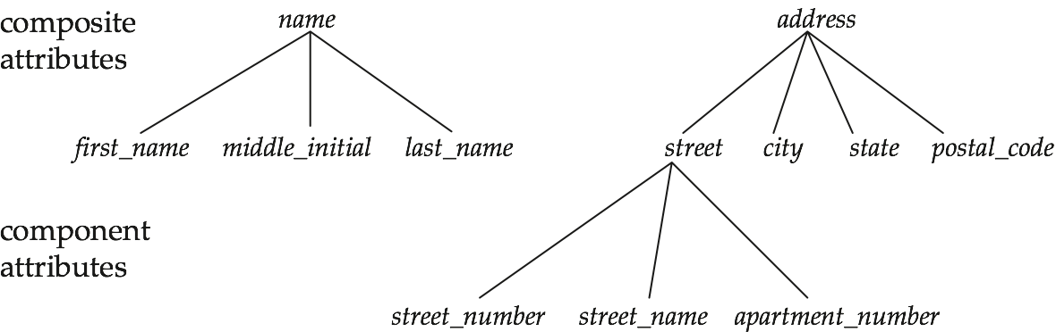
Composite Attributes

Slide 11
Attributes
Attribute types:
Simple and composite attributes.
Single-valued and multivalued attributes
Example: multivalued attribute: phone_numbers
Derived attributes
Can be computed from other attributes
Example: age, given date_of_birth

Slide 12
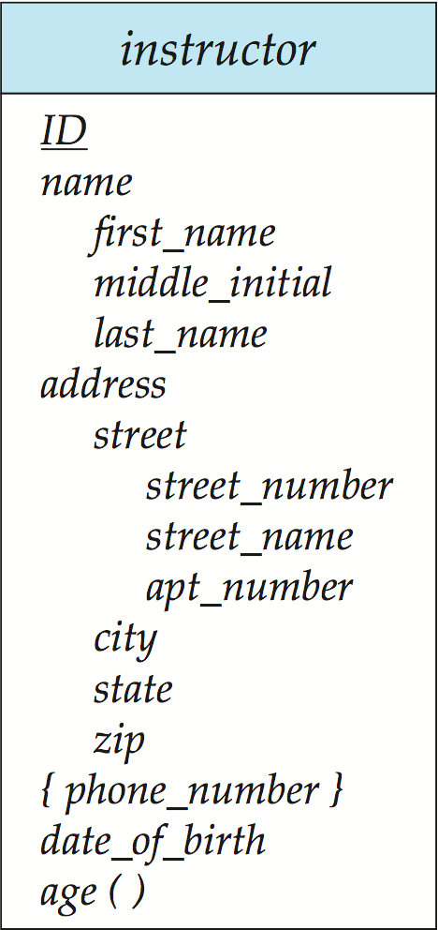
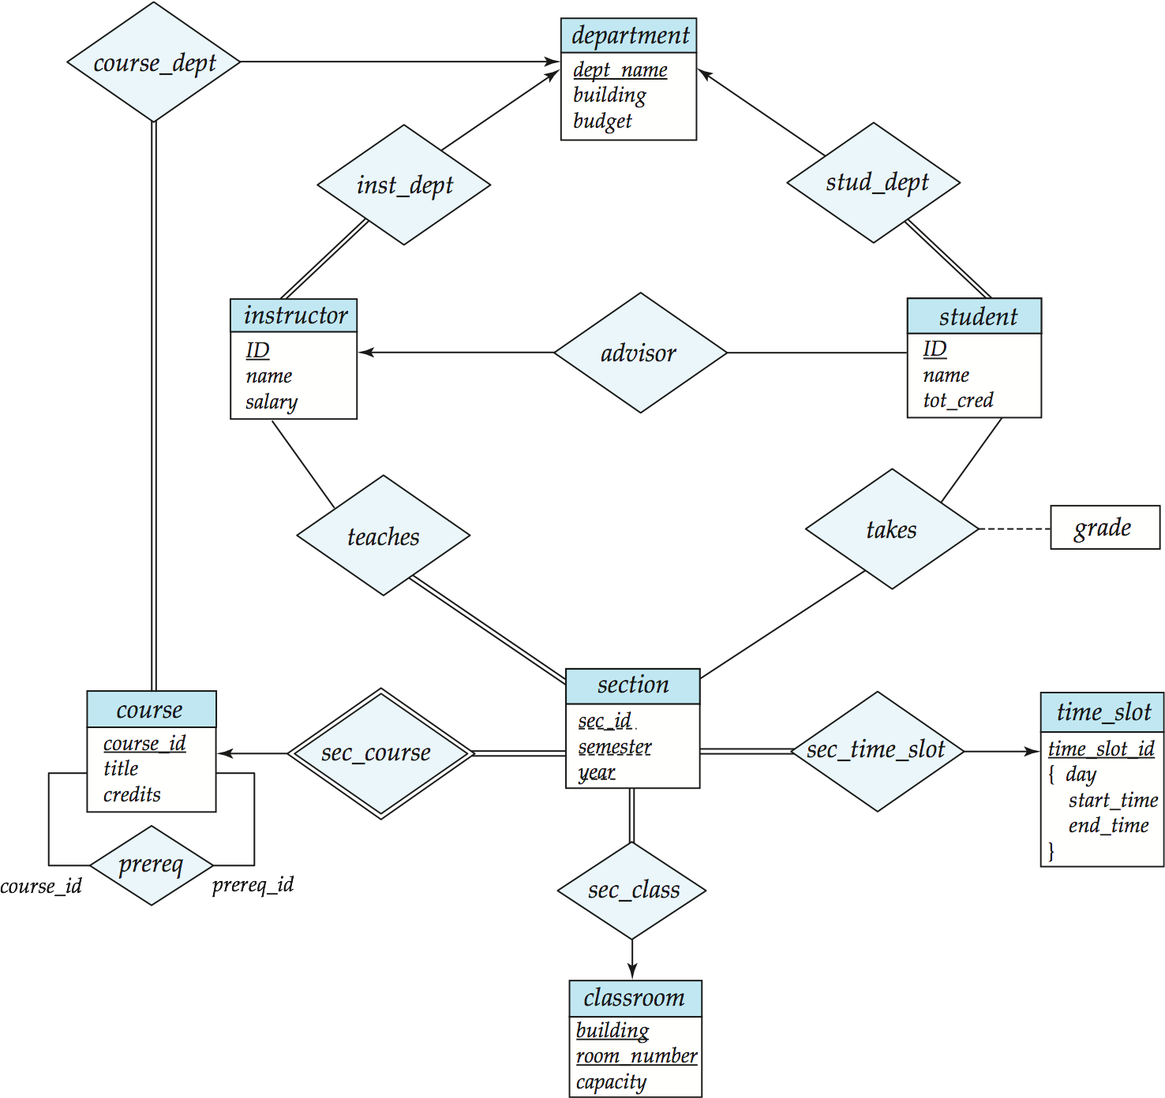
Entity With Composite, Multivalued, and Derived Attributes
Q: 請解釋此 entity 中
multi-value attributes 是哪個?
意義是什麼?

Slide 13
Relationship Sets
A relationship is an association among several entities
Example: 44553 (Peltier) advisor 22222 (Einstein) student entity relationship set instructor entity
A relationship set is a relation among n ≥ 2 entities sets
{(e₁, e₂, … e_{n}) | e₁ ∈ E₁, e₂ ∈ E₂, …, e_{n} ∈ E_{n}} where (e₁, e₂, …, e_{n}) is a relationship
Example:
(44553,22222) ∈ advisor

Slide 14
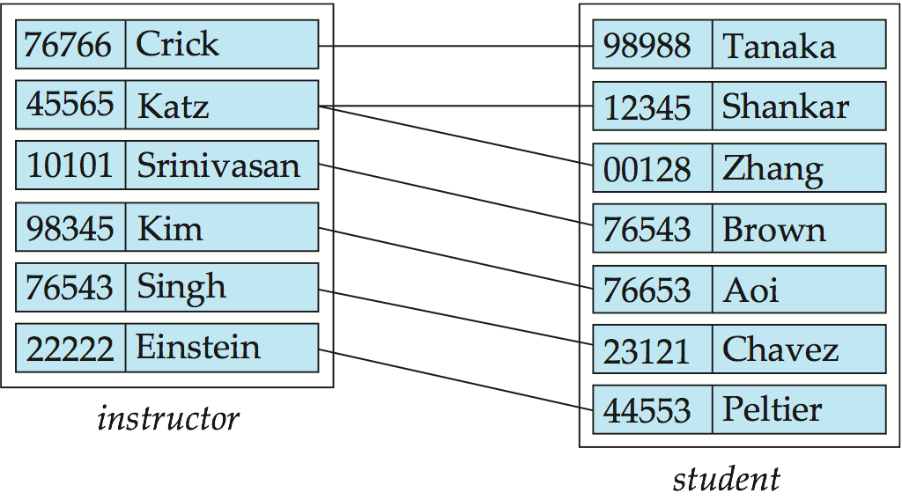
Relationship Set advisor

Slide 15
E-R Diagrams
Diamonds represent relationship sets.

Slide 16
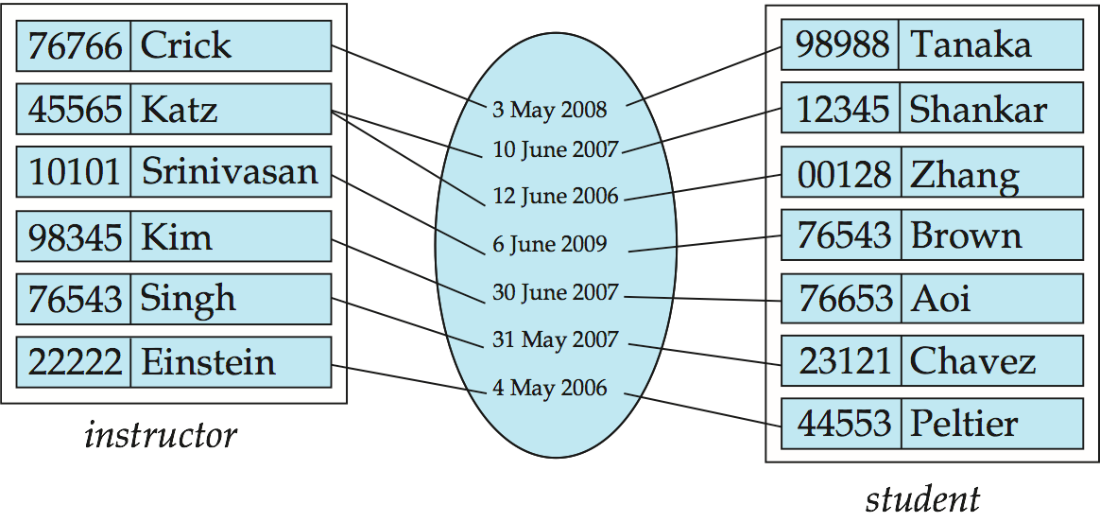
Relationship Sets (Cont.)
An attribute can also be property of a relationship set.

Slide 17
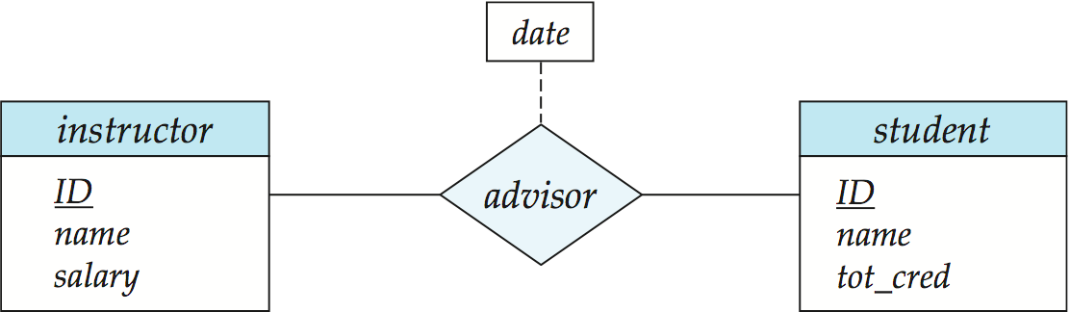
Relationship Sets with Attributes

Slide 18
Degree of a Relationship Set
binary relationship
involve two entity sets (or degree two).
Relationships between more than two entity sets
Example: students work on research projects under the guidance of an instructor.
relationship proj_guide is a ternary relationship between instructor, student, and project
Notes:
ternary 三元的

Slide 19
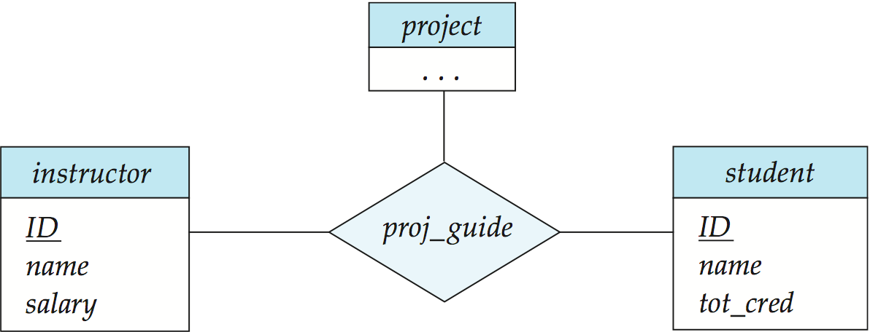
E-R Diagram with a Ternary Relationship

Slide 20
Mapping Cardinality Constraints
Express the number of entities to which another entity can be associated via a relationship set.
For a binary relationship set the type of mapping cardinality:
One to one
One to many
Many to one
Many to many
Notes:
老師 學生
Cardinality基數

Slide 21
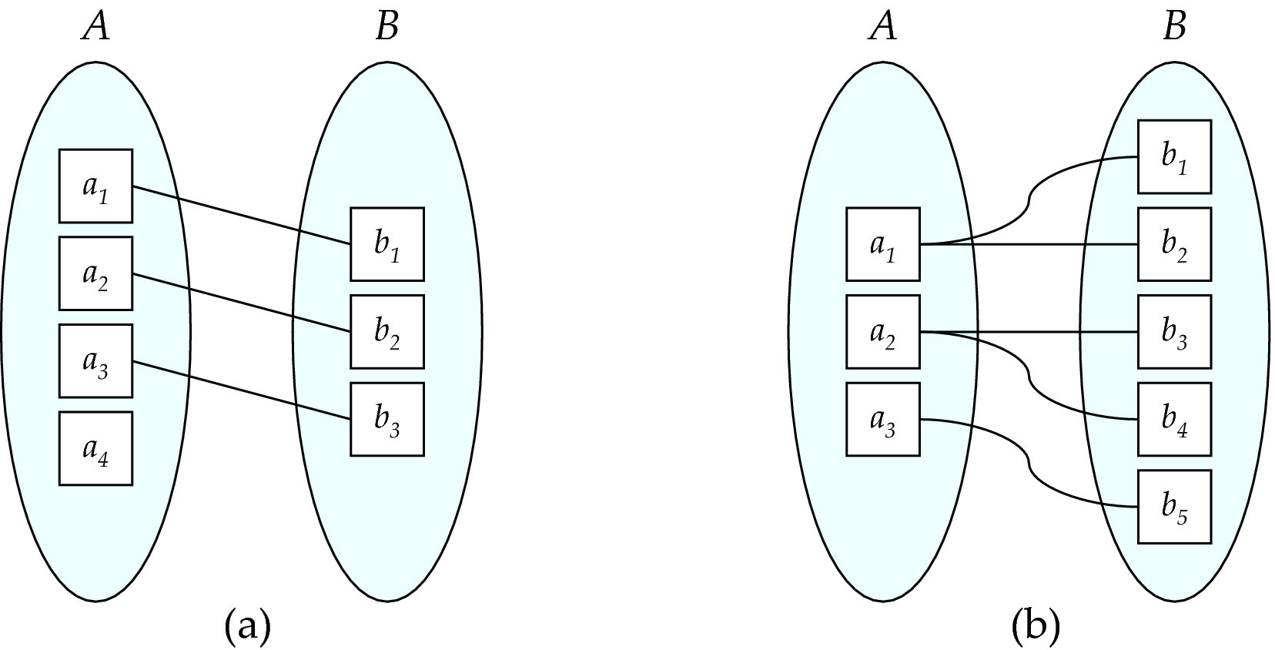
Mapping Cardinalities
One to one
One to many
Note: Some elements in A and B may not be mapped to any
elements in the other set

Slide 22
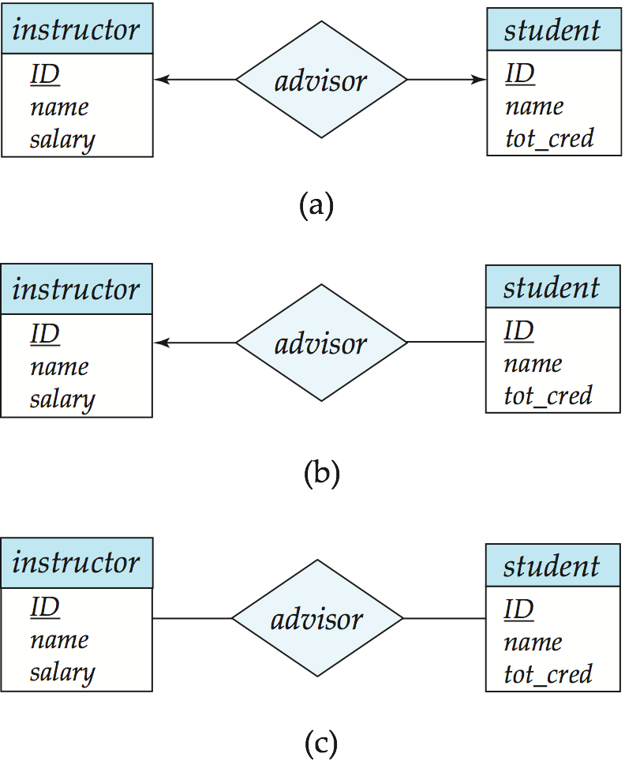
One-to-One Relationship
one-to-one relationship advisor between an instructor and a student
an instructor is associated with at most one student
a student is associated with at most one instructor

Slide 23
One-to-Many Relationship
one-to-many relationship advisor between an instructor and a student
an instructor is associated with several (including 0) students
a student is associated with at most one instructor

Slide 24
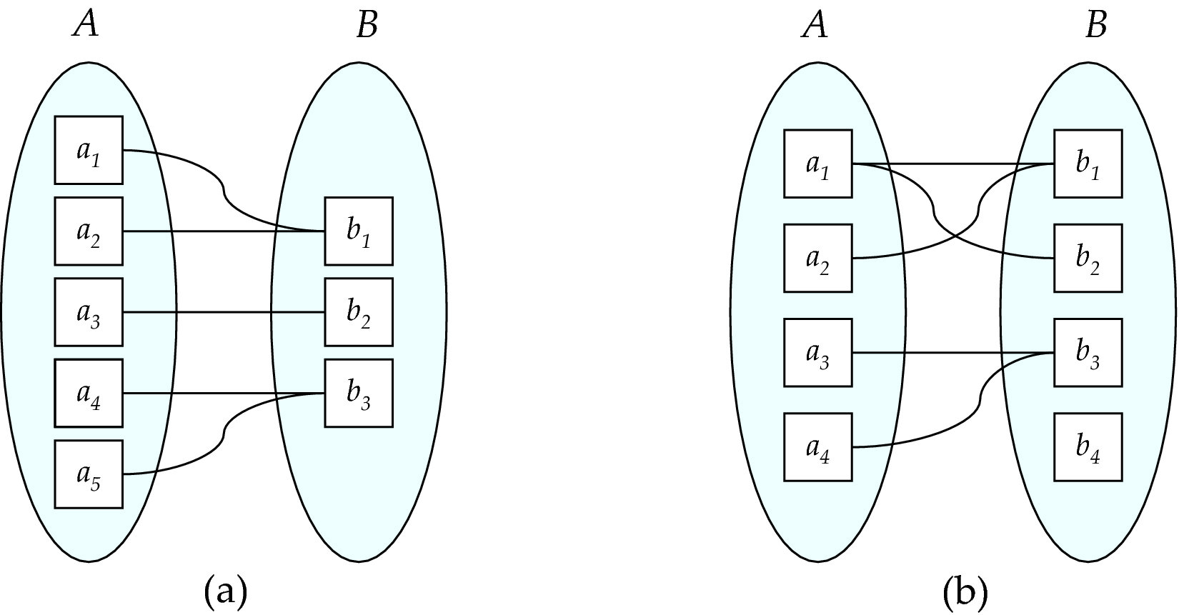
Mapping Cardinalities
Many to one
Many to many
Note: Some elements in A and B may not be mapped to any
elements in the other set

Slide 25
Many-to-One Relationships
A many-to-one relationship advisor between an instructor and a student
an instructor is associated with at most one student
and a student is associated with several (including 0) instructors

Slide 26

Many-to-Many Relationship
A many-to-many relationship advisor between an instructor and a student,
An instructor is associated with several (possibly 0) students
A student is associated with several (possibly 0) instructors

Slide 27
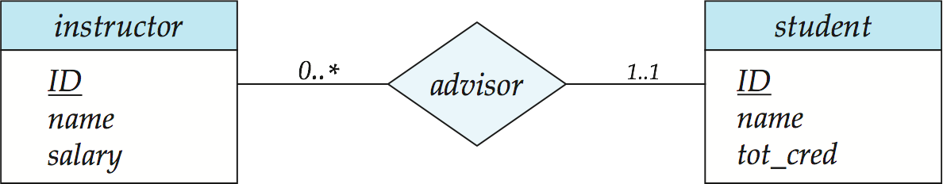
Alternative Notation for Cardinality Limits
Cardinality limits can also express participation constraints

Slide 28
Keys for Relationship Sets
What is the super key of advisor?
Notes:
Sid本身就是candidate key

Slide 29
Keys for Relationship Sets
What is the super key of advisor?
How about to track multiple meeting dates between a student and her advisor?
11 May 2006

Slide 30
Redundant Attributes
Suppose we have entity sets
instructor, with attributes including dept_name
department
and a relationship
inst_dept relating instructor and department
Attribute dept_name in entity instructor is redundant
department
inst_dept
dept_name
building
budget
dept_name

Slide 31
Participation of an Entity Set in a Relationship Set
Total participation
every entity in the entity set participates in at least one relationship in the relationship set
E.g.: every student must have an associated department
Partial participation
some entities may not participate in any relationship in the relationship set
E.g.: participation of instructor in advisor is partial

Slide 32
Total Participation Relationship

Slide 33
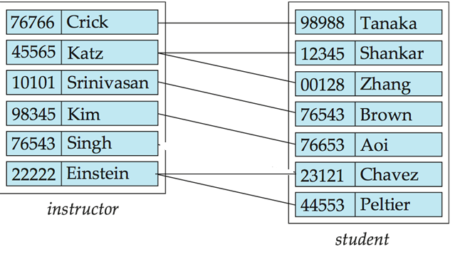
Partial Participation Relationship

Slide 34
E-R Diagram for a University Enterprise
Q: 請解釋此ER-diagram 中表達出來的關係特性
Notes:
學生對應老師-1個
老師對應學生-多個
1 對多
近-看單線還雙線(單-沒下限,雙-下限1)
遠-看有箭頭還沒箭頭(有-上限1;沒-沒上限)

Slide 35
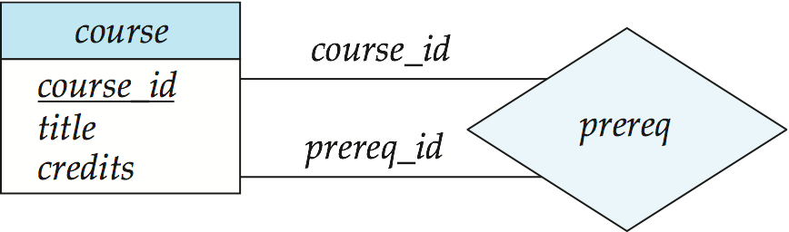
Roles
Entity sets of a relationship need not be distinct
Each occurrence of an entity set plays a “role” in the relationship
The labels “course_id” and “prereq_id” are called roles.
Notes:
(紅)一門課先修課程最多一門
(藍)一門課最多擋人一門

Slide 36
Cardinality Constraints on Ternary Relationship
We allow at most one arrow out of a ternary (or greater degree) relationship to indicate a cardinality constraint
E.g., an arrow from proj_guide to instructor indicates each student has at most one guide for a project

Slide 37
E-R Diagram with a Ternary Relationship

Slide 38
Practice Time
Construct an E-R diagram for a car insurance company
The customers own one or more cars each
Each car has associated with it zero to any number of recorded accidents.
Each insurance policy (保單) covers one or more cars
customer
accident
cus_id
name
age
a_id
time
buy
own
occur
insurrence
car
insurrance no
begin_date
for
licenece_id
type

Slide 39
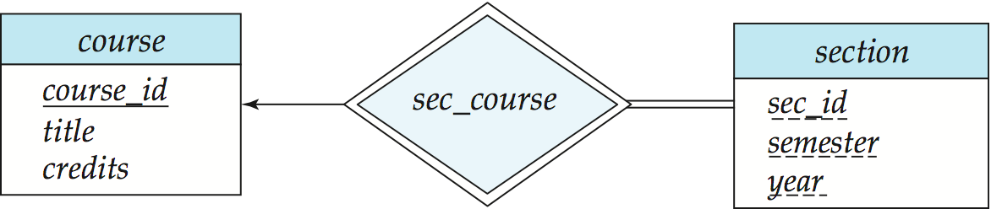
Weak Entity Sets
An entity set that does not have a primary key is referred to as a weak entity set.
The existence of a weak entity set depends on the existence of a identifying entity set
It must relate to the identifying entity set via a total, one-to-many relationship set from the identifying to the weak entity set
Identifying relationship depicted using a double diamond

Slide 40
Weak Entity Sets (Cont.)
We underline the discriminator of a weak entity set with a dashed line.
We put the identifying relationship of a weak entity in a double diamond.
account
transaction
account_no
cust_id
balance
Transactions
date
type
amount
Notes:
discriminator辨別者

Slide 41
Weak Entity Sets
The discriminator (or partial key) of a weak entity set
the set of attributes that distinguishes the entities of a weak entity set.
The primary key of a weak entity set
the primary key of the strong entity set on which the weak entity set is existence dependent,
plus the weak entity set’s discriminator.

Slide 42
Weak Entity Sets
Primary key for section
(course_id, sec_id, semester, year)

Slide 43
Practice Time
What is the primary key for transaction?
account
transaction
account_no
cust_id
balance
Transactions
date
type
amount
account_no + time

Slide 44
Practice Time
Construct an E-R diagram for a car insurance company
The customers own one or more cars each
Each car has associated with it zero to any number of recorded accidents.
Each insurrance policy (保單) covers one or more cars
Each insurance policy has one or more payments
Each payment is for a particular period of time, has a due date and a payment date
insurance
payment
insurrance_no
begin_date
insurrance_bill
due_date
payment_date
amount
Notes:
due_date(也可以用年分)
只用due_date不知道是那一張, 一天可能多張,故要加上payment_date

Slide 45
E-R Diagram for a University Enterprise
Q: 請解釋此ER-diagram 中表達出來的關係特性

Slide 46
E-R Diagram for a University Enterprise
Q: 請觀察此ER-diagram 中多了哪個關係?
classroom 的屬性適合直接記在section中嗎?

Slide 47
E-R Diagram for a University Enterprise
Q: 請觀察此ER-diagram 中多了哪些關係?
其對應資料的意義是什麼?

Slide 48
E-R Diagram for a University Enterprise

Slide 49
E-R Diagram for a University Enterprise

Slide 50
Reduction to Relational Schemas part 1

Slide 51
Reduction to Relation Schemas
Entity sets and relationship sets can be expressed uniformly as relation
Represent entity sets
Strong entity sets
Weak entity sets
Represent relationship sets
Consider the cardinality constraints

Slide 52
Representing Entity Sets With Simple Attributes
A strong entity set reduces to a schema with the same attributes
instructor(ID, name, salary)
student (ID, name, tot_cred)

Slide 53

Representing Relationship Sets
A many-to-many relationship set
is represented as a schema with
attributes for the primary keys of the two participating entity sets, and
any descriptive attributes of the relationship set.
Example: schema for relationship set advisor
advisor = (s_id, i_id)

Slide 54
Practice Time
找出 University ER-diagram 中strong entity 間的many-to-many relationship set
teaches 或 takes
2. 從schema diagram 中找出這些 many-to-many relationship set 對應的 relation 及其 primary key
teaches(ID, year, semester, course_id, sec_id)
takes(ID, year, semester, course_id, sec_id, grade)

Slide 55
Representing Relationship Sets
Many-to-one and one-to-many relationship sets that are total on the many-side
represented by adding the primary key of the “one” side to the “many” side
Student= (ID, name, tot_cred, dept_name)

Slide 56
Practice Time
找出 University ER-diagram 中strong entity 間的one-to-many relationship set
舉例: course_dept
2. 從schema diagram 中找出這些one-to-many relationship對應在哪個表中加入哪個表的 primary key?
(foreign key?)
在course 中加上department 的 primary key dept_name

Slide 57
Representing Relationship Sets
How about one-to-one relationship sets?
Notes:
57

Slide 58
Representing Relationship Sets
If participation is partial on the “many” side, replacing a schema by an extra attribute in the schema of the “many” side could result in null values

Slide 59

Representing Weak Entity Sets
A weak entity set becomes a table
- includes a column for the primary key of the identifying strong entity set
section ( course_id, sec_id, sem, year )

Slide 60
Practice Time
Which one is strong entity? Which is weak entity?
對應的表(relation)應該有哪些屬性欄位?
(foreign key?)
Strong entity: account Weak entity: transaction
account( account_no, cust_id, balance)
transaction( account_no, date, type, amount) 一天限定一筆交易
Foreign key: transaction.account
account
transaction
account_no
cust_id
balance
Transactions
date
type
amount

Slide 61
Representing Weak Entity Sets
The schema corresponding to a relationship set linking a weak entity set to its identifying strong entity set is redundant.
Example:
Notes:
61

Slide 62
Composite and Multivalued Attributes
Composite attributes are flattened out
create a separate attribute for each component attribute
Ignoring multivalued attributes
instructor(ID, first_name, middle_initial, last_name, street_number, street_name, apt_number, city, state, zip, date_of_birth)
Notes:
62
複合屬性一起描述名字
multivalue attribute 欄位先不看, age()也先不看

Slide 63
Composite and Multivalued Attributes
A multivalued attribute M of an entity E
represented by a separate schema EM
attributes: the primary key of E +
the multivalued attribute M
Example: Multivalued attribute phone_number of instructor
Represented as : inst_phone= ( ID, phone_num)
an instructor entity with ID 22222 and phone numbers 456-7890 and 123-4567
Primary key ?
Foreign key?
ID | Phone_num
22222 | 456-7890
22222 | 123-4567
Notes:
63
id 對到多支電話,故非primary key
id+phone_num為primary key
id設成foreign key指向instructor(因本來就從instructor來的)

Slide 64
Practice Time
Which one is multi-valued attribute?
對應的表(relation)應該有哪些屬性欄位?
What is primary key?
time_slot( time_slot_id, day, start_time, end_time)
Notes:
1.day,start_time,end_time
2. time_slot_id, day, start_time, end_time(原ER diagram 中primary key(time_slot_id)+multivalue attribute)
3.表中primary key:全(分開看)

Slide 65
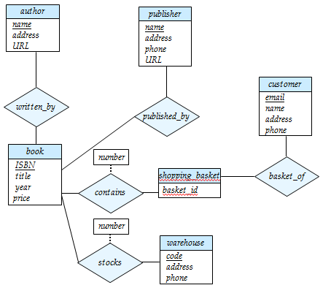
Practice Time
1. 解釋原來的ER_diagram
2. 請修改限制為
(1) 一個shopping_basket 一定對應到唯一的customer
(2) 一本book一定至少有一個且可多個出版商
(3) 一本book一定至少有一個且最多一個author
3.產生對應的 relations

Slide 66
1.p.27
2.p.29
3.p.44 payment date也是discriminator?
4.p.57-p.58 one to one relation?
5.p.60的意思應該是一筆交易只會被一個account 執行而非一天限定一筆交易吧?
6.p.61

