Slide 1
Chapter 8: Relational Database Design

Slide 2
Chapter 8: Relational Database Design
Features of Good Relational Design
Atomic Domains and First Normal Form
Functional Dependency Theory
Decomposition Using Functional Dependencies
Decomposition Algorithms
Decomposition Using Multivalued Dependencies
Database-Design Process

Slide 3
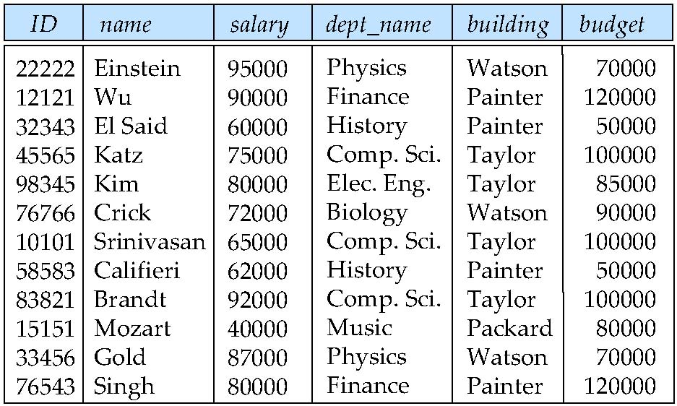
Combine Schemas?
Suppose we combine instructor and department into inst_dept
Result is possible repetition of information

Slide 4
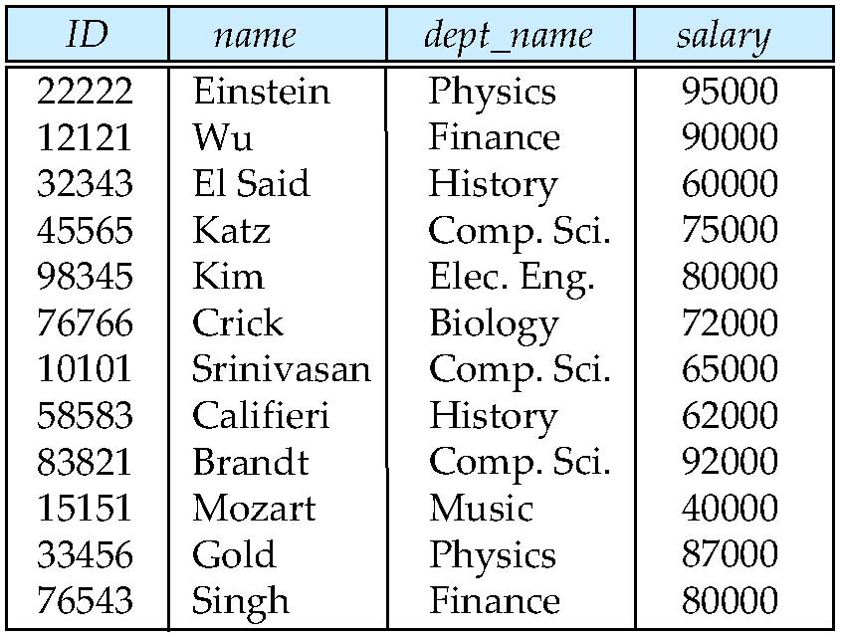
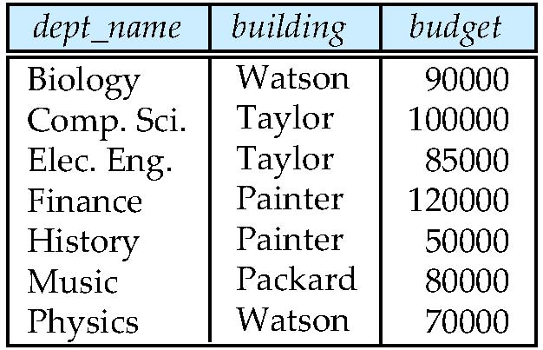
Decompose the Table

Slide 5
What About Smaller Schemas?
Suppose we had started with inst_dept.
How would we know to split up (decompose) it into instructor and department?
Functional dependency:
dept_name → building, budget
dept_name is not a candidate key,
the building and budget of a department may have to be repeated.
It indicates the need to decompose inst_dept

Slide 6
What About Smaller Schemas?
Not all decompositions are good.
Suppose we decompose employee(ID, name, street, city, salary) into
employee1 (ID, name)
employee2 (name, street, city, salary)

Slide 7
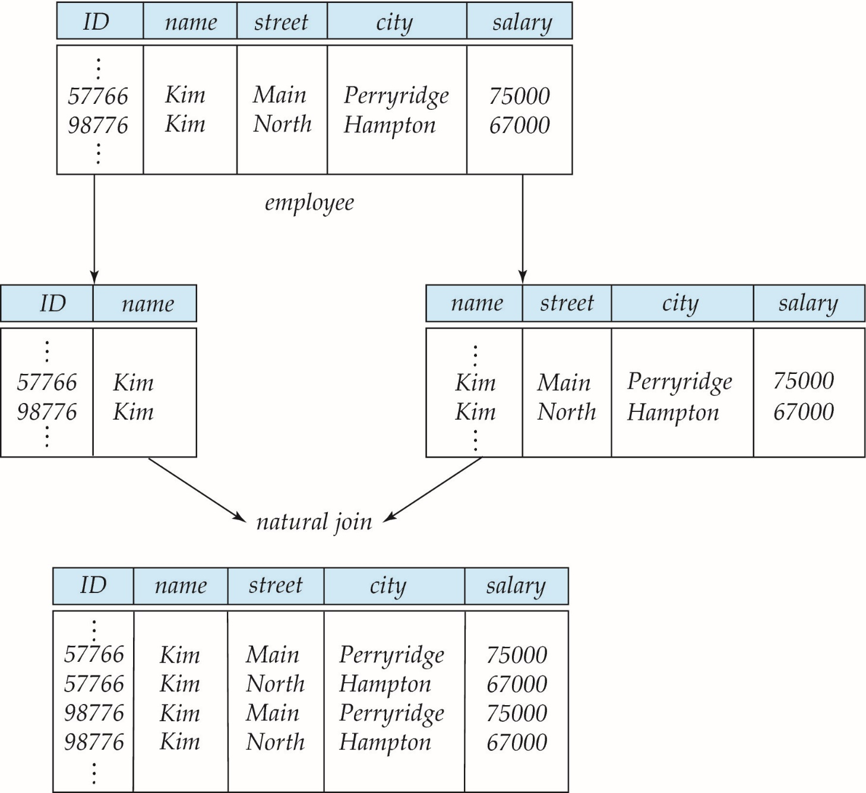
A Lossy Decomposition
we cannot reconstruct the original employee relation
=> a lossy decomposition.
Notes:
無法還原原來內容(多一筆讓人不知哪個正確)

Slide 8
Example of Lossless-Join Decomposition
Lossless join decomposition
Decomposition of R = (A, B, C) R₁ = (A, B) R₂ = (B, C)
A
B
C
A
B
B
C
α
β
1
2
A
B
α
β
1
2
1
2
A
B
r
∏_{A,B}(r)
∏_{B,C}(r)
∏_{A} (r) ∏_{B} (r)
A
B
C
α
β
1
2
A
B
Notes:
資料有重複,必須分解,但要是lossless join才能還原原來結果

Slide 9
Chapter 8: Relational Database Design
Features of Good Relational Design
Atomic Domains and First Normal Form
Functional Dependency Theory
Decomposition Using Functional Dependencies
Decomposition Algorithms
Decomposition Using Multivalued Dependencies
Database-Design Process
Notes:
有second、third normal form(愈來愈嚴格)

Slide 10
First Normal Form
Domain is atomic if its elements are considered to be indivisible units
Examples of non-atomic domains:
Set of names, composite attributes
Identification numbers like ‘CS101’ that should be broken up into parts
A relational schema R is in first normal form if the domains of all attributes of R are atomic
Notes:
relational schema 希望不要做分割處理

Slide 11
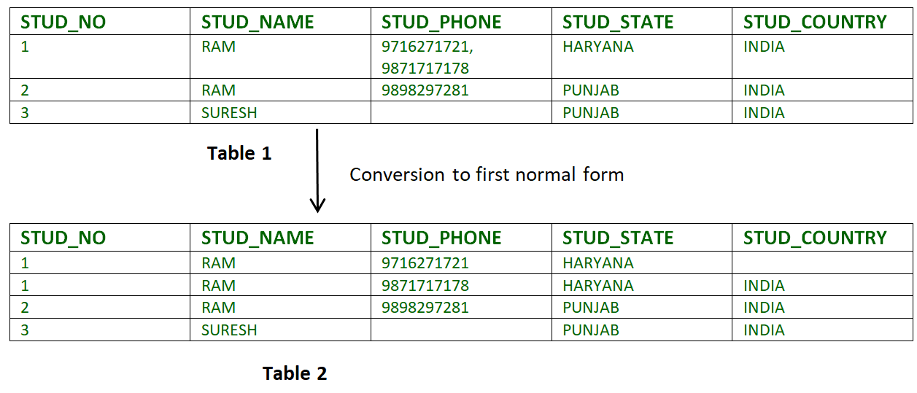
Example of First Normal Form

Slide 12
Goal — Devise a Theory for the Following
Decide whether a particular relation R is in “good” form.
In the case that a relation R is not in “good” form
decompose it into a set of relations {R₁, R₂, ..., R_{n}}
each relation is in good form
the decomposition is a lossless-join decomposition
Our theory is based on:
functional dependencies
multivalued dependencies

Slide 13
Chapter 8: Relational Database Design
Features of Good Relational Design
Atomic Domains and First Normal Form
Functional Dependency Theory
Decomposition Using Functional Dependencies
Decomposition Algorithms
Decomposition Using Multivalued Dependencies
Database-Design Process

Slide 14
Functional Dependencies
The value for a certain set of attributes determines uniquely the value for another set of attributes.
Let R be a relation schema
α ⊆ R and β ⊆ R
The functional dependency
α → β holds on R if and only if for any legal relations r(R)
t₁[α] = t₂ [α] ⇒ t₁[β ] = t₂ [β ]

Slide 15
Use of Functional Dependencies
Consider the schema:
inst_dept (ID, name, salary, dept_name, building, budget ).
Which functional dependencies are expected to hold?
dept_name→ building
ID → building
dept_name → salary

Slide 16
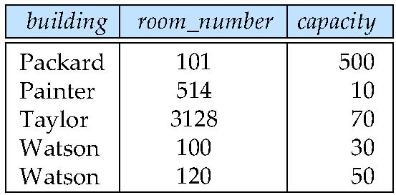
Practice Time
In the following table
room_number → capacity
building, room_number → capacity
Which one can show the real world situation?
Notes:
1不成立,因為不能只用表來定,在不同大樓可能會有同樣room number

Slide 17
Functional Dependencies
K is a superkey for relation schema R if and only if
K → R
K is a candidate key for R if and only if
K → R, and
for no α ⊂ K, α → R

Slide 18
Functional Dependencies (Cont.)
A functional dependency α → β is trivial
if β ⊆ α
Example:
ID, name → ID
name → name

Slide 19
Closure of a Set of Functional Dependencies
Given a set F of functional dependencies
there are certain other functional dependencies that are logically implied by F.
For example: If A → B and B → C, it infers that A → C
The set of all functional dependencies logically implied by F is the closure of F.
denote the closure of F by F⁺.
F⁺ is a superset of F.
Notes:
superset-母集

Slide 20
Closure of a Set of Functional Dependencies
We can find F^{+,} the closure of F, by repeatedly applying Armstrong’s Axioms:
if β ⊆ α, then α → β (reflexivity)
if α → β, then γ α → γ β (augmentation)
if α → β, and β → γ, then α → γ (transitivity)
Notes:
反身、擴增、遞移
axiom-公理

Slide 21
Example
R = (A, B, C, G, H, I) F = { A → B A → C CG → H CG → I B → H}
some members of F⁺
A → H
AG → I
CG → HI

Slide 22
Closure of Functional Dependencies (Cont.)
Additional rules:
If α → β holds and α → γ holds, then α → β γ holds (union)
If α → β γ holds, then α → β holds and α → γ holds (decomposition)
If α → β holds and γ β → δ holds, then α γ → δ holds (pseudotransitivity)
Notes:
聯集、分解、虛遞移
Additional-額外的

Slide 23
Closure of Attribute Sets
Given a set of attributes α
the closure of α under F (denoted by α⁺)
α → α⁺
derived from F

Slide 24
Example of Attribute Set Closure
R = (A, B, C, G, H, I)
F = {A → B B → C CG → H CG → I B → H}
(AG)⁺
result = AG
result = ABG
result = ABCG
result = ABCGH
result = ABCGHI

Slide 25
Closure of Attribute Sets
Algorithm to compute α⁺, the closure of α under F
result := α; while (changes to result) do for each β → γ in F do begin if β ⊆ result then result := result ∪ γ end

Slide 26
Practice Time
R = (A, B, C, G, H, I)
F = {A → B B → C CG → H CG → I B → H}
Find (BG)⁺
Notes:
BCGHI

Slide 27
Example of Attribute Set Closure
R = (A, B, C, G, H, I)
F = {A → B B → C CG → H CG → I B → H}
Is AG a candidate key?
Is AG a super key?
Does AG → R?
Is any subset of AG a superkey?
Does A → R?
Does G → R?

Slide 28
Uses of Attribute Closure
There are several uses of the attribute closure algorithm:
To test if α is a superkey:
check if α⁺ contains all attributes of R
Example: R = (A, B, C, G, H, I)
F = {A → B B → C CG → H CG → I B → H}
Find superkeys of R

Slide 29
Uses of Attribute Closure
To check if a functional dependency α → β holds
check if β ⊆ α⁺
Example: R = (A, B, C, G, H, I)
F = {A → B B → C CG → H CG → I B → H}
Whether BG → HI ?

Slide 30
Uses of Attribute Closure
Computing closure of F
For each γ ⊆ R, we find the closure γ⁺, and for each S ⊆ γ⁺, we output a functional dependency γ → S.
Example: R = (A, B, C, G)
F = {A → B A → C B → G}

Slide 31
Practice Time
Given a relation R(A, B, C, D, E) and Functional dependencies
F = {AB → DE C → A
D → C}
Which of the following FDs can be inferred?
AB → CE
BC → A
AB → A
C → E
BC → E
B → DE
Notes:
abce

Slide 32
Canonical Cover
Sets of functional dependencies may redundant
For example: A → C is redundant in:
{A → B, B → C, A→ C}
Parts of a functional dependency may be redundant
E.g.: on RHS: {A → B, B → C, A → CD} can be simplified to {A → B, B → C, A → D}
E.g.: on LHS: {A → B, B → C, AD → C} can be simplified to {A → B, B → C, A → C}
Notes:
RHS-right hand side
LHS-left hand side
canonical-related to a rule, principle, or law, especially in the Christian Church

Slide 33
Extraneous Attributes
Consider a set F of functional dependencies and the functional dependency α → β in F.
Attribute A is extraneous in α if A ∈ α, and F logically implies (α – A) → β.
Example: Given F = {A → C, AB → C }
B is extraneous in AB → C
Notes:
extraneous-not directly connected with or related to something:

Slide 34
Testing if an Attribute is Extraneous
Consider a set F of functional dependencies and the functional dependency α → β in F.
To test if attribute A ∈ α is extraneous in α
compute ({α} – A)⁺ using the dependencies in F
check whether ({α} – A)⁺ contains β
Example: Given F = {A → C, AB → C }
B is extraneous in AB → C
Notes:
看左邊(LHS)之attribute是否是Extraneous:
法一:compute ({α} – A)⁺ ,並看其是否包含β(是->為extraneous,否->不為extraneous)
法二:去掉A屬性,看其他functional dependency 是否可推到剩餘之functional dependency(可->為extraneous,不可->不為extraneous)

Slide 35
Extraneous Attributes (cont.)
Consider a set F of functional dependencies and the functional dependency α → β in F.
Attribute A is extraneous in β if A ∈ β and (F – {α → β} ) ∪ {α →(β – A)} logically implies F.
Example: Given F = {A → C, AB → CD}
C is extraneous in AB → CD
Notes:
看右邊(RHS)之attribute是否是Extraneous:
法一:check if (F – {α → β} ) ∪ {α →(β – A)} logically implies F.
法二:
1.compute α⁺ using only the dependencies in F’ = (F – {α → β}) ∪ {α →(β – A)},
2.check whether α⁺ contains A
法三:去掉A屬性,看其他functional dependency 是否可推到去掉那項之functional dependency(可->為extraneous,不可->不為extraneous)

Slide 36
Testing if an Attribute is Extraneous
Consider a set F of functional dependencies and the functional dependency α → β in F.
To test if attribute A ∈ β is extraneous in β
compute α⁺ using only the dependencies in F’ = (F – {α → β}) ∪ {α →(β – A)},
check whether α⁺ contains A
Example: Given F = {A → C, AB → CD}
C is extraneous in AB → CD

Slide 37
Canonical Cover
A canonical cover for F is a set of dependencies F_{c} such that
F ⇔ F_{c,} and
No functional dependency in F_{c} contains an extraneous attribute, and
Each left side of functional dependency in F_{c} is unique.
Notes:
canonical-related to a rule, principle, or law, especially in the Christian Church:

Slide 38
Compute a Canonical Cover
To compute a canonical cover for F: repeat Use the union rule to replace any dependencies in F α₁ → β₁ and α₁ → β₂ with α₁ → β₁ β₂
Find a functional dependency α → β with an extraneous attribute either in α or in β
If an extraneous attribute is found, delete it from α → β
until F does not change

Slide 39
Computing a Canonical Cover
R = (A, B, C) F = {A → BC B → C A → B AB → C}
Combine A → BC and A → B into A → BC
Set is now {A → BC, B → C, AB → C}
A is extraneous in AB → C
Set is now {A → BC, B → C}
C is extraneous in A → BC
The canonical cover is: A → B B → C

Slide 40
Practice Time
Consider the following three sets of functional dependencies over a relation R(A, B, C, D)
F1 = { A → B, B → C, A → CD }
F2 = { A → BD, B → C }
F3 = { A → BC, B → CD }
Are F1 and F2 equivalent?
Are F2 and F3 equivalent?
Are F1 and F3 equivalent?
Notes:
true false false

Slide 41
Practice Time
}
What is the canonical of
F = { A → BC, CD → E, B → D, E → A} on R(A, B, C, D, E)?
Other examples:
F = {A → BC, B → C, A → B, AB → C}
F = {A → B, AB → C, D → AC, D → E}

