Slide 1
Aggregate Functions
These functions operate on the multiset of values of a column of a relation, and return a value
avg: average value min: minimum value max: maximum value sum: sum of values count: number of values

Slide 2
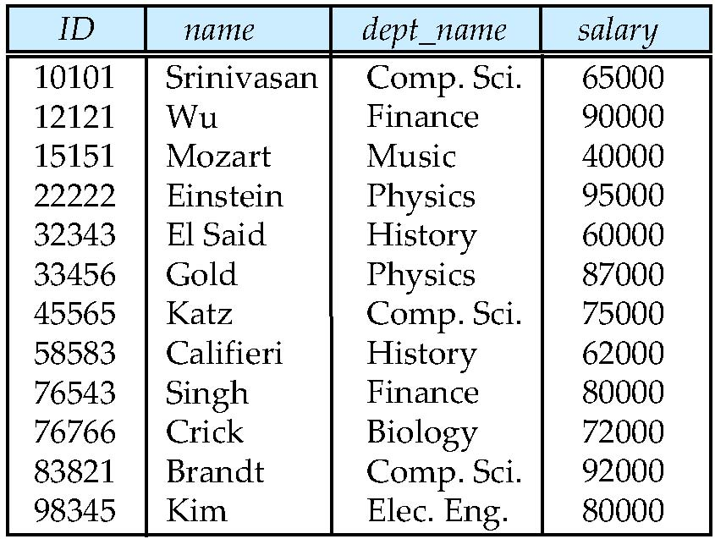
Aggregate Functions (Cont.)
Find the average salary of instructors in the Computer Science department
select avg (salary) as avg_salary from instructor where dept_name= ’Comp. Sci.’;
instructor
avg_salary
77333

Slide 3
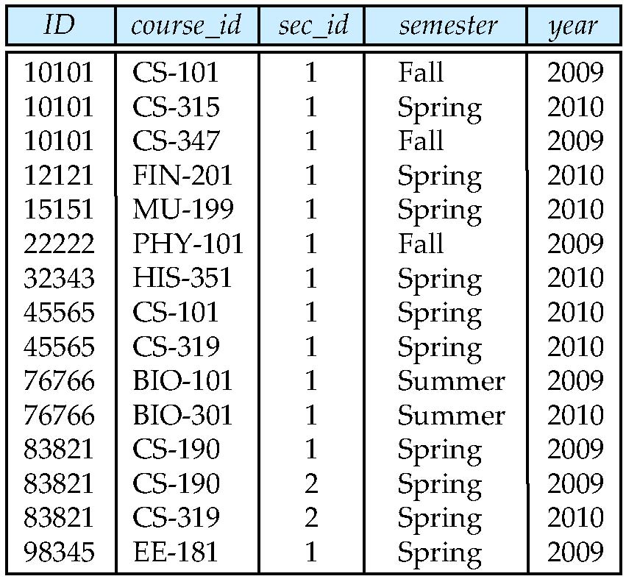
Aggregate Functions (Cont.)
Find the total number of instructors who teach a course in the Spring 2010 semester
select count (distinct ID) from teaches where semester = ’Spring’ and year = 2010;
teaches
count(distinct ID)
6

Slide 4
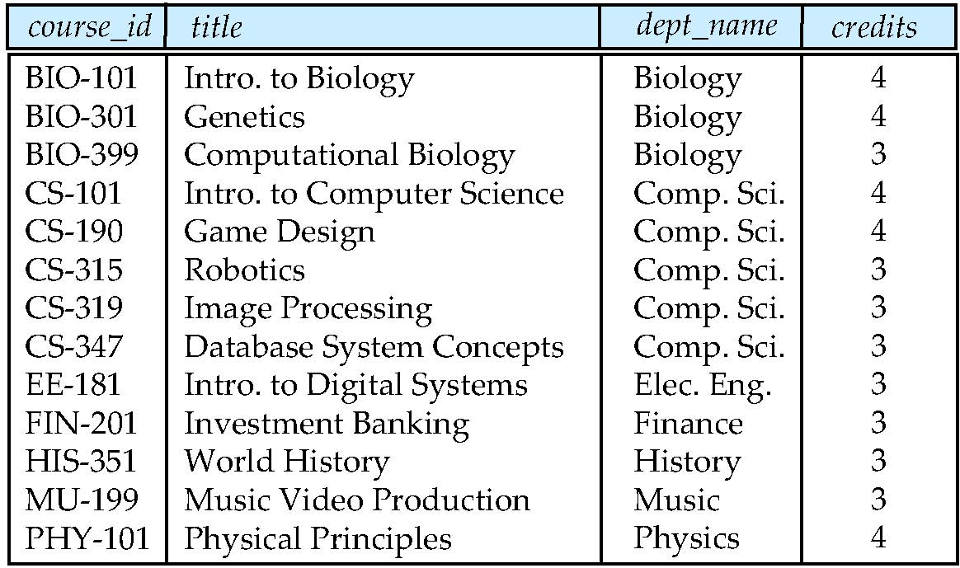
Aggregate Functions (Cont.)
Find the number of tuples in the course relation
select count (*) from course;
course
count(*)
13

Slide 5
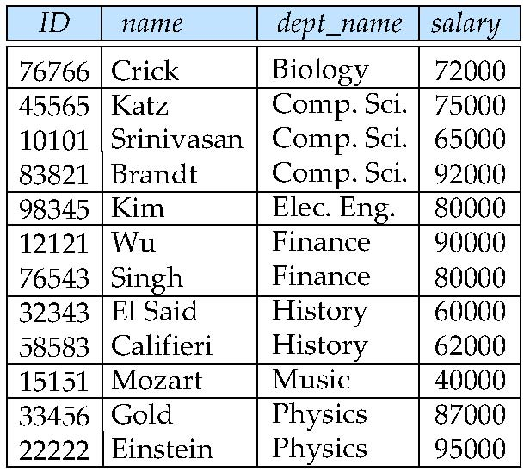
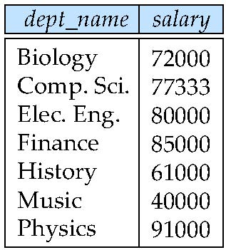
Aggregate Functions – Group By
Find the average salary of instructors in each department
select dept_name, avg(salary) as avg_salary from instructor group by dept_name;
round(avg(salary) )
instructor
avg_salary

Slide 6
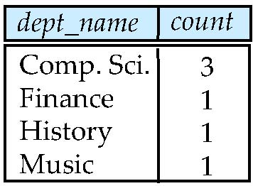
Aggregate Functions (Cont.)
Find the number of instructors in each department who teach a course in the Spring 2010 semester
select dept_name, count(distinct ID) as count from instructor natural join teaches where semester = ’Spring’ and year = 2010 group by dept_name;
teaches

Slide 7
Aggregation (Cont.)
Attributes in select clause outside of aggregate functions must appear in group by list
/* erroneous query */ select dept_name, ID, avg (salary) from instructor group by dept_name;
Notes:
erroneous不正確的
ID不可以出現!
下max 無法對應最高薪是哪個老師

Slide 8
Practice Time
Find the highest salary of instructors.
Find the highest salary of the instructors in each department.

Slide 9
Practice Time
Find the enrollment (修課人數) of each section that was offered in Autumn 2009.

Slide 10
Aggregate Functions – Group By
Find the average salary of instructors in each department
select dept_name, avg(salary) as avg_salary from instructor group by dept_name;
round(avg(salary) )
instructor
avg(salary)

Slide 11
Aggregate Functions – Group By
Find the average salary of instructors in each department
select dept_name, avg(salary) as avg_salary from instructor group by dept_name;
round(avg(salary) )
instructor
avg(salary)

Slide 12
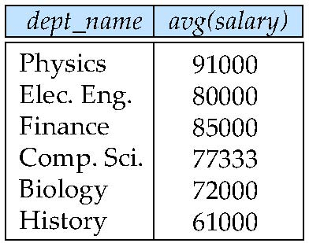
Aggregate Functions – Having Clause
Find the names and average salaries of all departments whose average salary is greater than 42000
select dept_name, round(avg(salary))
from instructor
group by dept_name
having avg (salary) > 42000;
instructor
avg(salary)

Slide 13
Aggregate Functions – Having Clause
For each course section offered in 2009, find the average total credits (tot_cred) of all students enrolled in the section, if the section had at least 2 students
select course_id, semester, year, sec_id, avg (total_cred)
from takes natural join student
where year =2009
group by course_id, semester, year, sec_id
having count(ID) >= 2;

Slide 14
Practice Time
Find the course_id and section_id for the sections in Autumn 2009 whose enrollment is larger than 2 students.

Slide 15
Null Values and Aggregates
Total salaries
select sum (salary ) from instructor
All aggregate operations except count(*) ignore tuples with null values on the aggregated attributes
What if collection has only null values?
count returns 0
all other aggregates return null

Slide 16
Nested Subqueries
SQL provides a mechanism for the nesting of subqueries.
A subquery is a select-from-where expression that is nested within another query.
A common use of subqueries is to perform tests for
set membership (in)
set comparisons (>some, > all)
set cardinality (exist)
select distinct course_id
from section
where semester = ’Fall’ and year= 2009 and course_id in (select course_id
from section
where semester = ’Spring’ and year= 2010);

Slide 17
Example Nested Subqueries (in)
Find courses offered in Fall 2009 and in Spring 2010
(select course_id
from section
where semester = ’Spring’ and year= 2010);
select distinct course_id
from section
where semester = ’Fall’ and year = 2009 and course_id in
(select course_id
from section
where semester = ’Spring’ and year = 2010);

Slide 18
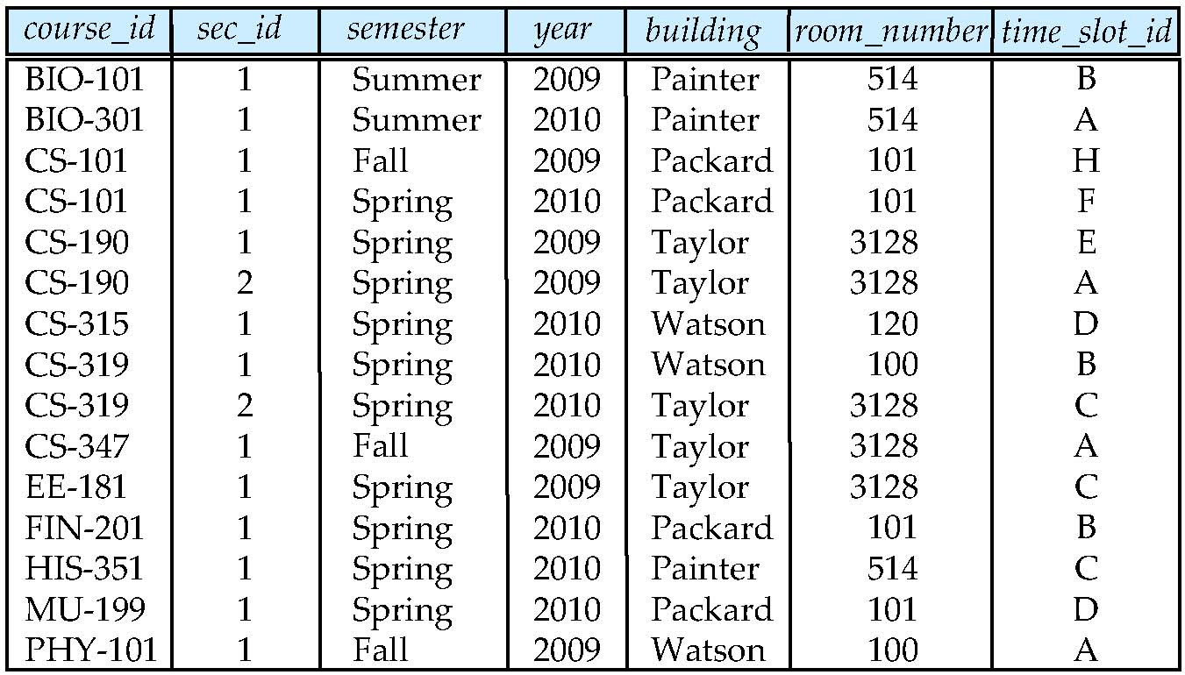
Example Nested Subqueries (in)
select distinct course_id
from section
where semester = ’Fall’ and year = 2009 and course_id in
(select course_id
from section
where semester = ’Spring’ and year = 2010);
course_id
CS-101
CS-315
CS-319
CS-319
FIN-201
HIS-351
MU-199
course_id
CS-101

Slide 19
Example Nested Subqueries (not in)
Find courses offered in Fall 2009 but not in Spring 2010
(select course_id
from section
where semester = ’Spring’ and year= 2010);
select distinct course_id
from section
where semester = ’Fall’ and year= 2009 and course_id not in
(select course_id
from section
where semester = ’Spring’ and year= 2010);

Slide 20
Example Nested Subqueries (not in)
select distinct course_id
from section
where semester = ’Fall’ and year = 2009 and course_id not in
(select course_id
from section
where semester = ’Spring’ and year = 2010);
course_id
CS-101
CS-315
CS-319
CS-319
FIN-201
HIS-351
MU-199
course_id
CS-347
PHY-101

Slide 21
Example Nested Subqueries (in)
Find the total number of (distinct) students who have taken course sections taught by the instructor with ID 10101
select count (distinct ID)
from takes
where (course_id, sec_id, semester, year) in (select course_id, sec_id, semester, year
from teaches
where teaches.ID= 10101);

Slide 22
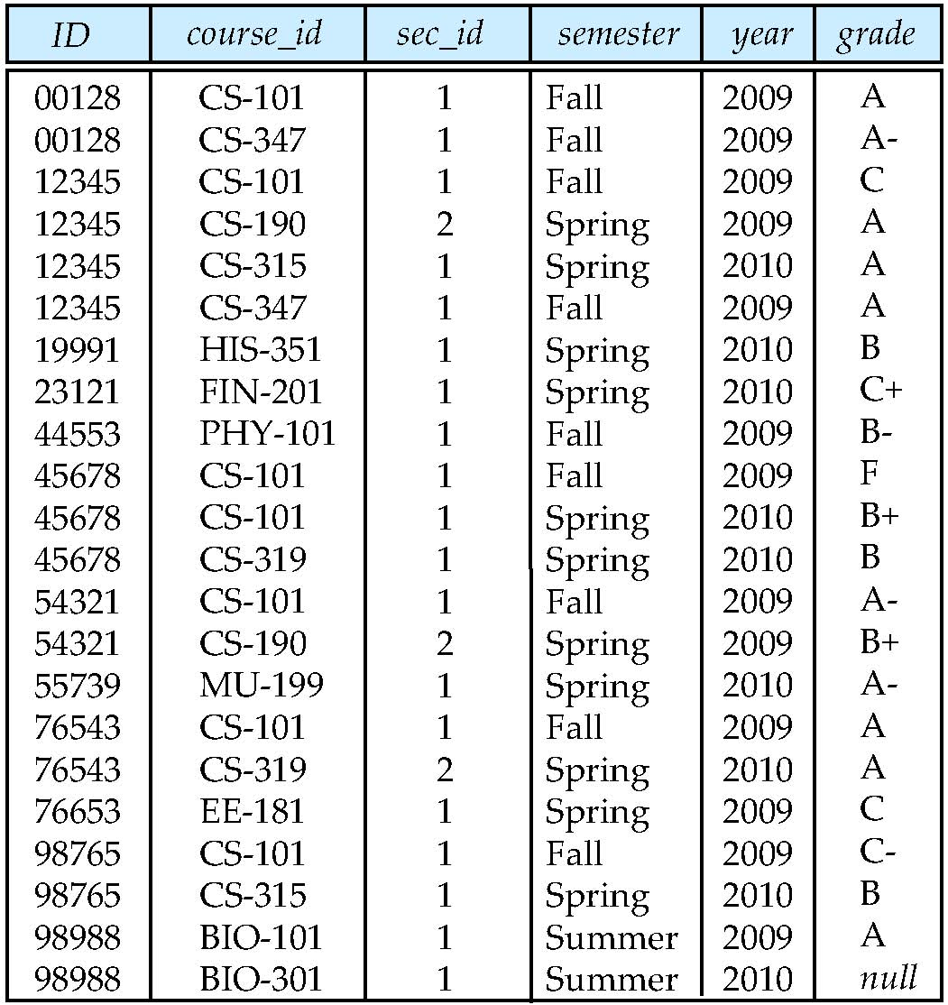
Example Nested Subqueries (in)
select count (distinct ID)
from takes
where (course_id, sec_id, semester, year) in (select course_id, sec_id, semester, year
from teaches
where teaches.ID= 10101);
count (distinct ID)
3

Slide 23
Set Comparison
Find names of instructors with salary greater than that of some (at least one) instructor in the Comp. Sci. department.
select distinct T.name
from instructor as T, instructor as S
where T.salary > S.salary and S.dept name = ’Comp. Sci.’;
Same query using > some clause
select name
from instructor
where salary > some
(select salary
from instructor
where dept name = ’Comp. Sci.’);

Slide 24
Example of Set Comparison
instructor
instructor
T
S
S
select distinct T.name
from instructor as T, instructor as S
where T.salary > S.salary and S.dept name = ’Comp. Sci.’;

Slide 25
Example of Set Comparison
instructor
salary
65000
75000
92000
name
Wu
Einstein
Gold
Katz
Singh
Crick
Brandt
Kim
select name
from instructor
where salary > some (select salary
from instructor
where dept name = ’Comp. Sci.’);

Slide 26
Definition of Some Clause
F <comp> some r ⇔ ∃ t ∈ r such that (F <comp> t ) Where <comp> can be: <, ≤, >, =, ≠
0
(5 < some
5
) =
True
(read: 5 < some tuple in the relation)
6
0
(5 < some
False
5
) =
0
True
(5 = some
) =
5
0
(5 ≠ some
) =
5
True
(since 0 ≠ 5)
(= some) ≡ in
However, ≠ some) ≡ not in

Slide 27
Example of Set Comparison
Find the names of all instructors whose salary is greater than the salary of all instructors in the Comp. Sci. department.
instructor
salary
65000
75000
92000
name
Einstein
select name
from instructor
where salary > all (select salary
from instructor
where dept name = ’Comp. Sci.’);

Slide 28
Definition of all Clause
F <comp> all r ⇔ ∀ t ∈ r (F <comp> t)
0
(5 < all
5
) =
False
6
6
True
(5 < all
) =
10
4
False
(5 = all
) =
5
4
(since 5 ≠ 4 and 5 ≠ 6)
(5 ≠ all
) =
6
True
(≠ all) ≡ not in
However, (= all) ≡ in

Slide 29
Practice Time
Find the instructor who has the highest salary of instructors. (please use nested subquery)

Slide 30
Practice Time
Find the names of all instructors who didn’t teach any course. (use subqueries and not in)

Slide 31
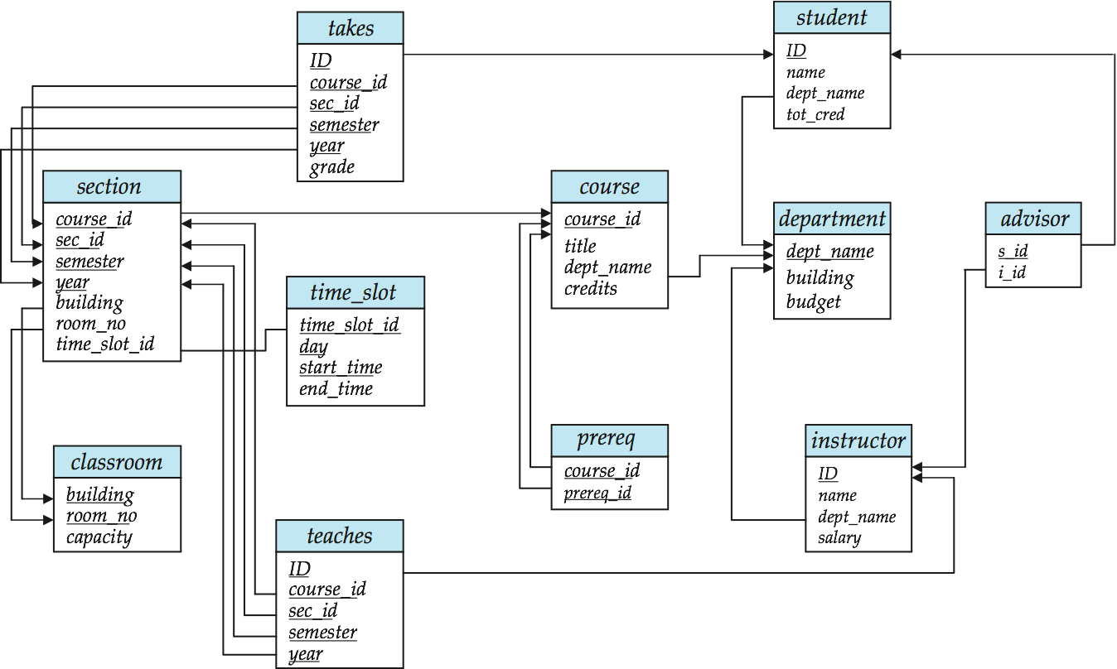
Schema Diagram for University Database

Slide 32
期中考5/3考到3-2

