Slide 1
Test for Empty Relations
The exists construct returns the value true if the argument subquery is nonempty.
exists r ⇔ r ≠ Ø
not exists r ⇔ r = Ø

Slide 2
Correlation Variables
“Find all courses taught in both the Fall 2009 semester and in the Spring 2010 semester”
select course_id from section as S where S.semester = ’Fall’ and S.year = 2009 and exists (select * from section as T where T.semester = ’Spring’ and T.year= 2010 and T.course_id = S.course_id );
Correlated subquery
Correlation name or correlation variable

Slide 3
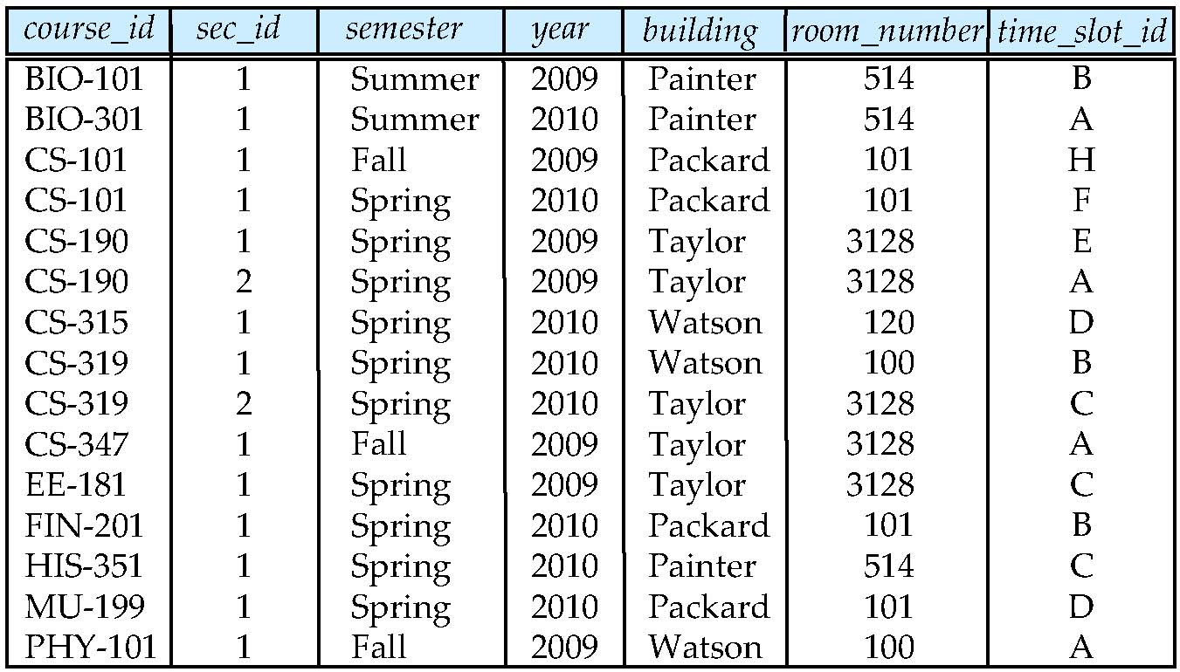
Example of Set-Difference
section
S→
T
S→
S→
course_id
CS-101
select course_id from section as S where S.semester = ’Fall’ and S.year = 2009 and exists (select * from section as T where T.semester = ’Spring’ and T.year= 2010 and T.course_id=S.course_id );
CS-101
BIO-101
BIO-301

Slide 4
Not Exists
Find all students who have taken all courses offered in the Biology department.
select distinct S.ID, S.name
from student as S
where not exists (
(select course_id
from course
where dept_name = ’Biology’
courses offered in
Biology
and course_id not in
courses a particular
student S took
(select T.course_id
from takes as T
where T.ID = S.ID)
);
Note that X – Y = Ø ⇔ X ⊆ Y
Note: Cannot write this query using = all

Slide 5
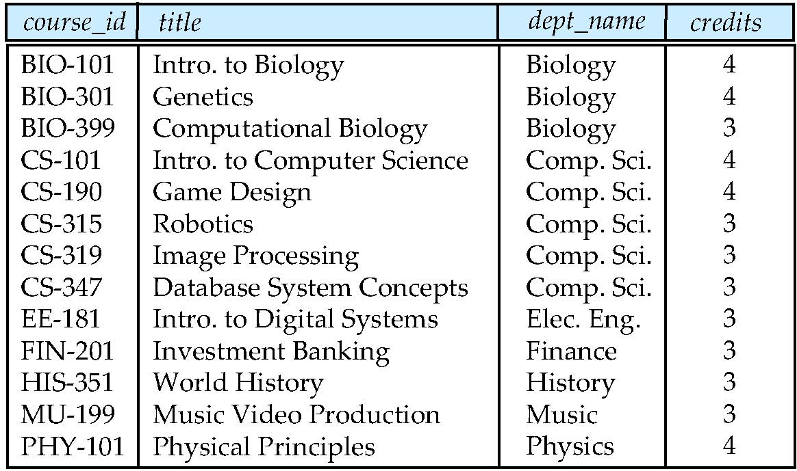
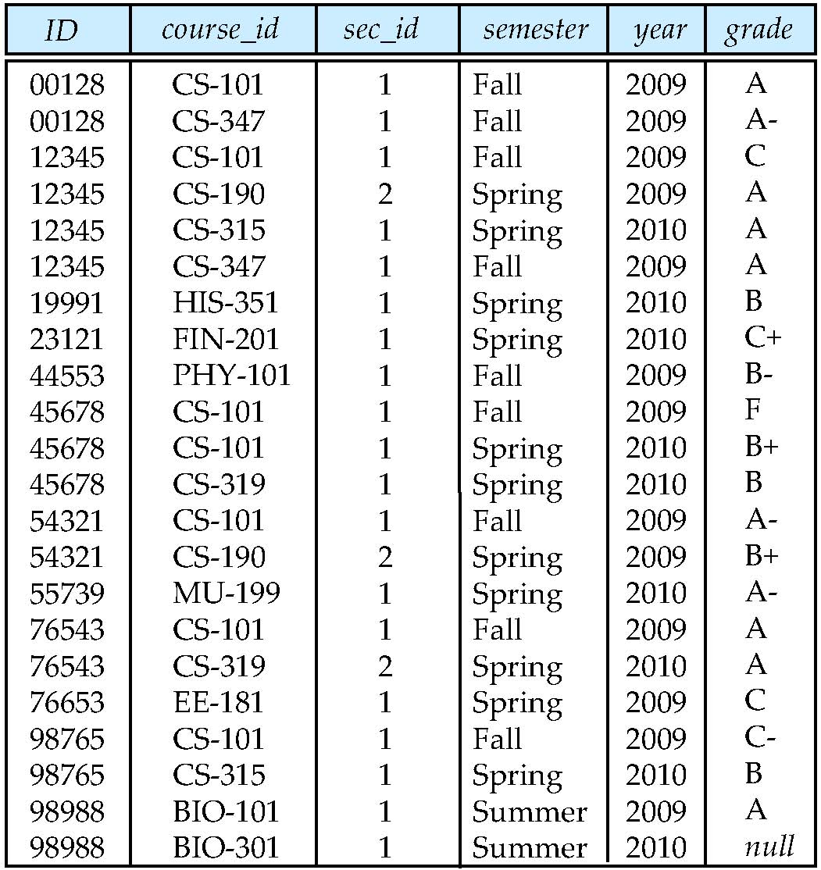
Not Exists
select distinct S.ID, S.name
from student as S
where not exists (
(select course_id
from course
where dept_name = ’Biology’
and course_id not in
(select T.course_id
from takes as T
where T.ID = S.ID)
ID | name | dept_name | tot_cred
98765 | John | Comp. CS | 40
98988 | Mary | Biology | 30
S→
S→
ID | name
98988 | Mary

Slide 6
Practice Time
Find the IDs of all instructors who didn’t teach any course (use subqueries and not exist).

Slide 7
Test for Absence of Duplicate Tuples
The unique construct tests whether a subquery has any duplicate tuples in its result.
If duplicate: evaluates to False
The unique construct evaluates to True on an empty set.
Find all course ids that were offered only once in 2009
select T.course_id from course as T where unique (select R.course_id from section as R where R.course_id =T.course_id and R.year = 2009);

Slide 8
Test for Absence of Duplicate Tuples
select T.course_id from course as T where unique (select R.course_id from section as R where R.course_id =T.course_id and R.year = 2009);
T→
course_id
BIO-101
CS-101
CS-347
EE-181
PHY-101
T→
T→

Slide 9
Test for Absence of Duplicate Tuples
Find all course titles that were offered only once in 2009
select T.course_id from course as T where unique (select R.course_id from section as R where R.course_id =T.course_id and R.year = 2009);
select T.course_id from course as T where 1 = (select count(R.course_id) from section as R where R.course_id =T.course_id and R.year = 2009);

Slide 10
Subqueries in the Form Clause
SQL allows a subquery expression to be used in the from clause
Find the average instructors’ salaries of those departments where the average salary is greater than $42,000.”
select dept_name, avg_salary from (select dept_name, avg (salary) as avg_salary from instructor group by dept_name) where avg_salary > 42000;
select dept_name, avg (salary)
from instructor group by (dept_name) having avg (salary) > 42000;
Notes:
屬性重新命名時,表格也要重新命名

Slide 11
Subqueries in the Form Clause
select dept_name, avg_salary from (select dept_name, avg (salary) as avg_salary from instructor group by dept_name) where avg_salary > 42000;
Another way to write above query
select dept_name, avg_salary from (select dept_name, avg (salary) from instructor group by dept_name ) as dept_avg (dept_name, avg_salary)
where avg_salary > 42000;
Notes:
select dept_name, avg_salary from (select dept_name, avg (salary) from instructor group by dept_name ) as dept_avg (dept_name, avg_salary)
where avg_salary > 42000;
無上述寫法

Slide 12
With Clause
The with clause provides a way of defining a temporary relation whose definition is available only to the query in which the with clause occurs.
Find all departments with the maximum budget
with max_budget (value) as (select max(budget) from department)
select budget from department, max_budget where department.budget = max_budget.value;

Slide 13
Complex Queries using With Clause
Find all departments where the total salary is greater than the average of the total salary at all departments
with dept _total (dept_name, value) as
(select dept_name, sum(salary)
from instructor
group by dept_name),
dept_total_avg(value) as
(select avg(value)
from dept_total)
select dept_name
from dept_total, dept_total_avg
where dept_total.value >= dept_total_avg.value;

Slide 14
Practice Time
Find the sections that had the maximum enrollment in Autumn 2009.

Slide 15
Modification of the Database
Deletion of tuples from a given relation
Insertion of new tuples into a given relation
Updating of values in some tuples in a given relation

Slide 16
Deletion
Delete all instructors
delete from instructor
Delete all instructors from the Finance department
delete from instructor where dept_name= ’Finance’;

Slide 17
Deletion
Delete all tuples in the instructor relation for those instructors associated with a department located in the Watson building.
delete from instructor where dept name in (select dept name from department where building = ’Watson’);

Slide 18
Deletion (Cont.)
Delete all instructors whose salary is less than the average salary of instructors
delete from instructor
where salary < (select avg (salary) from instructor);
Problem: as we delete tuples from deposit, the average salary changes
Solution used in SQL:
1. First, compute avg salary and find all tuples to delete
2. Next, delete all tuples found above (without recomputing avg)

Slide 19
Insertion
Add a new tuple to course
insert into course values (’CS-437’, ’Database Systems’, ’Comp. Sci.’, 4);
or equivalently
insert into course (course_id, title, dept_name, credits) values (’CS-437’, ’Database Systems’, ’Comp. Sci.’, 4);
Add a new tuple to student with tot_creds set to null
insert into student values (’3003’, ’Green’, ’Finance’, null);

Slide 20
Insertion (Cont.)
Add all instructors to the student relation with tot_creds set to 0
insert into student select ID, name, dept_name, 0 from instructor
The select from where statement is evaluated fully before any of its results are inserted into the relation.
Otherwise queries like
insert into table1 select * from table1
would cause problem

Slide 21
Updates
Increase salaries of instructors whose salary is over $100,000 by 3%, and all others receive a 5% raise
Write two update statements:
update instructor set salary = salary * 1.03 where salary > 100000;
update instructor set salary = salary * 1.05 where salary <= 100000;
The order is important
Can be done better using the case statement (next slide)

Slide 22
Case Statement for Conditional Updates
Same query as before but with case statement
update instructor set salary = case when salary <= 100000 then salary * 1.05 else salary * 1.03 end

Slide 23
Updates with Scalar Subqueries
Recompute and update tot_creds value for all students
update student S set tot_cred = ( select sum(credits) from takes natural join course where takes.ID=S.ID and takes.grade <> ’F’ and takes.grade is not null);
The above query will set tot_creds to null for students who have not taken any course
Notes:
有修課and有過and有成績

Slide 24
Updates with Scalar Subqueries
Instead of sum(credits), use:
update student S set tot_cred = (select case when sum(credits) is not null
then sum(credits) else 0 end from takes natural join course where takes.ID=S.ID and takes.grade <> ’F’ and takes.grade is not null);

Slide 25
Practice Time
Increase the salary of each instructor in the Comp. Sci. department by 10%.

Slide 26
Practice Time
Delete all courses that have never been offered (that is, do not occur in the section relation).

Slide 27
Practice Time
Insert every student whose tot_cred attribute is greater than 100 as an instructor in the same department, with a salary of $10,000.

Slide 28
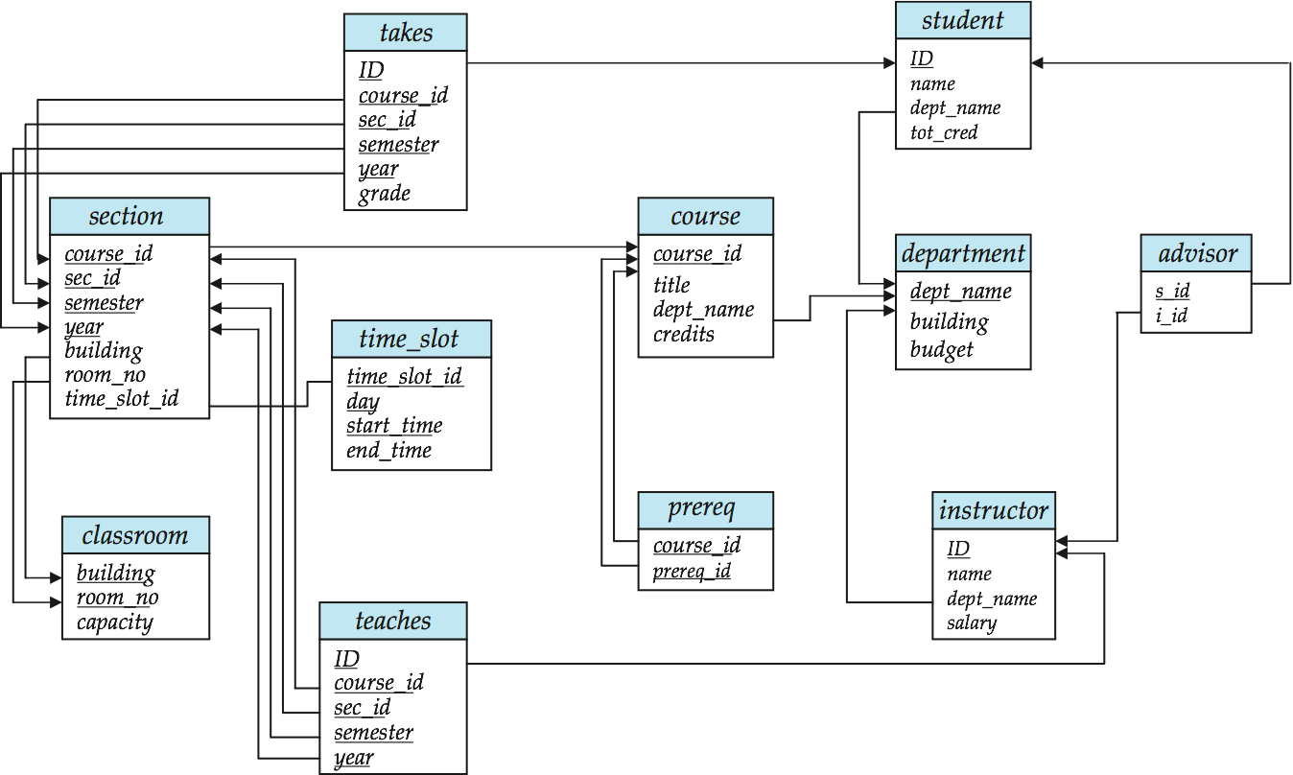
Schema Diagram for University Database

Slide 29
問題
1.p11

