Slide 1
Chapter 4: Intermediate SQL

Slide 2
Chapter 4: Intermediate SQL
View
Transaction
Integrity Constraints
Built-in Data Types in SQL
Index
Authorization
Notes:
1

Slide 3
Views
It is not desirable for all users to see all the actual relations stored in the database.
Consider a person who needs to know an instructors name and department, but not the salary.
This person should see a relation described, in SQL, by select ID, name, dept_name from instructor
A view
a mechanism to hide certain data from the view of certain users.

Slide 4
View Definition
A view is defined using the create view statement
create view v as < query expression >
where <query expression> is any legal SQL expression.
The view name can be used to refer to the virtual relation that the view generates.

Slide 5
Example Views
A view of instructors without their salary create view faculty as select ID, name, dept_name from instructor
Find all instructors in the Biology department select name from faculty where dept_name = 'Biology'

Slide 6
Example Views
Create a view of department salary totals
create view departments_total_salary(dept_name, total_salary) as select dept_name, sum(salary) from instructor group by dept_name;

Slide 7
Views Defined Using Other Views
create view physics_fall_2009 as select course.course_id, sec_id, building, room_number from course, section where course.course_id = section.course_id and course.dept_name = 'Physics' and section.semester = 'Fall' and section.year = '2009';
create view physics_fall_2009_watson as select course_id, room_number from physics_fall_2009 where building= 'Watson';

Slide 8
View Expansion
Expand use of a view in a query/another view
create view physics_fall_2009_watson as select course_id, room_number from physics_fall_2009 where building= ’Watson’;
create view physics_fall_2009_watson as
select course_id, room_number
from (select course.course_id, building, room_number
from course, section
where course.course_id = section.course_id
and course.dept_name = ’Physics’
and section.semester = ’Fall’
and section.year = ’2009’)
where building= ’Watson’;

Slide 9
Update of a View
instructor (ID, name, dept_name, salary)
create view faculty as select ID, name, dept_name from instructor
faculty(ID, name, dept_name)
Add a new tuple to faculty view which we defined earlier
insert into faculty values ('630765', 'Green ', 'Music ');
This insertion must be represented by inserting the tuple
('30765', 'Green', 'Music', null)
into the instructor relation

Slide 10
Some Updates cannot be Translated Uniquely
instructor (ID, name, dept_name, salary)
=
Instructor_info (ID, name, building)
department (dept_name, building, budget)
create view instructor_info as select ID, name, building from instructor, department where instructor.dept_name= department.dept_name;
insert into instructor_info values ('69987', 'White', 'Taylor');
which department, if multiple departments in Taylor?
what if no department is in Taylor?
Notes:
view若結合兩個以上無法update,因無法對應回去原表

Slide 11
Updates on Views
Most SQL implementations allow updates only on simple views
The from clause has only one database relation.
The select clause contains only attribute names of the relation, and does not have any expressions, aggregates, or distinct specification.
The query does not have a group by or having clause.
create view faculty as select ID, name, dept_name from instructor
create view instructor_info as select ID, name, building from instructor, department where instructor.dept_name= department.dept_name;
X

Slide 12
More Problems
create view history_instructors as select * from instructor where dept_name= 'History';
What happens if we perform
insert into history_instructors
values ('25566', 'Brown', 'Biology', 100000)
instructor (ID, name, dept_name, salary)
history_instructor (ID, name, dept_name, salary)
Notes:
透過view做update會放在底層的表(但建議不要透過view做update)。就此例而言,若再次對instructor查詢dept_name=‘History’會查不到,因為新增的資料是’Biology’。

Slide 13
Chapter 4: Intermediate SQL
View
Transaction
Integrity Constraints
Built-in Data Types in SQL
Index
Authorization
Notes:
1

Slide 14
Transactions
Unit of work
Atomic transaction
either fully executed or rolled back as if it never occurred
一套一起賣, 要嘛就全買, 不然就全部退(這裡是指一套指令)
(similar to buy/return a package of products)
像 Word 中編輯內容的改變
(Save/Quit without save editing)
Isolation from concurrent transactions

Slide 15
Transactions
Transactions begin implicitly
Ended by commit work or rollback work
像word 編輯後 “儲存” 跟 “不儲存直接關閉”
on most databases:
each SQL statement commits automatically
Can turn off auto commit for a session (e.g. using API)
In SQL:1999, can use: begin atomic …. end

Slide 16
Chapter 4: Intermediate SQL
View
Transaction
Integrity Constraints
Built-in Data Types in SQL
Index
Authorization
Notes:
1

Slide 17
Integrity Constraints
Integrity constraints
ensuring that authorized changes to the database do not result in a loss of data consistency
Examples:
A checking account must have a balance greater than $10,000.00
A salary of a bank employee must be at least $4.00 an hour
A customer must have a (non-null) phone number

Slide 18
Integrity Constraints on a Single Relation
not null
primary key
unique
check (P), where P is a predicate

Slide 19
Not Null and Unique Constraints
not null
Declare name and budget to be not null
name varchar(20) not null budget numeric(12,2) not null
unique ( A₁, A₂, …, A_{m})
The unique specification states that the attributes
A₁, A₂, … A_{m} form a candidate key.
Candidate keys are permitted to be null.

Slide 20
Not Null and Unique Constraints
Example
create table instructor
(ID varchar(5),
name varchar(20) unique,
dept_name varchar(20),
salary numeric(8,2),
primary key (ID));

Slide 21
The check clause
check (P)
where P is a predicate
Example: ensure that semester value is one of fall, winter, spring or summer:
create table section (
course_id varchar (8),
sec_id varchar (8),
semester varchar (6),
year numeric (4,0),
building varchar (15),
room_number varchar (7),
time slot id varchar (4),
primary key (course_id, sec_id, semester, year),
check (semester in (’Fall’, ’Winter’, ’Spring’, ’Summer’)) );

Slide 22
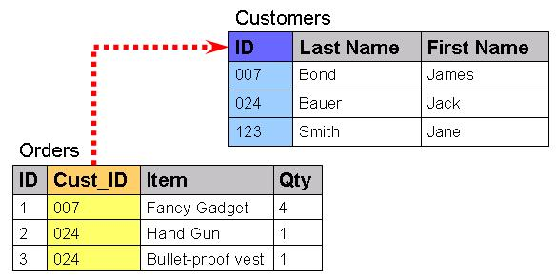
Referential Integrity
Let A be a set of attributes. Let R and S be two relations that contain attributes A and where A is the primary key of S.
A is said to be a foreign key of R
if for any values of A appearing in R these values also appear in S.
⊆

Slide 23
Practice Time
Consider the relational database .
employee(employee_name, street, city)
works(employee_name, company_name, salary)
company(company_name, city)
manages(employee_name, manager_name)
Identify referential-integrity constraints that should hold, and include them in the DDL definition.
works.employee_name -> employee.employee_name
works.company_name -> company. company_name
manages.employee_name -> employee.employee_name
manages.manager_name -> employee.employee_name

Slide 24
Cascading Actions in Referential Integrity
create table course ( course_id char(5), title varchar(20), dept_name varchar(20),
primary key (course_id)
foreign key (dept_name) references department)
create table course ( … dept_name varchar(20), foreign key (dept_name) references department on delete cascade on update cascade, . . . )
alternative actions to cascade: set null, set default

Slide 25
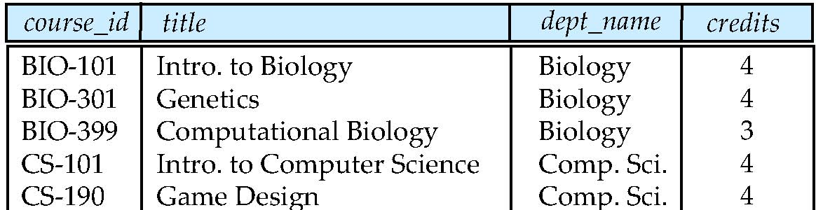
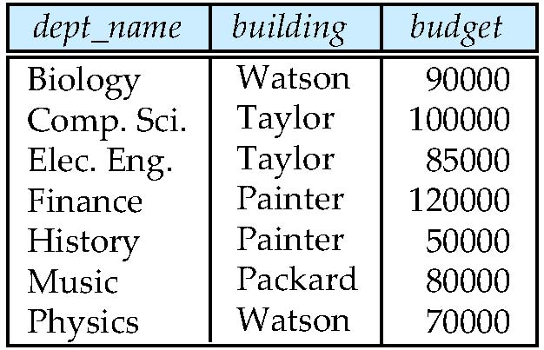
Cascading Actions in Referential Integrity
create table course ( … dept_name varchar(20), foreign key (dept_name) references department on delete cascade on update cascade )
alternative actions to cascade: set null, set default
Bio. Sci.
Bio. Sci.
Bio. Sci.
Bio. Sci.

Slide 26
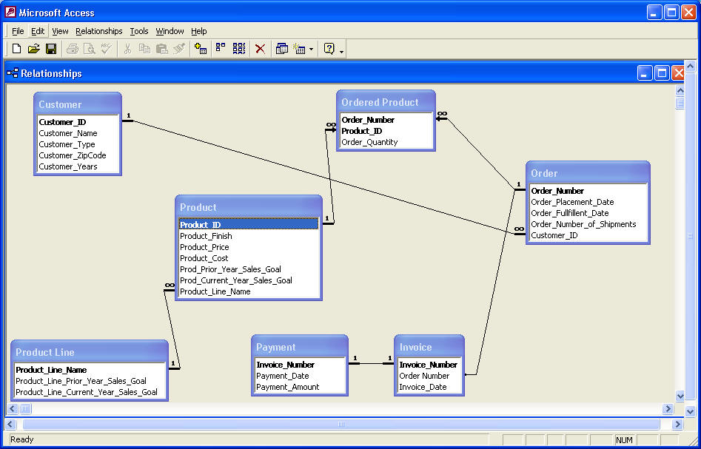
Cascading Actions in Referential Integrity

Slide 27
Practice Time
Decide the order of insertion tuples into the tables without causing foreign key constraint violation.
ProductLine < Product, Customer < Order
Order < OrderProduct, Product < OrderProduct
Order < Invoice, Invoice < Payment

Slide 28
Chapter 4: Intermediate SQL
View
Transaction
Integrity Constraints
Built-in Data Types in SQL
Index
Authorization
Notes:
1

Slide 29
Built-in Data Types in SQL
date: Dates, containing a (4 digit) year, month and date
Example: date ‘2005-7-27’
time: Time of day, in hours, minutes and seconds.
Example: time ‘09:00:30’ time ‘09:00:30.75’
timestamp: date plus time of day
Example: timestamp ‘2005-7-27 09:00:30.75’
interval: period of time
Example: interval ‘1’ day
Subtracting a date/time/timestamp value from another gives an interval value

Slide 30
Large-Object Types
Photos, videos, CAD files, etc. are stored as a large object:
blob: binary large object -- object is a large collection of uninterpreted binary data
clob: character large object -- object is a large collection of character data
When a query returns a large object, a pointer is returned rather than the large object itself.
Notes:
電腦輔助設計（英語：Computer Aided Design, CAD)

Slide 31
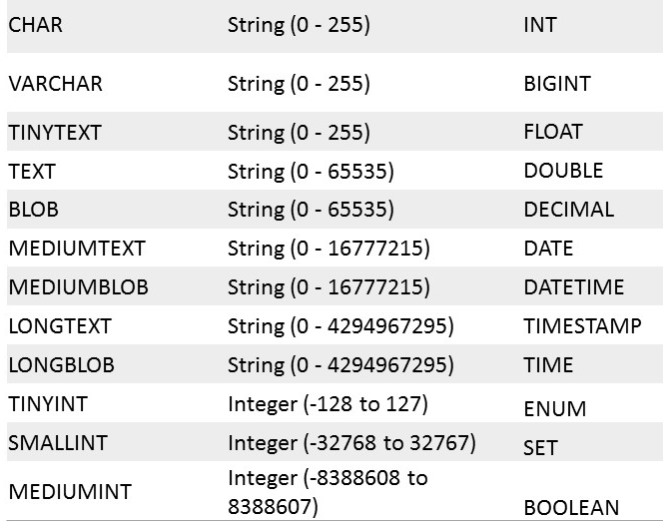
Some MySQL Data Types
https://www.mysqltutorial.org/mysql-data-types.aspx

Slide 32
Chapter 4: Intermediate SQL
View
Transaction
Integrity Constraints
Built-in Data Types in SQL
Index
Authorization
Notes:
1

Slide 33
Index Creation
create table student (ID varchar (5), name varchar (20) not null, dept_name varchar (20), tot_cred numeric (3,0) default 0, primary key (ID))
create index studentID_index on student(ID)
Indices are data structures used to speed up access to records with specified values for index attributes
e.g. select * from student where ID = ‘12345’
can be executed by using the index to find the required record

Slide 34
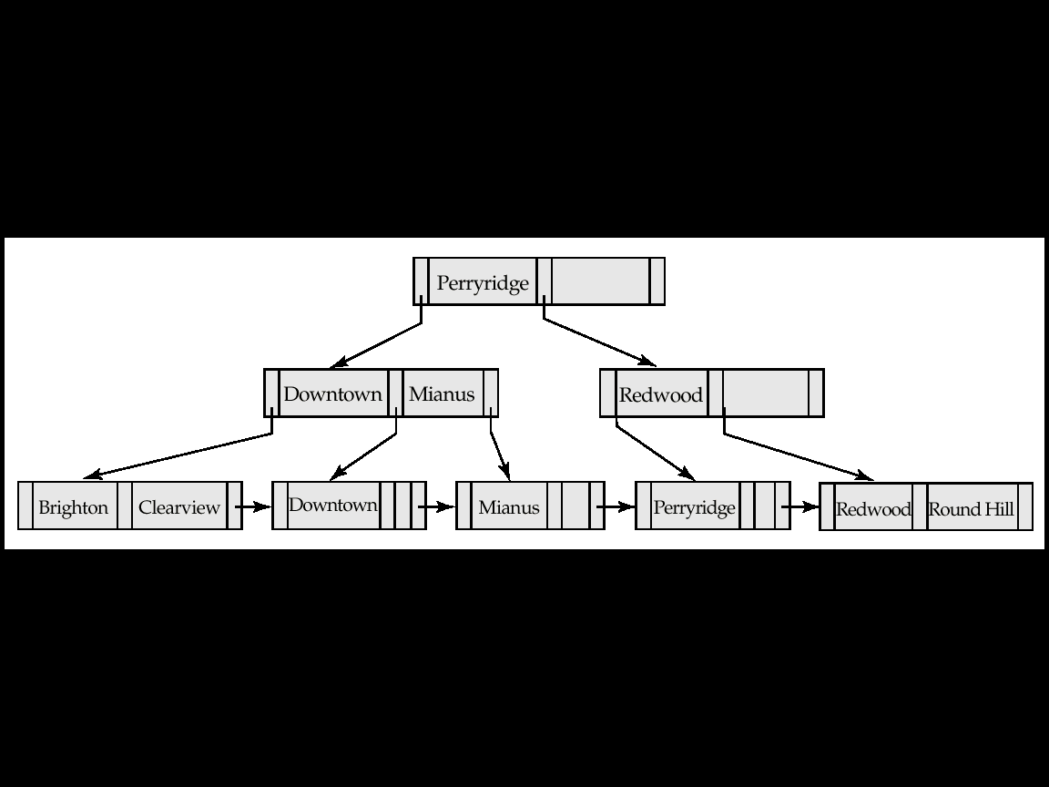
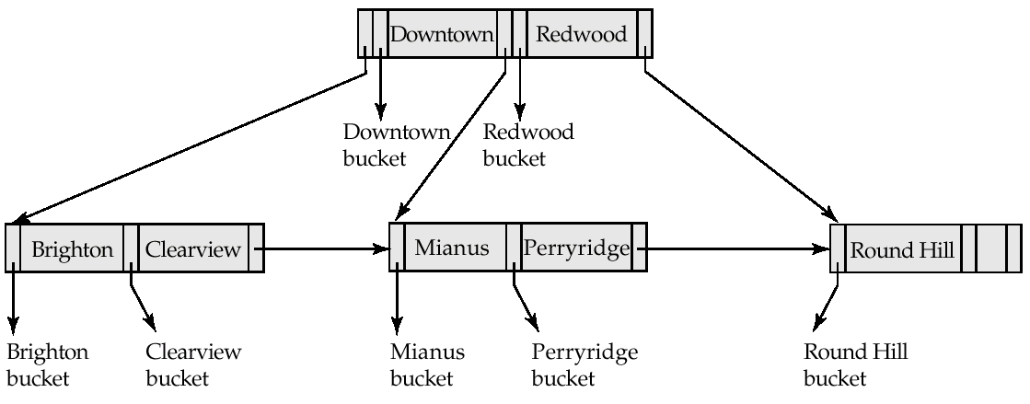
Tree based Index Structure
B⁺ tree
B tree

Slide 35
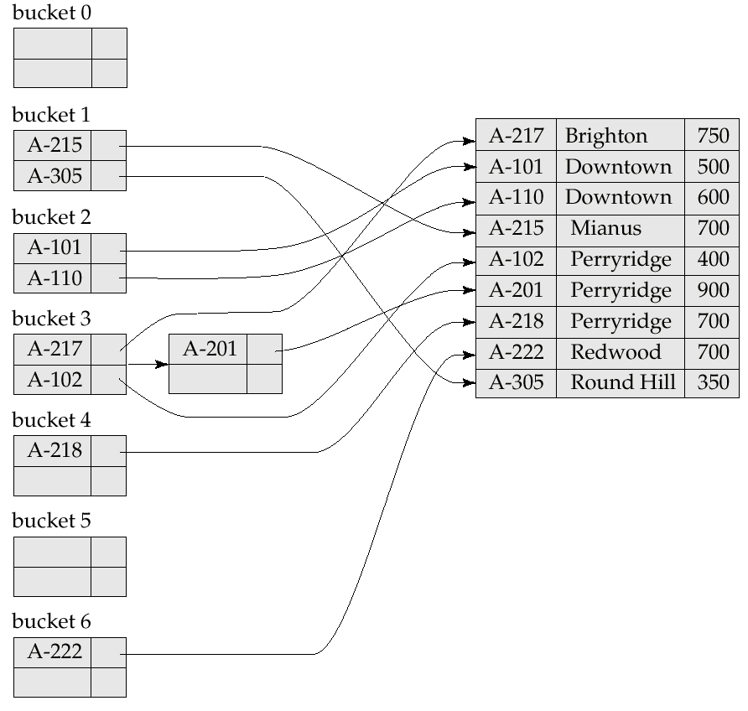
Hash-table based Index Structure

Slide 36
Chapter 4: Intermediate SQL
View
Transaction
Integrity Constraints
Built-in Data Types in SQL
Authorization
Notes:
1

Slide 37
Authorization
Forms of authorization on parts of the database:
Read data
Insert new data
Update data
Delete data
Forms of authorization on the database schema
Create relations
Modify relations
Drop relations

Slide 38
Authorization Specification in SQL
The grant statement is used to confer authorization
grant <privilege list>
on <relation name or view name> to <user list>
<user list> is:
a user-id
A role (more on this later)
public, which allows all valid users the privilege granted
The grantor of the privilege must already hold the privilege on the specified item.
Notes:
confer授予

Slide 39
Privileges in SQL
select: allows read access to relation, or the ability to query using the view
Example:
grant select on instructor to U₁, U₂, U₃
insert: the ability to insert tuples
update: the ability to update using the SQL update statement
grant update (budget) on department to Amit
delete: the ability to delete tuples.
all privileges: used as a short form for all the allowable privileges

Slide 40
Revoking Authorization in SQL
The revoke statement is used to revoke authorization.
revoke <privilege list>
on <relation name or view name> from <user list>
Example:
revoke select on branch from U₁, U₂, U₃
<privilege-list> may be all
If <revokee-list> includes public, all users lose the privilege except those granted it explicitly.
Notes:
revoke撤銷

Slide 41
Roles
create role instructor;
grant instructor to Amit;
Privileges can be granted to roles:
grant select on takes to instructor;
Roles can be granted to users, as well as to other roles
create role teaching_assistant;
grant teaching_assistant to instructor;
instructor inherits all privileges of teaching_assistant
Chain of Roles
create role dean;
grant instructor to dean;
grant dean to Satoshi;

Slide 42
Authorization on Views
create view geo_instructor as (select * from instructor where dept_name = ’Geology’);
grant select on geo_instructor to gio_staff
Suppose that a gio-staff member issues
select * from geo_instructor

Slide 43
Authorizations on Schema
references privilege to create foreign key
grant reference (dept_name) on department to Mariano;

Slide 44
Transfer of Privileges
Transfer of privileges
grant select on department to Amit with grant option;
revoke select on department from Amit, Satoshi cascade;
revoke select on department from Amit, Satoshi restrict;
Notes:
with grant option-授予他授予別人的權利
cascade-連帶(撤回他們授予權力的人之權力)
restrict-只撤回Amit Satoshi 之權限(但若他們已經授權別人, 則無法執行)

Slide 45
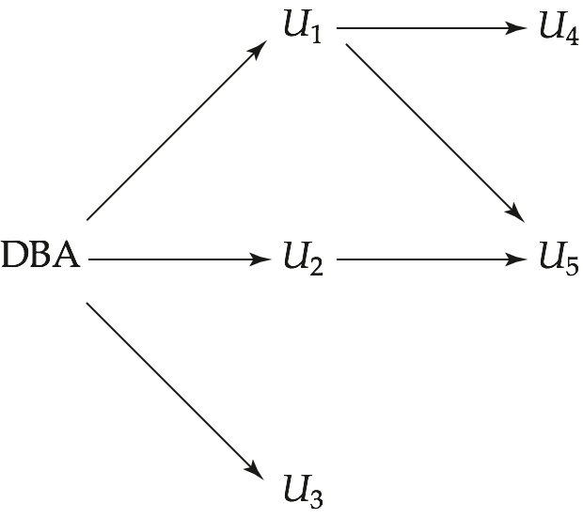
Practice Time
revoke select on department from U₁ cascade
revoke select on department from U₁ restrict
Notes:
45

Slide 46
Practice Time
revoke select on department from U₁ cascade
revoke select on department from U₁ restrict
revoke select on department from U₃ restrict
Notes:
46
revoke select on department from U₁ cascade -剩u3有權限
revoke select on department from U₁ restrict -全都有權限
revoke select on department from U₃ restrict-全都有權限

Slide 47
問題
1.p27
Notes:
複習b tree b+ tree

