Slide 1
Chapter 5: Advanced SQL

Slide 2
Chapter 5: Advanced SQL
Functions and Procedural Constructs
Triggers
Accessing SQL From a Programming Language
Dynamic SQL
JDBC and ODBC
Embedded SQL
Notes:
Java資料庫連接，（Java Database Connectivity，簡稱JDBC）是Java語言中用來規範客戶端程式如何來存取資料庫的應用程式介面，提供了諸如查詢和更新資料庫中資料的方法。
ODBC（Open Database Connectivity，開放資料庫互連）提供了一種標準的API（應用程式編程介面）方法來存取資料庫管理系統（DBMS）。 這些API利用SQL來完成其大部分任務。 ODBC本身也提供了對SQL語言的支援，使用者可以直接將SQL語句送給ODBC。

Slide 3
Procedural Constructs in SQL

Slide 4
Procedural Extensions and Stored Procedures
SQL provides a module language
Permits definition of procedures in SQL, with if-then-else statements, for and while loops, etc.
Stored Procedures
Can store procedures in the database
then execute them using the call statement
permit external applications to operate on the database without knowing about internal details

Slide 5
SQL Functions
Define a function that, given the name of a department, returns the count of the number of instructors in that department.
create function dept_count (dept_name varchar(20)) returns integer begin declare d_count integer; select count (* ) into d_count from instructor where instructor.dept_name = dept_name return d_count; end

Slide 6
SQL Functions
Find the department name and budget of all departments with more than 1 instructor.
select dept_name, budget from department where dept_count (dept_name) > 1

Slide 7
Table Functions
SQL:2003 added functions that return a relation as a result
Example: Return all accounts owned by a given customer
create function instructors_of (dept_name char(20))
returns table ( ID varchar(5), name varchar(20), dept_name varchar(20), salary numeric(8,2))
return (select ID, name, dept_name, salary from instructor where instructor.dept_name = instructors_of.dept_name)
Usage
select * from table (instructors_of (‘Music’))
Notes:
SQL:2003 is the fourth revision of the SQL database query language
題目應為:return 所有在given department 下之 instructor 資訊

Slide 8
SQL Procedures
The dept_count function could instead be written as procedure:
create procedure dept_count_proc (in dept_name varchar(20), out d_count int)
begin
select count(*) into d_count from instructor where instructor.dept_name = dept_name ;
end;
Procedures can be invoked either from an SQL procedure or from embedded SQL, using the call statement.
call dept_count_proc( ‘Physics’, @d_count);
Notes:
function會直接回傳結果
procedure-執行一個模組

Slide 9
Stored Procedures in MySQL
DELIMITER $$
CREATE PROCEDURE GetStudents()
BEGIN
SELECT ID, name, dept_name
FROM student
ORDER BY ID;
END$$
DELIMITER ;
CALL GetStudents();
https://www.mysqltutorial.org/mysql-stored-function/
Notes:
$$那行(也可以設成//或其他)-代表宣告結束
最後一行再把delimiter設回分號

Slide 10
Procedural Constructs
Warning: most database systems implement their own variant of the standard syntax below
Compound statement: begin … end,
May contain multiple SQL statements between begin and end.
While and repeat statements:
declare n integer default 0;
while n < 10 do
set n = n + 1
end while
repeat
set n = n – 1
until n = 0
end repeat
Notes:
variant變體

Slide 11
Procedural Constructs (Cont.)
For loop
Permits iteration over all results of a query
Example: declare n integer default 0; for r as select budget from department where dept_name = ‘Music’ do set n = n - r.budget end for

Slide 12
Procedural Constructs (cont.)
Conditional statements (if-then-else)
Example :
IF n_salary < n_mid_salary THEN
UPDATE employees
SET salary = n_mid_salary
WHERE employee_id = n_emp_id;
ELSE
UPDATE employees
SET salary = salary + salary * 5 /100
WHERE employee_id = n_emp_id;
END IF;

Slide 13
External Language Functions/Procedures
SQL:1999 permits the use of functions and procedures written in other languages such as C or C++
create procedure dept_count_proc(in dept_name varchar(20), out count integer) language C external name ’ /usr/avi/bin/dept_count_proc’
create function dept_count(dept_name varchar(20)) returns integer language C external name ‘/usr/avi/bin/dept_count’

Slide 14
External Language Routines (Cont.)
Benefits of external language functions/procedures:
more efficient for many operations, and more expressive power.
Drawbacks
Code to implement function is executed in the database system’s address space.
risk of accidental corruption of database structures
Notes:
routine-（電腦的）例行程式

Slide 15
Triggers
Notes:
觸發

Slide 16
Triggers
A trigger is a statement that is executed automatically by the system as a side effect of a modification to the database.
To design a trigger mechanism, we must:
Specify the conditions under which the trigger is to be executed.
Specify the actions to be taken when the trigger executes.
Syntax illustrated here may not work exactly on your database system; check the system manuals

Slide 17
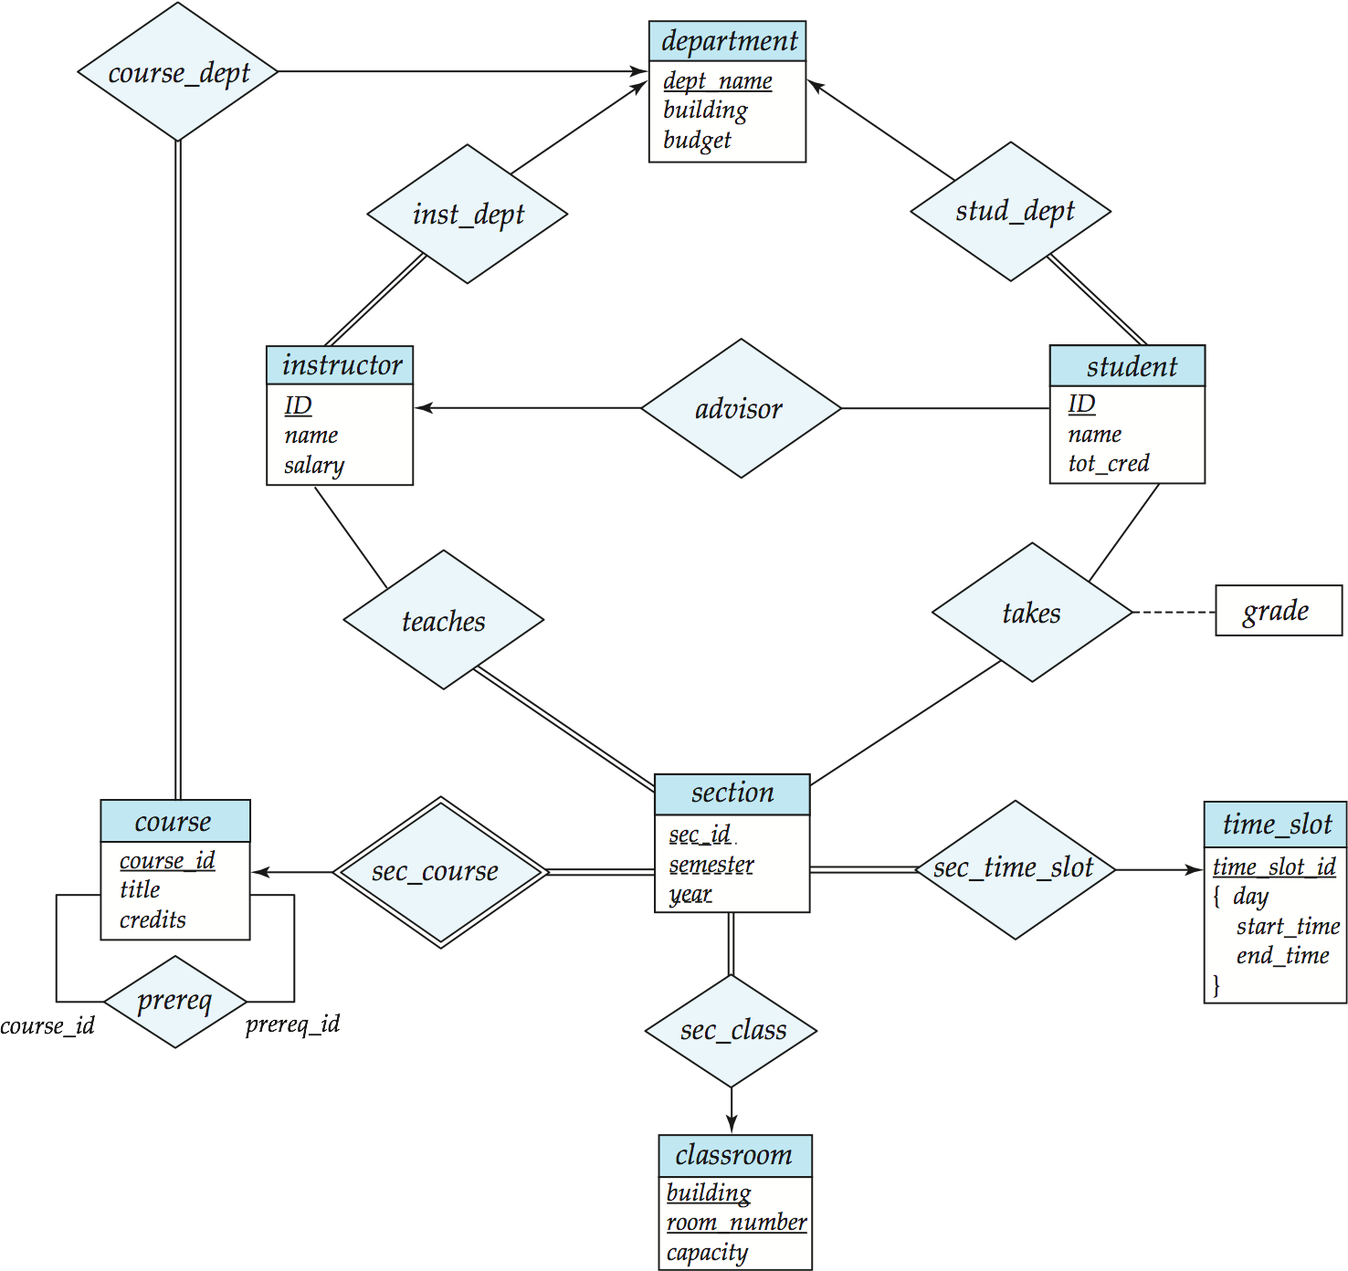
section
sec_id | semester | year | course_id | time_slot_id
01 | Spring | 2012 | CS101 | 0001
01 | Spring | 2012 | CS201 | 0002
01 | Summer | 2011 | CS101 | 0002
time_slot
time_slot_id | day | start_time | end_time
0001 | Mon | 9:00 | 9:50
0001 | Thr | 9:00 | 9:50
0002 | Wed | 9:00 | 9:50
0002 | Thr | 10:10 | 12:00

Slide 18
Trigger Example
E.g. time_slot_id is not a primary key of timeslot, so we cannot create a foreign key constraint from section to timeslot.
Use triggers on section and timeslot to enforce integrity constraints
create trigger timeslot_check1 after insert on section referencing new row as nrow for each row when (nrow.time_slot_id not in ( select time_slot_id from time_slot)) begin rollback end;
Notes:
after也可以改成before
要rollback ,autocommit要先設0
若新增後找不到就會撤回（ｒｏｌｌｂａｃｋ）達到類似foreign key效果

Slide 19
Trigger Example Cont.
create trigger timeslot_check2 after delete on timeslot referencing old row as orow for each row when (orow.time_slot_id not in ( select time_slot_id from time_slot) and orow.time_slot_id in ( select time_slot_id from section)) begin rollback end;

Slide 20
Triggering Events and Actions in SQL
Triggering event can be insert, delete or update
Triggers on update can be restricted to specific attributes
E.g., after update of takes on grade
Values of attributes before and after an update can be referenced
referencing old row as : for deletes and updates
referencing new row as : for inserts and updates

Slide 21
Triggering Events and Actions in SQL
Triggers can be activated before an event, which can serve as extra constraints.
E.g. convert blank grades to null.
create trigger setnull_trigger before update of takes referencing new row as nrow for each row when (nrow.grade = ‘ ‘) begin atomic set nrow.grade = null; end;

Slide 22
Trigger to Maintain credits_earned value
create trigger credits_earned after update of takes on (grade) referencing new row as nrow referencing old row as orow for each row when nrow.grade <> ’F’ and nrow.grade is not null and (orow.grade = ’F’ or orow.grade is null) begin atomic update student set tot_cred= tot_cred + (select credits from course where course.course_id= nrow.course_id) where student.id = nrow.id; end;

Slide 23
Statement Level Triggers
A single action can be executed for all rows affected by a transaction
Use for each statement instead of for each row
Use referencing old table or referencing new table to refer to temporary tables containing the affected rows
Can be more efficient when dealing with SQL statements that update a large number of rows

Slide 24
Trigger in MySQL
CREATE TRIGGER trigger_name
{BEFORE | AFTER} {INSERT | UPDATE| DELETE }
ON table_name
FOR EACH ROW trigger_body;

Slide 25
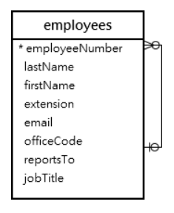
Trigger Example in MySQL
CREATE TRIGGER before_employee_update
BEFORE UPDATE ON employees
FOR EACH ROW INSERT INTO employees_audit
SET action = 'update’,
employeeNumber = OLD.employeeNumber, lastname = OLD.lastname,
changedat = NOW();
https://www.mysqltutorial.org/create-the-first-trigger-in-mysql.aspx

Slide 26
問題
p.22
p.22 trigger

