Slide 1
Chapter 6: Formal Relational Query Languages (Relational Algebra)

Slide 2
Relational Algebra
Procedural language
Six basic operators
selection: σ
project: ∏
union: ∪
set difference: –
Cartesian product: x
rename: ρ
The operators take one or two relations as inputs and produce a new relation as a result.
Notes:
為何沒交集?可用兩次差集做出

Slide 3
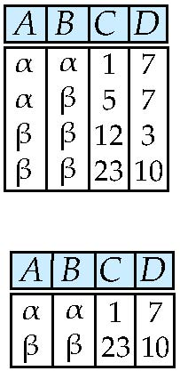
Selection Operation – Example
Relation r
σ_{A=B ^ D > 5} (r)

Slide 4
Selection Operation
Notation: σ _{p}(r)
p is called the selection predicate
Defined as: σ_{p}(r) = {t | t ∈ r and p(t)}
p : terms connected by : ∧ (and), ∨ (or), ¬ (not)
Each term is one of:
<attribute> op <attribute>
<attribute> op <constant>
op is one of: =, ≠, >, ≥. <. ≤
Example : σ _{dept_name=“Physics”}(instructor)

Slide 5
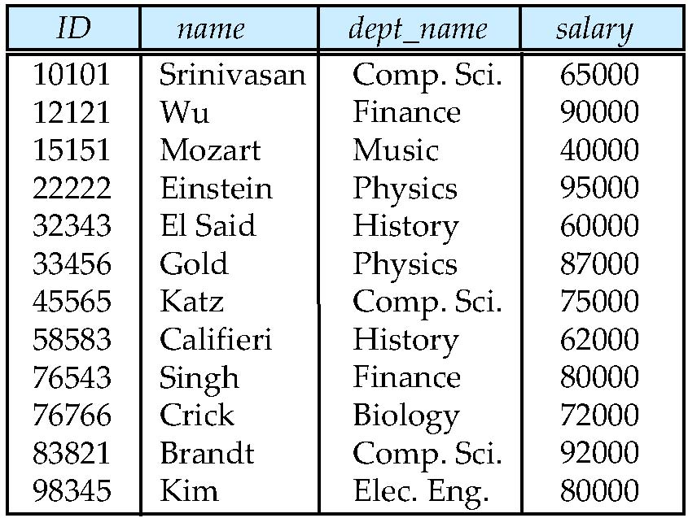
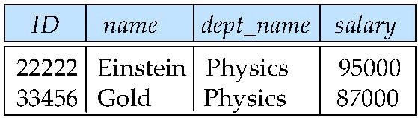
Example of Selection
instructor
σ _{dept_name=“Physics”}(instructor)

Slide 6
Practice Time
Find the titles of courses in the Comp. Sci. department that have 3 credits.

Slide 7
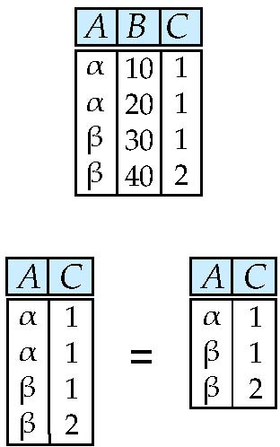
Project Operation – Example
Relation r:
∏_{A,C} (r)

Slide 8
Project Operation
where A₁, A₂ are attribute names and r is a relation name.
The result is
the relation of k columns that are listed
duplicate rows are removed from result
Example: ∏_{ID, name, salary} (instructor)

Slide 9
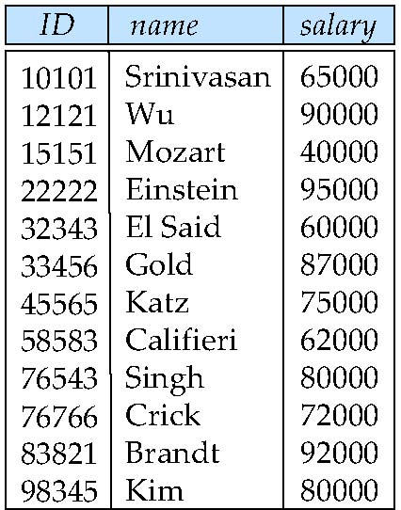
Example of Project
instructor
∏_{ID, name, salary} (instructor)

Slide 10
Practice Time
∏_{salary} (instructor)
What is the result of
instructor

Slide 11
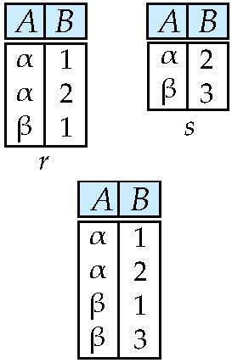
Union Operation – Example
Relations r, s:
r ∪ s:

Slide 12
Union Operation
r ∪ s
r ∪ s = {t | t ∈ r or t ∈ s}
For r ∪ s to be valid.
1. r, s must have the same arity (same number of attributes)
2. The attribute domains must be compatible
Example: to find all courses taught in the Fall 2009 semester, or in the Spring 2010 semester, or in both
∏_{course_id} (σ _{semester=“Fall” Λ year=2009} (section))
∏_{course_id} (σ _{semester=“Spring” Λ year=2010} (section))
∪

Slide 13
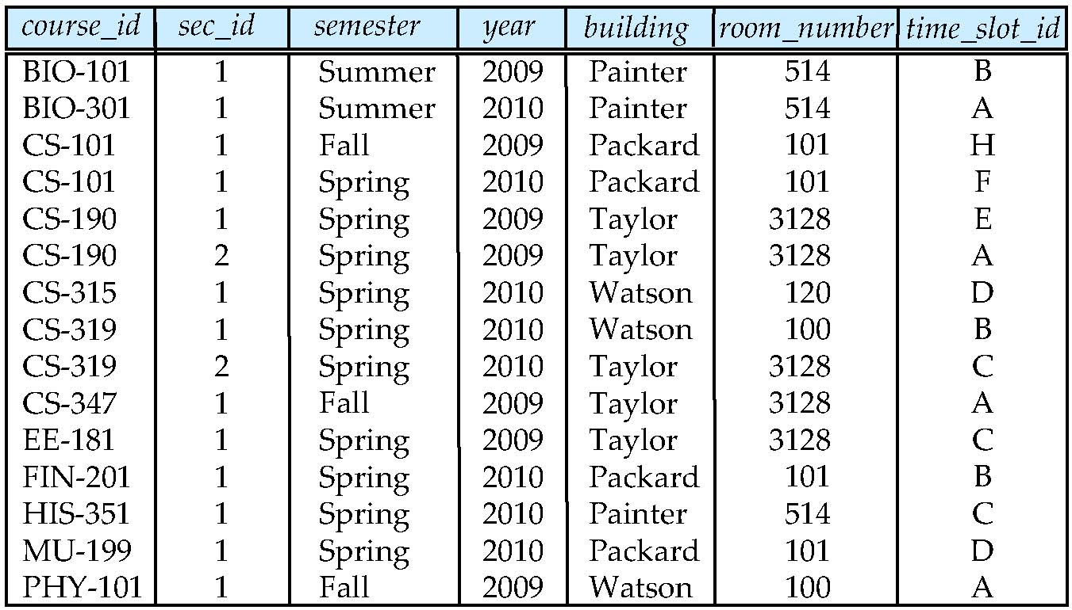
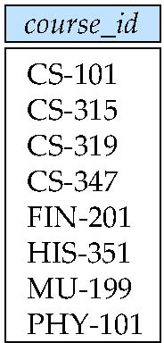
Example of Union
section
∏_{course_id} (σ _{semester=“Fall” Λ year=2009} (section)) ∪ ∏_{course_id} (σ _{semester=“Spring” Λ year=2010} (section))

Slide 14
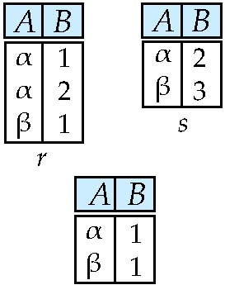
Set difference of two relations
Relations r, s:
r – s:

Slide 15
Set Difference Operation
r – s
{t | t ∈ r and t ∉ s}
Set differences must be taken between compatible relations.
r and s must have the same arity
attribute domains of r and s must be compatible
Example: to find all courses taught in the Fall 2009 semester, but not in the Spring 2010 semester
∏_{course_id} (σ _{semester=“Fall” Λ year=2009} (section)) ∏_{course_id} (σ _{semester=“Spring” Λ year=2010} (section))
–
Notes:
無法轉成and not->沒有一項會同時滿足2條件

Slide 16
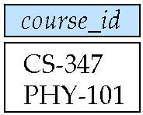
Example of Set-Difference
section
∏_{course_id} (σ _{semester=“Fall” Λ year=2009} (section)) - ∏_{course_id} (σ _{semester=“Spring” Λ year=2010} (section))

Slide 17
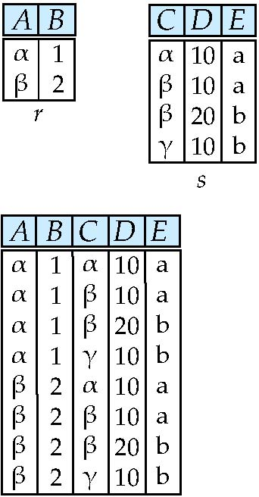
Cartesian-Product Operation – Example
Relations r, s:
r x s:

Slide 18
Cartesian-Product Operation
r x s
r x s = {t q | t ∈ r and q ∈ s}
Assume that attributes of r(R) and s(S) are disjoint.
If attributes of r(R) and s(S) are not disjoint, then renaming must be used.

Slide 19
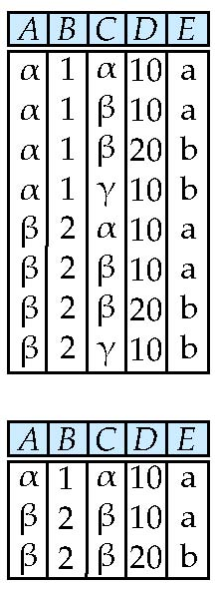
Composition of Operations
Can build expressions using multiple operations
Example: σ_{A=C}(r x s)
r x s
σ_{A=C}(r x s)

Slide 20
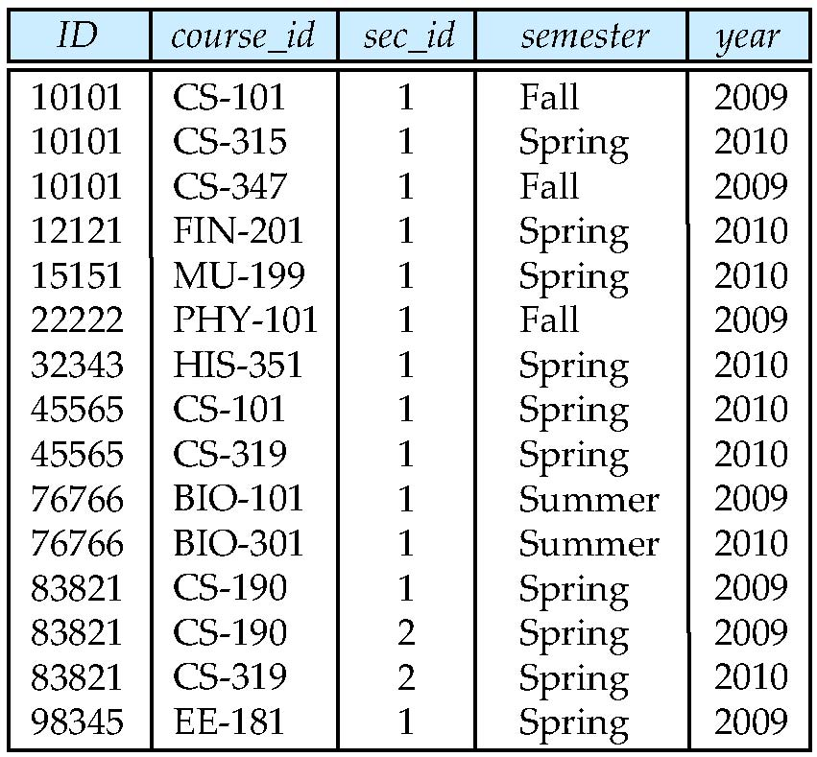
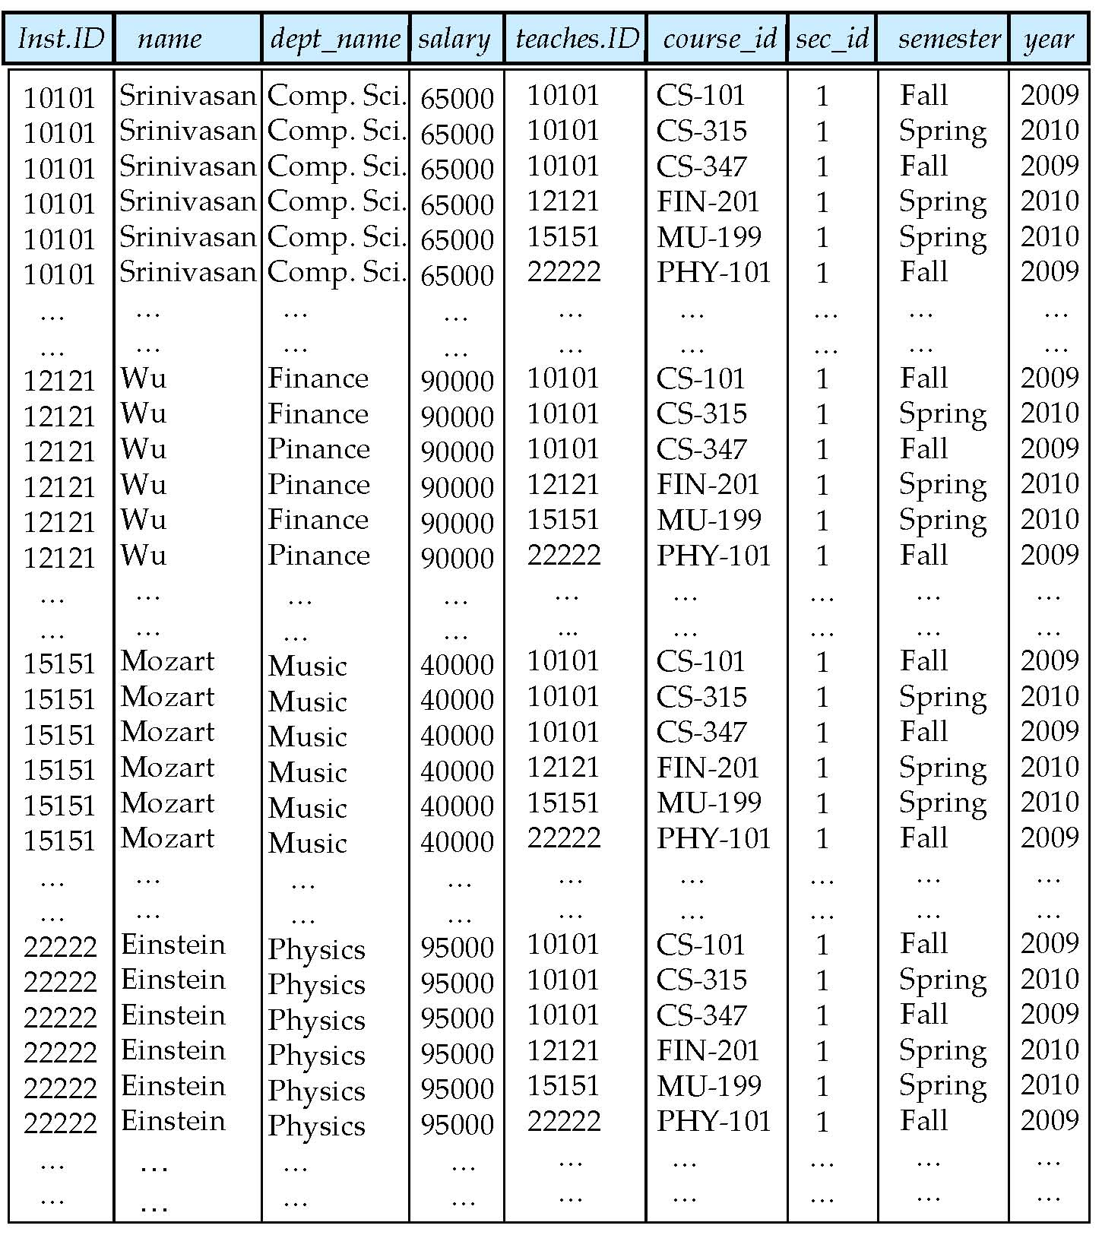
Example of Cartesian-Product
instructor
teaches
instructor × teaches

Slide 21
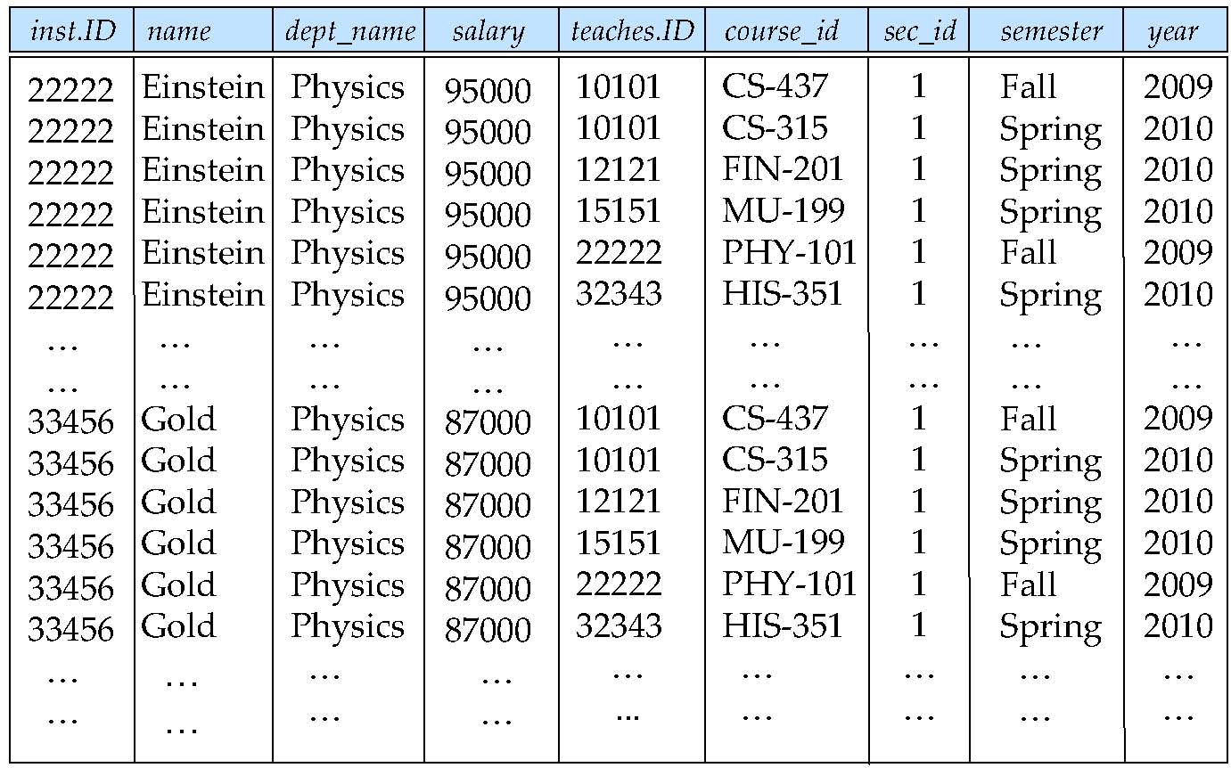
Composition of Operations (1)
instructor
teaches
σ_{depart_name=“Physics”} (instructor × teaches)

Slide 22
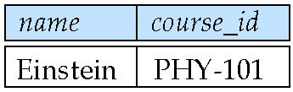
Composition of Operations (2)
σ_{depart_name=“Physics”} (instructor × teaches)
列出物理系有開課的老師及開課的課程編號
and 也可以
∏_{NAME},_{course_id}(σ_{instructor.ID=teaches.ID}(σ_{depart_name=“Physics”} (instructor × teaches)))
Notes:
藍色較有效率

Slide 23
Example Queries
Find the names of all instructors in the Physics department, along with the course_id of all courses they have taught
Query 1 ∏_{instructor.ID,course_id} (σ_{dept_name=“Physics”} ( σ _{instructor.ID=teaches.ID} (instructor x teaches)))
Query 2 ∏_{instructor.ID,course_id} (σ_{instructor.ID=teaches.ID} ( σ _{dept_name=“Physics”} (instructor) x teaches))

Slide 24
Practice Time
Write a relational algebra query to find
名為Katz老師的開課 課程編號

Slide 25
Rename Operation
Allows us
to name the results of relational-algebra expressions.
to refer to a relation by more than one name.
Example:
ρ _{x} (E)
returns the expression E under the name X
If a relational-algebra expression E has arity n, then
returns the result of expression E under the name x, and with the
attributes renamed to A₁ , A₂ , …., A_{n} .
Notes:
arity-number of arguments(attributes)

Slide 26
Example Query
Find the largest salary in the university
Step 1: find instructor salaries that are less than some other instructor salary (i.e. not maximum)
using a copy of instructor under a new name d
∏_{instructor.salary} (σ _{instructor.salary < d.salary} (instructor x ρ_{d} (instructor)))

Slide 27
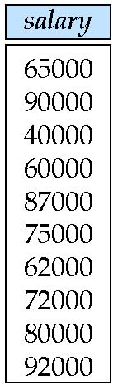
Example of Rename (1)
instructor
d
∏_{instructor.salary} (σ _{instructor.salary < d,salary} (instructor x ρ_{d} (instructor)))

Slide 28
Example Query
Find the largest salary in the university
Step 2: Find the largest salary
∏_{salary} (instructor) – ∏_{instructor.salary} (σ _{instructor.salary < d.salary} (instructor x ρ_{d} (instructor)))

Slide 29
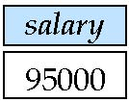
Example of Rename (2)
∏_{salary} (instructor) – ∏_{instructor.salary} (σ _{instructor.salary < d,salary} (instructor x ρ_{d} (instructor)))
instructor
–

Slide 30
Practice Time
Find the names of all instructors whose salaries are higher than at least one instructor of “Computer Science”. (要修改哪裡?)
∏_{instructor.salary} (σ _{instructor.salary < d,salary} (instructor x ρ_{d} (instructor)))

Slide 31
Practice Time
Find the names of all instructors whose salaries are higher than every instructor of “Computer Science”.
∏_{salary} (instructor) – ∏_{instructor.salary} (σ _{instructor.salary < d,salary} (instructor x ρ_{d} (instructor)))

Slide 32
Practice Time
Find the highest credit of all courses.

Slide 33
Formal Definition
A basic expression in the relational algebra :
A relation in the database
A constant relation
Let E₁ and E₂ be relational-algebra expressions :
E₁ ∪ E₂
E₁ – E₂
E₁ x E₂
σ_{p} (E₁), P is a predicate on attributes in E₁
∏_{s}(E₁), S is a list consisting of some of the attributes in E₁
ρ_{x} (E₁), x is the new name for the result of E₁

