Slide 1
Chapter 7: Entity-Relationship Model

Slide 2
Extended ER Features

Slide 3
Extended E-R Features: Specialization
Top-down design process;
subgroupings within an entity set.
E.g., instructor, student “is a” person
The ISA relationship also referred to as superclass - subclass relationship
Notes:
Specialization專業化

Slide 4
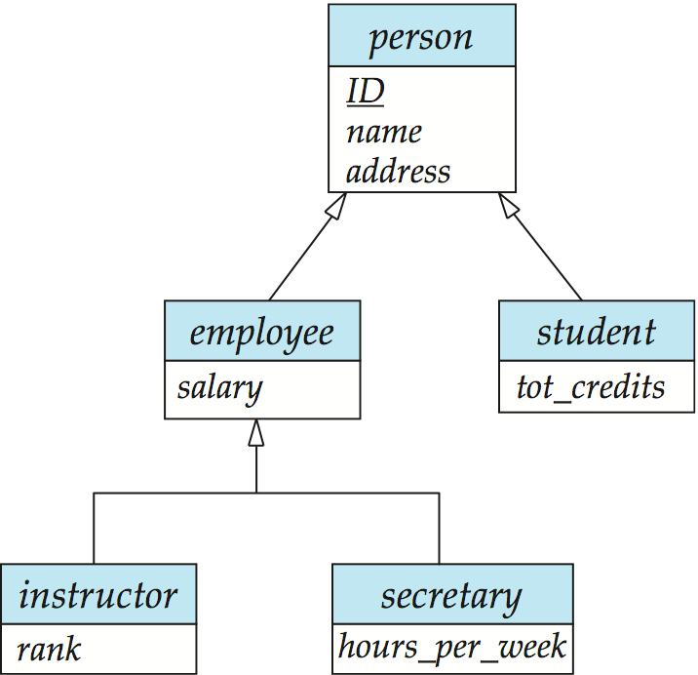
Specialization Example
Attribute inheritance
a lower-level entity set inherits all the attributes and relationship of the higher-level entity set

Slide 5
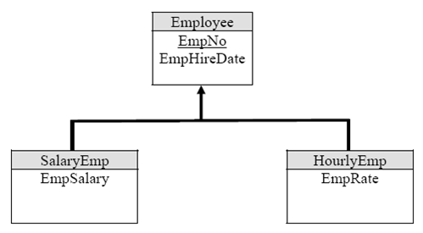
Extended ER Features: Generalization
A bottom-up design process
combine a number of entity sets that share the same features into a higher-level entity set.

Slide 6
Design Constraints on a Specialization/Generalization
Overlapping
一個person可同時是
employee 也是student
Disjoint
一個employee
是instructor
就不會是 secretary
Notes:
disjoint sets-互斥集

Slide 7
Design Constraints on a Specialization/Generalization (Cont.)
Whether an entity in the higher-level entity set must belong to at least one of the lower-level entity sets
total ⬄ partial
Employee
一定是 SalaryEmp 或
HourEmp
total

Slide 8
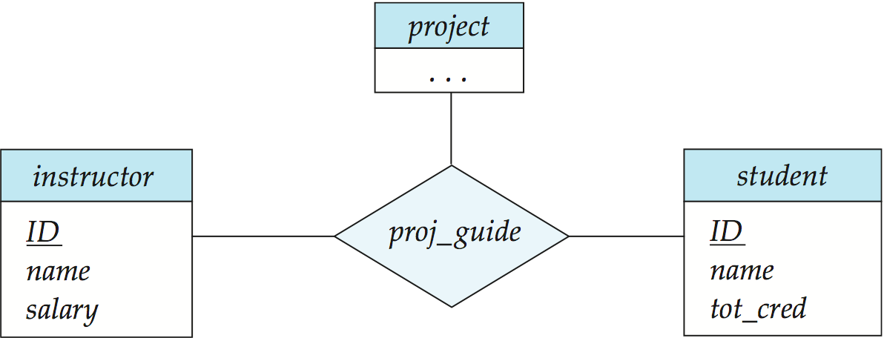
Aggregation
Consider the ternary relationship proj_guide
How to record evaluations of a student by a guide on a
project ?

Slide 9
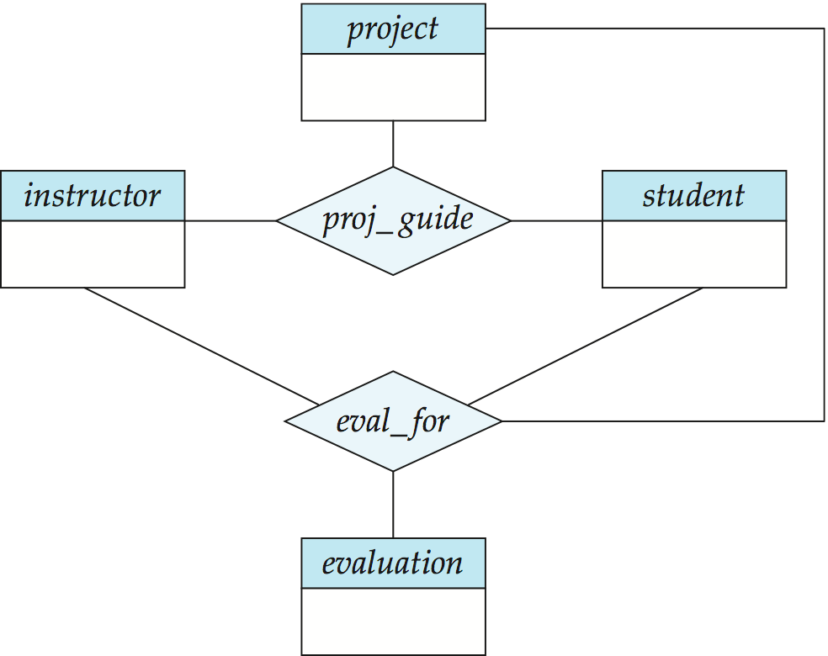
Aggregation

Slide 10
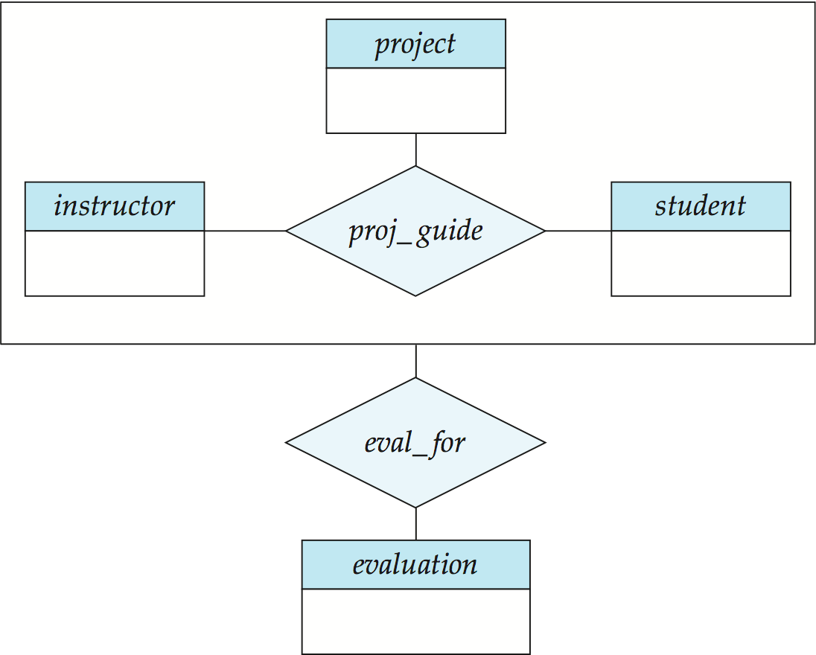
Aggregation (Cont.)
The following diagram represents:
A student, instructor, project combination may have an associated evaluation
Notes:
10

Slide 11
Reduction to Relational Schemas part 2

Slide 12
Representing Specialization via Schemas
Method 1:
只繼承 primary key
person(ID, name, address)
student(ID, tot_creds)
employee(ID, salary)
Q: 缺點?
Notes:
想取得下面基本資料時,要用id把它join 起來
經常性整體查詢

Slide 13
Specialization’s Schemas (Method1)
person
ID | name | Address
S01 | John | 北新路
S02 | Marry | 羅斯福路
I01 | Li | 中正紀念堂
I02 | Chen | 國語日報
S03 | May | 男三舍
student
employee
ID | Total_credit
S01 | 100
S02 | 80
S03 | 60
ID | salary
I01 | 30,000
I02 | 25,000

Slide 14
Representing Specialization as Schemas (Cont.)
Method 2:
繼承 所有attributes
person(ID, name, address) student( ID, name, address, tot_creds) employee( ID, name, address, salary)
If specialization is total
不須建立person 的relation
Q: 缺點?
Notes:
person 的name和address不用在存了,只存ID(為了方便知道總體的資料)
if person是 total ,person 可以刪掉

Slide 15
Specialization’s Schemas (Method2)
person
ID
I01
I02
S01
S02
S03
student
ID | name | Address | Total_credit
S01 | John | 北新路 | 100
S02 | Marry | 羅斯福路 | 80
S03 | May | 男三舍 | 60
employee
ID | name | Address | Salary
I01 | Li | 中正紀念堂 | 30,000
I02 | Chen | 國語日報 | 25,000
Notes:
留著ID是為了方便知道總體的資料
會記錄到找不到資料
各項查詢使用

Slide 16

Schemas Corresponding to Aggregation
To represent the relationship proj_guild
proj_guild(s_ID, project_id, i_ID)
To represent the relationship eval_for
eval_for (s_ID, project_id, i_ID, evaluation_id)
Schema proj_guide is redundant

Slide 17
ER-diagram Design Issues

Slide 18
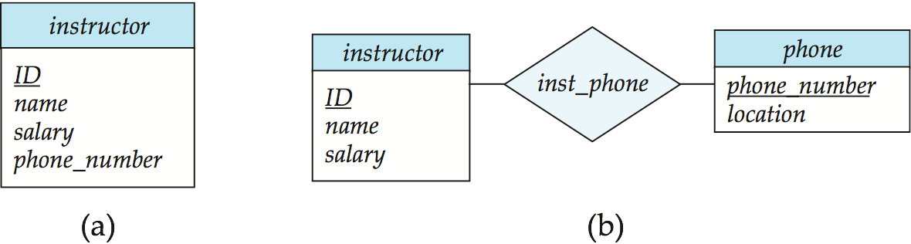
Design Issues
Use of entity sets vs. attributes
Use phone as an entity 有什麼好處?
Notes:
18
右:把電話視為獨立的東西,特別管理
左:電話視為老師的基本資料一部分,沒有要特別管理

Slide 19
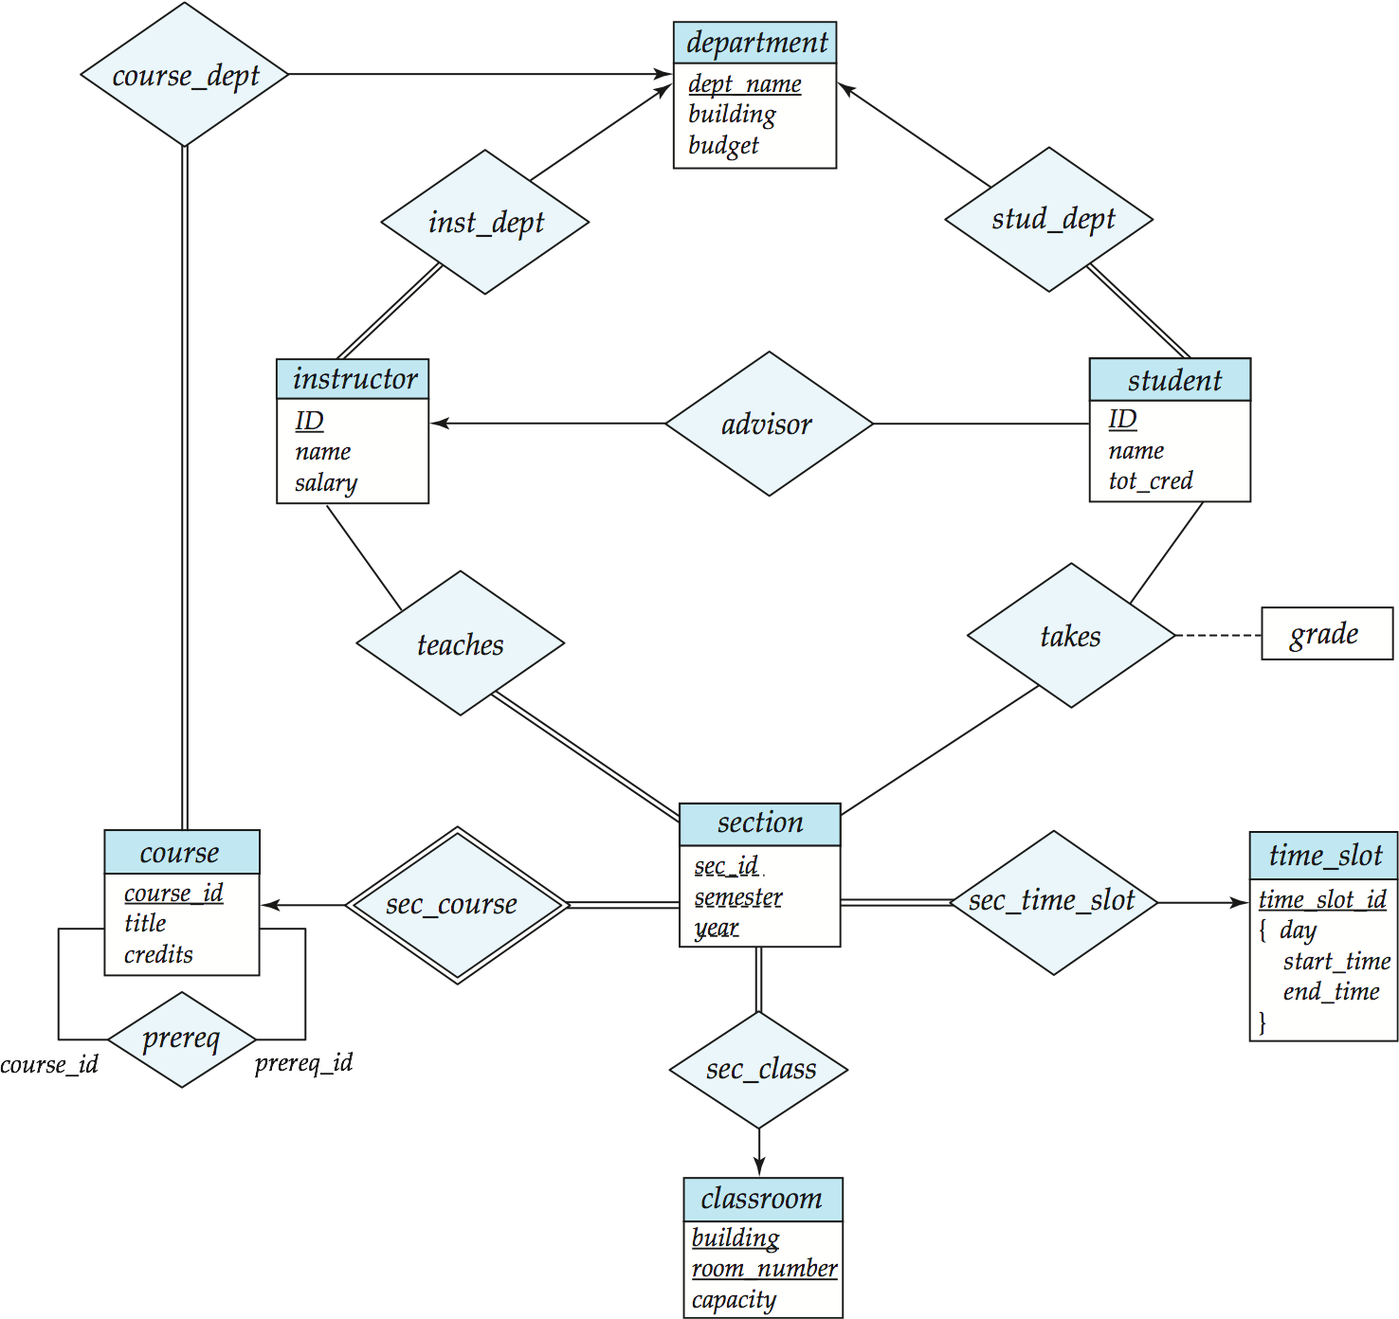
Design Issues
Use of entity sets vs. relationship sets
Notes:
19

Slide 20
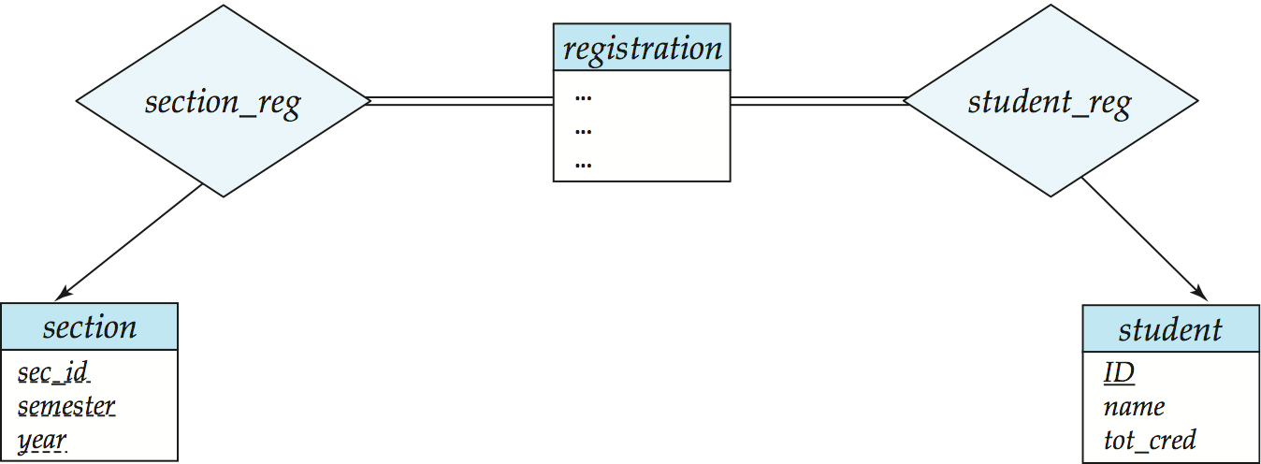
Design Issues
Use of entity sets vs. relationship sets To designate a relationship set to describe an action that occurs between entities
學生每選一門課, 有一個獨立的 registration id, 類似有加選編號
Notes:
20

Slide 21
Design Issues
Binary versus n-ary relationship sets
A n-ary relationship set shows more clearly that several entities participate in a single relationship.
Q: 可換成用幾個二元關係表示?
Notes:
21
3個

Slide 22
Design Issues
Binary versus n-ary relationship sets
SID | IID | projectID
S01 | I01 | ProjectB
S01 | I02 | ProjectA
S02 | I02 | ProjectB
SID | IID
S01 | I01
S01 | I02
S02 | I02
SID | projectID
S01 | ProjectB
S01 | ProjectA
S02 | ProjectB
IID | projectID
I01 | ProjectB
I02 | ProjectA
I02 | ProjectB
Notes:
22

Slide 23
Design Issues
Binary versus n-ary relationship sets
A n-ary relationship set shows more clearly that several entities participate in a single relationship.
Notes:
23

Slide 24
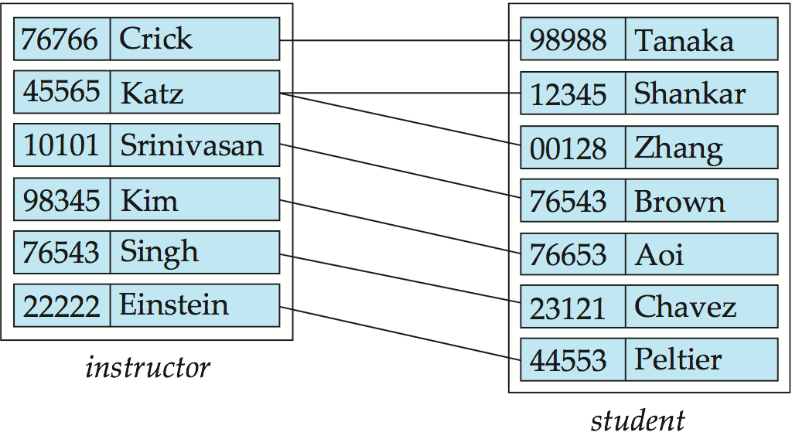
Design Issues
Placement of relationship attributes
date as attribute of student (指導日期)

Slide 25
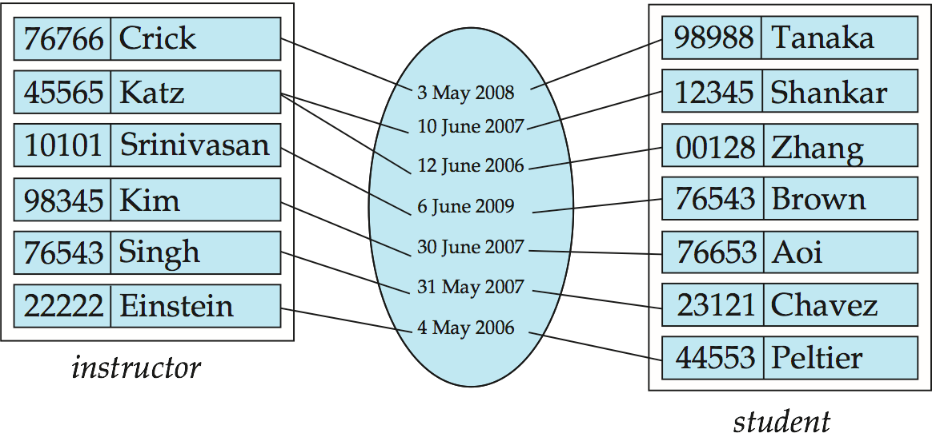
Design Issues
Placement of relationship attributes
date as attribute of student (指導日期)?

Slide 26
Design Issues
Placement of relationship attributes
date as attribute of advisor ?

Slide 27
How about doing another ER design interactively on the board?

Slide 28
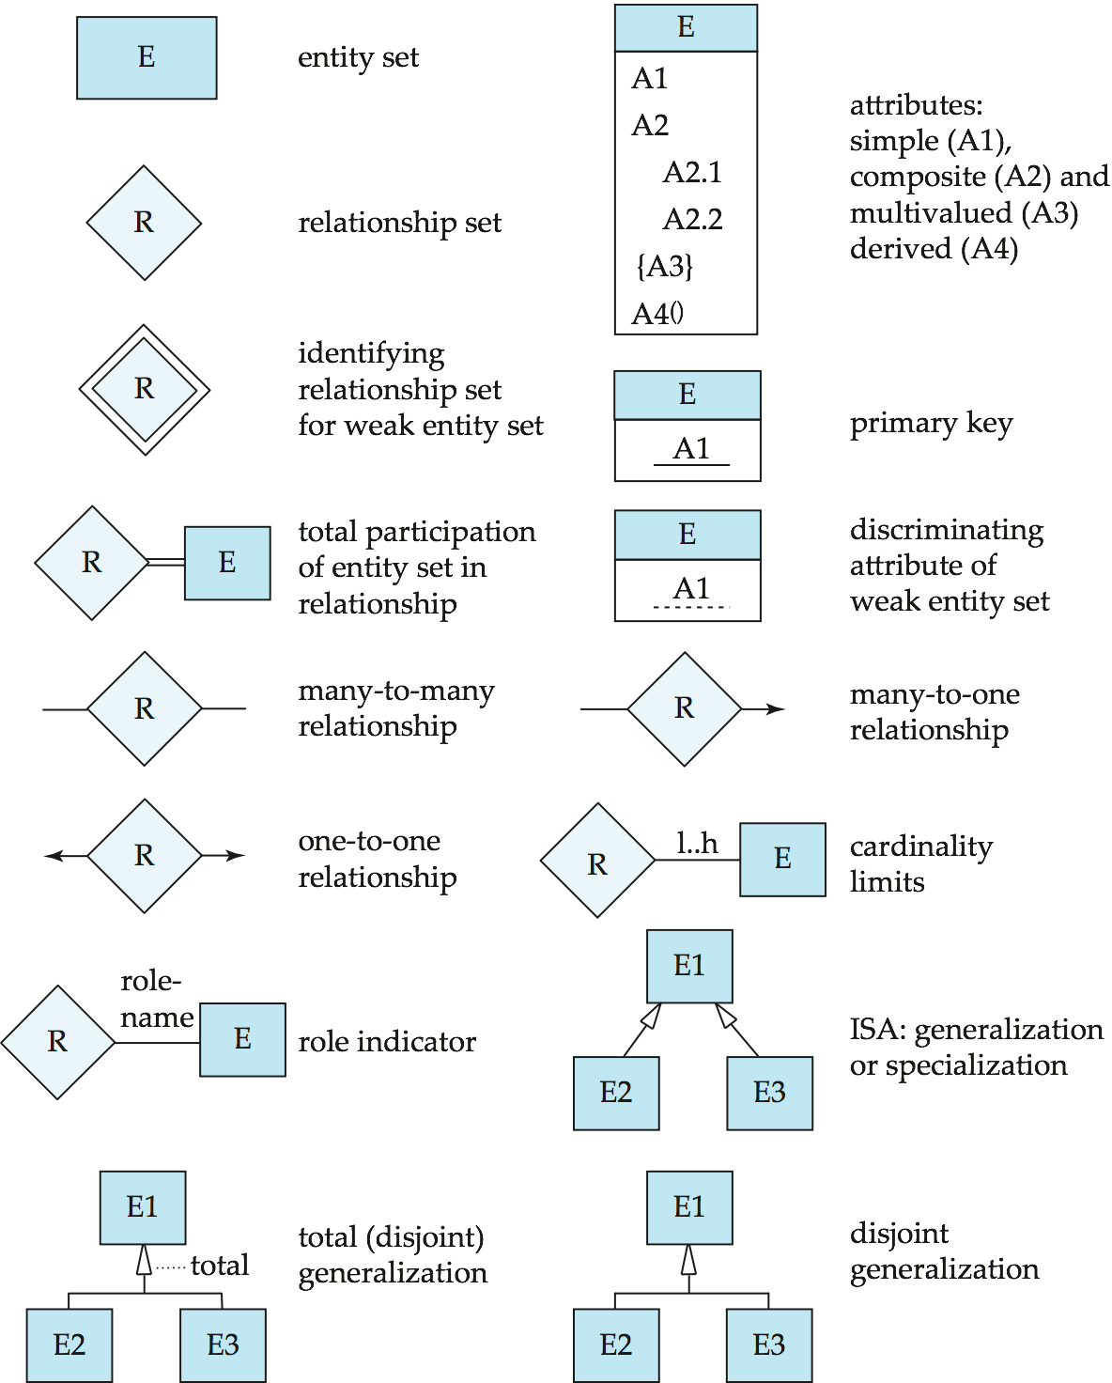
Summary of Symbols Used in E-R Notation

Slide 29
Symbols Used in E-R Notation (Cont.)

Slide 30
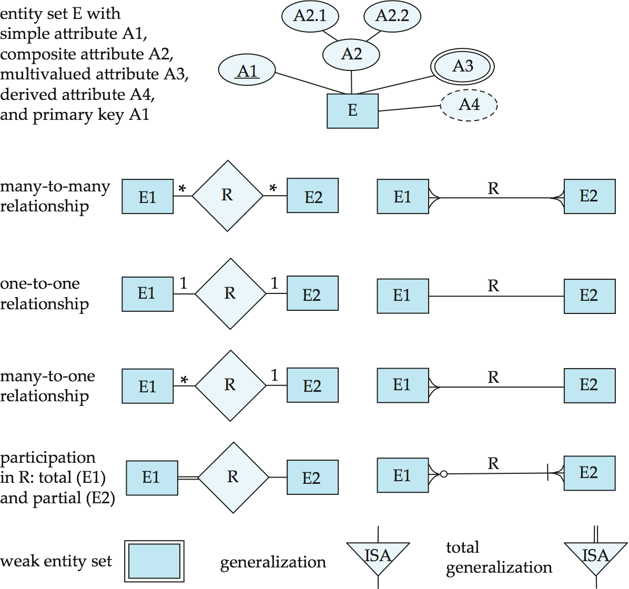
Alternative ER Notations
Chen, IDE1FX, …

Slide 31
Alternative ER Notations
Chen IDE1FX (Crows feet notation)
Notes:
crow-烏鴉

