Slide 1
Chapter 8: Relational Database Design

Slide 2
Chapter 8: Relational Database Design
Features of Good Relational Design
Atomic Domains and First Normal Form
Functional Dependency Theory
Decomposition Using Functional Dependencies
Decomposition Algorithms
Decomposition Using Multivalued Dependencies
Database-Design Process

Slide 3
Boyce-Codd Normal Form
A relation schema R is in BCNF if for all functional dependencies in F⁺ of the form
α→ β
where α ⊆ R and β ⊆ R, at least one of the following holds:
α → β is trivial (i.e., β ⊆ α)
α is a superkey for R

Slide 4
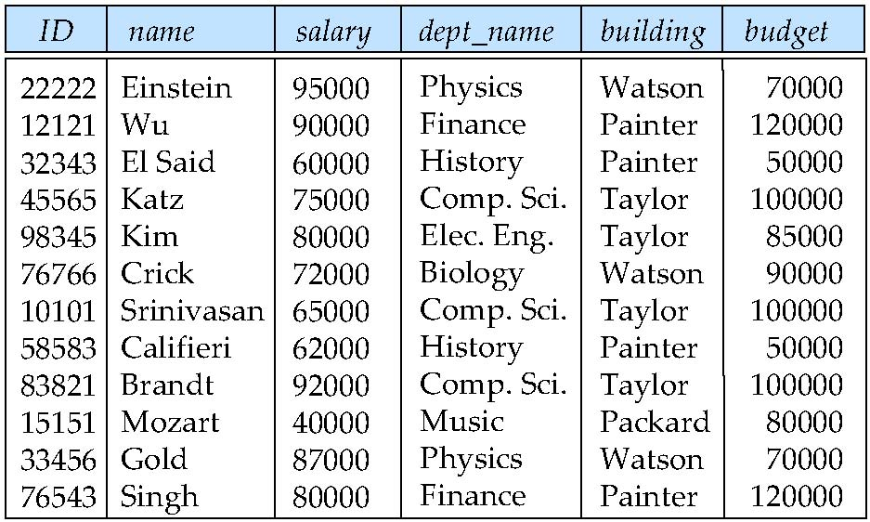
Boyce-Codd Normal Form
Example schema not in BCNF:
instr_dept (ID, name, salary, dept_name, building, budget )
dept_name→ building, budget
holds on instr_dept, but dept_name is not a superkey

Slide 5
Testing for BCNF
To check if a non-trivial dependency α→β causes a violation of BCNF
1. compute α⁺, and
verify that it includes all attributes of R.
Simplified test: To check only the dependencies in the given set F for violation of BCNF.

Slide 6
Goals of Normalization
In the case that a relation scheme R is not in “good” form, decompose it into a set of relation scheme {R₁, R₂, ..., R_{n}} such that
each relation scheme is in good form
the decomposition is a lossless-join decomposition
Preferably, the decomposition should be dependency preserving.

Slide 7
Lossless-join Decomposition
For the case of R = (R₁, R₂), we require that for all possible relations r on schema R
r = ∏_{R1} (r ) ∏_{R2} (r )
A decomposition of R into R₁ and R₂ is lossless join if in F⁺:
R₁ ∩ R₂ → R₁, or
R₁ ∩ R₂ → R₂

Slide 8
Lossless-join Decomposition Example
R = (A, B, C) F = {A → B, B → C)
Can be decomposed in two different ways
R₁ = (A, B), R₂ = (B, C)
Lossless-join decomposition:
R₁ ∩ R₂ = {B} and B → BC
R₁ = (A, B), R₂ = (A, C)
Lossless-join decomposition:
R₁ ∩ R₂ = {A} and A → AB
Notes:
共同欄位是任意一個的superkey就可以(可以靠推倒的去看)
若拆成AC、BC->Lossly-join Decomposition

Slide 9
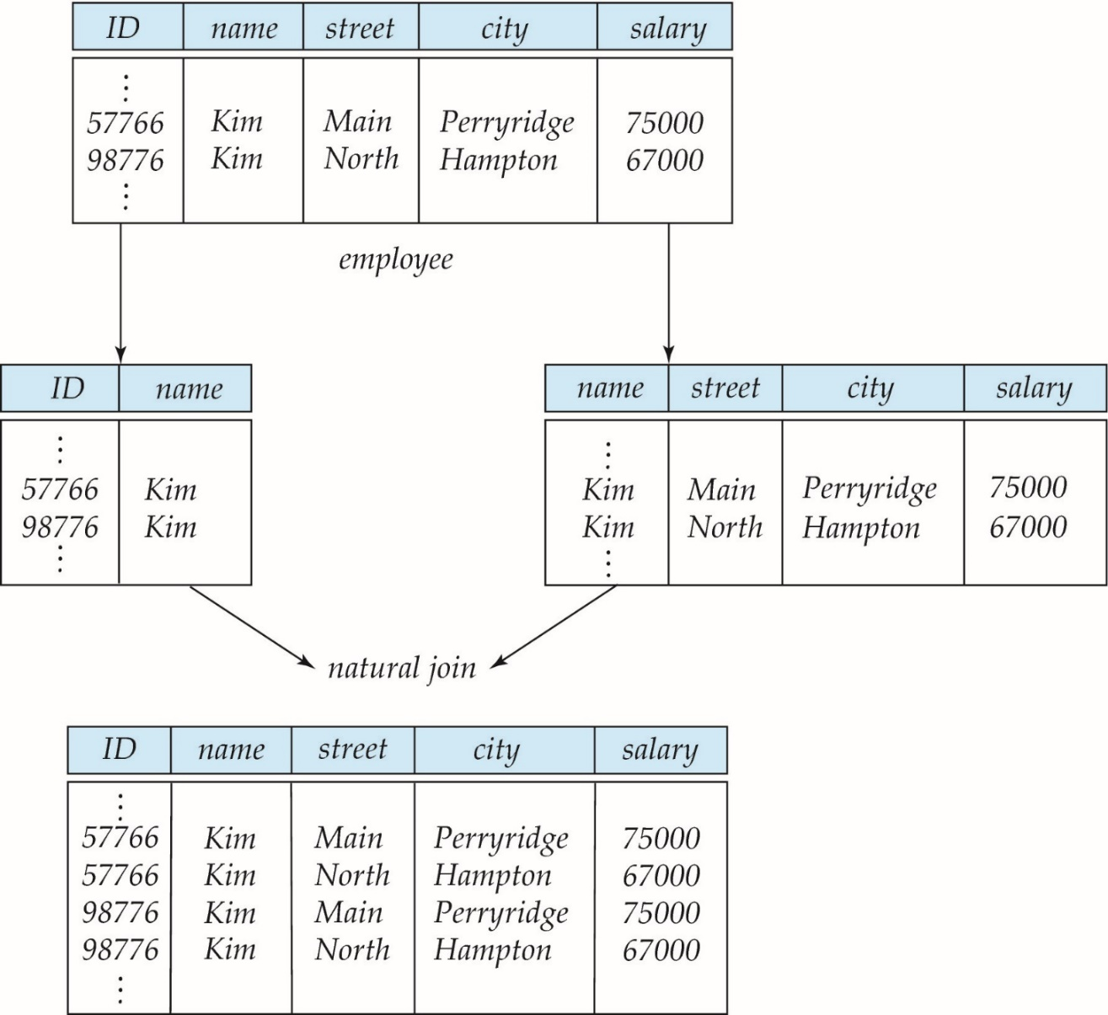
Lossly-join Decomposition Example

Slide 10
Dependency Preservation
Let F_{i} be the set of dependencies F ⁺ that include only attributes in R_{i}.
A decomposition is dependency preserving, if
(F₁ ∪ F₂ ∪ … ∪ F_{n} )⁺ = F ⁺

Slide 11
Example of Dependency Preservation
R = (A, B, C, D) F = {A → B, B → C, C → D)
decomposed into
R₁ = (A,B,C), R₂ = (C, D)
Notes:
F1={A->B,B->C} F2={C->D}
F+=(F1UF2)+
可拆

Slide 12
Example of non-Dependency Preservation
R = (A, B, C, D) F = {A → B, B → C, C → D)
decomposed into
R₁ = (A,C,D), R₂ = (B, C)
Notes:
R1={A,C,D} R2={B,C}
F1={A->C,C->D} F2={B->C}
F+ !=(F1UF2)+(缺A->B)
不可拆

Slide 13
Testing for Dependency Preservation
To check if a dependency α → β is preserved in a decomposition of R into R₁, R₂, …, R_{n}
result = α while (changes to result) do for each R_{i} in the decomposition t = (result ∩ R_{i})⁺ ∩ R_{i} result = result ∪ t
If result contains all attributes in β, then α → β is preserved.

Slide 14
Example
R = (A, B, C) F = {A → B, B → C)
Can be decomposed in two different ways
R₁ = (A, B), R₂ = (B, C)
Dependency preserving
R₁ = (A, B), R₂ = (A, C)
Not dependency preserving (cannot check B → C without computing R₁ R₂)
A->B
B->C
A->B
A->C

Slide 15
Practice Time
R = (A, B, C ) F = {A → B B → C} Key = {A}
Whether R is in BCNF ?
Decomposition R₁ = (A, B), R₂ = (B, C)
Lossless-join decomposition ?
Dependency preserving ?
Notes:
BCNF:
FD為trivial或左邊是SUPER KEY
lossless:共同欄位是R1或R2之superkey
此例
R1之F1={A->B}
R2之F2={B->C}(為superkey)
故是
Dependency preserving :
F+=(F1UF2)+

Slide 16
Practice Time
R = (A, B, C ) F = {AB → C C → B} Key = {AB}
Whether R is in BCNF ?
Decomposition R₁ = (A, C), R₂ = (B, C)
Lossless-join decomposition?
Dependency preserving?
Notes:
非BCNF(C非superkey)
是lossless-join(共同欄位C是R2之superkey)
非Dependency preserving
F1={∅}
F2={C->B}

Slide 17
Practice Time
R = (A, B, C, D, E ) F = {A→ C C → E
BC → D}
Which of the decomposition is a lossless-join decomposition?
(A,C), (C,E), (B,C,D)
(A,B,C), (C,D), (D,E)
(A,B), (B,C,D), (A,C,E)
(A,C), (C,D,E), (A,E)
Notes:
1.為lossly。AC和CE是ACE之lossless分解但ACE和BCD則是ABCDE之lossly分解。第二種分解法亦是lossly
2.(A,B,C,D,E)->(A,B,C),(C,D,E) (C,D,E)->(C,D),(D,E) lossly
3.(A,B,C,D,E)->(A,B,C,D),(D,E) (A,B,C,D)->(A,B,C),(C,D) lossless
(A,B,C,D,E)->(A,B,C,E),(B,C,D) (A,B,C,E)->(A,B),(A,C,E)lossless
4.(A,B,C,D,E)->(A,C,D,E),(A,E) (A,C,D,E)->(A,C),(C,D,E) lossly
(A,B,C,D,E)->(A,C,E),(C,D,E) (A,C,E)->(A,C),(A,E)lossly

Slide 18
Chapter 8: Relational Database Design
Features of Good Relational Design
Atomic Domains and First Normal Form
Functional Dependency Theory
Decomposition Using Functional Dependencies
Decomposition Algorithms
Decomposition Using Multivalued Dependencies
Database-Design Process

Slide 19
Decomposing a Schema into BCNF
Suppose we have a schema R and a non-trivial dependency α→β causes a violation of BCNF.
We decompose R into:
(αU β )
( R - β )
In our example,
(ID, name, salary, dept_name, building, budget)
α = dept_name
β = building, budget
and inst_dept is replaced by
(αU β ) = ( dept_name, building, budget )
( R - β ) = ( ID, name, salary, dept_name )

Slide 20
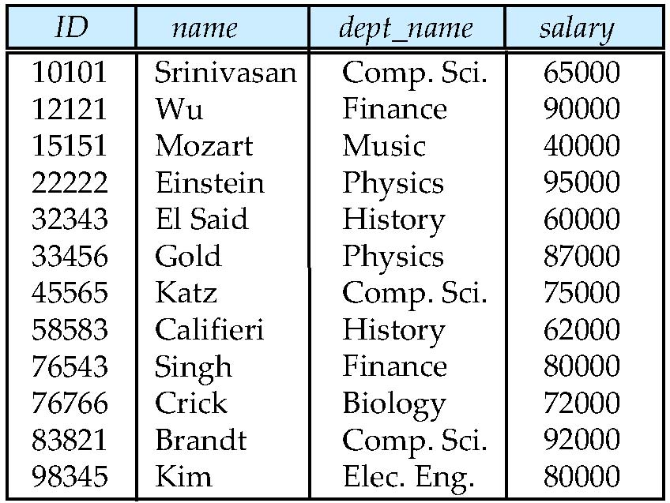
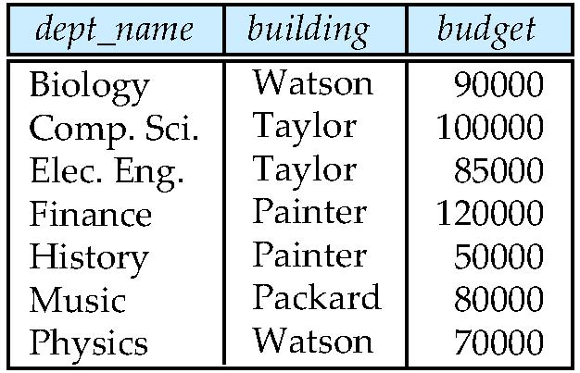

Slide 21
Testing for BCNF
Continue to check BCNF in a decomposition of R
Consider R = (A, B, C, D, E), with F = { A → B, BC → D}
Decompose R into R₁ = (A,B) and R₂ = (A,C,D,E)
The dependencies in R₁ ?
The dependencies in R₂ ?
Notes:
F1={A->B}
F2={}

Slide 22
Testing Decomposition for BCNF
To check if a relation R_{i} in a decomposition of R is in BCNF,
test R_{i} for BCNF with respect to the restriction of F to R_{i}
for every set of attributes α ⊆ R_{i}, check that α⁺
α→ (α⁺ - α) ∩ R_{i} hold on R_{i},
If some α→ β in F, but R_{i} is not a subset of α⁺ => R_{i} violates BCNF.

Slide 23
Practice Time
Given a relation R(A, B, C, D, E, F, G) with functional dependencies
F= { B → CF, B → DEF, AE → G, E → FG }
If a relation S(B, C, E, F) is decomposed from R.
What are the FDs that hold on S?
Notes:
F={B->CE,E->F}

Slide 24
Example of BCNF Decomposition
R = (A, B, C ) F = {A → B B → C} Key = {A}
R is not in BCNF (B → C but B is not superkey)
Decomposition
R₁ = (B, C)
R₂ = (A,B)
Notes:
此key代表candidate key(super key:A、AB)
檢查是否為bcnf:一項一項檢查左邊是否是super key

Slide 25
BCNF Decomposition Algorithm
result := {R }; done := false; compute F ⁺; while (not done) do if (there is a schema R_{i} in result that is not in BCNF) then begin let α → β that holds on R_{i} such that
α → R_{i} is not in F ⁺ and α ∩ β = ∅(代表α非Ri之super key 且α非trivial。代表Ri不滿足BCNF); result := (result – R_{i} ) ∪ (R_{i} – β) ∪ (α, β ); end else done := true;
Note: each R_{i} is in BCNF, and decomposition is lossless-join.
Notes:
可保證lossless但不保證dp
R = (J, K, L ) F = {JK → L,L → K }
J L LK

Slide 26
Example of BCNF Decomposition
class (course_id, title, dept_name, credits, sec_id, semester, year, building, room_number, capacity, time_slot_id)
Functional dependencies:
course_id→ title, dept_name, credits
building, room_number→capacity
course_id, sec_id, semester, year→building, room_number, time_slot_id
A candidate key {course_id, sec_id, semester, year}.
BCNF Decomposition:
course_id→ title, dept_name, credits holds
but course_id is not a superkey.
We replace class by:
course(course_id, title, dept_name, credits)
class-1 (course_id, sec_id, semester, year, building, room_number, capacity, time_slot_id)
course is in BCNF

Slide 27
BCNF Decomposition (Cont.)
class-1 (course_id, sec_id, semester, year, building, room_number, capacity, time_slot_id)
building, room_number→capacity holds on class-1
but {building, room_number} is not a superkey for class-1.
We replace class-1 by:
classroom (building, room_number, capacity)
section (course_id, sec_id, semester, year, building, room_number, time_slot_id)
classroom and section are in BCNF.

Slide 28
BCNF and Dependency Preservation
It is not always possible to get a BCNF decomposition that is dependency preserving
R = (J, K, L ) F = {JK → L L → K } Two candidate keys = JK and JL
R is not in BCNF
Any decomposition of R will fail to preserve
JK → L
This implies that testing for JK → L requires a join

Slide 29
Practice Time
Given a relation R(A, B, C, D) with functional dependencies
F={ A → B, B →AD, AC → D}
Find the candidate keys of R
Indicate all the BCNF violations
Decompose R into collections of relations that are in BCNF.
Notes:
(i)BC、AC
(ii)A->B ,B->AD
(iii)拆成違反+扣掉右邊
AB ACD ABD BC
F1={A->B,B->A} F2={AC->D} F1={B->AD} F2={}

Slide 30
Third Normal Form: Motivation
There are some situations where
efficient checking for FD violation on updates is important
but BCNF is not dependency preserving
Solution: define a weaker normal form, called Third Normal Form (3NF)
Allows some redundancy
There is always a lossless-join, dependency-preserving decomposition into 3NF.
Notes:
因為BCNF常無法維持DP->3-NF出現(故某些狀況較為放寬)

Slide 31
Testing for 3NF
For each dependency α → β
Use attribute closure to check if α is a superkey.
If α is not a superkey, verify if each attribute in β is contained in a candidate key of R
If a functional dependency makes R violates 3NF
Perform the 3NF decomposition algorithm
Notes:
檢查a是不是super key(if not,檢查b是不是在candidate key中)
都不滿足再拆

Slide 32
3NF Example
Relation dept_advisor:
dept_advisor (s_ID, i_ID, dept_name) F = {s_ID, dept_name → i_ID,
i_ID → dept_name}
Two candidate keys: { s_ID, dept_name} and {i_ID, s_ID}
Whether R is in 3NF ?
s_ID, dept_name → i_ID
s_ID, dept_name is a superkey
i_ID → dept_name
dept_name is contained in a candidate key

Slide 33
Redundancy in 3NF
There is some redundancy in this schema
Example of problems due to redundancy in 3NF
R = (J(s_id), K(dept_name), L(i_ID)) F = {JK → L, L → K }
J
L
K
j₁
j₂
j₃
null
l₁
l₁
l₁
l₂
k₁
k₁
k₁
k₂
repetition of information (e.g., the relationship l₁, k₁)
need to use null values
Notes:
3NF因L非superkey所以會造成重複現象,bcnf就不會有這個問題

Slide 34
Practice Time
Given a relation R(A, B, C, D) with functional dependencies
F={ AB → D, D →B, D → C}
Which FD is BCNF violation but not 3NF violation?
Notes:
candidate key:AB AD
V:符合
X:違反
1.V (V)
2.X V
3.X X

Slide 35
3NF Decomposition Algorithm
Let F_{c} be a canonical cover for F; i := 0; for each functional dependency α → β in F_{c} do if none of the schemas R_{j}, 1 ≤ j ≤ i contains α β then begin i := i + 1; R_{i} := α β end if none of the schemas R_{j}, 1 ≤ j ≤ i contains a candidate key for R then begin i := i + 1; R_{i} := any candidate key for R; end /* Optionally, remove redundant relations */
repeat if any schema R_{j} is contained in another schema R_{k} then /* delete R_{j} */ R_{j} = R;; i=i-1; return (R₁, R₂, ..., R_{i})
Notes:
一步驟就出來(不用像BCNF一直檢查),但3NF Decomposition Algorithm 之FC要是canonical cover

Slide 36
3NF Decomposition: An Example
Relation schema:
cust_banker_branch = (customer_id, employee_id, branch_name, type )
The functional dependencies for this relation schema are:
customer_id, employee_id → branch_name, type
employee_id → branch_name
customer_id, branch_name → employee_id
We first compute a canonical cover
branch_name is extraneous in the r.h.s. of the 1st dependency
No other attribute is extraneous, so we get F_{C} =
customer_id, employee_id → type employee_id → branch_name customer_id, branch_name → employee_id
Notes:
TYPE(服務型態):存款、貸款、投資...
step:
1.檢查是不是 3nf
(row1:bcnf,row2:3nf,row3:bcnf )
2.if 非3nf,照之前algo
A,B->C
B->D
A,D->B
candidate key:(AB)、(AD)
其實他有滿足,不用拆解

Slide 37
3NF Decompsition Example (Cont.)
The for loop generates following 3NF schema:
(customer_id, employee_id, type )
(employee_id, branch_name)
(customer_id, branch_name, employee_id)
(customer_id, employee_id, type ) contains a candidate key of the original schema
no further relation schema needs be added
At end of for loop, detect and delete schemas, such as (employee_id, branch_name), which are subsets of other schemas
The resultant simplified 3NF schema is:
(customer_id, employee_id, type)
(customer_id, branch_name, employee_id)

Slide 38
Practice Time
Consider the following the functional dependencies over a relation R(A, B, C, D, E, F, G)
F= { B → CF, B → DEF, AE → G, E → FG }
Find a canonical cover of F
Given a 3NF, lossless, and dependency preserving decomposition of R.
Notes:
canonical cover:{B->CDE,E->FG}
candidate key:AB
(B,C,D,E) (E,F,G)
F={B->CDE} F={E->FG}
要看有無candidate key,若無,要加進去
故答案(B,C,D,E),(E,F,G),(A,B)

Slide 39
Practice Time
Consider the following the functional dependencies over a relation R(A, B, C, D, E)
F= { A → BC, B → C, A → B, AB → C, BD → A}
Find a canonical cover of F
Given a 3NF, lossless, and dependency preserving decomposition of R.
Notes:
candidate key:ADE、BDE
F={A->B,B->C,BD->A}
(B,C) (B,D,A)
F={B->C} F={BD->A}
由於CK不在其中故要再加上ADE或BDE
故3NF=(B,C) (B,D,A)、(A,D,E)or(B,D,E)

Slide 40
Comparison of BCNF and 3NF
It is always possible to decompose a relation into a set of relations that are in 3NF such that:
the decomposition is lossless
the dependencies are preserved
It is always possible to decompose a relation into a set of relations that are in BCNF such that:
the decomposition is lossless
it may not be possible to preserve dependencies.
Notes:
如果沒有FD的話會算是BCNF、3NF、4NF嗎?
asn:yes

Slide 41
Design Goals
Goal for a relational database design is:
BCNF.
Lossless join.
Dependency preservation.
If we cannot achieve this, we accept one of
Lack of dependency preservation
Redundancy due to use of 3NF

Slide 42
Chapter 8: Relational Database Design
Features of Good Relational Design
Atomic Domains and First Normal Form
Decomposition Using Functional Dependencies
Functional Dependency Theory
Decomposition Algorithms
Decomposition Using Multivalued Dependencies
Database-Design Process

Slide 43
Multivalued Dependencies
Suppose we record names of children, and phone numbers for instructors:
inst_child(ID, child_name)
inst_phone(ID, phone_number)
If we were to combine these schemas to get
inst_info(ID, child_name, phone_number)
Example data:
This relation is in BCNF
Why?
ID | child_name | phone_number
99999 | David | 512-555-1234
99999 | David | 512-555-4321
99999 | William | 512-555-1234
99999 | William | 512-555-4321

Slide 44
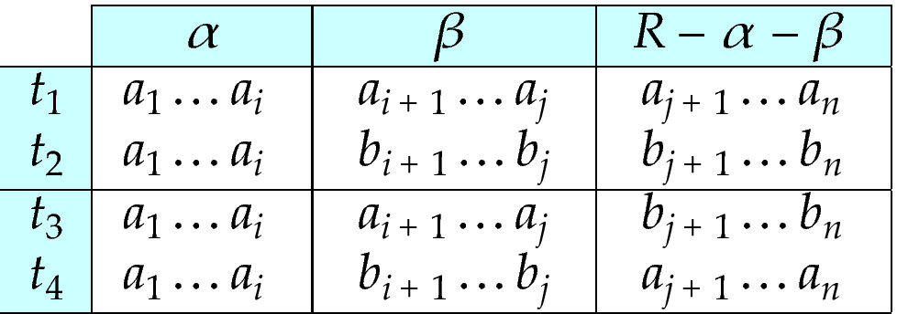
Multivalued Dependencies (MVDs)
Let R be a relation schema and let α ⊆ R and β ⊆ R. The multivalued dependency
α →→ β
holds on R

Slide 45
Example
Let R be a relation schema with a set of attributes that are partitioned into 3 nonempty subsets.
Y, Z, W
We say that Y →→ Z (Y multidetermines Z ) if and only if for all possible relations r (R )
< y₁, z₁, w₁ > ∈ r and < y₁, z₂, w₂ > ∈ r
then
< y₁, z₁, w₂ > ∈ r and < y₁, z₂, w₁ > ∈ r
Note that since the behavior of Z and W are identical it follows that
Y →→ Z if Y →→ W

Slide 46
Example (Cont.)
In our example:
ID →→ child_name ID →→ phone_number
These two sets are in some sense independent of each other.
ID | child_name | phone_number
99999 | David | 512-555-1234
99999 | David | 512-555-4321
99999 | William | 512-555-1234
99999 | William | 512-555-4321

Slide 47

Practice Time
Find multivalued dependency in the following table
Notes:
course->->BOOK
course->->Lecturer

Slide 48
Theory of MVDs
From the definition of multivalued dependency, we can derive the following rule:
If α → β, then α →→ β
The closure D⁺ of D is the set of all functional and multivalued dependencies logically implied by D.

Slide 49
Fourth Normal Form
A relation schema R is in 4NF with respect to a set D of functional and multivalued dependencies
if for all multivalued dependencies in D⁺ of the form α →→ β, at least one of the following hold:
α →→ β is trivial (i.e., β ⊆ α or α ∪ β = R)
α is a superkey for schema R
If a relation is in 4NF it is in BCNF

Slide 50
4NF Decomposition Algorithm
result: = {R}; done := false; compute D⁺; Let D_{i} denote the restriction of D⁺ to R_{i}
while (not done) if (there is a schema R_{i} in result that is not in 4NF) then begin
let α →→ β be a nontrivial multivalued dependency that holds on R_{i} such that α → R_{i} is not in D_{i}, and α∩β=φ; result := (result - R_{i}) ∪ (R_{i} - β) ∪ (α, β); end else done:= true;
Note: each R_{i} is in 4NF, and decomposition is lossless-join

Slide 51
Example
R =(A, B, C, G, H, I)
F ={ A →→ B
B →→ HI
CG →→ H }
R is not in 4NF since A →→ B and A is not a superkey for R
Decomposition
a) R₁ = (A, B) (R₁ is in 4NF)
b) R₂ = (A, C, G, H, I) (R₂ is not in 4NF, decompose into R₃ and R₄)
c) R₃ = (C, G, H) (R₃ is in 4NF)
d) R₄ = (A, C, G, I) (R₄ is not in 4NF, decompose into R₅ and R₆)
A →→ B and B →→ HI ➔ A →→ HI, (MVD transitivity), and
and hence A →→ I (MVD restriction to R₄)
e) R₅ = (A, I) (R₅ is in 4NF)
f)R₆ = (A, C, G) (R₆ is in 4NF)

Slide 52
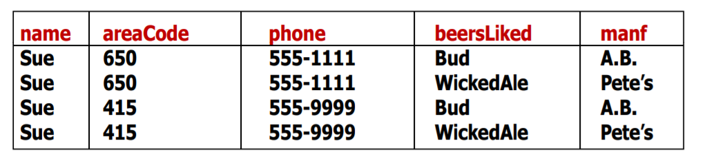
Practice Time
Decomposed R into 4NF relations
Notes:
name->->areacode
areacode-->phone
name->->beersLiked
beersLiked-->manf
A->->B
B->->C
A->->D
D->->E
F={A->->BD,B->->C,D->->E}
(B,C) (A,B,D) (D,E)
F={B->->C} F={A->->BD} F={D->->E}

Slide 53
Chapter 8: Relational Database Design
Features of Good Relational Design
Atomic Domains and First Normal Form
Decomposition Using Functional Dependencies
Functional Dependency Theory
Decomposition Algorithms
Decomposition Using Multivalued Dependencies
Database-Design Process

Slide 54
Overall Database Design Process
We assumed that schema R is given
R could have been generated when converting E-R diagram to a set of tables.
R could have been a single relation containing all attributes that are of interest (called universal relation).
R could have been the result of some ad hoc design of relations, which we then test/convert to normal form.
Normalization breaks R into smaller relations.
Notes:
Ad hoc is a Latin phrase meaning literally 'to this'. In English, it generally signifies a solution designed for a specific problem or task, non-generalizable, and not intended to be adapted to other purposes (compare with a priori)

Slide 55
ER Model and Normalization
When an E-R diagram is carefully designed,
the tables generated from the E-R diagram should not need further normalization.
In a real design, there can be functional dependencies from non-key attributes to other attributes
Example: an employee entity with attributes department_name and building, and a functional dependency department_name→ building
Good design would have made department an entity

Slide 56
Other Design Issues
Instead of earnings (company_id, year, amount ), use
earnings_2004, earnings_2005, earnings_2006, etc., all with the schema (company_id, earnings).
Above are in BCNF, but make querying across years difficult and needs new table each year
company_year (company_id, earnings_2004, earnings_2005, earnings_2006)
Also in BCNF, but also makes querying across years difficult and requires new attribute each year.

