Slide 1
Chapter 8: Relational Database Design

Slide 2
Chapter 8: Relational Database Design
Features of Good Relational Design
Atomic Domains and First Normal Form
Functional Dependency Theory
Decomposition Using Functional Dependencies
Decomposition Algorithms
Decomposition Using Multivalued Dependencies
Database-Design Process

Slide 3
Boyce-Codd Normal Form
A relation schema R is in BCNF if for all functional dependencies in F⁺ of the form
α→ β
where α ⊆ R and β ⊆ R, at least one of the following holds:
α  → β is trivial (i.e., β ⊆ α)
α is a superkey for R

Slide 4
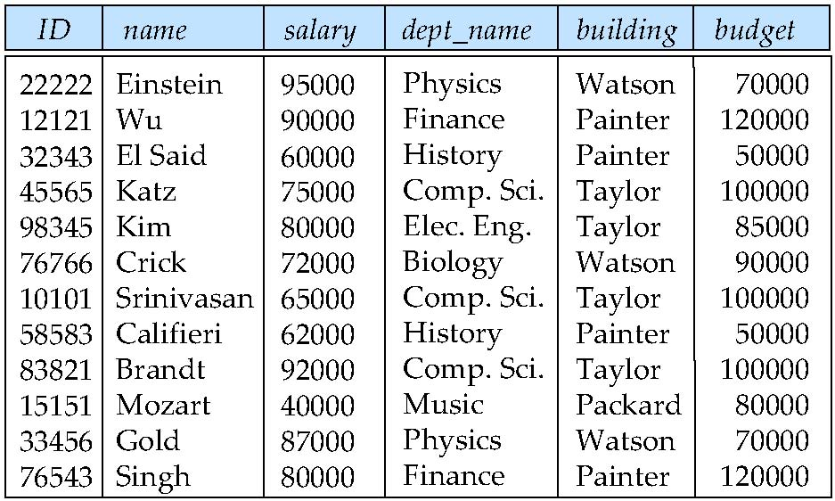
Boyce-Codd Normal Form
Example schema not in BCNF:
instr_dept (ID, name, salary, dept_name, building, budget )
dept_name→ building, budget
holds on instr_dept, but dept_name is not a superkey

Slide 5
Testing for BCNF
To check if a non-trivial dependency α →β causes a violation of BCNF
1. compute α⁺, and
verify that it includes all attributes of R.
Simplified test: To check only the dependencies in the given set F for violation of BCNF.

Slide 6
Goals of Normalization
In the case that a relation scheme R is not in “good” form, decompose it into a set of relation scheme {R₁, R₂, ..., R_{n}} such that
each relation scheme is in good form
the decomposition is a lossless-join decomposition
Preferably, the decomposition should be dependency preserving.

Slide 7
Lossless-join Decomposition
For the case of R = (R₁, R₂), we require that for all possible relations r on schema R
r = ∏_{R1} (r ) ∏_{R2} (r )
A decomposition of R into R₁ and R₂ is lossless join if in F⁺:
R₁ ∩ R₂ → R₁, or
R₁ ∩ R₂ → R₂

Slide 8
Lossless-join Decomposition Example
R = (A, B, C) F = {A → B, B → C)
Can be decomposed in two different ways
R₁ = (A, B), R₂ = (B, C)
Lossless-join decomposition:
R₁ ∩ R₂ = {B} and B → BC
R₁ = (A, B), R₂ = (A, C)
Lossless-join decomposition:
R₁ ∩ R₂ = {A} and A → AB

Slide 9
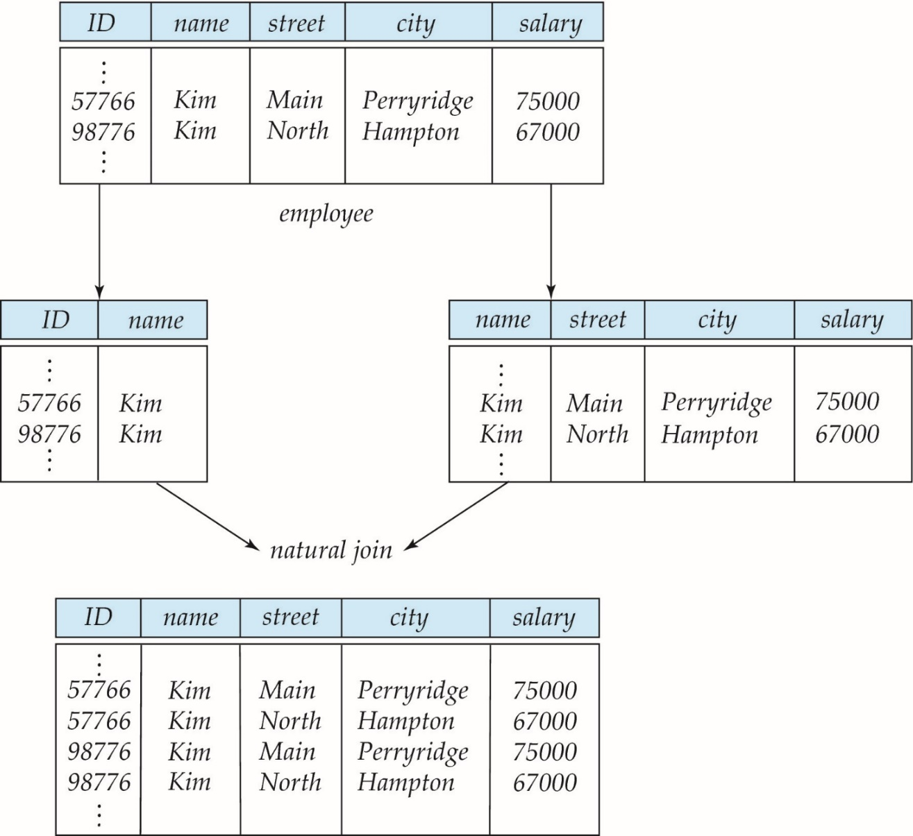
Lossly-join Decomposition Example

Slide 10
Dependency Preservation
Let F_{i} be the set of dependencies F ⁺ that include only attributes in R_{i}.
A decomposition is dependency preserving, if
(F₁ ∪ F₂ ∪ … ∪ F_{n} )⁺ = F ⁺

Slide 11
Example of Dependency Preservation
R = (A, B, C, D) F = {A → B, B → C, C → D)
decomposed into
R₁ = (A,B,C), R₂ = (C, D)

Slide 12
Example of non-Dependency Preservation
R = (A, B, C, D) F = {A → B, B → C, C → D)
decomposed into
R₁ = (A,C,D), R₂ = (B, C)

Slide 13
Testing for Dependency Preservation
To check if a dependency α → β is preserved in a decomposition of R into R₁, R₂, …, R_{n}
result = α while (changes to result) do for each R_{i} in the decomposition t = (result ∩ R_{i})⁺ ∩ R_{i} result = result ∪ t
If result contains all attributes in β, then α → β is preserved.

Slide 14
Example
R = (A, B, C) F = {A → B, B → C)
Can be decomposed in two different ways
R₁ = (A, B), R₂ = (B, C)
Dependency preserving
R₁ = (A, B), R₂ = (A, C)
Not dependency preserving (cannot check B → C without computing R₁ R₂)

Slide 15
Practice Time
R = (A, B, C ) F = {A → B B → C} Key = {A}
Whether R is in BCNF ?
No, Because B → C but B is not superkey of R
Decomposition R₁ = (A, B), R₂ = (B, C)
Lossless-join decomposition ?
Yes, because B is a superkey of R₂
Dependency preserving ?
Yes

Slide 16
Practice Time
R = (A, B, C ) F = {AB → C C → B} Key = {AB}
Whether R is in BCNF ?
No, Because C → B but C is not superkey of R
Decomposition R₁ = (A, C), R₂ = (B, C)
Lossless-join decomposition?
Yes, because C is a superkey of R₂
Dependency preserving?
No, because AB → C can not be reserved

Slide 17
Practice Time
R = (A, B, C, D, E ) F = {A→ C C → E
BC → D}
Which of the decomposition is a lossless-join decomposition?
(A,C), (C,E), (B,C,D)
(A,B,C), (C,D), (D,E)
(A,B), (B,C,D), (A,C,E) V
Join (A,B) and (A,C,E) , then Join (B,C,D)
(A,C), (C,D,E), (A,E)

Slide 18
Chapter 8: Relational Database Design
Features of Good Relational Design
Atomic Domains and First Normal Form
Functional Dependency Theory
Decomposition Using Functional Dependencies
Decomposition Algorithms
Decomposition Using Multivalued Dependencies
Database-Design Process

Slide 19
Decomposing a Schema into BCNF
Suppose we have a schema R and a non-trivial dependency α →β causes a violation of BCNF.
We decompose R into:
(α U β )
( R - ( β - α ) )
In our example,
(ID, name, salary, dept_name, building, budget)
α = dept_name
β = building, budget
and inst_dept is replaced by
(α U β ) = ( dept_name, building, budget )
( R - ( β - α ) ) = ( ID, name, salary, dept_name )

Slide 20
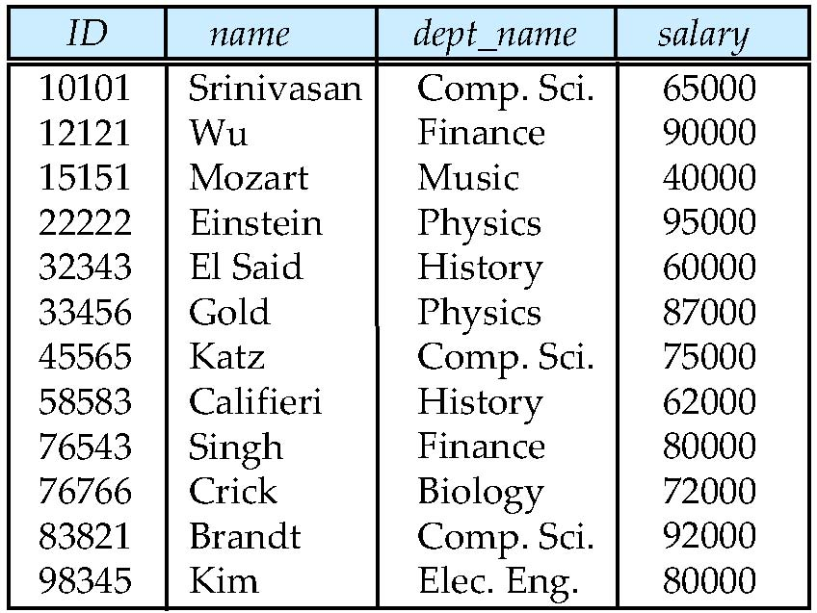
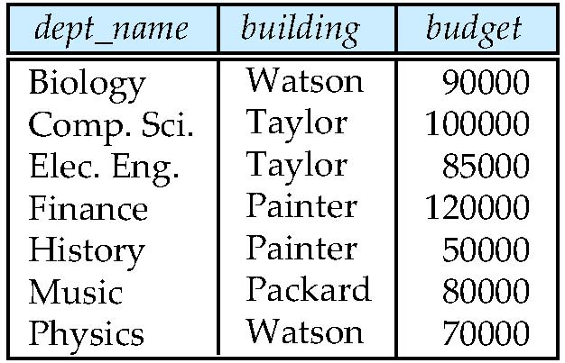

Slide 21
Testing for BCNF
Continue to check BCNF in a decomposition of R
Consider R = (A, B, C, D, E), with F = { A → B, BC → D}
Decompose R into R₁ = (A,B) and R₂ = (A,C,D,E)
The dependencies in R₁ ?
The dependencies in R₂ ?

Slide 22
Testing Decomposition for BCNF
To check if a relation R_{i} in a decomposition of R is in BCNF,
test R_{i} for BCNF with respect to the restriction of F to R_{i}
for every set of attributes α ⊆ R_{i}, check that α⁺
α→ (α⁺ - α) ∩ R_{i} hold on R_{i},
If some α→ β in F, but R_{i} is not a subset of α⁺ => R_{i} violates BCNF.

Slide 23
Practice Time
Given a relation R(A, B, C, D, E, F, G) with functional dependencies
F= { B → CF, B → DEF, AE → G, E → FG }
If a relation S(B, C, E, F) is decomposed from R.
What are the FDs that hold on S?
B → CEF, E → G

Slide 24
Example of BCNF Decomposition
R = (A, B, C ) F = {A → B B → C} Key = {A}
R is not in BCNF (B → C but B is not superkey)
Decomposition
R₁ = (B, C)
R₂ = (A,B)

Slide 25
BCNF Decomposition Algorithm
result := {R }; done := false; compute F ⁺; while (not done) do if (there is a schema R_{i} in result that is not in BCNF) then begin let α → β that holds on R_{i} such that
α → R_{i} is not in F ⁺ and α ∩ β = ∅; result := (result – R_{i} ) ∪ (R_{i} – β) ∪ (α, β ); end else done := true;
Note: each R_{i} is in BCNF, and decomposition is lossless-join.

Slide 26
Example of BCNF Decomposition
class (course_id, title, dept_name, credits, sec_id, semester, year, building, room_number, capacity, time_slot_id)
Functional dependencies:
course_id→ title, dept_name, credits
building, room_number→capacity
course_id, sec_id, semester, year→building, room_number, time_slot_id
A candidate key {course_id, sec_id, semester, year}.
BCNF Decomposition:
course_id→ title, dept_name, credits holds
but course_id is not a superkey.
We replace class by:
course(course_id, title, dept_name, credits)
class-1 (course_id, sec_id, semester, year, building, room_number, capacity, time_slot_id)
course is in BCNF

Slide 27
BCNF Decomposition (Cont.)
class-1 (course_id, sec_id, semester, year, building, room_number, capacity, time_slot_id)
building, room_number→capacity holds on class-1
but {building, room_number} is not a superkey for class-1.
We replace class-1 by:
classroom (building, room_number, capacity)
section (course_id, sec_id, semester, year, building, room_number, time_slot_id)
classroom and section are in BCNF.

Slide 28
BCNF and Dependency Preservation
It is not always possible to get a BCNF decomposition that is dependency preserving
R = (J, K, L ) F = {JK → L L → K } Two candidate keys = JK and JL
R is not in BCNF
Any decomposition of R will fail to preserve
JK → L
This implies that testing for JK → L requires a join

Slide 29
Practice Time
Given a relation R(A, B, C, D) with functional dependencies
F={ A → B, B →AD, AC → D}
Find the candidate keys of R
{AC, BC}
Indicate all the BCNF violations
A → B, B →AD
Decompose R into collections of relations that are in BCNF.
(A, B) (A, C, D) or (A, B, D) (B,C)

Slide 30
Third Normal Form: Motivation
There are some situations where
efficient checking for FD violation on updates is important
but BCNF is not dependency preserving
Solution: define a weaker normal form, called Third Normal Form (3NF)
Allows some redundancy
There is always a lossless-join, dependency-preserving decomposition into 3NF.

Slide 31
Testing for 3NF
For each dependency α → β
Use attribute closure to check if α is a superkey.
If α is not a superkey, verify if each attribute in β is contained in a candidate key of R
If a functional dependency makes R violates 3NF
Perform the 3NF decomposition algorithm

Slide 32
3NF Example
Relation dept_advisor:
dept_advisor (s_ID, i_ID, dept_name) F = {s_ID, dept_name → i_ID,
i_ID → dept_name}
Two candidate keys: { s_ID, dept_name} and {i_ID, s_ID}
Whether R is in 3NF ?
s_ID, dept_name → i_ID
s_ID, dept_name is a superkey
i_ID → dept_name
dept_name is contained in a candidate key

Slide 33
Redundancy in 3NF
There is some redundancy in this schema
Example of problems due to redundancy in 3NF
R = (J(s_id), K(dept_name), L(i_ID)) F = {JK → L, L → K }
J
L
K
j₁
j₂
j₃
null
l₁
l₁
l₁
l₂
k₁
k₁
k₁
k₂
repetition of information (e.g., the relationship l₁, k₁)
need to use null values

Slide 34
Practice Time
Given a relation R(A, B, C, D) with functional dependencies
F={ AB → D, D →B, D → C}
Find the candidate keys of R: {AB, AD}
Which FD is BCNF violation but not 3NF violation?
D →B because D is not a superkey of R,
but B is contained in a candidate key of R

Slide 35
3NF Decomposition Algorithm
Let F_{c} be a canonical cover for F; i := 0; for each functional dependency α → β in F_{c} do if none of the schemas R_{j}, 1 ≤ j ≤ i contains α β then begin i := i + 1; R_{i} := α β end if none of the schemas R_{j}, 1 ≤ j ≤ i contains a candidate key for R then begin i := i + 1; R_{i} := any candidate key for R; end /* Optionally, remove redundant relations */
repeat if any schema R_{j} is contained in another schema R_{k} then /* delete R_{j} */ R_{j} = R;; i=i-1; return (R₁, R₂, ..., R_{i})

Slide 36
3NF Decomposition: An Example
Relation schema:
cust_banker_branch = (customer_id, employee_id, branch_name, type )
The functional dependencies for this relation schema are:
customer_id, employee_id → branch_name, type
employee_id → branch_name
customer_id, branch_name → employee_id
We first compute a canonical cover
branch_name is extraneous in the r.h.s. of the 1st dependency
No other attribute is extraneous, so we get F_{C} =
customer_id, employee_id → type employee_id → branch_name customer_id, branch_name → employee_id

Slide 37
3NF Decompsition Example (Cont.)
The for loop generates following 3NF schema:
(customer_id, employee_id, type )
(employee_id, branch_name)
(customer_id, branch_name, employee_id)
(customer_id, employee_id, type ) contains a candidate key of the original schema
no further relation schema needs be added
At end of for loop, detect and delete schemas, such as (employee_id, branch_name), which are subsets of other schemas
The resultant simplified 3NF schema is:
(customer_id, employee_id, type)
(customer_id, branch_name, employee_id)

Slide 38
Practice Time
Consider the following the functional dependencies over a relation R(A, B, C, D, E, F, G)
F= { B → CF, B → DEF, AE → G, E → FG }
candidate key of R: AB
Find a canonical cover of F
F_{C}= { B → CDE, E → FG }
Given a 3NF, lossless, and dependency preserving decomposition of R.
(B,C,D,E), (E, F, G), (A, B)

Slide 39
Practice Time
Consider the following the functional dependencies over a relation R(A, B, C, D, E)
F= { A → BC, B → C, A → B, AB → C, BD → A}
candidate keys of R: ADE, BDE
Find a canonical cover of F
F_{C}= { A → B, B → C, BD → A }
Given a 3NF, lossless, and dependency preserving decomposition of R.
(B, C) (A, B, D) (A, D, E) or
(B, C) (A, B, D) (B, D, E)

Slide 40
Comparison of BCNF and 3NF
It is always possible to decompose a relation into a set of relations that are in 3NF such that:
the decomposition is lossless
the dependencies are preserved
It is always possible to decompose a relation into a set of relations that are in BCNF such that:
the decomposition is lossless
it may not be possible to preserve dependencies.

Slide 41
Design Goals
Goal for a relational database design is:
BCNF.
Lossless join.
Dependency preservation.
If we cannot achieve this, we accept one of
Lack of dependency preservation
Redundancy due to use of 3NF

Slide 42
Chapter 8: Relational Database Design
Features of Good Relational Design
Atomic Domains and First Normal Form
Decomposition Using Functional Dependencies
Functional Dependency Theory
Decomposition Algorithms
Decomposition Using Multivalued Dependencies
Database-Design Process

Slide 43
Multivalued Dependencies
Suppose we record names of children, and phone numbers for instructors:
inst_child(ID, child_name)
inst_phone(ID, phone_number)
If we were to combine these schemas to get
inst_info(ID, child_name, phone_number)
Example data:
This relation is in BCNF
Why?
ID | child_name | phone_number
99999 | David | 512-555-1234
99999 | David | 512-555-4321
99999 | William | 512-555-1234
99999 | William | 512-555-4321

Slide 44
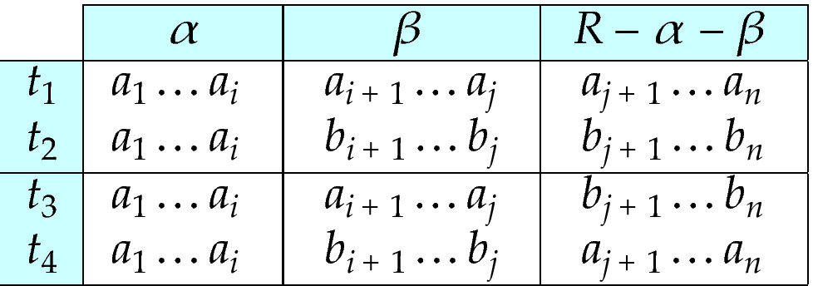
Multivalued Dependencies (MVDs)
Let R be a relation schema and let α ⊆ R and β ⊆ R. The multivalued dependency
α →→ β
holds on R

Slide 45
Example
Let R be a relation schema with a set of attributes that are partitioned into 3 nonempty subsets.
Y, Z, W
We say that Y →→ Z (Y multidetermines Z ) if and only if for all possible relations r (R )
< y₁, z₁, w₁ > ∈ r and < y₁, z₂, w₂ > ∈ r
then
< y₁, z₁, w₂ > ∈ r and < y₁, z₂, w₁ > ∈ r
Note that since the behavior of Z and W are identical it follows that
Y →→ Z if Y →→ W

Slide 46
Example (Cont.)
In our example:
ID →→ child_name ID →→ phone_number
These two sets are in some sense independent of each other.
ID | child_name | phone_number
99999 | David | 512-555-1234
99999 | David | 512-555-4321
99999 | William | 512-555-1234
99999 | William | 512-555-4321

Slide 47

Practice Time
Find multivalued dependency in the following table
course →→ Book
course →→ Lecturer

Slide 48
Theory of MVDs
From the definition of multivalued dependency, we can derive the following rule:
If α → β, then α →→ β
The closure D⁺ of D is the set of all functional and multivalued dependencies logically implied by D.

Slide 49
Fourth Normal Form
A relation schema R is in 4NF with respect to a set D of functional and multivalued dependencies
if for all multivalued dependencies in D⁺ of the form α →→ β, at least one of the following hold:
α →→ β is trivial (i.e., β ⊆ α or α ∪ β = R)
α is a superkey for schema R
If a relation is in 4NF it is in BCNF

Slide 50
4NF Decomposition Algorithm
result: = {R}; done := false; compute D⁺; Let D_{i} denote the restriction of D⁺ to R_{i}
while (not done) if (there is a schema R_{i} in result that is not in 4NF) then begin
let α →→ β be a nontrivial multivalued dependency that holds on R_{i} such that α → R_{i} is not in D_{i}, and α∩β=φ; result := (result - R_{i}) ∪ (R_{i} - β) ∪ (α, β); end else done:= true;
Note: each R_{i} is in 4NF, and decomposition is lossless-join

Slide 51
Example
R =(A, B, C, G, H, I)
F ={ A →→ B
B →→ HI
CG →→ H }
R is not in 4NF since A →→ B and A is not a superkey for R
Decomposition
a) R₁ = (A, B) (R₁ is in 4NF)
b) R₂ = (A, C, G, H, I) (R₂ is not in 4NF, decompose into R₃ and R₄)
c) R₃ = (C, G, H) (R₃ is in 4NF)
d) R₄ = (A, C, G, I) (R₄ is not in 4NF, decompose into R₅ and R₆)
A →→ B and B →→ HI ➔ A →→ HI, (MVD transitivity), and
and hence A →→ I (MVD restriction to R₄)
e) R₅ = (A, I) (R₅ is in 4NF)
f)R₆ = (A, C, G) (R₆ is in 4NF)

Slide 52
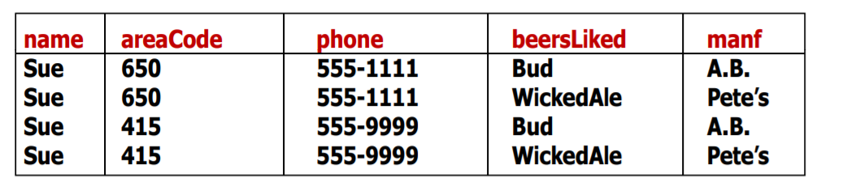
Practice Time
Decomposed R into 4NF relations
(name, areaCode, phone) and (name, beersLiked, manf)

Slide 53
Chapter 8: Relational Database Design
Features of Good Relational Design
Atomic Domains and First Normal Form
Decomposition Using Functional Dependencies
Functional Dependency Theory
Decomposition Algorithms
Decomposition Using Multivalued Dependencies
Database-Design Process

Slide 54
Overall Database Design Process
We assumed that schema R is given
R could have been generated when converting E-R diagram to a set of tables.
R could have been a single relation containing all attributes that are of interest (called universal relation).
R could have been the result of some ad hoc design of relations, which we then test/convert to normal form.
Normalization breaks R into smaller relations.

Slide 55
ER Model and Normalization
When an E-R diagram is carefully designed,
the tables generated from the E-R diagram should not need further normalization.
In a real design, there can be functional dependencies from non-key attributes to other attributes
Example: an employee entity with attributes department_name and building, and a functional dependency department_name→ building
Good design would have made department an entity

Slide 56
Other Design Issues
Instead of earnings (company_id, year, amount ), use
earnings_2004, earnings_2005, earnings_2006, etc., all with the schema (company_id, earnings).
Above are in BCNF, but make querying across years difficult and needs new table each year
company_year (company_id, earnings_2004, earnings_2005, earnings_2006)
Also in BCNF, but also makes querying across years difficult and requires new attribute each year.

