Slide 1
影像處理期末專題 手寫數字辨識
組別:第六組
組員:王樸、葉昱禛

Slide 2
專題目標
使用MNIST資料集和opencv的knn函式做分類學習，以分辨手寫數字

Slide 3
KNN分類器

Slide 4
K-NearestNeighbor
選取K個最近的資料來作為分類依據
With 1-nearest neighbor rule, the predicted class of test sample x is set equal to the true class ω of its nearest neighbor, where mi is a nearest neighbor to x if the distanced
(mi,x)=minj{d(mj,x)}.
For k-nearest neighbors, the predicted class of test sample x is set equal to the most frequent true class among k nearest training samples. This forms the decision rule D:x→ω^ .

Slide 5
1
1
2
2
2
1
1
1
2

Slide 6
1
1
2
2
2
?
1
1
1
2

Slide 7
1
1
2
2
2
1
?
1
1
1
2
K=1

Slide 8
1
1
2
2
2
2
?
1
1
1
2
K=3

Slide 9
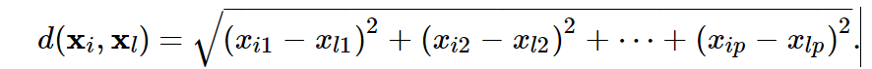
Characteristics of kNN
The k-nearest-neighbor classifier is commonly based on the Euclidean distance between a test sample and the specified training samples. Let xi be an input sample with p features (xi1,xi2,…,xip) , n be the total number of input samples (i=1,2,…,n) and p the total number of features (j=1,2,…,p) . The Euclidean distance between sample xi and xl (l=1,2,…,n) is defined as

Slide 10
KNN的特性
監督式學習(需要label)
During the training process, we use only the true class ω of each training sample to train the classifier, while during testing we predict the class ω^ of each test sample. It warrants noting that kNN is a "supervised" classification method in that it uses the class labels of the training data. Unsupervised classification methods, or "clustering" methods, on the other hand, do not employ the class labels of the training data.

Slide 11
KNN的特性
耗費空間和時間
K值過低時，對noise敏感

Slide 12
2
2
2
2
2
?
2
1
1
2
1
1
2
2
1
1
1
2
K=1
1
1
1

Slide 13
MNIST

Slide 14
MNIST
用於機器學習/深度學習的資料集
60000筆訓練資料及10000筆測試資料
包含0~9的手寫數字
modified
national
institute of
standards and
technology database

Slide 15
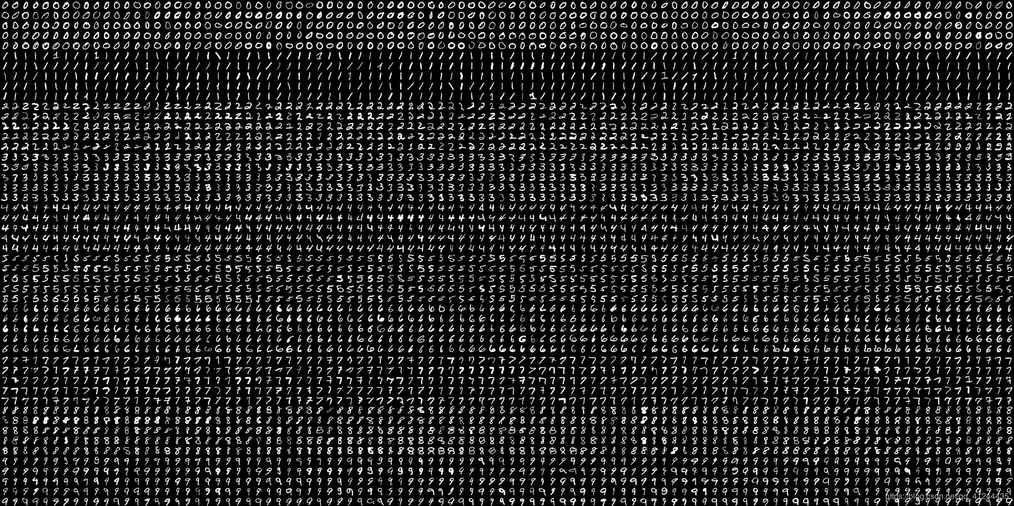

Slide 16
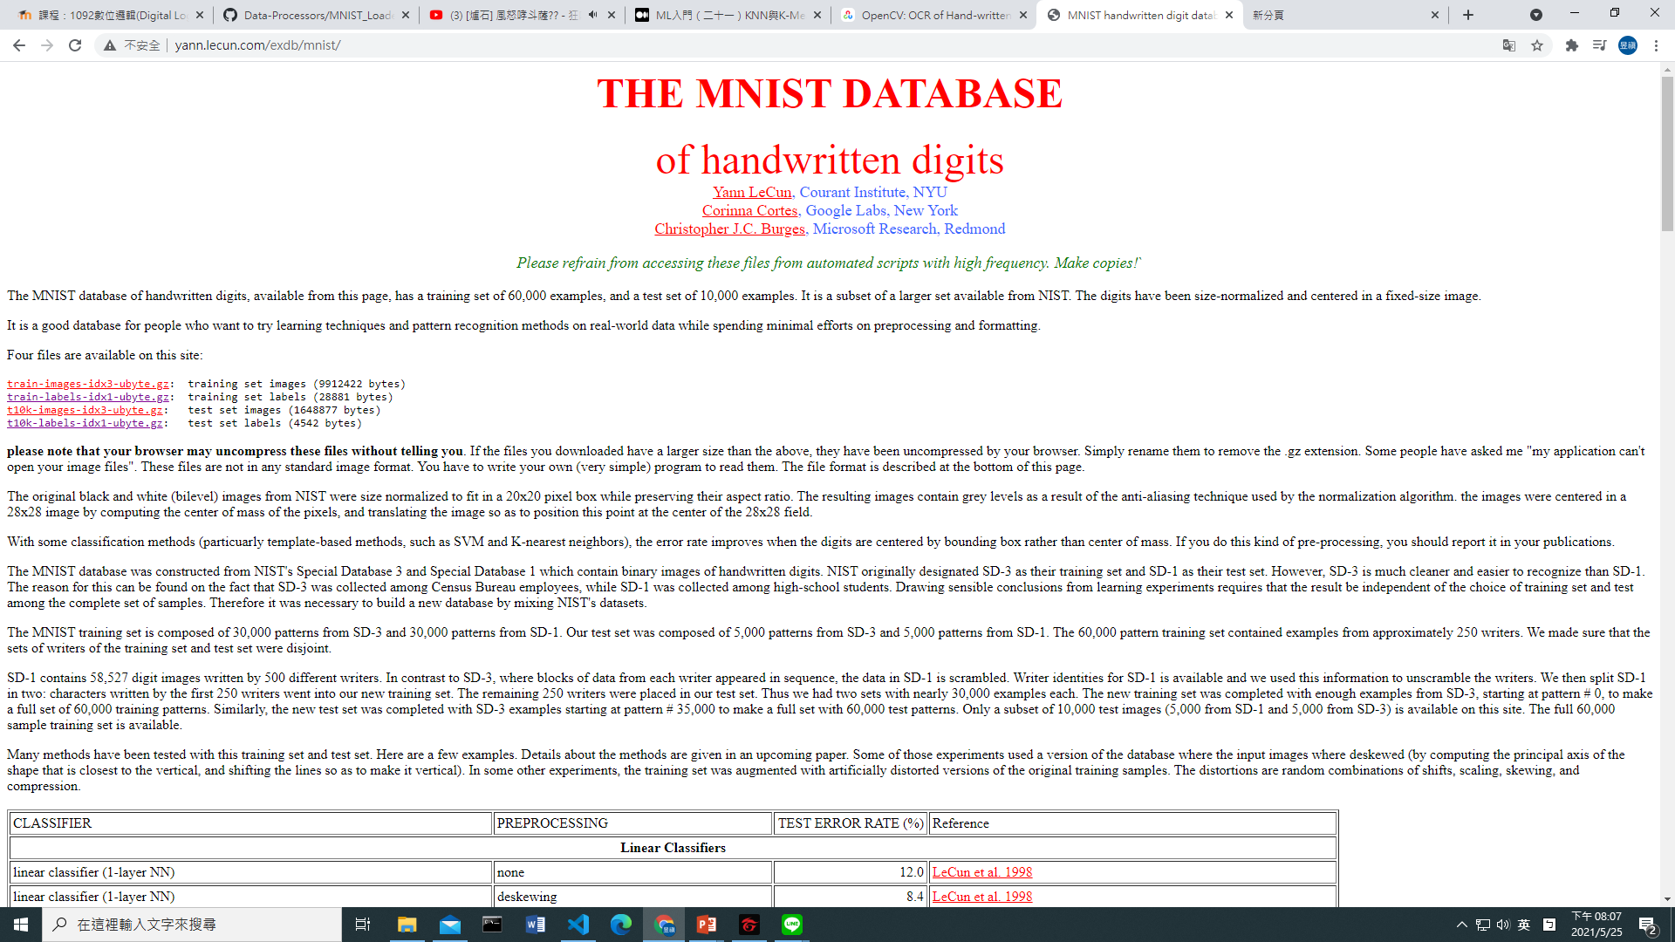
http://yann.lecun.com/exdb/mnist/

Slide 17
image
5
0
4
1
label

Slide 18
Image file format
Offset | Type | Value | Description
0000 | 4 byte integer | 0x00000801(2051) | magic number (MSB first)
0004 | 4 byte integer | 10000 or 60000 | number of images (test or train)
0008 | 4 byte integer | 28 | number of rows
0012 | 4 byte integer | 28 | number of columns
0016 | unsigned byte | ?? | pixel intensity (0-255)
0017 | unsigned byte | ?? | pixel intensity (0-255)
... | ... | ... | ...
xxxx | unsigned byte | ?? | pixel intensity (0-255)
16bytes
label file format
Offset | Type | Value | Description
0000 | 4 byte integer | 0x00000801(2049) | magic number (MSB first)
0004 | 4 byte integer | 10000 or 60000 | number of items (test or train)
0008 | unsigned byte | ?? | label
0009 | unsigned byte | ?? | label
... | ... | ... | ...
xxxx | unsigned byte | ?? | label
8bytes

Slide 19
以KNN進行MNIST手寫數字辨識實作

Slide 20
實驗步驟
讀取資料、標籤
Thresholding
計算資料特徵矩陣
根據歐式距離最小的K筆數據辨識數字

Slide 21
讀取資料、標籤
train-images-idx3-ubyte.gz: training set images (9912422 bytes)(60000張) train-labels-idx1-ubyte.gz: training set labels (28881 bytes) t10k-images-idx3-ubyte.gz: test set images (1648877 bytes)(10000張) t10k-labels-idx1-ubyte.gz: test set labels (4542 bytes)
28*28

Slide 22
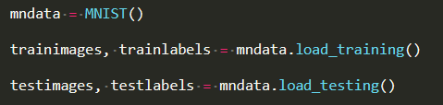
讀取資料、標籤
使用python mnist module
 | type | shape
trainimages | numpy.ndarray | (60000,784)
trainlabels | array
testimages | numpy.ndarray | (10000,784)
testlabels | array

Slide 23
Thresholding
要把灰度值二值化以便做特徵矩陣計算

Slide 24
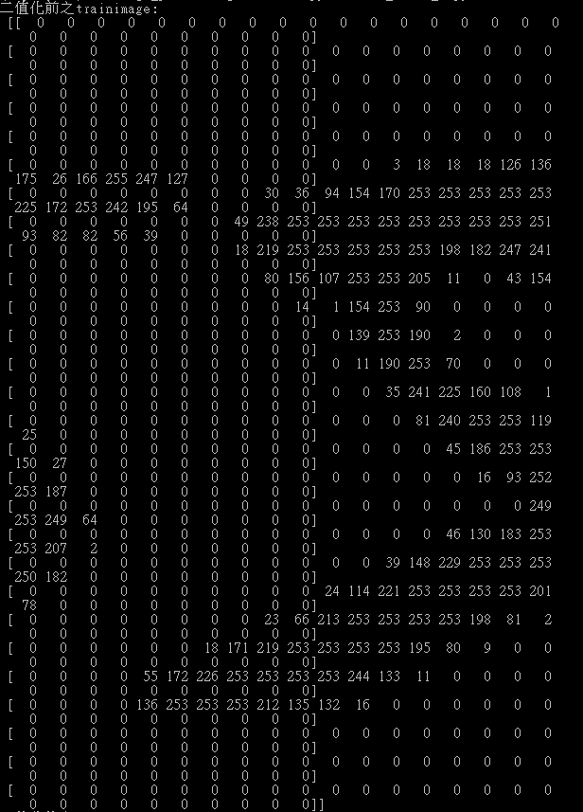
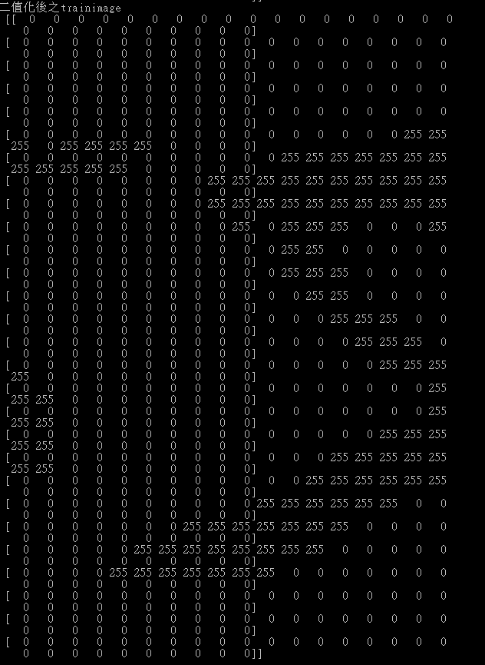

Slide 25
計算資料特徵矩陣
0 | 255 | 255 | 255 | 0 | 0 | 0 | 0 | 0
255 | 0 | 255 | 0 | 255 | 255 | 0 | 0 | 0
255 | 0 | 0 | 0 | 0 | 255 | 0 | 0 | 255
255 | 255 | 255 | 255 | 255 | 255 | 0 | 0 | 0
255 | 255 | 255 | 0 | 0 | 0 | 255 | 255 | 255
255 | 0 | 0 | 0 | 255 | 0 | 255 | 0 | 0
0 | 255 | 255 | 255 | 0 | 255 | 0 | 255 | 0
0 | 255 | 255 | 255 | 0 | 0 | 255 | 0 | 255
255 | 0 | 0 | 255 | 255 | 255 | 0 | 0 | 255
特徵矩陣
取‘255’之個數為特徵
5 | 4 | 1
7 | 4 | 4
5 | 6 | 4

Slide 26

根據歐式距離最小的K筆數據辨識數字
歐式距離:
(訓練資料之特徵矩陣每個元素-待測資料特徵矩陣中每個元素)之平方和開根號
取出歐式距離最小K筆數據,根據多數做預測
K值取奇數
若相同則需另寫判斷方式

Slide 27
程式碼及實作結果

Slide 28
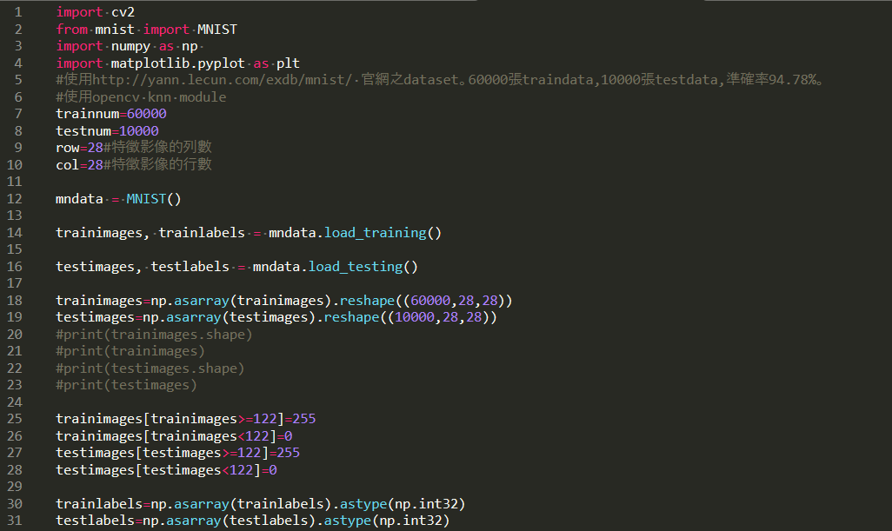

Slide 29
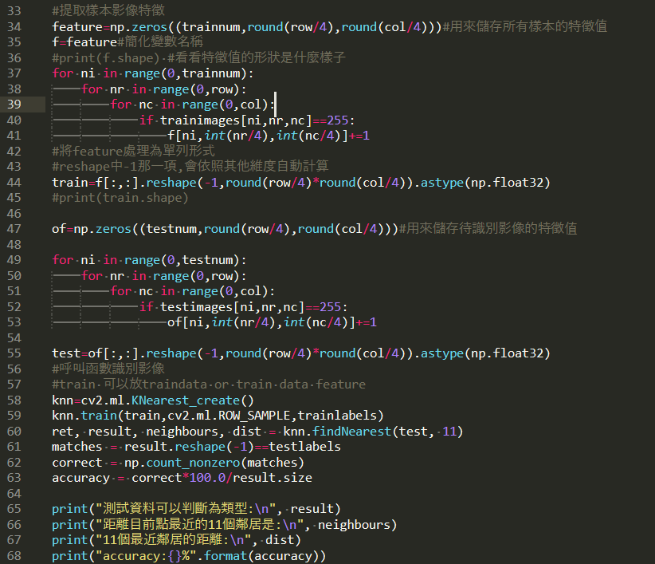

Slide 30
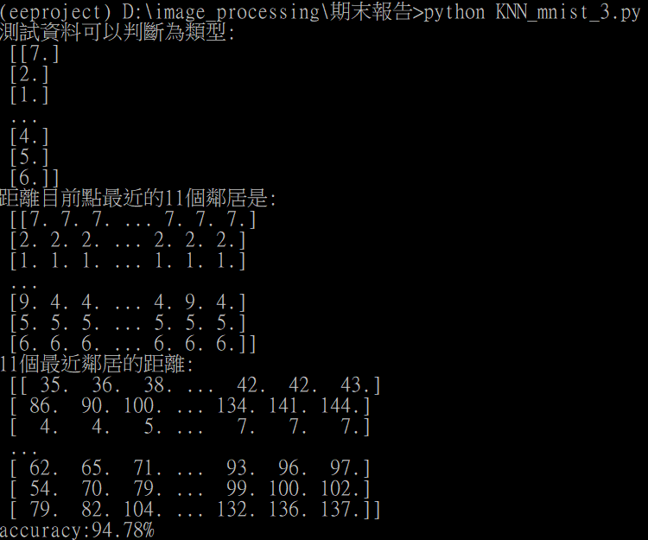

Slide 31
參考資料
https://docs.opencv.org/3.4/d5/d26/tutorial_py_knn_understanding.html
https://docs.opencv.org/3.4/d8/d4b/tutorial_py_knn_opencv.html
https://www.books.com.tw/products/0010836462
http://yann.lecun.com/exdb/mnist/
http://scholarpedia.org/article/K-nearest_neighbor

Slide 32
Q&A

