Slide 1
Homework 1 Due: 3/19
Input a color image C(R,G,B)
Output the color image C
3. Transform the color image C into a
grayscale image I by I = (R+G+B)/3
4. Show the grayscale image I.

Slide 2

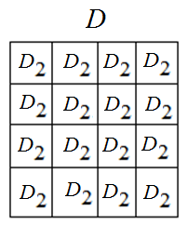
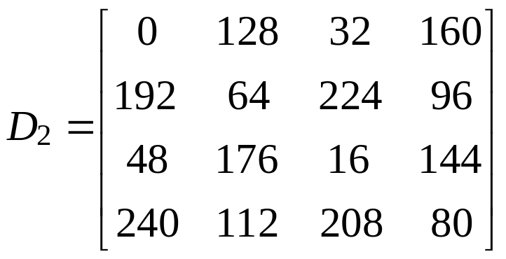
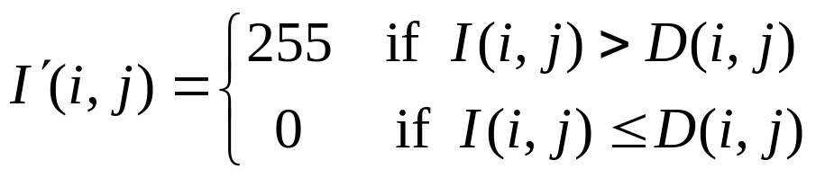

Homework 2 Due: 3/26
(A) Given a grayscale image I,
Step 1: Use the dithering matrix to generate an
array D of image size by repeating
Step 2: Threshold image I by
Step 3: Show images I and
3-<number>

Slide 3

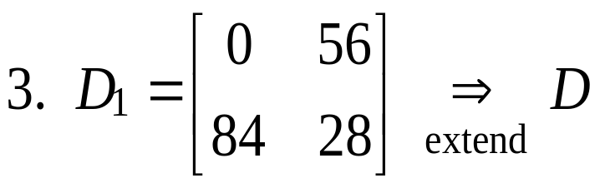
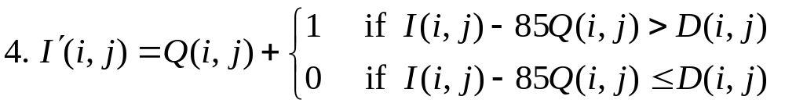

(B) Extend to n = 4 gray values
1. 255 / 3 = 85
5. Scale values of so that its values are in
[0, 255] for displaying
3-<number>

Slide 4
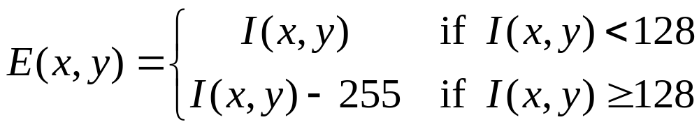
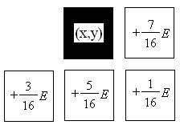
Homework 3 Due: 4/2
For each pixel I(x,y),
1) Calculate quantization error
2) Spread the error according to Floyd-Steinberg
i.e.,
3) Quantize new I(x,y)
to 0 or 255 using 128 as the threshold
3-<number>

Slide 5
Homework 4 Due: 4/9
Develop a histogram equalization (HE) program;
Apply the HE to i) gray, ii) color images;
3. For each input image, print out the input/output images and their histograms.
4. Discuss your experiments.
For a color image C,
(i) Convert it into a gray image G;
(ii) Apply HE to G to get G’;
(iii) For each pixel of C, modify its color (r,g,b)
by (r’,g’,b’) = (r,g,b) X G’ / G.

Slide 6
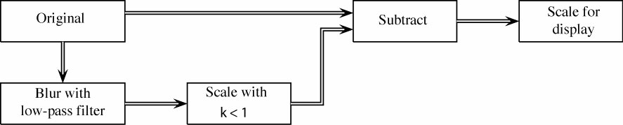
Homework 5 Due: 4/16
1. Select an experimental image
2. Apply a 3 by 3 (a) average filter and (b) median
filter to the image
3. Unsharp masking

Slide 7
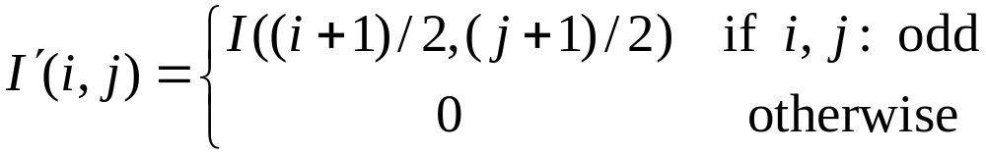

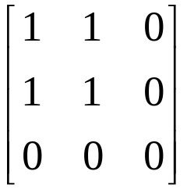
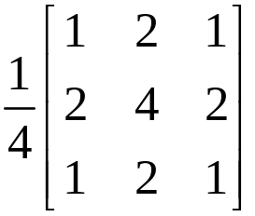
Image Enlargement
Homework 6 Due: 4/23
Step 1: Choose a grayscale image I
Step 2: Zero interleave
Step 3: Fill values by convolving with
(i) (ii)
NN
interpolation
Bilinear
interpolation
Step 4: Output enlarged images
6-<number>

Slide 8
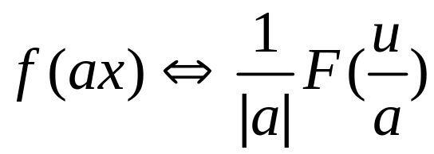
Homework 7 Due: 4/30
Show
(hint: let y = ax)

Slide 9
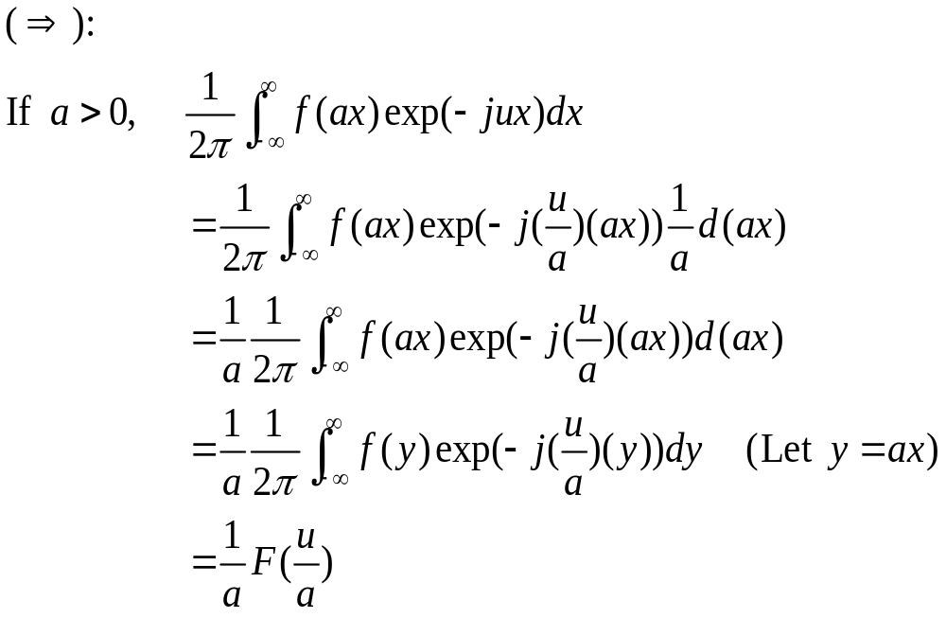
Ans:

Slide 10
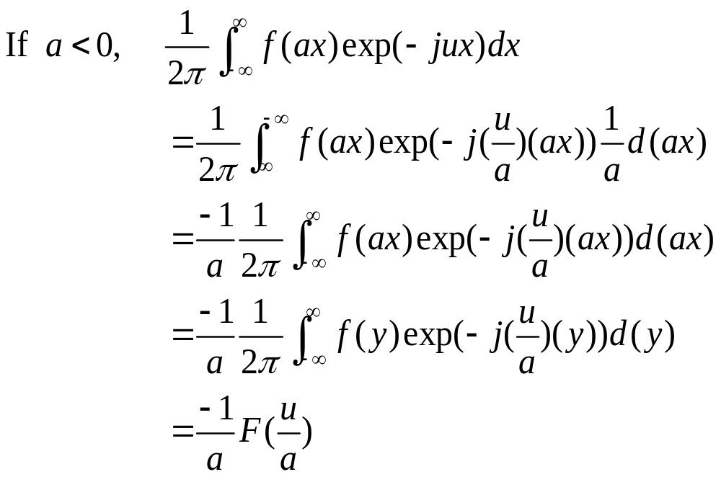

Slide 11
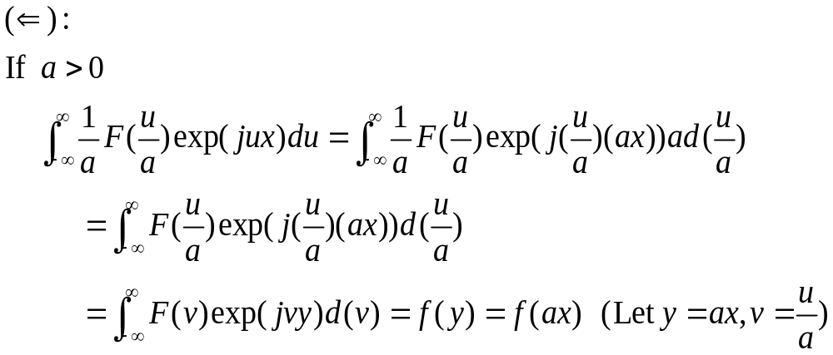
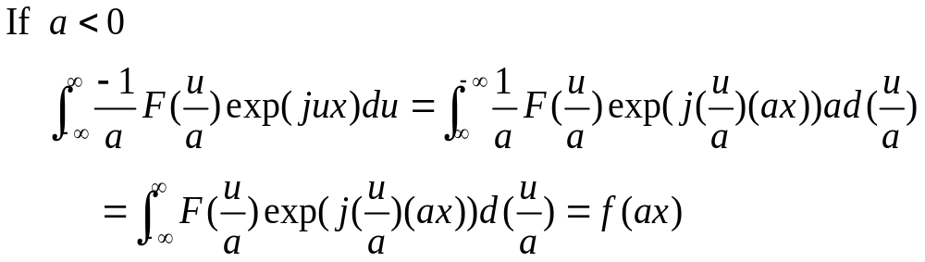

Slide 12
Homework 8 Due: 4/30
The FFT presented in the class is called the
successive doubling method (SDM). This
method assumes that the sizes of images were
power of two. However, it is common that the
size of an image is not power of two. Address
the idea how do you solve this problem using
the SDM.

Slide 13

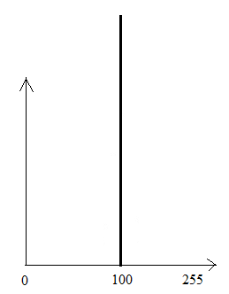
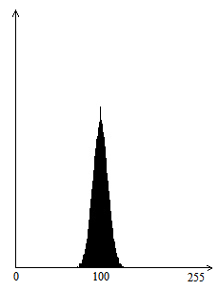


Homework 9 Due: 5/14
(1) Create an image g(x,y) whose pixels all have the same gray
value of 100. Show the image g(x,y).
(2) Generate Gaussian noise n(x,y), with , using
methods 1 and 2. Show the noisy image f(x,y)=g(x,y)+n(x,y).
(3) Display the histogram h(i) of f(x,y).
(4) Comment on your results.
Example:
Input image g(x,y) of gray values of 100
Histogram
of g(x,y)
Noisy image
f(x,y)
Histogram
of f(x,y)

Slide 14
Homework 10 Due: 5/21
Implement Otsu’s thresholding method

Slide 15
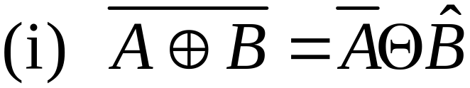
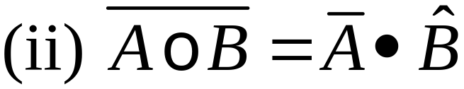
Homework 11 Due: 5/28
Prove
Options:

Slide 16
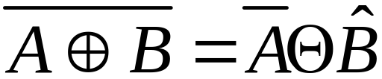
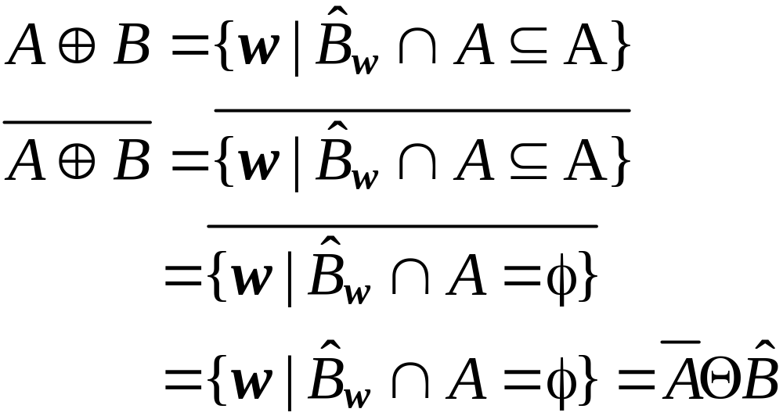
Show (i)

Slide 17
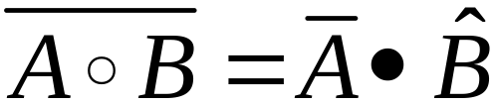
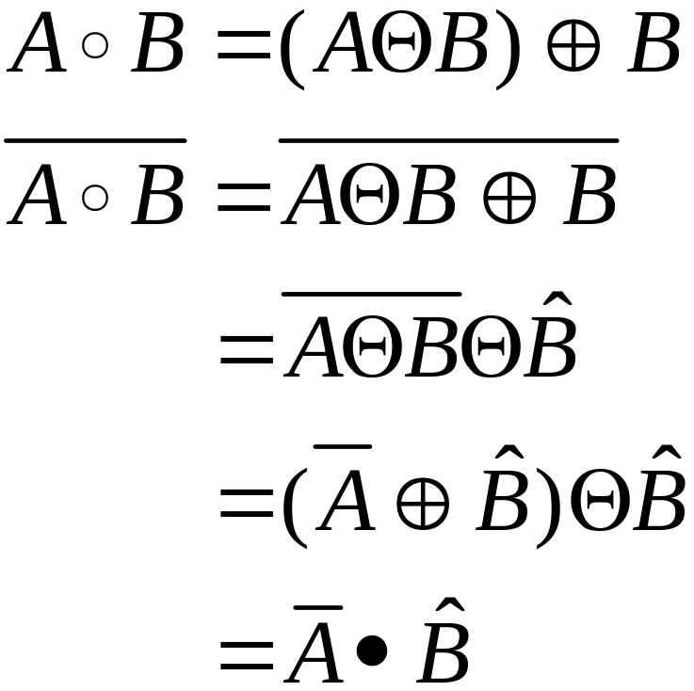
(ii)

Slide 18
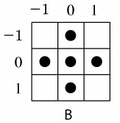



Homework 12 Due: 6/4
Implement the Lantuejoul’s skeletonization method
using the structuring element B:
Apply the method to the following input image
Input image
Experimental results

Slide 19
Homework 13 Due: 6/18
(i) Apply wavelet transform to the following
data sequence [71 67 24 26 36 32 14 18]
using average (s = (a + b) / 2) as the low pass
filtering and difference (d = a – s) as the high
pass filtering.
(ii) Recover the input sequence from the result
of wavelet transform in (i).
(B) Repeat (A) for the following data sequence
[18 14 32 36 26 24 67 71]

