Slide 1
Image Processing (I)
Instructor : Prof. Sei-Wang Chen, PhD (陳世旺)
Office : Applied Science Building,
Room 101
Contact : Tel: 7749-6661
E-mail: schen@csie.ntnu.edu.tw
Class Room: B101
Class Hr. : Thur. 9:10AM – 10:30AM
10:50AM – 12:00NOON
Office Hr. : Mon. 10:00AM – 12:00NOON
Wed. 10:00AM – 12:00NOON

Slide 2
Teaching assistant : 石展兢
Office : Applied Science Building,
Room 108
Telephone : 7749-6668
E-mail : ricky10402@gmail.com
Office Hrs. : Tue. 10:00AM – 12:00NOON
Fri. 10:00AM – 12:00NOON

Slide 3
Teaching Intention
Study on image processing, focusing
on practical techniques for 2D images.
This course covers a wide range of
application problems commonly encountered in image processing and
provides detailed algorithmic and
practical treatments for each.
Familiar with Opencv library and Python
language.

Slide 4
Textbook:
A Computational Introduction to
Digital Image Processing 2nd Ed.
Alasdair McAndrew, 2016
開發圖書公司
(02)82423988
魏錦鈴
0939852332

Slide 5
Contents
Ch.1: Introduction
Ch.2: Files and File Types
Ch.3: Image Display
Ch.4: Point Processing
Ch.5: Neighborhood Processing
Ch.6: Image Geometry
Ch.7: Fourier Transform
Ch.8: Image Restoration
Ch.9: Image Segmentation

Slide 6
Ch.10: Mathematical Morphology
Ch.11: Image Topology
Ch.12: Shapes and Boundaries
Ch.13: Color Processing
Ch.14: Image Coding and Compression
Ch.15: Wavelets
Ch.16: Special Effects
App. A: Introduction to MATLAB and Octave
App. B: Python and OpenCV
App. C: Fast Fourier Transform

Slide 7
Syllabus
Week Content
1 Chs0,1
2 AppB, Ch2
3 Chs3,4
4 Ch5
5 Presentation
6 Chs6,8
7 Ch8
8 Mid-Term Exam
9 Ch9
10 Ch9

Slide 8
Week Content
11 Ch10
12 Chs10,13
13 Ch13
14 Chs15
15 Project Report
16 Project Report
Mid-term Exam.
日期: Ch.8結束的下一週; 範圍: Chs.1-8

Slide 9
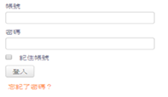
Steps for finding the PPTs of chapters:
(1) Moodle https://moodle.ntnu.edu.tw/
(2)登入
(3) 點選課程: 1092影像處理 (Image Processing)
(4)點選: 上課用PPT檔案區

Slide 10
Assignment Submission
(A) Prepare the assignment file
File Name: NAME.hw# , e.g., 陳世旺.hw1
Content:
(1) Problem statement
(2) (a) General assignment – Answer
(b) Program assignment –
(i) Experimental results:
Input/Output images
(ii) Source code
  (iii) Comments

Slide 11
Example:
Homework 1 (Due 3/4)
Input a color image C(R,G,B)
Output the color image C
3. Transform the color image C into a
grayscale image I by I = (R+G+B)/3
4. Show the grayscale image I.

Slide 12
File Name: 陳世旺.hw1
Content:
(1) Problem statement
Homework 1
Input a color image C(R,G,B)
Output the color image C
3. Transform the color image C into a
grayscale image I by I = (R+G+B)/3
4. Show the grayscale image I.

Slide 13
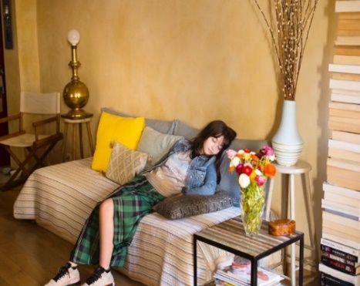
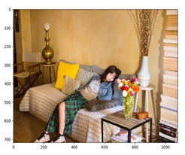
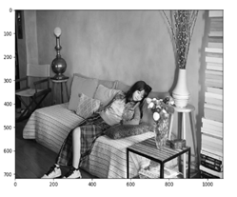
(a) General assignment – Answer
(b) Program Assignment --
(i) Experimental results:
Input color image C
Output color image C Grayscale image I

Slide 14
(ii) Source code
Python (color2grayscale):
# Load libraries
import sys
import numpy as np
import matplotlib.pyplot as plt
import matplotlib.image as mpimg
# Define RGB to grayscale function
# I = (R+G+B)/3
def rgb2gray(rgb):
return np.dot(rgb[..., :3], [0.333, 0.333, 0.333])
# Standard input image file name
img = mpimg.imread(sys.argv[1])
# Call RGB to grayscale function
gray = rgb2gray(img)
# Save output image file
plt.imsave(sys.argv[1].split('.')[-2] + "_gray." + sys.argv[1].split('.')[-1], gray, cmap='gray')
# Plot input and output images
figure, ax = plt.subplots(1, 2)
ax[0].imshow(img)
ax[1].imshow(gray, cmap='gray')
plt.show()
To execute this process:
$ python color2grayscale.py [FILE]

Slide 15
(iii) Comments
There are many libraries having functions for transforming color to grayscale images. Their
transformation coefficients, e.g., (0.2989, 0.5870, 0.1140), are different from the one (0.333, 0.333, 0.333) used in this homework.

Slide 16
(B) Submit the file to:
(1) Moodle https://moodle.ntnu.edu.tw/
(2)登入
(3) 點選課程: 1092影像處理 (Image Processing)
(4) 點選: 作業繳交區
(5) 上傳作業
作業繳交時間在下一次上課前

Slide 17
References:
Books
(1) Perception by R. Sekuler and R. Blake, 1985
(2) Digital Image Processing by K. R. Castleman,
1996
(3) Handbook of Computer Vision Algorithms in
Image Algebra by G. X. Ritter and J. N.
Wilson, 2001
(4) Image Processing, Analysis, and Machine
Vision by M. Sonka, V. Hlavac, and R. Boyle,
2015
(5) Digital Image Processing by R. C. Gonzalez
and R. E. Woods, 2018

Slide 18
(B) Journals
(1) IEEE Trans. on Pattern Analysis and
Machine Intelligence
(2) IEEE Trans. on Image Processing
(3) International Journal of Computer
Vision
(4) Computer Vision and Image
Understanding
(5) Pattern Recognition

Slide 19
(C) Conferences
(1) International Conference on Computer
Vision (ICCV)
(2) International Conference on Pattern
Recognition (ICPR)
(3) International Conference on Image
Processing (ICIP)
(4) Computer Vision and Pattern Recognition
(CVPR)

Slide 20
Evaluation
Interaction 5(10)%
Homework 10(20)%
Examination 25%
Presentation 10(20)%
Absence -1(-1.5) / Late -1/3(-1/2)
Late: after 9:30AM
Absence: after 10:30AM
Late homework will not be accepted
Plagiarism is definitely not allowed

