Slide 1
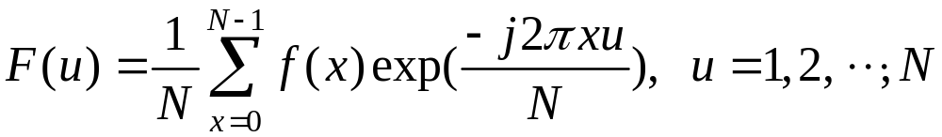



Chapter 15: Wavelets
Fourier transform
requires that the entire input signal
be readily available for calculating every
Fourier spectrum provides
all the frequencies present in a signal but does
not tell where they are present.
15-<number>

Slide 2
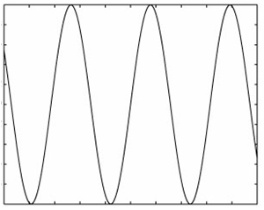
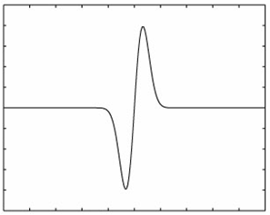
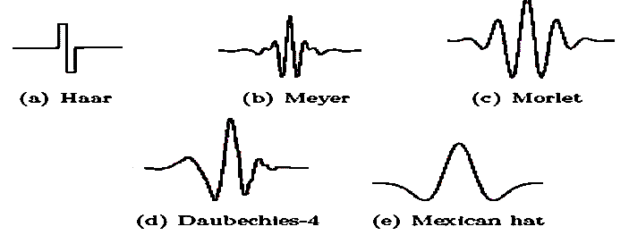
Windowed Fourier transform suffers from
Small range – poor frequency resolution
Large range – poor localization
Wavelet: wave that is only nonzero in a small region
Wave
Wavelet
Types of wavelets:
15-<number>

Slide 3
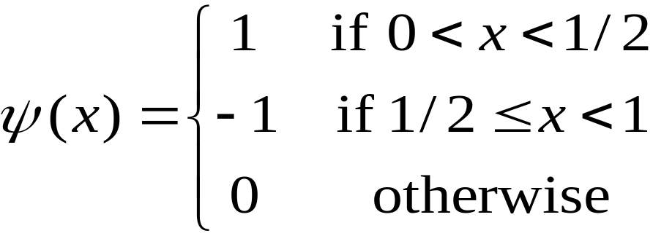

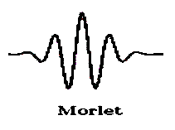
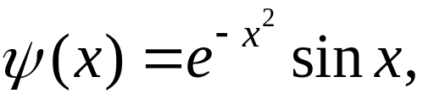
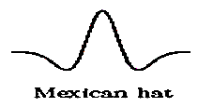
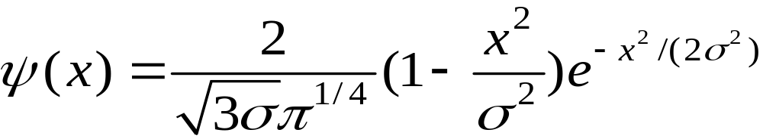
Haar:
Morlet:
Mexican hat:
DOG, LOG
LOG:
15-<number>

Slide 4








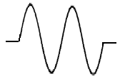



○ Operations on wavelet:
(a) Dilation:
i) Squashing ii) Expanding
(b) Translation:
i) Shift to the right ii) Shift to the left
(c) Magnitude change:
i) Amplification ii) Minification
15-<number>
Notes:
squash擠壓

Slide 5


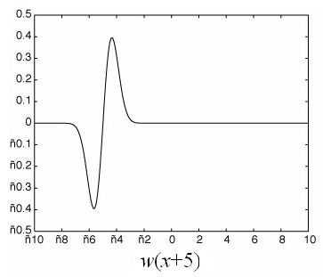
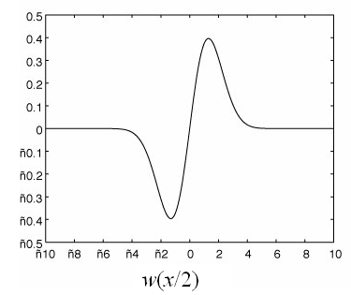
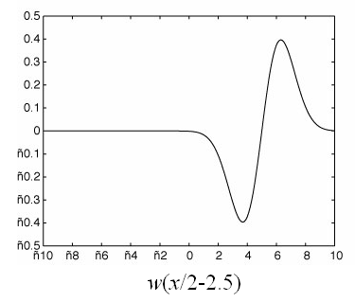
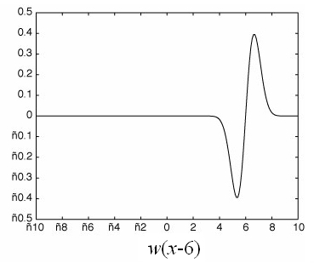
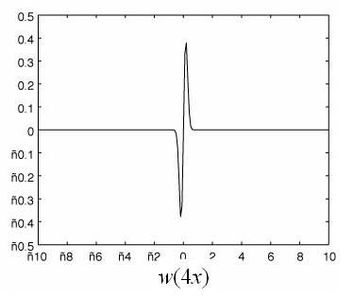
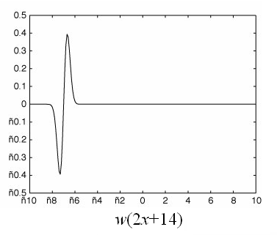
Any function can be expressed as a sum of wavelets
of the form , where govern the
amplitude, frequency and translation of wavelet i.
15-<number>
Notes:
不一定要週期

Slide 6
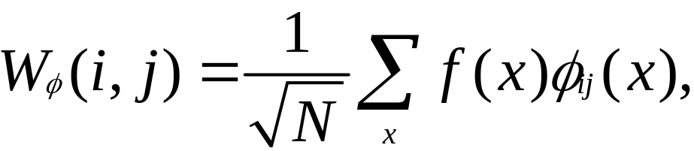
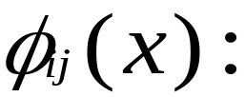
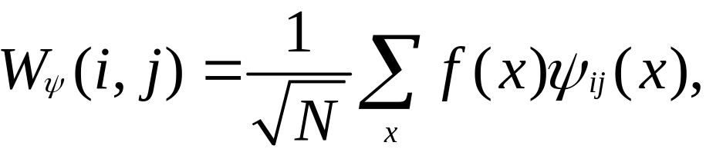

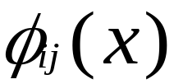
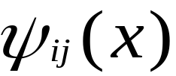
Discrete Wavelet Transform:
Approximation coefficients (cA)
scaling functions
Detail coefficients (cD)
wavelet functions
creates a series of approximations of f(x).
encodes differences between f(x) and its
approximations.
15-<number>
Notes:
出來都是2-d array

Slide 7

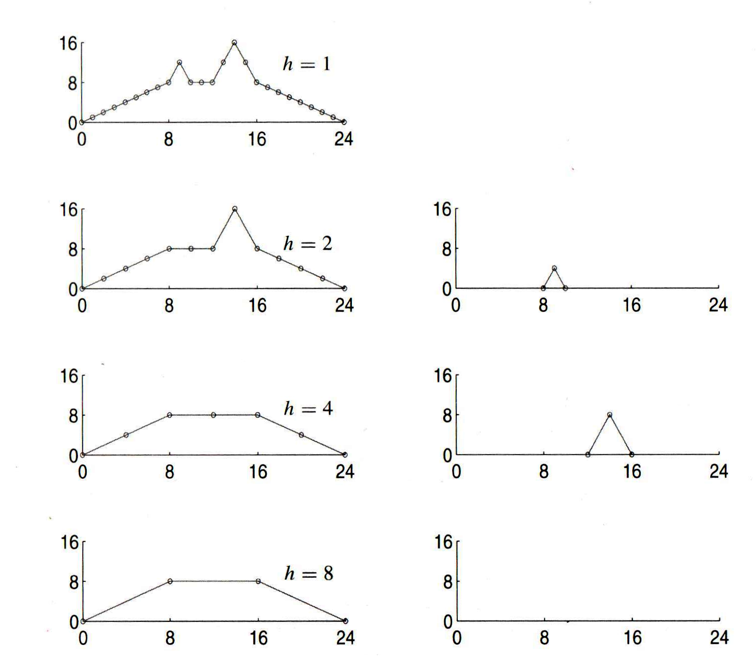

Average filtering
Difference filtering
Approximation
Detail
15-<number>

Slide 8

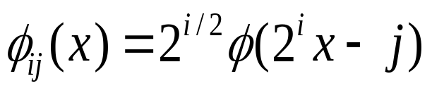
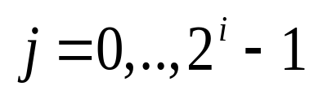
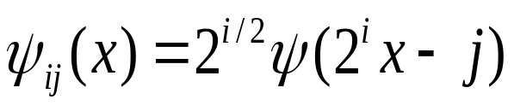
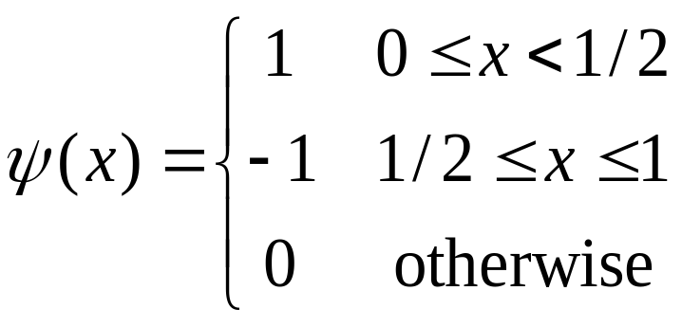
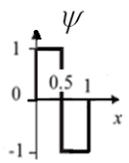
basis functions of wavelet transform
Dilations, translations, and magnitudes of the basis functions are all based on powers of 2, i.e.,
Scaling function
Wavelet function
Example:
Haar wavelet :
15-<number>
Notes:
各小波差異:
magnitude、translaiton、frequency不同

Slide 9
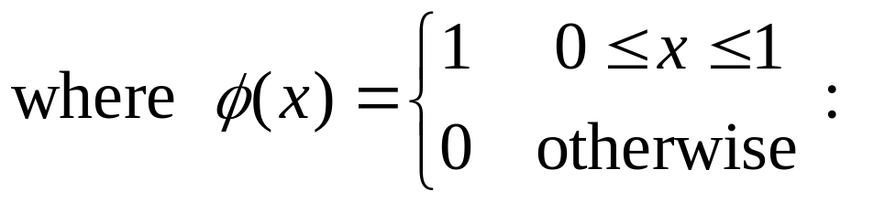
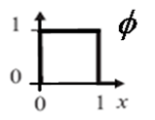
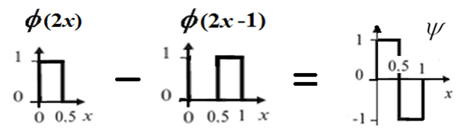


father wavelet
Dilations, translations, and magnitudes of functions
are based on powers of 2.
15-<number>

Slide 10
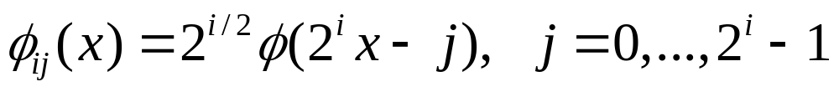

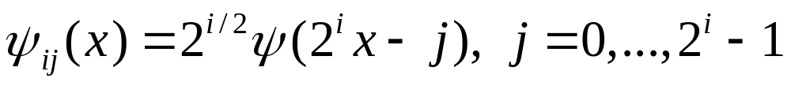
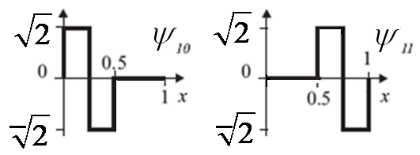
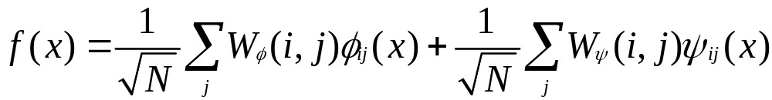
Inverse discrete wavelet transform:
15-<number>

Slide 11
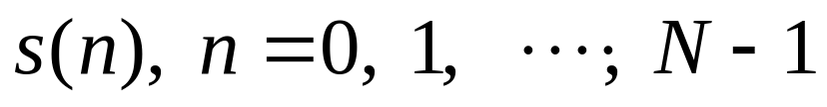
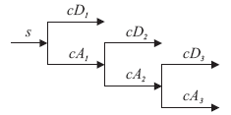
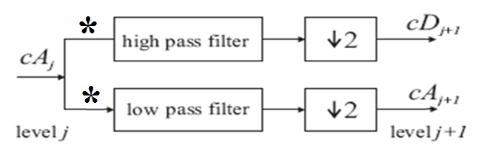

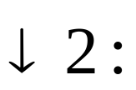
Fast Wavelet Transform
Discrete signal
to be transformed into wavelet coefficients
cA: approximate coef.
cD: detailed coef.
: convolution
downsampling by 2
15-<number>
Notes:
兩個取一個

Slide 12
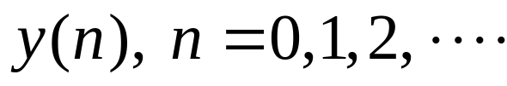
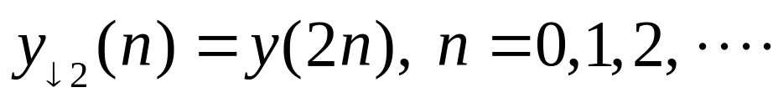
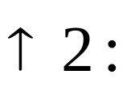
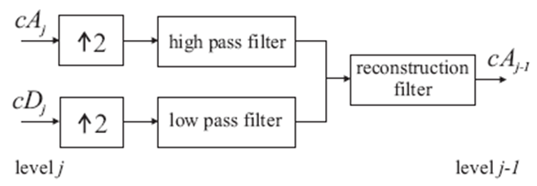
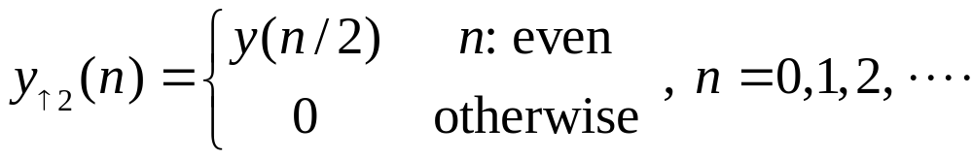
discard every other convolved value
e.g.,
Giving sequence
its downsampled sequence is
Inverse Wavelet Transform
upsampling by 2
15-<number>

Slide 13
○ Wavelet transforms work by taking low pass filtering
(LPF) and high pass filtering (HPF) of input data
e.g., Input data: a, b
LPF (+): s = a + b; HPF (–): d = a – b
Wavelet coefficients: (s, d).
○ Inverse wavelet transforms work by taking addition
and subtraction of wavelet coefficients
e.g., Input (s, d)
LPF(+/2) : (s+d)/2 = ((a+b)+(a–b))/2 = a,
HPF(–/2) : (s–d)/2 = ((a+b)– (a–b))/2 = b
Inverse wavelet coefficients: (a, b).
15-<number>

Slide 14
。 Example: Input data (14, 22)
Wavelet transform:
s =14＋22 = 36, d = 14 – 22= –8
Transform result (36, –8).
Inverse wavelet transform:
Input data (36 –8)
(s＋d)/2 = (36+(–8))/2 = 14,
(s－d)/2 = (36–(–8))/2 = 22
Inverse transform result (14, 22).
15-<number>

Slide 15
。 Example: Input data: [71 67 24 26 36 32 14 18]
Wavelet transform:
s1 = [(71+67) (24+26) (36+32) (14+18)]
= [138 50 68 32]
d1 = [(71–67) (24–26) (36–32) (14–18)]
= [4 –2 4 –4]
(cA)
(cD)
Transform result at 1 scale:
v1 = [s1 d1] = [138 50 68 32 4 –2 4 –4]
(cA)
(cD)
15-<number>
Notes:
HPF (–): d = a – b
LPF (+): s = a + b

Slide 16
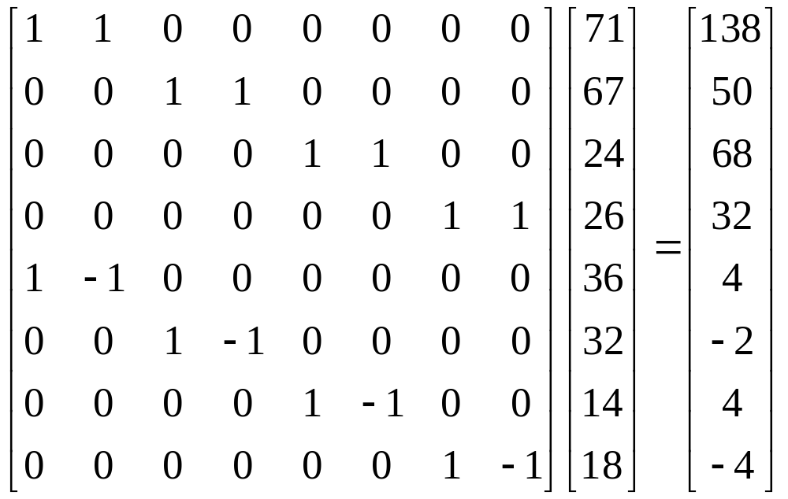
In matrix form:
15-<number>

Slide 17
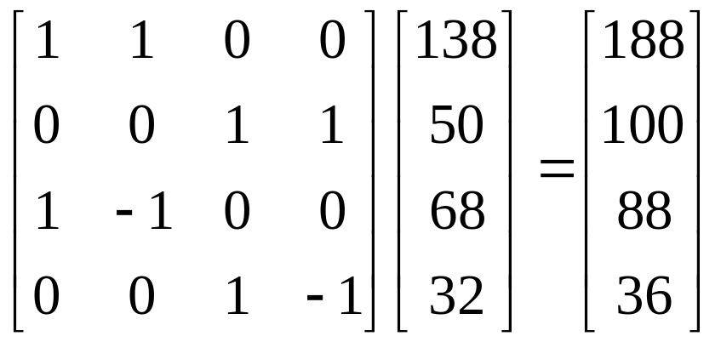
(cA): [138 50 68 32]
s2 = [(138+50) (68+32)] = [188 100]
d2 = [(138–50) (68–32)] = [88 36]
Transform result at 2 scale:
v2 = [s2 d2] = [188 100 88 36]
In matrix form:
15-<number>

Slide 18
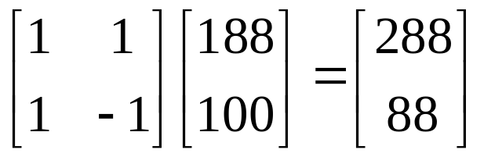
s3 = [(188+100)] = [288], d3 = [188–100] = [88]
Transform result at 3 scale:
v3 = [s3 d3] = [288 88]
In matrix form:
Inverse wavelet transform:
Input data: [s3 d3 d2 d1] =
[288 88 88 36 4 –2 4 –4]
15-<number>
Notes:
都沒做downsaple?

Slide 19
[(288+88)/2 (288–88)/2 88 36 4 –2 4 –4]
= [188 100 88 36 4 –2 4 –4]
[([188 100]+[88 36])/2 ([188 100]–[88 36])/2
4 –2 4 –4] = [[138 68] [50 32] 4 –2 4 –4]
= [138 50 68 32 4 –2 4 –4 ]
[([138 50 68 32]+[4 –2 4 –4 ])/2
([138 50 68 32]–[4 –2 4 –4 ])/2]
= [[71 24 36 14] [67 26 32 18]]
= [71 67 24 26 36 32 14 18]
15-<number>

Slide 20
○ If [4 –2 4 –4] are small, this leads to compression
by letting the transform values [288 88 88 36 0 0
0 0]. Inverse transform results [69 69 25 25 34 34
16 16] close to [71 67 24 26 36 32 14 18].
Or remove negative values [4 0 4 0] leading to the
transform values [288 88 88 36 4 0 4 0]. Its
inverse transform results [71 67 25 25 36 32 16 16].
○ Different filters can be used, e.g.,
Average (s = (a + b) / 2) as the low pass filter,
Difference (d = a – s) as the high pass filter.
15-<number>

Slide 21
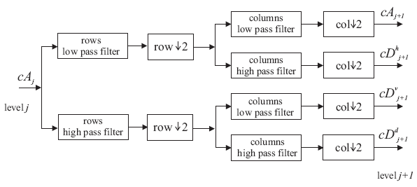
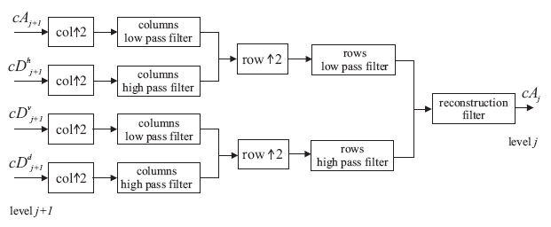
2-D:
15-<number>

Slide 22
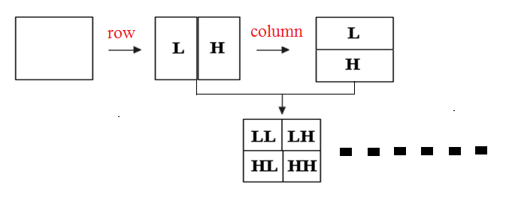
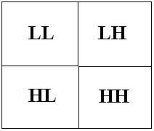


1-scale transform
2-scale transform
3-scale transform
15-<number>

Slide 23

15-<number>
Notes:
Wavelet 也可以用在影像壓縮

Slide 24




Example: High pass filtering
Set all the values to 0
Input
image
2-scale decomposition
3-scale decomposition
15-<number>
Notes:
可用來做 edge detection

Slide 25



Example: Denoising
Input noisy image
Set over
94% (d<0.3) of the DWT values to 0.
Set DWT
values that
are smaller
than d to 0.
d = 0.3
d = 0.5
15-<number>
Notes:
Discrete Wavelet Transform(DWT)

