Slide 1
20190909

Slide 2
A.
B. (better)
Input (Frame)
Input (Frame)
Hand&Object detector
Hand detector
Object detector
Hand pose
Object Info.
Hand pose + Object Info.
Decision
Decision
Output (Action Type)
Output (Action Type)

Slide 3
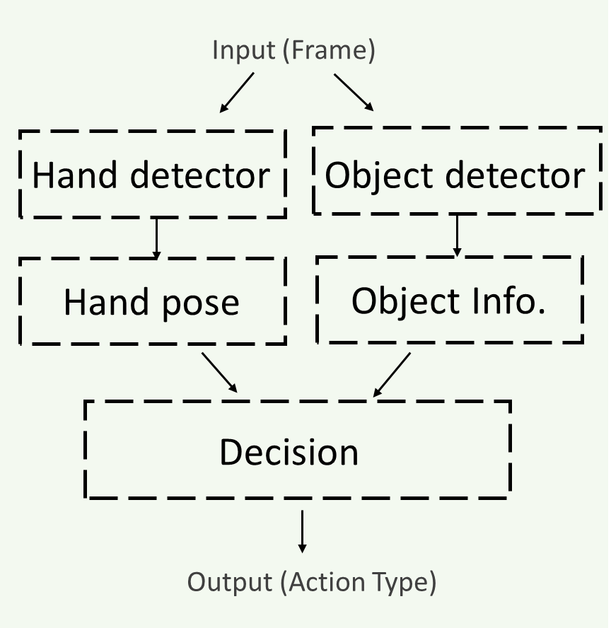
B.
Body Detector (Human, Head, Hand, ...)
Yolov3/
Mask-RCNN/
FCN/ Alphapose/
Features Extract
Supervised/
Base Unsupervised/
Our Unsupervised Structure/
Classifier
State Machines/
SVM/
C3D/
Seq2Seq/

Slide 4
Goal Datasets
HACS
UCF-101
DALY
HMDB
Our Datasets

