Slide 1
MNIST與CIFAR

Slide 2
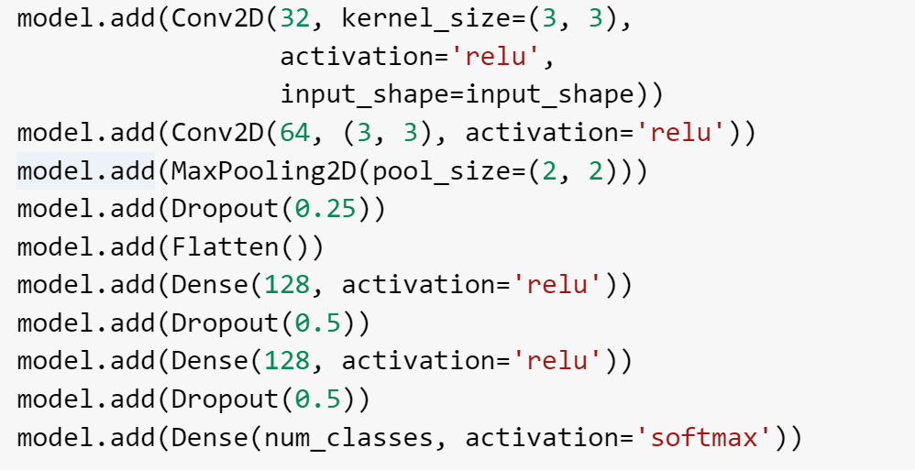
MNIST

Slide 3
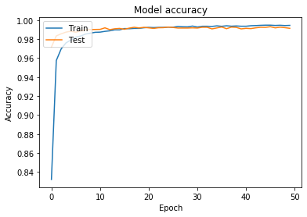
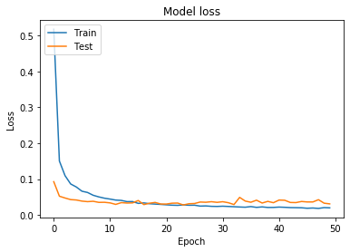
MNIST
Train Acc: 0.9995166666666667
Train loss: 0.0032525423670351603
Test Acc: 0.9914
Test loss: 0.030808242844304185

Slide 4
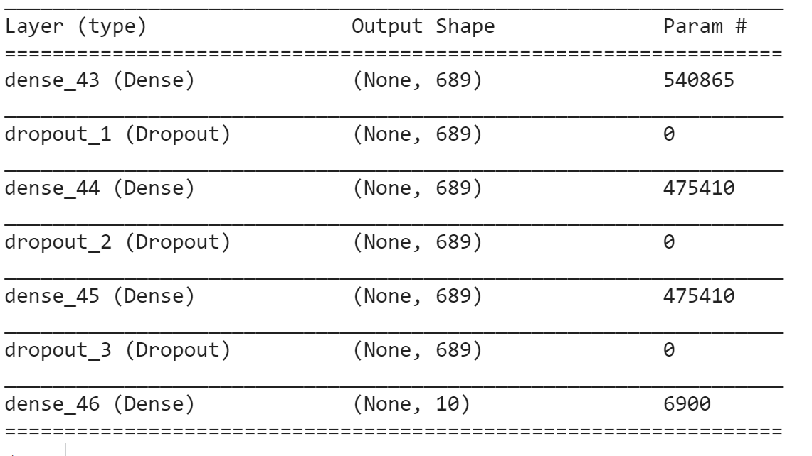
MNIST

Slide 5
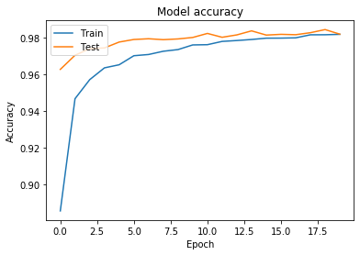
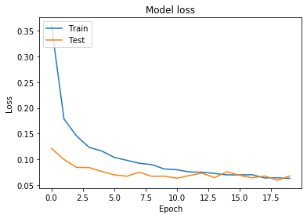
MNIST
Train Acc: 0.9956
Train loss: 0.015179064568885587
Test Acc: 0.9821
Test loss: 0.06778638932049426

Slide 6
CIFAR-10(CNN)
activation function =‘elu’
weight_decay
BatchNormalization
learning rate 漸小
epoch=125

Slide 7
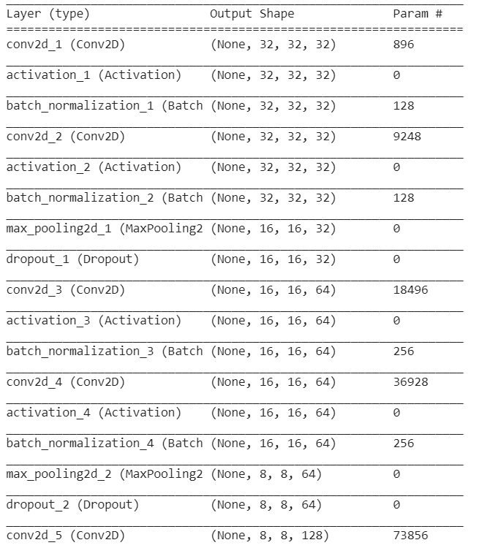
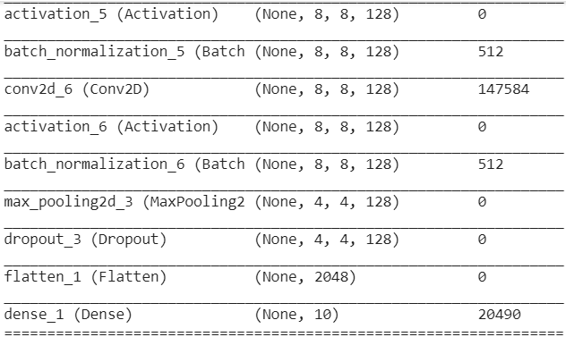
CIFAR-10(CNN)

Slide 8
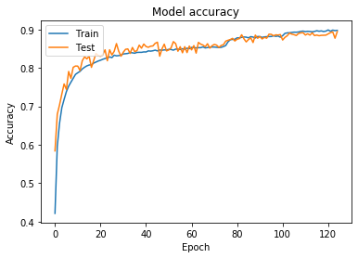
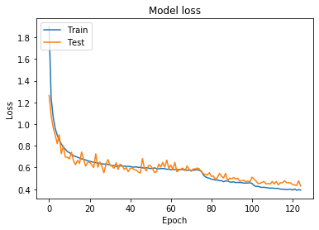
CIFAR-10(CNN)
Train Acc: 0.94314
Train loss: 0.266027303276062
Test Acc: 0.8945
Test loss: 0.42976608748435974

Slide 9
CIFAR-10(ResNet20)
Test Acc: 0.8397
Test loss: 1.06388071975708

