Slide 1
物聯網結合AI在魚類之應用
組員:吳承威、王樸
指導教授:林政宏

Slide 2
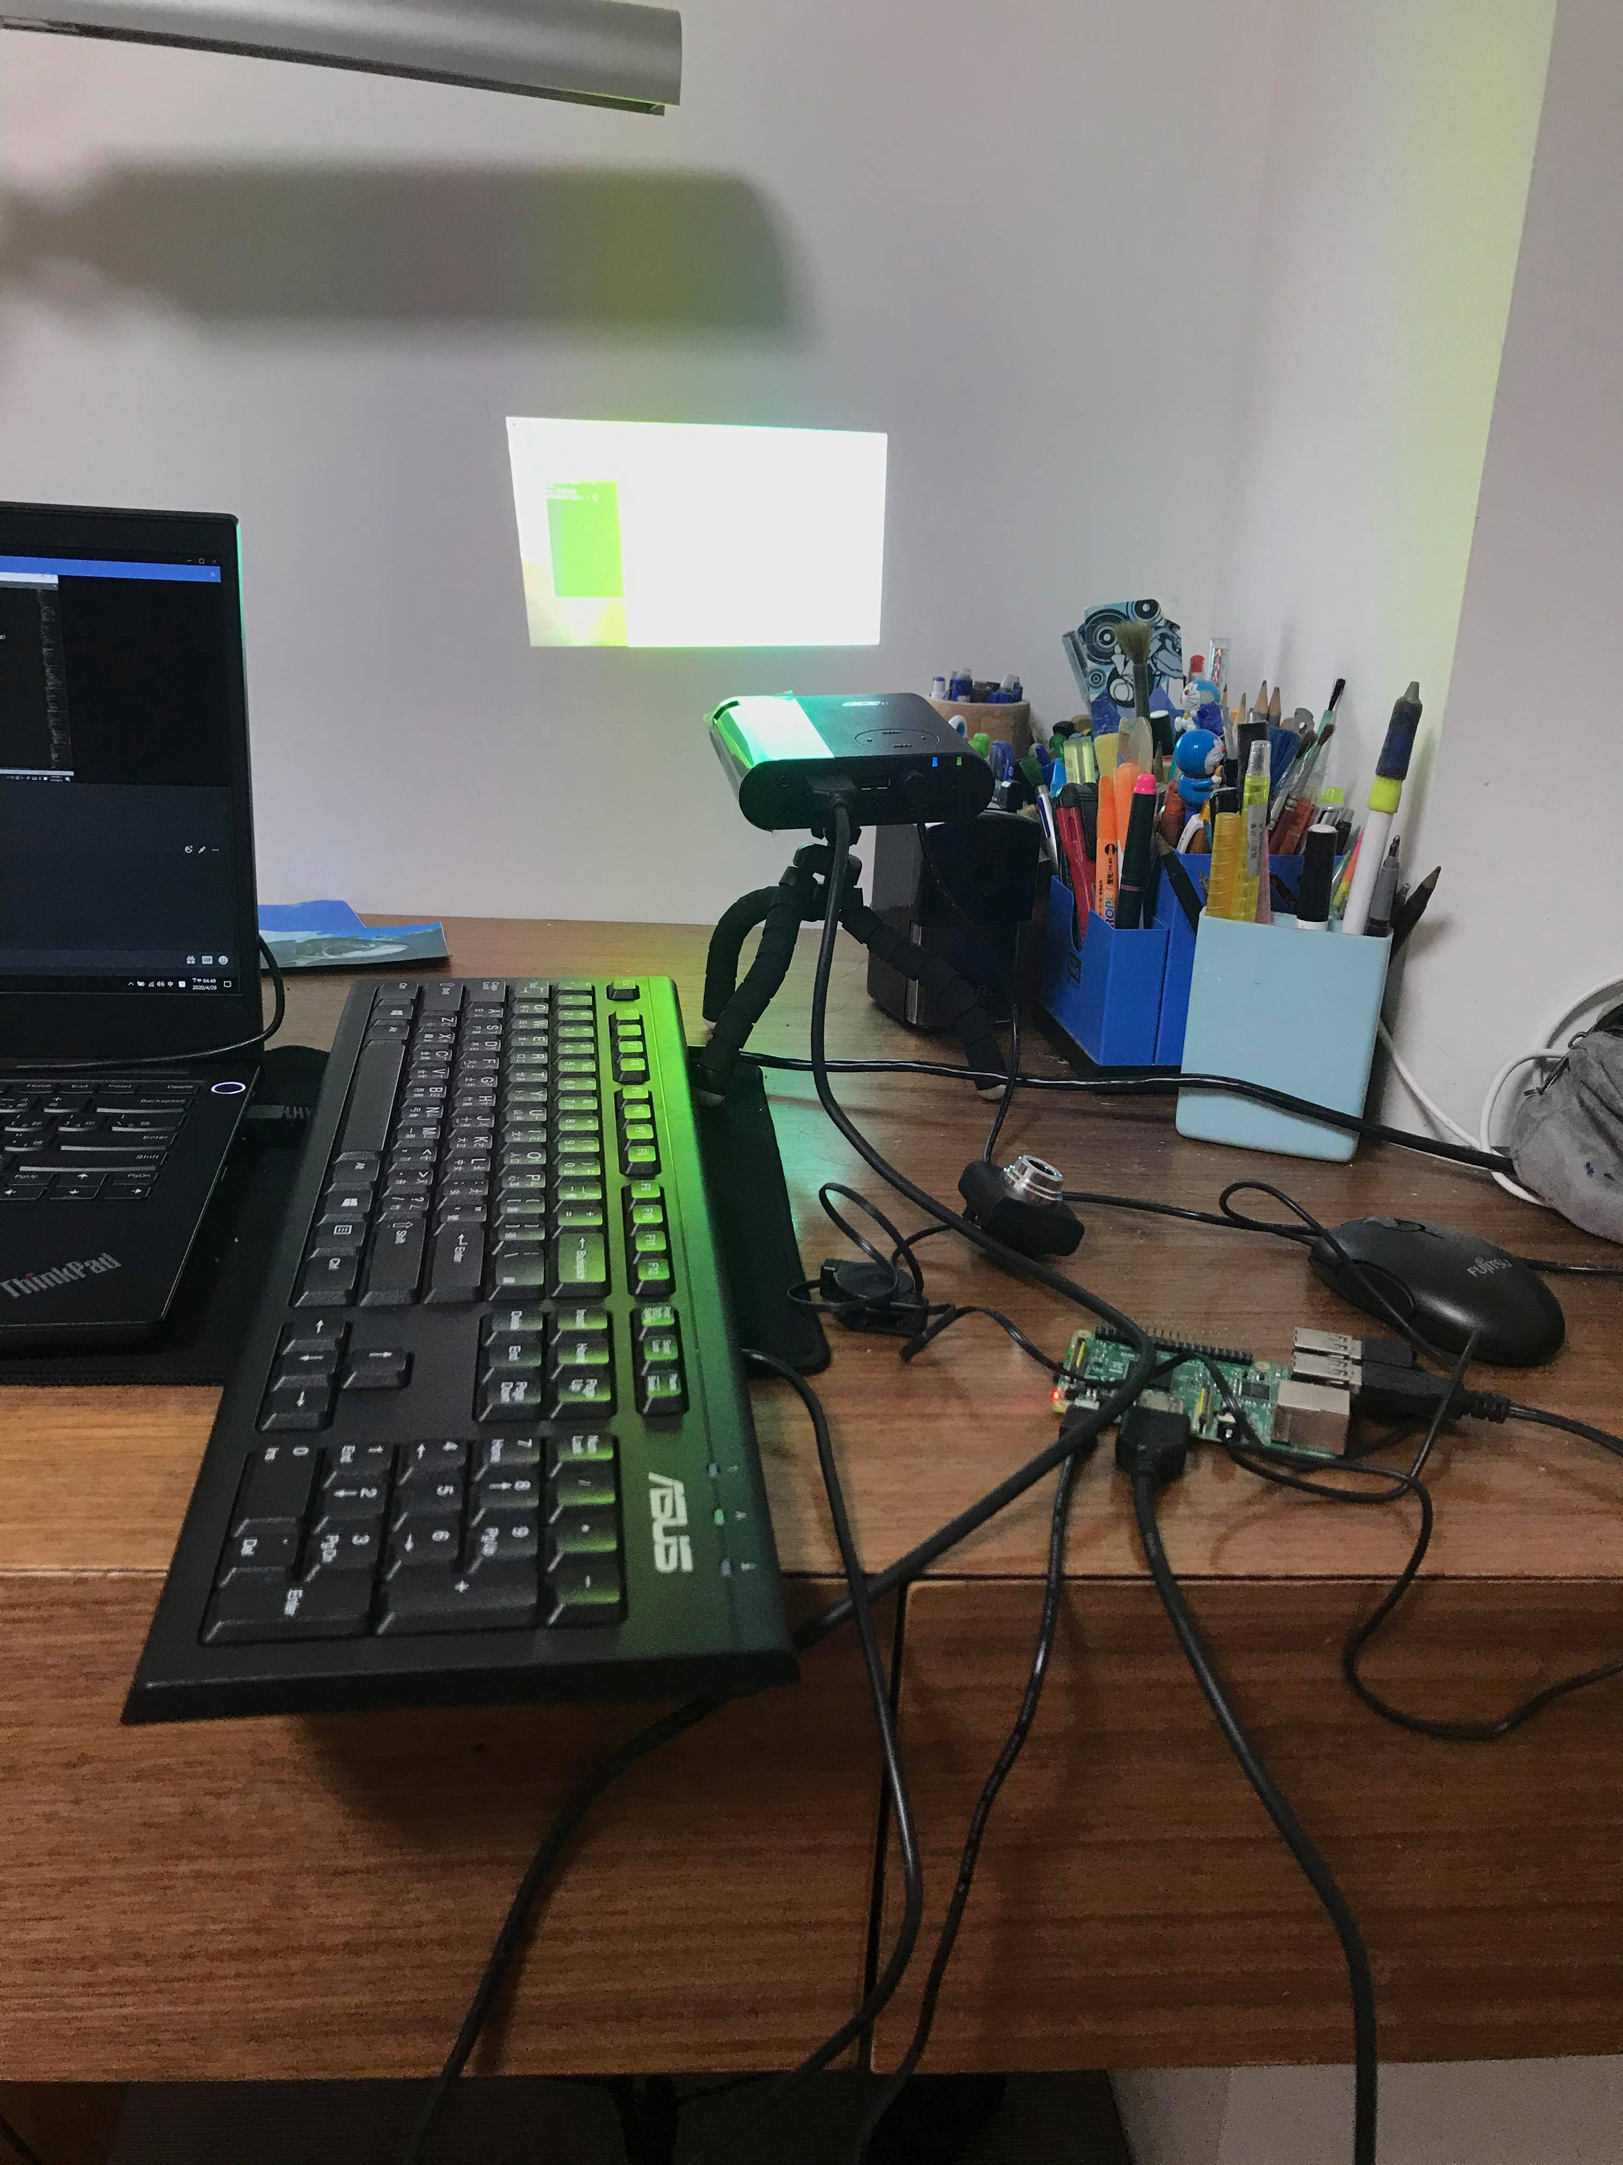
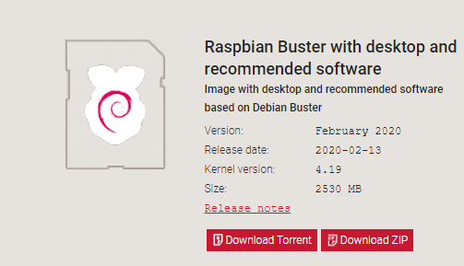
實驗裝置
USB攝像頭
藍芽秤重計(尚無)
raspberry pi 3B V1.2
OS:

Slide 3
計算魚長
背景與魚對比度要夠
不能以整個平面當成比例尺

Slide 4
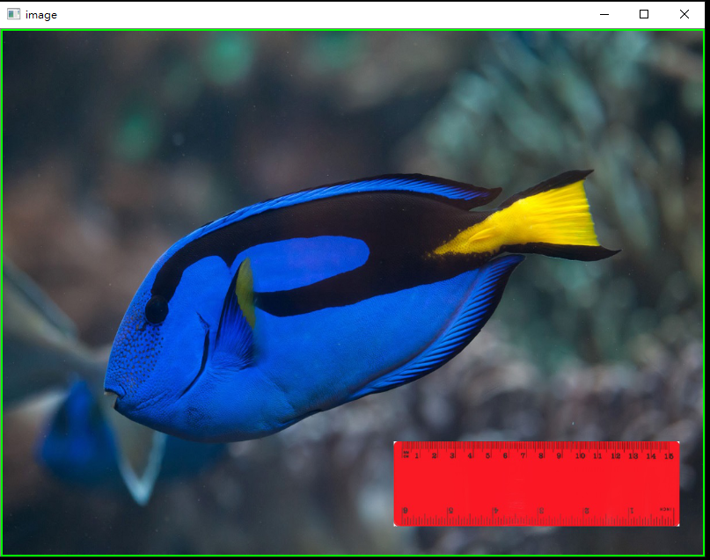
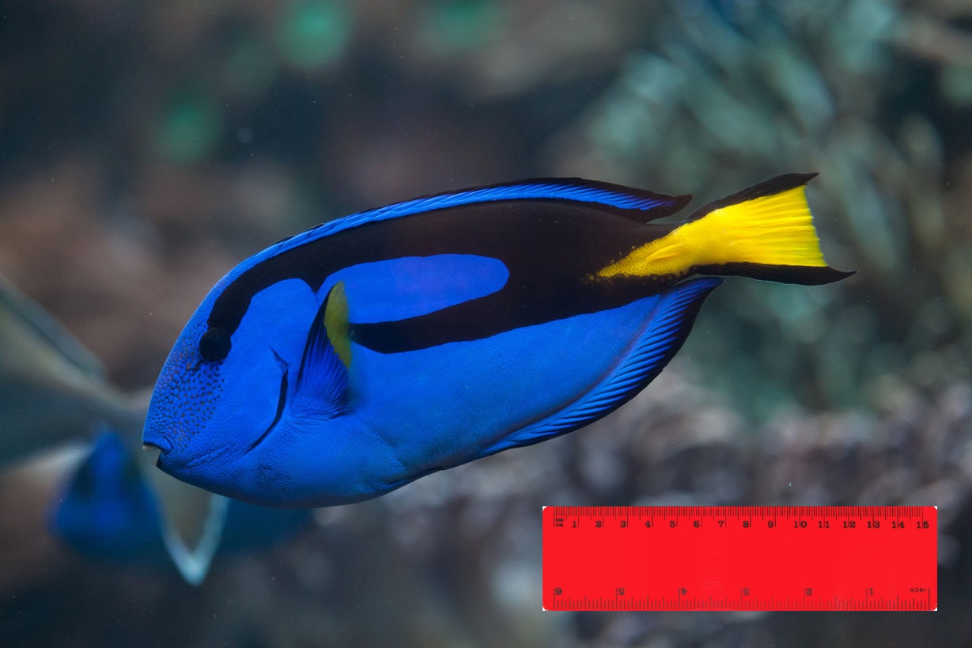

Slide 5
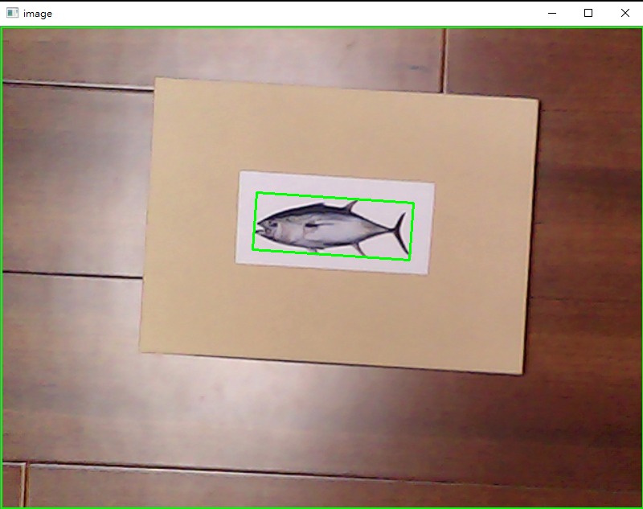
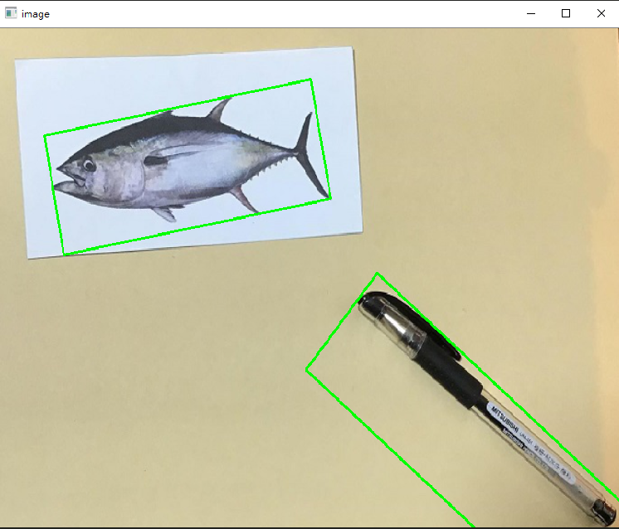

Slide 6
魚類辨識
YOLO

Slide 7
First dataset
Dataset problems:
Each class only have a few photo
A lot of photos are manmade

Slide 8
3 versions:
1st version (without modification)
Problems:
Too much classes (a lot of the classes are similar)
482 classes
2nd version (combine similar classes in one class)
problems:
Still too much classes
192 classes
3rd version only use 70 classes
Problem:
mAp still too low

Slide 9
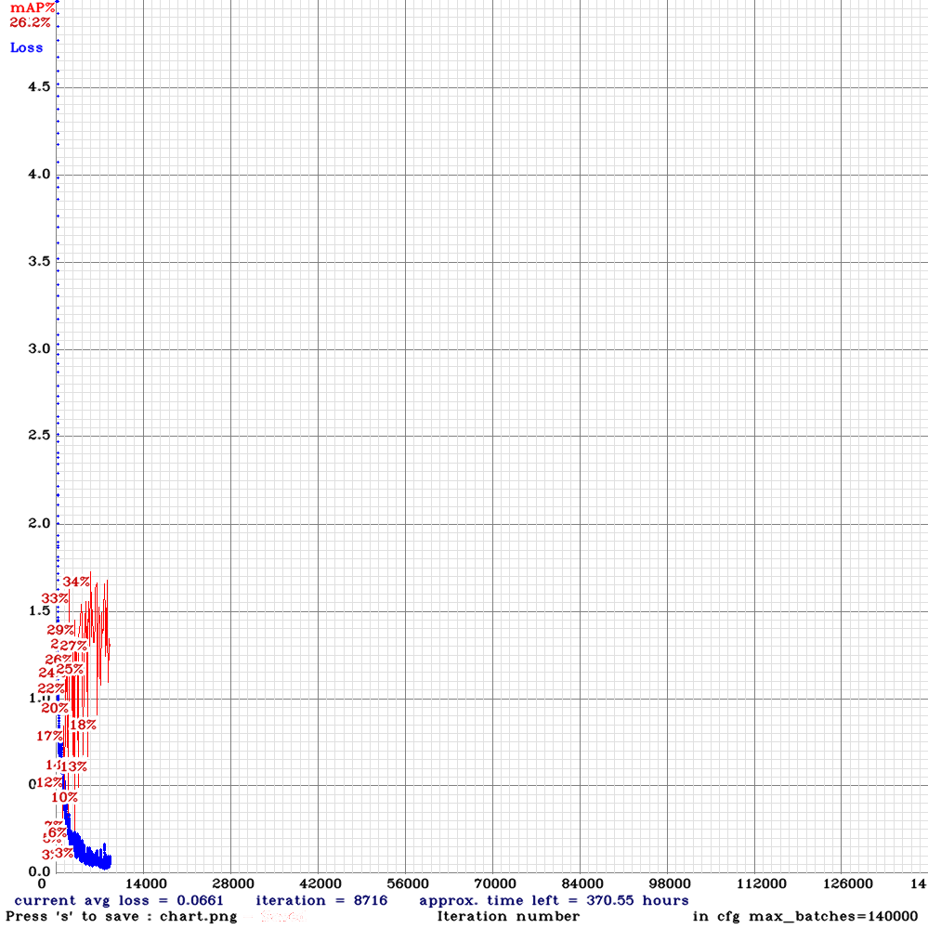

Slide 10
Second dataset
Problems:
bad resolution
To small
Pros :
Get a better mAP than the first dataset

Slide 11
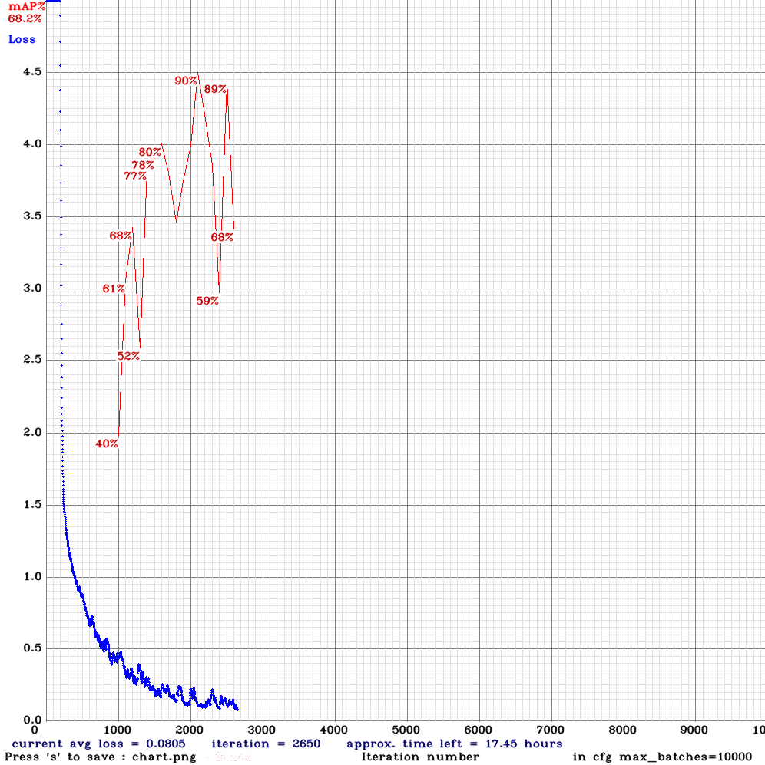

Slide 12
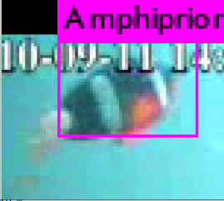
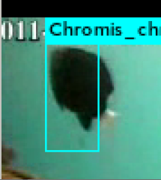
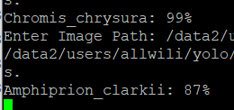

Slide 13
END

