Slide 1
Angular (v14* - TIAA) & Micro Front End Application Session 1 16/Aug/2023
Paul

Slide 2
Session Objective
Introduction – MFE Angular APP
Use of Angular
Differentiate between AngularJS vs Angular
Directives in Angular
Different types of Angular directives
Importance of NPM and Node_Modules folder
Importance of Package.json file in Angular
angular.json

Slide 3
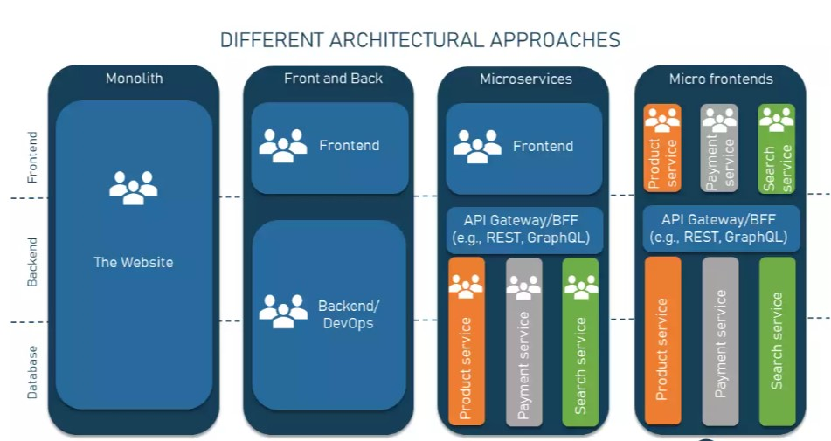
Why Micro Front End Arch – Angular?

Slide 4
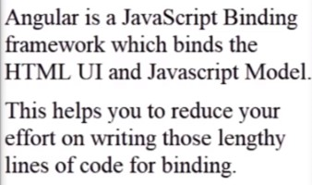
What is the use of Angular?

Slide 5
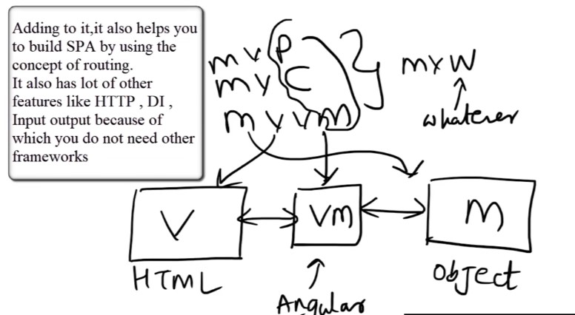
What is the use of Angular?

Slide 6
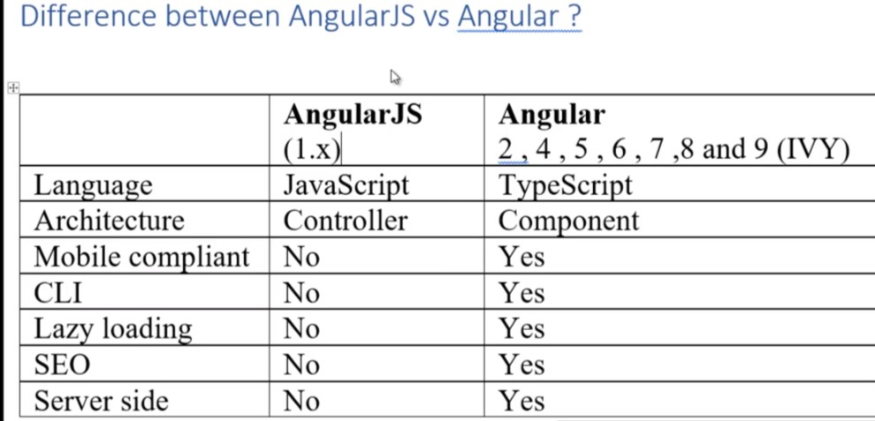
Difference Between AngularJS VS Angular
Difference

Slide 7
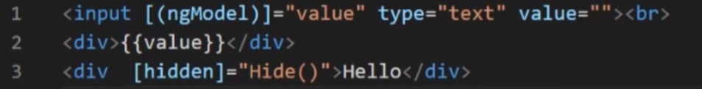
What are directives in Angular ?

Slide 8
What are directives in Angular ?

Slide 9
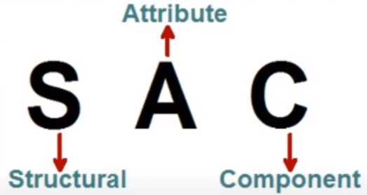
Different kinds of directives?
Faster and simpler deployments and rollbacks
It enables each service to be developed independently by a team that is focused on that service
Right framework/tool/language for each domain
Continuous Deployment
Better Availability
Clear ownership for each service
Domain Driven Design

Slide 10
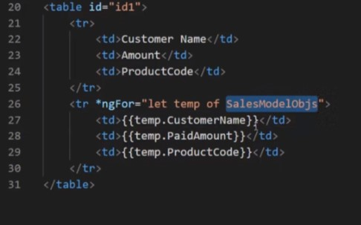
Different kinds of directives?
Faster and simpler deployments and rollbacks
It enables each service to be developed independently by a team that is focused on that service
Right framework/tool/language for each domain
Continuous Deployment
Better Availability
Clear ownership for each service
Domain Driven Design

Slide 11

Different kinds of directives?
Faster and simpler deployments and rollbacks
It enables each service to be developed independently by a team that is focused on that service
Right framework/tool/language for each domain
Continuous Deployment
Better Availability
Clear ownership for each service
Domain Driven Design

Slide 12

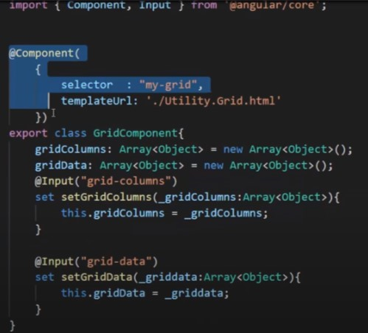
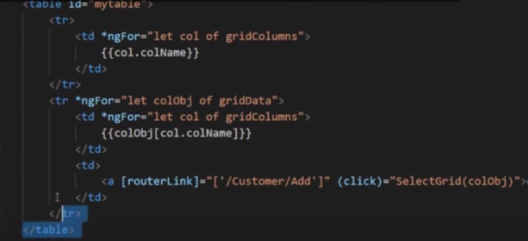
Different kinds of directives?
Faster and simpler deployments and rollbacks
It enables each service to be developed independently by a team that is focused on that service
Right framework/tool/language for each domain
Continuous Deployment
Better Availability
Clear ownership for each service
Domain Driven Design

Slide 13
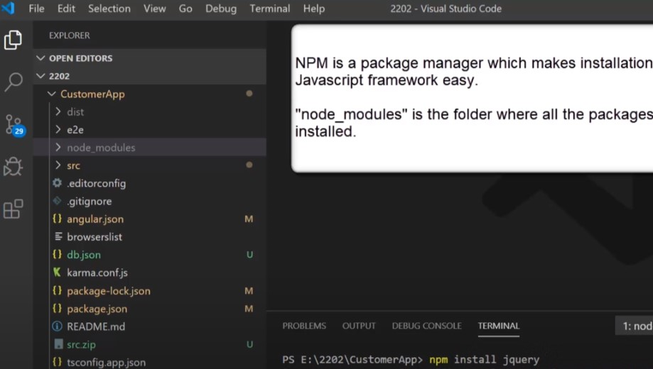
What is Node Modules And NPM?
Faster and simpler deployments and rollbacks
It enables each service to be developed independently by a team that is focused on that service
Right framework/tool/language for each domain
Continuous Deployment
Better Availability
Clear ownership for each service
Domain Driven Design

Slide 14
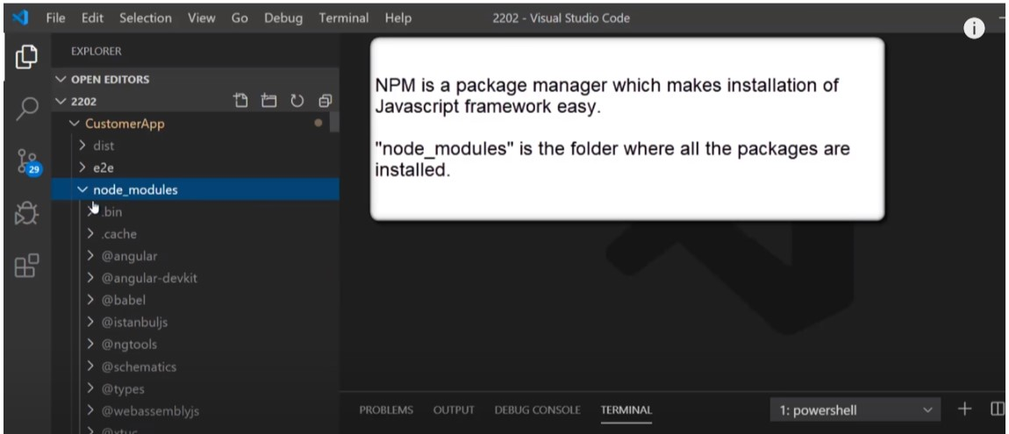
What is Node Modules And NPM?
Faster and simpler deployments and rollbacks
It enables each service to be developed independently by a team that is focused on that service
Right framework/tool/language for each domain
Continuous Deployment
Better Availability
Clear ownership for each service
Domain Driven Design

Slide 15
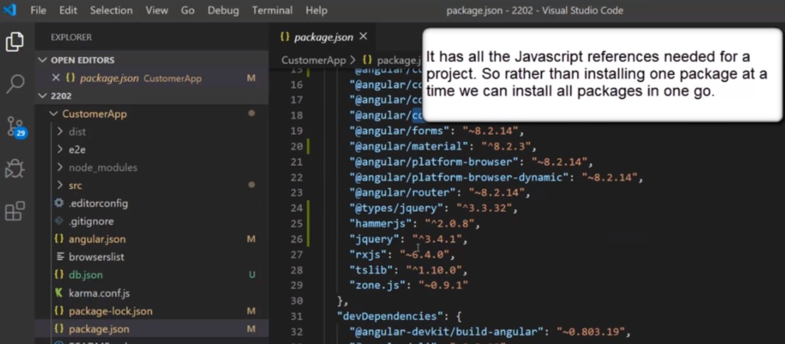
Different kinds of directives?
Faster and simpler deployments and rollbacks
It enables each service to be developed independently by a team that is focused on that service
Right framework/tool/language for each domain
Continuous Deployment
Better Availability
Clear ownership for each service
Domain Driven Design

Slide 16
Knowledge Check

Slide 17
Q & A

Slide 18
Thank you
Thank you!

