Slide 1
Lab 4. A Unix Shell SNU System Programming Assignment
Jongki Park
SNU TNET Lab.

Slide 2
What You Should Do
1. Implement basic shell functionality
Utilize parsed command line
Add job(s) to a job manager
External command execution
2. Support for redirection
Standard input redirection
Standard output redirection
3. Support for pipe
Single pipe support
Multiple pipe support

Slide 3
Extra Credit for Background Process Support
4. Support for background process
Running a process in the background mode
Handle the process when the background process terminates

Slide 4
Basic Shell Functions

Slide 5



What Is a Shell?
Shell: a program that executes commands typed by a user
A shell =
while(1) {
Receives an input command string from the user
Interprets the command
Executes the command requested by user
}
I want to run the program “a.out”!
Type
./a.out
Find the file “a.out”!
Load the file “a.out”!
Return results
Execute the “a.out”
from its main function!
Shell

Slide 6
Basic Shell Functionality
Command interpreter
Execute commands requested by the user
Basic logic
Display the prompt & parse input commands
External commands: fork and exec at child process
Internal commands: process without fork and exec
Parent process (Shell) waits for the child to end
Prompt ($)
Parse input command
External
Child process
Internal
Processing
Processing
(execute a new program)
Wait for the child

Slide 7
System Calls for Basic Shell Functions
fork()creates a child process that duplicates the parent
Manipulating fds after fork() does not affect the fds of the other process
execvp()finds, loads, and executes an external command in current process
Execvp()automatically searches directories in $PATH(env. var.) for the executable binary
The first parameter is the binary name without any path (“ls” not “/usr/bin/ls”)

Slide 8
A Minimal Shell for Executing a Single Command
Simple shell code
Job = user’s command line input
Notice
Return value/error checking is mandatory when doing the assignment to ensure proper error handling
The code here is simplified just for easy understanding
fgets(command, sizeof(command), stdin);
command[strlen(command)-1] = 0;
token = strtok(command, “ “);
if (token == NULL) {exit(-1);}
arguments[0] = token;
for (i = 1; i < 10; i++) {
token = strtok(NULL, “ “);
if (token == NULL)
break;
arguments[i] = token;
}
arguments[i] = NULL;
pid = fork();
if (pid == 0){
execvp(arguments[0], arguments);
}
/* Parent process */
while(1) {
// Check if a foreground job is
// still running
}
① Get the command
② Parse(Tokenize) command
③ Compose argument array
④ Fork child process
⑤ Child process:
changes its execution
image to arguments[0]
⑥ Parent process :
while loop waiting for the foreground job to finish

Slide 9
Your TO-DOs for snush: Basic Shell Functions

Slide 10
Functions for Basic Shell
No need to implement handling internal (built-in) commands
Two built-in commands are provided
cd command
Moves to the specified directory
If no argument is provided, use the env. variable (HOME) to navigate to the home directory
exit command to exit the shell snush
You need to implement fork_exec(), sigchld_handler()
Important system calls to utilize
fork(), execvp()
Important snush functions to utilize
build_command(): a wrapper for build_command_partial()
Uses a full range of token indices
wait_fg(): continuously checks whether the given job has finished executing
Do not modify build_command() & build_command_partial() & waitfg()

Slide 11
Implementing Basic Shell Functions - fork_exec()
Create a child process
Convert the tokenized input into an argument array for an external command
Do appropriate actions for supporting I/O redirection or a pipe
Parent process should add job to a job manager
Execute the command in the child process
Make sure the parent process waits properly with wait_fg()
The return value of fork_exec() should be the job id

Slide 12
Implementing Basic Shell Functions - sigchld_handler()
Child sends SIGCHLD signal to parent process when the child process exits
Each exited process must be removed from the process id list of its corresponding job in the job manager
The entire job should be removed from the job manager if all processes in a job have exited

Slide 13
Support for Redirection

Slide 14
System Calls for Redirection
Unix allows programmatic way to redirect stdin, stdout or stderr
How?
Use open() or create() to open a file for reading or writing, creating the file
Use close() to close unused file descriptors
Use dup2() to duplicate the file descriptor to any target descriptor, including stdin, stdout or stderr
For this assignment, support only stdin/stdout redirection (no stderr)

Slide 15
Simple Redirection Trace (1)
Simple code for implementing “someprogram > somefile”
A new child has the identical file descriptor table as parent’s
The first three file descriptors of a child point to the same terminal as parent’s
pid = fork();
if (pid == 0){
/* Child process */
fd = creat(“somefile”, 0640);
dup2(fd, 1);
close(fd);
execvp(“someprogram”, program_args);
fprintf(stderr, “exec failed\n”);
exit(EXIT_FAILURE);
}
/* Parent process */
pid = wait(NULL);
Parent process
/dev/tty
Child process
File
descriptor
table
0
0
File
descriptor
table
1
1
2
2
3
3
…
…

Slide 16
Simple Redirection Trace (2)
Child process creates somefile
pid = fork();
if (pid == 0){
/* Child process */
fd = creat(“somefile”, 0640);
dup2(fd, 1);
close(fd);
execvp(“someprogram”, program_args);
fprintf(stderr, “exec failed\n”);
exit(EXIT_FAILURE);
}
/* Parent process */
pid = wait(NULL);
Parent process
/dev/tty
Child process
File
descriptor
table
0
0
File
descriptor
table
1
1
2
2
3
somefile
3
…
…

Slide 17
Simple Redirection Trace (3)
fd and file descriptor number 1 can be used interchangeably after the successful call of dup2()
pid = fork();
if (pid == 0){
/* Child process */
fd = creat(“somefile”, 0640);
dup2(fd, 1);
close(fd);
execvp(“someprogram”, program_args);
fprintf(stderr, “exec failed\n”);
exit(EXIT_FAILURE);
}
/* Parent process */
pid = wait(NULL);
Parent process
/dev/tty
Child process
File
descriptor
table
0
0
File
descriptor
table
1
1
2
2
3
somefile
3
…
…

Slide 18
Simple Redirection Trace (4)
Closes fd (index 3 at file descriptor table)
pid = fork();
if (pid == 0){
/* Child process */
fd = creat(“somefile”, 0640);
dup2(fd, 1);
close(fd);
execvp(“someprogram”, program_args);
fprintf(stderr, “exec failed\n”);
exit(EXIT_FAILURE);
}
/* Parent process */
pid = wait(NULL);
Parent process
/dev/tty
Child process
File
descriptor
table
0
0
File
descriptor
table
1
1
2
2
3
somefile
3
…
…

Slide 19
Simple Redirection Trace (5)
someprogram executes with stdout redirected to somefile
pid = fork();
if (pid == 0){
/* Child process */
fd = creat(“somefile”, 0640);
dup2(fd, 1);
close(fd);
execvp(“someprogram”, program_args);
fprintf(stderr, “exec failed\n”);
exit(EXIT_FAILURE);
}
/* Parent process */
pid = wait(NULL);
Parent process
/dev/tty
Child process
File
descriptor
table
0
0
File
descriptor
table
1
1
2
2
3
somefile
3
…
…

Slide 20
Your TO-DOs for snush: Redirection

Slide 21
Functions for Redirection
You need to implement redout_handler()
Sample implementation of redin_handler()is provided in the skeleton code
Important system calls to utilize
open()
close()
dup2()

Slide 22
Implementing Redirection in snush
Redirect its input and output to a specified file before the command is executed
stdin redirection: opens a file (w/ read-only perm.), replaces stdin with the fd
stdout redirection: replaces stdout with the redirected fd
Set appropriate permissions for the output file
No need to support stderr redirection

Slide 23
Support for Pipe

Slide 24
System calls for Pipe
A pipe allows two processes on the same machine to exchange data
stdout of the previous program flows into stdin of the next program
How?
Use pipe()to create a pair of fds (2 fds) that are connected to each other
pipe() creates a unidirectional communication line (one for read-only, the other for write-only)
Use fork()to create a child process that shares the two fds with the parent
Use dup2()to duplicate any fd, including stdin, stdout or stderr
Pipe descriptors are file descriptors in UNIX

Slide 25
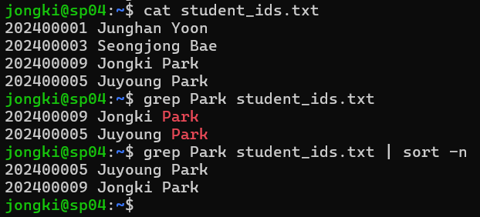
Example Use of Pipes
The file “student_ids.txt” contains many student entries
Find all students with the last name “Park”
$ grep Park student_ids.txt
List the results in order of student id
$ grep Park student_ids.txt | sort -n

Slide 26
Unidirectional Communication
pipe() creates a communication line (fd[0] for read-only, fd[1] for write-only)
pipe(), fork()
Executing fork() after pipe() inherits the same file descriptors pointing to the same file
0 | 1 | 2 | fd[0] | fd[1]
0 | 1 | 2 | fd[0] | fd[1]
File (pipe buffer)
<case 1>
0 | 1 | 2 | fd[0] | fd[1]
0 | 1 | 2 | fd[0] | fd[1]
File (pipe buffer)
<case 2>

Slide 27
Duplicate to Other File Descriptors
dup2()
Use dup2() to duplicate stdin, stdout, or other file descriptors to the file descriptors created by pipe()
The output of the process can be passed to the input of the next process
<case 1>
0 | 1 | 2 | fd[0] | fd[1]
0 | 1 | 2 | fd[0] | fd[1]
Before dup2()
File (pipe buffer)
0 | 1 | 2 | fd[0] | fd[1]
0 | 1 | 2 | fd[0] | fd[1]
After dup2()
File (pipe buffer)

Slide 28

Simple Pipe example
Example code
Inter Process Communication between the child and the parent
int pid, p[2];
if (pipe(p) == -1)
exit(1);
pid = fork();
if (pid == 0) {
close(p[1]);
dup2(p[0],0);
close(p[0]);
… read from stdin …
}
else {
close(p[0]);
dup2(p[1],1);
close(p[1]);
… write to stdout …
wait(&status);
}
① Create pipe read: fd[0],
write: fd[1]
② Child makes stdin (0) the read side of the pipe
③ Parent makes stdout (1) the write side of the pipe
fd=1
fd=0
parent
write
read
child
stdout
stdin

Slide 29
Your TO-DO for snush: Pipe

Slide 30
Functions for Pipe
You need to implement iter_pipe_fork_exec()
Important system calls to utilize
fork()
dup2()
close()
execvp()
Important snush functions to utilize (Do not modify the functions listed below)
dynarray_get(): get tokens of a specific index, where index starts at 0
dynarray_get_length(): get total number of tokens
build_command_partial(): construct the command array passed as argument to execvp()
wait_fg(): continuously checks whether the given job has finished executing

Slide 31
Implementing Pipe in snush
Decompose the token array based on the pipe symbol ( ‘|’ )
Note that the pipe symbol cannot be preceded by an output (‘>’) or input (‘<‘) redirection operator
Set up pipes
Create child processes and run each command on each child
Create a child process for each command in the pipe
Convert the tokenized input to an argument array for external command execution
Execute a specified command at the child process
The output of the previous process becomes the input of the next process
Use wait_fg() to make sure the parent processis waiting properly
iter_pipe_fork_exec() should return the PID of the first child

Slide 32
Support for Background Execution

Slide 33
Example for Background Process Execution
Run tasks in the background and work on other commands simultaneously
Useful for long-running processes (e.g., file downloads, backups, or large data processing)
Child sends SIGCHLD signal to parent process when the child process exits

Slide 34
Simple Background Execution
If parent process wants to wait for the child to finish, call wait_fg()
Otherwise, do not wait for the child to finish its execution and call print_job()
pid = fork();
if (pid < 0) {
perror("fork failed");
exit(EXIT_FAILURE);
}else if (pid == 0) {
execl("/bin/sleep", "sleep", "20", NULL);
// execlp("sleep", "sleep", "20", NULL);
perror("execlp failed");
exit(EXIT_FAILURE);
}else {
if (!background) {
wait_fg();
}else {
print_job();
//printf("Background: child process (PID: %d)\n", pid);
}
exit(EXIT_SUCCESS);
}
① Create a child process using fork()
② If it is a child process,
change its execution image to another
③ If it is a parent process, decide whether to wait or not
④ If it is needs a background execution,
a parent process do not wait for the child to exit

Slide 35
Your TO-DO for snush: Background Execution

Slide 36
Functions for Background Execution
You need to implement(modify) sigchld_handler() & check_bg_status()
check_bg_status() to print out the message that the background job has completed
Important snush functions to utilize (Do not modify the functions listed below)
print_job(): announce the start of a background job

Slide 37
Implementing Background Execution in snush
Child sends SIGCHLD signal to parent process when the child process exits
Each exited process must be removed from the process id list of its corresponding job in the job manager
After all processes belonging to a background job have terminated, move a finished job to a done_bg_jobs in the job manager
A message should be printed at check_bg_status() to indicate that the background job has completed
Do not use printf() in signal handler (refer to the README file)
After printing out the message, remove the background job from the done_bg_jobs in the job manager

Slide 38
Final Guidelines for snush

Slide 39
Notice
Do not change the name and the prototype of the skeleton code
What to submit
Directory name should be 202500000_assign4
Place the entire source codes in a single directory 202500000_assign4
Make a gzipped tar file for submission

Slide 40
Deadline
Deadline: ~ 2025. 05. 29 21:00
0 Points if deadline is missed
0 Points for copying
Contact
Lab 4 TA e-mail: jkipark@snu.ac.kr
TA mailing list: snu-sysp@googlegroups.com
Directory name should be 202500000_assign4
Place the entire source codes in a single directory 202500000_assign4
Make a gzipped tar file for submission
Submit to Claussum submission page

Slide 41
Appendix

Slide 42
snush Function for Parsing Input Command Line
Take advantage of the command line parser that is already implemented
lex_line(): gets a command from stdin, parses, and store the array of token pointers
syntax_check(): checks if generated tokens are in an executable token format
Do not modify lex_line()and syntax_check()
Do not modify these functions

Slide 43
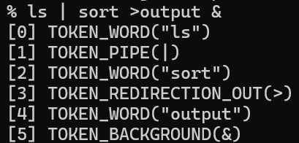
The Result of Parsing in snush
Set env. variable (DEBUG) before running your shell to see the tokenized output
$ export DEBUG=1
$ unset DEBUG (to turn it off)
Example of how the lex_line() function works
$ ls | sort > output &
Syntax check
Function syntax_check()
Performs an analysis to see if the tokenization
with the lex_line() is in the executable form
Token
Type : TOKEN_WORD
Value : ls
Token
Type : TOKEN_PIPE
Value : \0
Token
Type : TOKEN_WORD
Value : sort
Token
Type : TOKEN_REDIRECTION_OUT
Value : \0
Token
Type : TOKEN_WORD
Value : output
Token
Type : TOKEN_BG
Value : \0

Slide 44
snush Functions for Checking the Presence of Pipe or Background
Pipe / background command check
count_pipe(): counts the number of pipes in the command
check_bg(): checks if background process control operator ‘&’ exists
Do not modify these functions

Slide 45
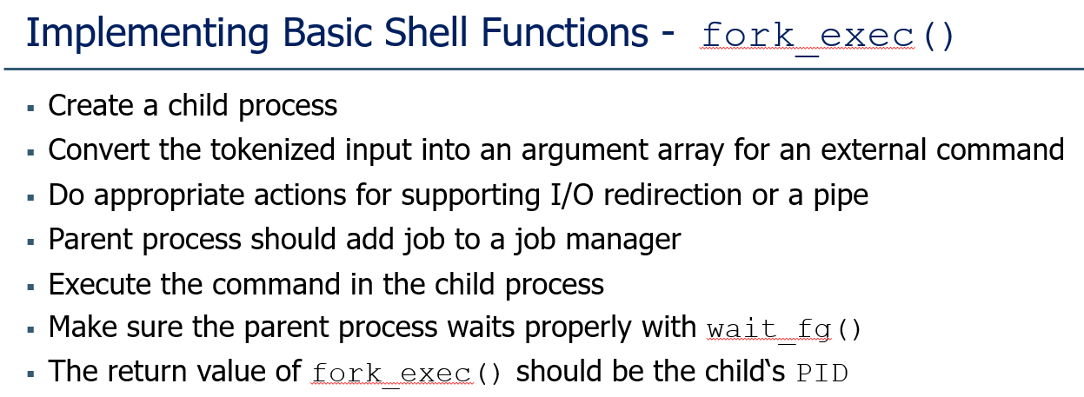
Execution Order of the Shell and its Child Process
In the fork_exec() & iter_pipe_fork_exec()
A job must be added by the parent process before the child process begins executing the new binary program
Use pipe(), read(), write() to ensure their ordering
By default, read() performs blocking I/O
Execution order matters!

Slide 46
THANK YOU
Q & A

