Slide 1
Lab 1. Decommenter System Programming Assignment
Seongjong Bae
SNU TNET Lab.

Slide 2
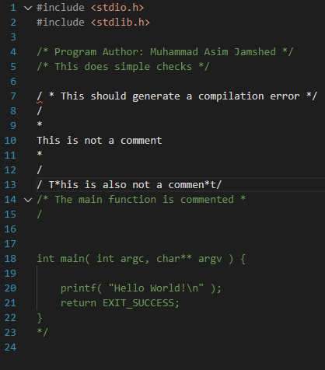
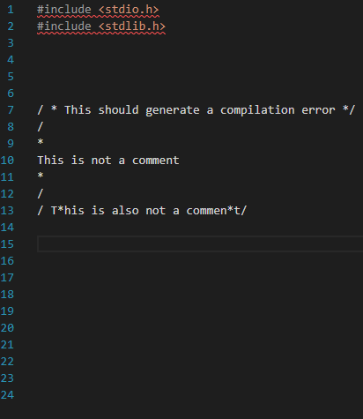
What Is Decommenter
Decommented test0.c
Decommenter: Tool to remove comments within source code files

Slide 3
Usage Instructions for Decommenter
./decomment < somefile.c > output 2> errors
Your executable file
Target(input) file
Result
Error log
Input and output for “decomment” should be handled via redirection
Default functionality in C program
No special additional work required

Slide 4
Requirements – Replace Each Comment with a Space (1/9)
Standard Input Stream | Standard Output Stream | Standard Error Stream
abc/*def*/ghi_{n} | abc_{s}ghi_{n}
In the following examples,
“_{s}”: a space character
“_{n}”: a newline character

Slide 5
Requirements – Support Both Types of Comments (2/9)
Case | Standard Input Stream | Standard Output Stream | Standard Error Stream
Single line comment | abc//def_{n} | abc_{sn}
Multi-line comment | abc/*def_{n}ghi*/jkl_{n}mno_{n} | abc_{sn}jkl_{n}mno_{n}
2 Types of comments:
“//”: Single line comment
“/* … */”: Multi-line comment
Ensure the program adds blank lines as needed to preserve original line numbering

Slide 6
Requirements – Comments within Comments(3/9)
Standard Input Stream | Standard Output Stream | Standard Error Stream
abc/*def/*ghi*/jkl*/mno_{n} | abc_{s}jkl*/mno_{n}
A multi-line comment begins when the preprocess encounters "/*" for the first time
The comment ends when it encounters "*/" after the comment begins

Slide 7
Requirements – Exceptions: Comment in Str or Char Const (4/9)
Case | Standard Input Stream | Standard Output Stream | Standard Error Stream
Part of the string | abc"def/*ghi*/jkl"mno_{n} | abc"def/*ghi*/jkl"mno_{n}
Part of the character constant | abc'def/*ghi*/jkl'mno_{n} | abc'def/*ghi*/jkl'mno_{n}
Do not de-comment the comment when:
Part of the string or character constant

Slide 8
Requirements – Handle ‘\’+ following char as ordinary characters (5/9)
Case | Standard Input Stream | Standard Output Stream | Standard Error Stream
Part of the string | abc"def\"ghi"jkl_{n} | abc"def\"ghi"jkl_{n}
Part of the character constant | abc'def\'ghi'jkl_{n} | abc'def\'ghi'jkl_{n}
Handle ‘\’+ following char as ordinary characters when
Within the string or character constant
A C compiler would incur an error (multiple characters in a character constant)
But many C preprocessors would not
And your program should not either

Slide 9
Requirements – Newline Characters in Str or Char Const (6/9)
Case | Standard Input Stream | Standard Output Stream | Standard Error Stream
Part of the string | abc"def_{n}ghi"jkl_{n} | abc"def_{n}ghi"jkl_{n}
Part of the character constant | abc'def_{n}ghi'jkl_{n} | abc'def_{n}ghi'jkl_{n}
Handle the newline character in str or chat const without generating errors or warnings
A C compiler would incur an error (newline character in a string constant)
But many C preprocessors would not
And your program should not either

Slide 10
Requirements – Handle Unterminated Str and Char Const (7/9)
Case | Standard Input Stream | Standard Output Stream | Standard Error Stream
Part of the string | abc"def/*ghi*/jkl_{n} | abc"def/*ghi*/jkl_{n}
Part of the character constant | abc'def/*ghi*/jkl_{n} | abc'def/*ghi*/jkl_{n}
Handle unterminated str and char const w/o generating errors or warnings
A C compiler would incur an error (newline character in a string constant)
But many C preprocessors would not
And your program should not either

Slide 11
Requirements – Error: EOF Before a Comment Is Terminated (8/9)
Standard Input Stream | Standard Output Stream | Standard Error Stream
abcdef_{n}ghi/*_{n} | abcdef_{n}ghi_{sn} | Error:_{s}line_{s}2:_{s}unterminated_{s}comment_{n}
Include the line number where the comment starts in the error message
Return EXIT_FAILURE when an unterminated comment was detected
Except for this case, you should return EXIT_SUCCESS in all other cases
EXIT_FAILURE and EXIT_SUCCESS are defined as macros in stdlib.h
so add #include <stdlib.h> to your C code

Slide 12
Requirements – Miscellaneous Features (9/9)
Your program should work for standard input lines of any length
You may assume that the final line of the standard input stream ends with a newline character
Backslash-newline character sequence does not occur in the standard input stream
Logical lines == physical lines in the standard input stream
You may place all source code in a single file
We suggest using standard C getchar() function, fprintf() function
Etc…
Please read the README.md

Slide 13
Do Your Assignment Step-by-Step
Step 1. Design a state transition diagram (dfa.pptx or dfa.pdf or dfa.jpg …)
Step 2. Create source code (decomment.c)
Step 3. Preprocess, compile, assemble, and link (decomment.i, .s, .o)
Step 4. Execute
Step 5. Create a readme file (without filename extension)
…
Please refer to the README.md’s “Logistics” part!

Slide 14
How to Test Your Code
“assignment1/reference/” directory
Sample executable file (sampledecomment) is located
“assignment1 /test_files/” directory
Sample test*.c files are located
“diff” command: Check differences between two files
Here is an example:
./sampledecomment < decomment.c > output1 2> errors1
./decomment < decomment.c > output2 2> errors2
diff -c output1 output2
diff -c errors1 errors2
rm output1 errors1 output2 errors2

Slide 15
Submit Format (1/2)
Structure of directory:
YourID_assign1
|-decomment.c (source file)
|-decomment.i (preprocessed file)
|-decomment.s (assembly file)
|-decomment.o (object file)
|-readme
`-dfa.pptx or dfa.pdf or dfa.jpg …
Example:
202500000_assign1
|-decomment.c (source file)
|-decomment.i (preprocessed file)
|-decomment.s (assembly file)
|-decomment.o (object file)
|-readme
`-dfa.pptx or dfa.pdf or dfa.jpg …
Please set files and directory’s names to match the examples above
Please place all source code in a single file
Structure files and directories as shown above, then proceed with compression
Deadline: ~3.20 21:00

Slide 16
Submit Format (2/2)
Helpful commands
mkdir 202500000_assign1
mv readme dfa.pptx 202500000_assign1
mv decomment.c decomment.i decomment.s decomment.o 202500000_assign1
tar zcf 202500000_assign1.tar.gz 202500000_assign1
Submit to Classum submission page

Slide 17
Grading
Sumbission format (Penalty for non-compliance)
From the user’s point of view: Correct functioning of the program
From the programmer’s point of view:
A program has quality if it is well styled and thereby easy to maintain
Here are the examples:
1. Names: Clear and consistent style for variable and function names
2. Comments: Each function should begin with a comment that describes what the function does from the point of view of the caller
3. Function modularity (most important): Your program should not consist of one large main function, instead your program should consist of multiple small functions
4. Line lengths: Limit line lengths in your source code to 72 characters (for better readability)

