Slide 1
Lab 0. Intro to Environments & Tools
Seongjong Bae
SNU TNET Lab.

Slide 2
Links
TA mailing list: snu-sysp@googlegroups.com
Professor prefers you ask your questions on Classum!
Classum: https://www.classum.com/main/space/216196/community
For course announcements, Q&A, discussions, etc.
One-on-one conversation with professor/TA possible
We do not use eTL!

Slide 3
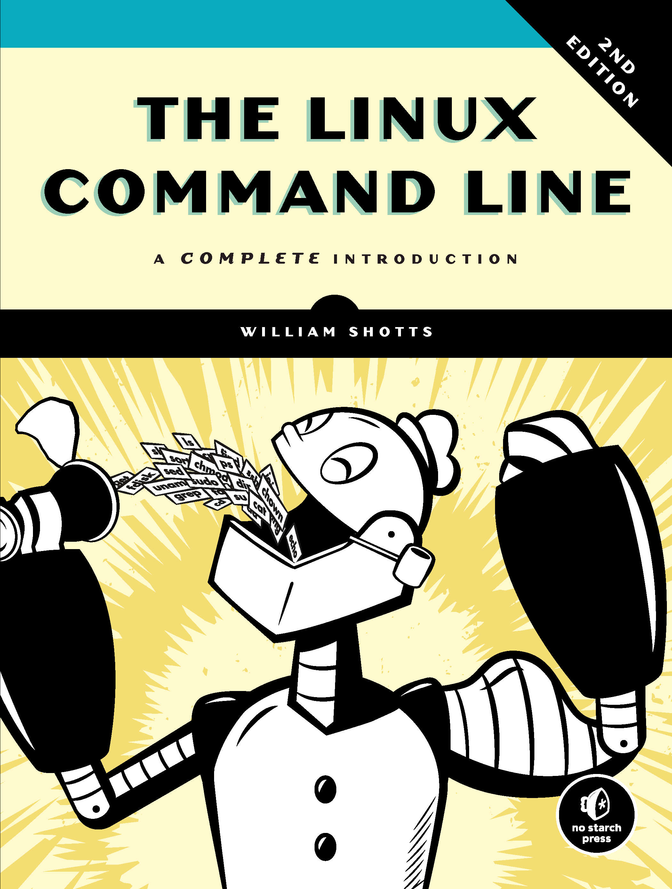
Goals & Recommended Books
Goal: getting familiar with the Linux programming environment
Corollary: feel comfortable with tools for system programming assignments
Tools: shell commands, editor, ctags/cscope, compiler, debugger, source code management, commands, script languages, trace tools
Recommended books
Bryant and O'Hallaron, “Computer Systems: A Programmer's Perspective (3rd Edition)”, 2015.
Low-level programming and systems environments
William Shotts, “The Linux Command Line”, 2nd Edition
Linux commands, Bash shell, ssh/scp, etc.
Neil Matthew & Richard Stones, “Beginning Linux Programming”, 4th Edition
Richard Blum & Christine Bresnahan, “Linux Command Line and Shell Scripting Bible”

Slide 4

Linux Programming Environment
Linux
Free, open-sourced operating system (OS)
We use a Ubuntu distribution (Ubuntu Linux)
How to use Linux?
Option1. Remote access to Bacchus VMs (sp01, sp02, sp03, sp04.snucse.org)
Option2. Install Ubuntu on your own PC in a virtual machine
If you use Windows 10/11, consider windows subsystem for Linux (WSL)
https://docs.microsoft.com/en-us/windows/wsl/install-win10

Slide 5
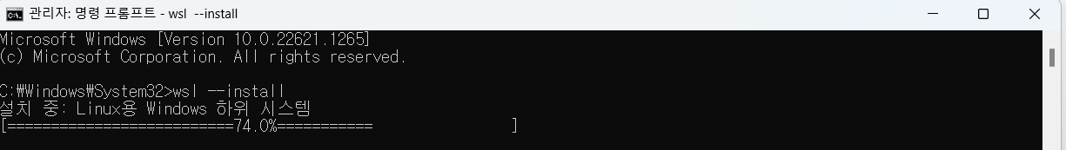
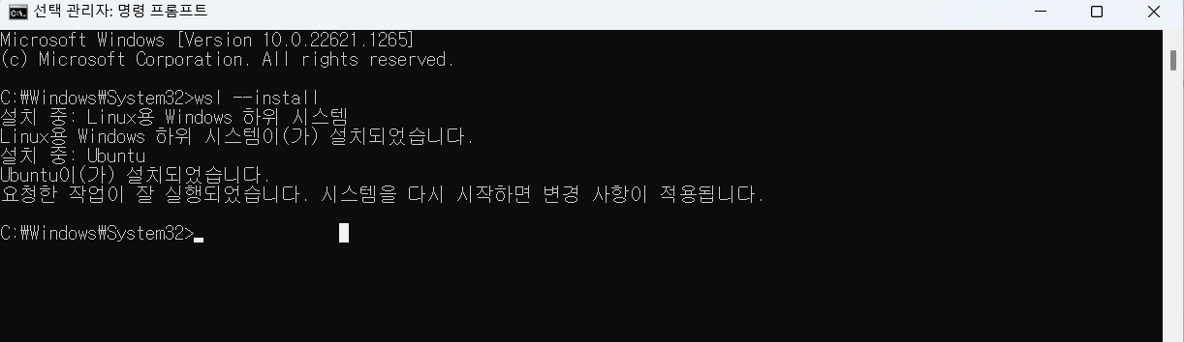
WSL on windows
Run command prompt as administrator
Type ‘wsl --install’

Slide 6
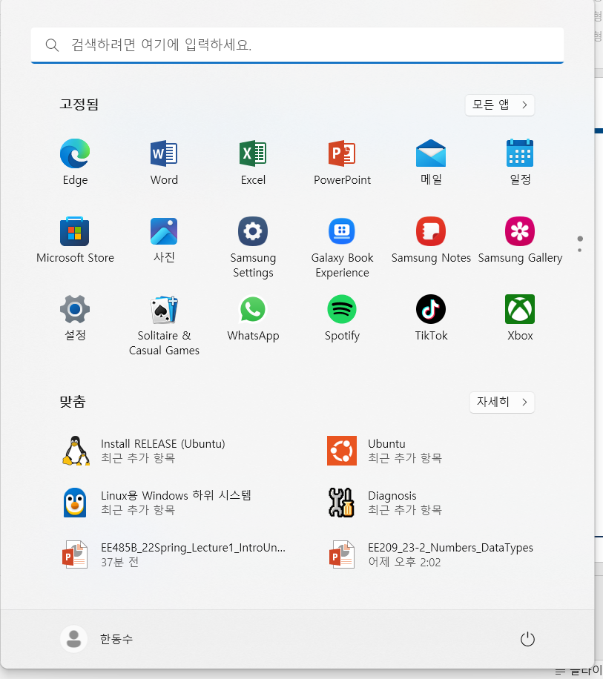


WSL on windows
Run ubuntu from start menu
Or type ‘wsl’ in cmd
User_name
User_name
Host_name

Slide 7
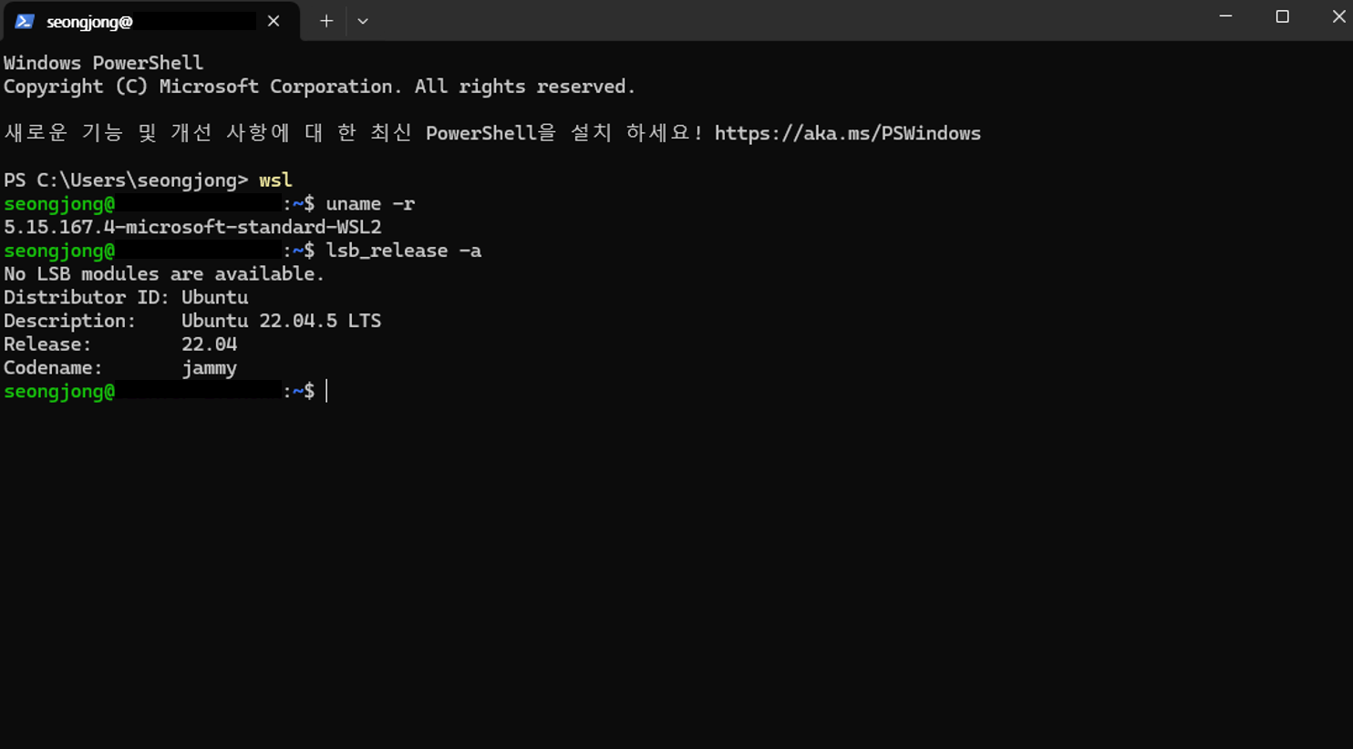
WSL on windows

Slide 8
Bacchus VMs
Linux is installed on the remote VMs
2013-xxxxx to 2020-13xxx: sp01.snucse.org
2020-14xxx to 2021-14xxx: sp02.snucse.org
2021-15xxx to 2022-17xxx: sp03.snucse.org
2022-18xxx and later: sp04.snucse.org
Accessible in campus network
Your account should be already created
ID: sp<Your_student_id_without_dash>
E.g., 2025-35498 → sp202535498
Please check your password from Classum
If your ID does not exist or you forgot your password, please contact the TAs

Slide 9
Remote Access to Bacchus VMs
You can use tools like ‘ssh’ to access the machines remotely
SSH: secure shell (over network)
You invoke a shell on a machine, and securely access it over a network
Network communication on ssh is ‘encrypted’ and ‘authenticated’ (secure)
For Windows users: use command prompt or PuTTY
cmd: Type ‘ssh <your ID>@sp01 .snucse.org –p 2222’
PuTTY: Details in the following slide
For MAC OS or Linux: use Terminal
Search and open ‘Terminal’ program.
Type ‘ssh <your ID>@sp01.snucse.org –p 2222’
Unix shell: A command line interpreter

Slide 10

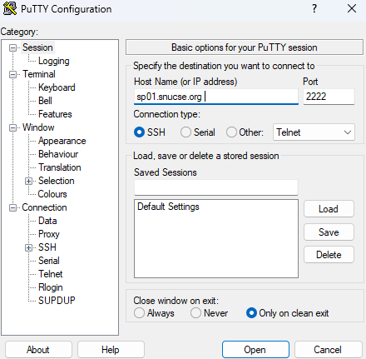
Remote Access via PuTTY
Download PuTTY program
http://www.putty.org/
Single file: putty.exe
Open putty.exe
Input “Host Name”
sp01.cse.snu.ac.kr, sp02.cse.snu.ac.kr, …
Input “Port”
2222 (not 22)
Press Open
Type in ID/password and press ENTER
Enter “yes” at first login

Slide 11
MobaXterm
https://mobaxterm.mobatek.net/
Better looking + more features
Embedded X window server for remote graphics

Slide 12
gcc800 vs. gcc?
gcc800 is a special script made for this lecture
Script: a text file that contains commands to execute a series of tasks
gcc800 adds a number of options to catch improper programming
e.g. warns unused variable, use variable without initializing it, etc.
You can make this script by yourself using emacs editor (or whatever editor you like)
$ emacs gcc800
Make this script executable:
$chmod +x gcc800
Move this file to folder that can be accessed globally
$sudo mv gcc800 /usr/bin/gcc800
#!/bin/bash
gcc -Wall -Werror -ansi -pedantic -std=c99 "$@"

