Slide 1
專題研究 week6 - Live DEMO
吳克駿 江昶翰

Slide 2
Live DEMO
Our Voice with
Basic Model
tree/training model/Language model/lexicon
To form
output sentence

Slide 3
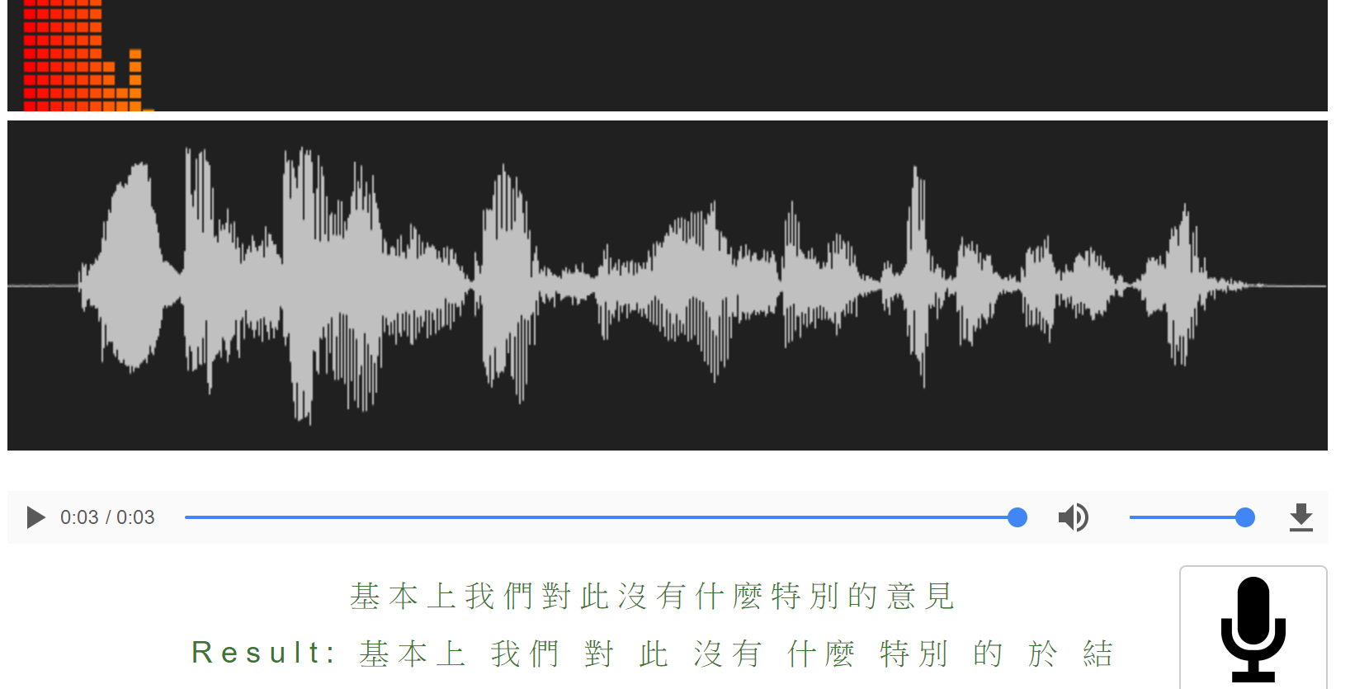

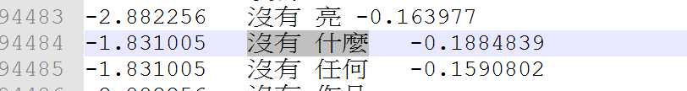
Test OUR Model with same LM

Slide 4
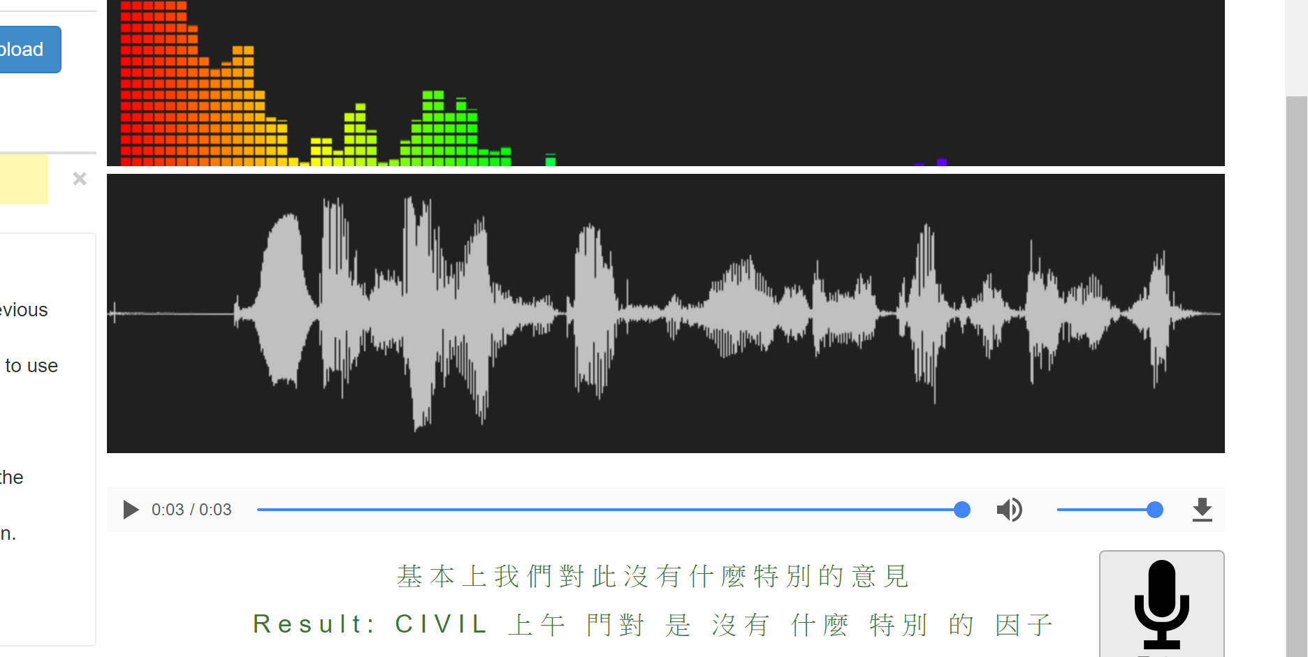
test basic model

Slide 5
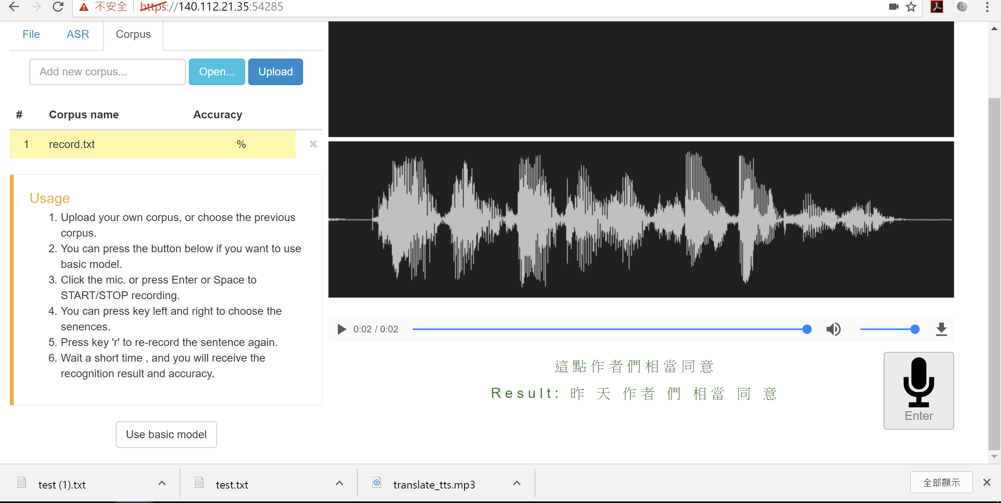
TEST our Model WITH Same LM

Slide 6
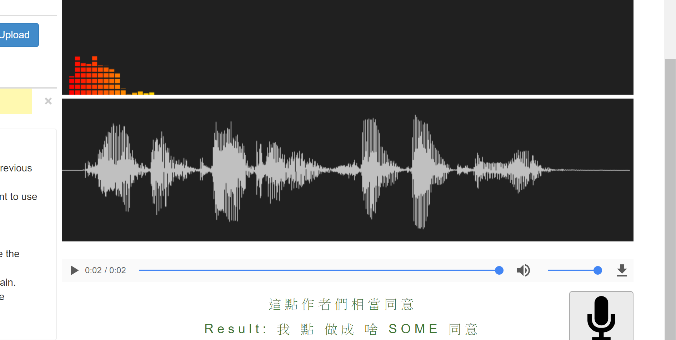
TESt basic model

Slide 7
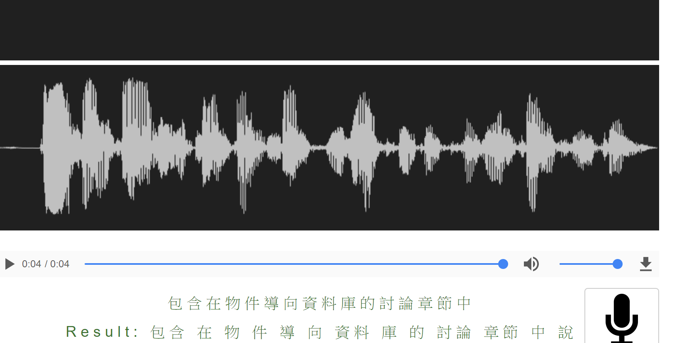
Test OUR MODEL

Slide 8
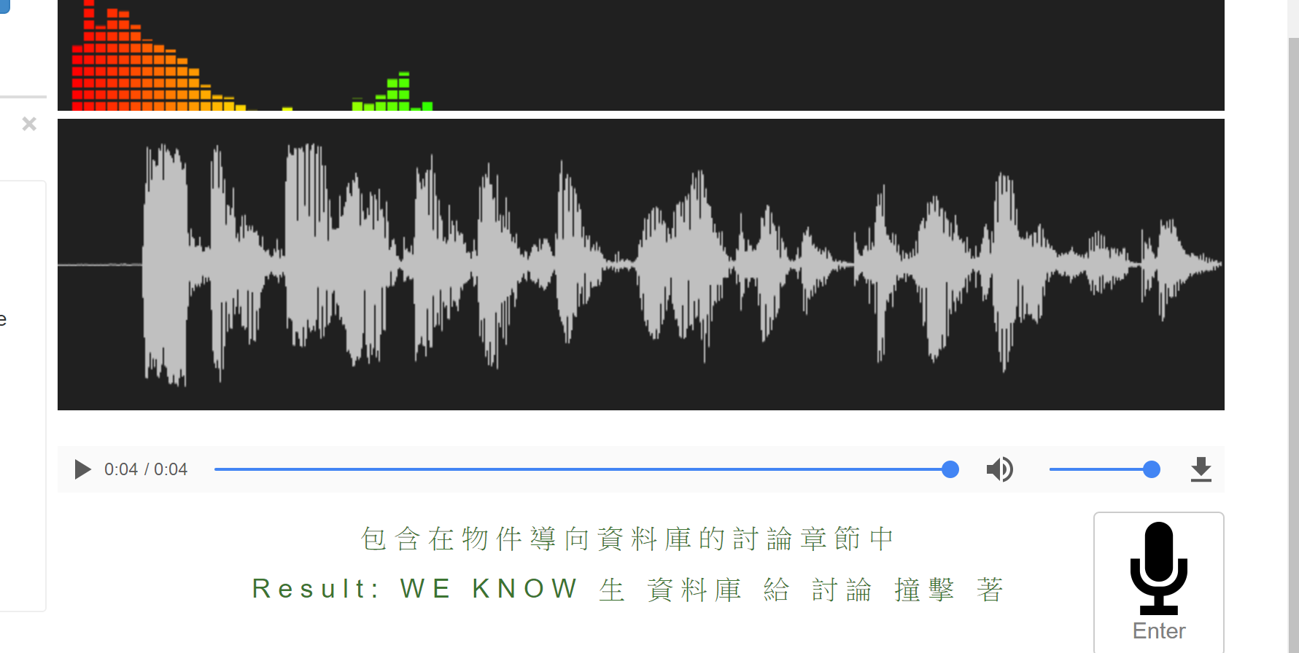
TEST BASIC MODEL

Slide 9
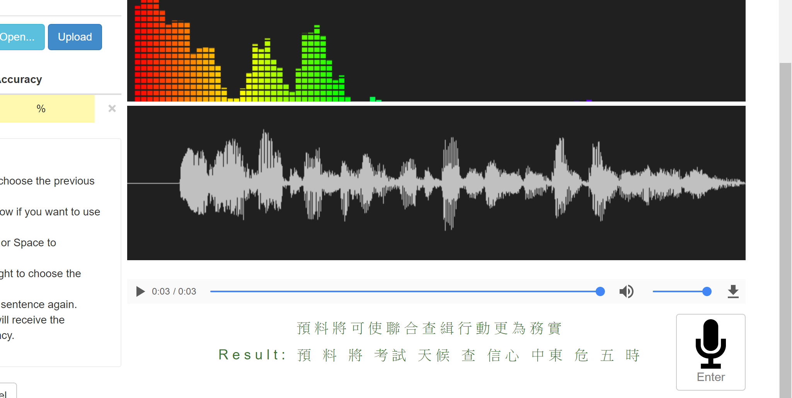
Test OUR MODEL

Slide 10
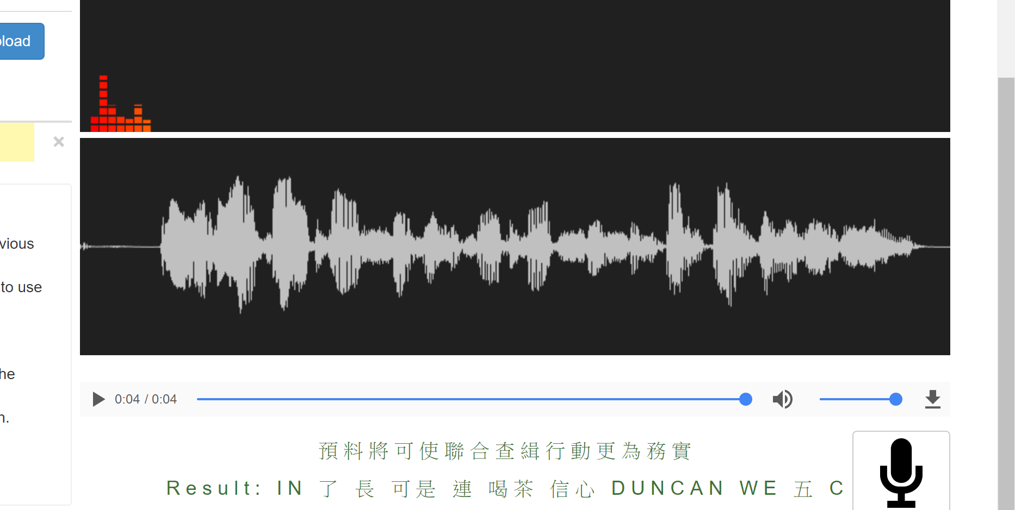
Test basic model

Slide 11
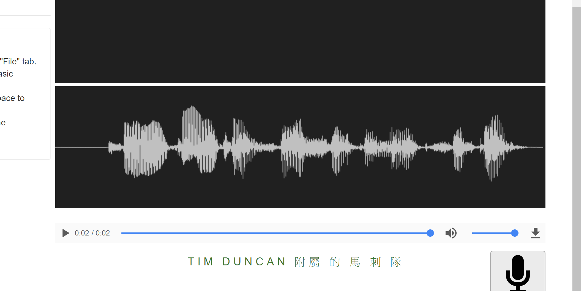
ENGLISH MODEL?
Tim Duncun所屬的馬刺隊

Slide 12
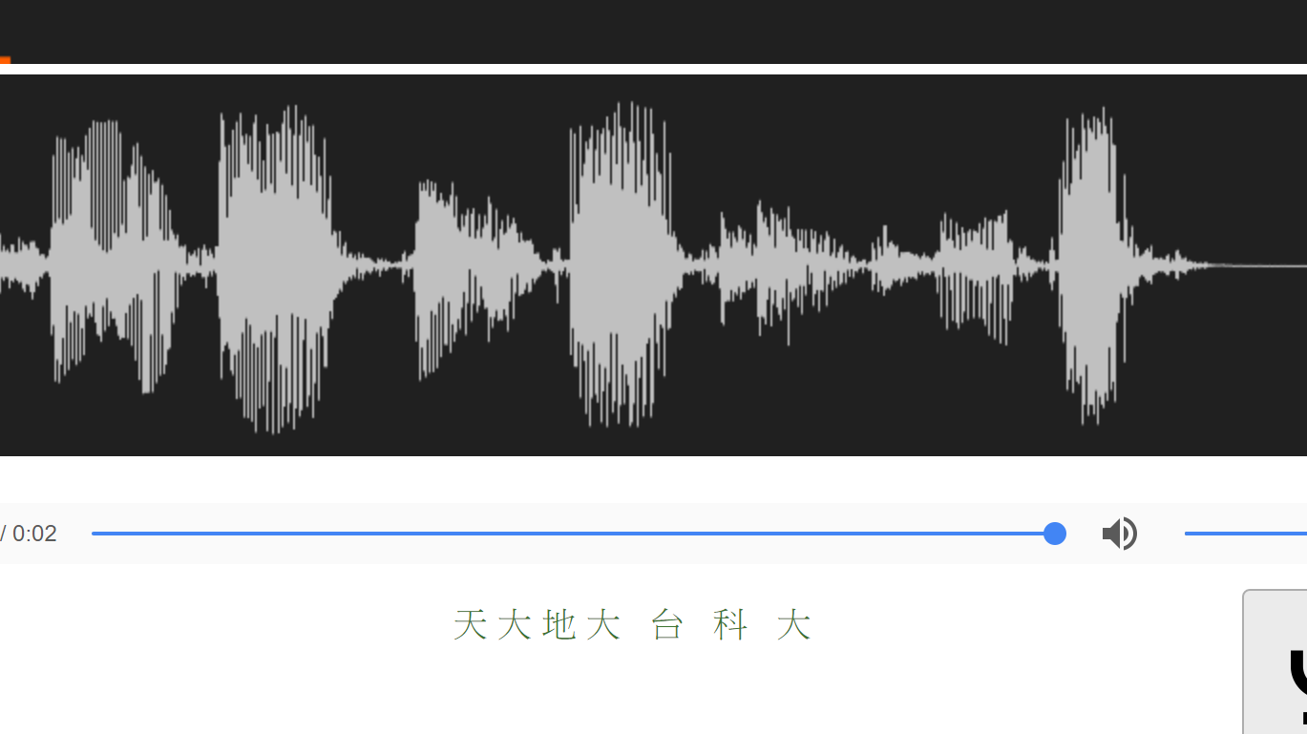
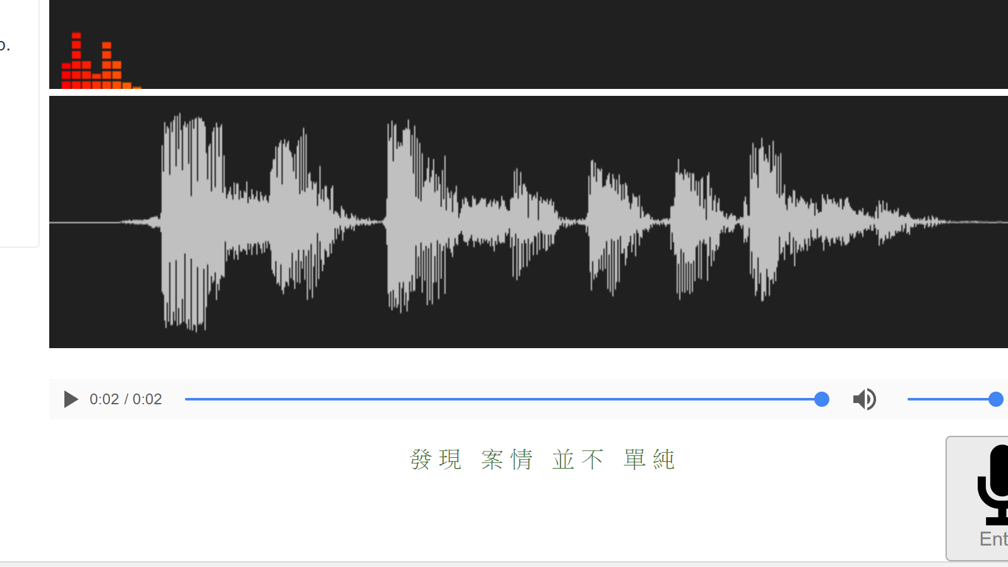
Test PTT(? Model

Slide 13
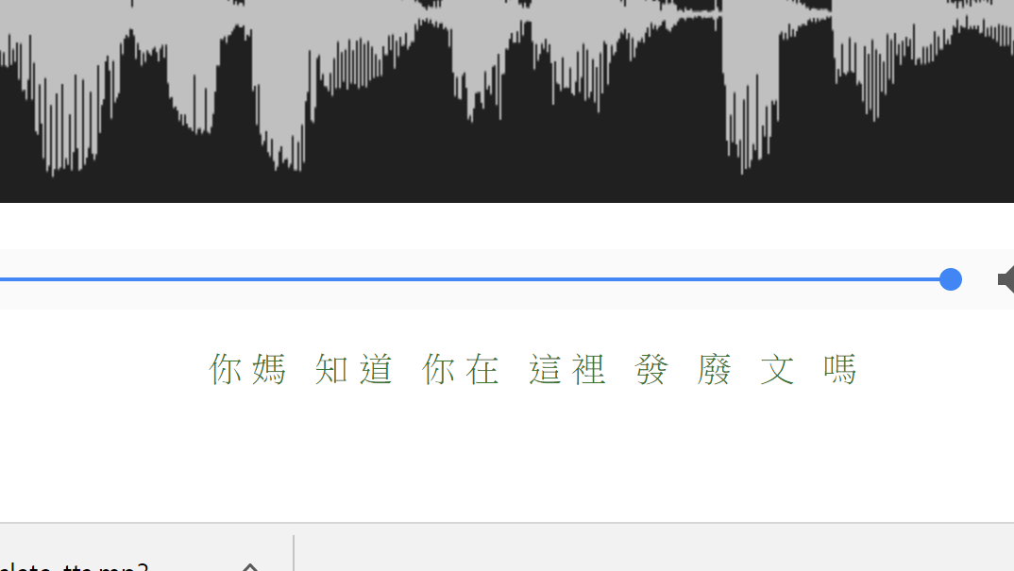
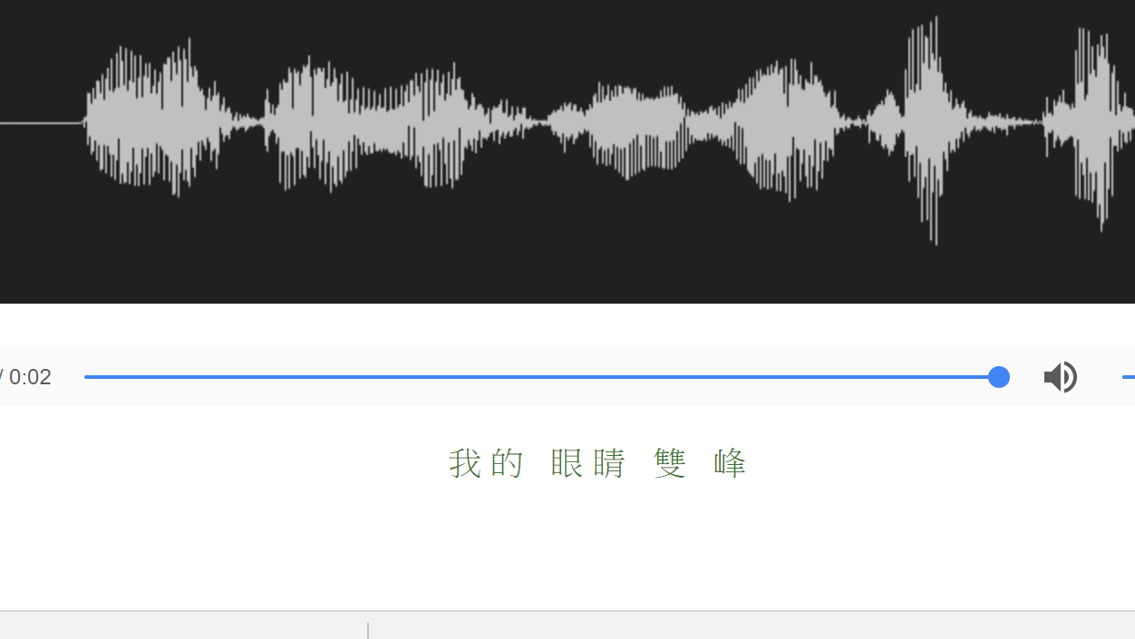
Test PTT(? Model
我的眼睛業障重

