Slide 1
影片敘述之自動生成
吳克駿、江昶翰

Slide 2
影片敘述之自動生成 Video caption generation
助教: 莊舜博（alex82528@hotmail.com.tw）
從文章總結出文章大意(summary)或者是從照片辨識出其中物件(image recognition)為機器學習(machine learning)中常見的應用，都是教電腦學習我們輸入的資料，並基於機器的理解產生相對應的輸出。
在這個專題中將會以影片為主軸，給機器看一段影片及其聲音後，使其學習理解影片內容，並自動產生與影片相關的敘述。

Slide 3
Paper Reading
Sequence to sequence-
Viedo to Text

Slide 4
Abstract
CNN and LSTM have demonstrated state-of-the-art performance in image caption generation
But how about Video?

Slide 5
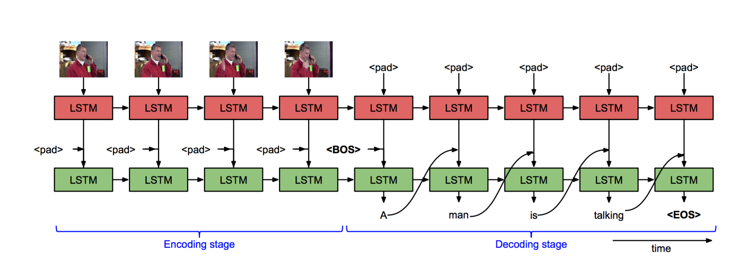
Use Sequence to Sequence

Slide 6
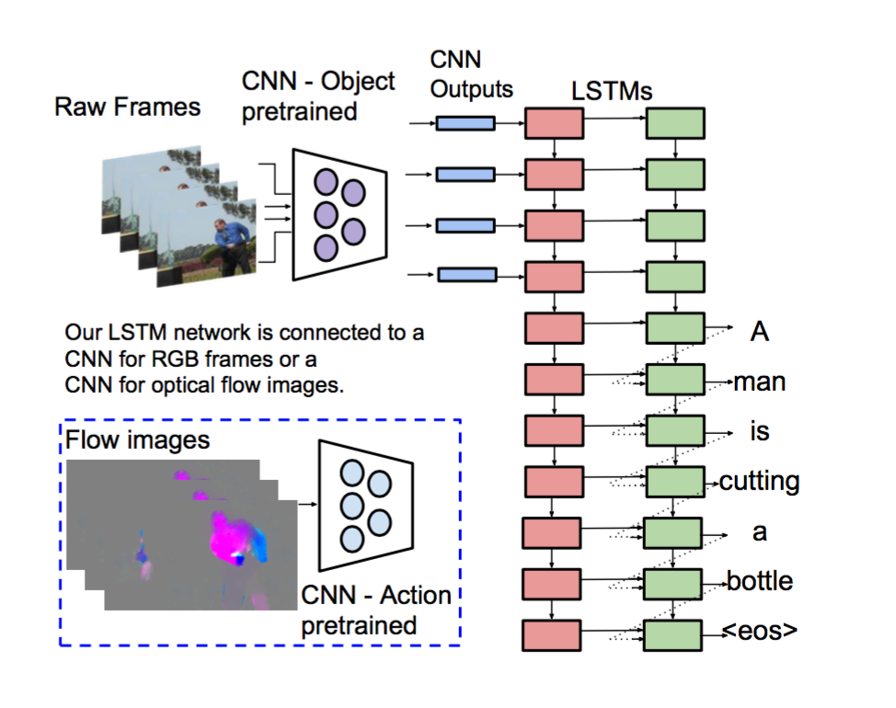
Overview Flowchart

Slide 7
How to improve?
Optical Flow
In addition to CNN outputs from raw image(RGB) frames
Incorporating optical flow improves activity classification

Slide 8

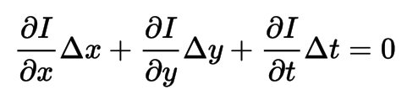
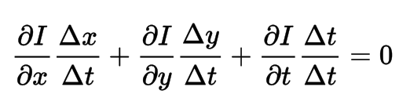

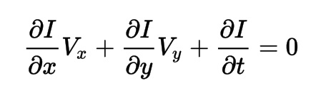
optical flow

Slide 9
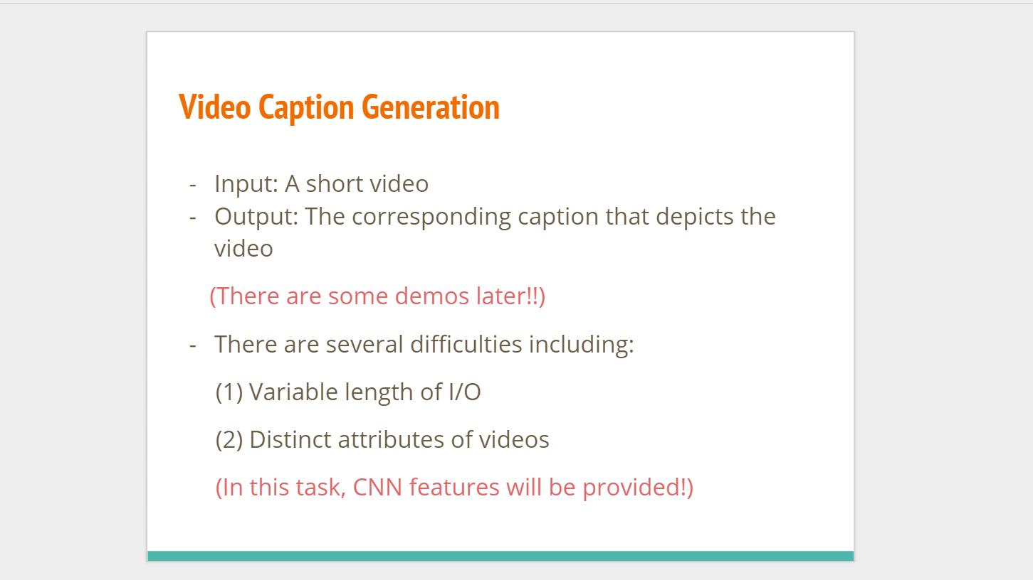
Future work

Slide 10
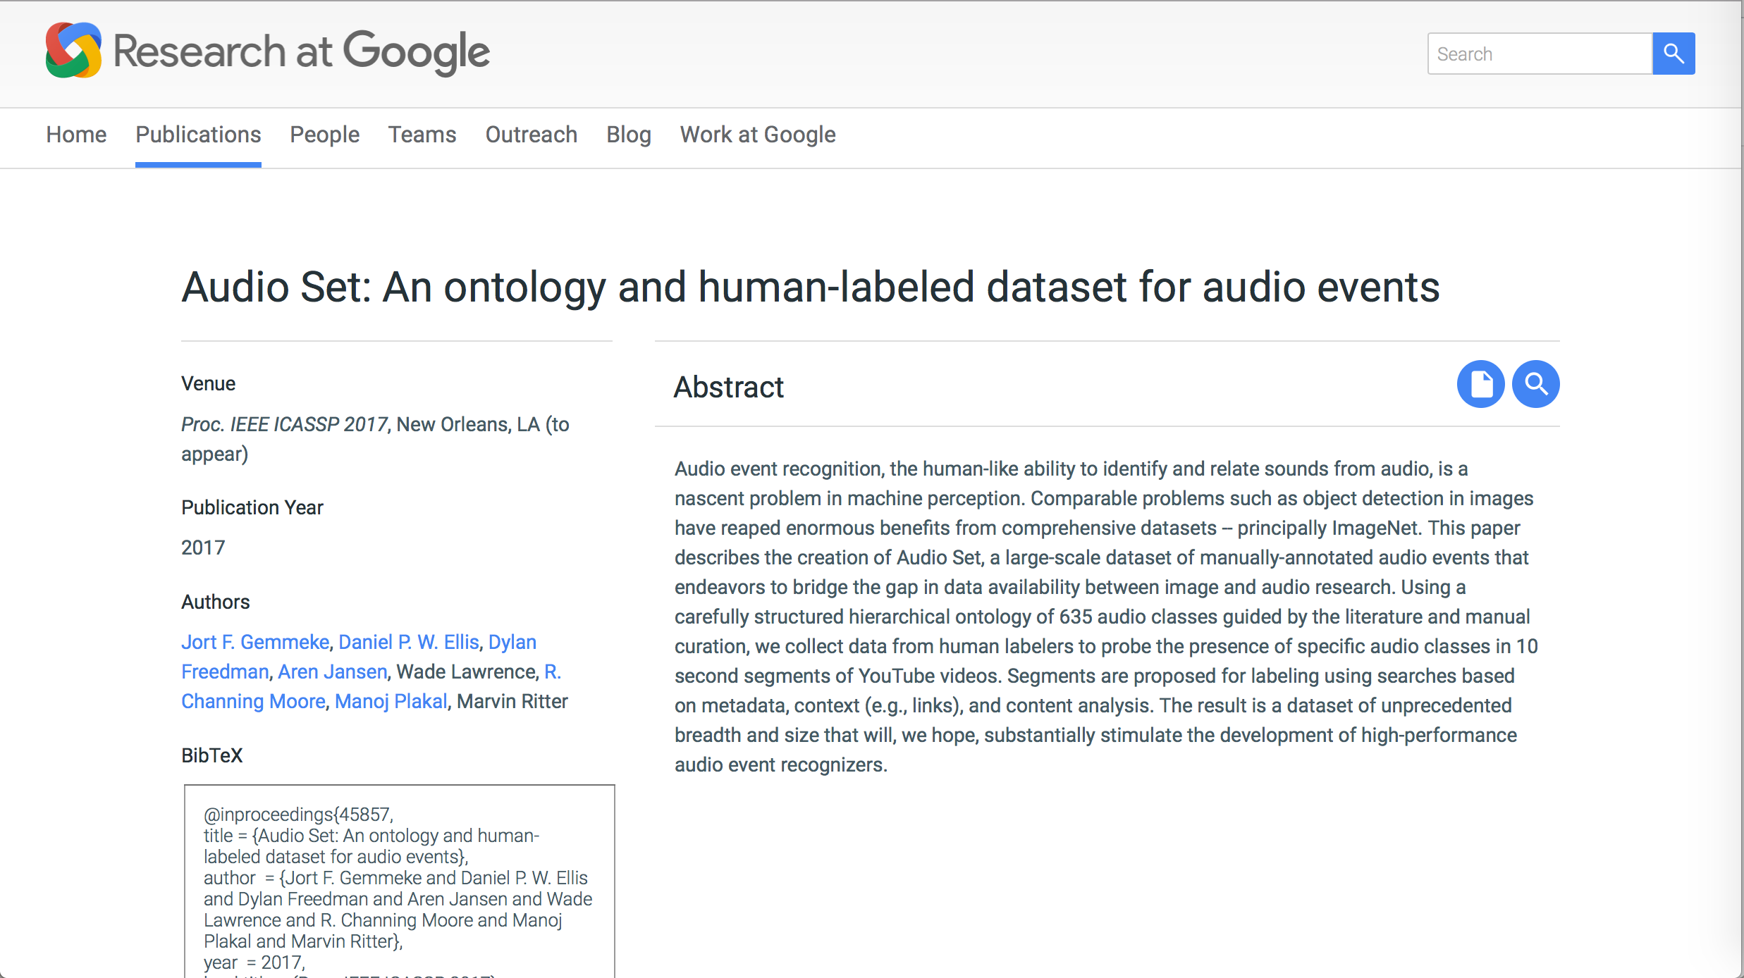
Future work

Slide 11
Future work
Tensor flow code : https://github.com/jazzsaxmafia/video_to_sequence https://github.com/tsenghungchen/SA-tensorflow
Detail LSTM for Video Description: https://arxiv.org/pdf/1606.04631.pdf

Slide 12
Reference
http://www.cs.utexas.edu/~ml/papers/venugopalan.iccv15.pdf
MLDS HW2- Video CaptionGeneration

