Slide 1
A CHALLENGING BUT FEASIBLE BLOCKWISE-ADAPTIVE CHOSEN-PLAINTEXT ATTACK ON SSL
Gregory V. Bard
University of Maryland, Department of Mathematics College Park, MD, 20914, USA
Email: gregory.bard@ieee.org

Slide 2
Outline
Overview of CBC encryption
Attack on CBC
Attack requirement
Feasibility
Conclusion

Slide 3
Outline
Overview of CBC encryption
Attack on CBC
Attack requirement
Feasibility
Conclusion

Slide 4
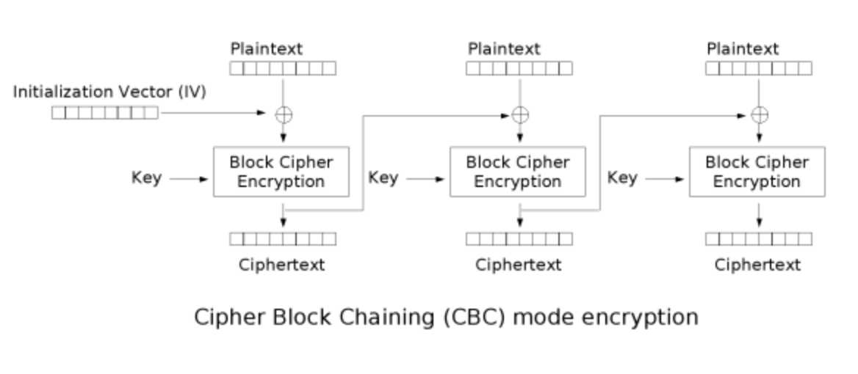
SSL 3.0-CBC mode

Slide 5
Outline
Overview of CBC encryption
Attack on CBC
Attack requirement
Feasibility
Conclusion

Slide 6
attack on CBC
We have known Ci , Ci-1 , Cj-1
1. Guess Pi=x
2. Choose the first block of next plaintext Pj = Cj-1 ⊕ Ci-1 ⊕ x
3. Cj = E_{k}(Pj ⊕ C_{j-1}) = E_{k}(Cj-1 ⊕ Ci-1 ⊕ x ⊕ C_{j-1}) =E_{k}( Ci-1 ⊕ x ) = Ci

Slide 7
Outline
Overview of CBC encryption
Attack on CBC
Attack requirement
Feasibility
Conclusion

Slide 8
Attack Requirement
plaintext block j contains the desired information
Cj−1
the value of the IV that is going to be used for the next message

Slide 9
Outline
Overview of CBC encryption
Attack on CBC
Attack requirement
Feasibility
Conclusion

Slide 10
Feasibility
Using one common key
Learning the plaintext format
Ensuring that the adversary’s chosen plaintext block is encrypted first.
Encrypting Chosen Plaintext

Slide 11
Outline
Overview of CBC encryption
Attack on CBC
Attack requirement
Feasibility
Conclusion

Slide 12
Conclusion
It is not easy that it can be done.
This work takes a step toward opening the dialog between protocol designers and theoretical cryptographer.
Demonstrate attack on ssl: https://www.youtube.com/watch?v=BTqAIDVUvrU&t=54s

Slide 13
Reference
https://www.researchgate.net/profile/Gregory_Bard/publication/220335433_A_Challenging_but_Feasible_Blockwise-Adaptive_Chosen-Plaintext_Attack_on_SSL/links/53e19ed70cf2235f352bd197.pdf

