Slide 1
ASP.NET Core,
PEEk into the future
By Expert Network
@FII Practic

Slide 2
Who are we
Developers (fancy way of saying I google code online fast)

Slide 3
What do we do
Mainly nothing daily

Slide 4
What's the plan
Get you familiar with .NET Core
We will do a project together ~week 4 until the end
And we will have a gathering where you will showcase your fancy project to your collegues
Have fun and learn stuff

Slide 5
What will you do
Learn how to make an enterprise ASP.NET Core Web Application
Ask us everytime you have a question or just have something you are not familiar with (that’s why we’re here after all)
Call us by our first name, no mister or other fancy stuff

Slide 6
What is .net?
.NET is a free platform for building many different types of applications (web, mobile, desktop, gaming, IoT)
.NET applications can be written in C#, F# or Visual Basic

Slide 7
.NET Implementations
.NET Core – cross-platform .NET implementation for websites, servers and console apps on Windows, Linux and macOS
.NET Framework – supports websites, services, desktop apps, and more on Windows
Xamarin/Mono - .NET implementation for running apps on all major mobile operating systems

Slide 8
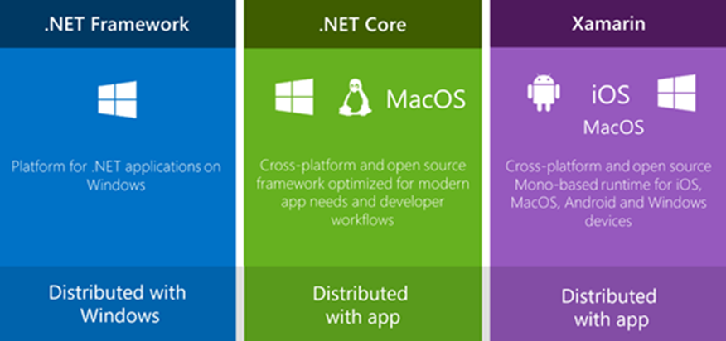
The .net family of frameworks

Slide 9
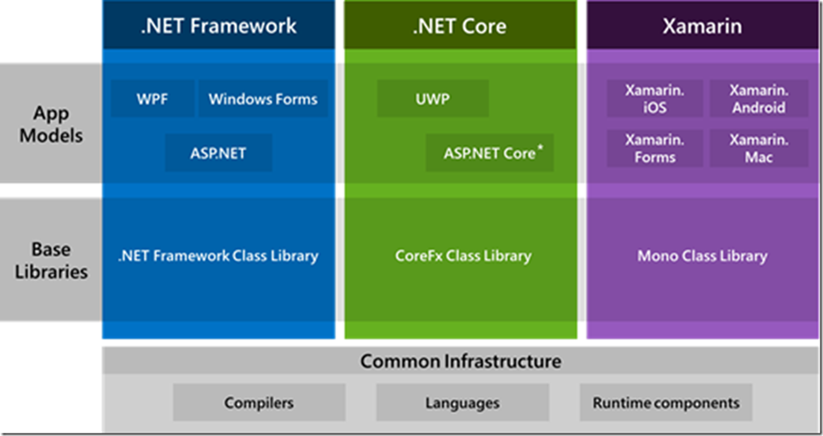
The .net ecosystem

Slide 10
Did you know?
StackOverflow
Microsoft
GoDaddy
DELL
Where all made in ASP.NET?

Slide 11
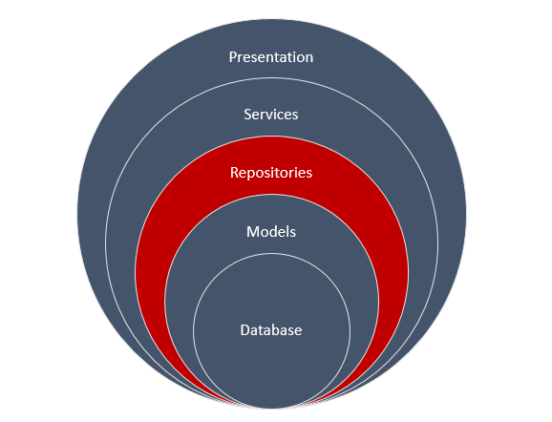
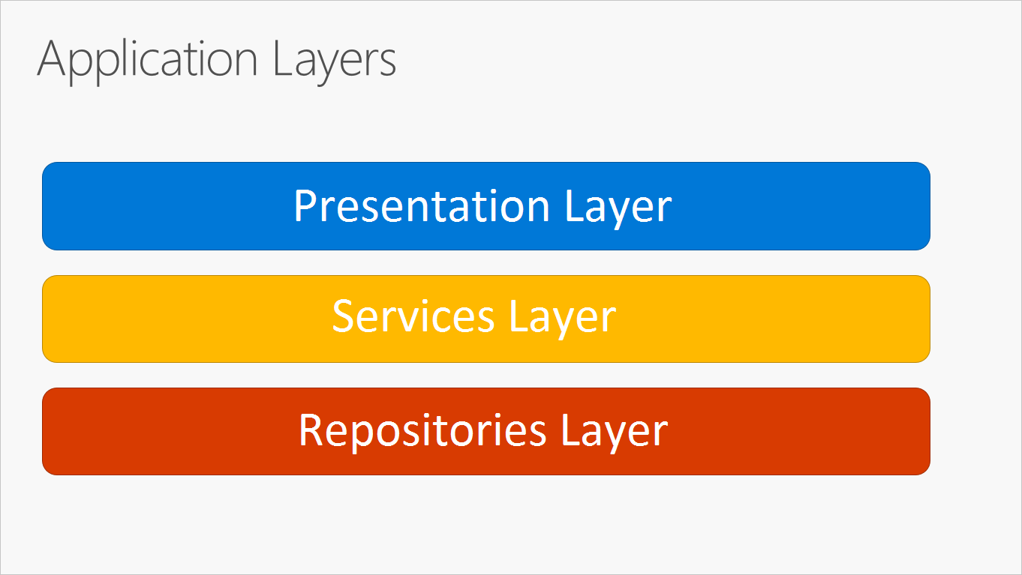
N-Layer Architecture

Slide 12
Let’s get started with the basics

Slide 13
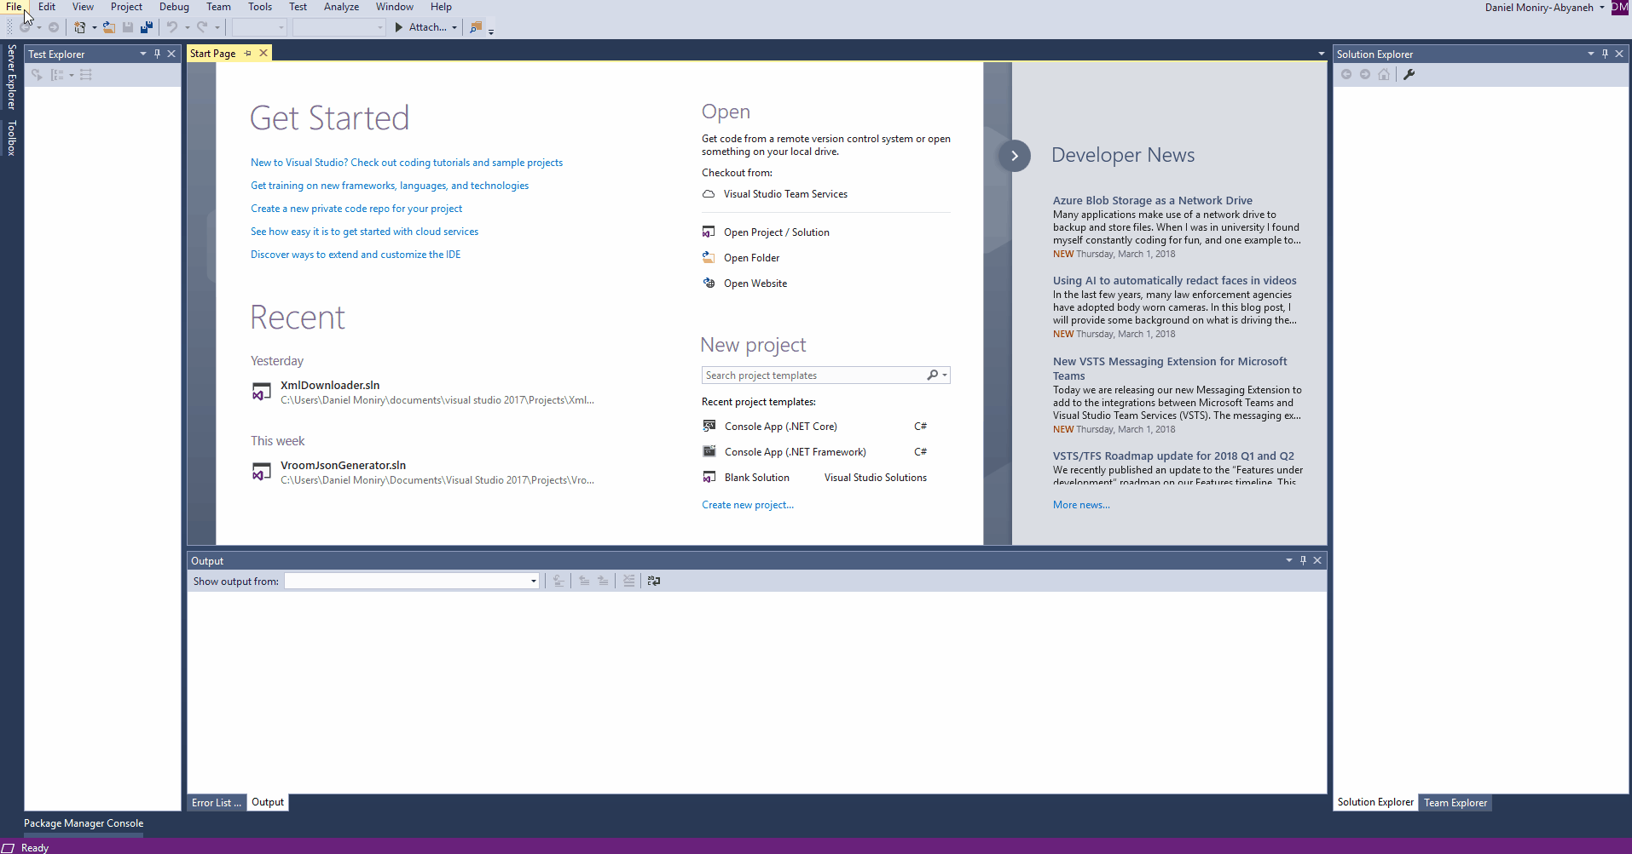

Create a new Console Application in VS
VS > File > New > Project
.NET Core > Console App

Slide 14
Even more basics

Slide 15
Most used Data types
Data Type | C++ | Java | C#
Boolean | bool | boolean | bool
Number | int | int | int
Real number | decimal | java.math.BigDecimal | decimal
Nullable Boolean | - | java.lang.Boolean | bool?
Nullable Number | - | java.lang.Integer | int?
Nullable real number | - | java.math.BigDecimal | decimal?
Text | char[∞] | java.lang.String | string

Slide 16
Power of var keyword

Slide 17
How Some people do it
Dictionary<string, string> dict = new Dictionary<string, string>();

Slide 18
How Other people do it
var dict = new Dictionary<string, string>();

Slide 19
Declaration may var-y
Implicitly typed
Explicitily typed
var i = 10;
var user = new User();
var magicResult = GenerateMagicMethod();
var map = new Dictionary<string, string>();
int i = 10;
User user = new User();
Magic magicResult = GenerateMagicMethod();
Dictionary<string, string> map = new Dictionary<string, string>();//this says a lot

Slide 20
Only variables declared at method scope can use var
This works
This doesn’t
public int Number = 1;
public int Increment()
{
var newNumber = Number + 1;
return newNumber;
}
public var Number = 1;
public int Increment()
{
var newNumber = Number + 1;
return newNumber;
}

Slide 21
Only variables with a clear type can use var
This works
This doesn’t
  int five;
  five = 5;
  int six = 6;
  var five; //← Compile-Time Error
  five = 5;
  var six = 6

Slide 22
Cool! En-List ME

Slide 23
Lists
var integerList = new List<int>();
integerList.Add(2);
integerList.Add(3);
integerList.Add(5);
integerList.Add(6);

Slide 24
ITERATING
for(var i = 0; i < integerList.Count; i++)
{
Console.WriteLine(integerList[i]);
}
foreach(var integer in integerList)
{
Console.WriteLine(integer);
}
integerList.ForEach(integer => Console.WriteLine(integer)); //Next chapter

Slide 25
Basic usage
myList.Add();
myList.AddRange();
myList.Remove();
myList.RemoveAt();
myList.RemoveRange();

Slide 26
Classes

Slide 27
Declaring Classes
public class Customer
{
//Fields, properties, methods go here...
}

Slide 28
Creating objects
var object1 = new Customer(); //object1 is a reference to a Customer object

Slide 29
Constructors

Slide 30
Default constructors
If you don't provide a constructor for your class, compiler creates one by default that instantiates the object and sets member variables to the default values.
public class Customer
{
}
var customerObject = new Customer(); //calls default constructor

Slide 31
Constructor syntax
public class Person
{
private string last;
private string first;
public Person(string lastName, string firstName)
{
last = lastName;
first = firstName;
}
}
var person1 = new Person("John", "Doe");
var person2 = new Person(); //<--Doesn't work

Slide 32
Constructor syntax
public class Person
{
private string last;
private string first;
public Person(string lastName, string firstName)
{
last = lastName;
first = firstName;
}
public Person()
{
}
}
var person1 = new Person("John", "Doe");
var person2 = new Person(); //<--Works now

Slide 33
Methods

Slide 34
Methods
A method is a code block that contains a series of statements. In C#, every executed instruction is performed in the context of a method.

Slide 35
Method signatures
Methods are declared in a class or struct by specifying:
An optional access level, such as public or private (default).
Optional modifiers such as abstract or sealed.
The return value, or void if the method has none.
The method name.
Any method parameters, enclosed in parentheses and separated by commas. Empty parentheses indicate that the method required no parameters.

Slide 36
Method signatures
public void Method(int a, int b=1)
Because of the optional parameter b this method can be called in two ways:
Method(2, 5);
Method(2);//b will be 1
Access level
Method name
Return type or in this case void
Method parameters

Slide 37
Inheritance

Slide 38
Inheritance
public class User
{
public string Name {get;set;}
}
public class DetailedUser : User
{
public string City {get;set;}
}
var detailedUser = new DetailedUser();
detailedUser.Name= "John Doe";
detailedUser.City= "Iasi";

Slide 39
Inheritance
public class User
{
public string Name {get;set;}
public User(string name)
{
Name = name;
}
}
public class DetailedUser : User
{
public string City {get;set;}
public DetailedUser(string name, string city): base(name)
{
City = city;
}
}
var detailedUser = new DetailedUser("John Doe", "Iasi");

Slide 40
polymorphism

Slide 41
Virtual and override
public class Rectangle
{
public int Length {get;set;}
public int Width {get;set;}
public virtual int Area()
{
return Length * Width;
}
}
public class Square : Rectangle
{
public override int Area()
{
return Length * Length;
}
}
var rectangle = new Rectangle {Length = 2, Width = 3};
rectangle.Area(); // returns 6
var square = new Square {Length = 2};
square.Area(); // returns 4

Slide 42
LINQ

