Slide 1
ASP.NET Core,
PEEk into the future
By Expert Network
@FII Practic

Slide 2
So, week 2, huh?

Slide 3
Guest(S)
Placeholder

Slide 4
Short recap

Slide 5
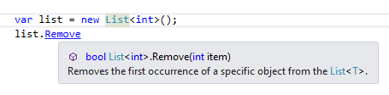
About that remove
This apperas on hover

Slide 6
Linq sintaxes
Method Sintax
Query Sintax
var names = collection
.Where(item => item.Name == "Fred") .OrderBy(item => item.Age)
.Select(item => item.FullName);
var names = from item in collection
where item.Name == "Fred"
order by item.Age
select item.FullName;

Slide 7
Linq sintaxes
Method Sintax
Query Sintax
var names = collection
.Count(item => item.Name == "Fred");
var names = (from item in collection
where item.Name == "Fred"
select item).Count()

Slide 8
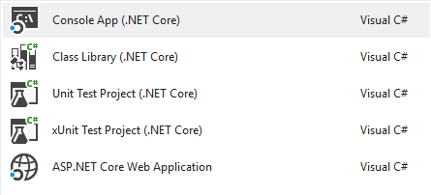
.net core project types

Slide 9
N-Layer

Slide 10
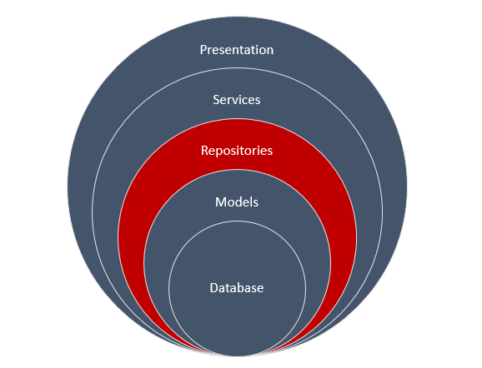
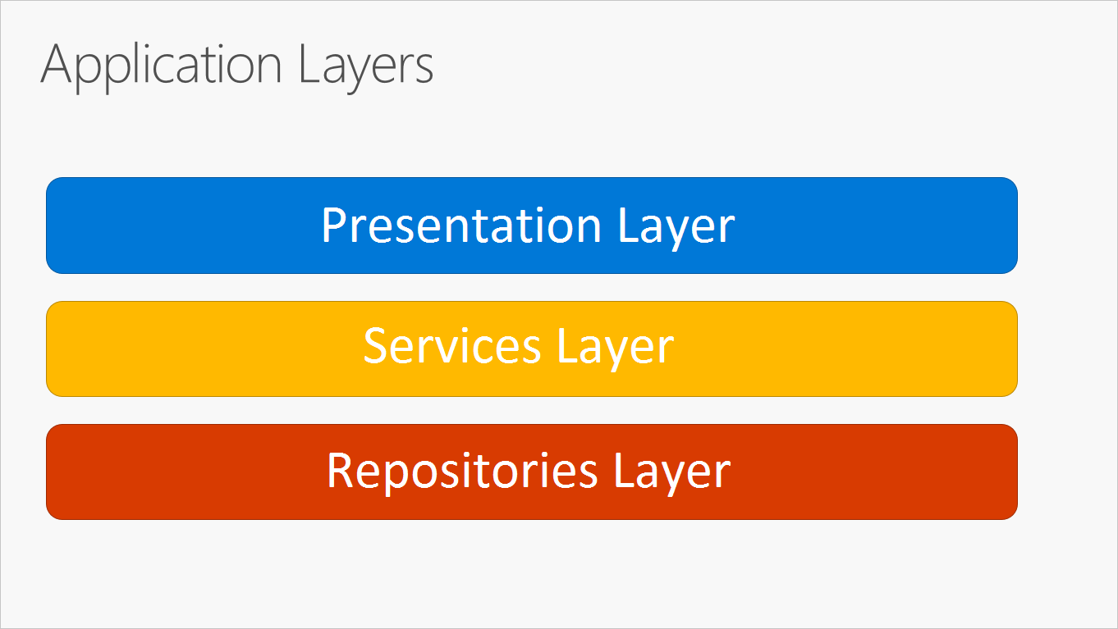
N-Layer Architecture

Slide 11
Facebook

Slide 12


How Facebook uses diferent presentation layers
https://www.facebook.com/ExpertNetwork/
https://m.facebook.com/ExpertNetwork/

Slide 13
Netflix

Slide 14
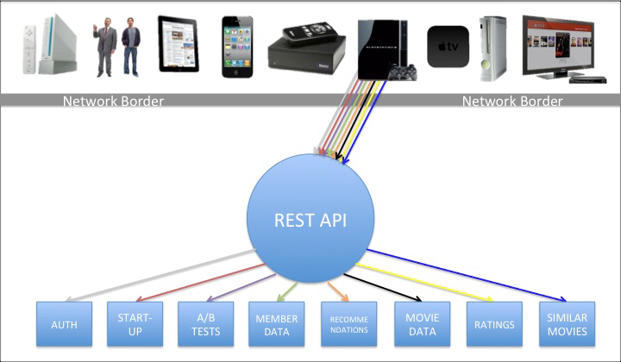
How Netflix Used to chill

Slide 15
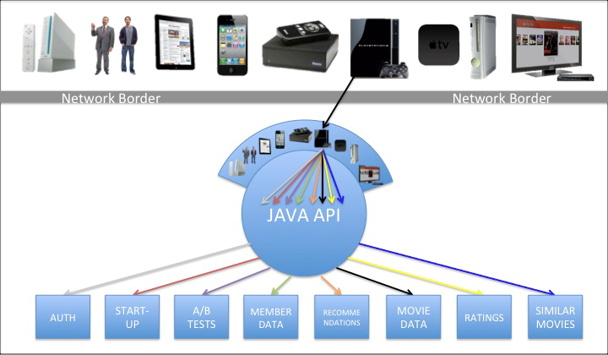
How Netflix Chills now

Slide 16
New netflix philosophies
Embrace the differences of the devices
Separate content gathering from content formatting/delivery

Slide 17
About that homework

Slide 18
Why this never happens
public List<User> Users { get; set; }
//trying to mimic a database
public UserService(List<User> users)
{
Users = users;
}

Slide 19
Entity Framework Core

Slide 20
Database

Slide 21
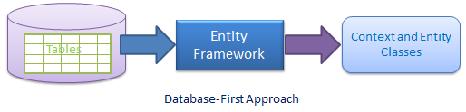
Create classes using an existing database

Slide 22
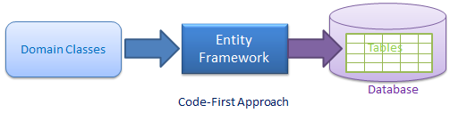
Create a Database using existing classes

Slide 23
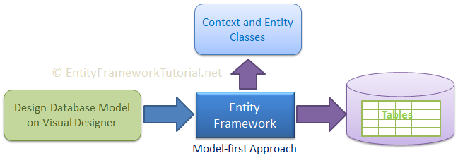
There is another one but we will not talk about it

Slide 24
command line interface
dotnet new [console|classlib|web|mvc|…] –n <OUTPUT_NAME>
dotnet build
dotnet run

Slide 25
Code first

Slide 26
Create a new Class Library
dotnet new sln –n CodeFirst
dotnet new classlib –n CodeFirst.Data –f netcoreapp2.0
dotnet sln list
dotnet sln add CodeFirst.Data/CodeFirst.Data.csproj
dotnet sln list

Slide 27
Prerequisites
cd CodeFirst.Data
dotnet add package Microsoft.EntityFrameworkCore.SqlServer
dotnet add package Microsoft.EntityFrameworkCore.Design

Slide 28
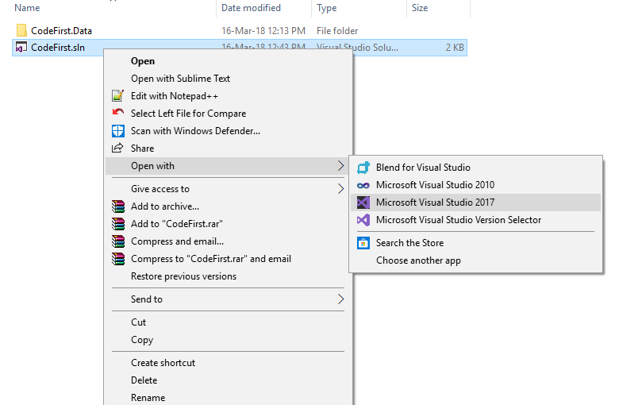
Open the Solution

Slide 29
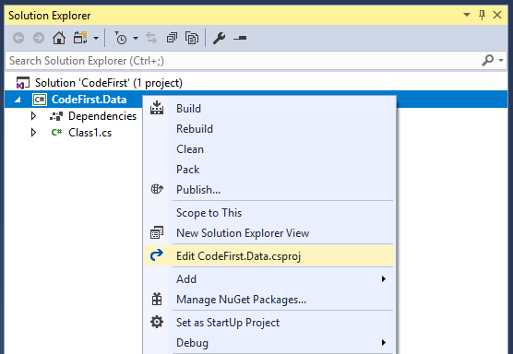
Edit the Class Library project

Slide 30
You need to add this Ef Core CLI Reference
<ItemGroup>
<DotNetCliToolReference Include="Microsoft.EntityFrameworkCore.Tools.DotNet" Version="2.0.0" />
</ItemGroup>

Slide 31
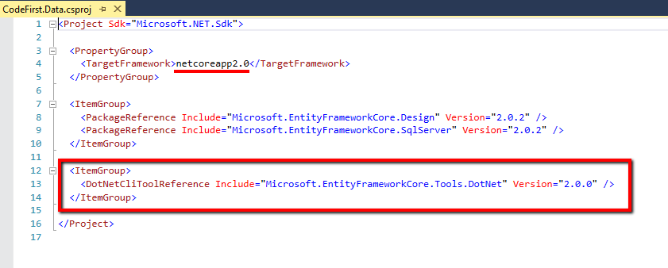
It should look somewhat similar to this

Slide 32
To install this reference you’ll need to restore the project
dotnet ef <- will not work
dotnet restore
dotnet ef <- will work

Slide 33
The added CLI commands
dotnet ef dbcontext list
dotnet ef dbcontext info
dotnet ef migrations list
dotnet ef migrations add <Migration Name>
dotnet ef migrations remove <- removes the last migration

Slide 34
Let’s make a simple DB

Slide 35
Add an Entity
(class that represents a table)
public class User
{
public int Id { get; set; }
public string Name { get; set; }
}

Slide 36
Add A Context
(class that represents a database)
public class TestContext : DbContext
{
  public DbSet<User> Users { get; set; }
protected override void OnConfiguring(DbContextOptionsBuilder ){…}
}

Slide 37
Connection String
protected override void OnConfiguring(DbContextOptionsBuilder optionsBuilder)
{
optionsBuilder.UseSqlServer(
“Data Source=office.expertnetwork.ro,14334;Initial Catalog={YourDbName};User Id=fiipractic1;Password=jYnLUUBALrbI4vsSVh7l;”
);
}

Slide 38
Now to create a new Mgration
dotnet ef migrations list <- No migrations were found
dotnet ef migrations add InitialCreate <- If it doesn’t work see next slide
dotnet ef migrations list <- {DateTime formated}_InitialCreate
wild guess but I think something like 20180317111624

Slide 39
If it doesn’t work (Optional)
Go to C:\Program Files\dotnet\shared\Microsoft.NETCore.App
See the latest version (should be something like 2.0.X)
Edit the class library (CodeFirst.Data)
Add <RuntimeFrameworkVersion>2.0.X</RuntimeFrameworkVersion> under <TargetFramework>netcoreapp2.0</TargetFramework>

Slide 40
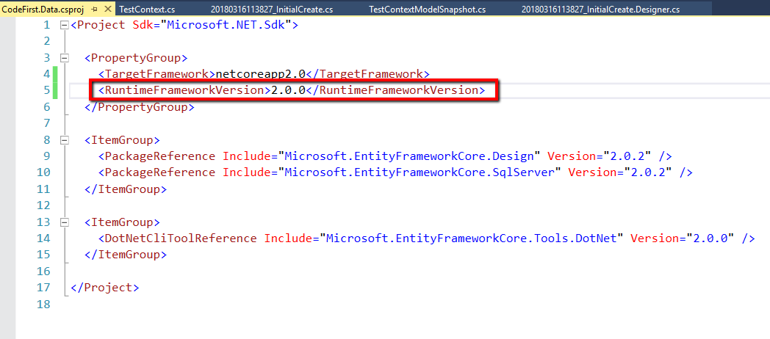
If it doesn’t work (Optional)
How it look on my pc
Add your version here (mine is 2.0.0)

Slide 41
If it doesn’t work (Optional)
Save the file
dotnet restore
Try again

Slide 42
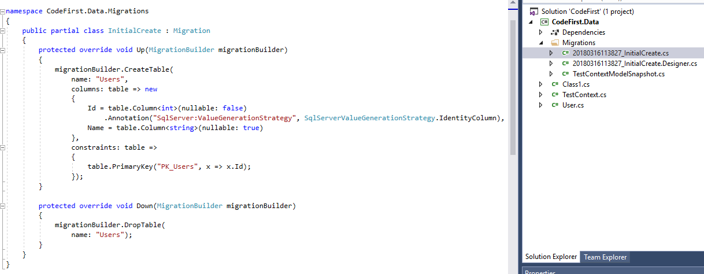
Check how your db will look like

Slide 43
If all good then update
dotnet ef database update

Slide 44
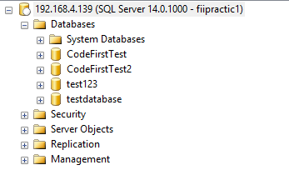
Now open SQL Server Management Studio to check if all good
You DB should be here

Slide 45
How come User has primary key?
Entity Framework Core has some conventions for asigning a primary key when you do not assign one
By convention, a property named Id or <type name>Id will be configured as the primary key of an entity

Slide 46
Convention PK or
Data annotations PK
EF takes Id as PK by default
EF takes MyCustomKey as PK
public class User
{
public int Id { get; set; }
public string Name { get; set; }
}
public class User
{
[Key]
public int MyCustomKey{ get; set; }
public string Name { get; set; }
}

Slide 47
Let’s make a more complex DB

Slide 48
One to many

Slide 49
Let’s say that an Article has a title and an id
public class Article
{
public int Id { get; set; }
public string Title { get; set; }
}

Slide 50
A user can have Many articles
public class User
{
public int Id { get; set; }
public string Name { get; set; }
public List<Article> Articles { get; set; }
}

Slide 51
An article can have One User
public class Article
{
public int Id { get; set; }
public string Title { get; set; }
public int UserId { get; set; }
public User User { get; set; }
}

Slide 52
What is up with UserId?
public class Article
{
public int Id { get; set; }
public string Title { get; set; }
public int UserId { get; set; }
public User User { get; set; }
}
This signals EF Core that it should add a foreign key called UserId to the table User

Slide 53
How EF Core handels
Foreign Keys
Entity Framework Core also has conventions for asigning a foreign key when you do not assign one
First you have a navigational link between them (in User have a reference to Article and vice versa)
If the dependent entity contains a property named
  <primary key property name>
  <navigation property name><primary key property name>
  <principal entity name><primary key property name>

Slide 54
Convention FK or
Data annotations fK
EF takes UserId as PK by default
EF takes MyCustomFK as FK
public int UserId { get; set; }
public User User { get; set; }
public int MyCustomFK { get; set; }
[ForeignKey(“MyCustomFK”)]
public User User { get; set; }

Slide 55
Now add it to the context
public class TestContext : DbContext
{
public DbSet<User> Users { get; set; }
  public DbSet<Article> Articles { get; set; }
…
}

Slide 56
Create a new Migration and update the database
dotnet ef migrations add OneToMany
dotnet ef database update

Slide 57
Many to Many

Slide 58
Let’s say that we add tags on each article
public class Tag
{
public int Id { get; set; }
public string Name { get; set; }
}

Slide 59
We need to create a class that conects the two
public class ArticleTag
{
  public int ArticleId { get; set; }
  public Article Article { get; set; }
  public int TagId { get; set; }
  public Tag Tag { get; set; }
}

Slide 60
And Each class needs to have a reference to ArticleTag
public class Article
{
public string Title { get; set; }
public int UserId { get; set; }
public User User { get; set; }
public List<ArticleTag> ArticleTags { get; set; }
}
public class Tag
{
public string Name { get; set; }
public List<ArticleTag> ArticleTags { get; set; }
}

Slide 61
Now we need to add a primary key to the connection table
public class TestContext : DbContext
{
…
public DbSet<Tag> Tags { get; set; }
protected override void OnModelCreating(ModelBuilder modelBuilder)
{
modelBuilder.Entity<ArticleTag>()
.ToTable("ArticleTags")
.HasKey(t => new { t.ArticleId, t.TagId });
}
…
}
We add this so we can name this table however we want (by default it is ArticleTag, the name of the entity)

Slide 62
Create a new Migration and update the database
dotnet ef migrations add ManyToMany
dotnet ef database update

